Slide 1
Computer Networks
Lecture 10: Transport layer Part II
Based on slides from D. Choffnes Northeastern U. and P. Gill from StonyBrook University
Revised Autumn 2015 by S. Laki

Slide 2
Transport Layer
Function:
Demultiplexing of data streams
Optional functions:
Creating long lived connections
Reliable, in-order packet delivery
Error detection
Flow and congestion control
Key challenges:
Detecting and responding to congestion
Balancing fairness against high utilization
Application
Presentation
Session
Transport
Network
Data Link
Physical

Slide 3
TCP Congestion Control
The network is congested if the load in the network is higher than its capacity.
Each TCP connection has a window
Controls the number of unACKed packets
Sending rate is ~ window/RTT
Idea: vary the window size to control the send rate
Introduce a congestion window at the sender
Congestion control is sender-side problem

Slide 4
Two Basic Components
Detect congestion
Packet dropping is most reliably signal
Delay-based methods are hard and risky
How do you detect packet drops? ACKs
Timeout after not receiving an ACK
Several duplicate ACKs in a row (ignore for now)
Rate adjustment algorithm
Modify cwnd
Probe for bandwidth
Responding to congestion

Slide 5
Rate Adjustment
Recall: TCP is ACK clocked
Congestion = delay = long wait between ACKs
No congestion = low delay = ACKs arrive quickly
Basic algorithm
Upon receipt of ACK: increase cwnd
Data was delivered, perhaps we can send faster
cwnd growth is proportional to RTT
On loss: decrease cwnd
Data is being lost, there must be congestion
Question: increase/decrease functions to use? !!!!

Slide 6
Implementing Congestion Control
Maintains three variables:
cwnd: congestion window
adv_wnd: receiver advertised window
ssthresh: threshold size (used to update cwnd)
For sending, use: wnd = min(cwnd, adv_wnd)
Two phases of congestion control
Slow start (cwnd < ssthresh)
Probe for bottleneck bandwidth
Congestion avoidance (cwnd >= ssthresh)
AIMD
Notes:
Got to here.

Slide 7
Slow Start
Goal: reach knee quickly
Upon starting (or restarting) a connection
cwnd =1
ssthresh = adv_wnd
Each time a segment is ACKed, cwnd++
Continues until…
ssthresh is reached
Or a packet is lost
Slow Start is not actually slow
cwnd increases exponentially
Knee
Cliff
Goodput
Load

Slide 8
Slow Start Example
cwnd = 1
cwnd grows rapidly
Slows down when…
cwnd >= ssthresh
Or a packet drops
1
cwnd = 2
2
3
cwnd = 4
4
5
6
7
cwnd = 8

Slide 9
Congestion Avoidance
Additive Increase Multiplicative Decrease (AIMD) mode
ssthresh is lower-bound guess about location of the knee
If cwnd >= ssthresh then each time a segment is ACKed increment cwnd by 1/cwnd (cwnd += 1/cwnd).
So cwnd is increased by one only if all segments have been acknowledged

Slide 10
Congestion Avoidance Example
cwnd = 1
cwnd = 2
cwnd >= ssthresh
cwnd = 4
ssthresh = 8
cwnd (in segments)
Slow Start
cwnd = 8
cwnd = 9
Round Trip Times

Slide 11
The Big Picture – TCP Tahoe (the original TCP)
ssthresh
Timeout
Congestion
Avoidance
cwnd
Slow Start
Time

Slide 12
Outline
UDP
TCP
Congestion Control
Evolution of TCP
Problems with TCP

Slide 13
The Evolution of TCP
Thus far, we have discussed TCP Tahoe
Original version of TCP
However, TCP was invented in 1974!
Today, there are many variants of TCP
Early, popular variant: TCP Reno
Tahoe features, plus…
Fast retransmit
3 duplicate ACKs? -> retransmit (don’t wait for RTO)
Fast recovery
On loss: set cwnd = cwnd/2 (ssthresh = new cwnd value)

Slide 14
TCP Reno: Fast Retransmit
Problem: in Tahoe, if segment is lost, there is a long wait until the RTO
Reno: retransmit after 3 duplicate ACKs
cwnd = 1
1
2
cwnd = 2
2
3
3
4
cwnd = 4
4
5
6
7
4
3 Duplicate ACKs
4
4

Slide 15
TCP Reno: Fast Recovery
After a fast-retransmit set cwnd to cwnd/2
Also reset ssthresh to the new halved cwnd value
i.e. don’t reset cwnd to 1
Avoid unnecessary return to slow start
Prevents expensive timeouts
But when RTO expires still do cwnd = 1
Return to slow start, same as Tahoe
Indicates packets aren’t being delivered at all
i.e. congestion must be really bad

Slide 16
Fast Retransmit and Fast Recovery
ssthresh
Timeout
Congestion Avoidance
Fast Retransmit/Recovery
Timeout
cwnd
Slow Start
Time
At steady state, cwnd oscillates around the optimal window size
TCP always forces packet drops

Slide 17
Many TCP Variants…
Tahoe: the original
Slow start with AIMD
Dynamic RTO based on RTT estimate
Reno:
fast retransmit (3 dupACKs)
fast recovery (cwnd = cwnd/2 on loss)
NewReno: improved fast retransmit
Each duplicate ACK triggers a retransmission
Problem: >3 out-of-order packets causes pathological retransmissions
Vegas: delay-based congestion avoidance
And many, many, many more…

Slide 18
TCP in the Real World
What are the most popular variants today?
Key problem: TCP performs poorly on high bandwidth-delay product networks (like the modern Internet)
Compound TCP (Windows)
Based on Reno
Uses two congestion windows: delay based and loss based
Thus, it uses a compound congestion controller
TCP CUBIC (Linux)
Enhancement of BIC (Binary Increase Congestion Control)
Window size controlled by cubic function
Parameterized by the time T since the last dropped packet

Slide 19
High Bandwidth-Delay Product
Key Problem: TCP performs poorly when
The capacity of the network (bandwidth) is large
The delay (RTT) of the network is large
Or, when bandwidth * delay is large
b * d = maximum amount of in-flight data in the network
a.k.a. the bandwidth-delay product
Why does TCP perform poorly?
Slow start and additive increase are slow to converge
TCP is ACK clocked
i.e. TCP can only react as quickly as ACKs are received
Large RTT → ACKs are delayed → TCP is slow to react

Slide 20
Goals
Fast window growth
Slow start and additive increase are too slow when bandwidth is large
Want to converge more quickly
Maintain fairness with other TCP varients
Window growth cannot be too aggressive
Improve RTT fairness
TCP Tahoe/Reno flows are not fair when RTTs vary widely
Simple implementation

Slide 21
Compound TCP Implementation
Default TCP implementation in Windows
Key idea: split cwnd into two separate windows
Traditional, loss-based window
New, delay-based window
wnd = min(cwnd + dwnd, adv_wnd)
cwnd is controlled by AIMD
dwnd is the delay window
Rules for adjusting dwnd:
If RTT is increasing, decrease dwnd (dwnd >= 0)
If RTT is decreasing, increase dwnd
Increase/decrease are proportional to the rate of change

Slide 22
Compound TCP Example
Faster cwnd growth
High
RTT
Low
RTT
Slower cwnd growth
Timeout
Timeout
cwnd
Slow Start
Time
Aggressiveness corresponds to changes in RTT
Advantages: fast ramp up, more fair to flows with different RTTs
Disadvantage: must estimate RTT, which is very challenging

Slide 23
TCP CUBIC Implementation
Default TCP implementation in Linux
Replace AIMD with cubic function
B → a constant fraction for multiplicative increase
T → time since last packet drop
W_max ➔ cwnd when last packet dropped

Slide 24
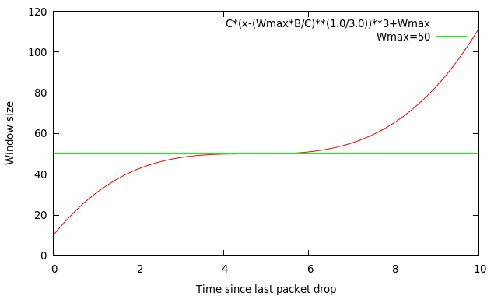
TCP CUBIC Implementation
Default TCP implementation in Linux
Replace AIMD with cubic function
B → a constant fraction for multiplicative increase
T → time since last packet drop
W_max ➔ cwnd when last packet dropped

Slide 25
TCP CUBIC Example
Slowly accelerate to probe for bandwidth
CUBIC Function
Timeout
cwnd_{max}
cwnd
Stable
Region
Slow Start
Fast ramp up
Time
Less wasted bandwidth due to fast ramp up
Stable region and slow acceleration help maintain fairness
Fast ramp up is more aggressive than additive increase
To be fair to Tahoe/Reno, CUBIC needs to be less aggressive

Slide 26
Outline
UDP
TCP
Congestion Control
Evolution of TCP
Problems with TCP

Slide 27
Issues with TCP
The vast majority of Internet traffic is TCP
However, many issues with the protocol
Poor performance with small flows
Really poor performance on wireless networks
Susceptibility to denial of service

Slide 28
Small Flows
Problem: TCP is biased against short flows
1 RTT wasted for connection setup (SYN, SYN/ACK)
cwnd always starts at 1
Vast majority of Internet traffic is short flows
Mostly HTTP transfers, <100KB
Most TCP flows never leave slow start!
Proposed solutions (driven by Google):
Increase initial cwnd to 10
TCP Fast Open: use cryptographic hashes to identify receivers, eliminate the need for three-way handshake

Slide 29
Wireless Networks
Problem: Tahoe and Reno assume loss = congestion
True on the WAN, bit errors are very rare
False on wireless, interference is very common
TCP throughput ~ 1/sqrt(drop rate)
Even a few interference drops can kill performance
Possible solutions:
Break layering, push data link info up to TCP
Use delay-based congestion detection (TCP Vegas)
Explicit congestion notification (ECN)

Slide 30
Denial of Service
Problem: TCP connections require state
Initial SYN allocates resources on the server
State must persist for several minutes (RTO)
SYN flood: send enough SYNs to a server to allocate all memory/meltdown the kernel
Solution: SYN cookies
Idea: don’t store initial state on the server
Securely insert state into the SYN/ACK packet (sequence number field)
Client will reflect the state back to the server

Slide 31
Further topics

Slide 32
Typical Internet Queuing
FIFO + drop-tail
Simplest choice
Used widely in the Internet
FIFO (first-in-first-out)
Implies single class of traffic
Drop-tail
Arriving packets get dropped when queue is full regardless of flow or importance
Important distinction:
FIFO: scheduling discipline
Drop-tail: drop policy

Slide 33
RED Algorithm
Maintain running average of queue length
If avgq < min_{th} do nothing
Low queuing, send packets through
If avgq > max_{th}, drop packet
Protection from misbehaving sources
Else mark packet in a manner proportional to queue length
Notify sources of incipient congestion
E.g. by ECN IP field or dropping packets with a given probability

Slide 34
RED Operation
Max thresh
Min thresh
Average Queue Length
P(drop)
1.0
max_{P}
min_{th}
max_{th}
Avg queue length

Slide 35
RED Algorithm
Maintain running average of queue length
For each packet arrival
Calculate average queue size (avg)
If min_{th} ≤ avgq < max_{th}
Calculate probability P_{a}
With probability P_{a}
Mark the arriving packet: drop or set-up ECN
Else if max_{th} ≤ avg
Mark the arriving packet: drop, ECN

Slide 36
Data Center TCP: DCTCP

Slide 37



Generality of Partition/Aggregate
The foundation for many large-scale web applications.
Web search, Social network composition, Ad selection, etc.
Example: Facebook
Partition/Aggregate ~ Multiget
Aggregators: Web Servers
Workers: Memcached Servers
Internet
Web
Servers
Memcached Protocol
Memcached Servers

Slide 38



Workloads
Partition/Aggregate
(Query)
Short messages [50KB-1MB]
(Coordination, Control state)
Large flows [1MB-50MB]
(Data update)
Delay-sensitive
Delay-sensitive
Throughput-sensitive
Notes:
Replace PDF

Slide 39
Impairments
Incast
Queue Buildup
Buffer Pressure

Slide 40

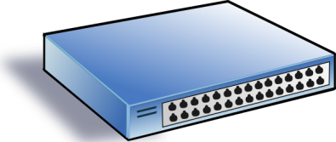
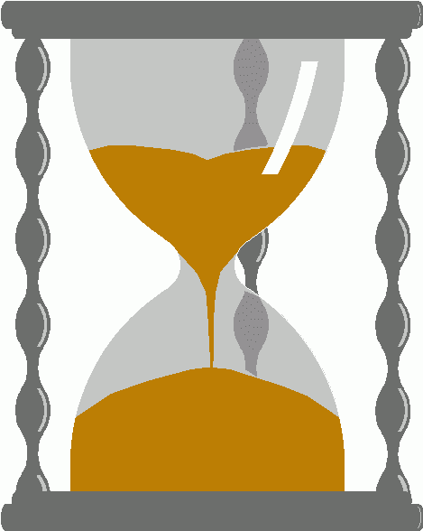
Incast
Worker 1
Synchronized mice collide.
Caused by Partition/Aggregate.
Aggregator
Worker 2
Worker 3
RTO_{min} = 300 ms
Worker 4
TCP timeout

Slide 41
Queue Buildup
Sender 1
Big flows buildup queues.
Increased latency for short flows.
Receiver
Sender 2
Measurements in Bing cluster
For 90% packets: RTT < 1ms
For 10% packets: 1ms < RTT < 15ms

Slide 42
Data Center Transport Requirements
High Burst Tolerance
Incast due to Partition/Aggregate is common.
Low Latency
Short flows, queries
3. High Throughput
Continuous data updates, large file transfers
The challenge is to achieve these three together.

Slide 43
DCTCP: The TCP/ECN Control Loop
Sender 1
ECN = Explicit Congestion Notification
ECN Mark (1 bit)
Receiver
Sender 2
Notes:
DCTCP is based on the existing Explicit Congestion Notification framework in TCP.

Slide 44
DCTCP: Two Key Ideas
React in proportion to the extent of congestion, not its presence.
Reduces variance in sending rates, lowering queuing requirements.
Mark based on instantaneous queue length.
Fast feedback to better deal with bursts.
ECN Marks | TCP | DCTCP
1 0 1 1 1 1 0 1 1 1 | Cut window by 50% | Cut window by 40%
0 0 0 0 0 0 0 0 0 1 | Cut window by 50% | Cut window by 5%

Slide 45
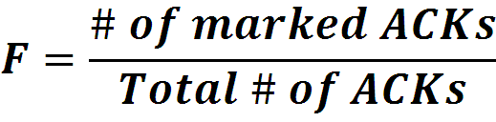

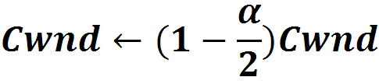
Data Center TCP Algorithm
B
K
Switch side:
Mark packets when Queue Length > K.
Mark
Don’t
Mark
Sender side:
Maintain running average of fraction of packets marked (α).
In each RTT:
Adaptive window decreases:
Note: decrease factor between 1 and 2.
Notes:
very simple marking mechanism
not all the tunings other aqms have
on the source side, the source is tryign to estimate the fraction of packets getting marked
using the obs that there is a stream of ecn marks coming back – more info in the stream than in any single bit
trying to maintain smooth rate variations to operate well even when using shallow buffers, and only a few flows (no stat mux)
F over the last RTT. In TCP there is always a way to get the next RTT from the window size. Comes from the self-clocking of TCP.
Only changing the decrease. Simplest version – makes a lot of sense. So generic could apply it to any algorithm – CTCP, CUBIC – how to cut its window leaving increase part to what it already does. Have to be careful here.

