Slide 1
Computer Networks
Lecture 11-12: Transport layer Part II
DNS, HTTP
Based on slides from D. Choffnes Northeastern U. and P. Gill from StonyBrook University
Revised Autumn 2015 by S. Laki

Slide 2
Transport Layer
Function:
Demultiplexing of data streams
Optional functions:
Creating long lived connections
Reliable, in-order packet delivery
Error detection
Flow and congestion control
Key challenges:
Detecting and responding to congestion
Balancing fairness against high utilization
Application
Presentation
Session
Transport
Network
Data Link
Physical

Slide 3
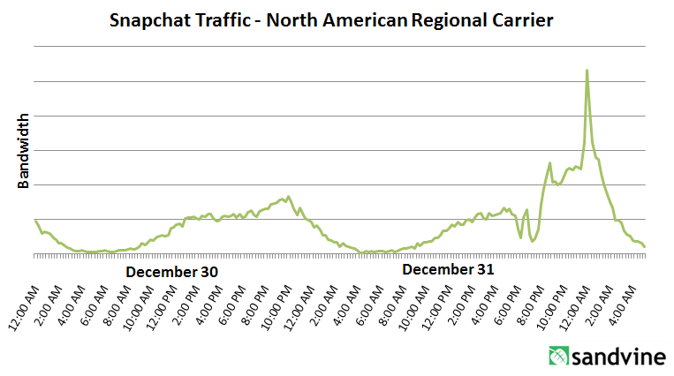
What is Congestion?
Load on the network is higher than capacity
Capacity is not uniform across networks
Modem vs. Cellular vs. Cable vs. Fiber Optics
There are multiple flows competing for bandwidth
Residential cable modem vs. corporate datacenter
Load is not uniform over time
10pm, Sunday night = Bittorrent Game of Thrones

Slide 4
Cong. Control vs. Cong. Avoidance
Congestion Avoidance:
Stay left of the knee
Congestion Control:
Stay left of the cliff
Knee
Cliff
Congestion Collapse
Goodput
Load

Slide 5
TCP Congestion Control
Each TCP connection has a window
Controls the number of unACKed packets
Sending rate is ~ window/RTT
Idea: vary the window size to control the send rate
Introduce a congestion window at the sender
Congestion control is sender-side problem

Slide 6
Two Basic Components
Detect congestion
Packet dropping is most reliably signal
Delay-based methods are hard and risky
How do you detect packet drops? ACKs
Timeout after not receiving an ACK
Several duplicate ACKs in a row (ignore for now)
Rate adjustment algorithm
Modify cwnd
Probe for bandwidth
Responding to congestion

Slide 7
Rate Adjustment
Recall: TCP is ACK clocked
Congestion = delay = long wait between ACKs
No congestion = low delay = ACKs arrive quickly
Basic algorithm
Upon receipt of ACK: increase cwnd
Data was delivered, perhaps we can send faster
cwnd growth is proportional to RTT
On loss: decrease cwnd
Data is being lost, there must be congestion
Question: increase/decrease functions to use? !!!!

Slide 8
Implementing Congestion Control
Maintains three variables:
cwnd: congestion window
adv_wnd: receiver advertised window
ssthresh: threshold size (used to update cwnd)
For sending, use: wnd = min(cwnd, adv_wnd)
Two phases of congestion control
Slow start (cwnd < ssthresh)
Probe for bottleneck bandwidth
Congestion avoidance (cwnd >= ssthresh)
AIMD
Notes:
Got to here.

Slide 9
Slow Start
Goal: reach knee quickly
Upon starting (or restarting) a connection
cwnd =1
ssthresh = adv_wnd
Each time a segment is ACKed, cwnd++
Continues until…
ssthresh is reached
Or a packet is lost
Slow Start is not actually slow
cwnd increases exponentially
Knee
Cliff
Goodput
Load

Slide 10
Slow Start Example
cwnd = 1
cwnd grows rapidly
Slows down when…
cwnd >= ssthresh
Or a packet drops
1
cwnd = 2
2
3
cwnd = 4
4
5
6
7
cwnd = 8

Slide 11
Congestion Avoidance
Additive Increase Multiplicative Decrease (AIMD) mode
ssthresh is lower-bound guess about location of the knee
If cwnd >= ssthresh then each time a segment is ACKed increment cwnd by 1/cwnd (cwnd += 1/cwnd).
So cwnd is increased by one only if all segments have been acknowledged

Slide 12
Congestion Avoidance Example
cwnd = 1
cwnd = 2
cwnd >= ssthresh
cwnd = 4
ssthresh = 8
cwnd (in segments)
Slow Start
cwnd = 8
cwnd = 9
Round Trip Times

Slide 13
The Big Picture – TCP Tahoe (the original TCP)
ssthresh
Timeout
Congestion
Avoidance
cwnd
Slow Start
Time

Slide 14
Outline
UDP
TCP
Congestion Control
Evolution of TCP
Problems with TCP

Slide 15
The Evolution of TCP
Thus far, we have discussed TCP Tahoe
Original version of TCP
However, TCP was invented in 1974!
Today, there are many variants of TCP
Early, popular variant: TCP Reno
Tahoe features, plus…
Fast retransmit
3 duplicate ACKs? -> retransmit (don’t wait for RTO)
Fast recovery
On loss: set cwnd = cwnd/2 (ssthresh = new cwnd value)

Slide 16
TCP Reno: Fast Retransmit
Problem: in Tahoe, if segment is lost, there is a long wait until the RTO
Reno: retransmit after 3 duplicate ACKs
cwnd = 1
1
2
cwnd = 2
2
3
3
4
cwnd = 4
4
5
6
7
4
3 Duplicate ACKs
4
4

Slide 17
TCP Reno: Fast Recovery
After a fast-retransmit set cwnd to cwnd/2
Also reset ssthresh to the new halved cwnd value
i.e. don’t reset cwnd to 1
Avoid unnecessary return to slow start
Prevents expensive timeouts
But when RTO expires still do cwnd = 1
Return to slow start, same as Tahoe
Indicates packets aren’t being delivered at all
i.e. congestion must be really bad

Slide 18
Fast Retransmit and Fast Recovery
ssthresh
Timeout
Congestion Avoidance
Fast Retransmit/Recovery
Timeout
cwnd
Slow Start
Time
At steady state, cwnd oscillates around the optimal window size
TCP always forces packet drops

Slide 19
Many TCP Variants…
Tahoe: the original
Slow start with AIMD
Dynamic RTO based on RTT estimate
Reno:
fast retransmit (3 dupACKs)
fast recovery (cwnd = cwnd/2 on loss)
NewReno: improved fast retransmit
Each duplicate ACK triggers a retransmission
Problem: >3 out-of-order packets causes pathological retransmissions
Vegas: delay-based congestion avoidance
And many, many, many more…

Slide 20
TCP in the Real World
What are the most popular variants today?
Key problem: TCP performs poorly on high bandwidth-delay product networks (like the modern Internet)
Compound TCP (Windows)
Based on Reno
Uses two congestion windows: delay based and loss based
Thus, it uses a compound congestion controller
TCP CUBIC (Linux)
Enhancement of BIC (Binary Increase Congestion Control)
Window size controlled by cubic function
Parameterized by the time T since the last dropped packet

Slide 21
High Bandwidth-Delay Product
Key Problem: TCP performs poorly when
The capacity of the network (bandwidth) is large
The delay (RTT) of the network is large
Or, when bandwidth * delay is large
b * d = maximum amount of in-flight data in the network
a.k.a. the bandwidth-delay product
Why does TCP perform poorly?
Slow start and additive increase are slow to converge
TCP is ACK clocked
i.e. TCP can only react as quickly as ACKs are received
Large RTT → ACKs are delayed → TCP is slow to react

Slide 22
Goals
Fast window growth
Slow start and additive increase are too slow when bandwidth is large
Want to converge more quickly
Maintain fairness with other TCP varients
Window growth cannot be too aggressive
Improve RTT fairness
TCP Tahoe/Reno flows are not fair when RTTs vary widely
Simple implementation

Slide 23
Compound TCP Implementation
Default TCP implementation in Windows
Key idea: split cwnd into two separate windows
Traditional, loss-based window
New, delay-based window
wnd = min(cwnd + dwnd, adv_wnd)
cwnd is controlled by AIMD
dwnd is the delay window
Rules for adjusting dwnd:
If RTT is increasing, decrease dwnd (dwnd >= 0)
If RTT is decreasing, increase dwnd
Increase/decrease are proportional to the rate of change

Slide 24
Compound TCP Example
Faster cwnd growth
High
RTT
Low
RTT
Slower cwnd growth
Timeout
Timeout
cwnd
Slow Start
Time
Aggressiveness corresponds to changes in RTT
Advantages: fast ramp up, more fair to flows with different RTTs
Disadvantage: must estimate RTT, which is very challenging

Slide 25
TCP CUBIC Implementation
Default TCP implementation in Linux
Replace AIMD with cubic function
B → a constant fraction for multiplicative increase
T → time since last packet drop
W_max ➔ cwnd when last packet dropped

Slide 26
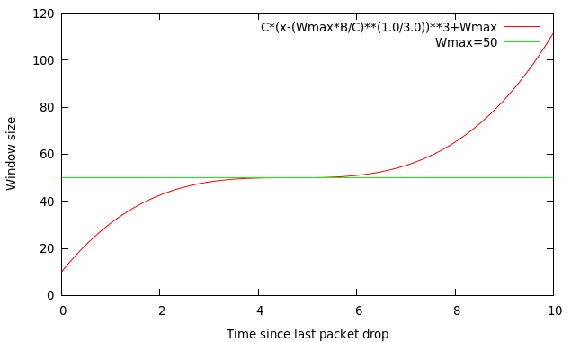
TCP CUBIC Implementation
Default TCP implementation in Linux
Replace AIMD with cubic function
B → a constant fraction for multiplicative increase
T → time since last packet drop
W_max ➔ cwnd when last packet dropped

Slide 27
TCP CUBIC Example
Slowly accelerate to probe for bandwidth
CUBIC Function
Timeout
cwnd_{max}
cwnd
Stable
Region
Slow Start
Fast ramp up
Time
Less wasted bandwidth due to fast ramp up
Stable region and slow acceleration help maintain fairness
Fast ramp up is more aggressive than additive increase
To be fair to Tahoe/Reno, CUBIC needs to be less aggressive

Slide 28
Outline
UDP
TCP
Congestion Control
Evolution of TCP
Problems with TCP

Slide 29
Issues with TCP
The vast majority of Internet traffic is TCP
However, many issues with the protocol
Poor performance with small flows
Really poor performance on wireless networks
Susceptibility to denial of service

Slide 30
Small Flows
Problem: TCP is biased against short flows
1 RTT wasted for connection setup (SYN, SYN/ACK)
cwnd always starts at 1
Vast majority of Internet traffic is short flows
Mostly HTTP transfers, <100KB
Most TCP flows never leave slow start!
Proposed solutions (driven by Google):
Increase initial cwnd to 10
TCP Fast Open: use cryptographic hashes to identify receivers, eliminate the need for three-way handshake

Slide 31
Wireless Networks
Problem: Tahoe and Reno assume loss = congestion
True on the WAN, bit errors are very rare
False on wireless, interference is very common
TCP throughput ~ 1/sqrt(drop rate)
Even a few interference drops can kill performance
Possible solutions:
Break layering, push data link info up to TCP
Use delay-based congestion detection (TCP Vegas)
Explicit congestion notification (ECN)

Slide 32
Denial of Service
Problem: TCP connections require state
Initial SYN allocates resources on the server
State must persist for several minutes (RTO)
SYN flood: send enough SYNs to a server to allocate all memory/meltdown the kernel
Solution: SYN cookies
Idea: don’t store initial state on the server
Securely insert state into the SYN/ACK packet (sequence number field)
Client will reflect the state back to the server

Slide 33
DNS

Slide 34
Layer 8 (The Carbon-based nodes)
If you want to…
Call someone, you need to ask for their phone number
You can’t just dial “P R O F G I L L ”
Mail someone, you need to get their address first
What about the Internet?
If you need to reach Google, you need their IP
Does anyone know Google’s IP?
Problem:
People can’t remember IP addresses
Need human readable names that map to IPs

Slide 35
Internet Names and Addresses
Addresses, e.g. 129.10.117.100
Computer usable labels for machines
Conform to structure of the network
Names, e.g. www.northeastern.edu
Human usable labels for machines
Conform to organizational structure
How do you map from one to the other?
Domain Name System (DNS)

Slide 36
History
Before DNS, all mappings were in hosts.txt
/etc/hosts on Linux
C:\Windows\System32\drivers\etc\hosts on Windows
Centralized, manual system
Changes were submitted to SRI via email
Machines periodically FTP new copies of hosts.txt
Administrators could pick names at their discretion
Any name was allowed
alans_server_at_sbu_pwns_joo_lol_kthxbye

Slide 37
Towards DNS
Eventually, the hosts.txt system fell apart
Not scalable, SRI couldn’t handle the load
Hard to enforce uniqueness of names
e.g MIT
Massachusetts Institute of Technology?
Melbourne Institute of Technology?
Many machines had inaccurate copies of hosts.txt
Thus, DNS was born

Slide 38
Outline
DNS Basics
DNS Security
DNS and Censorship

Slide 39
DNS at a High-Level
Domain Name System
Distributed database
No centralization
Simple client/server architecture
UDP port 53, some implementations also use TCP
Why?
Hierarchical namespace
As opposed to original, flat namespace
e.g. .com → google.com → mail.google.com

Slide 40
Naming Hierarchy
Root
net
edu
com
gov
mil
org
uk
fr
etc.
Top Level Domains (TLDs) are at the top
Maximum tree depth: 128
Each Domain Name is a subtree
.edu → neu.edu → ccs.neu.edu → www.ccs.neu.edu
Name collisions are avoided
neu.com vs. neu.edu
neu
mit
ccs
ece
husky
www
login
mail

Slide 41
Hierarchical Administration
Verisign
Root
ICANN
net
edu
com
gov
mil
org
uk
fr
etc.
Tree is divided into zones
Each zone has an administrator
Responsible for the part of the hierarchy
Example:
CCIS controls *.ccs.neu.edu
NEU controls *.neu.edu
neu
mit
ccs
www
login
mail

Slide 42
Server Hierarchy
Functions of each DNS server:
Authority over a portion of the hierarchy
No need to store all DNS names
Store all the records for hosts/domains in its zone
May be replicated for robustness
Know the addresses of the root servers
Resolve queries for unknown names
Root servers know about all TLDs
The buck stops at the root servers

Slide 43
Root Name Servers
Responsible for the Root Zone File
Lists the TLDs and who controls them
~272KB in size
com. 172800 IN NS a.gtld-servers.net.
com. 172800 IN NS b.gtld-servers.net.
com. 172800 IN NS c.gtld-servers.net.
Administered by ICANN
13 root servers, labeled A→M
6 are anycasted, i.e. they are globally replicated
Contacted when names cannot be resolved
In practice, most systems cache this information

Slide 44
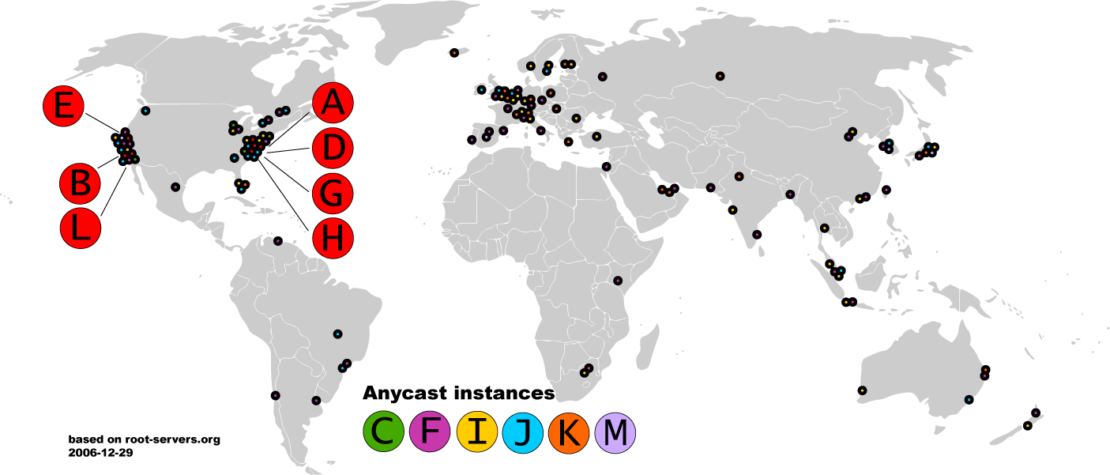
Map of the Roots

Slide 45


Local Name Servers
Where is google.com?
Northeastern
Each ISP/company has a local, default name server
Often configured via DHCP
Hosts begin DNS queries by contacting the local name server
Frequently cache query results

Slide 46
Authoritative Name Servers
www.neu.edu = 155.33.17.68
Where is www.neu.edu?
www.neu.edu
Northeastern
Root
edu
neu
Authority for ‘edu’
Authority for ‘neu.edu’
Stores the name→IP mapping for a given host

Slide 47
Basic Domain Name Resolution
Every host knows a local DNS server
Sends all queries to the local DNS server
If the local DNS can answer the query, then you’re done
Local server is also the authoritative server for that name
Local server has cached the record for that name
Otherwise, go down the hierarchy and search for the authoritative name server
Every local DNS server knows the root servers
Use cache to skip steps if possible
e.g. skip the root and go directly to .edu if the root file is cached

Slide 48
Recursive DNS Query
www.google.com
Where is www.google.com?
Puts the burden of resolution on the contacted name server
How does asgard know who to forward responses too?
Random IDs embedded in DNS queries
asgard.ccs.neu.edu
ns1.google.com
com
Root

Slide 49
Iterated DNS query
www.google.com
Where is www.google.com?
Contact server replies with the name of the next authority in the hierarchy
“I don’t know this name, but this other server might”
This is how DNS works today
asgard.ccs.neu.edu
ns1.google.com
com
Root

Slide 50
DNS Propagation
How many of you have purchased a domain name?
Did you notice that it took ~72 hours for your name to become accessible?
This delay is called DNS Propagation
www.my-new-site.com
Root
com
asgard.ccs.neu.edu
ns.godaddy.com
Why would this process fail for a new DNS name?

Slide 51
Caching vs. Freshness
DNS Propagation delay is caused by caching
Where is
www.my-new-site.com?
That name does not exist.
Cached Root Zone File
Cached .com Zone File
Cached .net Zone File
Etc.
asgard.ccs.neu.edu
Zone files may be cached for 1-72 hours
Root
com
www.my-new-site.com
ns.godaddy.com

Slide 52
DNS Resource Records
DNS queries have two fields: name and type
Resource record is the response to a query
Four fields: (name, value, type, TTL)
There may be multiple records returned for one query
What do the name and value mean?
Depends on the type of query and response

Slide 53
DNS Types
Type = A / AAAA
Name = domain name
Value = IP address
A is IPv4, AAAA is IPv6
Type = NS
Name = partial domain
Value = name of DNS server for this domain
“Go send your query to this other server”
Name: www.ccs.neu.edu
Type: A
Query
Name: www.ccs.neu.edu
Value: 129.10.116.81
Resp.
Name: ccs.neu.edu
Type: NS
Query
Name: ccs.neu.edu
Value: 129.10.116.51
Resp.

Slide 54
DNS Types, Continued
Type = CNAME
Name = hostname
Value = canonical hostname
Useful for aliasing
CDNs use this
Type = MX
Name = domain in email address
Value = canonical name of mail server
Name: foo.mysite.com
Type: CNAME
Query
Name: foo.mysite.com
Value: bar.mysite.com
Resp.
Name: ccs.neu.edu
Type: MX
Query
Name: ccs.neu.edu
Value: amber.ccs.neu.edu
Resp.

Slide 55
Reverse Lookups
What about the IP→name mapping?
Separate server hierarchy stores reverse mappings
Rooted at in-addr.arpa and ip6.arpa
Additional DNS record type: PTR
Name = IP address
Value = domain name
Not guaranteed to exist for all IPs
Name: 129.10.116.51 Type: PTR
Query
Name: 129.10.116.51 Value: ccs.neu.edu
Resp.

Slide 56
DNS as Indirection Service
DNS gives us very powerful capabilities
Not only easier for humans to reference machines!
Changing the IPs of machines becomes trivial
e.g. you want to move your web server to a new host
Just change the DNS record!

Slide 57
Aliasing and Load Balancing
One machine can have many aliases
www.reddit.com
david.choffnes.com
www.foursquare.com
alan.mislo.ve
www.huffingtonpost.com
*.blogspot.com
One domain can map to multiple machines
www.google.com

Slide 58
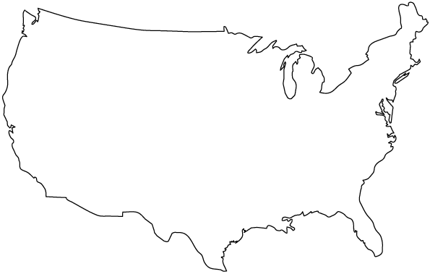


Content Delivery Networks
DNS responses may vary based on geography, ISP, etc

Slide 59
Outline
HTTP Connection Basics
HTTP Protocol
Cookies, keeping state + tracking

Slide 60
Web and HTTP
First, a review…
web page consists of objects
object can be HTML file, JPEG image, Java applet, audio file,…
web page consists of base HTML-file which includes several referenced objects
each object is addressable by a URL, e.g.,
www.someschool.edu/someDept/pic.gif
host name
path name

Slide 61


HTTP overview
HTTP: hypertext transfer protocol
Web’s application layer protocol
client/server model
client: browser that requests, receives, (using HTTP protocol) and “displays” Web objects
server: Web server sends (using HTTP protocol) objects in response to requests
HTTP request
PC running
Firefox browser
HTTP response
HTTP request
server
running
Apache Web
server
HTTP response
iphone running
Safari browser

Slide 62
HTTP overview (continued)
uses TCP:
client initiates TCP connection (creates socket) to server, port 80
server accepts TCP connection from client
HTTP messages (application-layer protocol messages) exchanged between browser (HTTP client) and Web server (HTTP server)
TCP connection closed
HTTP is “stateless” (in theory…)
server maintains no information about past client requests
aside
protocols that maintain “state” are complex!
past history (state) must be maintained
if server/client crashes, their views of “state” may be inconsistent, must be reconciled

Slide 63
HTTP connections
non-persistent HTTP
at most one object sent over TCP connection
connection then closed
downloading multiple objects required multiple connections
persistent HTTP
multiple objects can be sent over single TCP connection between client, server

Slide 64
Example Web Page
Harry Potter Movies
As you all know,
the new HP book
will be out in June
and then there will
be a new movie
shortly after that…
“Harry Potter and
the Bathtub Ring”
hpface.jpg
page.html
castle.gif

Slide 65
Client
Server
Non-Persistent HTTP
TCP SYN
G
page.html
The “classic” approach
in HTTP/1.0 is to use one
HTTP request per TCP
connection, serially.
TCP FIN
TCP SYN
G
hpface.jpg
TCP FIN
TCP SYN
G
castle.gif
TCP FIN

Slide 66
Client
Server
Concurrent (parallel) TCP
connections can be used
to make things faster.
TCP SYN
G
C
S
C
S
page.html
S
S
TCP FIN
G
G
hpface.jpg
castle.gif
F
F

Slide 67
Persistent HTTP
non-persistent HTTP issues:
requires 2 RTTs per object
OS overhead for each TCP connection
browsers often open parallel TCP connections to fetch referenced objects
persistent HTTP:
server leaves connection open after sending response
subsequent HTTP messages between same client/server sent over open connection
client sends requests as soon as it encounters a referenced object
as little as one RTT for all the referenced objects

Slide 68
Non-persistent HTTP: response time
RTT: time for a packet to travel from client to server and back
HTTP response time:
one RTT to initiate TCP connection
one RTT for HTTP request and first few bytes of HTTP response to return
This assumes HTTP GET piggy backed on the ACK
file transmission time
non-persistent HTTP response time =
2RTT+ file transmission time
initiate TCP
connection
RTT
request
file
RTT
time to
transmit
file
file
received
time
time

Slide 69
Client
Server
Persistent HTTP
TCP SYN
G
page.html
The “persistent HTTP”
approach can re-use the
same TCP connection for
Multiple HTTP transfers,
one after another, serially.
Amortizes TCP overhead,
but maintains TCP state
longer at server.
G
hpface.jpg
G
castle.gif
Timeout
TCP FIN

Slide 70
Client
Server
TCP SYN
G
page.html
GG
The “pipelining” feature
in HTTP/1.1 allows
requests to be issued
asynchronously on a
persistent connection.
Requests must be
processed in proper order.
Can do clever packaging.
hpface.jpg
castle.gif
Timeout
TCP FIN

Slide 71
Outline
HTTP Connection Basics
HTTP Protocol
Cookies, keeping state + tracking

Slide 72
HTTP request message
two types of HTTP messages: request, response
HTTP request message:
ASCII (human-readable format)
carriage return character
request line
(GET, POST,
HEAD commands)
line-feed character
GET /index.html HTTP/1.1\r\n
Host: www-net.cs.umass.edu\r\n
User-Agent: Firefox/3.6.10\r\n
Accept: text/html,application/xhtml+xml\r\n
Accept-Language: en-us,en;q=0.5\r\n
Accept-Encoding: gzip,deflate\r\n
Accept-Charset: ISO-8859-1,utf-8;q=0.7\r\n
Keep-Alive: 115\r\n
Connection: keep-alive\r\n
\r\n
header
lines
carriage return,
line feed at start
of line indicates
end of header lines

Slide 73
HTTP request message: general format
method
sp
URL
sp
version
cr
lf
request
line
header field name
value
cr
lf
~
~
header
lines
~
~
header field name
value
cr
lf
cr
lf
~
entity body
~
body
~
~

Slide 74
Uploading form input
POST method:
web page often includes form input
input is uploaded to server in entity body
URL method:
uses GET method
input is uploaded in URL field of request line:
www.somesite.com/animalsearch?monkeys&banana

Slide 75
Method types
HTTP/1.0:
GET
POST
HEAD
asks server to leave requested object out of response
HTTP/1.1:
GET, POST, HEAD
PUT
uploads file in entity body to path specified in URL field
DELETE
deletes file specified in the URL field

Slide 76
HTTP response message
status line
(protocol
status code
status phrase)
HTTP/1.1 200 OK\r\n
Date: Sun, 26 Sep 2010 20:09:20 GMT\r\n
Server: Apache/2.0.52 (CentOS)\r\n
Last-Modified: Tue, 30 Oct 2007 17:00:02 GMT\r\n
ETag: "17dc6-a5c-bf716880"\r\n
Accept-Ranges: bytes\r\n
Content-Length: 2652\r\n
Keep-Alive: timeout=10, max=100\r\n
Connection: Keep-Alive\r\n
Content-Type: text/html; charset=ISO-8859-1\r\n
\r\n
data data data data data ...
header
lines
data, e.g.,
requested
HTML file

Slide 77
HTTP response status codes
status code appears in 1st line in server-to-client response message.
some sample codes:
200 OK
request succeeded, requested object later in this msg
301 Moved Permanently
requested object moved, new location specified later in this msg (Location:)
400 Bad Request
request msg not understood by server
404 Not Found
requested document not found on this server
505 HTTP Version Not Supported

Slide 78
Trying out HTTP (client side) for yourself
1. Telnet to your favorite Web server:
telnet cis.poly.edu 80
opens TCP connection to port 80
(default HTTP server port) at cis.poly.edu.
anything typed in sent
to port 80 at cis.poly.edu
2. type in a GET HTTP request:
GET /~ross/ HTTP/1.1
Host: cis.poly.edu
by typing this in (hit carriage
return twice), you send
this minimal (but complete)
GET request to HTTP server
3. look at response message sent by HTTP server!
(or use Wireshark to look at captured HTTP request/response)

Slide 79
Outline
HTTP Connection Basics
HTTP Protocol
Cookies, keeping state + tracking

Slide 80
User-server state: cookies
example:
Susan always access Internet from PC
visits specific e-commerce site for first time
when initial HTTP requests arrives at site, site creates:
unique ID
entry in backend database for ID
many Web sites use cookies
four components:
1) cookie header line of HTTP response message
2) cookie header line in next HTTP request message
3) cookie file kept on user’s host, managed by user’s browser
4) back-end database at Web site

Slide 81
Cookies: keeping “state” (cont.)
client
server
ebay 8734
usual http request msg
Amazon server
creates ID
1678 for user
cookie file
usual http response
set-cookie: 1678
backend
database
create
entry
ebay 8734
amazon 1678
usual http request msg
cookie: 1678
cookie-
specific
action
access
usual http response msg
one week later:
access
ebay 8734
amazon 1678
usual http request msg
cookie: 1678
cookie-
specific
action
usual http response msg

Slide 82
Cookies (continued)
aside
what cookies can be used for:
authorization
shopping carts
recommendations
user session state (Web e-mail)
cookies and privacy:
cookies permit sites to learn a lot about you
you may supply name and e-mail to sites
how to keep “state”:
protocol endpoints: maintain state at sender/receiver over multiple transactions
cookies: http messages carry state

Slide 83

Cookies + Third Parties
Example page (from Wired.com)

Slide 84



How it works
And it’s not just Facebook!
Wired.com
GET article.html
GET sharebutton.gif
Cookie: FBCOOKIE
Facebook now knows you visited this Wired article.
Works for all pages where ‘like’/’share’ button is embedded!

