Slide 1
Computer Networks
Lecture 1: Logistics
Based on slides from D. Choffnes Northeastern U. and P. Gill from StonyBrook University
Revised Autumn 2015 by S. Laki

Slide 2
Hello!
Welcome to Computer Networks
Are you in the right classroom?
Okay, good.
Who am I?
Sándor Laki, PhD
Assistant Professor at Dept. Of Information Systems
lakis@inf.elte.hu
Office: Southern Building, Room 2.506
Office Hours: 10-11 Monday, in room 2.506

Slide 3
Why Take This Course?
How many of you have checked your e-mail, FB, text…
Today?
In the past hour?
Since I started talking?

Slide 4



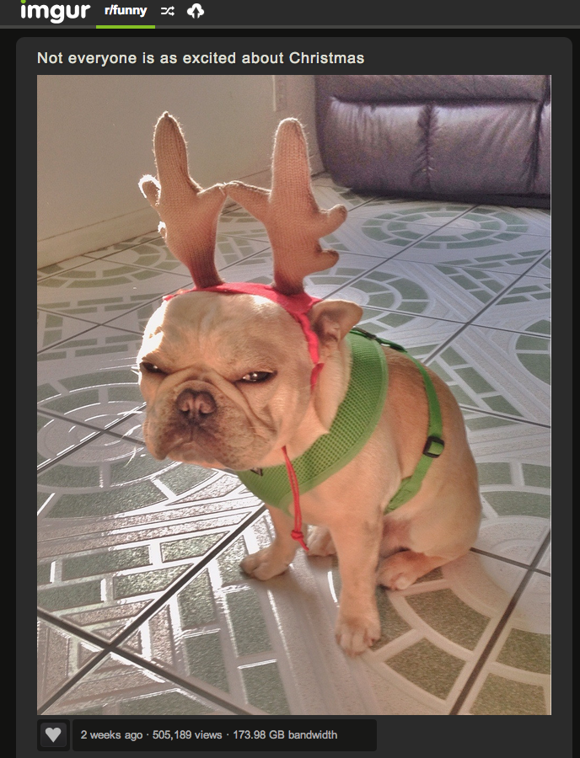

Computer networks are ubiquitous
Networks touch every part of our daily life
Web search
Social networking
Watching movies
Ordering merchandise
Wasting time

Slide 5
Computer networks are ubiquitous
Networking is one of the most critical topics in CS
There would be no…
Big Data
Cloud
Apps or Mobile Computing
… without networks

Slide 6
Goals
Fundamental understanding about computer networks
Layered approach covering routing algorithms and protocols up the stack
Not just how it works, but how did it end up that way?
Issues arising with new popular applications online
How might we rethink protocols and assumptions of the past ☺
Focus on software and protocols
Not hardware
Minimal theory
We will be putting concepts into historical perspective

Slide 7
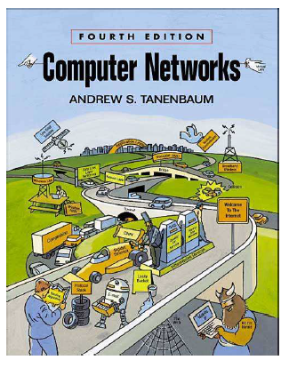
Resources
Visit for slides
http://lakis.web.elte.hu
Choose Computer Networks
Class forum
Email
Canvas?
FB?

Slide 8
Teaching Style
I am a network researcher
Things make sense to me that may not make sense to you
If you do not understand something, do not be shy to stop me and ask
Seriously, ask questions!!!
Standing up here in silence is very awkward
I will stand here until you answer my questions
Help me learn your names
Say your name before each question

Slide 9
Course = Lecture + Practice
Practice
Lecturer: Peter Vörös, Teaching assistant
Requirements will be announced at the first class
Lecture
After a successfully passed practical part…
Final exam at end of the semester
one occasion per week in the exam period
written exam – tests + essay

Slide 10
Cheating
Do not do it
Seriously, don’t make me say it again
Cheating is an automatic zero
Will be referred to the university for discipline and possible expulsion

Slide 11
Final Grades
At the end of the semester, all of your grades will sum to 100 points
Final grades are based on a simple scale:
5 - >85,
4 - 70-85,
3 - 60-70,
2 - 50-60,
1 - 0-50

Slide 12
Questions?
http://lakis.web.elte.hu
lakis@inf.elte.hu

