Slide 1
Computer Networks
Lecture 2: Internet Architecture
(Layer cake and an hourglass)
Based on slides from D. Choffnes Northeastern U. and P. Gill from StonyBrook University
Revised Autumn 2017 by S. Laki

Slide 2
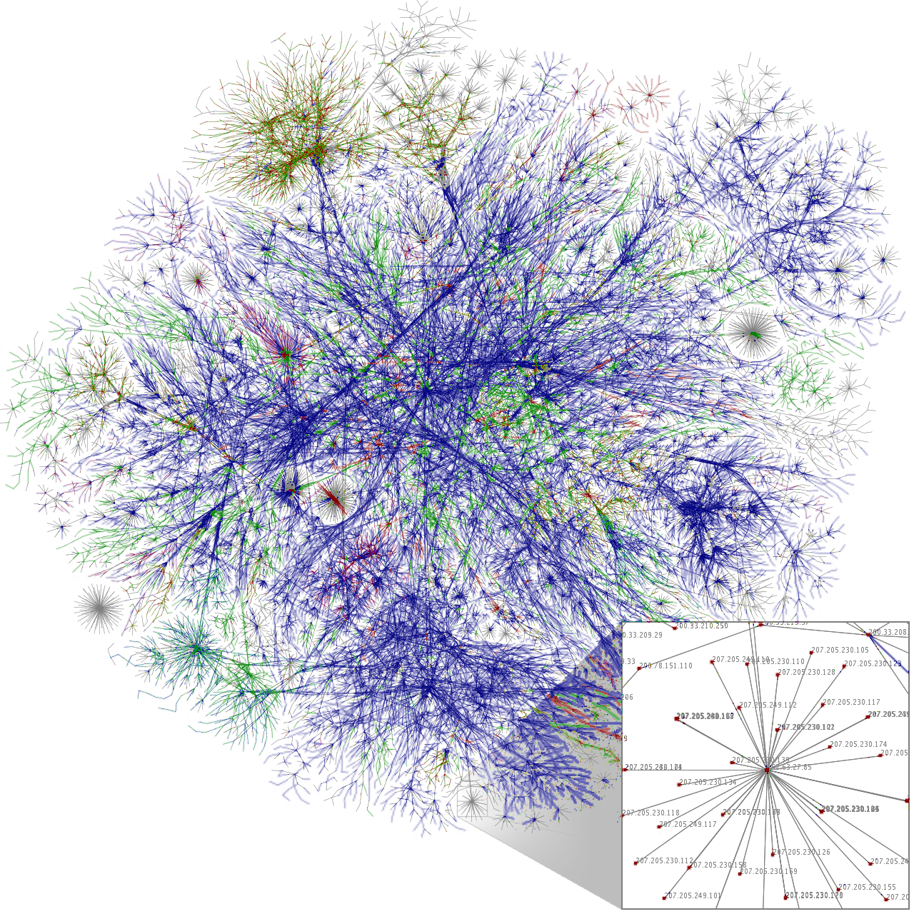
What is Internet?
Network of networks
Largest wide area network
Properties
System independent, heterogeneous
No central control
Built up from small networks called Local Area Networks (LANs)
global
It offers services like WWW, email, FB…
Forrás: [1]

Slide 3
History1/2
1957
First long-distance connection between two computers
Szputnyik–1
1958
DARPA is established
1966
Planning of ARPANET
Other initiatives:
RAND – Military network in the USA
NPL – Commercial network in UK
CYCLADES – Scientific network in France
Notes:
1957 előtt egy számítógép egyszerre egy feladatot tudott elvégezni. (BATCH feldolgozás)
A méretnövekedés miatt speciális hűtőszobákba kellett őket tárolni. Ezért a fejlesztők nem dolgozhattak direkten a számítógépen.
Idő-osztásos hozzáférés témájának megjelenése.
(SZPUTNYiK 1) Alacsony pályája miatt három hónap után megsemmisült a légkörben.
A tudás eddig csak emberek által volt terjesztve.
Három másik irány is volt. (katonai(USA), üzleti(anglia), tudományos(francia) ) Ezek az alapjai a modern internetnek
/ARPA/ MAINFRAME(futtatott), IMP(komunikált) -> IMP subnet (NCP protokoll=>TCP (verifikáció))
/NPL/ ütközés elkerülésre darabolás csomagokra
(1962) Félelem az atomháborútól, központosított számítógépek. => decentralizálás
Rádió helyett direkt kapcsolás.
CYCADES inter-net koncept (protokoll, hardverbe építve) [END-TO-END struktúra]
Telefon szolgáltatók x.25 <=> DARPA gateway-ek (OSI referencia modell), TCP/IP az összemosáshoz
1990-ben az ARPANET megszünt

Slide 4
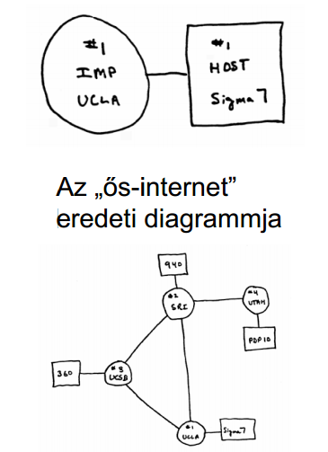
History 2/2
1961 July – „Packet Switching Theory” (J.C.R. Licklider)
1962 – Concept of „Galactic Network” (J.C.R. Licklider)
October – DARPA („Defense Advanced Research Projects Agency”)
1965 – Per-Internet (Thomas Merrill, Laurence G. Roberts)
1967 – ARPANET concept
1969 – First “ARPANET” node
1990 – End of ARPANET
Sketches about the Pre-Internet

Slide 5
ARPANET 1/3
1969 December
1970 July
SRI
UTAH
ILLINOIS
MIT
LINCOLN
CASE
1971 March
UCSB
STAN
SCD
CRAN
UCLA
RAND
BBN
HARVARD
BURROUGHS

Slide 6
ARPANET 2/3
1972 April

Slide 7
ARPANET 3/3
1972 September

Slide 8
Organizing Network Functionality
Networks are built from many components
Networking technologies
Ethernet, Wifi, Bluetooth, Fiber Optic, Cable Modem, DSL
Network styles
Circuit switch, packet switch
Wired, Wireless, Optical, Satellite
Applications
Email, Web (HTTP), FTP, BitTorrent, VoIP
How do we make all this stuff work together?!

Slide 9
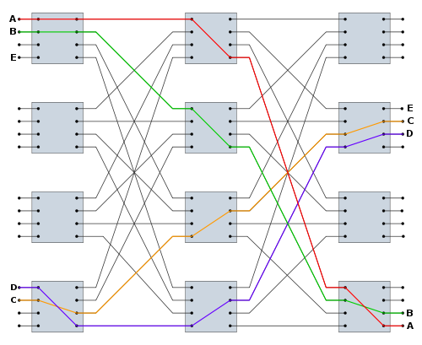





Network styles
Packet switching network
e.g. Internet
Circuit swtiching network
e.g. wired phone system
Packets
Notes:
For circuit switching: In the early days of telephony, through roughly the 1960s, companies used manual telephone switchboards, and switchboard operators connected calls by inserting a pair of phone plugs into the appropriate jacks.

Slide 10




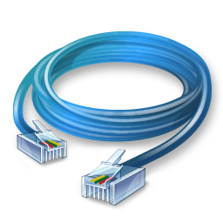
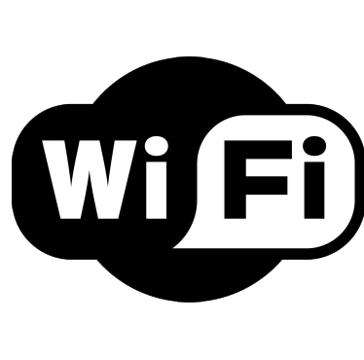


Problem Scenario
Web
Email
Bittorrent
VoIP
This is a nightmare scenario
Huge amounts of work to add new apps or media
Limits growth and adoption
Ethernet
802.11
Bluetooth
Cellular

Slide 11
More Problems
Bittorrent
Bittorrent
Application endpoints may not be on the same media
Ethernet
802.11

Slide 12
Solution: Use Indirection
Web
Email
Bittorrent
VoIP
API
O(1) work to add new apps, media
Few limits on new technology
Magical Network Abstraction Layer
API
API
API
Ethernet
802.11
Bluetooth
Cellular

Slide 13
Layered Network Stack
Applications
Modularity
Does not specify an implementation
Instead, tells us how to organize functionality
Encapsulation
Interfaces define cross-layer interaction
Layers only rely on those below them
Flexibility
Reuse of code across the network
Module implementations may change
Unfortunately, there are tradeoffs
Interfaces hide information
As we will see, may hurt performance…
Layer N
…
Layer 2
Layer 1
Physical
Media

Slide 14


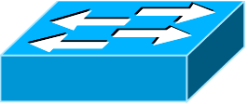
Key Questions
How do we divide functionality into layers?
Routing
Congestion control
Error checking
How do we distribute functionality across devices?
Example: who is responsible for security?
Security
Fairness
And many more…
Switch
Switch
Router

Slide 15
Outline
Layering
The OSI Model
Communicating
The End-to-End Argument

Slide 16
The ISO OSI Model
OSI: Open Systems Interconnect Model
Host 1
Router/Switch
Host 2
Application
All devices implement the first two or three layers
Application
Presentation
Layers communicate peer-to-peer
Presentation
Layers communicate peer-to-peer
Session
Session
Transport
Transport
Network
Network
Network
Data Link
Data Link
Data Link
Physical
Physical
Physical

Slide 17
Layer Features
Service
What does this layer do?
Interface
How do you access this layer?
Protocol
How is this layer implemented?
Application
Presentation
Session
Transport
Network
Data Link
Physical

Slide 18
Physical Layer
Service
Move information between two systems connected by a physical link
Interface
Specifies how to send one bit
Protocol
Encoding scheme for one bit
Voltage levels
Timing of signals
Examples: coaxial cable, fiber optics, radio frequency transmitters
Application
Presentation
Session
Transport
Network
Data Link
Physical

Slide 19
Data Link Layer
Service
Data framing: boundaries between packets
Media access control (MAC)
Per-hop reliability and flow-control
Interface
Send one packet between two hosts connected to the same media
Protocol
Physical addressing (e.g. MAC address)
Examples: Ethernet, Wifi, DOCSIS
Application
Presentation
Session
Transport
Network
Data Link
Physical

Slide 20
Network Layer
Service
Deliver packets across the network
Handle fragmentation/reassembly
Packet scheduling
Buffer management
Interface
Send one packet to a specific destination
Protocol
Define globally unique addresses
Maintain routing tables
Example: Internet Protocol (IP), IPv6
Application
Presentation
Session
Transport
Network
Data Link
Physical

Slide 21
Transport Layer
Service
Multiplexing/demultiplexing
Congestion control
Reliable, in-order delivery
Interface
Send message to a destination
Protocol
Port numbers
Reliability/error correction
Flow-control information
Examples: UDP, TCP
Application
Presentation
Session
Transport
Network
Data Link
Physical

Slide 22
Session Layer
Service
Access management
Synchronization
Interface
It depends…
Protocol
Token management
Insert checkpoints
Examples: none
Application
Presentation
Session
Transport
Network
Data Link
Physical

Slide 23
Presentation Layer
Service
Convert data between different representations
E.g. big endian to little endian
E.g. Ascii to Unicode
Interface
It depends…
Protocol
Define data formats
Apply transformation rules
Examples: none
Application
Presentation
Session
Transport
Network
Data Link
Physical

Slide 24
Application Layer
Service
Whatever you want :)
Interface
Whatever you want :D
Protocol
Whatever you want ;)
Examples: turn on your smartphone and look at the list of apps
Application
Presentation
Session
Transport
Network
Data Link
Physical

Slide 25
Encapsulation
How does data move through the layers?
Data
Application
Presentation
Session
Transport
Network
Data Link
Physical
Data

Slide 26



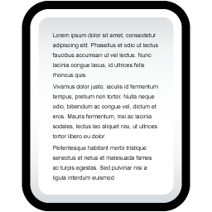




Real Life Analogy
Doesn’t know how the Postal network works
Label contains routing info
Un-packing
Doesn’t know contents of letter
Postal Service

Slide 27
Network Stack in Practice
Host 1
Switch
Host 2
Application
Application
Presentation
Presentation
Video Client
Video Server
Session
Session
FTP Client
FTP Server
UDP
UDP
Transport
Transport
TCP
TCP
Network
Network
Network
IP
IP
IP
Data Link
Data Link
Data Link
Ethernet
Ethernet
802.11n
Ethernet
802.11n
802.11n
Physical
Physical
Physical

Slide 28
Encapsulation, Revisited
HTTP Header
Web Page
Web Server
TCP Header
HTTP Header
Web Page
TCP
TCP Segment
IP Header
TCP Header
HTTP Header
Web Page
IP
IP Datagram
Ethernet Header
IP Header
TCP Header
HTTP Header
Web Page
Ethernet Trailer
Ethernet
Ethernet Frame

Slide 29
The Hourglass
HTTP, FTP, RTP, IMAP, Jabber, …
One Internet layer means all networks interoperate
All applications function on all networks
Room for development above and below IP
But, changing IP is insanely hard
TCP, UDP, ICMP
Think about the difficulty of deploying IPv6…
IPv4
Ethernet, 802.11x, DOCSIS, …
Fiber, Coax, Twisted Pair, Radio, …

Slide 30
Orthogonal Planes
Control plane: How Internet paths are established
Application
Presentation
We’ll cover this later…
Session
Transport
IP
BGP
RIP
OSPF
Control Plane
Data Link
Physical

Slide 31
Orthogonal Planes
Data plane: How data is forwarded over Internet paths
Host 1
Routers/Switches
Host 2
Application
Application
Transport
Transport
Network
Network
Network
Data Link
Data Link
Data Link

Slide 32
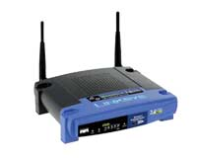


Reality Check
The layered abstraction is very nice
Does it hold in reality?
No.
Firewalls
Analyze application layer headers
Transparent Proxies
Simulate application endpoints within the network
NATs
Break end-to-end network reachability

Slide 33
Outline
Layering
The OSI Model
Communicating
The End-to-End Argument

Slide 34
From Layers to Eating Cake
IP gives us best-effort datagram forwarding
So simple anyone can do it
Large part of why the Internet has succeeded
…but it sure isn’t giving us much
Layers give us a way to compose functionality
Example: HTTP over TCP for Web browsers with reliable connections
…but they do not tell us where (in the network) to implement the functionality

Slide 35
Where to Place Functionality
How do we distribute functionality across devices?
Example: who is responsible for security?
?
?
?
?
?
Switch
Switch
Router
“The End-to-End Arguments in System Design”
Saltzer, Reed, and Clark
The Sacred Text of the Internet
Endlessly debated by researchers and engineers

Slide 36
Basic Observation
Some applications have end-to-end requirements
Security, reliability, etc.
Implementing this stuff inside the network is hard
Every step along the way must be fail-proof
Different applications have different needs
End hosts…
Can’t depend on the network
Can satisfy these requirements without network level support

Slide 37


Example: Reliable File Transfer
Integrity Check
Integrity Check
Integrity Check
App has to do a check anyway!
Solution 1: Make the network reliable
Solution 2: App level, end-to-end check, retry on failure

Slide 38
Example: Reliable File Transfer
Please Retry
In-network implementation…
Doesn’t reduce host complexity
Does increase network complexity
Increased overhead for apps that don’t need functionality
But, in-network performance may be better
Full functionality can be built at App level
Solution 1: Make the network reliable
Solution 2: App level, end-to-end check, retry on failure

Slide 39
Conservative Interpretation
“Don’t implement a function at the lower levels of the system unless it can be completely implemented at this level” (Peterson and Davie)
Basically, unless you can completely remove the burden from end hosts, don’t bother

Slide 40
Radical Interpretation
Don’t implement anything in the network that can be implemented correctly by the hosts
Make network layer absolutely minimal
Ignore performance issues

Slide 41
Moderate Interpretation
Think twice before implementing functionality in the network
If hosts can implement functionality correctly, implement it a lower layer only as a performance enhancement
But do so only if it does not impose burden on applications that do not require that functionality…
…and if it doesn’t cost too much $ to implement

Slide 42
Reality Check, Again
Layering and E2E principals regularly violated
Firewalls
Transparent Proxies
NATs
Conflicting interests
Architectural purity
Commercial necessity

Slide 43
Takeaways
Layering for network functions
Helps manage diversity in computer networks
Not optimal for everything, but simple and flexible
Narrow waist ensures interoperability, enables innovation
E2E argument (attempts) to keep IP layer simple
Think carefully when adding functionality into the network

