Slide 1
Computer Networks
Lecture 2: Data Link
Based on slides from D. Choffnes Northeastern U. and P. Gill from StonyBrook University
Revised Autumn 2015 by S. Laki

Slide 2
Data Link Layer
Function:
Send blocks of data (frames) between physical devices
Regulate access to the physical media
Key challenge:
How to delineate frames?
How to detect errors?
How to perform media access control (MAC)?
How to recover from and avoid collisions?
Application
Presentation
Session
Transport
Network
Data Link
Physical

Slide 3
Outline
Framing
Error Checking and Reliability
Media Access Control
802.3 Ethernet
802.11 Wifi

Slide 4
Framing
Physical layer determines how bits are encoded
Next step, how to encode blocks of data
Packet switched networks
Each packet includes routing information
Data boundaries must be known so headers can be read
Types of framing
Byte oriented protocols
Bit oriented protocols
Clock based protocols

Slide 5
Byte Oriented: Byte Stuffing
FLAG
Data
DLE
DLE
DLE
FLAG
FLAG
Add FLAG bytes as sentinel to the beginning and end of the data
Problem: what if FLAG appears in the data?
Add a special DLE (Data Link Escape) character before FLAG
What if DLE appears in the data? Add DLE before it.
Similar to escape sequences in C
printf(“You must \”escape\” quotes in strings”);
printf(“You must \\escape\\ forward slashes as well”);
Used by Point-to-Point protocol, e.g. modem, DSL, cellular

Slide 6
Byte Oriented: Byte Counting
132
132
Data
Sender: insert length of the data in bytes at the beginning of each frame
Receiver: extract the length and read that many bytes
What happens if there is an error transmitting the count field?

Slide 7
Bit Oriented: Bit Stuffing
01111110
Data
01111110
Add sentinels to the start and end of data (similarly to byte stuffing)
Both sentinels are the same
Example: 01111110 in High-level Data Link Protocol (HDLC)
Sender: insert a 0 after each 11111 in data
Known as “bit stuffing”
Receiver: after seeing 11111 in the data…
111110 → remove the 0 (it was stuffed)
111111 → look at one more bit
1111110 → end of frame
1111111 → error! Discard the frame
Disadvantage: 20% overhead at worst
What happens if error in sentinel transmission?
Notes:
HDLC used in SoNET phone

Slide 8
Clock-based Framing: SONET
Synchronous Optical Network
Transmission over very fast optical links
STS-n, e.g. STS-1: 51.84 Mbps, STS-768: 36.7 Gbps
STS-1 frames based on fixed sized frames
9*90 = 810 bytes → after 810 bytes look for start pattern
Physical layer details
Bits are encoded using NRZ
Payload is XORed with a special 127-bit pattern to avoid long sequences of 0 and 1
90 Columns
Special start pattern
Payload
9 Rows
Overhead

Slide 9
Outline
Framing
Error Checking
Media Access Control
802.3 Ethernet
802.11 Wifi

Slide 10
Dealing with Noise
The physical world is inherently noisy
Interference from electrical cables
Cross-talk from radio transmissions, microwave ovens
Solar storms
How to detect bit-errors in transmissions?
How to recover from errors?

Slide 11
Naïve Error Detection
Idea: send two copies of each frame
if (memcmp(frame1, frame2) != 0) { OH NOES, AN ERROR! }
Why is this a bad idea?
Extremely high overhead
Poor protection against errors
Twice the data means twice the chance for bit errors

Slide 12
Parity Bits
Idea: add extra bits to keep the number of 1s even
Example: 7-bit ASCII characters + 1 parity bit
0101001
1
1101001
0
1011110
1
0001110
1
0110100
1
10
1
Detects 1-bit errors and some 2-bit errors
Not reliable against bursty errors

Slide 13
Error control
Error Control Strategies
Error Correcting codes (Forward Error Correction (FEC))
Error detection and retransmission Automatic Repeat Request (ARQ)

Slide 14
Error control
Objectives
Error detection
with correction
Forward error correction
without correction -> e.g. drop a frame
Backward error correction
The erroneous frame needs to be retransmitted
Error correction
without error detection
e.g. in voice transmission

Slide 15
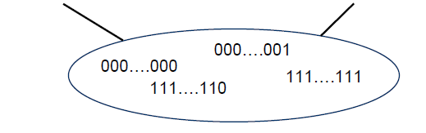
Redundancy
Redundancy is required for error control
Without redundancy
2^{m} possible data messages can be represented as data on m bits
They all are legal!!!
Each error results a new legal data message
How to detect errors???
All the possible
frames
Legal frames

Slide 16
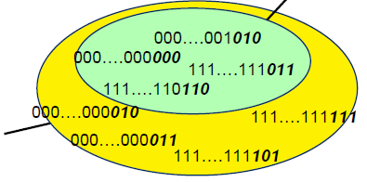
Error-correcting codes Redundancy
Legal frames
A frame consists of
m data bits (message)
r redundant/check bits
The total length n = m + r
This n-bit unit is referred to as an n-bit codeword!
All the possible frames

Slide 17
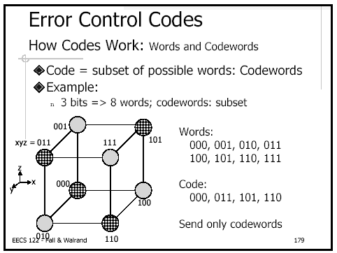
Error

Slide 18

Hamming distance
The Hamming distance between two codewords is the number of differences between corresponding bits.
1. The Hamming distance d(000, 011) is 2 because
2. The Hamming distance d(10101, 11110) is 3 because

Slide 19

Hamming distance
If not all the 2^{n} possible codewords are used
Set of legal codewords =: S
Hamming distance of the complete code
The smallest Hamming distance of between all the possible pairs in the set of legal codewords (S)

Slide 20
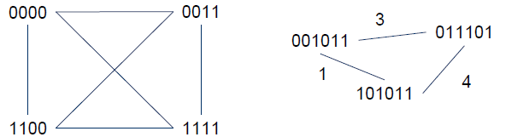
What is the Hamming distance?
Two examples:

Slide 21
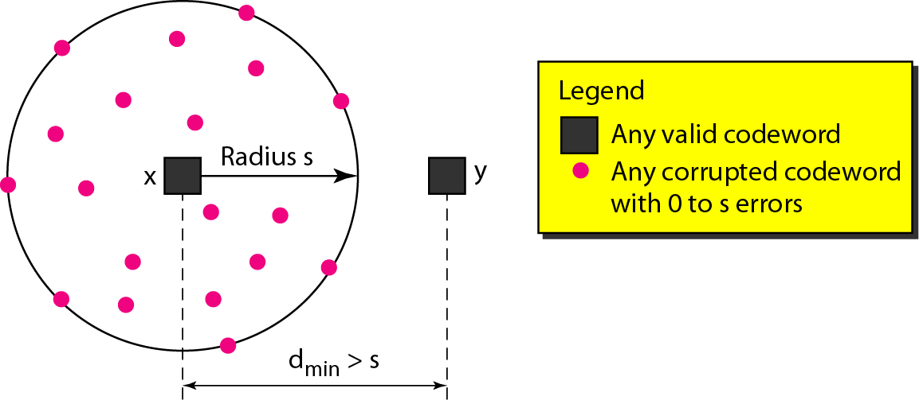
Error detection
To detect d errors, you need a distance d+1 code.

Slide 22
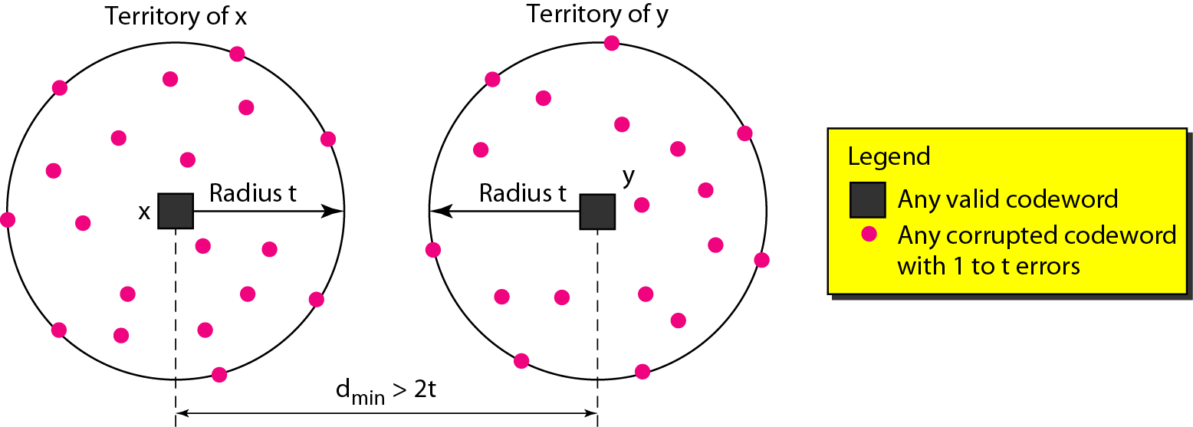
Error correction
To correct d errors, you need a distance 2d+1 code.

Slide 23
Example
S={ 00000000,
00001111,
11110000,
11111111
}

Slide 24
Parity bit – already discussed
A single parity bit is appended to the data
Choosen according to the number of 1 bits in the message
odd or even
An example using even parity
Original message: 1011010
A 0 bit is added to the end: 10110100
m=8 and r=1 in this case
The distance of this code is 2, since any single-bit error produces a codeword with the wrong parity.

Slide 25
Checksums
Idea:
Add up the bytes in the data
Include the sum in the frame
Use ones-complement arithmetic
Lower overhead than parity: 16 bits per frame
But, not resilient to errors
Why?
Used in UDP, TCP, and IP
START
Data
Checksum
END
1
0
0101001
+
1101001= 10010010
Notes:
Multiple values can sum to same checksum

Slide 26
Cyclic Redundancy Check (CRC)
Uses field theory to compute a semi-unique value for a given message
Much better performance than previous approaches
Fixed size overhead per frame (usually 32-bits)
Quick to implement in hardware
Only 1 in 2³² chance of missing an error with 32-bit CRC

Slide 27
CRC (Cyclic Redundancy Check)
Polynomial code
Treating bit strings as representations of polynomials with coefficients of 0 and 1.
CRC
Add k bits of redundant data to an n-bit message.
Represent n-bit message as an n-1 degree polynomial;
e.g., MSG=10011010 corresponds to M(x) = x⁷+ x⁴ + x³ + x¹.
Let k be the degree of some divisor polynomial G(x);
e.g., G(x) = x³+ x² + 1.
Generator polynomial
Agreed upon it in advance

Slide 28
CRC
Transmit polynomial P(x) that is evenly divisible by G(x), and receive polynomial P(x) + E(x);
E(x)=0 implies no errors.
Recipient divides (P(x) + E(x)) by G(x);
the remainder will be zero in only two cases:
E(x) was zero (i.e. there was no error),
or E(x) is exactly divisible by C(x).
Choose G(x) to make second case extremely rare.

Slide 29
A basic example with numbers
Make all legal messages divisible by 3
If you want to send 10
First multiply by 4 to get 40
Now add 2 to make it divisible by 3 = 42
When the data is received ..
Divide by 3, if there is no remainder there is no error
If no error, divide by 4 to get sent message
If we receive 43, 44, 41, 40, then error
45 would not be recognized as an error

Slide 30
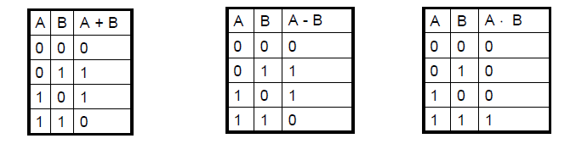

Mod 2 arithmetic
Operations are done modulo 2
1111
+1010
=====
0101
11001
x 101
=====
11001
+ 11001
=========
1111101

Slide 31
A basic example with polynomials
Sender:
multiply M(x) = x⁷+ x⁴ + x³ + x¹ by x^{k}; for our example, we get
x¹⁰ + x⁷ + x⁶ + x⁴ (10011010000);
divide result by C(x) (1101);
Send 10011010000 + 101 = 10011010101,
since this must be exactly divisible by C(x);
11111001
10011010000 Message
1101
1001
1101
1000
1101
1011
1101
1100
1101
1000
1101
101 Remainder
Generator 1101

Slide 32
Further properties
Want to ensure that G(x) does not divide evenly into polynomial E(x).
All single-bit errors, as long as the x^{k} and x⁰ terms have non-zero coefficients.
All double-bit errors, as long as G(x) has a factor with at least three terms.
Any odd number of errors, as long as G(x) contains the factor (x + 1).
Any “burst” error (i.e sequence of consecutive errored bits) for which the length of the burst is less than k bits.
Most burst errors of larger than k bits can also be detected.

Slide 33
Even Parity
Actually consists of using x+1 polynomial
Given message 0111, multiply by x to get 01110
Now divide by x+1=11
11 01110
11
0010
11
1=remainder
Message = 01110+1=01111 even parity
0101

Slide 34
Common polynomials for C(x):
CRC
CRC-8
CRC-10
CRC-12
CRC-16
CRC-CCITT
CRC-32
C(x)
x⁸+x²+x¹+1
x¹⁰+x⁹+x⁵+x⁴+x¹+1
x¹²+x¹¹+x³+x²+x¹+1
x¹⁶+x¹⁵+x²+1
x¹⁶+x¹²+x⁵+1
x³²+x²⁶+x²³+x²²+x¹⁶+x¹²+x¹¹+x¹⁰+x⁸+x⁷+x⁵+x⁴+x²+x+1

