Slide 1
Computer Networks
Lecture 3: Data Link - part II
Based on slides from D. Choffnes Northeastern U. and P. Gill from StonyBrook University
Revised Autumn 2015 by S. Laki

Slide 2
Data Link Layer
Function:
Send blocks of data (frames) between physical devices
Regulate access to the physical media
Key challenge:
How to delineate frames?
How to detect errors?
How to perform media access control (MAC)?
How to recover from and avoid collisions?
Application
Presentation
Session
Transport
Network
Data Link
Physical

Slide 3
Outline
Framing
Error Checking and Reliability
Media Access Control
802.3 Ethernet
802.11 Wifi

Slide 4
Error control
Error Control Strategies
Error Correcting codes (Forward Error Correction (FEC))
Error detection and retransmission Automatic Repeat Request (ARQ)

Slide 5
Error control
Objectives
Error detection
with correction
Forward error correction
without correction -> e.g. drop a frame
Backward error correction
The erroneous frame needs to be retransmitted
Error correction
without error detection
e.g. in voice transmission

Slide 6
Should We Error Check in the Data Link?
Recall the End-to-End Argument
Cons:
Error free transmission cannot be guaranteed
Not all applications want this functionality
Error checking adds CPU and packet size overhead
Error recovery requires buffering
Pros:
Potentially better performance than app-level error checking
Data link error checking in practice
Most useful over lossy links
Wifi, cellular, satellite

Slide 7
Backward Error Correction

Slide 8
Backward error correction
Error detection at the receiver side
The sender retransmits a frame until it received by the other side correctly.
Network Layer
Packets
Network Layer
from_upper(p)
to_upper(p)
Data Link Layer
Frames
Data Link Layer
to_lower(p)
from_lower(p)
Physical Layer
Bits

Slide 9
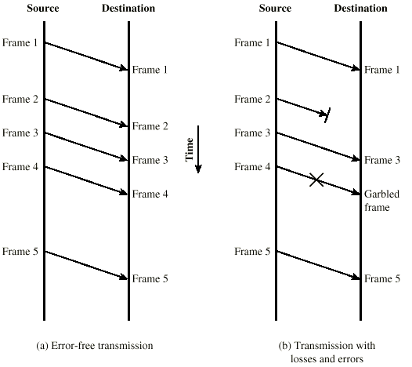
Model of Frame Transmission

Slide 10
Elementary Data Link Protocols
Simplex Stop-and-Wait Protocol
Alternate Bit Protocol
Sliding Window Protocol

Slide 11
Simple Stop-and-Wait Protocol
A sends a message to B
A stops and waits for an answer from B
Acknowledgement message (ACK)
After receiving the message B sends an ACK back to the sender.
A retransmits the message until it receives an ACK from B
If the ACK arrived, the next message may be sent.

Slide 12
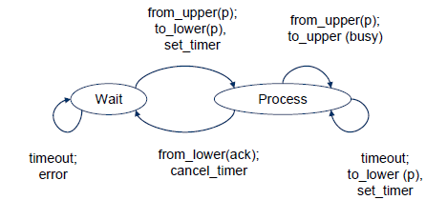
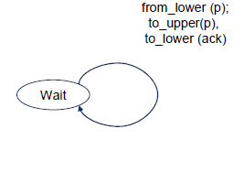
Simplex Stop-and-Wait Protocol
Sender
Receiver

Slide 13
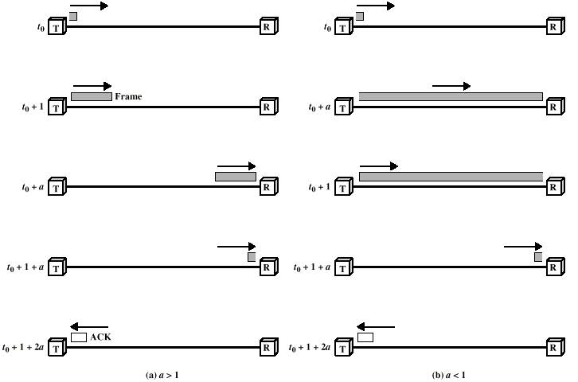
Stop-and-Wait Link Utilization

Slide 14
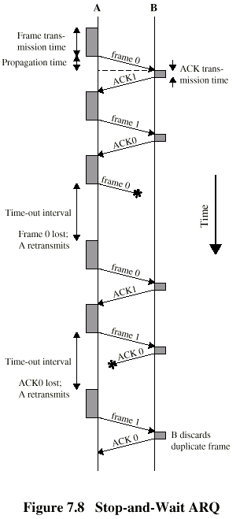
Stop-and-Wait Diagram
Simple, but inefficient for long distance and high speed applications.
We can use sliding-window technique to improve the efficiency.

Slide 15
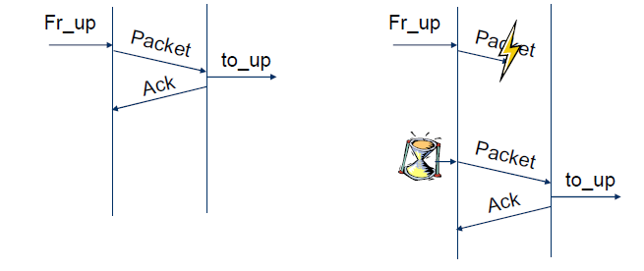
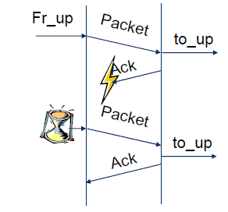
What’s the problem?
Usually
Packet loss
ACK loss

Slide 16
Alternating Bit Protocol (ABP)
Let
A be the sender
B be the receiver
A and B maintain internal one-bit counter
A value that is 0 or 1
Each message from A to B contains
a data part and
a one-bit sequence number
E.g. a value that is 0 or 1
After receiving A’s message, B sends an ACK back to A
which also contains a one-bit sequence number
Retransmission until A receives an ACK from B with the same sequence number
Then A complements its sequence number
0->1 or
1->0

Slide 17
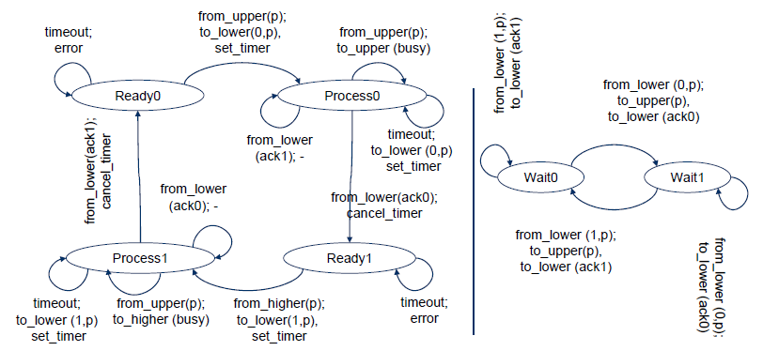
Alternating Bit Protocol (ABP)
Sender
Receiver

Slide 18
Alternating Bit Protocol (ABP)
A reliable data transport over a noisy channel
Basic flow control
The sender has to wait for the ACK from the receiver before sending the next message
Automatic Repeat reQest (ARQ) protocol
An acknowledgement
marks that the new message has been delivered.
allows the sender to tranmit the next frame.

Slide 19
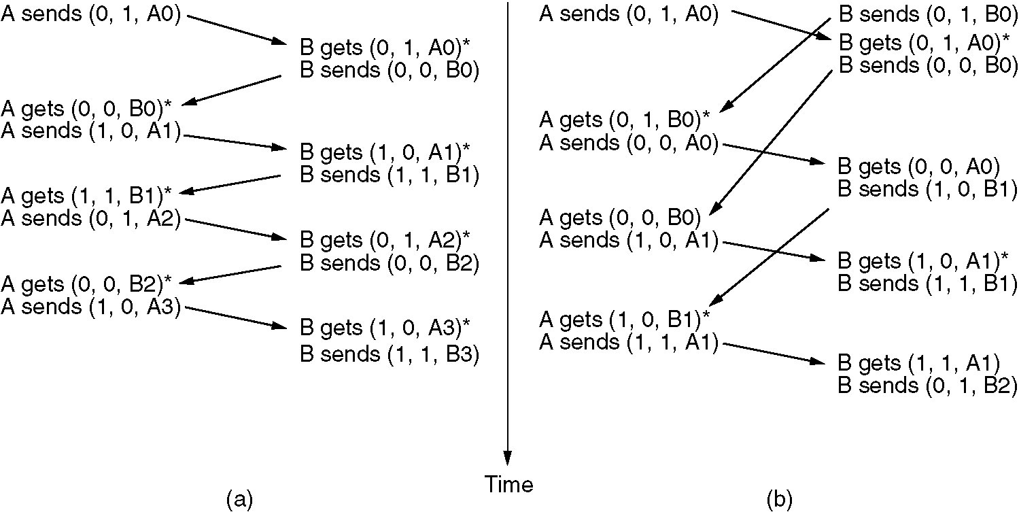
Alternating Bit Protocol
Two scenarios for ABP. (a) Normal case. (b) Abnormal case. The notation is (seq, ack, packet number). An asterisk indicates where a network layer accepts a packet.

Slide 20
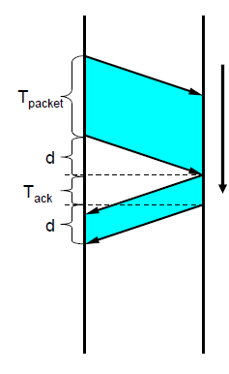
ABP – Channel utilization
Utilization (η) is the ratio of
The time needed for the transmission of a frame (T_{packet})
The time ellapsed until the next frame can be transmitted
In the fig.: (T_{packet} + d + T_{ack} + d)
Now:
η = T_{packet} / (T_{packet} + d + T_{ack} + d)
If the propagation delay is large, the ABP is not efficient.
Time

Slide 21
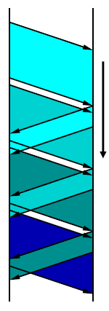
How to improve the efficency?
The sender transmit frames continously one after another
More frames are sent out, but not acknowledged.
Pipeline technique
Introduce sequence numbers
Time

Slide 22
Sliding Window Protocols
Similar to ABP
but allow multiple frames to transmit
Receiver has a buffer of W frames
Sender can send up to W frames without receiving ACK
Bidirectional
Each outgoing frame contains a seq. number from 0 to 2^{n}-1.
So it fits in an n-bit field
ABP uses n=1
Each ACK carries the sequence number of the next expected frame by the receiver

Slide 23
Sliding Window Protocols
At the sender
Sending window
a set of sequence numbers corresponding to frames being under transmission (finite range of numbers)
At the receiver
Receiving window
Sequence numbers for frames it is permitted to accept (finite range of numbers)
The sender’s and receiver’s windows need
not have tha same lower and upper bounds and
even have the same size.
The window size can be
fixed or
grow or shrink over the course of time as frames are sent and received

Slide 24
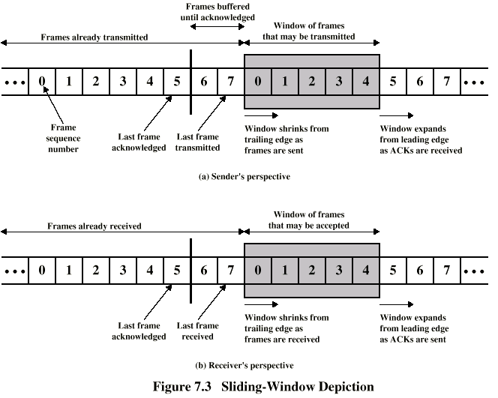
Sliding-Window Diagram
Need to buffer them in case of retransmission
Notes:
Assume 3-bit sequence number is used. Frames are numbered sequentially from 0 through 7.
In Fig.(a), each time a frame is sent, the shaded window shrinks; each time an ACK is received, the shaded window grows.

Slide 25
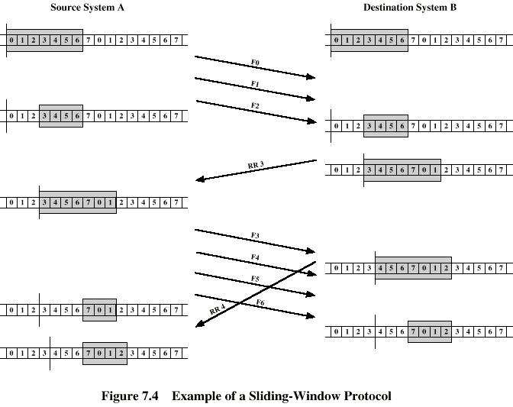
Example Sliding-Window
RR3 means the receiver has received all frames up to frame 2 and is ready to receive frame 3.
Have been delivered to upper layer
More spaces for future frames
Notes:
It is not necessary to acknowledge every frame.

Slide 26
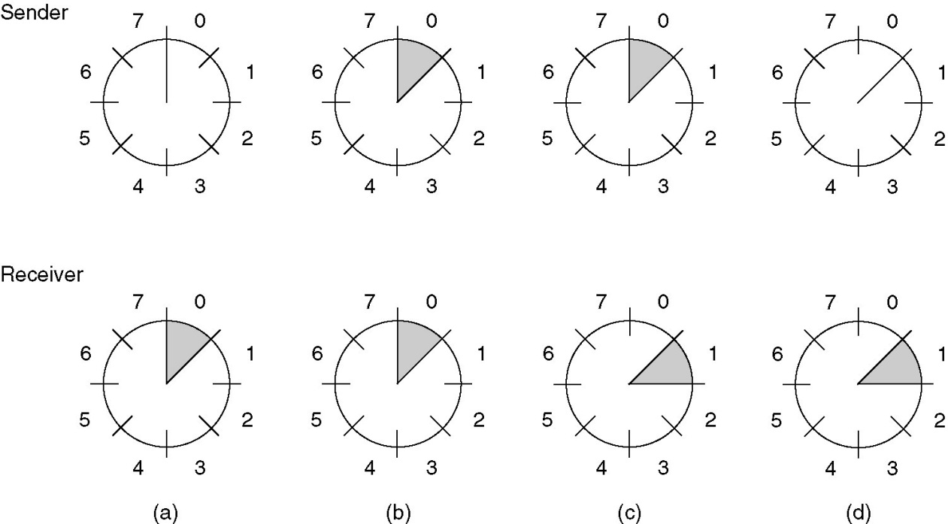
Sliding Window Protocols
A sliding window of size 1, with a 3-bit sequence number.
(a) Initially.
(b) After the first frame has been sent.
(c) After the first frame has been received.
(d) After the first acknowledgement has been received.

Slide 27
Go-Back-N
A sliding window protocol where
the receiver’s window size is fixed to 1,
while the sender has window size > 0.
After receiving a damaged frame
Receiver discards all subsequent frames
Sender retransmits the damaged frame and all its successors after the times out

Slide 28
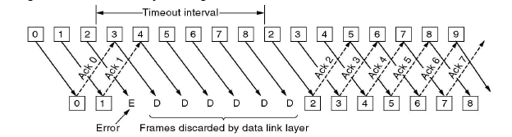
Go-Back-N

Slide 29
Selective Repeat
Receiver’s window size is n ( n >1 )
At most n frames can be buffered
Receiver stores all the correct frames following the bad one
The sender retransmits only the bad frame not all its successors

Slide 30
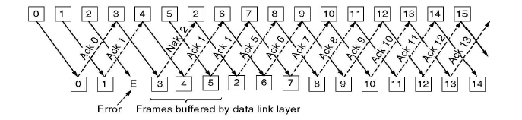
Selective Repeat

Slide 31
Communication channels and piggybacking
Simplex
Communication in one direction only
Half-duplex
Communication in both directions, but only one direction at a time, not simultaneously.
Full-duplex
Communication in both directions simultaneously
The previous protocols assumed
a simplex channel to the upper (network) layer and
a (half-)duplex channel to the physical layer
If we use duplex channel to the upper layers
Transmitting data packet and acknowledgements in both directions separately
Or using piggybacking
The header of a data packet sent in the opposite direction carries the acknowledgement back to the other side
widely applied in practice

Slide 32
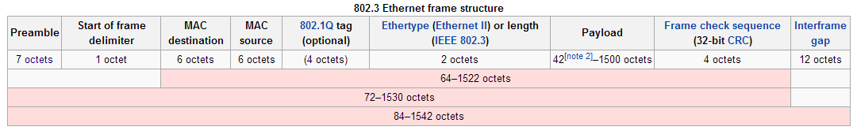
Ethernet frame

Slide 33
Outline
Framing
Error Checking and Reliability
Media Access Control
802.3 Ethernet
802.11 Wifi

Slide 34
What is Media Access?
Ethernet and Wifi are both multi-access technologies
Broadcast medium, shared by many hosts
Simultaneous transmissions cause collisions
This destroys the data
Media Access Control (MAC) protocols are required
Rules on how to share the medium
Strategies for detecting, avoiding, and recovering from collisions

Slide 35
Strategies for Media Access
Channel partitioning
Divide the resource into small pieces
Allocate each piece to one host
Example: Time Division Multi-Access (TDMA) cellular
Example: Frequency Division Multi-Access (FDMA) cellular
Taking turns
Tightly coordinate shared access to avoid collisions
Example: Token ring networks

Slide 36
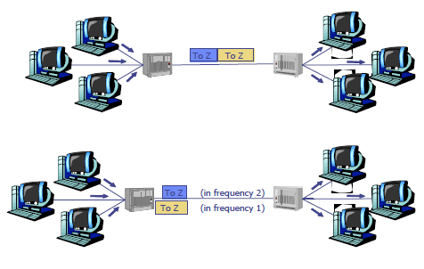
Channel Partitioning
Frequency Division Multiplexing
E.g. a telephone trunk
Time Division Multiplexing
Are they good solutions?
if data rates are fixed
if the link utilization is good

Slide 37
What’s the problem?
The number of senders is large
continuously varying
bursty traffic

Slide 38
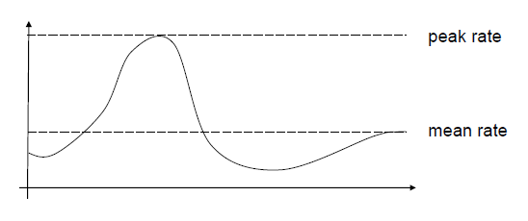
Bursty traffic
If there’s huge difference between the peak rate and the mean (or average) rate
In computer networks it is not rare
peak rate/mean rate = 1000/1

Slide 39
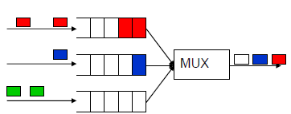
Bursty traffic with Static Channel Allocation
The capacity of the channels must be
Either quite large to handle peak rates
Waste of resources
The mean rate is much less than the peak one
Or based on the mean rate
We need buffers/queues to store packets coming faster than the mean rate
Queuing delays
BUFFERS
Incoming packets

Slide 40
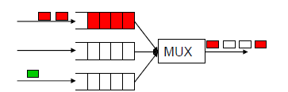
What’s about delays?
If there’s no multiplexing
A source has data rate of p bps
The capacity of the link is C bps
The delay is T
Bursty traffic with static channel allocation
Dividing the channel into N static subchannels
With sending rate p/N bps and capacity C/N
The delay is N T
Static channel allocation increases the packet delays
Because of the idle subchannels

Slide 41
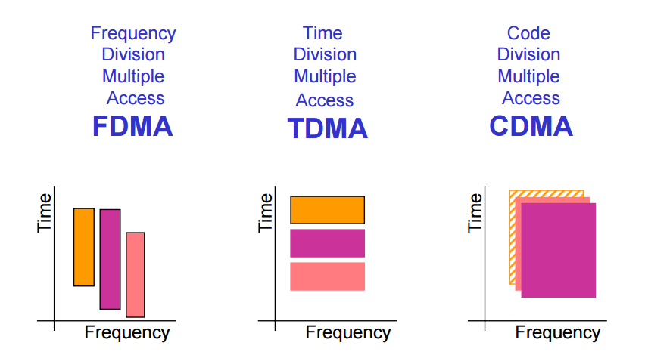
CDMA – Code Division Multiple Access

Slide 42
CDMA Analogy
10 people in a room.
5 speak English, 2 speak Spanish, 2 speak Chinese, and 1 speaks Russian.
Everyone is talking at relatively the same time over the same medium – the air.
Who can listen to whom and why?
Who can’t you understand?
Who can’t speak to anyone else?

Slide 43
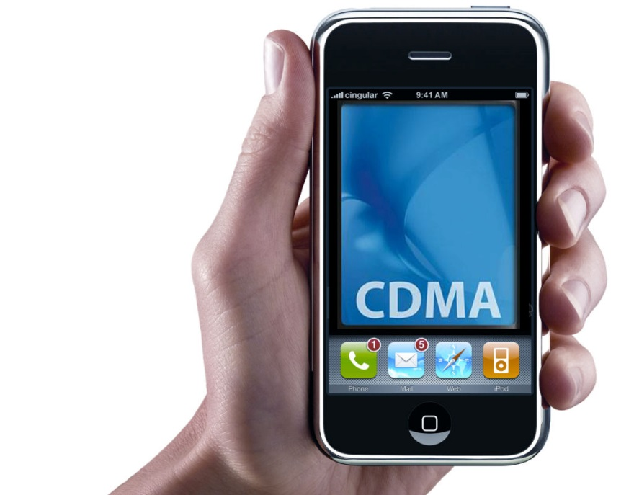
CDMA – Code Division Multiple Access
Used by 3G and 4G cellular networks
Each station can broadcast at any time in the full frequency spectrum
The signals may interfere
Resulting in a linear combination of individual signals
Algorithm
We assign a vector of length m to each station: v
Pairwise orthogonal vectors!!!
Each bit is encoded by the chip vector of the sender or it’s complement: v or -v
If it sends bit 1, it transmits v
If it sends bit 0, it transmits -v
Result is a sequence of vectors of length m

Slide 44
CDMA – Code Division Multiple Access
Interference
A sends a,-a,a,a
B sends b,b,-b,-b
After interference we receive: a+b,-a+b,a-b,a-b ???
How to decode?

Slide 45
CDMA – Code Division Multiple Access
Interference
A sends a,-a,a,a
B sends b,b,-b,-b
After interference we receive: a+b,-a+b,a-b,a-b ???
Decoding the message of A
Take the dot product by the sender’s chip code
(a+b)a > 0 => 1
(-a+b)a < 0 => 0
(a-b)a >0 => 1
(a-b)a > 0 => 1
If the dot product is
<0: bit 0 was sent by A
>0: bit 1 was sent by A
=0: nothing was sent by A
the channel is not used by A

