Slide 1
Computer Networks
Lecture 5: Data Link - part III
Based on slides from D. Choffnes Northeastern U. and P. Gill from StonyBrook University
Revised Autumn 2015 by S. Laki

Slide 2
Data Link Layer
Function:
Send blocks of data (frames) between physical devices
Regulate access to the physical media
Key challenge:
How to delineate frames?
How to detect errors?
How to perform media access control (MAC)?
How to recover from and avoid collisions?
Application
Presentation
Session
Transport
Network
Data Link
Physical

Slide 3
Outline
Framing
Error Checking and Reliability
Media Access Control
802.3 Ethernet
802.11 Wifi

Slide 4
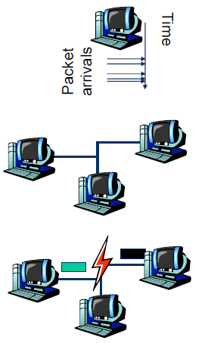
Dynamic Channel Allocation in LANs and MANs
1. Station Model.
N terminals/hosts
The prob. of a frame being generated in Δt is λΔt, where the arrival rate is λ.
2. Single Channel Assumption.
All stations are equivalent
A single channel is available for all communications
3. Collision Assumption.
If two frames are transmitted simultaneously, they overlap in time which results a garbled signal
This event is called collision
4. Continuous Time VS Slotted Time.
5. Carrier Sense VS No Carrier Sense.

Slide 5
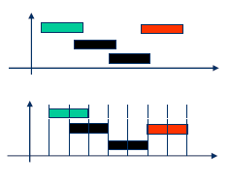
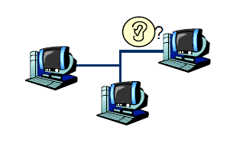
Dynamic Channel Allocation in LANs and MANs
4. Continuous Time VS Slotted Time.
5. Carrier Sense VS No Carrier Sense.
Time
Time

Slide 6
How can the efficiency be measured?
Throughput (S)
Number of packets/frames transmitted in a time unit (successfully)
Delay
The time needs for transmitting a packet
Fairness
All the terminals are treated as equals

Slide 7
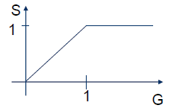
Throughput and offered load
Offered load (G)
The number of packets in a time unit that the protocol must handle
G>1: overloading
An ideal protocol
If G<1, S=G
If G≥1, S=1
where sending out a packet takes 1 time unit.

Slide 8
Strategies for Media Access
Channel partitioning
Divide the resource into small pieces
Allocate each piece to one host
Example: Time Division Multi-Access (TDMA) cellular
Example: Frequency Division Multi-Access (FDMA) cellular
Taking turns
Tightly coordinate shared access to avoid collisions
Example: Token ring networks
Contention
Allow collisions, but use strategies to recover
Examples: Ethernet, Wifi

Slide 9
Contention MAC Goals
Share the medium
Two hosts sending at the same time collide, thus causing interference
If no host sends, channel is idle
Thus, want one user sending at any given time
High utilization
TDMA is low utilization
Just like a circuit switched network
Simple, distributed algorithm
Multiple hosts that cannot directly coordinate
No fancy (complicated) token-passing schemes

Slide 10
Contention Protocol Evolution
ALOHA
Developed in the 70’s for packet radio networks
Stations transmit data immedately
If there is a collision, it retransmits the packet later.
Slotted ALOHA
Start transmissions only at fixed time slots
Significantly fewer collisions than ALOHA
Carrier Sense Multiple Access (CSMA)
Start transmission only if the channel is idle
CSMA / Collision Detection (CSMA/CD)
Stop ongoing transmission if collision is detected
Notes:
ALOHA:
Send data if you have data (doesn’t bother sensing the medium)
Later → back off period e.g., exponential backofff etc.

Slide 11

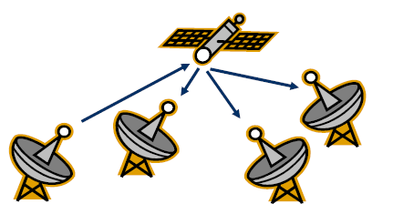
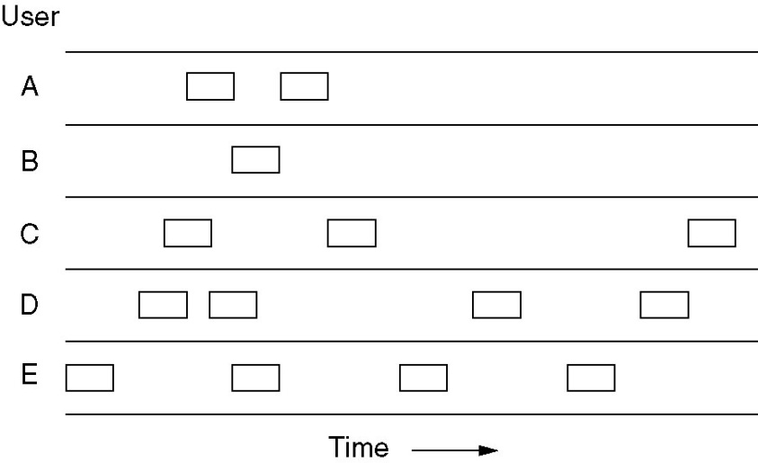
Pure ALOHA
The goal was to use low-cost commercial radio equipment to connect users on Oahu and the other Hawaiian islands with a central time-sharing computer on the main Oahu campus.
Algorithm was developed by Uni. of Hawaii
If you have data to send, send the data
Low-cost and very simple

Slide 12
ALOHA
Topology: radio broadcast with multiple stations
Protocol:
Stations transmit data immediately
Receivers ACK all packets
No ACK = collision, wait a random time then retransmit
Simple, but radical concept
Previous attempts all divided the channel
TDMA, FDMA, etc.
Optimized for the common case: few senders
A
B
C

Slide 13
Performance analysis -Poisson Process
The Poisson Process is a celebrated model used in Queuing Theory for “random arrivals”. Assumptions leading to this model include:
The probability of an arrival during a short time interval Δt is proportional to the length of the interval, and does not depend on the origin of the time interval (memory-less property)
The probability of having multiple arrivals during a short time interval Δt approaches zero.

Slide 14
Performance analysis - Poisson Distribution
The probability of having k arrivals during a time interval of length t is given by:
where λ is the arrival rate. Note that this is a single-parameter model; all we have to know is λ.

Slide 15
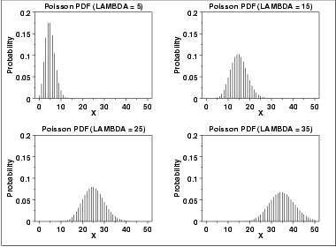
FYI: Poisson Distribution
The following is the plot of the Poisson probability density function for four values of λ.

Slide 16
Analysis of Pure ALOHA
Notation:
T_{f} = frame time (processing, transmission, propagation)
S: Average number of successful transmissions per T_{f} ; that is, the throughput
G: Average number of total frames transmitted per T_{f}
D: Average delay between the time a packet is ready for transmission and the completion of successful transmission.
We will make the following assumptions
All frames are of constant length
The channel is noise-free; the errors are only due to collisions.
Frames do not queue at individual stations
The channel acts as a Poisson process.

Slide 17
Analysis of Pure ALOHA…
Since S represents the number of “good” transmissions per frame time, and G represents the total number of attempted transmissions per frame time, then we have:
S = G × (Probability of good transmission)
The vulnerable time for a successful transmission is 2T_{f}
So, the probability of good transmission is not to have an “arrival” during the vulnerable time .

Slide 18
Analysis of Pure ALOHA…
Collides with
the start of
the shaded
frame
Collides with
the end of
the shaded
frame
t
t₀
t₀ + t
t₀ + 2t
t₀ + 3t
Vulnerable
Time
Vulnerable period for the shaded frame
Notes:
2

Slide 19
Analysis of Pure ALOHA…
Using:
And setting t = 2T_{f} and k = 0, we get

Slide 20
Analysis of Pure ALOHA…
If we differentiate S = Ge^{-2G} with respect to G and set the result to 0 and solve for G, we find that the maximum occurs when
G = 0.5,
and for that S = 1/2e = 0.18. So, the maximum throughput is only 18% of capacity.
Notes:
2

Slide 21
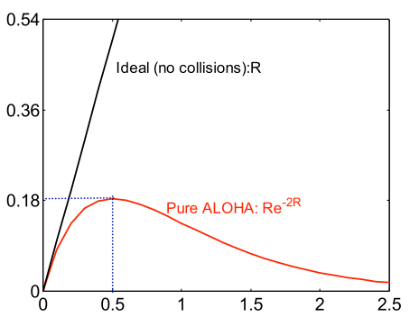
Tradeoffs vs. TDMA
In TDMA, each host must wait for its turn
Delay is proportional to number of hosts
In Aloha, each host sends immediately
Much lower delay
But, much lower utilization
Throughput
Sender A
ALOHA Frame
Sender B
ALOHA Frame
Time
Load
Maximum throughput is ~18% of channel capacity

Slide 22
Slotted ALOHA
Channel is organized into uniform slots whose size equals the frame transmission time.
Transmission is permitted only to begin at a slot boundary.
Here is the procedure:
While there is a new frame A to send do
Send frame A at (the next) slot boundary
Notes:
2

Slide 23
Analysis of Slotted ALOHA
Note that the vulnerable period is now reduced in half. Using:
And setting t = T_{f} and k = 0, we get

Slide 24
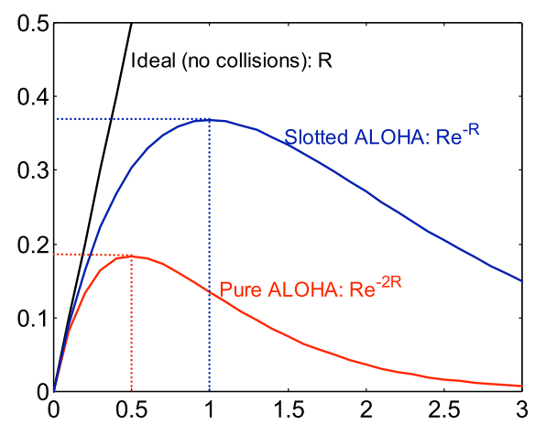
Slotted ALOHA
Protocol
Same as ALOHA, except time is divided into slots
Hosts may only transmit at the beginning of a slot
Thus, frames either collide completely, or not at all
37% throughput vs. 18% for ALOHA
But, hosts must have synchronized clocks
Throughput
Load

Slide 25
802.3 Ethernet
Bytes
7
1
6
6
2
0-1500
0-46
4
Preamble
SF
Source
Dest.
Length
Data
Pad
Checksum
Preamble is 7 bytes of 10101010. Why?
Start Frame (SF) is 10101011
Source and destination are MAC addresses
E.g. 00:45:A5:F3:25:0C
Broadcast: FF:FF:FF:FF:FF:FF
Minimum packet length of 64 bytes, hence the pad
Notes:
7 bytes → allows hosts on the network to

Slide 26
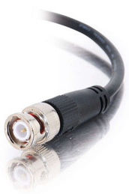

Broadcast Ethernet
Originally, Ethernet was a broadcast technology
Terminator
10Base2
Repeater
Tee Connector
Hubs and repeaters are layer-1 devices, i.e. physical only
10BaseT and 100BaseT
T stands for Twisted Pair
Hub

Slide 27
Carrier Sense Multiple Access (CSMA)
Additional assumption:
Each station is capable of sensing the medium to determine if another transmission is underway

Slide 28
Non-persistent CSMA
While there is a new frame A to send
Check the medium
If the medium is busy, wait some time, and go to 1.
(medium idle) Send frame A

Slide 29
1-persistent CSMA
While there is a new frame A to send
Check the medium
If the medium is busy, go to 1.
(medium idle) Send frame A

Slide 30
p-persistent CSMA
While there is a new frame A to send
Check the medium
If the medium is busy, go to 1.
(medium idle) With probability p send frame A, and probability (1- p) delay one time slot and go to 1.

Slide 31
CSMA Summary
Nonpersistent
1-persistent
p-persistent
CSMA persistence and backoff
Non-persistent:
Transmit if idle
Otherwise, delay, try again
Constant or variable
Delay
Channel busy
Time
Ready
1-persistent:
Transmit as soon as
channel goes idle
If collision, back off and try again
p-persistent:
Transmit as soon as channel goes
idle with probability p
Otherwise, delay one slot, repeat process
Notes:
2

Slide 32
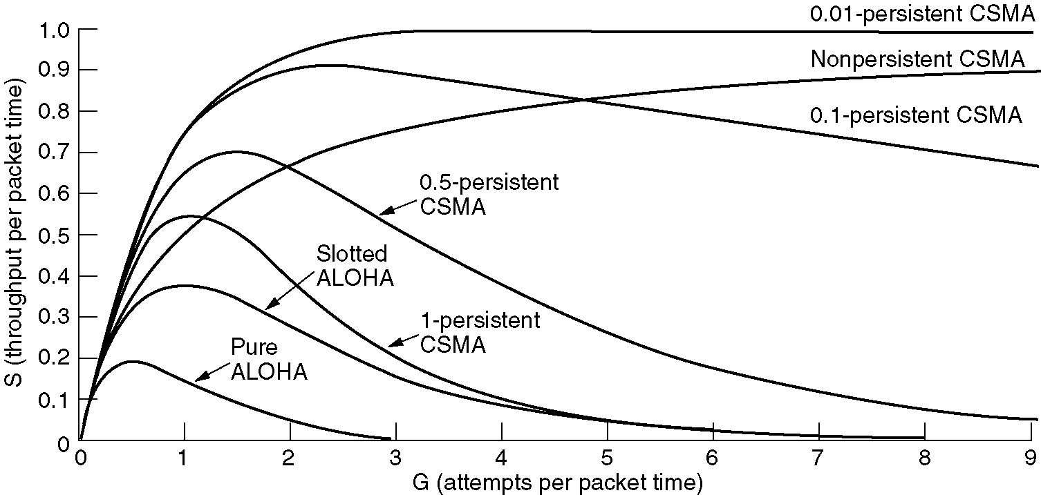
Persistent and Non-persistent CSMA
Comparison of throughput versus load for various random access protocols.

Slide 33
CSMA with Collision Detection
Stations can sense the medium while transmitting
A station aborts its transmission if it senses another transmission is also happening (that is, it detects collision)
Question: When can a station be sure that it has seized the channel?
Minimum time to detect collision is the time it takes for a signal to traverse between two farthest apart stations.

Slide 34
CSMA/CD
A station is said to seize the channel if all the other stations become aware of its transmission.
There has to be a lower bound on the length of each frame for the collision detection feature to work out.
Ethernet uses CSMA/CD

Slide 35
CSMA/CD
Carrier sense multiple access with collision detection
Key insight: wired protocol allows us to sense the medium
Algorithm
Sense for carrier
If carrier is present, wait for it to end
Sending would cause a collision and waste time
Send a frame and sense for collision
If no collision, then frame has been delivered
If collision, abort immediately
Why keep sending if the frame is already corrupted?
Perform exponential backoff then retransmit

Slide 36
CSMA/CD Collisions
Spatial Layout of Hosts
Collisions can occur
Collisions are quickly detected and aborted
Note the role of distance, propagation delay, and frame length
A
B
C
D
t₀
t₁
Time
Detect Collision and Abort

Slide 37
Exponential Backoff
When a sender detects a collision, send “jam signal”
Make sure all hosts are aware of collision
Jam signal is 32 bits long (plus header overhead)
Exponential backoff operates:
Select k ∈ [0, 2^{n} – 1] unif. rnd., where n = number of collisions
Wait k time units (packet times) before retransmission
n is capped at 10, frame dropped after 16 collisions
Backoff time is divided into contention slots
Remember this number

Slide 38
Minimum Packet Sizes
Why is the minimum packet size 64 bytes?
To give hosts enough time to detect collisions
What is the relationship between packet size and cable length?
A
B
Time t: Host A starts transmitting
Time t + d: Host B starts transmitting
Time t + 2*d: collision detected
Propagation Delay (d)
Basic idea: Host A must be transmitting at time 2*d!

Slide 39
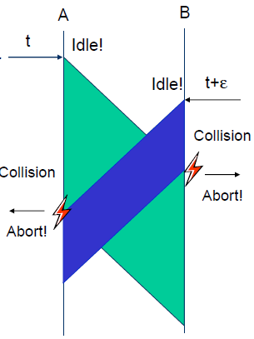
CSMA/CD
CSMA/CD can be in one of three states: contention, transmission, or idle.
To detect all the collisions we need
T_{f} ≥ 2T_{pg}
where T_{f} is the time needed to send the frame
And T_{pg} is the propagation delay between A and B

Slide 40
Minimum Packet Size
Host A must be transmitting after 2*d time units
Min_pkt = rate (b/s) * 2 * d (s)
… but what is d? propagation delay: limited by speed of light
Propagation delay (d) = distance (m) / speed of light (m/s)
This gives:
Min_pkt = rate (b/s) * 2 * dist (m) / speed of light (m/s)
So cable length is equal ….
Dist = min_pkt * light speed /(2 * rate)
10 Mbps Ethernet
Packet and cable lengths change for faster Ethernet standards
(64B*8)*(2.5*10⁸mps)/(2*10⁷bps) = 6400 meters

Slide 41
Cable Length Examples
min_frame_size*light_speed/(2*bandwidth) = max_cable_length
(64B*8)*(2.5*10⁸mps)/(2*10Mbps) = 6400 meters
What is the max cable length if min packet size were changed to 1024 bytes?
102.4 kilometers
What is max cable length if bandwidth were changed to 1 Gbps ?
64 meters
What if you changed min packet size to 1024 bytes and bandwidth to 1 Gbps?
1024 meters

Slide 42
Maximum Packet Size
Maximum Transmission Unit (MTU): 1500 bytes
Pros:
Bit errors in long packets incur significant recovery penalty
Cons:
More bytes wasted on header information
Higher per packet processing overhead
Datacenters shifting towards Jumbo Frames
9000 bytes per packet

Slide 43
Long Live Ethernet
Today’s Ethernet is switched
More on this later
1Gbit and 10Gbit Ethernet now common
100Gbit on the way
Uses same old packet header
Full duplex (send and receive at the same time)
Auto negotiating (backwards compatibility)
Can also carry power

