Slide 1
Computer Networks
Physical Layer
Based on slides from Zoltán Ács ELTE and D. Choffnes Northeastern U., Philippa Gill from StonyBrook University , Revised in 2018 by S. Laki

Slide 2
Last week in Computer Networks

Slide 3
The four goals of reliable transfer
correctness ensure data is delivered, in order, and untouched
timeliness minimize time until data is transferred
efficiency optimal use of bandwidth
fairness play well with concurrent communications

Slide 4
Here is one correct, timely, efficient and fair transport mechanism
ACKing full information ACK
retransmission after timeout
after k subsequent ACKs
window management additive increase upon successful delivery
multiple decrease when timeouts
More details later when we see TCP

Slide 5
Examples
Go-back-N and Selective Repeat

Slide 6
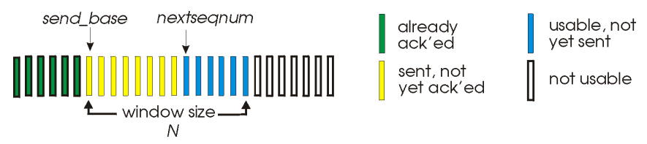
Go-Back-N (GBN)
a simple sliding window protocol using cumulative ACKs
goal receiver should be as simple as possible
receiver delivers packets in-order to the upper layer
receiver wnd size is 1
sender use a single timer to detect loss, reset at each new ACK
upon timeout, resend all WND packets
starting with the lost one

Slide 7
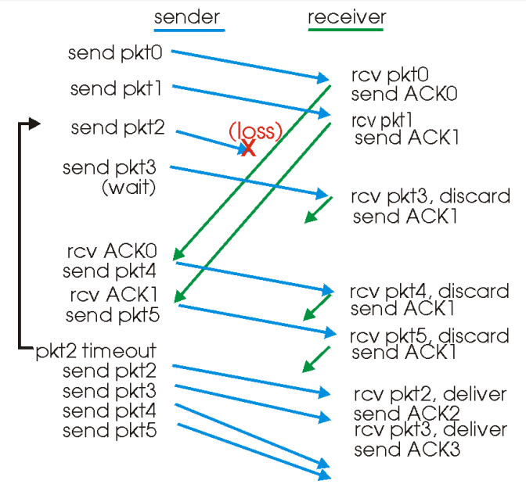
GBN in action

Slide 8
Selective Repeat (SR)
avoid unnecessary retransmissions by using per-packet ACKs
goal avoids unnecessary retransmissions
receiver ACK each packet, in-order or not
buffer out-of-order packets
sender use per-packet timer to detect loss
upon loss, only the lost packet

Slide 9
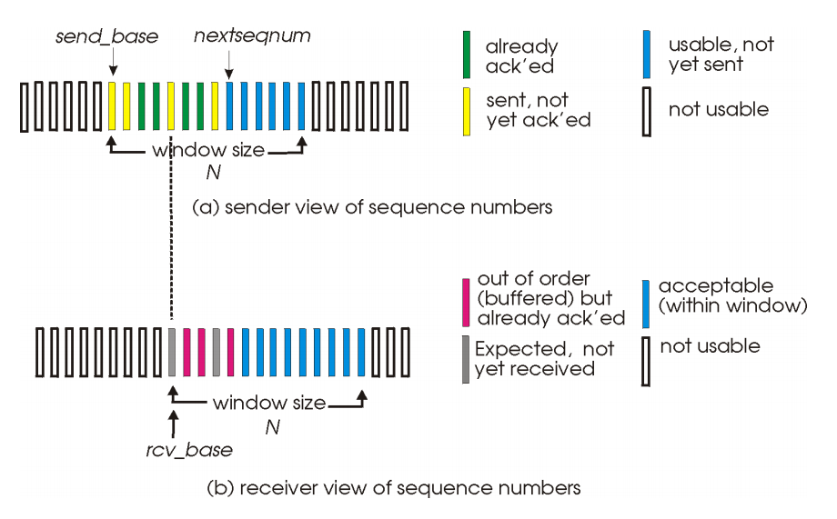
SR - windows

Slide 10
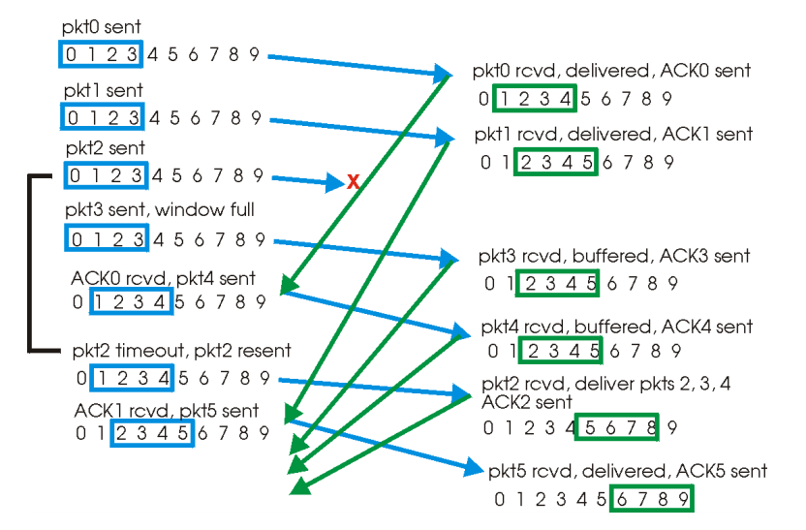
SR in action

Slide 11
Physical Layer
Function:
Get bits across a physical medium
Key challenge:
How to represent bits in analog
Ideally, want high-bit rate
But, must avoid desynchronization
Application
Presentation
Session
Transport
Network
Data Link
Physical

Slide 12
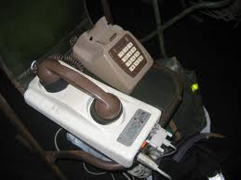
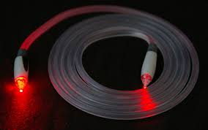
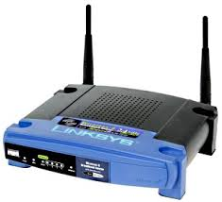
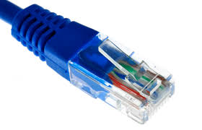
Key challenge
Digital computers
0s and 1s
Analog world
Amplitudes and frequencies

Slide 13
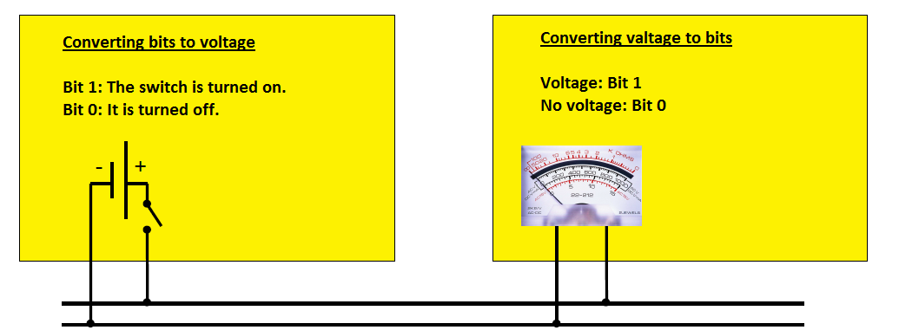
Simple transmission - baseband
Bit 1: voltage or current strength
Bit 0: no voltage

Slide 14
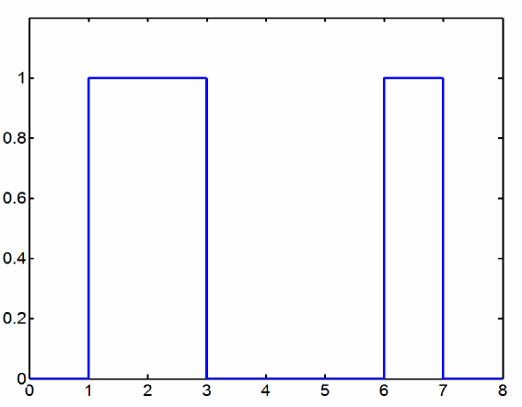
Transmission of „b”
More than one bit is needed for tranmitting char „b”
„b” in ASCII: 01100010
Voltage
Current
No voltage
Time

Slide 15
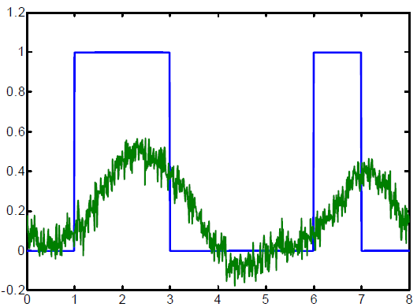
Transmission of „b” in a real world
Poor reception – a typical pattern at the receiver
Current
Time

Slide 16
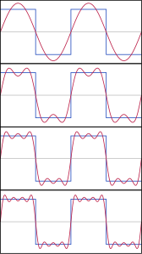
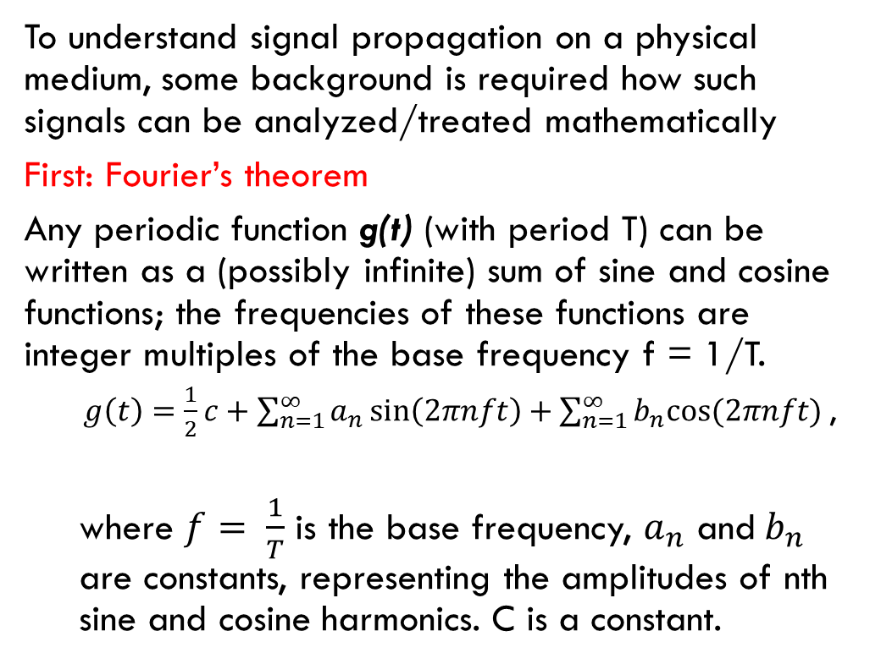
Fundamentals – Singals
To understand signal propagation on a physical medium, some background is required how such signals can be analyzed/treated mathematically
First: Fourier’s theorem
Any periodic function g(t) (with period T) can be written as a (possibly infinite) sum of sine and cosine functions; the frequencies of these functions are integer multiples of the base frequency f = 1/T.
$g\left(t\right)=\frac{1}{2}c+\sum_{n=1}^{∞}{a_{n}\sin\left(2πnft\right)}+\sum_{n=1}^{∞}{b_{n}cos(2πnft) }$,
where $f= \frac{1}{T}$ is the base frequency, $a_{n}$ and$b_{n}$ are constants, representing the amplitudes of nth sine and cosine harmonics. C is a constant.

Slide 17
Fundamental – Terms of the Fourier series
$$a_{n}=\frac{2}{T}\int_{0}^{T}{g(t)}\sin\left(2πnft\right)dt$$
$$b_{n}=\frac{2}{T}\int_{0}^{T}{g(t)}\cos\left(2πnft\right)dt$$
$$c=\frac{2}{T}\int_{0}^{T}{g(t)}dt$$

Slide 18
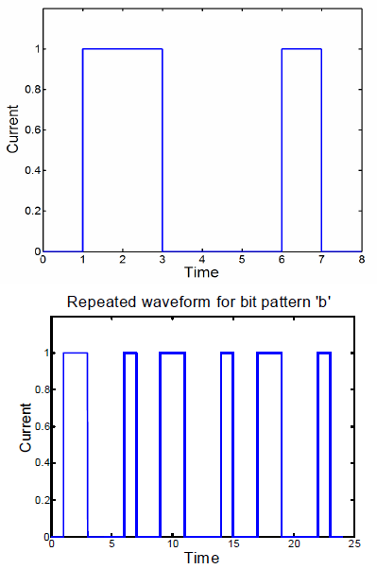
Application
A digital signal is not periodic
E.g. the ASCII code of „b” is 8 bits long
Use a trick: Suppose waveform is repeated infinitely often,
For „b”, resulting in a periodic waveform with period 8 bit times

Slide 19
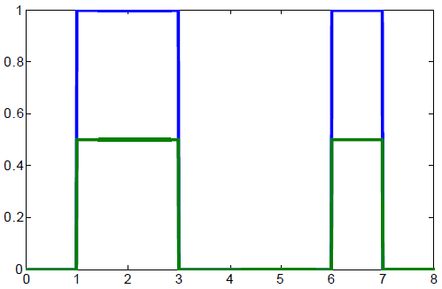
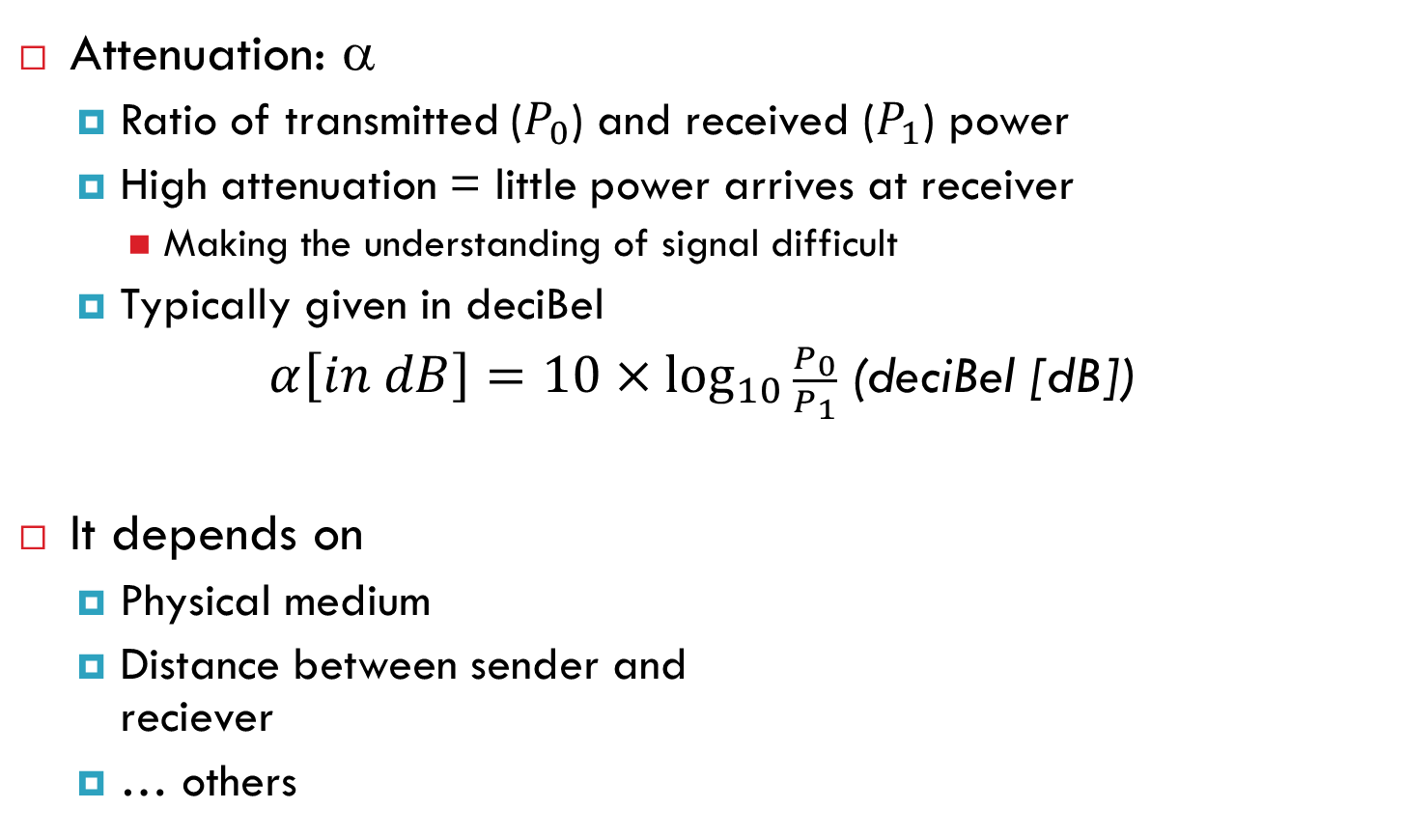
Fundamentals - Attenuation
Attenuation: α
Ratio of transmitted ($P_{0}$) and received ($P_{1}$) power
High attenuation = little power arrives at receiver
Making the understanding of signal difficult
Typically given in deciBel
$α\left[in dB\right]=10×\log_{10}{\frac{P_{0}}{P_{1}}}$(deciBel [dB])
It depends on
Physical medium
Distance between sender and reciever
… others
Current
Time

Slide 20
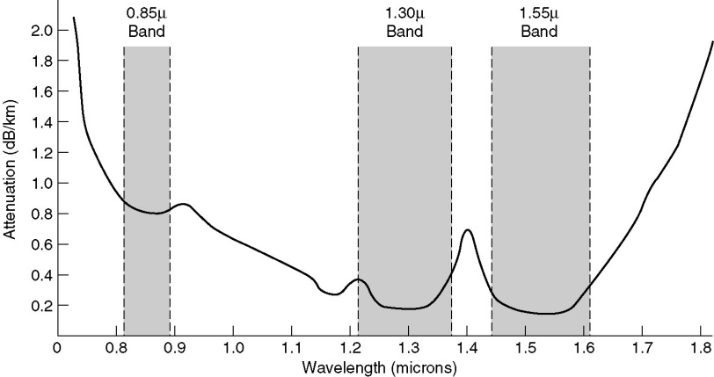
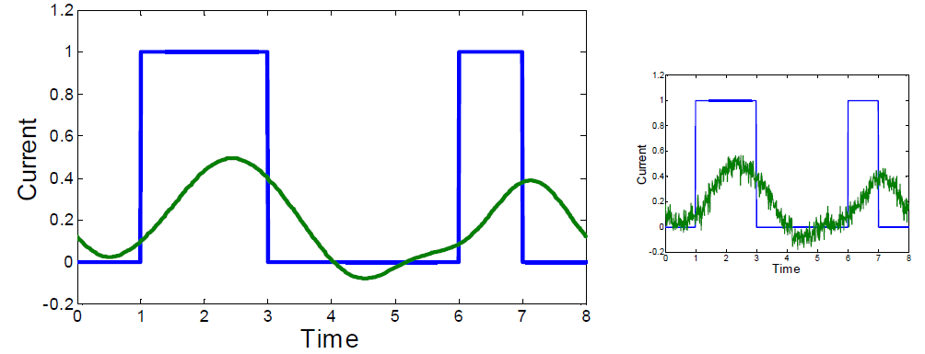
Fundamentals - Attenuation
In reality
Attenuation is not uniform, depends on frequency
Not all frequencies pass through a medium
Phase shifting
Different frequencies have different signal propagation speed
Frequency-based disortion
Noise
Hő, más rendszerek …
Optical cable

Slide 21
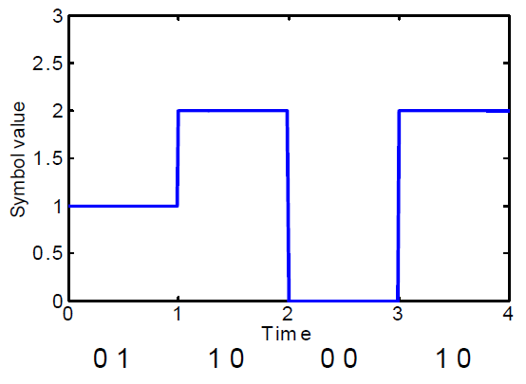
Symbols and bits
Use more symbols than 0 and 1 in the channel
Example:
Having 4 symbols: A(00),B(01),C(10),D(11)
Symbol rate: (BAUD)
Transmitted symbols per sec
Data rate (bps):
Transmitted bits per sec
Example:
A 600 Baud modem with 16 symbols, one can reach data rate of 2400 bps.

Slide 22
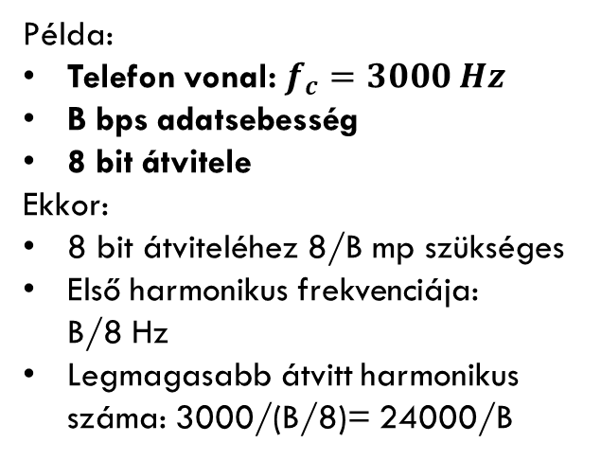
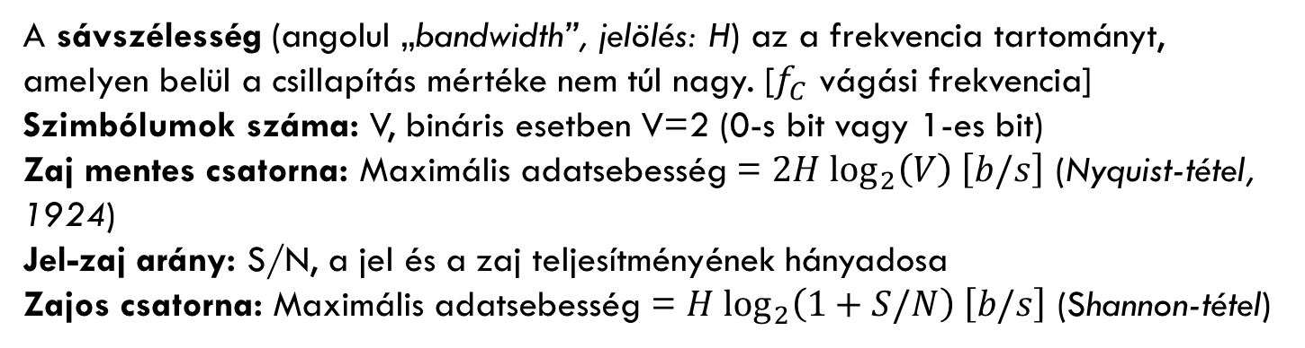
Elméleti alapok – adatátvitel
Példa:
Telefon vonal: $f_{c}=3000 Hz$
B bps adatsebesség
8 bit átvitele
Ekkor:
8 bit átviteléhez 8/B mp szükséges
Első harmonikus frekvenciája: B/8 Hz
Legmagasabb átvitt harmonikus száma: 3000/(B/8)= 24000/B
A sávszélesség (angolul „bandwidth”, jelölés: H) az a frekvencia tartományt, amelyen belül a csillapítás mértéke nem túl nagy. [$f_{C}$ vágási frekvencia]
Szimbólumok száma: V, bináris esetben V=2 (0-s bit vagy 1-es bit)
Zaj mentes csatorna: Maximális adatsebesség = $2H \log_{2}\left(V\right) \left[b/s\right]$ (Nyquist-tétel, 1924)
Jel-zaj arány: S/N, a jel és a zaj teljesítményének hányadosa
Zajos csatorna: Maximális adatsebesség = $H \log_{2}\left(1+S/N\right) \left[b/s\right]$ (Shannon-tétel)
Notes:
Véges átvitel még tökéletes csatornán is!
H a sávszélesség
V a jel szintek száma (diszkrét)

Slide 23
Physical media – wired 1/1
Magnetic storage – e.g. never underestimate the power of a truck of hard disks
Twisted pair – telephone networks; double copper wire, both analog and digital; UTP and STP
Coaxial cable – Higher speed and larger distance than with twisted pair; analog (75 Ω) and digital (50 Ω)
(Tanenbaum)
Notes:
Sodort (dns szerűen, 2 rézhuzal), hosszabb távnál jelerősítőkre van szükség

Slide 24
Physical media – wired 2/2
Optical cable – parts: light source, media and detector; light impulse = 1 bit, no light impulse = 0 bit;
Optical cables:
(Tanenbaum)

Slide 25
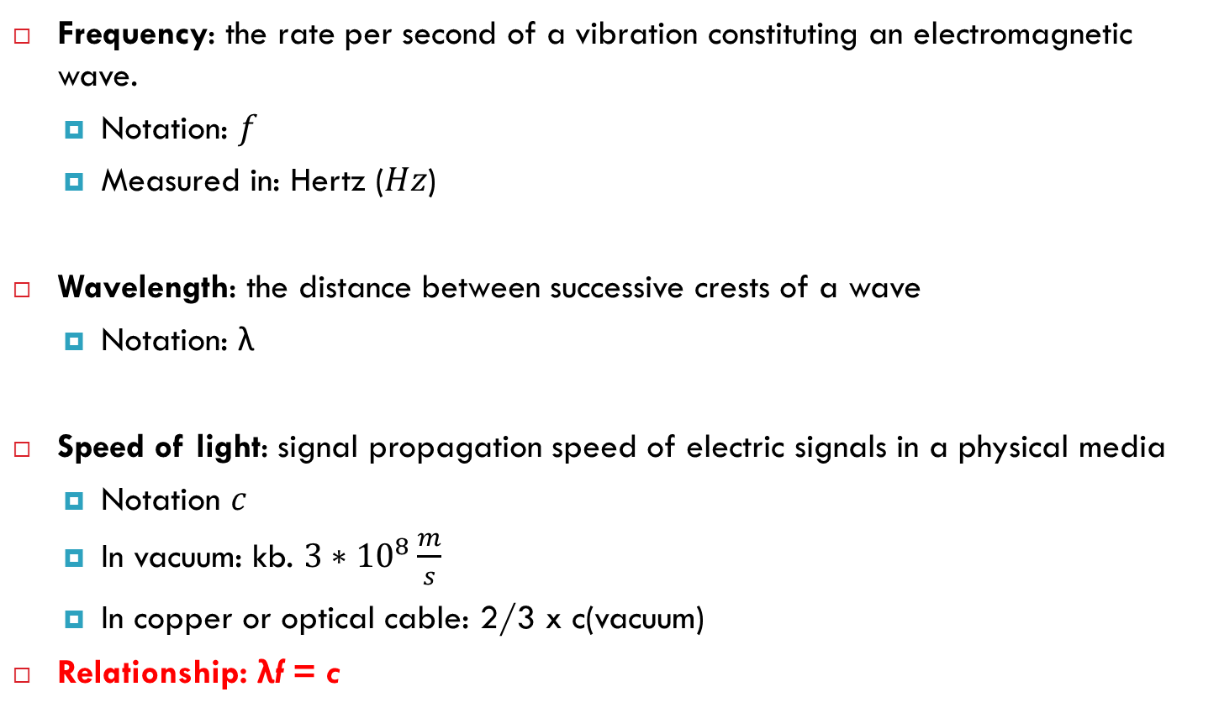
Fundamentals – wireless transmission
Frequency: the rate per second of a vibration constituting an electromagnetic wave.
Notation: $f$
Measured in: Hertz ($Hz$)
Wavelength: the distance between successive crests of a wave
Notation: λ
Speed of light: signal propagation speed of electric signals in a physical media
Notation $c$
In vacuum: kb. $3∗{10}^{8}\frac{m}{s}$
In copper or optical cable: 2/3 x c(vacuum)
Relationship: λf = c
Notes:
A VEZETÉKES NEHÉZKES LEHET BIZONYOS TEREPEK ESETÉN
Hawai-szigetekről indult a történet, mivel a telefonrendszer a szigetek között nem volt lehetséges
ELEKTONOK MOZGÁSA HULLÁMOKAT KELT (1865 Maxwell, 1887 Hertz)
MEGFELELŐ MÉRETŰ ANTENNA ÁRAMKÖRHÖZ CSATOLÁSÁVAL A HULLÁMOK SZÉTSZÓRHATÓAK.
VÁKUMBAN A FREKVENCIÁTÓL FÜGGETLENÜL MINDEN EH azonos SEBESSÉGGEL TERJED

Slide 26
Funamentals – wireless
Radio frequency transmission – simple; large distances; indoor and outdoor; frequency-dependent propagation properties
Microwave transmission – propagation along a straight line; attenuation; cheap
Infrared and millimeter-wave – small distances; cannot go through objects
Visible light – laser; high speed, cheap; weather conditions;
Notes:
[CADILLAC] Teljesítmény csökkenés 1/r^3 rádió hullám esetén
(A) VLF, LF, MF (B) HF
--------------------------
ISMÉTLŐK KELLENEK AZ EGYENES VONALÚ TERJEDÉS MIATT
ÉPÜLET FALAK GONDOT OKOZNAK
Több utas gyengülés (időjárás, frekvencia) ált. 10% backup
4GHZ->víz elnyel
-------------------------
-------------------------
KONFERENCIA PÉLDA (eső baj, napsütés se mindig jó)

Slide 27
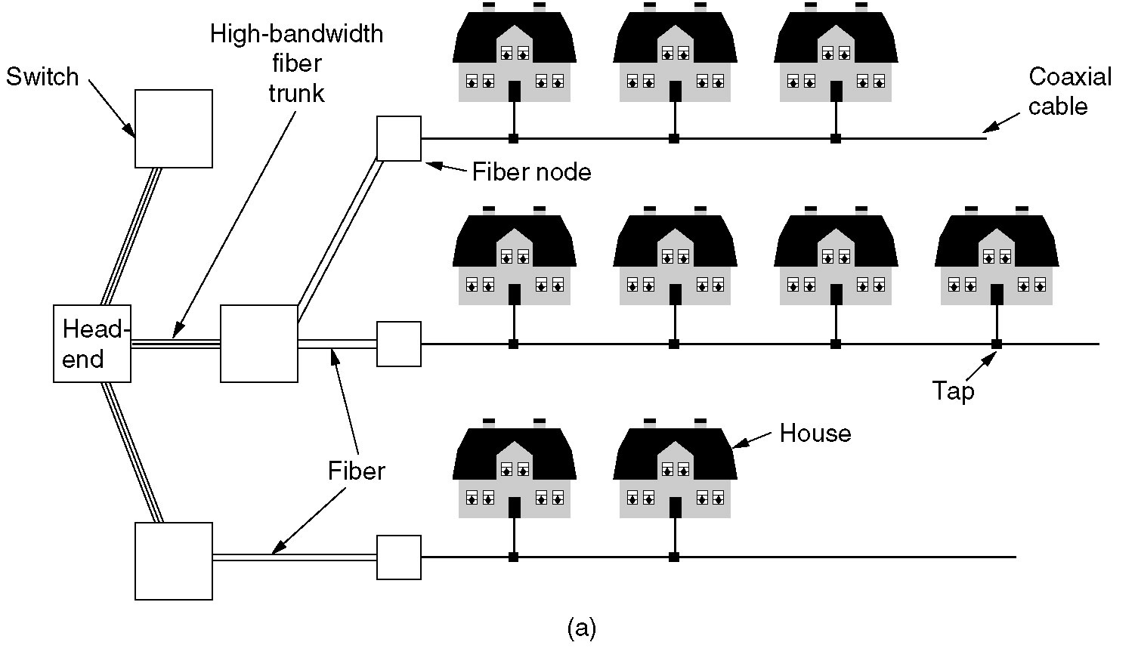
Internet in a cable TV network

Slide 28
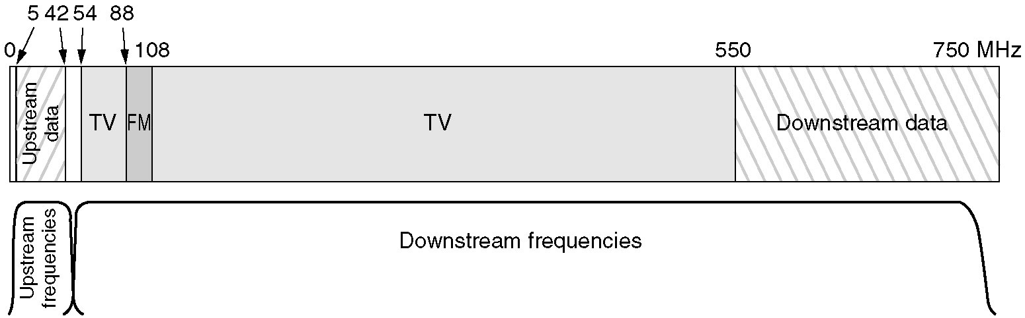
Internet in a cable TV network
Already discussed…

Slide 29
Data transmission

Slide 30
Assumptions
We have two discrete signals, high and low, to encode 1 and 0
Transmission is synchronous, i.e. there is a clock that controls signal sampling
Amplitude and duration of signal must be significant
Sample
Time

Slide 31
Non-Return to Zero (NRZ)
1 → high signal, 0 → low signal
0
0
1
0
1
0
1
1
0
0
NRZ
Clock
Problem: long strings of 0 or 1 cause desynchronization
How to distinguish lots of 0s from no signal?
How to recover the clock during lots of 1s?

Slide 32
Desynchronization
Problem: how to recover the clock during sequences of 0’s or 1’s?
0
1
1
1
1
1
1
1
1
0
NRZ
0
1
1
1
1
1
1
1
0
Transitions signify clock ticks
Receiver misses a 1 due to skew

Slide 33
Clock drift is major problem – two different clocks never stay in perfect synchrony

Slide 34
Options to tell the receiver when to sample
Relying on permanently synchronized clocks does not work
Explicit clock signal
Needs parallel transmission over some additional channel
Must be in synch with the actual data, otherwise pointless !
Useful only for short-range communication
Synchronize the receiver at crucial points (e.g., start of a character or of a block)
Otherwise, let the receiver clock run freely
Relies on short-term stability of clock generators (do not diverge too quickly)
Extract clock information from the received signal itself
Self-clocked signals
Put enough information into the data signal itself so that the receiver can know immediately when a bit starts/stop

Slide 35
Non-Return to Zero Inverted (NRZI)
1 → make transition, 0 → remain the same
0
0
1
0
1
0
1
1
0
0
NRZI
Clock
Solves the problem for sequences of 1s, but not 0s

Slide 36
Ethernet examples:
10BASE-TX
100BASE-TX

Slide 37
Manchester – used by 10BASE-TX
1 → high-to-low, 0 → low-to-high
0
0
1
1
0
NRZI
Clock
Good: Solves clock skew (every bit is a transition)
Bad: Halves throughput (two clock cycles per bit)

Slide 38
4-bit/5-bit (100 Mbps Ethernet)
Observation: NRZI works as long as no sequences of 0
Idea: encode all 4-bit sequences as 5-bit sequences with no more than one leading 0 and two trailing 0
Tradeoff: efficiency drops to 80%
8-bit / 10-bit used in Gigabit Ethernet
4-bit 5-bit
4-bit 5-bit
0000 11110
0001 01001
0010 10100
0011 10101
0100 01010
0101 01011
0110 01110
0111 01111
1000 10010
1001 10011
1010 10110
1011 10111
1100 11010
1101 11011
1110 11100
1111 11101

Slide 39
Signal transmission

Slide 40
Baseband VS broadband transmission
baseband
Baseband transmission directly puts the digital symbol sequences onto the wire
At different levels of current, voltage, … essentially, direct current (DC) is used for signaling
Baseband transmission suffers from the problems discussed above
Limited bandwidth reshapes the signal at receiver
Attenuation and distortion depend on frequency and baseband transmissions have many different frequencies because of their wide Fourier spectrum
broadband
Idea: get rid of the wide spectrum needed for DC transmission
Use a sine wave as a carrier for the symbols to be transmitted
Typically, the sine wave has high frequency
But only a single frequency!
Pure sine waves has no information, so its shape has to be influenced according to the symbols to be transmitted
The carrier has to be modulated by the symbols (widening the spectrum)
Three parameters that can be influenced Amplitude, Frequency, Phase

Slide 41
Digital baseband transmission
Source encoding
Channel encoding
Physical transmiss.
source
Channel symbols
media
Source bits
Source decoding
Channel decoding
Physical reception
sink,.

Slide 42
Bring source information in digital form
E.g., sample and quantize an analog voice signal, represent text as ASCII
Source encode: Remove redundant or irrelevant data
E.g., lossy compression (MP3, MPEG 4); lossless compression (Huffmann coding, runlength coding)
Channel encode: Map source bits to channel symbols
Potentially several bits per symbol
May add redundancy bits to protect against errors
Tailored to channel characteristics
Physical transmit: Turn the channel symbols into physical signals
At receiver: Reverse all these steps

Slide 43
Digital broadband transmission
Source encoding
Channel encoding
Modulation
Physical transm.
source
Channel symbols
Finite set of wave forms
madia
Source bits
Source decoding
Channel decoding
Demodulation
Physical reception
sink,.

Slide 44

Three key properties used to carry information
$s\left(t\right)=A \sin\left(2πft+φ\right)$, where A is the amplitude, f the frequency and $φ$ the phase.

Slide 45
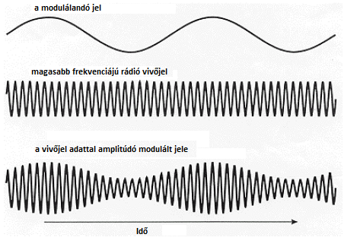
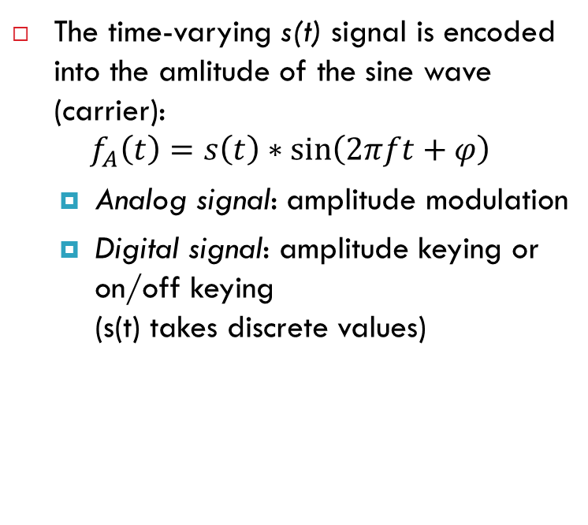
Amplitude modulation
The time-varying s(t) signal is encoded into the amlitude of the sine wave (carrier):
$$f_{A}\left(t\right)=s\left(t\right)∗\sin\left(2πft+φ\right)$$
Analog signal: amplitude modulation
Digital signal: amplitude keying or on/off keying (s(t) takes discrete values)

Slide 46
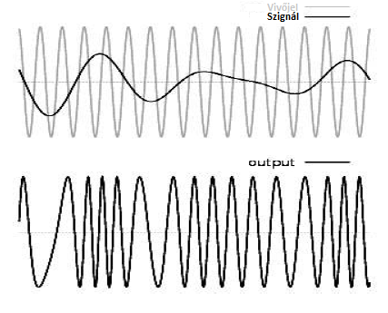

Frequency modulation
The time-varying s(t) signal is encoded into the frequency of the sine wave:
$$f_{F}\left(t\right)=a∗\sin\left(2πs(t)t+φ\right)$$
analog signal: frequency modulation
Digital signal: frequency-shift keying

Slide 47
Illustration - AM & FM for analog signals

Slide 48
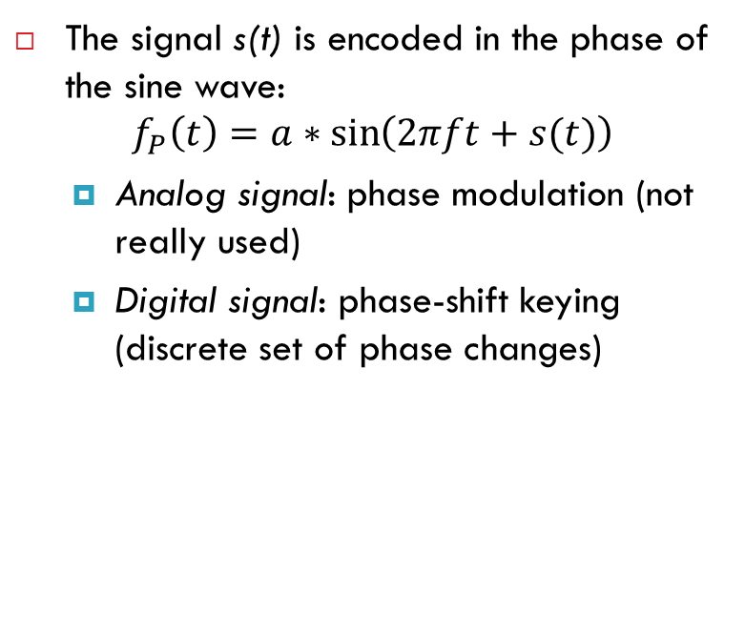
Phase modulation
The signal s(t) is encoded in the phase of the sine wave:
$$f_{P}\left(t\right)=a∗\sin\left(2πft+s(t)\right)$$
Analog signal: phase modulation (not really used)
Digital signal: phase-shift keying (discrete set of phase changes)

Slide 49
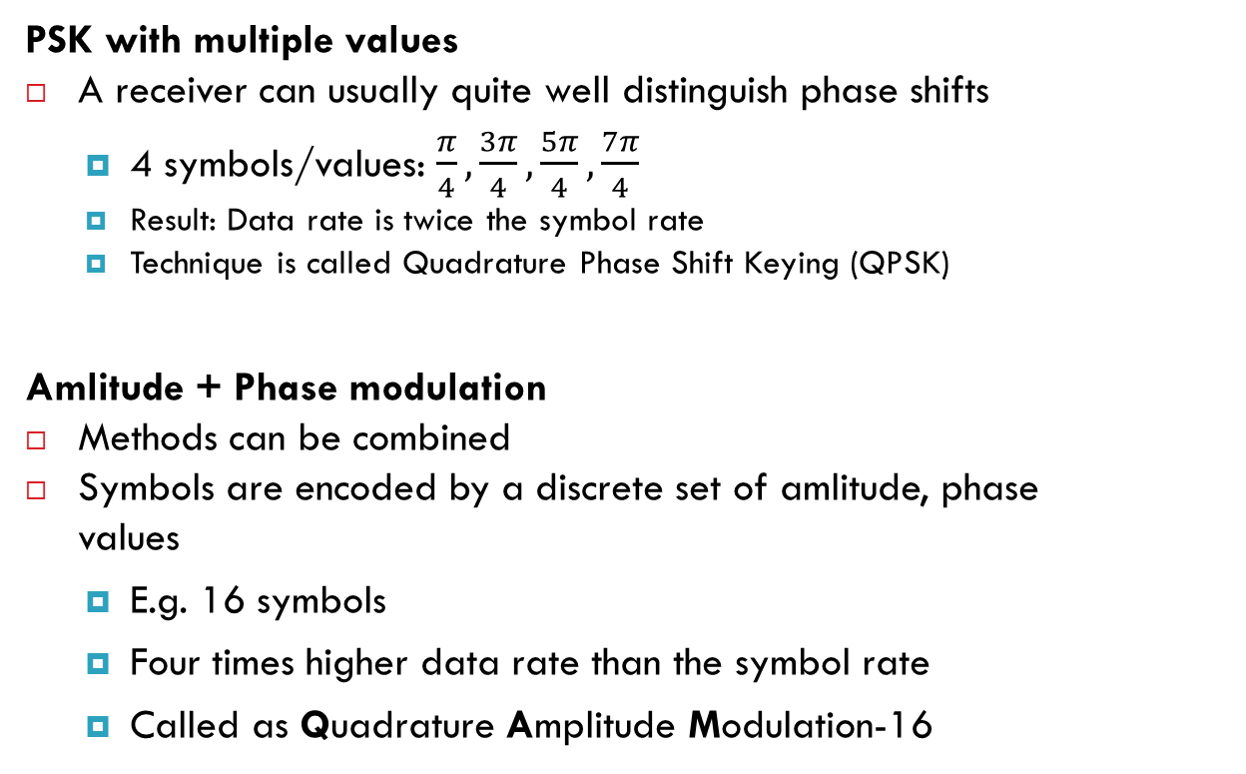
Usage of multiple symbols
PSK with multiple values
A receiver can usually quite well distinguish phase shifts
4 symbols/values: $\frac{π}{4},\frac{3π}{4},\frac{5π}{4},\frac{7π}{4}$
Result: Data rate is twice the symbol rate
Technique is called Quadrature Phase Shift Keying (QPSK)
Amlitude + Phase modulation
Methods can be combined
Symbols are encoded by a discrete set of amlitude, phase values
E.g. 16 symbols
Four times higher data rate than the symbol rate
Called as Quadrature Amplitude Modulation-16

Slide 50
Digital VS analog signals
A sender has two principal options what types of signals to generate
It can choose from a finite set of different signals – digital transmission
There is an infinite set of possible signals – analog transmission
Simplest example: Signal corresponds to current/voltage level on the wire
In the digital case, there are finitely many voltage levels to choose from
In the analog case, any voltage is legal
More complicated example: finite/infinitely many sinus functions
In both cases, the resulting wave forms in the medium can well be continuous functions of time!
Advantage of digital signals: There is a principal chance that the receiver can precisely reconstruct the transmitted signal

Slide 51
Static Channel Allocation

Slide 52
Multiplexing
Enabling multiple signals to travel through the same media at the same time
To this end, the channel is split into multiple smaller subchannels
A special device (multiplexer) is needed at the sender, transmitting signals to the proper subchannel

Slide 53
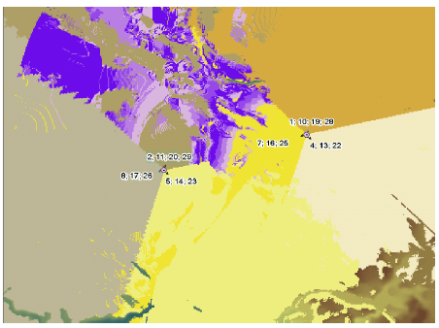
Space-Division Multiplexing
Simplest way of multiplexing
Wired example: point-to-point wire for each subchannel
Wireless example: Different antennas for the subchannels

Slide 54
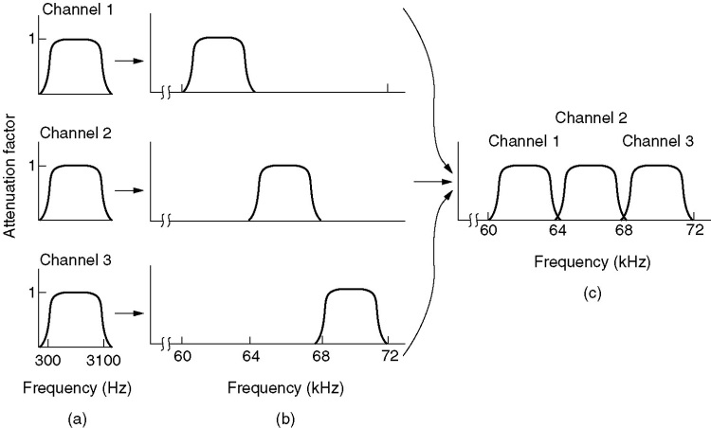
Frequency-Division Multiplexing
Multiple signals are combined and transmitted over the channel
Each signal is transmitted in different frequency ranges
Typically used for analog transmission
Multiple implementations…

Slide 55
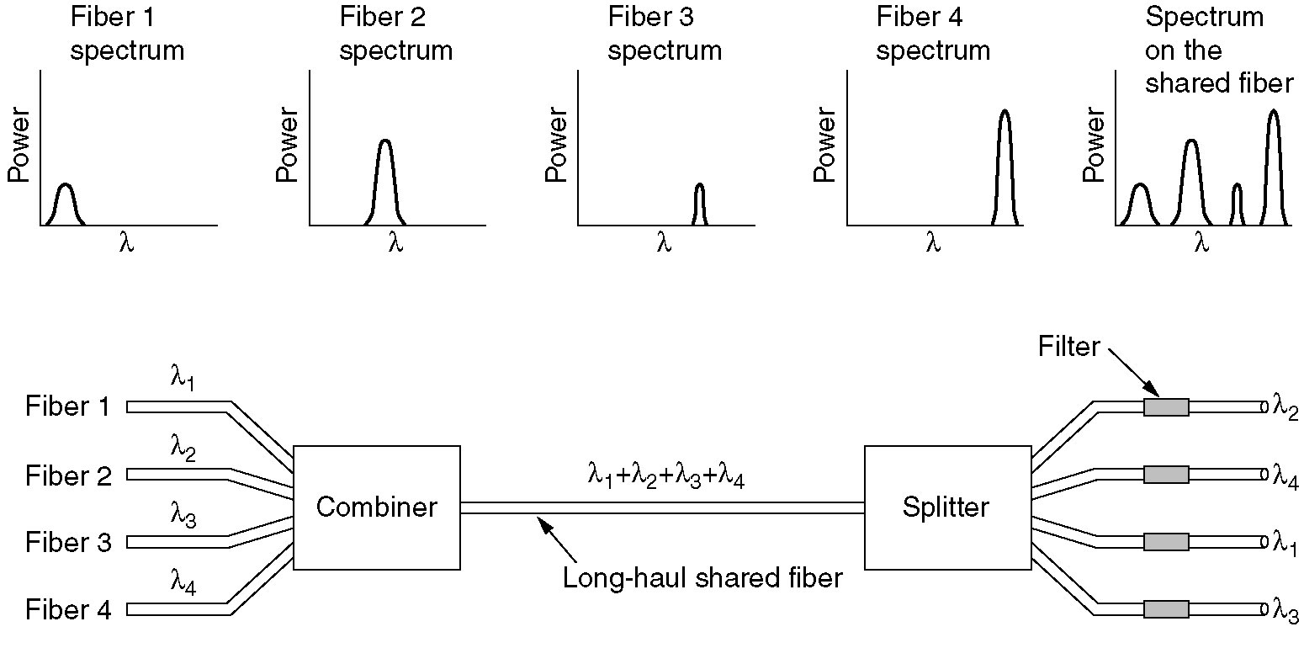
Wavelength-Division Multiplexing
Used for optical cables
IR laser rays at different wavelengths
TR1
TR1
W
D
M
W
D
M
TR2
TR2
TR3
TR3
TR4
TR4
Notes:
Több szignált kombinál össze lézersugarakkal különféle infravörös hullámhosszokon az optikai kábelen történő átvitelhez,
míg a fogadó oldalon különféle filterek használ a
hullámhosszok elkülönítésére.
MINDEN EGYES LÉZER önálló szignál halmazt alkalmaz
Jeladó (TR)
Klasszikus változatban 2 hullámhossz volt

Slide 56
Time-Division Multiplexing
Time is divided into not overlapping intervals
Each time slot is assigned to a sender, exlusively.
Empty slots may happen.
A
T
D
M
T
D
M
A
B
B
C
A
B
C
A
B
C
C

Slide 57
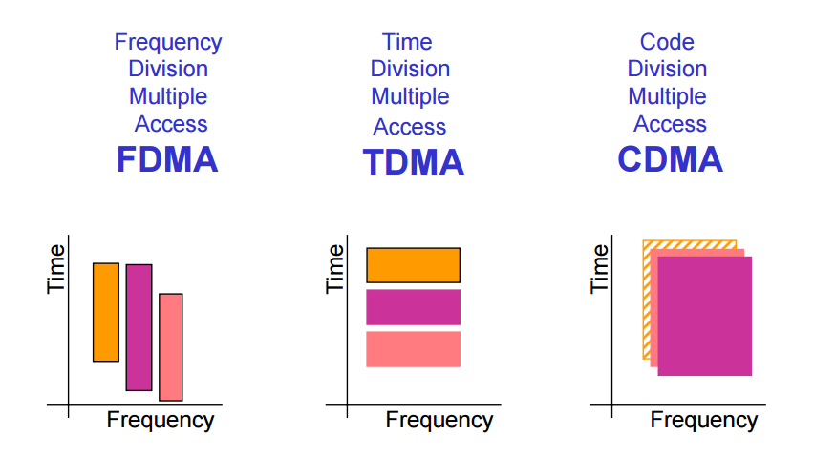
CDMA – Code Division Multiple Access

Slide 58
CDMA Analogy
10 people in a room.
5 speak English, 2 speak Spanish, 2 speak Chinese, and 1 speaks Russian.
Everyone is talking at relatively the same time over the same medium – the air.
Who can listen to whom and why?
Who can’t you understand?
Who can’t speak to anyone else?

Slide 59
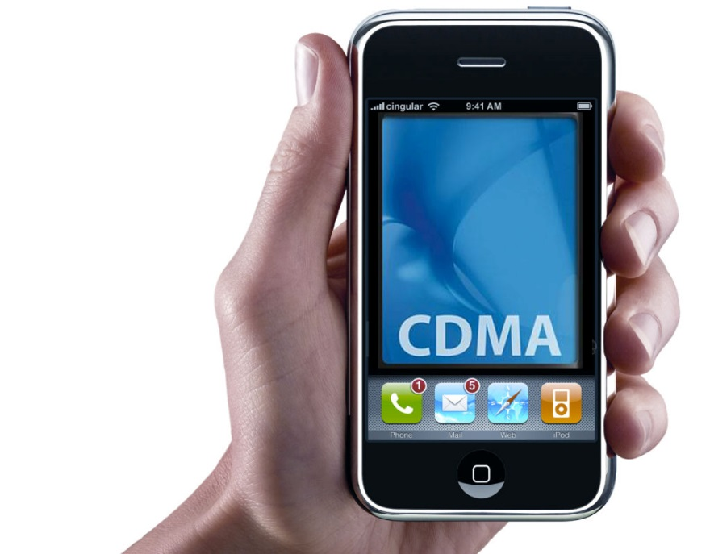
CDMA – Code Division Multiple Access
Used by 3G and 4G cellular networks
Each station can broadcast at any time in the full frequency spectrum
The signals may interfere
Resulting in a linear combination of individual signals
Algorithm
We assign a vector of length m to each station: v
Pairwise orthogonal vectors!!!
Each bit is encoded by the chip vector of the sender or it’s complement: v or -v
If it sends bit 1, it transmits v
If it sends bit 0, it transmits -v
Result is a sequence of vectors of length m

Slide 60
CDMA – Code Division Multiple Access
Interference
A sends a,-a,a,a
B sends b,b,-b,-b
After interference we receive: a+b,-a+b,a-b,a-b ???
How to decode?

Slide 61
CDMA – Code Division Multiple Access
Interference
A sends a,-a,a,a
B sends b,b,-b,-b
After interference we receive: a+b,-a+b,a-b,a-b ???
Decoding the message of A
Take the dot product by the sender’s chip code
(a+b)a > 0 => 1
(-a+b)a < 0 => 0
(a-b)a >0 => 1
(a-b)a > 0 => 1
If the dot product is
<0: bit 0 was sent by A
>0: bit 1 was sent by A
=0: nothing was sent by A
the channel is not used by A

Slide 62
Thank you…

