Slide 1
Computer Networks
Lecture 6a: Interconnecting LANs
Based on slides from D. Choffnes Northeastern U. and P. Gill from StonyBrook University
Revised Autumn 2015 by S. Laki

Slide 2
Just Above the Data Link Layer
Bridging
How do we connect LANs?
Function:
Route packets between LANs
Key challenges:
Plug-and-play, self configuration
How to resolve loops
Application
Presentation
Session
Transport
Network
Data Link
Physical

Slide 3
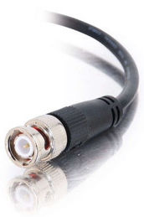

Recap
Originally, Ethernet was a broadcast technology
Terminator
Repeater
Tee Connector
Pros: Simplicity
Hardware is stupid and cheap
Cons: No scalability
More hosts = more collisions = pandemonium
Hub

Slide 4
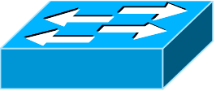
Bridging the LANs
Hub
Hub
Bridging limits the size of collision domains
Vastly improves scalability
Question: could the whole Internet be one bridging domain?
Tradeoff: bridges are more complex than hubs
Physical layer device vs. data link layer device
Need memory buffers, packet processing hardware, routing tables

Slide 5
Bridges
Original form of Ethernet switch
Connect multiple IEEE 802 LANs at layer 2
Goals
Reduce the collision domain
Complete transparency
“Plug-and-play,” self-configuring
No hardware of software changes on hosts/hubs
Should not impact existing LAN operations
Forwarding of frames
Learning of (MAC) Addresses
Spanning Tree Algorithm (to handle loops)
Hub

Slide 6
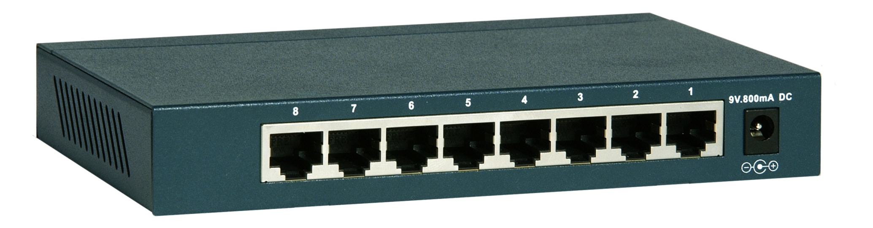
Frame Forwarding Tables
Each bridge maintains a forwarding table
MAC Address | Port | Age
00:00:00:00:00:AA | 1 | 1 minute
00:00:00:00:00:BB | 2 | 7 minutes
00:00:00:00:00:CC | 3 | 2 seconds
00:00:00:00:00:DD | 1 | 3 minutes

Slide 7
Learning Addresses
Manual configuration is possible, but…
Time consuming
Error Prone
Not adaptable (hosts may get added or removed)
Instead, learn addresses using a simple heuristic
Look at the source of frames that arrive on each port
Delete old entries after a timeout
MAC Address | Port | Age
00:00:00:00:00:AA | 1 | 0 minutes
00:00:00:00:00:AA
00:00:00:00:00:BB | 2 | 0 minutes
Port 1
Port 2
Hub
00:00:00:00:00:BB

Slide 8
The Danger of Loops
<Src=AA, Dest=DD>
This continues to infinity
How do we stop this?
Remove loops from the topology
Without physically unplugging cables
802.1 (LAN architecture) uses an algorithm to build and maintain a spanning tree for routing
CC
DD
Hub
Port 2
Port 2
AA | 1
AA | 2
AA | 1
AA | 1
AA | 2
AA | 1
Port 1
Port 1
Hub
AA
BB

Slide 9
Spanning Tree Definition
A subset of edges in a graph that:
Span all nodes
Do not create any cycles
This structure is a tree
5
1
1
2
2
3
3
4
6
2
5
3
5
4
1
4
6
7
6
7
7

Slide 10
802.1 Spanning Tree Approach
Elect a bridge to be the root of the tree
Every bridge finds shortest path to the root
Union of these paths becomes the spanning tree
Bridges exchange Configuration Bridge Protocol Data Units (BPDUs) to build the tree
Used to elect the root bridge
Calculate shortest paths
Locate the next hop closest to the root, and its port
Select ports to be included in the spanning trees

Slide 11
Determining the Root
Initially, all hosts assume they are the root
Bridges broadcast BPDUs:
Based on received BPDUs, each switch chooses:
A new root (smallest known Root ID)
A new root port (what interface goes towards the root)
A new designated bridge (who is the next hop to root)
Bridge ID
Root ID
Path Cost to Root

Slide 12
Spanning Tree Construction
3: 0/2
0: 0/0
12: 0/1
3: 3/0
12: 12/0
41: 3/1
27: 0/1
41: 0/2
27: 27/0
41: 41/0
68: 3/2
68: 9/1
9: 3/2
68: 0/3
9: 0/3
68: 68/0
9: 9/0

Slide 13
Bridges vs. Switches
Bridges make it possible to increase LAN capacity
Reduces the amount of broadcast packets
No loops
Switch is a special case of a bridge
Each port is connected to a single host
Either a client machine
Or another switch
Links are full duplex
Simplified hardware: no need for CSMA/CD!
Can have different speeds on each port

Slide 14
Switching the Internet
Capabilities of switches:
Network-wide routing based on MAC addresses
Learn routes to new hosts automatically
Resolve loops
Could the whole Internet be one switching domain?
NO
Notes:
Flooding packets until routes figured out
No load balancing
Addressing!

Slide 15
Limitations of MAC Routing
Inefficient
Flooding packets to locate unknown hosts
Poor Performance
Spanning tree does not balance load
Hot spots
Extremely Poor Scalability
Every switch needs every MAC address on the Internet in its routing table!
IP addresses these problems (next …)

Slide 16
Computer Networks
Lecture 6b: Network Layer
Based on slides from D. Choffnes Northeastern U. and P. Gill from StonyBrook University
Revised Autumn 2015 by S. Laki

Slide 17
Network Layer
Function:
Route packets end-to-end on a network, through multiple hops
Key challenge:
How to represent addresses
How to route packets
Scalability
Convergence
Application
Presentation
Session
Transport
Network
Data Link
Physical

Slide 18

Routers, Revisited
How to connect multiple LANs?
LANs may be incompatible
Ethernet, Wifi, etc…
Connected networks form an internetwork
The Internet is the best known example
Routers

Slide 19
Internetworking Issues
Internet Service Model
Best-effort (i.e. things may break)
Store-and-forward datagram network
Lowest common denominator
Naming / Addressing
How do you designate hosts?
Routing
Must be scalable (i.e. a switched Internet won’t work)
Service Model
What gets sent?
How fast will it go?
What happens if there are failures?
Must deal with heterogeneity
Remember, every network is different

Slide 20
Outline
Addressing
Class-based
CIDR
IPv4 Protocol Details
Packed Header
Fragmentation
IPv6

Slide 21
Possible Addressing Schemes
Flat
e.g. each host is identified by a 48-bit MAC address
Router needs an entry for every host in the world
Too big
Too hard to maintain (hosts come and go all the time)
Too slow (more later)
Hierarchy
Addresses broken down into segments
Each segment has a different level of specificity
Notes:
If time, show correlation between lookup speed and maximum line rate

Slide 22
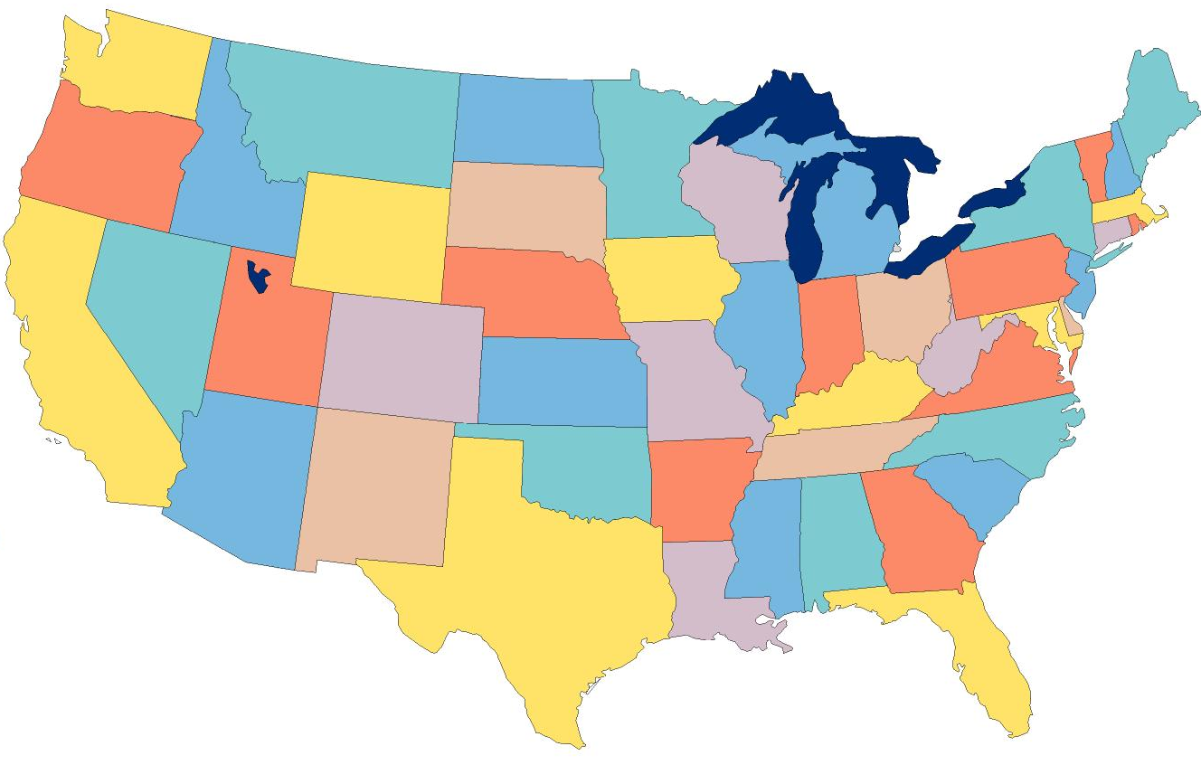
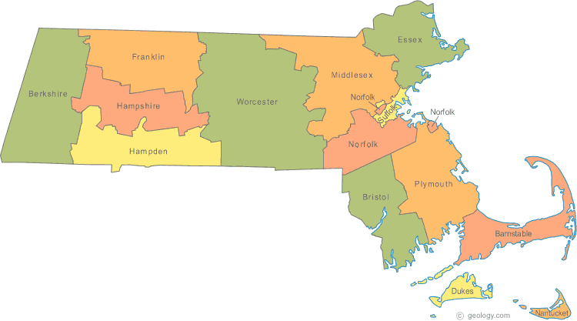

Example: Telephone Numbers
1-617-373-1234
3278
Very General
West Village H
Room 256
West Village G
Room 1234
Updates are Local
Very Specific

Slide 23
Binary Hierarchy Example
1**
Datagram, Destination = 101
10*
100
101
11*
0**
110
00*
111
000
001
01*
010
011

Slide 24
IP Addressing
IPv4: 32-bit addresses
Usually written in dotted notation, e.g. 192.168.21.76
Each number is a byte
0
8
16
24
31
Decimal
192
168
21
76
Hex
C0
A8
15
4C
Binary
11000000
10101000
00010101
01001100

Slide 25
IP Addressing and Forwarding
Routing Table Requirements
For every possible IP, give the next hop
But for 32-bit addresses, 2³² possibilities!
Hierarchical address scheme
Separate the address into a network and a host
0
31
Pfx
Network
Host
Known by all routers
Known by edge (LAN) routers

Slide 26
Classes of IP Addresses
0
1
8
16
24
31
Class A
0
Ntwk
Host
Example: MIT
18.*.*.*
1-126
0
2
8
16
24
31
Class B
10
Network
Host
Example: NEU
129.10.*.*
128-191
0
3
8
16
24
31
Class C
110
Network
Host
Example:
216.63.78.*
192-223

Slide 27

How Do You Get IPs?
IP address ranges controlled by IANA
Internet Assigned Number Authority
Roots go back to 1972, ARPANET, UCLA
Today, part of ICANN
IANA grants IPs to regional authorities
ARIN (American Registry of Internet Numbers) may grant you a range of IPs
You may then advertise routes to your new IP range
There are now secondary markets, auctions, …

Slide 28
Two Level Hierarchy
Pfx
Network
Host
…
Subtree size determined by network class
…

Slide 29
Class Sizes
Way too big
Class | Prefix Bits | Network Bits | Number of Classes | Hosts per Class
A | 1 | 7 | 2⁷ – 2 = 126 (0 and 127 are reserved) | 2²⁴ – 2 = 16,777,214 (All 0 and all 1 are reserved)
B | 2 | 14 | 2¹⁴ = 16,398 | 2¹⁶ – 2 = 65,534 (All 0 and all 1 are reserved)
C | 3 | 21 | 2²¹ = 2,097,512 | 2⁸ – 2 = 254 (All 0 and all 1 are reserved)
 |  |  | Total: 2,114,036
Too many network IDs
Too small to be useful

Slide 30
Subnets
Problem: need to break up large A and B classes
Solution: add another layer to the hierarchy
From the outside, appears to be a single network
Only 1 entry in routing tables
Internally, manage multiple subnetworks
Split the address range using a subnet mask
Pfx
Ntwk
Subnet
Host
Subnet Mask:
11111111 11111111 11000000 00000000

Slide 31
Subnet Example
Extract network:
IP Address:
10110101 11011101 01010100 01110010
Subnet Mask:
& 11111111 11111111 11000000 00000000
Result:
10110101 11011101 01000000 00000000
Extract host:
IP Address:
10110101 11011101 01010100 01110010
Subnet Mask:
& ~(11111111 11111111 11000000 00000000)
Result:
00000000 00000000 00010100 01110010

Slide 32
N-Level Subnet Hierarchy
Pfx
Network
Subnet
Host
…
Tree does not have a fixed depth
Increasingly specific subnet masks
…
Subtree size determined by length of subnet mask
…

Slide 33
Example Routing Table
Address Pattern | Subnet Mask | Destination Router
0.0.0.0 | 0.0.0.0 | Router 4
18.0.0.0 | 255.0.0.0 | Router 2
128.42.0.0 | 255.255.0.0 | Router 3
128.42.128.0 | 255.255.128.0 | Router 5
128.42.222.0 | 2555.255.255.0 | Router 1
Question: 128.42.222.198 matches four rows
Which router do we forward to?
Longest prefix matching
Use the row with the longest number of 1’s in the mask
This is the most specific match

Slide 34
Subnetting Revisited
Question: does subnetting solve all the problems of class-based routing?
NO
Classes are still too coarse
Class A can be subnetted, but only 126 available
Class C is too small
Class B is nice, but there are only 16,398 available
Routing tables are still too big
2.1 million entries per router

Slide 35
Classless Inter Domain Routing
CIDR, pronounced ‘cider’
Key ideas:
Get rid of IP classes
Use bitmasks for all levels of routing
Aggregation to minimize FIB (forwarding information base)
Arbitrary split between network and host
Specified as a bitmask or prefix length
Example: Stony Brook
130.245.0.0 with netmask 255.255.0.0
130.245.0.0 / 16

Slide 36
Aggregation with CIDR
Original use: aggregating class C ranges
One organization given contiguous class C ranges
Example: Microsoft, 207.46.192.* – 207.46.255.*
Represents 2⁶ = 64 class C ranges
Specified as CIDR address 207.46.192.0/18
0
8
16
24
31
Decimal
207
46
192
0
Hex
CF
2E
C0
00
Binary
11001111
00101110
11xxxxxx
xxxxxxxx
18 Bits Frozen By Netmask
14 Arbitrary Bits

Slide 37
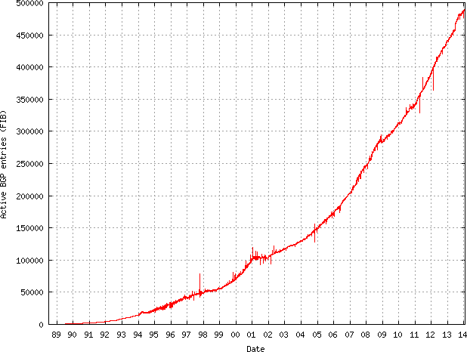
Size of CIDR Routing Tables
From www.cidr-report.org
CIDR has kept IP routing table sizes in check
Currently ~500,000 entries for a complete IP routing table
Only required by backbone routers

Slide 38
We had a special day in summer 2014!
512K day – August 12, 2014
Default threshold size for IPv4 route data in older Cisco routers → 512K routes
Some routers failed over to slower memory
RAM vs. CAM (content addressable memory)
Some routes dropped
Cisco issues update in May anticipating this issue
Reallocated some IPv6 space for IPv4 routes
Part of the cause
Growth in emerging markets
http://cacm.acm.org/news/178293-internet-routing-failures-bring-architecture-changes-back-to-the-table/fulltext

Slide 39
Takeaways
Hierarchical addressing is critical for scalability
Not all routers need all information
Limited number of routers need to know about changes
Non-uniform hierarchy useful for heterogeneous networks
Class-based addressing is too course
CIDR improves scalability and granularity
Implementation challenges
Longest prefix matching is more difficult than schemes with no ambiguity

