Slide 1
Computer Networks
Lecture 2: Physical layer +
Data Link layer
Based on slides from D. Choffnes Northeastern U. and P. Gill from StonyBrook University
Revised Autumn 2015 by S. Laki

Slide 2
Static Channel Allocation

Slide 3
Multiplexing
Enabling multiple signals to travel through the same media at the same time
To this end, the channel is split into multiple smaller subchannels
A special device (multiplexer) is needed at the sender, transmitting signals to the proper subchannel

Slide 4
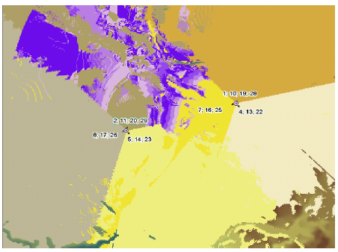
Space-Division Multiplexing
Simplest way of multiplexing
Wired example: point-to-point wire for each subchannel
Wireless example: Different antennas for the subchannels

Slide 5
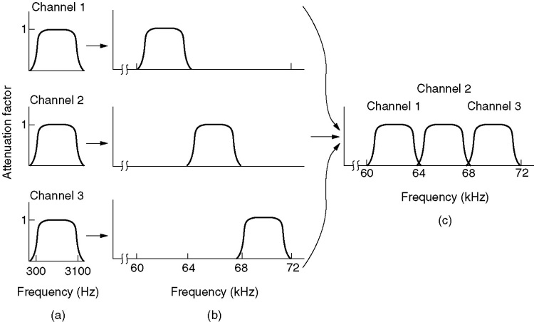
Frequency-Division Multiplexing
Multiple signals are combined and transmitted over the channel
Each signal is transmitted in different frequency ranges
Typically used for analog transmission
Multiple implementations…

Slide 6
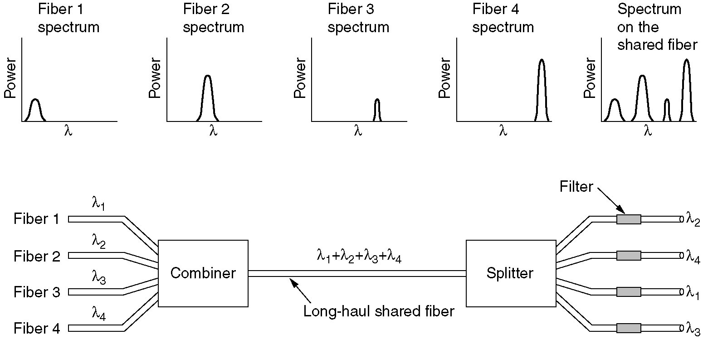
Wavelength-Division Multiplexing
Used for optical cables
IR laser rays at different wavelengths
TR1
TR1
W
D
M
W
D
M
TR2
TR2
TR3
TR3
TR4
TR4
Notes:
Több szignált kombinál össze lézersugarakkal különféle infravörös hullámhosszokon az optikai kábelen történő átvitelhez,
míg a fogadó oldalon különféle filterek használ a
hullámhosszok elkülönítésére.
MINDEN EGYES LÉZER önálló szignál halmazt alkalmaz
Jeladó (TR)
Klasszikus változatban 2 hullámhossz volt

Slide 7
Time-Division Multiplexing
Time is divided into not overlapping intervals
Each time slot is assigned to a sender, exlusively.
Empty slots may happen.
A
T
D
M
T
D
M
A
B
B
C
A
B
C
A
B
C
C

Slide 8
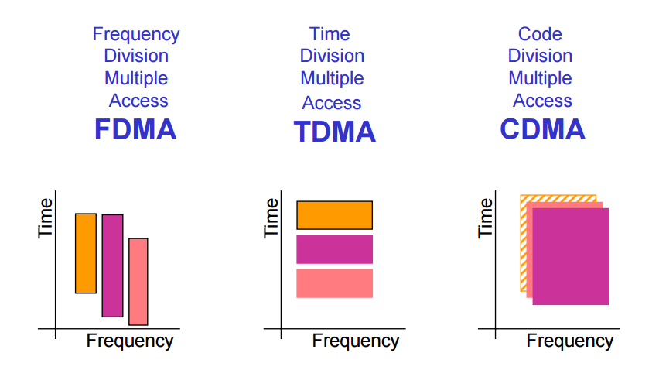
CDMA – Code Division Multiple Access

Slide 9
CDMA Analogy
10 people in a room.
5 speak English, 2 speak Spanish, 2 speak Chinese, and 1 speaks Russian.
Everyone is talking at relatively the same time over the same medium – the air.
Who can listen to whom and why?
Who can’t you understand?
Who can’t speak to anyone else?

Slide 10

CDMA – Code Division Multiple Access
Used by 3G and 4G cellular networks
Each station can broadcast at any time in the full frequency spectrum
The signals may interfere
Resulting in a linear combination of individual signals
Algorithm
We assign a vector of length m to each station: v
Pairwise orthogonal vectors!!!
Each bit is encoded by the chip vector of the sender or it’s complement: v or -v
If it sends bit 1, it transmits v
If it sends bit 0, it transmits -v
Result is a sequence of vectors of length m

Slide 11
CDMA – Code Division Multiple Access
Interference
A sends a,-a,a,a
B sends b,b,-b,-b
After interference we receive: a+b,-a+b,a-b,a-b ???
How to decode?

Slide 12
CDMA – Code Division Multiple Access
Interference
A sends a,-a,a,a
B sends b,b,-b,-b
After interference we receive: a+b,-a+b,a-b,a-b ???
Decoding the message of A
Take the dot product by the sender’s chip code
(a+b)a > 0 => 1
(-a+b)a < 0 => 0
(a-b)a >0 => 1
(a-b)a > 0 => 1
If the dot product is
<0: bit 0 was sent by A
>0: bit 1 was sent by A
=0: nothing was sent by A
the channel is not used by A

Slide 13
Data Link Layer
Function:
Send blocks of data (frames) between physical devices
Regulate access to the physical media
Key challenge:
How to delineate frames?
How to detect errors?
How to perform media access control (MAC)?
How to recover from and avoid collisions?
Application
Presentation
Session
Transport
Network
Data Link
Physical

Slide 14
Outline
Framing
Error Checking and Reliability
Media Access Control
802.3 Ethernet
802.11 Wifi

Slide 15
Framing
Physical layer determines how bits are encoded
Next step, how to encode blocks of data
Packet switched networks
Each packet includes routing information
Data boundaries must be known so headers can be read
Types of framing
Byte oriented protocols
Bit oriented protocols
Clock based protocols

Slide 16
Byte Oriented: Byte Stuffing
FLAG
Data
DLE
DLE
DLE
FLAG
FLAG
Add FLAG bytes as sentinel to the beginning and end of the data
Problem: what if FLAG appears in the data?
Add a special DLE (Data Link Escape) character before FLAG
What if DLE appears in the data? Add DLE before it.
Similar to escape sequences in C
printf(“You must \”escape\” quotes in strings”);
printf(“You must \\escape\\ forward slashes as well”);
Used by Point-to-Point protocol, e.g. modem, DSL, cellular

Slide 17
Byte Oriented: Byte Counting
132
132
Data
Sender: insert length of the data in bytes at the beginning of each frame
Receiver: extract the length and read that many bytes
What happens if there is an error transmitting the count field?

Slide 18
Bit Oriented: Bit Stuffing
01111110
Data
01111110
Add sentinels to the start and end of data (similarly to byte stuffing)
Both sentinels are the same
Example: 01111110 in High-level Data Link Protocol (HDLC)
Sender: insert a 0 after each 11111 in data
Known as “bit stuffing”
Receiver: after seeing 11111 in the data…
111110 → remove the 0 (it was stuffed)
111111 → look at one more bit
1111110 → end of frame
1111111 → error! Discard the frame
Disadvantage: 20% overhead at worst
What happens if error in sentinel transmission?
Notes:
HDLC used in SoNET phone

Slide 19
Clock-based Framing: SONET
Synchronous Optical Network
Transmission over very fast optical links
STS-n, e.g. STS-1: 51.84 Mbps, STS-768: 36.7 Gbps
STS-1 frames based on fixed sized frames
9*90 = 810 bytes → after 810 bytes look for start pattern
Physical layer details
Bits are encoded using NRZ
Payload is XORed with a special 127-bit pattern to avoid long sequences of 0 and 1
90 Columns
Special start pattern
Payload
9 Rows
Overhead

Slide 20
Outline
Framing
Error Checking
Media Access Control
802.3 Ethernet
802.11 Wifi

Slide 21
Dealing with Noise
The physical world is inherently noisy
Interference from electrical cables
Cross-talk from radio transmissions, microwave ovens
Solar storms
How to detect bit-errors in transmissions?
How to recover from errors?

Slide 22
Naïve Error Detection
Idea: send two copies of each frame
if (memcmp(frame1, frame2) != 0) { OH NOES, AN ERROR! }
Why is this a bad idea?
Extremely high overhead
Poor protection against errors
Twice the data means twice the chance for bit errors

Slide 23
Parity Bits
Idea: add extra bits to keep the number of 1s even
Example: 7-bit ASCII characters + 1 parity bit
0101001
1
1101001
0
1011110
1
0001110
1
0110100
1
10
1
Detects 1-bit errors and some 2-bit errors
Not reliable against bursty errors

Slide 24
Error control
Error Control Strategies
Error Correcting codes (Forward Error Correction (FEC))
Error detection and retransmission Automatic Repeat Request (ARQ)

Slide 25
Error control
Objectives
Error detection
with correction
Forward error correction
without correction -> e.g. drop a frame
Backward error correction
The erroneous frame needs to be retransmitted
Error correction
without error detection
e.g. in voice transmission

Slide 26
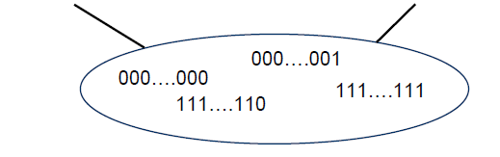
Redundancy
Redundancy is required for error control
Without redundancy
2^{m} possible data messages can be represented as data on m bits
They all are legal!!!
Each error results a new legal data message
How to detect errors???
All the possible
frames
Legal frames

Slide 27
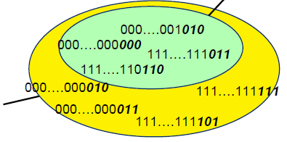
Error-correcting codes Redundancy
Legal frames
A frame consists of
m data bits (message)
r redundant/check bits
The total length n = m + r
This n-bit unit is referred to as an n-bit codeword!
All the possible frames

Slide 28
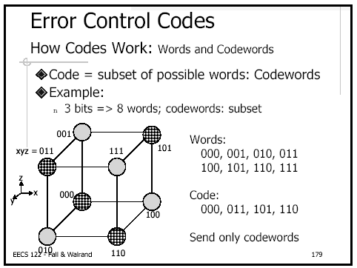
Error

Slide 29

Hamming distance
The Hamming distance between two codewords is the number of differences between corresponding bits.
1. The Hamming distance d(000, 011) is 2 because
2. The Hamming distance d(10101, 11110) is 3 because

Slide 30

Hamming distance
If not all the 2^{n} possible codewords are used
Set of legal codewords =: S
Hamming distance of the complete code
The smallest Hamming distance of between all the possible pairs in the set of legal codewords (S)

Slide 31
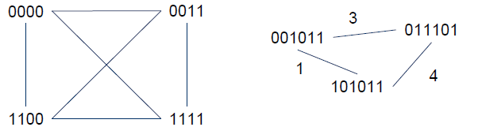
What is the Hamming distance?
Two examples:

Slide 32
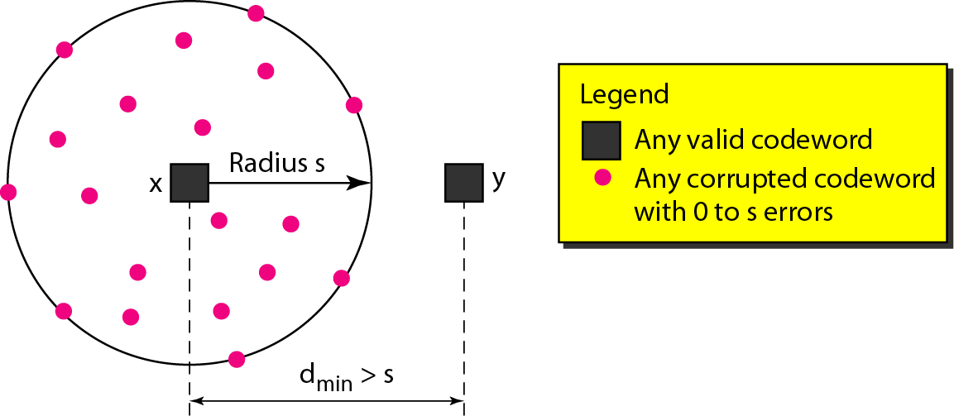
Error detection
To detect d errors, you need a distance d+1 code.

Slide 33
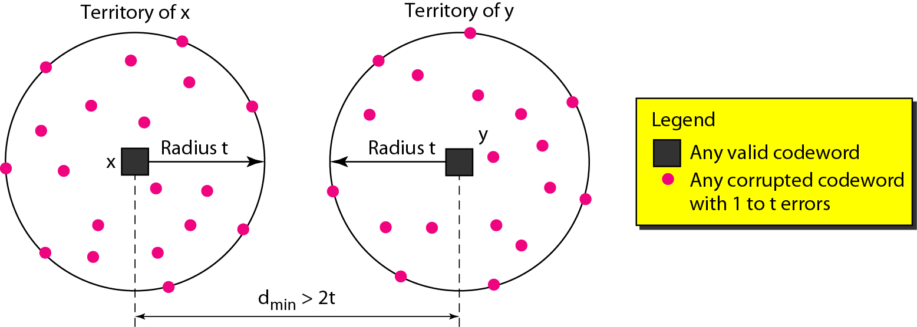
Error correction
To correct d errors, you need a distance 2d+1 code.

Slide 34
Example
S={ 00000000,
00001111,
11110000,
11111111
}

Slide 35
Parity bit – already discussed
A single parity bit is appended to the data
Choosen according to the number of 1 bits in the message
odd or even
An example using even parity
Original message: 1011010
A 0 bit is added to the end: 10110100
m=8 and r=1 in this case
The distance of this code is 2, since any single-bit error produces a codeword with the wrong parity.

Slide 36
Checksums
Idea:
Add up the bytes in the data
Include the sum in the frame
Use ones-complement arithmetic
Lower overhead than parity: 16 bits per frame
But, not resilient to errors
Why?
Used in UDP, TCP, and IP
START
Data
Checksum
END
1
0
0101001
+
1101001= 10010010
Notes:
Multiple values can sum to same checksum

Slide 37
Cyclic Redundancy Check (CRC)
Uses field theory to compute a semi-unique value for a given message
Much better performance than previous approaches
Fixed size overhead per frame (usually 32-bits)
Quick to implement in hardware
Only 1 in 2³² chance of missing an error with 32-bit CRC

Slide 38
CRC (Cyclic Redundancy Check)
Polynomial code
Treating bit strings as representations of polynomials with coefficients of 0 and 1.
CRC
Add k bits of redundant data to an n-bit message.
Represent n-bit message as an n-1 degree polynomial;
e.g., MSG=10011010 corresponds to M(x) = x⁷+ x⁴ + x³ + x¹.
Let k be the degree of some divisor polynomial G(x);
e.g., G(x) = x³+ x² + 1.
Generator polynomial
Agreed upon it in advance

Slide 39
CRC
Transmit polynomial P(x) that is evenly divisible by G(x), and receive polynomial P(x) + E(x);
E(x)=0 implies no errors.
Recipient divides (P(x) + E(x)) by G(x);
the remainder will be zero in only two cases:
E(x) was zero (i.e. there was no error),
or E(x) is exactly divisible by C(x).
Choose G(x) to make second case extremely rare.

Slide 40
A basic example with numbers
Make all legal messages divisible by 3
If you want to send 10
First multiply by 4 to get 40
Now add 2 to make it divisible by 3 = 42
When the data is received ..
Divide by 3, if there is no remainder there is no error
If no error, divide by 4 to get sent message
If we receive 43, 44, 41, 40, then error
45 would not be recognized as an error

Slide 41
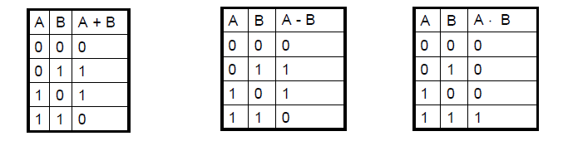

Mod 2 arithmetic
Operations are done modulo 2
1111
+1010
=====
0101
11001
x 101
=====
11001
+ 11001
=========
1111101

Slide 42
A basic example with polynomials
Sender:
multiply M(x) = x⁷+ x⁴ + x³ + x¹ by x^{k}; for our example, we get
x¹⁰ + x⁷ + x⁶ + x⁴ (10011010000);
divide result by C(x) (1101);
Send 10011010000 + 101 = 10011010101,
since this must be exactly divisible by C(x);
11111001
10011010000 Message
1101
1001
1101
1000
1101
1011
1101
1100
1101
1000
1101
101 Remainder
Generator 1101

Slide 43
Further properties
Want to ensure that G(x) does not divide evenly into polynomial E(x).
All single-bit errors, as long as the x^{k} and x⁰ terms have non-zero coefficients.
All double-bit errors, as long as G(x) has a factor with at least three terms.
Any odd number of errors, as long as G(x) contains the factor (x + 1).
Any “burst” error (i.e sequence of consecutive errored bits) for which the length of the burst is less than k bits.
Most burst errors of larger than k bits can also be detected.

