Slide 1
Computer Networks
Lecture 7: Data Link layer
Based on slides from D. Choffnes Northeastern U. and P. Gill from StonyBrook University
Revised Autumn 2015 by S. Laki

Slide 2
Cyclic Redundancy Check (CRC)
Uses field theory to compute a semi-unique value for a given message
Much better performance than previous approaches
Fixed size overhead per frame (usually 32-bits)
Quick to implement in hardware
Only 1 in 2³² chance of missing an error with 32-bit CRC

Slide 3
CRC (Cyclic Redundancy Check)
Polynomial code
Treating bit strings as representations of polynomials with coefficients of 0 and 1.
CRC
Add k bits of redundant data to an n-bit message.
Represent n-bit message as an n-1 degree polynomial;
e.g., MSG=10011010 corresponds to M(x) = x⁷+ x⁴ + x³ + x¹.
Let k be the degree of some divisor polynomial G(x);
e.g., G(x) = x³+ x² + 1.
Generator polynomial
Agreed upon it in advance

Slide 4
CRC
Transmit polynomial P(x) that is evenly divisible by G(x), and receive polynomial P(x) + E(x);
E(x)=0 implies no errors.
Recipient divides (P(x) + E(x)) by G(x);
the remainder will be zero in only two cases:
E(x) was zero (i.e. there was no error),
or E(x) is exactly divisible by C(x).
Choose G(x) to make second case extremely rare.

Slide 5
A basic example with numbers
Make all legal messages divisible by 3
If you want to send 10
First multiply by 4 to get 40
Now add 2 to make it divisible by 3 = 42
When the data is received ..
Divide by 3, if there is no remainder there is no error
If no error, divide by 4 to get sent message
If we receive 43, 44, 41, 40, then error
45 would not be recognized as an error

Slide 6
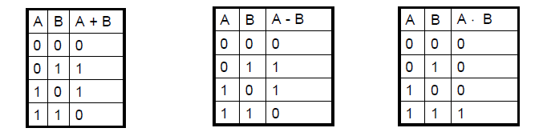

Mod 2 arithmetic
Operations are done modulo 2
1111
+1010
=====
0101
11001
x 101
=====
11001
+ 11001
=========
1111101

Slide 7
A basic example with polynomials
Sender:
multiply M(x) = x⁷+ x⁴ + x³ + x¹ by x^{k}; for our example, we get
x¹⁰ + x⁷ + x⁶ + x⁴ (10011010000);
divide result by C(x) (1101);
Send 10011010000 + 101 = 10011010101,
since this must be exactly divisible by C(x);
11111001
10011010000 Message
1101
1001
1101
1000
1101
1011
1101
1100
1101
1000
1101
101 Remainder
Generator 1101

Slide 8
Further properties
Want to ensure that G(x) does not divide evenly into polynomial E(x).
All single-bit errors, as long as the x^{k} and x⁰ terms have non-zero coefficients.
All double-bit errors, as long as G(x) has a factor with at least three terms.
Any odd number of errors, as long as G(x) contains the factor (x + 1).
Any “burst” error (i.e sequence of consecutive errored bits) for which the length of the burst is less than k bits.
Most burst errors of larger than k bits can also be detected.

Slide 9
Even Parity
Actually consists of using x+1 polynomial
Given message 0111, multiply by x to get 01110
Now divide by x+1=11
11 01110
11
0010
11
1=remainder
Message = 01110+1=01111 even parity
0101

Slide 10
Common polynomials for C(x):
CRC
CRC-8
CRC-10
CRC-12
CRC-16
CRC-CCITT
CRC-32
C(x)
x⁸+x²+x¹+1
x¹⁰+x⁹+x⁵+x⁴+x¹+1
x¹²+x¹¹+x³+x²+x¹+1
x¹⁶+x¹⁵+x²+1
x¹⁶+x¹²+x⁵+1
x³²+x²⁶+x²³+x²²+x¹⁶+x¹²+x¹¹+x¹⁰+x⁸+x⁷+x⁵+x⁴+x²+x+1

Slide 11
Error control
Error Control Strategies
Error Correcting codes (Forward Error Correction (FEC))
Error detection and retransmission Automatic Repeat Request (ARQ)

Slide 12
Error control
Objectives
Error detection
with correction
Forward error correction
without correction -> e.g. drop a frame
Backward error correction
The erroneous frame needs to be retransmitted
Error correction
without error detection
e.g. in voice transmission

Slide 13
Should We Error Check in the Data Link?
Recall the End-to-End Argument
Cons:
Error free transmission cannot be guaranteed
Not all applications want this functionality
Error checking adds CPU and packet size overhead
Error recovery requires buffering
Pros:
Potentially better performance than app-level error checking
Data link error checking in practice
Most useful over lossy links
Wifi, cellular, satellite

Slide 14
Backward Error Correction

Slide 15
Backward error correction
Error detection at the receiver side
The sender retransmits a frame until it received by the other side correctly.
Network Layer
Packets
Network Layer
from_upper(p)
to_upper(p)
Data Link Layer
Frames
Data Link Layer
to_lower(p)
from_lower(p)
Physical Layer
Bits

Slide 16
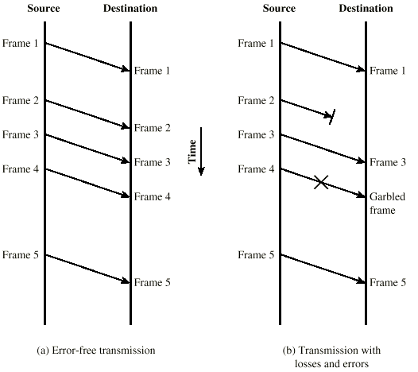
Model of Frame Transmission

Slide 17
Elementary Data Link Protocols
Simplex Stop-and-Wait Protocol
Alternate Bit Protocol
Sliding Window Protocol

Slide 18
Simple Stop-and-Wait Protocol
A sends a message to B
A stops and waits for an answer from B
Acknowledgement message (ACK)
After receiving the message B sends an ACK back to the sender.
A retransmits the message until it receives an ACK from B
If the ACK arrived, the next message may be sent.

Slide 19
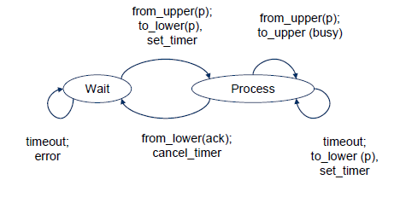
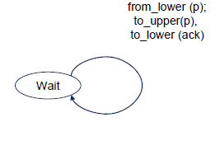
Simplex Stop-and-Wait Protocol
Sender
Receiver

Slide 20
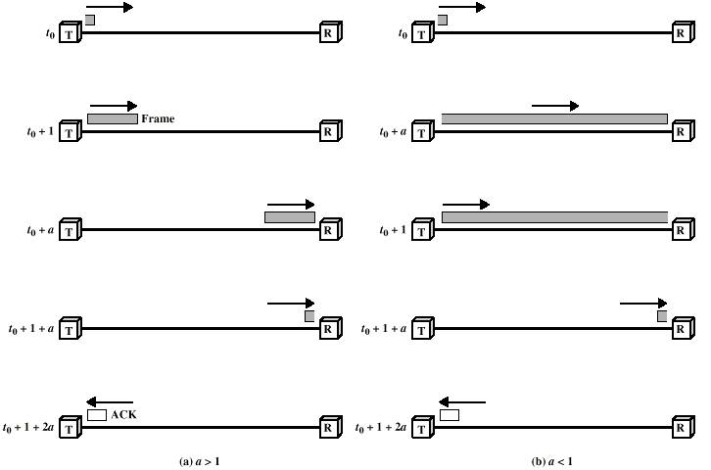
Stop-and-Wait Link Utilization

Slide 21
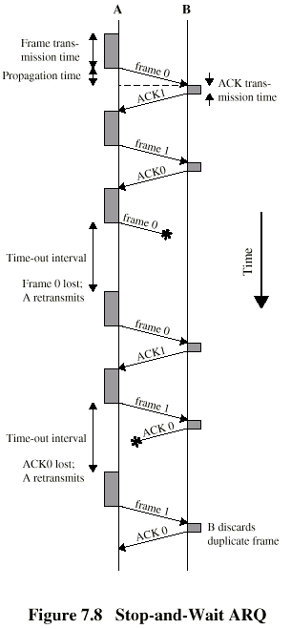
Stop-and-Wait Diagram
Simple, but inefficient for long distance and high speed applications.
We can use sliding-window technique to improve the efficiency.

Slide 22
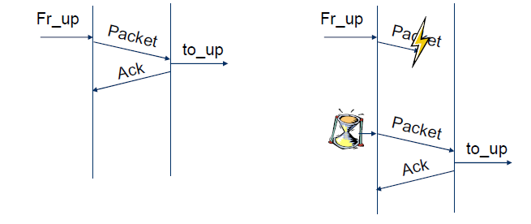
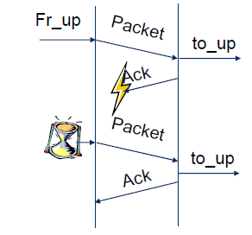
What’s the problem?
Usually
Packet loss
ACK loss

Slide 23
Alternating Bit Protocol (ABP)
Let
A be the sender
B be the receiver
A and B maintain internal one-bit counter
A value that is 0 or 1
Each message from A to B contains
a data part and
a one-bit sequence number
E.g. a value that is 0 or 1
After receiving A’s message, B sends an ACK back to A
which also contains a one-bit sequence number
Retransmission until A receives an ACK from B with the same sequence number
Then A complements its sequence number
0->1 or
1->0

Slide 24
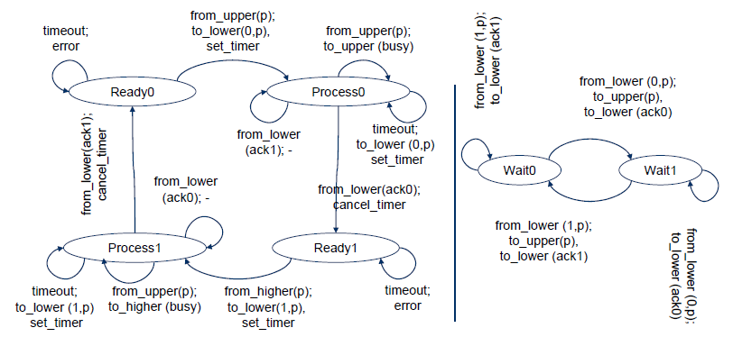
Alternating Bit Protocol (ABP)
Sender
Receiver

Slide 25
Alternating Bit Protocol (ABP)
A reliable data transport over a noisy channel
Basic flow control
The sender has to wait for the ACK from the receiver before sending the next message
Automatic Repeat reQest (ARQ) protocol
An acknowledgement
marks that the new message has been delivered.
allows the sender to tranmit the next frame.

Slide 26
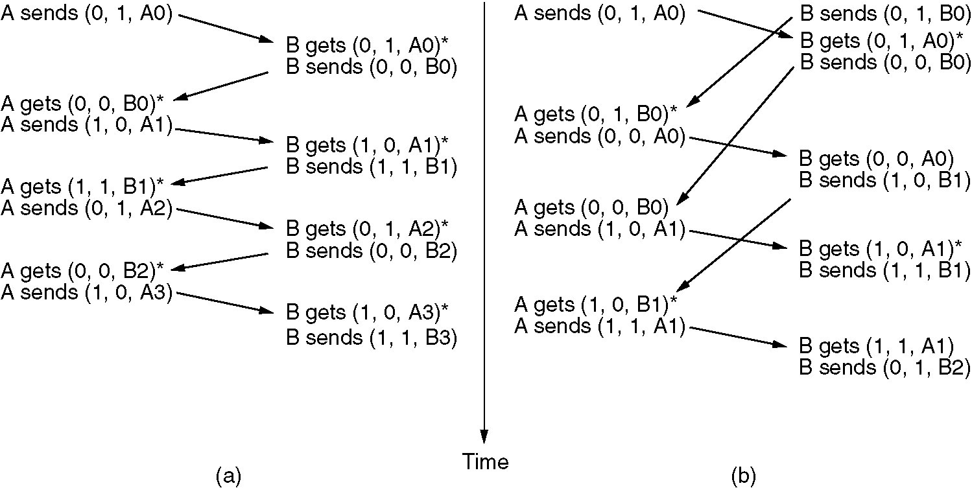
Alternating Bit Protocol
Two scenarios for ABP. (a) Normal case. (b) Abnormal case. The notation is (seq, ack, packet number). An asterisk indicates where a network layer accepts a packet.

Slide 27
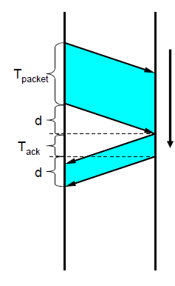
ABP – Channel utilization
Utilization (η) is the ratio of
The time needed for the transmission of a frame (T_{packet})
The time ellapsed until the next frame can be transmitted
In the fig.: (T_{packet} + d + T_{ack} + d)
Now:
η = T_{packet} / (T_{packet} + d + T_{ack} + d)
If the propagation delay is large, the ABP is not efficient.
Time

Slide 28
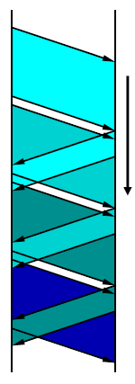
How to improve the efficency?
The sender transmit frames continously one after another
More frames are sent out, but not acknowledged.
Pipeline technique
Introduce sequence numbers
Time

Slide 29
Sliding Window Protocols
Similar to ABP
but allow multiple frames to transmit
Receiver has a buffer of W frames
Sender can send up to W frames without receiving ACK
Bidirectional
Each outgoing frame contains a seq. number from 0 to 2^{n}-1.
So it fits in an n-bit field
ABP uses n=1
Each ACK carries the sequence number of the next expected frame by the receiver

Slide 30
Sliding Window Protocols
At the sender
Sending window
a set of sequence numbers corresponding to frames being under transmission (finite range of numbers)
At the receiver
Receiving window
Sequence numbers for frames it is permitted to accept (finite range of numbers)
The sender’s and receiver’s windows need
not have tha same lower and upper bounds and
even have the same size.
The window size can be
fixed or
grow or shrink over the course of time as frames are sent and received

Slide 31
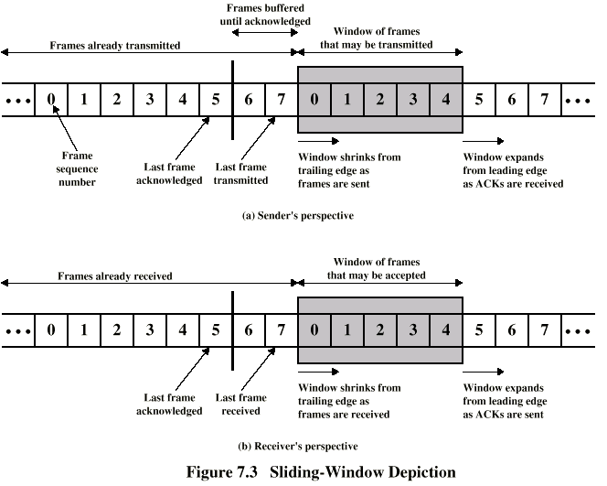
Sliding-Window Diagram
Need to buffer them in case of retransmission
Notes:
Assume 3-bit sequence number is used. Frames are numbered sequentially from 0 through 7.
In Fig.(a), each time a frame is sent, the shaded window shrinks; each time an ACK is received, the shaded window grows.

Slide 32
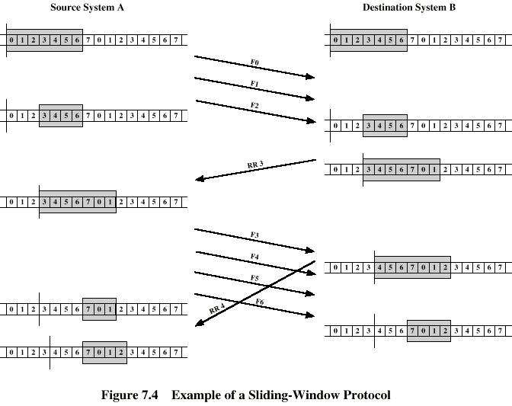
Example Sliding-Window
RR3 means the receiver has received all frames up to frame 2 and is ready to receive frame 3.
Have been delivered to upper layer
More spaces for future frames
Notes:
It is not necessary to acknowledge every frame.

Slide 33
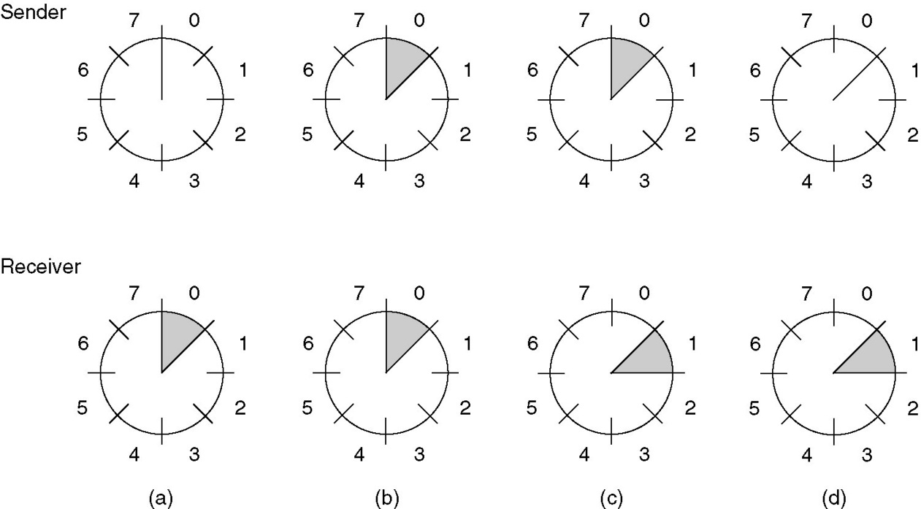
Sliding Window Protocols
A sliding window of size 1, with a 3-bit sequence number.
(a) Initially.
(b) After the first frame has been sent.
(c) After the first frame has been received.
(d) After the first acknowledgement has been received.

Slide 34
Go-Back-N
A sliding window protocol where
the receiver’s window size is fixed to 1,
while the sender has window size > 0.
After receiving a damaged frame
Receiver discards all subsequent frames
Sender retransmits the damaged frame and all its successors after the times out

Slide 35
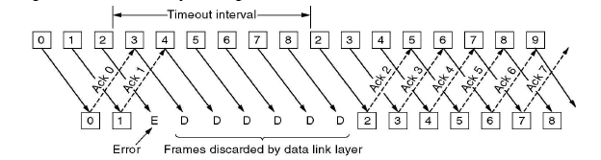
Go-Back-N

Slide 36
Selective Repeat
Receiver’s window size is n ( n >1 )
At most n frames can be buffered
Receiver stores all the correct frames following the bad one
The sender retransmits only the bad frame not all its successors

Slide 37
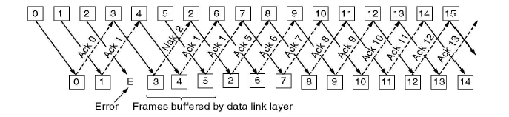
Selective Repeat

Slide 38
Communication channels and piggybacking
Simplex
Communication in one direction only
Half-duplex
Communication in both directions, but only one direction at a time, not simultaneously.
Full-duplex
Communication in both directions simultaneously
The previous protocols assumed
a simplex channel to the upper (network) layer and
a (half-)duplex channel to the physical layer
If we use duplex channel to the upper layers
Transmitting data packet and acknowledgements in both directions separately
Or using piggybacking
The header of a data packet sent in the opposite direction carries the acknowledgement back to the other side
widely applied in practice

Slide 39
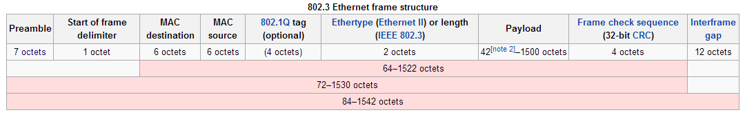
Ethernet frame

Slide 40
Outline
Framing
Error Checking and Reliability
Media Access Control
802.3 Ethernet
802.11 Wifi

Slide 41
What is Media Access?
Ethernet and Wifi are both multi-access technologies
Broadcast medium, shared by many hosts
Simultaneous transmissions cause collisions
This destroys the data
Media Access Control (MAC) protocols are required
Rules on how to share the medium
Strategies for detecting, avoiding, and recovering from collisions

Slide 42
Strategies for Media Access
Channel partitioning
Divide the resource into small pieces
Allocate each piece to one host
Example: Time Division Multi-Access (TDMA) cellular
Example: Frequency Division Multi-Access (FDMA) cellular
Taking turns
Tightly coordinate shared access to avoid collisions
Example: Token ring networks

Slide 43
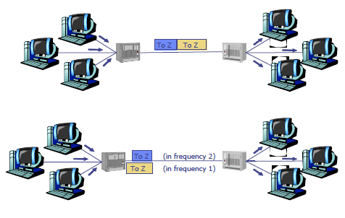
Channel Partitioning
Frequency Division Multiplexing
E.g. a telephone trunk
Time Division Multiplexing
Are they good solutions?
if data rates are fixed
if the link utilization is good

Slide 44
What’s the problem?
The number of senders is large
continuously varying
bursty traffic

Slide 45
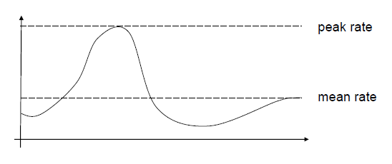
Bursty traffic
If there’s huge difference between the peak rate and the mean (or average) rate
In computer networks it is not rare
peak rate/mean rate = 1000/1

Slide 46
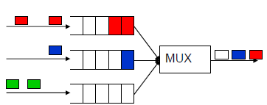
Bursty traffic with Static Channel Allocation
The capacity of the channels must be
Either quite large to handle peak rates
Waste of resources
The mean rate is much less than the peak one
Or based on the mean rate
We need buffers/queues to store packets coming faster than the mean rate
Queuing delays
BUFFERS
Incoming packets

Slide 47
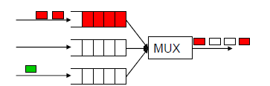
What’s about delays?
If there’s no multiplexing
A source has data rate of p bps
The capacity of the link is C bps
The delay is T
Bursty traffic with static channel allocation
Dividing the channel into N static subchannels
With sending rate p/N bps and capacity C/N
The delay is N T
Static channel allocation increases the packet delays
Because of the idle subchannels

Slide 48
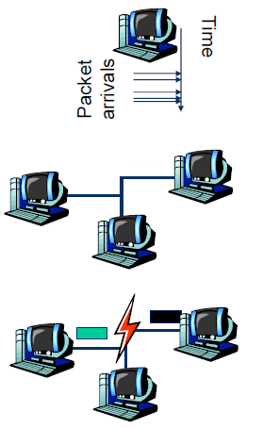
Dynamic Channel Allocation in LANs and MANs
1. Station Model.
N terminals/hosts
The prob. of a frame being generated in Δt is λΔt, where the arrival rate is λ.
2. Single Channel Assumption.
All stations are equivalent
A single channel is available for all communications
3. Collision Assumption.
If two frames are transmitted simultaneously, they overlap in time which results a garbled signal
This event is called collision
4. Continuous Time VS Slotted Time.
5. Carrier Sense VS No Carrier Sense.

Slide 49
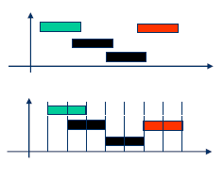
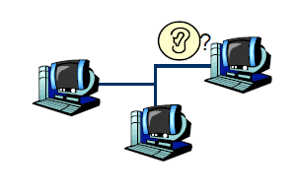
Dynamic Channel Allocation in LANs and MANs
4. Continuous Time VS Slotted Time.
5. Carrier Sense VS No Carrier Sense.
Time
Time

Slide 50
How can the efficiency be measured?
Throughput (S)
Number of packets/frames transmitted in a time unit (successfully)
Delay
The time needs for transmitting a packet
Fairness
All the terminals are treated as equals

Slide 51
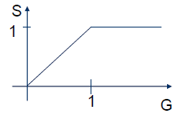
Throughput and offered load
Offered load (G)
The number of packets in a time unit that the protocol must handle
G>1: overloading
An ideal protocol
If G<1, S=G
If G≥1, S=1
where sending out a packet takes 1 time unit.

Slide 52
Strategies for Media Access
Channel partitioning
Divide the resource into small pieces
Allocate each piece to one host
Example: Time Division Multi-Access (TDMA) cellular
Example: Frequency Division Multi-Access (FDMA) cellular
Taking turns
Tightly coordinate shared access to avoid collisions
Example: Token ring networks
Contention
Allow collisions, but use strategies to recover
Examples: Ethernet, Wifi

Slide 53
Contention MAC Goals
Share the medium
Two hosts sending at the same time collide, thus causing interference
If no host sends, channel is idle
Thus, want one user sending at any given time
High utilization
TDMA is low utilization
Just like a circuit switched network
Simple, distributed algorithm
Multiple hosts that cannot directly coordinate
No fancy (complicated) token-passing schemes

Slide 54
Contention Protocol Evolution
ALOHA
Developed in the 70’s for packet radio networks
Stations transmit data immedately
If there is a collision, it retransmits the packet later.
Slotted ALOHA
Start transmissions only at fixed time slots
Significantly fewer collisions than ALOHA
Carrier Sense Multiple Access (CSMA)
Start transmission only if the channel is idle
CSMA / Collision Detection (CSMA/CD)
Stop ongoing transmission if collision is detected
Notes:
ALOHA:
Send data if you have data (doesn’t bother sensing the medium)
Later → back off period e.g., exponential backofff etc.

Slide 55

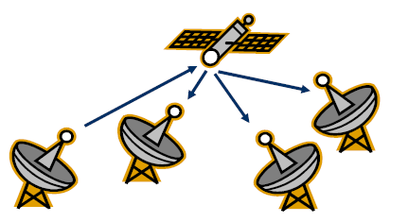
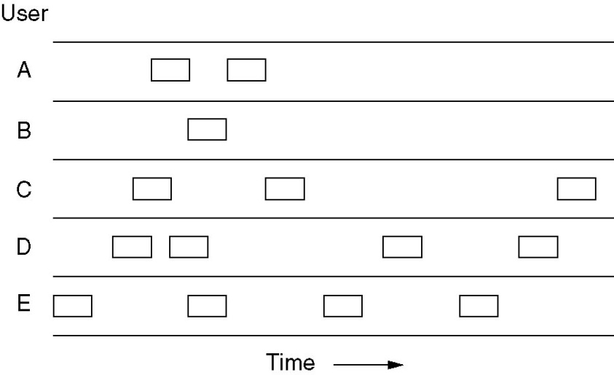
Pure ALOHA
The goal was to use low-cost commercial radio equipment to connect users on Oahu and the other Hawaiian islands with a central time-sharing computer on the main Oahu campus.
Algorithm was developed by Uni. of Hawaii
If you have data to send, send the data
Low-cost and very simple

Slide 56
ALOHA
Topology: radio broadcast with multiple stations
Protocol:
Stations transmit data immediately
Receivers ACK all packets
No ACK = collision, wait a random time then retransmit
Simple, but radical concept
Previous attempts all divided the channel
TDMA, FDMA, etc.
Optimized for the common case: few senders
A
B
C

Slide 57
Performance analysis -Poisson Process
The Poisson Process is a celebrated model used in Queuing Theory for “random arrivals”. Assumptions leading to this model include:
The probability of an arrival during a short time interval Δt is proportional to the length of the interval, and does not depend on the origin of the time interval (memory-less property)
The probability of having multiple arrivals during a short time interval Δt approaches zero.

Slide 58
Performance analysis - Poisson Distribution
The probability of having k arrivals during a time interval of length t is given by:
where λ is the arrival rate. Note that this is a single-parameter model; all we have to know is λ.

Slide 59
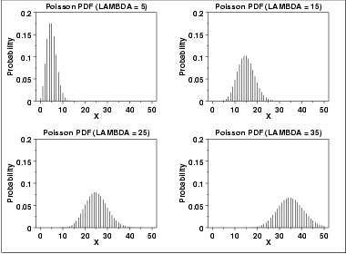
FYI: Poisson Distribution
The following is the plot of the Poisson probability density function for four values of λ.

Slide 60
Analysis of Pure ALOHA
Notation:
T_{f} = frame time (processing, transmission, propagation)
S: Average number of successful transmissions per T_{f} ; that is, the throughput
G: Average number of total frames transmitted per T_{f}
D: Average delay between the time a packet is ready for transmission and the completion of successful transmission.
We will make the following assumptions
All frames are of constant length
The channel is noise-free; the errors are only due to collisions.
Frames do not queue at individual stations
The channel acts as a Poisson process.

Slide 61
Analysis of Pure ALOHA…
Since S represents the number of “good” transmissions per frame time, and G represents the total number of attempted transmissions per frame time, then we have:
S = G × (Probability of good transmission)
The vulnerable time for a successful transmission is 2T_{f}
So, the probability of good transmission is not to have an “arrival” during the vulnerable time .

Slide 62
Analysis of Pure ALOHA…
Collides with
the start of
the shaded
frame
Collides with
the end of
the shaded
frame
t
t₀
t₀ + t
t₀ + 2t
t₀ + 3t
Vulnerable
Time
Vulnerable period for the shaded frame
Notes:
2

Slide 63
Analysis of Pure ALOHA…
Using:
And setting t = 2T_{f} and k = 0, we get

Slide 64
Analysis of Pure ALOHA…
If we differentiate S = Ge^{-2G} with respect to G and set the result to 0 and solve for G, we find that the maximum occurs when
G = 0.5,
and for that S = 1/2e = 0.18. So, the maximum throughput is only 18% of capacity.
Notes:
2

Slide 65
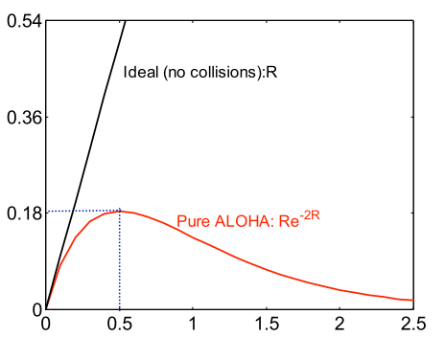
Tradeoffs vs. TDMA
In TDMA, each host must wait for its turn
Delay is proportional to number of hosts
In Aloha, each host sends immediately
Much lower delay
But, much lower utilization
Throughput
Sender A
ALOHA Frame
Sender B
ALOHA Frame
Time
Load
Maximum throughput is ~18% of channel capacity

Slide 66
Slotted ALOHA
Channel is organized into uniform slots whose size equals the frame transmission time.
Transmission is permitted only to begin at a slot boundary.
Here is the procedure:
While there is a new frame A to send do
Send frame A at (the next) slot boundary
Notes:
2

Slide 67
Analysis of Slotted ALOHA
Note that the vulnerable period is now reduced in half. Using:
And setting t = T_{f} and k = 0, we get

Slide 68
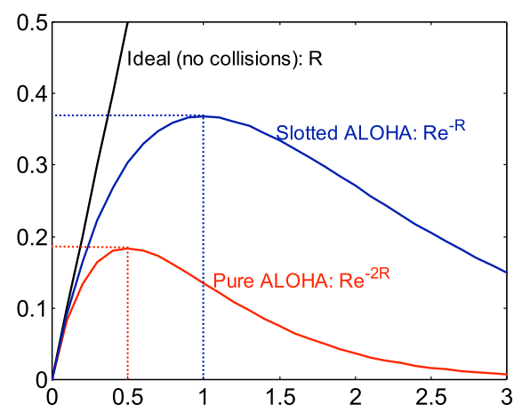
Slotted ALOHA
Protocol
Same as ALOHA, except time is divided into slots
Hosts may only transmit at the beginning of a slot
Thus, frames either collide completely, or not at all
37% throughput vs. 18% for ALOHA
But, hosts must have synchronized clocks
Throughput
Load

Slide 69
802.3 Ethernet
Bytes
7
1
6
6
2
0-1500
0-46
4
Preamble
SF
Source
Dest.
Length
Data
Pad
Checksum
Preamble is 7 bytes of 10101010. Why?
Start Frame (SF) is 10101011
Source and destination are MAC addresses
E.g. 00:45:A5:F3:25:0C
Broadcast: FF:FF:FF:FF:FF:FF
Minimum packet length of 64 bytes, hence the pad
Notes:
7 bytes → allows hosts on the network to

Slide 70
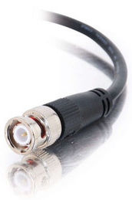

Broadcast Ethernet
Originally, Ethernet was a broadcast technology
Terminator
10Base2
Repeater
Tee Connector
Hubs and repeaters are layer-1 devices, i.e. physical only
10BaseT and 100BaseT
T stands for Twisted Pair
Hub

Slide 71
Carrier Sense Multiple Access (CSMA)
Additional assumption:
Each station is capable of sensing the medium to determine if another transmission is underway

Slide 72
Non-persistent CSMA
While there is a new frame A to send
Check the medium
If the medium is busy, wait some time, and go to 1.
(medium idle) Send frame A

Slide 73
1-persistent CSMA
While there is a new frame A to send
Check the medium
If the medium is busy, go to 1.
(medium idle) Send frame A

Slide 74
p-persistent CSMA
While there is a new frame A to send
Check the medium
If the medium is busy, go to 1.
(medium idle) With probability p send frame A, and probability (1- p) delay one time slot and go to 1.

Slide 75
CSMA Summary
Nonpersistent
1-persistent
p-persistent
CSMA persistence and backoff
Non-persistent:
Transmit if idle
Otherwise, delay, try again
Constant or variable
Delay
Channel busy
Time
Ready
1-persistent:
Transmit as soon as
channel goes idle
If collision, back off and try again
p-persistent:
Transmit as soon as channel goes
idle with probability p
Otherwise, delay one slot, repeat process
Notes:
2

Slide 76
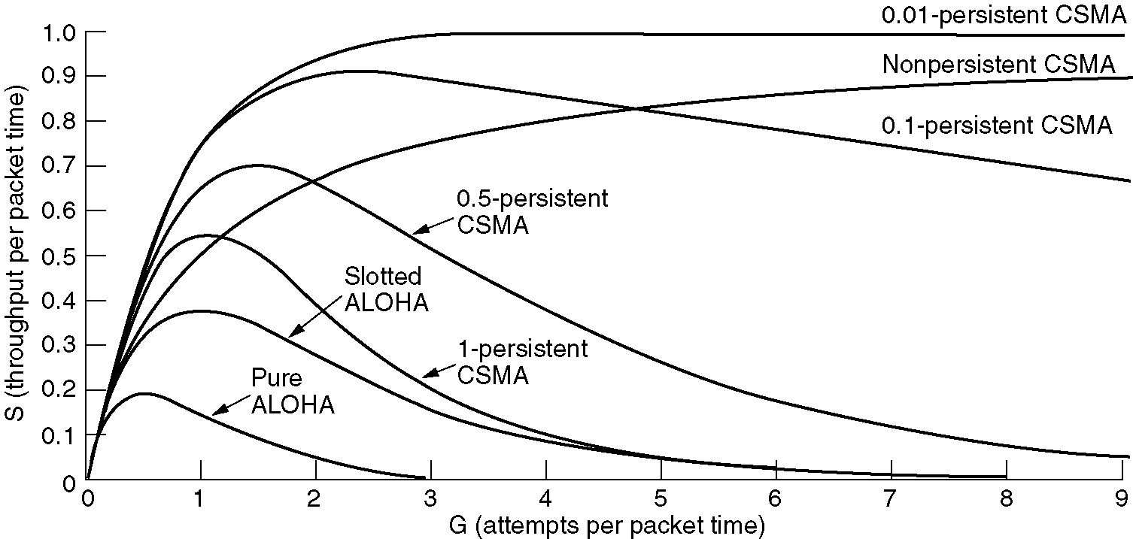
Persistent and Non-persistent CSMA
Comparison of throughput versus load for various random access protocols.

Slide 77
CSMA with Collision Detection
Stations can sense the medium while transmitting
A station aborts its transmission if it senses another transmission is also happening (that is, it detects collision)
Question: When can a station be sure that it has seized the channel?
Minimum time to detect collision is the time it takes for a signal to traverse between two farthest apart stations.

Slide 78
CSMA/CD
A station is said to seize the channel if all the other stations become aware of its transmission.
There has to be a lower bound on the length of each frame for the collision detection feature to work out.
Ethernet uses CSMA/CD

Slide 79
CSMA/CD
Carrier sense multiple access with collision detection
Key insight: wired protocol allows us to sense the medium
Algorithm
Sense for carrier
If carrier is present, wait for it to end
Sending would cause a collision and waste time
Send a frame and sense for collision
If no collision, then frame has been delivered
If collision, abort immediately
Why keep sending if the frame is already corrupted?
Perform exponential backoff then retransmit

Slide 80
CSMA/CD Collisions
Spatial Layout of Hosts
Collisions can occur
Collisions are quickly detected and aborted
Note the role of distance, propagation delay, and frame length
A
B
C
D
t₀
t₁
Time
Detect Collision and Abort

Slide 81
Exponential Backoff
When a sender detects a collision, send “jam signal”
Make sure all hosts are aware of collision
Jam signal is 32 bits long (plus header overhead)
Exponential backoff operates:
Select k ∈ [0, 2^{n} – 1] unif. rnd., where n = number of collisions
Wait k time units (packet times) before retransmission
n is capped at 10, frame dropped after 16 collisions
Backoff time is divided into contention slots
Remember this number

Slide 82
Minimum Packet Sizes
Why is the minimum packet size 64 bytes?
To give hosts enough time to detect collisions
What is the relationship between packet size and cable length?
A
B
Time t: Host A starts transmitting
Time t + d: Host B starts transmitting
Time t + 2*d: collision detected
Propagation Delay (d)
Basic idea: Host A must be transmitting at time 2*d!

Slide 83
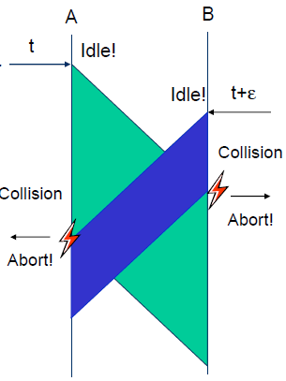
CSMA/CD
CSMA/CD can be in one of three states: contention, transmission, or idle.
To detect all the collisions we need
T_{f} ≥ 2T_{pg}
where T_{f} is the time needed to send the frame
And T_{pg} is the propagation delay between A and B

Slide 84
Minimum Packet Size
Host A must be transmitting after 2*d time units
Min_pkt = rate (b/s) * 2 * d (s)
… but what is d? propagation delay: limited by speed of light
Propagation delay (d) = distance (m) / speed of light (m/s)
This gives:
Min_pkt = rate (b/s) * 2 * dist (m) / speed of light (m/s)
So cable length is equal ….
Dist = min_pkt * light speed /(2 * rate)
10 Mbps Ethernet
Packet and cable lengths change for faster Ethernet standards
(64B*8)*(2.5*10⁸mps)/(2*10⁷bps) = 6400 meters

Slide 85
Cable Length Examples
min_frame_size*light_speed/(2*bandwidth) = max_cable_length
(64B*8)*(2.5*10⁸mps)/(2*10Mbps) = 6400 meters
What is the max cable length if min packet size were changed to 1024 bytes?
102.4 kilometers
What is max cable length if bandwidth were changed to 1 Gbps ?
64 meters
What if you changed min packet size to 1024 bytes and bandwidth to 1 Gbps?
1024 meters

Slide 86
Maximum Packet Size
Maximum Transmission Unit (MTU): 1500 bytes
Pros:
Bit errors in long packets incur significant recovery penalty
Cons:
More bytes wasted on header information
Higher per packet processing overhead
Datacenters shifting towards Jumbo Frames
9000 bytes per packet

Slide 87
Long Live Ethernet
Today’s Ethernet is switched
More on this later
1Gbit and 10Gbit Ethernet now common
100Gbit on the way
Uses same old packet header
Full duplex (send and receive at the same time)
Auto negotiating (backwards compatibility)
Can also carry power

