Slide 1
Computer Networks
Lecture 8: Network layer Part III
Inter Domain Routing
(It’s all about the Money)
Based on slides from D. Choffnes Northeastern U. and P. Gill from StonyBrook University
Revised Autumn 2015 by S. Laki

Slide 2
Distance Vector Routing Algorithm
Wait for change in local link cost or message from neighbor
Recompute distance table
If least cost path to any destination has changed, notify neighbors

Slide 3
Distance Vector Initialization
Node A
Node B
3
B
D
Dest. | Cost | Next
B | 2 | B
C | 7 | C
D | ∞
Dest. | Cost | Next
A | 2 | A
C | 1 | C
D | 3 | D
2
1
1
A
7
C
Initialization:
for all neighbors V do
if V adjacent to A
D(A, V) = c(A,V);
else
D(A, V) = ∞;
…
Node D
Node C
Dest. | Cost | Next
A | 7 | A
B | 1 | B
D | 1 | D
Dest. | Cost | Next
A | ∞
B | 3 | B
C | 1 | C

Slide 4
Distance Vector: 1st Iteration
Node A
Node B
3
B
D
Dest. | Cost | Next
B | 2 | B
C | 7 | C
D | ∞
Dest. | Cost | Next
A | 2 | A
C | 1 | C
D | 3 | D
2
1
1
3
B
A
7
C
5
8
C
B
2
C
…
loop:
…
else if (update D(V, Y) received from V)
for all destinations Y do
if (destination Y through V)
D(A,Y) = D(A,V) + D(V, Y);
else
D(A, Y) =
min(D(A, Y),
D(A, V) + D(V, Y));
if (there is a new min. for dest. Y)
send D(A, Y) to all neighbors
forever
D(A,C) = min(D(A,C), D(A,B)+D(B,C))
= min(7, 2 + 1) = 3
Node C
Node D
D(A,D) = min(D(A,D), D(A,B)+D(B,D))
= min(8, 2 + 3) = 5
D(A,D) = min(D(A,D), D(A,C)+D(C,D))
= min(∞, 7 + 1) = 8
Dest. | Cost | Next
A | 7 | A
B | 1 | B
D | 1 | D
Dest. | Cost | Next
A | ∞
B | 3 | B
C | 1 | C
3
B
4
B

Slide 5
Distance Vector: End of 3rd Iteration
Node A
Node B
3
B
D
Dest. | Cost | Next
B | 2 | B
C | 3 | B
D | 4 | B
Dest. | Cost | Next
A | 2 | A
C | 1 | C
D | 2 | C
2
1
1
A
7
C
…
loop:
…
else if (update D(V, Y) received from V)
for all destinations Y do
if (destination Y through V)
D(A,Y) = D(A,V) + D(V, Y);
else
D(A, Y) =
min(D(A, Y),
D(A, V) + D(V, Y));
if (there is a new min. for dest. Y)
send D(A, Y) to all neighbors
forever
Nothing changes, algorithm terminates
Until something changes…
Node C
Node D
Dest. | Cost | Next
A | 3 | B
B | 1 | B
D | 1 | D
Dest. | Cost | Next
A | 4 | C
B | 2 | C
C | 1 | C

Slide 6
loop:
wait (link cost update or update message)
if (c(A,V) changes by d)
for all destinations Y through V do
D(A,Y) = D(A,Y) + d
else if (update D(V, Y) received from V)
for all destinations Y do
if (destination Y through V)
D(A,Y) = D(A,V) + D(V, Y);
else
D(A, Y) = min(D(A, Y), D(A, V) + D(V, Y));
if (there is a new minimum for destination Y)
send D(A, Y) to all neighbors
forever
B
4
1
1
A
50
C
Link Cost Changes,
Algorithm Starts
Algorithm Terminates
Good news travels fast
D | C | N
A | 4 | A
C | 1 | B
D | C | N
A | 1 | A
C | 1 | B
D | C | N
A | 1 | A
C | 1 | B
D | C | N
A | 1 | A
C | 1 | B
Node B
D | C | N
A | 5 | B
B | 1 | B
D | C | N
A | 5 | B
B | 1 | B
D | C | N
A | 2 | B
B | 1 | B
D | C | N
A | 2 | B
B | 1 | B
Node C
Time
Notes:
Change circles to rectangles, don’t block the text

Slide 7
Count to Infinity Problem
Node B knows D(C, A) = 5
However, B does not know the path is C → B → A
Thus, D(B,A) = 6 !
B
4
60
1
A
C
Bad news travels slowly
50
D | C | N
A | 4 | A
C | 1 | B
D | C | N
A | 6 | C
C | 1 | B
D | C | N
A | 6 | C
C | 1 | B
D | C | N
A | 8 | C
C | 1 | B
Node B
D | C | N
A | 5 | B
B | 1 | B
D | C | N
A | 5 | B
B | 1 | B
D | C | N
A | 7 | B
B | 1 | B
D | C | N
A | 7 | B
B | 1 | B
Node C
Time

Slide 8
Poisoned Reverse
If C routes through B to get to A
C tells B that D(C, A) = ∞
Thus, B won’t route to A via C
B
4
60
1
A
50
C
D | C | N
A | 4 | A
C | 1 | B
D | C | N
A | 60 | A
C | 1 | B
D | C | N
A | 60 | A
C | 1 | B
D | C | N
A | 51 | C
C | 1 | B
Node B
D | C | N
A | 5 | B
B | 1 | B
D | C | N
A | 5 | B
B | 1 | B
D | C | N
A | 50 | A
B | 1 | B
D | C | N
A | 50 | A
B | 1 | B
Node C
Time

Slide 9
Outline
Distance Vector Routing
RIP
Link State Routing
OSPF
IS-IS

Slide 10

Link State Routing
Each node knows its connectivity and cost to direct neighbors
Each node tells every other node this information
Each node learns complete network topology
Use Dijkstra to compute shortest paths
Notes:
Why can we get away with this

Slide 11
Flooding Details
Each node periodically generates Link State Packet
ID of node generating the LSP
List of direct neighbors and costs
Sequence number (64-bit, assumed to never wrap)
Time to live
Flood is reliable (ack + retransmission)
Sequence number “versions” each LSP
Receivers flood LSPs to their own neighbors
Except whoever originated the LSP
LSPs also generated when link states change

Slide 12
Dijkstra’s Algorithm
Step | Start S | →B | →C | →D | →E | →F
0 | A | 2, A | 5, A | 1, A | ∞ | ∞
1 | AD |  | 4, D |  | 2, D | ∞
2 | ADE |  | 3, E |  |  | 4, E
3 | ADEB
4 | ADEBC
5 | ADEBCF
5
…
Loop
find w not in S s.t. D(w) is a minimum;
add w to S;
update D(v) for all v adjacent
to w and not in S:
D(v) = min( D(v), D(w) + c(w,v) );
until all nodes in S;
3
Initialization:
S = {A};
for all nodes v
if v adjacent to A
then D(v) = c(A,v);
else D(v) = ∞;
…
B
C
5
2
A
2
1
F
3
1
2
D
E
1

Slide 13
OSPF vs. IS-IS
Two different implementations of link-state routing
OSPF
IS-IS
Favored by companies, datacenters
More optional features
Built on top of IPv4
LSAs are sent via IPv4
OSPFv3 needed for IPv6
Favored by ISPs
Less “chatty”
Less network overhead
Supports more devices
Not tied to IP
Works with IPv4 or IPv6

Slide 14
Different Organizational Structure
OSPF
IS-IS
Organized around overlapping areas
Area 0 is the core network
Organized as a 2-level hierarchy
Level 2 is the backbone
Area 1
Area 2
Level 1
Level 1-2
Level 2
Area 0
Area 4
Area 3

Slide 15
Link State vs. Distance Vector
 | Link State | Distance Vector
Message Complexity | O(n²*e) | O(d*n*k)
Time Complexity | O(n*log n) | O(n)
Convergence Time | O(1) | O(k)
Robustness | Nodes may advertise incorrect link costs Each node computes their own table | Nodes may advertise incorrect path cost Errors propagate due to sharing of DV tables
Which is best?
In practice, it depends.
In general, link state is more popular.
n = number of nodes in the graph
d = degree of a given node
k = number of rounds

Slide 16
Network Layer, Control Plane
Function:
Set up routes between networks
Key challenges:
Implementing provider policies
Creating stable paths
Data Plane
Application
Presentation
Session
Transport
Network
RIP
OSPF
BGP
Control Plane
Data Link
Physical

Slide 17
Outline
BGP Basics
Stable Paths Problem
BGP in the Real World
Debugging BGP Path Problems

Slide 18


ASs, Revisited
AS-1
AS-3
Interior Routers
AS-2
BGP Routers

Slide 19
AS Numbers
Each AS identified by an ASN number
16-bit values (latest protocol supports 32-bit ones)
64512 – 65535 are reserved
Currently, there are ~ 40000 ASNs
AT&T: 5074, 6341, 7018, …
Sprint: 1239, 1240, 6211, 6242, …
ELTE: 2012
Google 15169, 36561 (formerly YT), + others
Facebook 32934
North America ASs → ftp://ftp.arin.net/info/asn.txt

Slide 20
Inter-Domain Routing
Global connectivity is at stake!
Thus, all ASs must use the same protocol
Contrast with intra-domain routing
What are the requirements?
Scalability
Flexibility in choosing routes
Cost
Routing around failures
Question: link state or distance vector?
Trick question: BGP is a path vector protocol

Slide 21
BGP
Border Gateway Protocol
De facto inter-domain protocol of the Internet
Policy based routing protocol
Uses a Bellman-Ford path vector protocol
Relatively simple protocol, but…
Complex, manual configuration
Entire world sees advertisements
Errors can screw up traffic globally
Policies driven by economics
How much $$$ does it cost to route along a given path?
Not by performance (e.g. shortest paths)

Slide 22
BGP Relationships
Provider
Peer 2 has no incentive to route 1→ 3
Peers do not pay each other
$
Customer
Provider
Customer
Peer 1
Peer 2
Peer 3
Customer pays provider
Customer

Slide 23
Tier-1 ISP Peering
Inteliquent
Centurylink
Verizon Business
AT&T
So you want to be a tier 1 network?
All you have to do is get all the other tier 1s to peer with you!
(not that easy ☺)
Level 3
Sprint
XO Communications

Slide 24
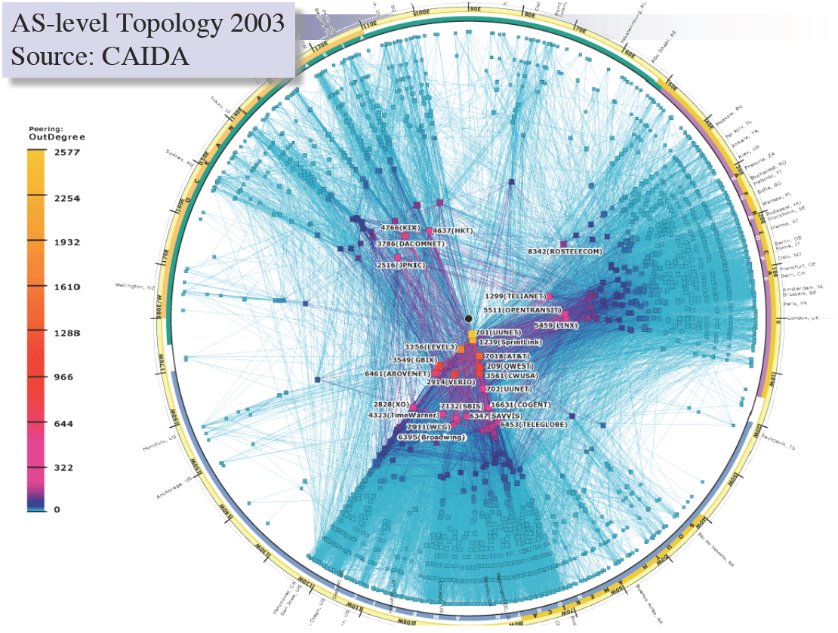

Slide 25
Peering Wars
Peer
Don’t Peer
Reduce upstream costs
Improve end-to-end performance
May be the only way to connect to parts of the Internet
You would rather have customers
Peers are often competitors
Peering agreements require periodic renegotiation
Peering struggles in the ISP world are extremely contentious agreements are usually confidential
Example: If you are a customer of my peer why should I peer with you? You should pay me too!
Incentive to keep relationships private!

Slide 26
Two Types of BGP Neighbors
Exterior routers also speak IGP
IGP
eBGP
eBGP
iBGP
iBGP

Slide 27
Full iBGP Meshes
Question: why do we need iBGP?
OSPF does not include BGP policy info
Prevents routing loops within the AS
iBGP updates do not trigger announcements
eBGP
iBGP

Slide 28
Path Vector Protocol
AS-path: sequence of ASs a route traverses
Like distance vector, plus additional information
Used for loop detection and to apply policy
E.g., pick cheapest/shortest path
Routing done based on longest prefix match
AS 4
120.10.0.0/16
AS 3
130.10.0.0/16
AS 5
AS 2
110.10.0.0/16
120.10.0.0/16: AS 2 → AS 3 → AS 4
130.10.0.0/16: AS 2 → AS 3
110.10.0.0/16: AS 2 → AS 5
AS 1

Slide 29

Path-Vector Routing
Extension of distance-vector routing
Support flexible routing policies
Avoid count-to-infinity problem
Key idea: advertise the entire path
Distance vector: send distance metric per dest d
Path vector: send the entire path for each dest d
“d: path (2,1)”
“d: path (1)”
3
2
1
data traffic
data traffic
d

Slide 30
Flexible Policies
Each node can apply local policies
Path selection: Which path to use?
Path export: Which paths to advertise?
Examples
Node 2 may prefer the path “2, 3, 1” over “2, 1”
Node 1 may not let node 3 hear the path “1, 2”
2
3
1

Slide 31
BGP Operations (Simplified)
Establish session on TCP port 179
AS-1
Exchange active routes
BGP Session
AS-2
Exchange incremental updates

Slide 32
Four Types of BGP Messages
Open: Establish a peering session.
Keep Alive: Handshake at regular intervals.
Notification: Shuts down a peering session.
Update: Announce new routes or withdraw previously announced routes.
announcement = IP prefix + attributes values

Slide 33
BGP Attributes
Attributes used to select “best” path
LocalPref
Local preference policy to choose most preferred route
Overrides default fewest AS behavior
Multi-exit Discriminator (MED)
Specifies path for external traffic destined for an internal network
Chooses peering point for your network
Import Rules
What route advertisements do I accept?
Export Rules
Which routes do I forward to whom?

Slide 34
Shortest AS Path != Shortest Path
4 hops
4 ASs
9 hops
2 ASs
Source
?
?
Destination

Slide 35
Hot Potato Routing
Pick the next hop with the shortest IGP route
Source
?
?
Destination

Slide 36
Importing Routes
From Provider
ISP Routes
From Peer
From Peer
From Customer

Slide 37
Exporting Routes
$$$ generating routes
Customer and ISP routes only
To Provider
To Peer
To Peer
To Customer
Customers get all routes

Slide 38

Modeling BGP
AS relationships
Customer/provider
Peer
Sibling, IXP
Gao-Rexford model
AS prefers to use customer path, then peer, then provider
Follow the money!
Valley-free routing
Hierarchical view of routing (incorrect but frequently used)
P-P
P-P
C-P
P-C
P-C
P-P

Slide 39
AS Relationships: It’s Complicated
GR Model is strictly hierarchical
Each AS pair has exactly one relationship
Each relationship is the same for all prefixes
In practice it’s much more complicated
Rise of widespread peering
Regional, per-prefix peerings
Tier-1’s being shoved out by “hypergiants”
IXPs dominating traffic volume
Modeling is very hard, very prone to error
Huge potential impact for understanding Internet behavior

Slide 40
Other BGP Attributes
AS_SET
Instead of a single AS appearing at a slot, it’s a set of Ases
Communities
Arbitrary number that is used by neighbors for routing decisions
Export this route only in Europe
Do not export to your peers
Usually stripped after first interdomain hop
Why?
Prepending
Lengthening the route by adding multiple instances of ASN
Why?

Slide 41
Outline
BGP Basics
Stable Paths Problem
BGP in the Real World
Debugging BGP Path Problems

Slide 42
The Stable Paths Problem
An instance of the SPP:
Graph of nodes and edges
Node 0, called the origin
A set of permitted paths from each node to the origin
Each set of paths is ranked
2 1 0
2 0
5
5 2 1 0
2
2
4 2 0
4 3 0
4
0
1
3
3 0
1 3 0
1 0

Slide 43
A Solution to the SPP
A solution is an assignment of permitted paths to each node such that:
Node u’s path is either null or uwP, where path wP is assigned to node w and edge u → w exists
Each node is assigned the highest ranked path that is consistent with their neighbors
2 1 0
2 0
5
5 2 1 0
2
2
Solutions need not use the shortest paths, or form a spanning tree
4 2 0
4 3 0
4
0
1
3
3 0
1 3 0
1 0

Slide 44
Simple SPP Example
1 0
1 3 0
2 0
2 1 0
1
2
2
Each node gets its preferred route
Totally stable topology
0
3
4
3 0
4 3 0
4 2 0
4 2 0
4 3 0

Slide 45
Good Gadget
1 3 0
1 0
2 1 0
2 0
1
2
2
Not every node gets preferred route
Topology is still stable
Only one stable configuration
No matter which node chooses first!
0
3
4
3 0
4 3 0
4 2 0

Slide 46
SPP May Have Multiple Solutions
1 2 0
1 0
1 2 0
1 0
1 2 0
1 0
1
1
1
0
0
0
2
2
2
2 1 0
2 0
2 1 0
2 0
2 1 0
2 0

Slide 47
Bad Gadget
1 3 0
1 0
2 1 0
2 0
That was only one round of oscillation!
This keeps going, infinitely
Problem stems from:
Local (not global) decisions
Ability of one node to improve its path selection
1
2
2
0
3
4
3 4 2 0
3 0
4 2 0
4 3 0

Slide 48
SPP Explains BGP Divergence
BGP is not guaranteed to converge to stable routing
Policy inconsistencies may lead to “livelock”
Protocol oscillation
Solvable
Can Diverge
Good Gadgets
Bad Gadgets
Must
Converge
Must
Diverge
Naughty Gadgets

Slide 49
Beware of Backup Policies
1 3 0
1 0
2 1 0
2 0
1
2
2
BGP is not robust
It may not recover from link failure
0
3
4
3 4 2 0
3 0
4 0
4 2 0
4 3 0

Slide 50
BGP is Precarious
If node 1 uses path 1 → 0, this is solvable
4 3 1 0
4 5 3 1 2 0
4 3 1 2 0
1 2 0
1 0
4
1
3 1 0
3 1 2 0
3
No longer stable
0
5
6
2
5 3 1 0
5 6 3 1 2 0
5 3 1 2 0
6 3 1 0
6 4 3 1 2 0
6 3 1 2 0
2 1 0
2 0

Slide 51
Can BGP Be Fixed?
Unfortunately, SPP is NP-complete
Possible Solutions
Static Approach
Dynamic Approach
Extend BGP to
detect and suppress
policy-based oscillations?
Automated Analysis
of Routing Policies
(This is very hard)
Inter-AS
coordination
These approaches are complementary

Slide 52
Transport Layer
Function:
Demultiplexing of data streams
Optional functions:
Creating long lived connections
Reliable, in-order packet delivery
Error detection
Flow and congestion control
Key challenges:
Detecting and responding to congestion
Balancing fairness against high utilization
Application
Presentation
Session
Transport
Network
Data Link
Physical

Slide 53
Outline
UDP
TCP
Congestion Control
Evolution of TCP
Problems with TCP

Slide 54



The Case for Multiplexing
Datagram network
No circuits
No connections
Clients run many applications at the same time
Who to deliver packets to?
IP header “protocol” field
8 bits = 256 concurrent streams
Insert Transport Layer to handle demultiplexing
Transport
Network
Data Link
Physical
Packet

Slide 55


Demultiplexing Traffic
Server applications communicate with multiple clients
Host 1
Host 2
Host 3
Unique port for each application
Application
Applications share the same network
Transport
P1
P2
P3
P4
P5
P6
P7
Network
Endpoints identified by <src_ip, src_port, dest_ip, dest_port>

Slide 56
Layering, Revisited
Layers communicate peer-to-peer
Host 1
Router
Host 2
Application
Application
Transport
Transport
Network
Network
Network
Data Link
Data Link
Data Link
Physical
Physical
Physical
Lowest level end-to-end protocol
Transport header only read by source and destination
Routers view transport header as payload

Slide 57
User Datagram Protocol (UDP)
0
16
31
Source Port
Destination Port
Payload Length
Checksum
Simple, connectionless datagram
C sockets: SOCK_DGRAM
Port numbers enable demultiplexing
16 bits = 65535 possible ports
Port 0 is invalid
Checksum for error detection
Detects (some) corrupt packets
Does not detect dropped, duplicated, or reordered packets

Slide 58
Uses for UDP
Invented after TCP
Why?
Not all applications can tolerate TCP
Custom protocols can be built on top of UDP
Reliability? Strict ordering?
Flow control? Congestion control?
Examples
RTMP, real-time media streaming (e.g. voice, video)
Facebook datacenter protocol

