Slide 1
Computer Networks
Lecture 8: Interconnecting LANs
Based on slides from D. Choffnes Northeastern U. and P. Gill from StonyBrook University
Revised Autumn 2015 by S. Laki

Slide 2
Just Above the Data Link Layer
Bridging
How do we connect LANs?
Function:
Route packets between LANs
Key challenges:
Plug-and-play, self configuration
How to resolve loops
Application
Presentation
Session
Transport
Network
Data Link
Physical

Slide 3
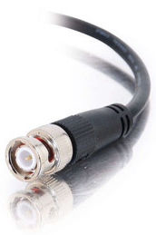

Recap
Originally, Ethernet was a broadcast technology
Terminator
Repeater
Tee Connector
Pros: Simplicity
Hardware is stupid and cheap
Cons: No scalability
More hosts = more collisions = pandemonium
Hub

Slide 4

Bridging the LANs
Hub
Hub
Bridging limits the size of collision domains
Vastly improves scalability
Question: could the whole Internet be one bridging domain?
Tradeoff: bridges are more complex than hubs
Physical layer device vs. data link layer device
Need memory buffers, packet processing hardware, routing tables

Slide 5
Bridges
Original form of Ethernet switch
Connect multiple IEEE 802 LANs at layer 2
Goals
Reduce the collision domain
Complete transparency
“Plug-and-play,” self-configuring
No hardware of software changes on hosts/hubs
Should not impact existing LAN operations
Forwarding of frames
Learning of (MAC) Addresses
Spanning Tree Algorithm (to handle loops)
Hub

Slide 6
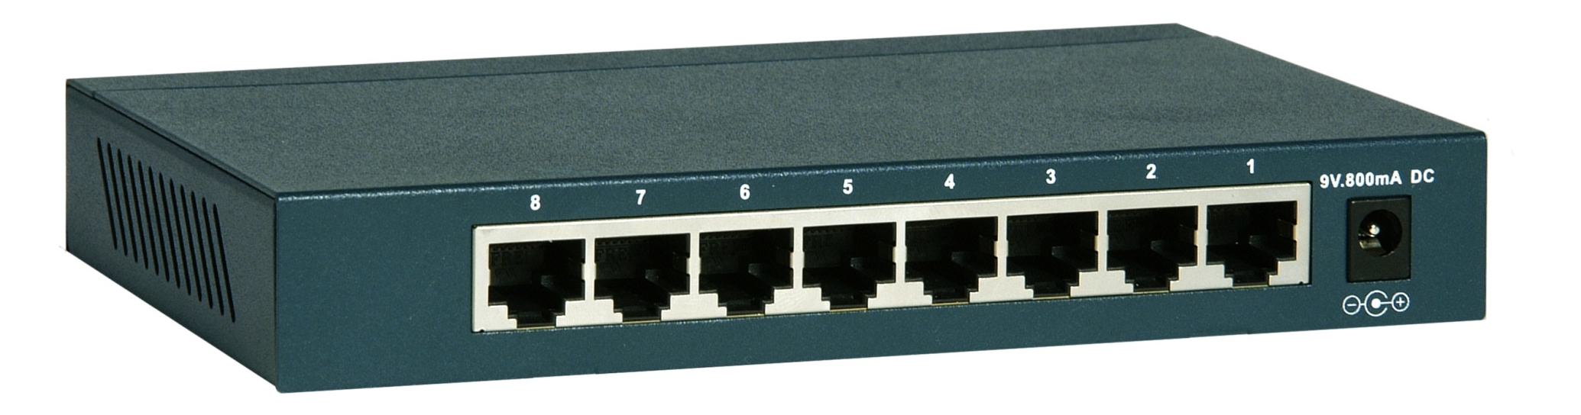
Frame Forwarding Tables
Each bridge maintains a forwarding table
MAC Address | Port | Age
00:00:00:00:00:AA | 1 | 1 minute
00:00:00:00:00:BB | 2 | 7 minutes
00:00:00:00:00:CC | 3 | 2 seconds
00:00:00:00:00:DD | 1 | 3 minutes

Slide 7
Learning Addresses
Manual configuration is possible, but…
Time consuming
Error Prone
Not adaptable (hosts may get added or removed)
Instead, learn addresses using a simple heuristic
Look at the source of frames that arrive on each port
Delete old entries after a timeout
MAC Address | Port | Age
00:00:00:00:00:AA | 1 | 0 minutes
00:00:00:00:00:AA
00:00:00:00:00:BB | 2 | 0 minutes
Port 1
Port 2
Hub
00:00:00:00:00:BB

Slide 8
The Danger of Loops
<Src=AA, Dest=DD>
This continues to infinity
How do we stop this?
Remove loops from the topology
Without physically unplugging cables
802.1 (LAN architecture) uses an algorithm to build and maintain a spanning tree for routing
CC
DD
Hub
Port 2
Port 2
AA | 1
AA | 2
AA | 1
AA | 1
AA | 2
AA | 1
Port 1
Port 1
Hub
AA
BB

Slide 9
Spanning Tree Definition
A subset of edges in a graph that:
Span all nodes
Do not create any cycles
This structure is a tree
5
1
1
2
2
3
3
4
6
2
5
3
5
4
1
4
6
7
6
7
7

Slide 10
802.1 Spanning Tree Approach
Elect a bridge to be the root of the tree
Every bridge finds shortest path to the root
Union of these paths becomes the spanning tree
Bridges exchange Configuration Bridge Protocol Data Units (BPDUs) to build the tree
Used to elect the root bridge
Calculate shortest paths
Locate the next hop closest to the root, and its port
Select ports to be included in the spanning trees

Slide 11
Determining the Root
Initially, all hosts assume they are the root
Bridges broadcast BPDUs:
Based on received BPDUs, each switch chooses:
A new root (smallest known Root ID)
A new root port (what interface goes towards the root)
A new designated bridge (who is the next hop to root)
Bridge ID
Root ID
Path Cost to Root

Slide 12
Spanning Tree Construction
3: 0/2
0: 0/0
12: 0/1
3: 3/0
12: 12/0
41: 3/1
27: 0/1
41: 0/2
27: 27/0
41: 41/0
68: 3/2
68: 9/1
9: 3/2
68: 0/3
9: 0/3
68: 68/0
9: 9/0

Slide 13
Bridges vs. Switches
Bridges make it possible to increase LAN capacity
Reduces the amount of broadcast packets
No loops
Switch is a special case of a bridge
Each port is connected to a single host
Either a client machine
Or another switch
Links are full duplex
Simplified hardware: no need for CSMA/CD!
Can have different speeds on each port

Slide 14
Switching the Internet
Capabilities of switches:
Network-wide routing based on MAC addresses
Learn routes to new hosts automatically
Resolve loops
Could the whole Internet be one switching domain?
NO
Notes:
Flooding packets until routes figured out
No load balancing
Addressing!

Slide 15
Limitations of MAC Routing
Inefficient
Flooding packets to locate unknown hosts
Poor Performance
Spanning tree does not balance load
Hot spots
Extremely Poor Scalability
Every switch needs every MAC address on the Internet in its routing table!
IP addresses these problems (next …)

Slide 16
Computer Networks
Lecture 8: Network Layer
Based on slides from D. Choffnes Northeastern U. and P. Gill from StonyBrook University
Revised Autumn 2015 by S. Laki

Slide 17
Network Layer
Function:
Route packets end-to-end on a network, through multiple hops
Key challenge:
How to represent addresses
How to route packets
Scalability
Convergence
Application
Presentation
Session
Transport
Network
Data Link
Physical

Slide 18

Routers, Revisited
How to connect multiple LANs?
LANs may be incompatible
Ethernet, Wifi, etc…
Connected networks form an internetwork
The Internet is the best known example
Routers

Slide 19
Internetworking Issues
Internet Service Model
Best-effort (i.e. things may break)
Store-and-forward datagram network
Lowest common denominator
Naming / Addressing
How do you designate hosts?
Routing
Must be scalable (i.e. a switched Internet won’t work)
Service Model
What gets sent?
How fast will it go?
What happens if there are failures?
Must deal with heterogeneity
Remember, every network is different

Slide 20
Outline
Addressing
Class-based
CIDR
IPv4 Protocol Details
Packed Header
Fragmentation
IPv6

Slide 21
Possible Addressing Schemes
Flat
e.g. each host is identified by a 48-bit MAC address
Router needs an entry for every host in the world
Too big
Too hard to maintain (hosts come and go all the time)
Too slow (more later)
Hierarchy
Addresses broken down into segments
Each segment has a different level of specificity
Notes:
If time, show correlation between lookup speed and maximum line rate

Slide 22
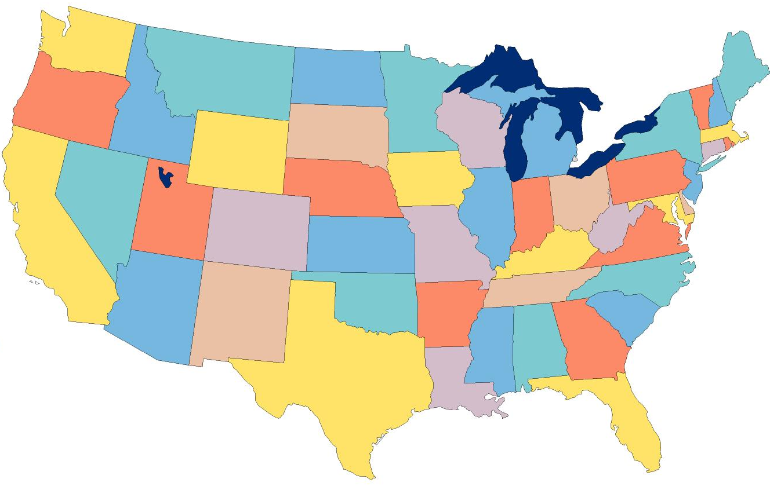
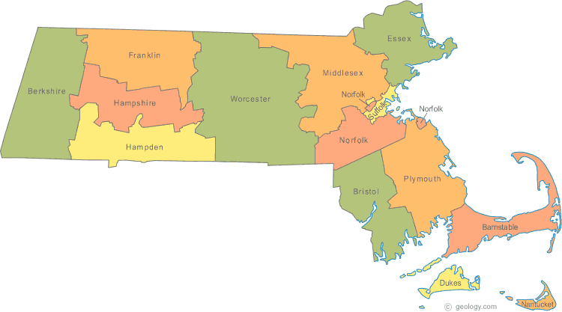

Example: Telephone Numbers
1-617-373-1234
3278
Very General
West Village H
Room 256
West Village G
Room 1234
Updates are Local
Very Specific

Slide 23
Binary Hierarchy Example
1**
Datagram, Destination = 101
10*
100
101
11*
0**
110
00*
111
000
001
01*
010
011

Slide 24
IP Addressing
IPv4: 32-bit addresses
Usually written in dotted notation, e.g. 192.168.21.76
Each number is a byte
0
8
16
24
31
Decimal
192
168
21
76
Hex
C0
A8
15
4C
Binary
11000000
10101000
00010101
01001100

Slide 25
IP Addressing and Forwarding
Routing Table Requirements
For every possible IP, give the next hop
But for 32-bit addresses, 2³² possibilities!
Hierarchical address scheme
Separate the address into a network and a host
0
31
Pfx
Network
Host
Known by all routers
Known by edge (LAN) routers

Slide 26
Classes of IP Addresses
0
1
8
16
24
31
Class A
0
Ntwk
Host
Example: MIT
18.*.*.*
1-126
0
2
8
16
24
31
Class B
10
Network
Host
Example: NEU
129.10.*.*
128-191
0
3
8
16
24
31
Class C
110
Network
Host
Example:
216.63.78.*
192-223

Slide 27

How Do You Get IPs?
IP address ranges controlled by IANA
Internet Assigned Number Authority
Roots go back to 1972, ARPANET, UCLA
Today, part of ICANN
IANA grants IPs to regional authorities
ARIN (American Registry of Internet Numbers) may grant you a range of IPs
You may then advertise routes to your new IP range
There are now secondary markets, auctions, …

Slide 28
Two Level Hierarchy
Pfx
Network
Host
…
Subtree size determined by network class
…

Slide 29
Class Sizes
Way too big
Class | Prefix Bits | Network Bits | Number of Classes | Hosts per Class
A | 1 | 7 | 2⁷ – 2 = 126 (0 and 127 are reserved) | 2²⁴ – 2 = 16,777,214 (All 0 and all 1 are reserved)
B | 2 | 14 | 2¹⁴ = 16,398 | 2¹⁶ – 2 = 65,534 (All 0 and all 1 are reserved)
C | 3 | 21 | 2²¹ = 2,097,512 | 2⁸ – 2 = 254 (All 0 and all 1 are reserved)
 |  |  | Total: 2,114,036
Too many network IDs
Too small to be useful

Slide 30
Subnets
Problem: need to break up large A and B classes
Solution: add another layer to the hierarchy
From the outside, appears to be a single network
Only 1 entry in routing tables
Internally, manage multiple subnetworks
Split the address range using a subnet mask
Pfx
Ntwk
Subnet
Host
Subnet Mask:
11111111 11111111 11000000 00000000

Slide 31
Subnet Example
Extract network:
IP Address:
10110101 11011101 01010100 01110010
Subnet Mask:
& 11111111 11111111 11000000 00000000
Result:
10110101 11011101 01000000 00000000
Extract host:
IP Address:
10110101 11011101 01010100 01110010
Subnet Mask:
& ~(11111111 11111111 11000000 00000000)
Result:
00000000 00000000 00010100 01110010

Slide 32
N-Level Subnet Hierarchy
Pfx
Network
Subnet
Host
…
Tree does not have a fixed depth
Increasingly specific subnet masks
…
Subtree size determined by length of subnet mask
…

Slide 33
Example Routing Table
Address Pattern | Subnet Mask | Destination Router
0.0.0.0 | 0.0.0.0 | Router 4
18.0.0.0 | 255.0.0.0 | Router 2
128.42.0.0 | 255.255.0.0 | Router 3
128.42.128.0 | 255.255.128.0 | Router 5
128.42.222.0 | 2555.255.255.0 | Router 1
Question: 128.42.222.198 matches four rows
Which router do we forward to?
Longest prefix matching
Use the row with the longest number of 1’s in the mask
This is the most specific match

Slide 34
Subnetting Revisited
Question: does subnetting solve all the problems of class-based routing?
NO
Classes are still too coarse
Class A can be subnetted, but only 126 available
Class C is too small
Class B is nice, but there are only 16,398 available
Routing tables are still too big
2.1 million entries per router

Slide 35
Classless Inter Domain Routing
CIDR, pronounced ‘cider’
Key ideas:
Get rid of IP classes
Use bitmasks for all levels of routing
Aggregation to minimize FIB (forwarding information base)
Arbitrary split between network and host
Specified as a bitmask or prefix length
Example: Stony Brook
130.245.0.0 with netmask 255.255.0.0
130.245.0.0 / 16

Slide 36
Aggregation with CIDR
Original use: aggregating class C ranges
One organization given contiguous class C ranges
Example: Microsoft, 207.46.192.* – 207.46.255.*
Represents 2⁶ = 64 class C ranges
Specified as CIDR address 207.46.192.0/18
0
8
16
24
31
Decimal
207
46
192
0
Hex
CF
2E
C0
00
Binary
11001111
00101110
11xxxxxx
xxxxxxxx
18 Bits Frozen By Netmask
14 Arbitrary Bits

Slide 37
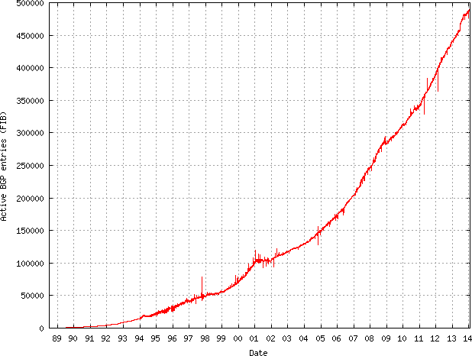
Size of CIDR Routing Tables
From www.cidr-report.org
CIDR has kept IP routing table sizes in check
Currently ~500,000 entries for a complete IP routing table
Only required by backbone routers

Slide 38
We had a special day in summer 2014!
512K day – August 12, 2014
Default threshold size for IPv4 route data in older Cisco routers → 512K routes
Some routers failed over to slower memory
RAM vs. CAM (content addressable memory)
Some routes dropped
Cisco issues update in May anticipating this issue
Reallocated some IPv6 space for IPv4 routes
Part of the cause
Growth in emerging markets
http://cacm.acm.org/news/178293-internet-routing-failures-bring-architecture-changes-back-to-the-table/fulltext

Slide 39
Takeaways
Hierarchical addressing is critical for scalability
Not all routers need all information
Limited number of routers need to know about changes
Non-uniform hierarchy useful for heterogeneous networks
Class-based addressing is too course
CIDR improves scalability and granularity
Implementation challenges
Longest prefix matching is more difficult than schemes with no ambiguity

Slide 40
Outline
Addressing
Class-based
CIDR
IPv4 Protocol Details
Packed Header
Fragmentation
IPv6

Slide 41
IP Datagrams
IP Datagrams are like a letter
Totally self-contained
Include all necessary addressing information
No advanced setup of connections or circuits
0
4
8
12
16
19
24
31
Version
HLen
DSCP/ECN
Datagram Length
Identifier
Flags
Offset
TTL
Protocol
Checksum
Source IP Address
Destination IP Address
Options (if any, usually not)
Data

Slide 42
IP Header Fields: Word 1
Version: 4 for IPv4
Header Length: Number of 32-bit words (usually 5)
Type of Service: Priority information (unused)
Datagram Length: Length of header + data in bytes
0
4
8
12
16
19
24
31
Version
HLen
DSCP/ECN
Datagram Length
Identifier
Flags
Offset
TTL
Protocol
Checksum
Limits packets to 65,535 bytes
Source IP Address
Destination IP Address
Options (if any, usually not)
Data

Slide 43
IP Header Fields: Word 3
Time to Live: decremented by each router
Used to kill looping packets
Protocol: ID of encapsulated protocol
6 = TCP, 17 = UDP
Checksum
0
4
8
12
16
19
24
31
Version
HLen
DSCP/ECN
Datagram Length
Identifier
Flags
Offset
TTL
Protocol
Checksum
Source IP Address
Used to implement trace route
Destination IP Address
Options (if any, usually not)
Data

Slide 44
IP Header Fields: Word 4 and 5
Source and destination address
In theory, must be globally unique
In practice, this is often violated
0
4
8
12
16
19
24
31
Version
HLen
DSCP/ECN
Datagram Length
Identifier
Flags
Offset
TTL
Protocol
Checksum
Source IP Address
Destination IP Address
Options (if any, usually not)
Data

Slide 45
Problem: Fragmentation
MTU = 4000
MTU = 2000
MTU = 1500
Datagram
Dgram1
Dgram2
1
2
3
4
Problem: each network has its own MTU
DARPA principles: networks allowed to be heterogeneous
Minimum MTU may not be known for a given path
IP Solution: fragmentation
Split datagrams into pieces when MTU is reduced
Reassemble original datagram at the receiver

Slide 46
IP Header Fields: Word 2
Identifier: a unique number for the original datagram
Flags: M flag, i.e. this is the last fragment
Offset: byte position of the first byte in the fragment
Divided by 8
0
4
8
12
16
19
24
31
Version
HLen
TOS
Datagram Length
Identifier
Flags
Offset
TTL
Protocol
Checksum
Source IP Address
Destination IP Address
Options (if any, usually not)
Data

Slide 47
Fragmentation Example
MTU = 4000
MTU = 2000
MTU = 1500
Length = 2000, M = 1
Offset = 0
IP
Data
Length = 3820, M = 0
20
1980
IP Hdr
Data
3800
1980
+ 1820
= 3800
20
Length = 1840, M = 0
Offset = 1980
IP
Data
20
1820

Slide 48
Fragmentation Example
MTU = 2000
MTU = 1500
Length = 2000, M = 1
Offset = 0
Length = 1500, M = 1
Offset = 0
IP
Data
IP
Data
Length = 1500, M = 1
Offset = 1980
20
1980
20
1480
IP
Data
Length = 520, M = 1
Offset = 1480
1480
+ 500
= 1980
20
1480
Length = 1840, M = 0
Offset = 1980
IP
Data
Length = 360, M = 0
Offset = 3460
IP
Data
20
500
IP
Data
20
1820
20
340

Slide 49
IP Fragment Reassembly
Length = 1500, M = 1, Offset = 0
Performed at destination
M = 0 fragment gives us total data size
360 – 20 + 3460 = 3800
Challenges:
Out-of-order fragments
Duplicate fragments
Missing fragments
Basically, memory management nightmare
IP
Data
20
1480
Length = 520, M = 1, Offset = 1480
IP
Data
20
500
Length = 1500, M = 1, Offset = 1980
IP
Data
20
1480
Length = 360, M = 0, Offset = 3460
IP
Data
20
340

Slide 50
Fragmentation Concepts
Highlights many key Internet characteristics
Decentralized and heterogeneous
Each network may choose its own MTU
Connectionless datagram protocol
Each fragment contains full routing information
Fragments can travel independently, on different paths
Best effort network
Routers/receiver may silently drop fragments
No requirement to alert the sender
Most work is done at the endpoints
i.e. reassembly

Slide 51
Fragmentation in Reality
Fragmentation is expensive
Memory and CPU overhead for datagram reconstruction
Want to avoid fragmentation if possible
MTU discovery protocol
Send a packet with “don’t fragment” bit set
Keep decreasing message length until one arrives
May get “can’t fragment” error from a router, which will explicitly state the supported MTU
Router handling of fragments
Fast, specialized hardware handles the common case
Dedicated, general purpose CPU just for handling fragments

Slide 52
Outline
Addressing
Class-based
CIDR
IPv4 Protocol Details
Packed Header
Fragmentation
IPv6

Slide 53
The IPv4 Address Space Crisis
Problem: the IPv4 address space is too small
2³² = 4,294,967,296 possible addresses
Less than one IP per person
Parts of the world have already run out of addresses
IANA assigned the last /8 block of addresses in 2011
Region | Regional Internet Registry (RIR) | Exhaustion Date
Asia/Pacific | APNIC | April 19, 2011
Europe/Middle East | RIPE | September 14, 2012
North America | ARIN | 13 Jan 2015 (Projected)
South America | LACNIC | 13 Jan 2015 (Projected)
Africa | AFRINIC | 17 Jan 2022(Projected)

Slide 54
IPv6
IPv6, first introduced in 1998(!)
128-bit addresses
4.8 * 10²⁸ addresses per person
Address format
8 groups of 16-bit values, separated by ‘:’
Leading zeroes in each group may be omitted
Groups of zeroes can be omitted using ‘::’
2001:0db8:0000:0000:0000:ff00:0042:8329
2001:0db8:0:0:0:ff00:42:8329
2001:0db8::ff00:42:8329

Slide 55
IPv6 Trivia
Who knows the IP for localhost?
127.0.0.1
What is localhost in IPv6?
::1

Slide 56
IPv6 Header
Double the size of IPv4 (320 bits vs. 160 bits)
0
4
8
12
16
19
24
31
Version
DSCP/ECN
Flow Label
Datagram Length
Next Header
Hop Limit
Version = 6
Same as IPv4
Groups packets into flows, used for QoS
Source IP Address
Same as IPv4
Same as Protocol in IPv4
Same as TTL in IPv4
Destination IP Address

Slide 57
Differences from IPv4 Header
Several header fields are missing in IPv6
Header length – rolled into Next Header field
Checksum – was useless, so why keep it
Identifier, Flags, Offset
IPv6 routers do not support fragmentation
Hosts are expected to use path MTU discovery
Reflects changing Internet priorities
Today’s networks are more homogeneous
Instead, routing cost and complexity dominate

Slide 58
Performance Improvements
No checksums to verify
No need for routers to handle fragmentation
Simplified routing table design
Address space is huge
No need for CIDR (but need for aggregation)
Standard subnet size is 2⁶⁴ addresses
Simplified auto-configuration
Neighbor Discovery Protocol
Used by hosts to determine network ID
Host ID can be random!

Slide 59
Additional IPv6 Features
Source Routing
Host specifies the route to wants packet to take
Mobile IP
Hosts can take their IP with them to other networks
Use source routing to direct packets
Privacy Extensions
Randomly generate host identifiers
Make it difficult to associate one IP to a host
Jumbograms
Support for 4Gb datagrams

Slide 60
Deployment Challenges
HTTP, FTP, SMTP, RTP, IMAP, …
TCP, UDP, ICMP
IPv4
Ethernet, 802.11x, DOCSIS, …
Fiber, Coax, Twisted Pair, Radio, …
Switching to IPv6 is a whole-Internet upgrade
All routers, all hosts
ICMPv6, DHCPv6, DNSv6
2013: 0.94% of Google traffic was IPv6, 2.5% today

Slide 61

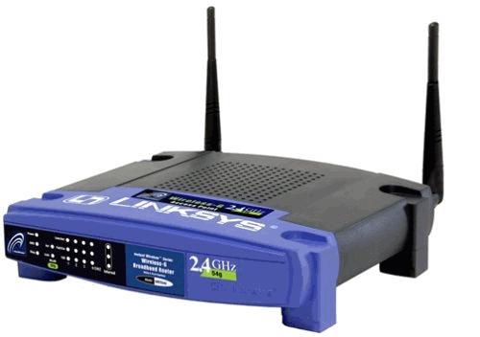
Transitioning to IPv6
How do we ease the transition from IPv4 to IPv6?
Today, most network edges are IPv6 ready
Windows/OSX/iOS/Android all support IPv6
Your wireless access point probably supports IPv6
The Internet core is hard to upgrade
… but a IPv4 core cannot route IPv6 traffic
IPv6 Ready
IPv4 Only :(
IPv6 Ready
IPv6 Packets
Home
Network
Core
Internet
Business
Network

Slide 62
Transition Technologies
How do you route IPv6 packets over an IPv4 Internet?
Transition Technologies
Use tunnels to encapsulate and route IPv6 packets over the IPv4 Internet
Several different implementations
6to4
IPv6 Rapid Deployment (6rd)
Teredo
… etc.

Slide 63
Network Layer, Control Plane
Function:
Set up routes within a single network
Key challenges:
Distributing and updating routes
Convergence time
Avoiding loops
Data Plane
Application
Presentation
Session
Transport
Network
RIP
OSPF
BGP
Control Plane
Data Link
Physical

Slide 64
Internet Routing
Internet organized as a two level hierarchy
First level – autonomous systems (AS’s)
AS – region of network under a single administrative domain
Examples: Comcast, AT&T, Verizon, Sprint, etc.
AS’s use intra-domain routing protocols internally
Distance Vector, e.g., Routing Information Protocol (RIP)
Link State, e.g., Open Shortest Path First (OSPF)
Connections between AS’s use inter-domain routing protocols
Border Gateway Routing (BGP)
De facto standard today, BGP-4

Slide 65

AS Example
AS-1
AS-3
Interior Routers
AS-2
BGP Routers

Slide 66
Why Do We Need ASs?
Routing algorithms are not efficient enough to execute on the entire Internet topology
Different organizations may use different routing policies
Allows organizations to hide their internal network structure
Allows organizations to choose how to route across each other (BGP)
Easier to compute routes
Greater flexibility
More autonomy/independence

Slide 67
Routing on a Graph
Goal: determine a “good” path through the network from source to destination
What is a good path?
Usually means the shortest path
Load balanced
Lowest $$$ cost
Network modeled as a graph
Routers → nodes
Link → edges
Edge cost: delay, congestion level, etc.
5
3
B
C
5
2
A
2
1
F
3
1
D
E
2
1

Slide 68
Shortest Path Routing
Bellman-Ford Algorithm [Distance Vector]
Dijkstra’s Algorithm [Link State]
What does it mean to be the shortest (or optimal) route?
Minimize mean packet delay
Maximize the network throughput
Mininize the number of hops along the path

Slide 69
Dijkstra’s Shortest Path Algorithm
Initially mark all nodes (except source) with infinite distance.
working node = source node
Sink node = destination node
While the working node is not equal to the sink
1. Mark the working node as permanent.
2. Examine all adjacent nodes in turn
If the sum of label on working node plus distance from working node to adjacent node is less than current labeled distance on the adjacent node, this implies a shorter path. Relabel the distance on the adjacent node and label it with the node from which the probe was made.
3. Examine all tentative nodes (not just adjacent nodes) and mark the node with the smallest labeled value as permanent. This node becomes the new working node.
Reconstruct the path backwards from sink to source.

Slide 70
Dijkstra’s Algorithm
Dijkstra(graph (G,w), vertex s)
InitializeSingleSource(G, s)
S ← ∅
Q ← V[G]
while Q ≠ 0 do
u ← ExtractMin(Q)
S ← S ∪ {u}
for u ∈ Adj[u] do
Relax(u,v,w)
executed Θ(V) times
Θ(E) times in total
InitializeSingleSource(graph G, vertex s)
for v ∈ V[G] do
d[v] ← ∞
p[v] ← 0
d[s] ← 0
Θ(V)
Relax(vertex u, vertex v, weight w)
if d[v] > d[u] + w(u,v) then
d[v] ← d[u] + w(u,v)
p[v] ← u
Θ(1) ?

Slide 71
Dijkstra’s Algorithm - Example
1
10
2
3
9
4
6
5
7
2

Slide 72
Dijkstra’s Algorithm - Example
1
∞
∞
10
2
3
9
0
4
6
5
7
∞
∞
2

Slide 73
Dijkstra’s Algorithm - Example
1
10
∞
10
2
3
9
0
4
6
5
7
5
∞
2

Slide 74
Dijkstra’s Algorithm - Example
1
10
∞
10
2
3
9
0
4
6
5
7
5
∞
2

Slide 75
Dijkstra’s Algorithm - Example
1
8
14
10
2
3
9
0
4
6
5
7
5
7
2

Slide 76
Dijkstra’s Algorithm - Example
1
8
14
10
2
3
9
0
4
6
5
7
5
7
2

Slide 77
Dijkstra’s Algorithm - Example
1
8
13
10
2
3
9
0
4
6
5
7
5
7
2

Slide 78
Dijkstra’s Algorithm - Example
1
8
13
10
2
3
9
0
4
6
5
7
5
7
2

Slide 79
Dijkstra’s Algorithm - Example
1
8
9
10
2
3
9
0
4
6
5
7
5
7
2

Slide 80
Dijkstra’s Algorithm - Example
1
8
9
10
2
3
9
0
4
6
5
7
5
7
2

Slide 81
Bellman-Ford Algorithm
BellmanFord(graph (G,w), vertex s)
InitializeSingleSource(G, s)
for i ← 1 to |V[G] − 1| do
for (u,v) ∈ E[G] do
Relax(u,v,w)
for (u,v) ∈ E[G] do
if d[v] > d[u] + w(u,v) then
return false
return true

Slide 82
Bellman-Ford Algorithm - Example
-2
5
6
-3
8
-4
7
7
2
9

Slide 83
Bellman-Ford Algorithm - Example
-2
∞
5
∞
6
-3
8
0
7
-4
7
2
∞
9
∞

Slide 84
Bellman-Ford Algorithm - Example
-2
6
5
∞
6
-3
8
0
7
-4
7
2
7
9
∞

Slide 85
Bellman-Ford Algorithm - Example
-2
6
5
4
6
-3
8
0
7
-4
7
2
7
9
2

Slide 86
Bellman-Ford Algorithm - Example
-2
2
5
4
6
-3
8
0
7
-4
7
2
7
9
2

Slide 87
Bellman-Ford Algorithm - Example
-2
2
5
4
6
-3
8
0
7
-4
7
2
7
9
-2

Slide 88
Bellman-Ford Algorithm - Complexity
BellmanFord(graph (G,w), vertex s)
InitializeSingleSource(G, s)
for i ← 1 to |V[G] − 1| do
for (u,v) ∈ E[G] do
Relax(u,v,w)
for (u,v) ∈ E[G] do
if d[v] > d[u] + w(u,v) then
return false
return true
executed Θ(V) times
Θ(E)
Θ(1)
Θ(E)

Slide 89
Internetwork Routing [Halsall]
Adaptive Routing
Centralized
Distributed
[RCC]
[IGP]
Intradomain routing
Interdomain routing
[EGP]
Interior
Gateway Protocols
[BGP,IDRP]
Exterior
Gateway Protocols
Distance Vector routing
Link State routing
[RIP]
[OSPF,IS-IS,PNNI]

Slide 90
Routing Problems
Assume
A network with N nodes
Each node only knows
Its immediate neighbors
The cost to reach each neighbor
How does each node learn the shortest path to every other node?
5
3
B
C
5
2
A
2
1
F
3
1
D
E
2
1

Slide 91
Intra-domain Routing Protocols
Distance vector
Routing Information Protocol (RIP), based on Bellman-Ford
Routers periodically exchange reachability information with neighbors
Link state
Open Shortest Path First (OSPF), based on Dijkstra
Each network periodically floods immediate reachability information to all other routers
Per router local computation to determine full routes

Slide 92
Outline
Distance Vector Routing
RIP
Link State Routing
OSPF
IS-IS

Slide 93
Distance Vector Routing
What is a distance vector?
Current best known cost to reach a destination
Idea: exchange vectors among neighbors to learn about lowest cost paths
No entry for C
Initially, only has info for immediate neighbors
Other destinations cost = ∞
Eventually, vector is filled
Destination | Cost
A | 7
B | 1
D | 2
E | 5
F | 1
DV Table
at Node C
Routing Information Protocol (RIP)

Slide 94
Distance Vector Routing Algorithm
Wait for change in local link cost or message from neighbor
Recompute distance table
If least cost path to any destination has changed, notify neighbors

Slide 95
Distance Vector Initialization
Node A
Node B
3
B
D
Dest. | Cost | Next
B | 2 | B
C | 7 | C
D | ∞
Dest. | Cost | Next
A | 2 | A
C | 1 | C
D | 3 | D
2
1
1
A
7
C
Initialization:
for all neighbors V do
if V adjacent to A
D(A, V) = c(A,V);
else
D(A, V) = ∞;
…
Node D
Node C
Dest. | Cost | Next
A | 7 | A
B | 1 | B
D | 1 | D
Dest. | Cost | Next
A | ∞
B | 3 | B
C | 1 | C

Slide 96
Distance Vector: 1st Iteration
Node A
Node B
3
B
D
Dest. | Cost | Next
B | 2 | B
C | 7 | C
D | ∞
Dest. | Cost | Next
A | 2 | A
C | 1 | C
D | 3 | D
2
1
1
3
B
A
7
C
5
8
C
B
2
C
…
loop:
…
else if (update D(V, Y) received from V)
for all destinations Y do
if (destination Y through V)
D(A,Y) = D(A,V) + D(V, Y);
else
D(A, Y) =
min(D(A, Y),
D(A, V) + D(V, Y));
if (there is a new min. for dest. Y)
send D(A, Y) to all neighbors
forever
D(A,C) = min(D(A,C), D(A,B)+D(B,C))
= min(7, 2 + 1) = 3
Node C
Node D
D(A,D) = min(D(A,D), D(A,B)+D(B,D))
= min(8, 2 + 3) = 5
D(A,D) = min(D(A,D), D(A,C)+D(C,D))
= min(∞, 7 + 1) = 8
Dest. | Cost | Next
A | 7 | A
B | 1 | B
D | 1 | D
Dest. | Cost | Next
A | ∞
B | 3 | B
C | 1 | C
3
B
4
B

Slide 97
Distance Vector: End of 3rd Iteration
Node A
Node B
3
B
D
Dest. | Cost | Next
B | 2 | B
C | 3 | B
D | 4 | B
Dest. | Cost | Next
A | 2 | A
C | 1 | C
D | 2 | C
2
1
1
A
7
C
…
loop:
…
else if (update D(V, Y) received from V)
for all destinations Y do
if (destination Y through V)
D(A,Y) = D(A,V) + D(V, Y);
else
D(A, Y) =
min(D(A, Y),
D(A, V) + D(V, Y));
if (there is a new min. for dest. Y)
send D(A, Y) to all neighbors
forever
Nothing changes, algorithm terminates
Until something changes…
Node C
Node D
Dest. | Cost | Next
A | 3 | B
B | 1 | B
D | 1 | D
Dest. | Cost | Next
A | 4 | C
B | 2 | C
C | 1 | C

Slide 98
loop:
wait (link cost update or update message)
if (c(A,V) changes by d)
for all destinations Y through V do
D(A,Y) = D(A,Y) + d
else if (update D(V, Y) received from V)
for all destinations Y do
if (destination Y through V)
D(A,Y) = D(A,V) + D(V, Y);
else
D(A, Y) = min(D(A, Y), D(A, V) + D(V, Y));
if (there is a new minimum for destination Y)
send D(A, Y) to all neighbors
forever
B
4
1
1
A
50
C
Link Cost Changes,
Algorithm Starts
Algorithm Terminates
Good news travels fast
D | C | N
A | 4 | A
C | 1 | B
D | C | N
A | 1 | A
C | 1 | B
D | C | N
A | 1 | A
C | 1 | B
D | C | N
A | 1 | A
C | 1 | B
Node B
D | C | N
A | 5 | B
B | 1 | B
D | C | N
A | 5 | B
B | 1 | B
D | C | N
A | 2 | B
B | 1 | B
D | C | N
A | 2 | B
B | 1 | B
Node C
Time
Notes:
Change circles to rectangles, don’t block the text

Slide 99
Count to Infinity Problem
Node B knows D(C, A) = 5
However, B does not know the path is C → B → A
Thus, D(B,A) = 6 !
B
4
60
1
A
C
Bad news travels slowly
50
D | C | N
A | 4 | A
C | 1 | B
D | C | N
A | 6 | C
C | 1 | B
D | C | N
A | 6 | C
C | 1 | B
D | C | N
A | 8 | C
C | 1 | B
Node B
D | C | N
A | 5 | B
B | 1 | B
D | C | N
A | 5 | B
B | 1 | B
D | C | N
A | 7 | B
B | 1 | B
D | C | N
A | 7 | B
B | 1 | B
Node C
Time

Slide 100
Poisoned Reverse
If C routes through B to get to A
C tells B that D(C, A) = ∞
Thus, B won’t route to A via C
B
4
60
1
A
50
C
D | C | N
A | 4 | A
C | 1 | B
D | C | N
A | 60 | A
C | 1 | B
D | C | N
A | 60 | A
C | 1 | B
D | C | N
A | 51 | C
C | 1 | B
Node B
D | C | N
A | 5 | B
B | 1 | B
D | C | N
A | 5 | B
B | 1 | B
D | C | N
A | 50 | A
B | 1 | B
D | C | N
A | 50 | A
B | 1 | B
Node C
Time

