Slide 1
Execution of a SELECT statement
SELECT col1 FROM Tab1 WHERE col2 = …
How does the DBMS find the pieces of Data on disk?
Data blocks
Records
Fields

Slide 2
Tablespaces and Data Files
  Tablespaces consist of one or more data files.
  Data files belong to only one tablespace.
Data file 1
Data file 2
USERS tablespace
Notes:
Tablespaces and Data Files
A database is divided into logical storage units called tablespaces, which can be used to group related logical structures together. Each database is logically divided into one or more tablespaces. One or more data files are explicitly created for each tablespace to physically store the data of all logical structures in a tablespace.
Note: You can also create the bigfile tablespaces, which are tablespaces with a single but very large (up to 4 billion data blocks) data file. The traditional smallfile tablespaces (which are the default) can contain multiple data files, but the files cannot be as large. For more information about the bigfile tablespaces, see the Database Administrator’s Guide.

Slide 3




Segments, Extents, and Blocks
  Segments exist within a tablespace.
  Segments are made up of a collection of extents.
  Extents are a collection of data blocks.
  Data blocks are mapped to disk blocks.
Segment
Extents
Data blocks
Disk blocks
Notes:
Segments, Extents, and Blocks
Database objects, such as tables and indexes, are stored as segments in tablespaces. Each segment contains one or more extents. An extent consists of contiguous data blocks, which means that each extent can exist only in one data file. Data blocks are the smallest unit of I/O in the database.
When the database requests a set of data blocks from the operating system (OS), the OS maps this to an actual file system or disk block on the storage device. Because of this, you need not know the physical address of any of the data in your database. This also means that a data file can be striped or mirrored on several disks.
The size of the data block can be set at the time of the creation of the database. The default size of 8 KB is adequate for most databases. If your database supports a data warehouse application that has large tables and indexes, then a larger block size may be beneficial.
If your database supports a transactional application where reads and writes are random, then specifying a smaller block size may be beneficial. The maximum block size depends on your OS. The minimum Oracle block size is 2 KB and should rarely (if ever) be used.
You can have tablespaces with different block sizes. However, this should be used only for transportable tablespaces. For details, see the Database Administrator’s Guide.

Slide 4
Logical and Physical Database Structures
Logical
Physical
Database
Schema
Tablespace
Data file
Segment
Extent
Oracle data
block
OS block
Notes:
Logical and Physical Database Structures
An Oracle database is a collection of data that is treated as a unit. The general purpose of a database is to store and retrieve related information. The database has logical structures and physical structures.
Tablespaces
A database is divided into logical storage units called tablespaces, which group related logical structures together. For example, tablespaces commonly group all of an application’s objects to simplify some administrative operations. You may have a tablespace for application data and an additional one for application indexes.
Databases, Tablespaces, and Data Files
The relationship among databases, tablespaces, and data files is illustrated in the slide. Each database is logically divided into one or more tablespaces. One or more data files are explicitly created for each tablespace to physically store the data of all logical structures in a tablespace. If it is a TEMPORARY tablespace, instead of a data file, then the tablespace has a temporary file.

Slide 5
How Table Data Is Stored
Columns
Blocks
Table A
Table B
Rows
Segment
Segment
Table
Tablespace
Row piece
Extent
Notes:
How Table Data Is Stored
When a table is created, a segment is created to hold its data. A tablespace contains a collection of segments. Logically, a table contains rows of column values. A row is ultimately stored in a database block in the form of a row piece. It is called a row piece because under some circumstances the entire row may not be stored in one place. This happens when an inserted row is too large to fit into a single block or when an update causes an existing row to outgrow its current space.

Slide 6
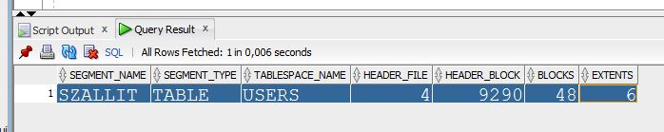
Where Table Data is Stored?
SELECT segment_name, segment_type, tablespace_name,
header_file, header_block, blocks, extents
FROM dba_segments where owner='NIKOVITS'
AND segment_name='SZALLIT' AND segment_type='TABLE';

Slide 7
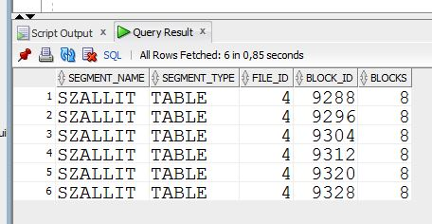
Where Table Data is Stored?
SELECT segment_name, segment_type,
file_id, block_id, blocks
FROM dba_extents where owner='NIKOVITS'
AND segment_name='SZALLIT' AND segment_type='TABLE';

Slide 8
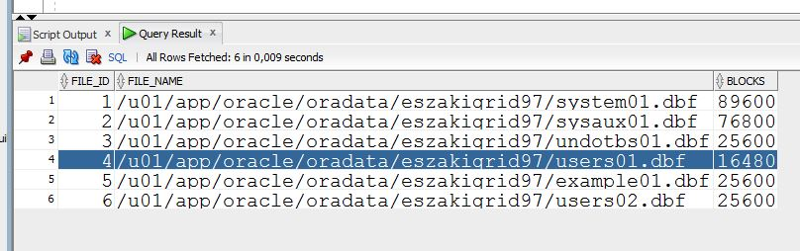
Where Table Data is Stored?
SELECT file_id, file_name, blocks
FROM dba_data_files;

Slide 9
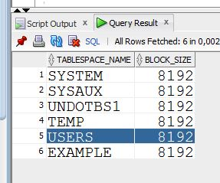
Which part of the Datafile?
(What is the block size?)
SELECT tablespace_name, block_size
FROM dba_tablespaces;

Slide 10
Anatomy of a Database Block
Block header
Growth
Free space
Row data
Notes:
Database Block: Contents
Oracle data blocks contain the following:
Block header: The block header contains the segment type (such as table or index), data block address, table directory, row directory, and transaction slots of size 23 bytes each, which are used when modifications are made to rows in the block. The block header grows downward from the top.
Row data: This is the actual data for the rows in the block. Row data space grows upward from the bottom.
Free space: Free space is in the middle of the block. This enables the header and the row data space to grow when necessary. Row data takes up free space as new rows are inserted or columns of existing rows are updated with larger values. The examples of events that cause header growth are when the row directory needs more row entries or more transaction slots are required than initially configured. Initially, the free space in a block is contiguous. However, deletions and updates may fragment the free space in the block. The free space in the block is coalesced by the Oracle server when necessary.

Slide 11
Variable-length records
(finding records within blocks)
When do we have a file with variable-length records?
  file contains records of multiple tables
  create table t (field1 int, field2 varchar2(n))
Problems:
  Holes created upon deletion have variable size
  Find large enough free space for new record
Could use previous approaches: maximum record size
  a lot of space wasted
Use slotted page structure
  Slot directory
  Each slot storing offset, size of record
  Record IDs: page number, slot number
...
32
...
N
16
38
Advanced Databases
Physical Storage Organization
N
2
1

Slide 12
Record Organization
(finding fields within records)
Fixed-length record formats
  Fields stored consecutively
Variable-length record formats
  Array of offsets
  NULL values when start offset = end offset
f1
f2
f3
f4
Base address (B)
L1
L2
L3
L4
f3 Address = B+L1+L2
f1
f2
f3
f4
Base address (B)
Advanced Databases
Physical Storage Organization
Notes:
Where are the number of fields and data types stored?
Record that grows moves subsequent fields

