Slide 1
Ullman et al. :
Database System Principles
Disk Organization

Slide 2
Topics for today
How to lay out data on disk
How to move it to memory

Slide 3
What are the data items we want to store?
a salary
a name
a date
a picture
What we have available: Bytes
8
bits

Slide 4
To represent:
Integer (short): 2 bytes
e.g., 35 is
00000000
00100011
Real, floating point
  n bits for mantissa, m for exponent….

Slide 5
To represent:
Characters
→ various coding schemes suggested,
most popular is ascii
Example:
A: 1000001
a: 1100001
5: 0110101
LF: 0001010

Slide 6
To represent:
Boolean
e.g., TRUE FALSE
1111 1111
0000 0000
Application specific
e.g., RED → 1 GREEN → 3
BLUE → 2 YELLOW → 4 …
Can we use less than 1 byte/code?
    Yes, but only if desperate...

Slide 7
To represent:
Dates
e.g.: - Integer, # days since Jan 1, 1900
- 8 characters, YYYYMMDD
- 7 characters, YYYYDDD
(not YYMMDD! Why?)
Time
e.g. - Integer, seconds since midnight
- characters, HHMMSSFF

Slide 8
To represent:
String of characters
  Null terminated
  e.g.,
  Length given
  e.g.,
  - Fixed length
c
a
t
3
c
a
t

Slide 9
To represent:
Bag of bits
Length
Bits

Slide 10
Key Point
Fixed length items
Variable length items
- usually length given at beginning

Slide 11
Also
Type of an item: Tells us how to
interpret
(plus size if fixed)

Slide 12
Overview
Data Items
Records
Blocks
Files
Memory

Slide 13
Record - Collection of related data items (called FIELDS)
E.g.: Employee record:
name field,
salary field,
date-of-hire field, ...

Slide 14
Types of records:
Main choices:
  FIXED vs VARIABLE FORMAT
  FIXED vs VARIABLE LENGTH

Slide 15
Fixed format
A SCHEMA (not record) contains
following information
- # fields
- type of each field
- order in record
- meaning of each field

Slide 16
Example: fixed format and length
Employee record
(1) E#, 2 byte integer
(2) E.name, 10 char. Schema
(3) Dept, 2 byte code
55
s m i t h
02
Records
83
j o n e s
01

Slide 17
Variable format
Record itself contains format
“Self Describing”

Slide 18
Example: variable format and length
2
# Fields
Code identifying
field as E#
Integer type
Code for Ename
String type
Length of str.
5
I
46
4
S
4
F
O
R
D
Field name codes could also be strings, i.e. TAGS

Slide 19
Variable format useful for:
“sparse” records
repeating fields
evolving formats
But may waste space...

Slide 20
EXAMPLE: var format record with
repeating fields
Employee → one or more → children
3
E_name: Fred
Child: Sally
Child: Tom

Slide 21
Note: Repeating fields does not imply
- variable format, nor
- variable size
John
Sailing
Chess
--
Key is to allocate maximum number of
repeating fields (if not used → null)

Slide 22
Many variants between fixed - variable format:
Example: Include record type in record
record type record length
tells me what
to expect
(i.e. points to schema)
5
27
. . . .

Slide 23
Record header - data at beginning that describes record
May contain:
- record type
- record length
- time stamp
- other stuff ...

Slide 24
Next: placing records into blocks
blocks ...
a file
assume fixed
length blocks
assume a single file (for now)

Slide 25
Options for storing records in blocks:
(1) separating records
(2) spanned vs. unspanned
(3) sequencing
(4) indirection

Slide 26
(1) Separating records
Block
(a) no need to separate - fixed size recs.
(b) special marker
(c) give record lengths (or offsets)
- within each record
- in block header
R1
R2
R3

Slide 27
(2) Spanned vs. Unspanned
Unspanned: records must be within one block
block 1 block 2
...
Spanned
block 1 block 2 ...
R1
R2
R3
R4
R5
R1
R2
R3
(a)
R3
(b)
R4
R5
R6
R7
(a)

Slide 28
With spanned records:
need indication need indication
of partial record of continuation
“pointer” to rest (+ from where?)
R1
R2
R3
(a)
R3
(b)
R4
R5
R6
R7
(a)

Slide 29
Spanned vs. unspanned:
Unspanned is much simpler, but may waste space…
Spanned essential if
record size > block size

Slide 30
(3) Sequencing
Ordering records in file (and block) by some key value
Sequential file ( ⇒ sequenced)

Slide 31
Why sequencing?
Typically to make it possible to efficiently read records in order
(e.g., to do a merge-join — discussed later)

Slide 32
Sequencing Options
(a) Next record physically contiguous
...
(b) Linked
R1
Next (R1)
R1
Next (R1)

Slide 33
Sequencing Options
(c) Overflow area
Records
in sequence
header
R1
R2.1
R2
R1.3
R3
R4.7
R4
R5

Slide 34
(4) Indirection
How does one refer to records?
Rx

Slide 35
(4) Indirection
How does one refer to records?
Rx
Many options:
Physical Indirect

Slide 36
Purely Physical
Device ID
E.g., Record Cylinder #
Address = Track #
or ID Block #
Offset in block
Block ID

Slide 37
Fully Indirect
E.g., Record ID is arbitrary bit string
map
rec ID
r address
a
Rec ID
Physical
addr.

Slide 38
Tradeoff
Flexibility Cost
to move records of indirection
(for deletions, insertions)

Slide 39
Physical Indirect
Many options
in between …

Slide 40
Example: Indirection in block
Header
A block: Free space
R3
R4
R1 R2

Slide 41
Block header - data at beginning that describes block
May contain:
- File ID (or RELATION or DB ID)
- This block ID
- Record directory
- Pointer to free space
- Type of block (e.g. contains recs type 4;
is overflow, …)
- Pointer to other blocks “like it”
- Timestamp ...

Slide 42
Other Topics
(1) Insertion/Deletion
(2) Buffer Management
(3) Comparison of Schemes

Slide 43
Deletion
Block
Rx

Slide 44
Options:
(a) Immediately reclaim space
(b) Mark deleted
  May need chain of deleted records
(for re-use)
  Need a way to mark:
    special characters
    delete field
    in map

Slide 45
As usual, many tradeoffs...
How expensive is to move valid record to free space for immediate reclaim?
How much space is wasted?
  e.g., deleted records, delete fields, free space chains,...

Slide 46
Concern with deletions
Dangling pointers
R1
?

Slide 47
Solution #1: Do not worry

Slide 48
Solution #2: Tombstones
E.g., Leave “MARK” in map or old location
Physical IDs
A block
This space This space can
never re-used be re-used

Slide 49
Logical IDs
Solution #2: Tombstones
E.g., Leave “MARK” in map or old location
map
ID
LOC
Never reuse
ID 7788 nor
space in map...
7788

Slide 50
Insert
Easy case: records not in sequence
→ Insert new record at end of file or in deleted slot
→ If records are variable size, not as easy...

Slide 51
Insert
Hard case: records in sequence
→ If free space “close by”, not too bad...
→ Or use overflow idea...

Slide 52
Interesting problems:
How much free space to leave in each block, track, cylinder?
How often do I reorganize file + overflow?

Slide 53
Free
space

Slide 54
Buffer Management
DB features needed
Why LRU may be bad
Pinned blocks
Forced output
Double buffering

Slide 55
Row vs Column Store
So far we assumed that fields of a record are stored contiguously (row store)...
Another option is to store like fields together (column store)

Slide 56
Row Store
Example: Order consists of
  id, cust, prod, store, price, date, qty

Slide 57
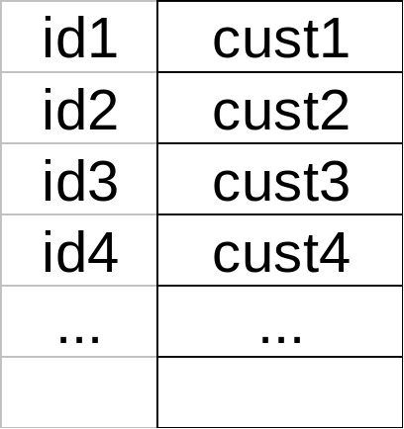
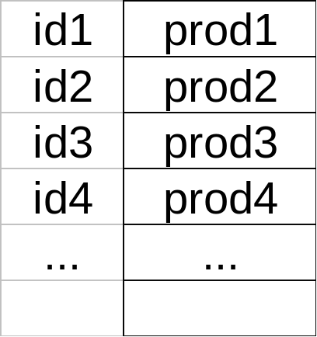
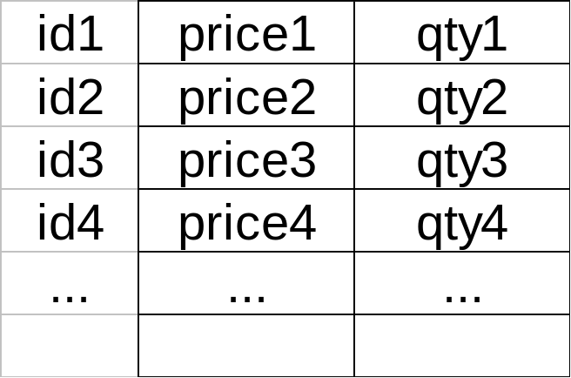
Column Store
Example: Order consists of
  id, cust, prod, store, price, date, qty
ids may or may not be stored explicitly

Slide 58
Row vs Column Store
Advantages of Column Store
  more compact storage (fields need not start at byte boundaries)
  efficient reads on data mining operations
Advantages of Row Store
  writes (multiple fields of one record)more efficient
  efficient reads for record access (OLTP)

Slide 59
Comparison
There are 10,000,000 ways to organize my data on disk…
Which is right for me?

Slide 60
Issues:
Flexibility Space Utilization
Complexity Performance

Slide 61
To evaluate a given strategy, compute following parameters:
-> space used for expected data
-> expected time to
- fetch record given key
- fetch record with next key
- insert record
- append record
- delete record
- update record
- read all file
- reorganize file

Slide 62
Summary
How to lay out data on disk
Data Items
Records
Blocks
Files
Memory
DBMS

Slide 63
Next
How to find a record quickly,
given a key

