Slide 1
Physical Storage Organization

Slide 2
Outline
Where and How data are stored?
  physical level
  logical level

Slide 3
Building a Database: High-Level
Design conceptual schema using a data model, e.g. ER, UML, etc.
stid
student
1:N
takes
0:N
course
name

Slide 4
Building a Database: Logical-Level
Design logical schema, e.g. relational, network, hierarchical, object-relational, XML, etc schemas
Data Definition Language (DDL)
CREATE TABLE student
(cid char(8) primary key,name varchar(32))
student
cid | name
Notes:
show example in psql
\d
\d student

Slide 5
Populating a Database
Data Manipulation Language (DML)
INSERT INTO student VALUES (‘00112233’, ‘Paul’)
student
cid | name
00112233 | Paul

Slide 6
Transaction operations
Transaction: a collection of operations performing a single logical function
A failure during a transaction can leave system in an inconsistent state, eg transfers between bank accounts.
BEGIN TRANSACTION transfer UPDATE bank-account SET balance = balance - 100 WHERE account=1 UPDATE bank-account SET balance = balance + 100 WHERE account=2 COMMIT TRANSACTION transfer

Slide 7
Where and How all this information is stored?
Metadata: tables, attributes, data types, constraints, etc
Data: records
Transaction logs, indices, etc

Slide 8
Where: In Main Memory?
Fast!
But:
  Too small
  Too expensive
  Volatile

Slide 9
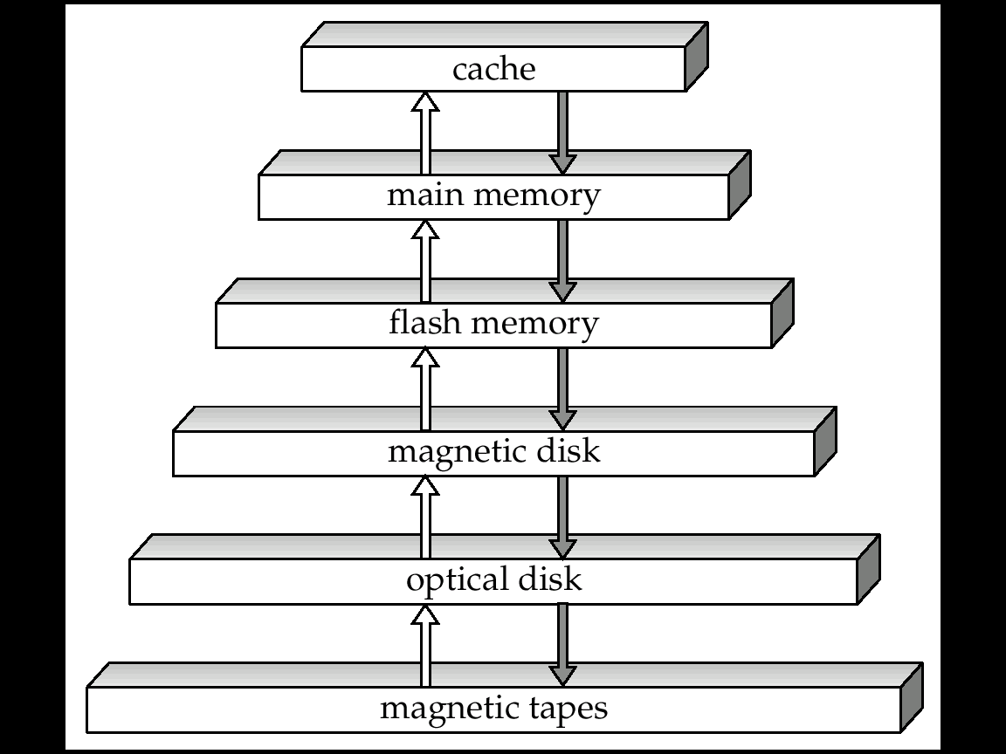
Physical Storage Media
Primary Storage
  Cache
  Main memory
Secondary Storage
  Flash memory
  Magnetic disk
Offline Storage
  Optical disk
  Magnetic tape
Notes:
- the higher the faster and more expensive

Slide 10
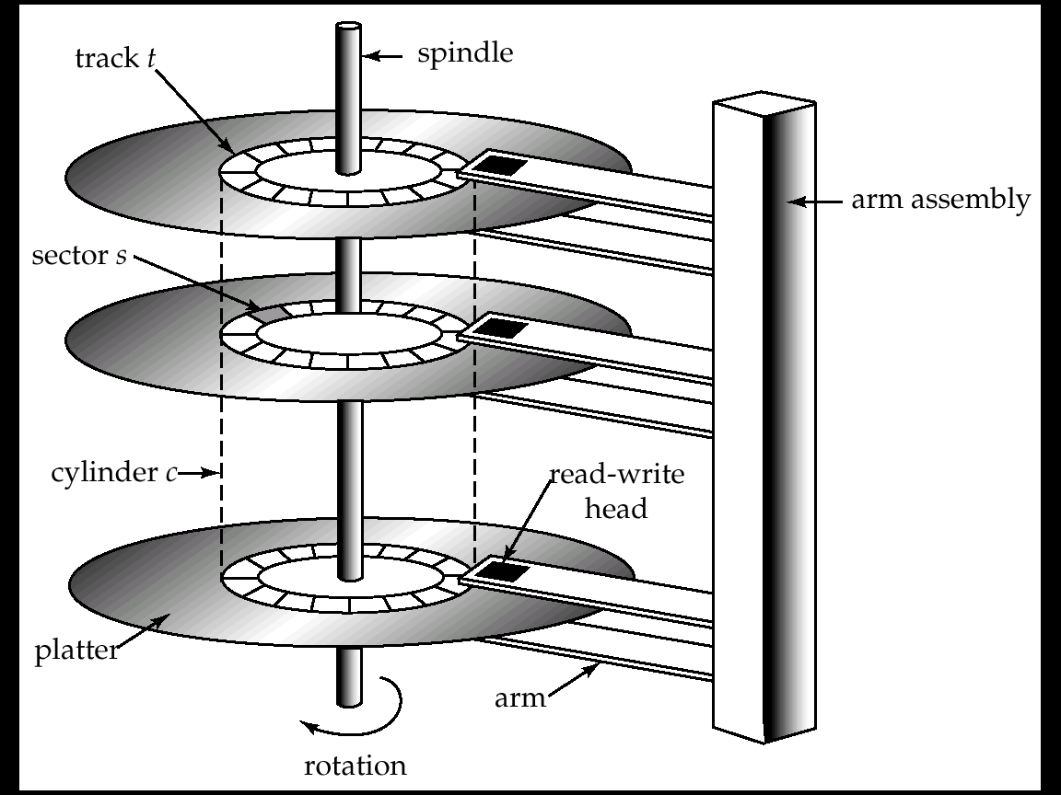
Magnetic Disks
Random Access
Inexpensive
Non-volatile

Slide 11
How do disks work?
Platter: covered with magnetic recording material
Track: logical division of platter surface
Sector: hardware division of tracks
Block: OS division of tracks
  Typical block sizes:
    512 B, 2KB, 4KB
Read/write head

Slide 12
Disk I/O
Disk I/O := block I/O
  Hardware address is converted to Cylinder, Surface and Sector number
  Modern disks: Logical Sector Address 0…n
Access time: time from read/write request to when data transfer begins
  Seek time: the head reaches correct track
    Average seek time 5-10 msec
  Rotation latency time: correct block rotated
  under head
    5400 RPM, 15K RPM
    On average 4-11 msec
Block Transfer Time

Slide 13
Optimize I/O
Database system performance I/O bound
Improve the speed of access to disk:
  Scheduling algorithms
  File Organization
Introduce disk redundancy
  Redundant Array of Independent Disks (RAID)
Reduce number of I/Os
  Query optimization, indices
Notes:
elevator scheduling algorithm
Keep logical close blocks physically close

Slide 14
Where and How all this information is stored?
Metadata: tables, attributes, data types, constraints, etc
Data: records
Transaction logs, indices, etc
A collection of files (or tables)
  Physically partitioned into pages or data blocks
  Logically partitioned into records
Notes:
Example in postgres in iBook

Slide 15
Storage Access
A collection of files
  Physically partitioned into pages
  Typical database page sizes: 2KB, 4KB, 8KB
  Reduce number of block I/Os := reduce number of page I/Os
  How?
Buffer Manager
Notes:
Before we introduce buffer management, an exercise

Slide 16
Buffer Management (1/2)
Buffer: storing a page copy
Buffer manager: manages a pool of buffers
  Requested page in pool: hit!
  Requested page in disk:
    Allocate page frame
    Read page and pin
Problems?
Page request
Page request
disk
buffer pool

Slide 17
Buffer Management (2/2)
What if no empty page frame exists:
  Select victim page
  Each page associated with dirty flag
  If page selected dirty, then write it back to disk
Which page to select?
  Replacement policies (LRU, MRU)
Page request
disk
buffer pool
Notes:
Replacement policies similar to OS page replacement policies, eg:
Least Recently Used pages
Most Recently Used
Could have a short exercise

Slide 18
Disk Arrays
Single disk becomes bottleneck
Disk arrays
  instead of single large disk
  many small parallel disks
    read N blocks in a single access time
    concurrent queries
    tables spanning among disks
Redundant Arrays of Independent Disks (RAID)
  7 levels (0-6)
  reliability
  redundancy
  parallelism

Slide 19
RAID level 0
Block level striping
No redundancy
maximum bandwidth
automatic load balancing
best write performance
but, no reliability
0
1
2
3
4
5
disk 1
disk 2
disk 3
disk 4

Slide 20
Raid level 1
Mirroring
  Two identical copies stored in two different disks
Parallel reads
Sequential writes
transfer rate comparable to single disk rate
most expensive solution
0
0
2
2
1
1
disk 1
disk 2
mirror of disk 1
disk 3
disk 4
mirror of disk 3

Slide 21
RAID levels 2 and 3
bit level striping (next bit on a separate disk)
error detection and correction
RAID 2
  ECC error correction codes (Hamming code)
  Bit level striping, several parity bits
RAID 3
  Byte level striping, single parity bit
  error detection by disk controllers (hardware)
RAID 4
  - Block level striping, single parity bit

Slide 22
RAID level 4
block level striping
parity block for each block in data disks
  P1 = B0 XOR B1 XOR B2
  B2 = B0 XOR B1 XOR P1
an update:
  P1’ = B0’ XOR B0 XOR P1 (every update -> must write parity disk)
B0
B1
B2
P1
disk 1
disk 2
disk 3
disk 4

Slide 23
RAID level 5 and 6
subsumes RAID 4
parity disk not a bottleneck
  parity blocks distributed on all disks
RAID 6
  tolerates two disk failures
  P+Q redundancy scheme
    2 bits of redundant data for each 4 bits of data
  more expensive writes
BM
B1
B0
PX’
B2
P1
PN
BY’
PX
BY
disk 1
disk 2
disk 3
disk 4

Slide 24
What pages contain logically?
Files:
  Physically partitioned into pages
  Logically partitioned into records
Each file is a sequence of records
Each record is a sequence of fields
student
cid | name
00112233 | Paul
student record:
00112233
Paul
8 + 4 = 12 Bytes

Slide 25

Page Organization
Student record size: 12 Bytes
Typical page size: 2 KB
Record identifiers: <Page identifier, offset>
How records are distributed into pages:
  Unspanned organization
    Blocking factor =
  Spanned organization
Page i
Page i+1
Page i
Page i+1
unspanned
spanned
Notes:
q1: what if large records (over a single page)?
Q2: what if large records, BLOBs (over multiple pages)?

Slide 26
What if a record is deleted?
Depending on the type of records:
  Fixed-length records
  Variable-length records
Notes:
Which is the easiest one and why?

Slide 27
Fixed-length record files
Upon record deletion:
  Packed page scheme
  Bitmap
Slot 1
Slot 1
Slot 2
Slot 2
...
...
...
Slot N
Slot N
...
Free Space
Slot M
Page header
N
1
N-1
1
...
...
0
0
1
N
M
N
2
1
Packed
Bitmap
Notes:
Problem with packed scheme, RID do not change
But you can’t store a sorted file on bitmap

Slide 28
Variable-length record files
When do we have a file with variable-length records?
  file contains records of multiple tables
  create table t (field1 int, field2 varchar2(n))
Problems:
  Holes created upon deletion have variable size
  Find large enough free space for new record
Could use previous approaches: maximum record size
  a lot of space wasted
Use slotted page structure
  Slot directory
  Each slot storing offset, size of record
  Record IDs: page number, slot number
...
32
...
N
16
38
N
2
1
Notes:
So in this case record IDs are still valid when record’s moved
Slots are not removed, but scanned

Slide 29
Record Organization
Fixed-length record formats
  Fields stored consecutively
Variable-length record formats
  Array of offsets
  NULL values when start offset = end offset
f1
f2
f3
f4
Base address (B)
L1
L2
L3
L4
f3 Address = B+L1+L2
f1
f2
f3
f4
Base address (B)
Notes:
Where are the number of fields and data types stored?
Record that grows moves subsequent fields

Slide 30
File Organization
(later we study it in a more detailed way)
Heap files: unordered records
Sorted files: ordered records
Hashed files: records partitioned into buckets

Slide 31
Heap Files
Simplest file structure
Efficient insert
Slow search and delete
  Equality search: half pages fetched on average
  Range search: all pages must be fetched
file
header

Slide 32
Sorted files
Sorted records based on ordering field
  If ordering field same as key field, ordering key field
Slow inserts and deletes
Fast logarithmic search
start of file
Page 1
Page 2
insert
start of file
Page 1
Page 2

Slide 33
Hashed Files
Hash function h on hash field distributes pages into buckets
Efficient equality searches, inserts and deletes
No support for range searches
null
null
hash field
h
Overflow page
…

Slide 34
Summary (1/2)
Why Physical Storage Organization?
  understanding low-level details which affect data access
  make data access more efficient
Primary Storage, Secondary Storage
  memory fast
  disk slow but non-volatile
Data stored in files
  partitioned into pages physically
  partitioned into records logically
Optimize I/Os
  scheduling algorithms
  RAID
  page replacement strategies

Slide 35
Summary (2/2)
File Organization
  how each file type performs
Page Organization
  strategies for record deletion
Record Organization

