Slide 1
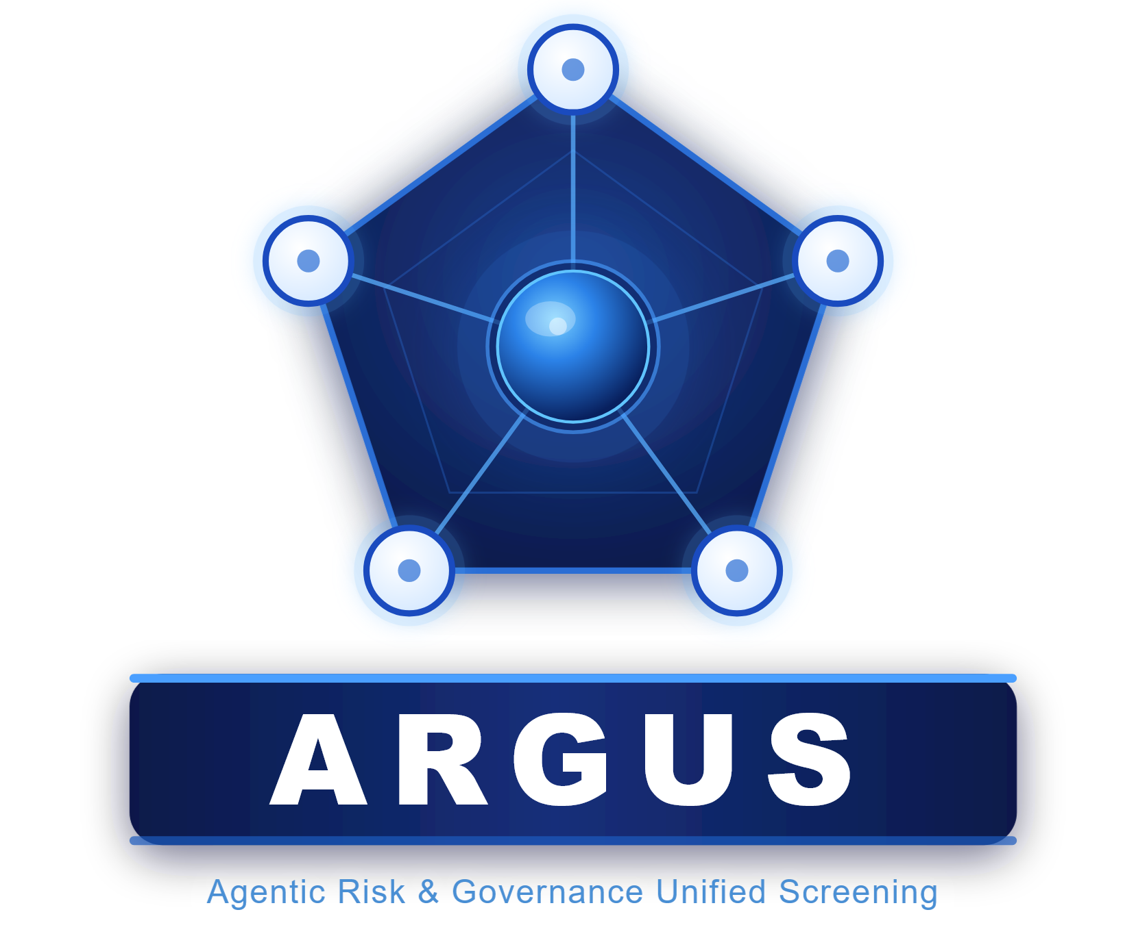
ARGUS Agentic Risk & Governance Unified Screening
Multi-Agent Compliance Intelligence
Microsoft Agents League 2026
Reasoning Agents Track

Slide 2
ARGUS Agentic Risk & Governance Unified Screening
Built with Microsoft Foundry
Multi-Agent Compliance Intelligence
Reasoning Agents Track
THANK YOU

