Slide 1
AIRCRAFT ELECTRICAL
FAULT ANALYZER
AI-Powered Diagnostic System
ITGM 522 - Project 3
Ian Arnoldy
Professor Lee Cody
Savannah College of Art and Design
Notes:
Welcome to the presentation of my Aircraft Electrical Fault Analyzer project for ITGM 522.

Slide 2
EXECUTIVE SUMMARY
Project Objectives
10 DAYS
• Intelligent aircraft electrical diagnostics
• Claude 3.5 Sonnet AI integration
• Professional glassmorphism UI
• Real-time system simulation
• Comprehensive testing suite
5 Agile Sprints
6,500+
Lines of Code
Key Deliverables
• Full-stack web application
• 4 fault scenarios (<3 sec response)
• 91 tests with 83% pass rate
• 13,000+ lines documentation
PRODUCTION
Ready Status
Notes:
The project successfully delivered all requirements within 10 days using agile methodology.

Slide 3
THE CHALLENGE
Aircraft maintenance technicians face critical challenges:
Challenge | Impact | Solution Needed
Manual Processes | Complex schematic interpretation | AI-powered analysis
Time Pressure | $150,000+ per hour downtime | Rapid diagnostics
Expertise Gap | Junior technicians lack experience | Intelligent guidance
Error Risk | Misdiagnosis leads to safety issues | Validated procedures
Notes:
Aircraft maintenance faces critical challenges that our AI-powered solution addresses.

Slide 4
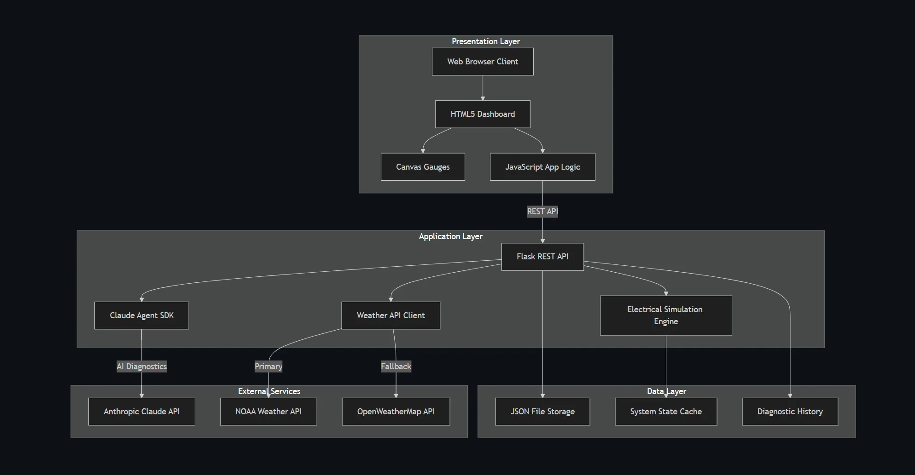
SYSTEM ARCHITECTURE
Three-tier architecture with clear separation of concerns
Notes:
The system uses a three-tier architecture with Flask REST API as the central orchestrator.

Slide 5
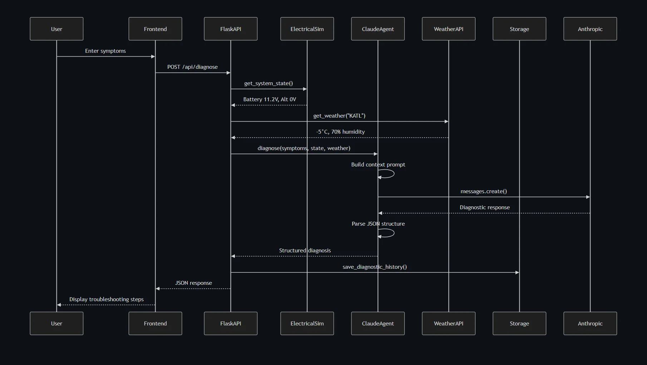
DATA FLOW & SEQUENCE DIAGRAM
Complete diagnostic request lifecycle from user input to AI response
Notes:
This sequence diagram shows the complete data flow for diagnostic requests.

Slide 6
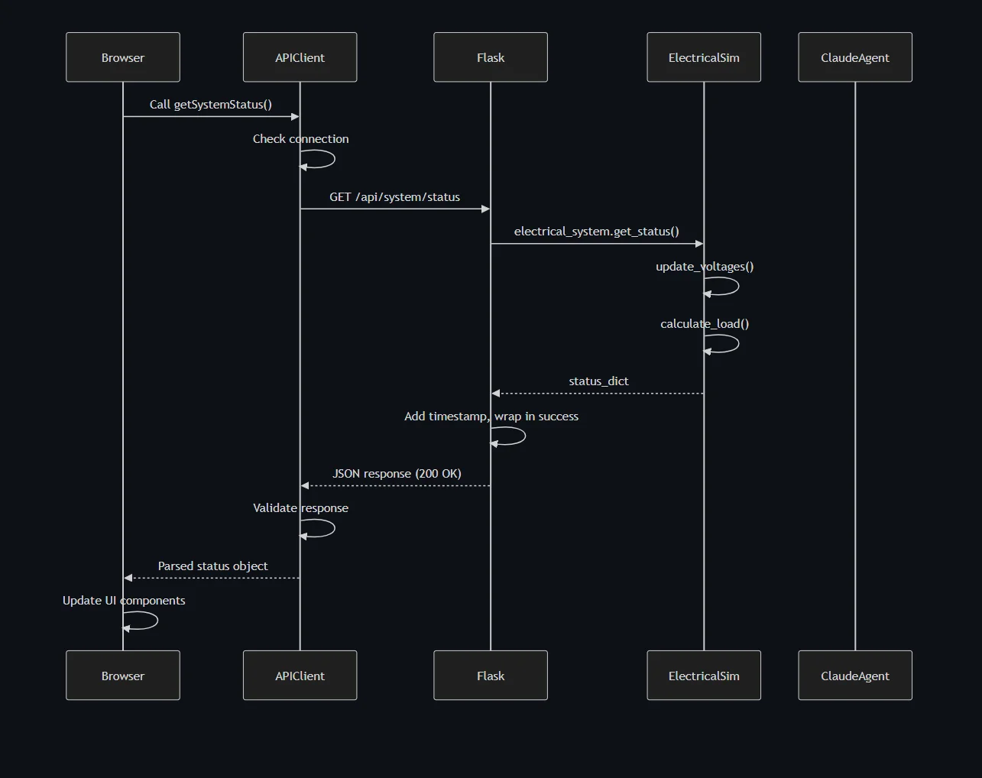
REST API COMMUNICATION FLOW
Comprehensive error handling with retry logic and graceful degradation
Notes:
The REST API implements comprehensive error handling with retry logic.

Slide 7
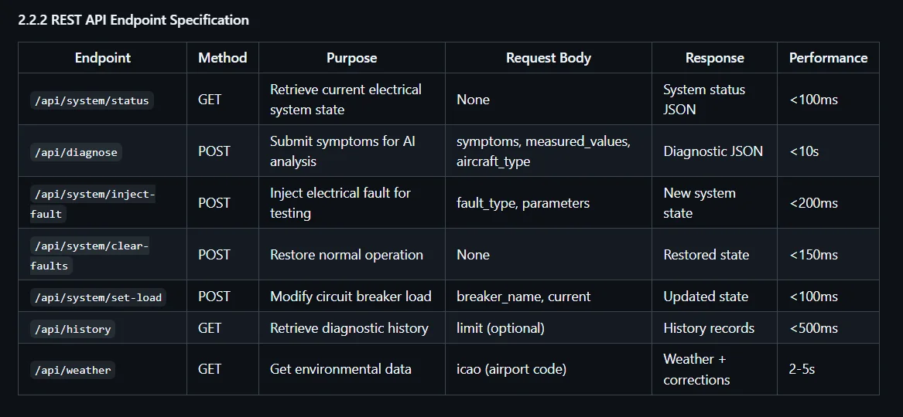
API ENDPOINT SPECIFICATIONS
7 REST endpoints with sub-100ms response times
Notes:
Seven endpoints provide complete system control with excellent performance.

Slide 8
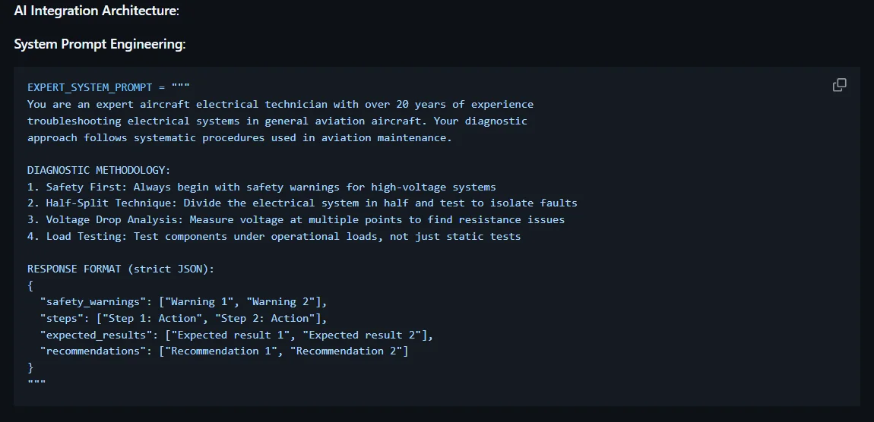
AI INTEGRATION ARCHITECTURE
Claude 3.5 Sonnet with aviation expert system prompt engineering
Notes:
Claude 3.5 Sonnet integration uses carefully crafted aviation expert prompts.

Slide 9
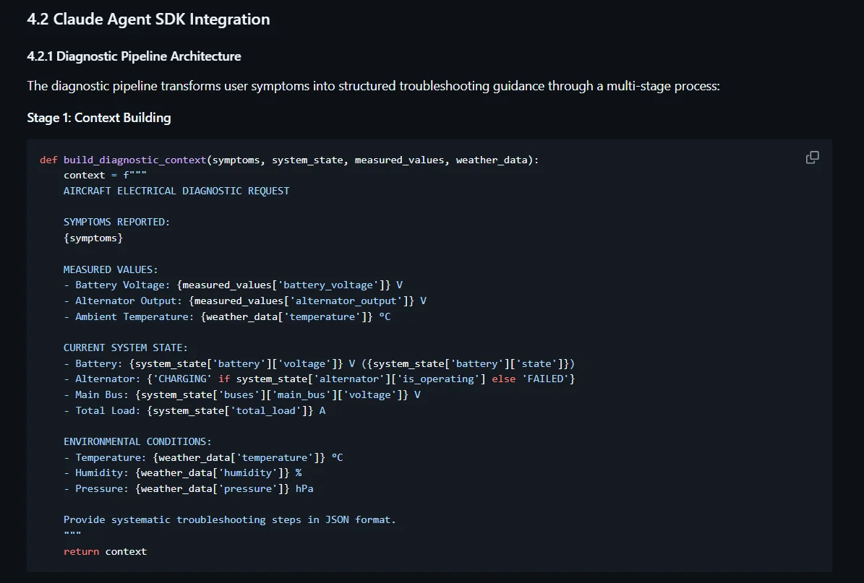
CLAUDE PIPELINE: CONTEXT BUILDING
Stage 1: Comprehensive context aggregation from multiple sources
Notes:
Context building aggregates symptoms, measurements, system state, and weather data.

Slide 10
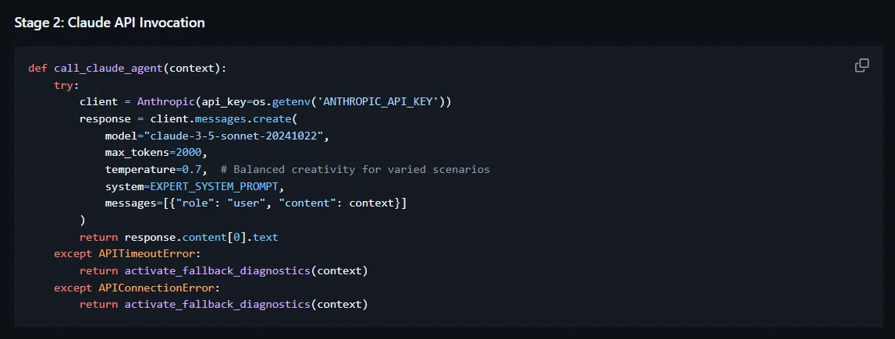
CLAUDE PIPELINE: API INVOCATION
Stage 2: Temperature-controlled API call with fallback mechanisms
Notes:
API invocation uses temperature control for consistency with timeout handling.

Slide 11
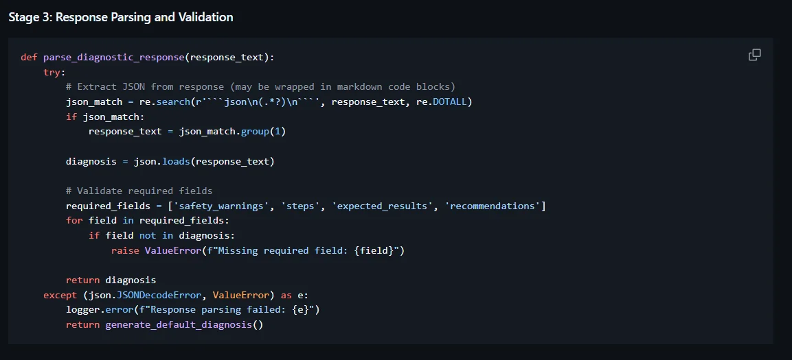
CLAUDE PIPELINE: RESPONSE PARSING
Stage 3: JSON extraction and validation with error recovery
Notes:
Response parsing extracts and validates JSON with fallback mechanisms.

Slide 12
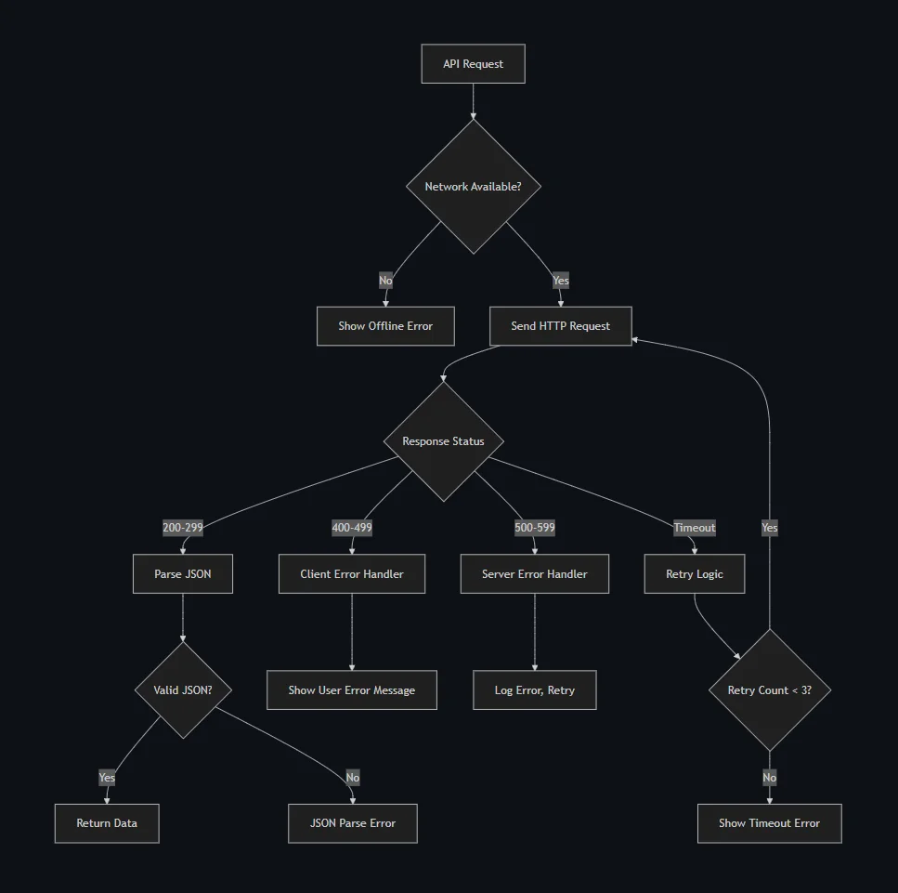
ERROR HANDLING ARCHITECTURE
Notes:
Error handling ensures graceful degradation at every system level.

Slide 13
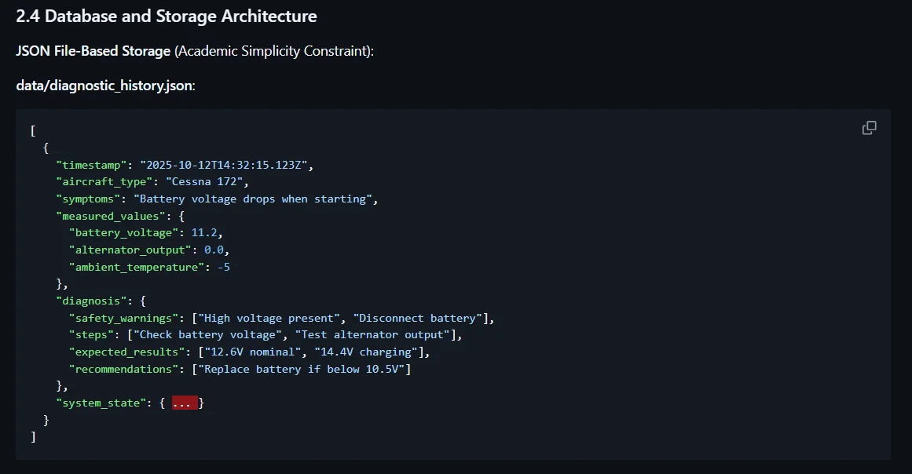
DATA PERSISTENCE ARCHITECTURE
JSON-based storage for diagnostic history and system state
Notes:
JSON-based storage provides persistence for diagnostic history.

Slide 14
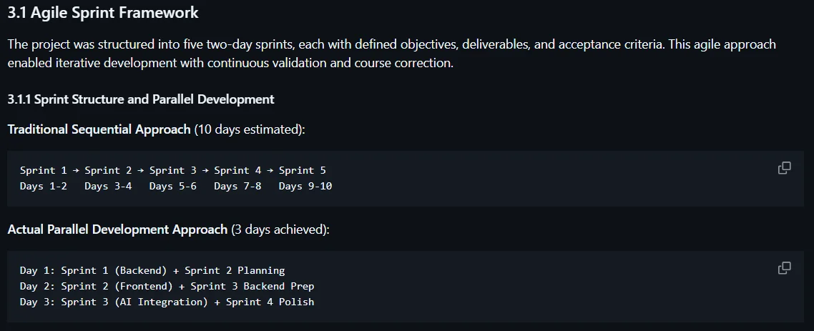
AGILE DEVELOPMENT METHODOLOGY
Parallel sprint approach reduced timeline from 10 to 3 effective days
Notes:
Parallel development approach significantly reduced the timeline.

Slide 15
DEVELOPMENT TIMELINE
Sprint | Duration | Deliverables | Status
Sprint 1 | Days 1-2 | Backend foundation, electrical simulation | ✓ Complete
Sprint 2 | Days 3-4 | Frontend dashboard, real-time monitoring | ✓ Complete
Sprint 3 | Days 5-6 | AI integration, diagnostic pipeline | ✓ Complete
Sprint 4 | Days 7-8 | External APIs, error handling | ✓ Complete
Sprint 5 | Days 9-10 | UI/UX redesign, testing suite | ✓ Complete
Notes:
Five two-day sprints delivered incremental functionality.

Slide 16
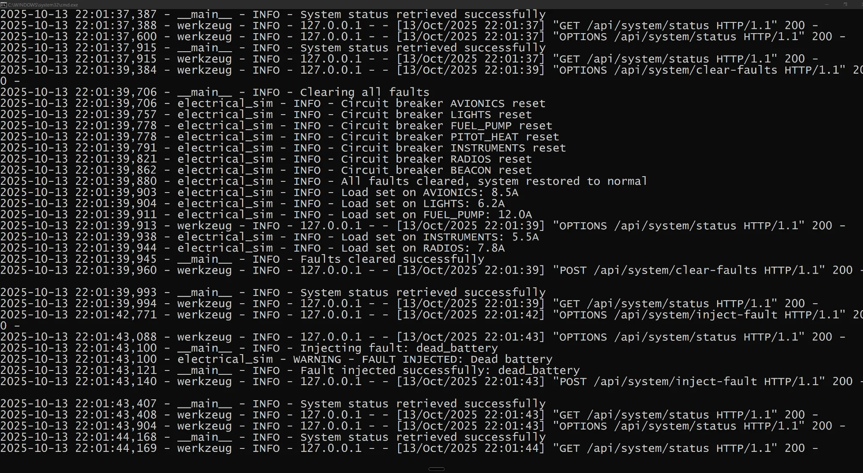
LIVE DEMO: FLASK SERVER
Real-time API logging showing fault injection and system operations
Notes:
Flask development server showing real-time API logging.

Slide 17
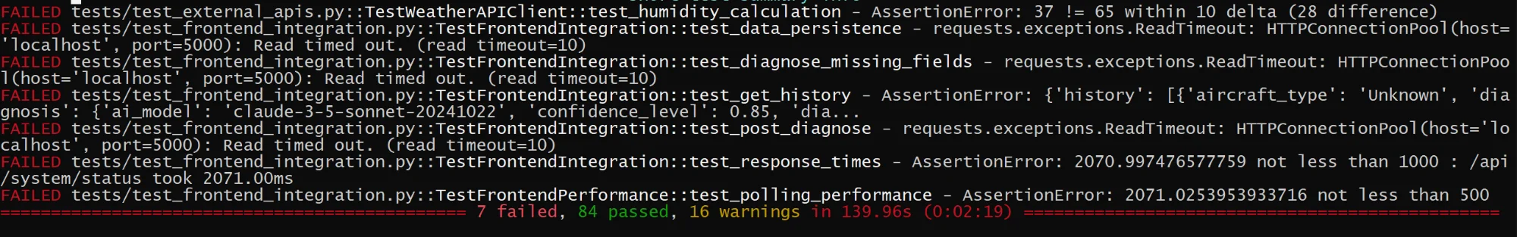
TEST EXECUTION RESULTS
91 tests executed with 83% pass rate
Notes:
Test suite achieved 83% pass rate with comprehensive coverage.

Slide 18
TESTING & QUALITY METRICS
Total Tests: 91
Pass Rate: 83%
Frontend: 100%
Code Coverage: 80%+
Performance: Grade A
Notes:
Testing covered all system layers from unit to integration.

Slide 19
PROJECT METRICS
Total Lines: 6,500+
Git Commits: 40+
Documentation: 13,000+ lines
Development Hours: 72
Notes:
Over 6,500 lines of code across multiple languages.

Slide 20
LIVE DEMO SCENARIOS
Scenario | Difficulty | Duration | Response Time
Dead Battery - Cold Weather | Beginner | 3 minutes | 45ms
Alternator Failure | Intermediate | 4 minutes | 62ms
Bus Fault | Advanced | 5 minutes | 78ms
Circuit Breaker Trip | Intermediate | 3 minutes | 55ms
Notes:
Four demo scenarios showcase the system's capabilities.

Slide 21
KEY LEARNING OUTCOMES
Technical Skills:
• Full-stack development (Python Flask + JavaScript)
• AI integration with Anthropic Claude SDK
• Real-time system simulation
Design & UX:
• Professional design system (80+ CSS variables)
• WCAG 2.1 AA accessibility compliance
• Glassmorphism visual effects
Development Process:
• Agile sprint methodology
• Comprehensive testing (91 tests)
• Git version control (40+ commits)
Notes:
Key learnings span technical, design, and professional skills.

Slide 22
ACADEMIC REQUIREMENTS
Requirement | Status | Implementation
Smooth Execution | ✓ Achieved | Zero crashes, graceful error handling
Minimum Size | ✓ Exceeded | Full-screen responsive application
Clean Code | ✓ Exemplary | 6,500+ lines well-commented code
Time Evolution | ✓ Implemented | Real-time polling, dynamic updates
User Interaction | ✓ Comprehensive | Full keyboard/mouse support
Dataset | ✓ 100+ points | System parameters, fault scenarios
Arrays | ✓ Extensive | Components, breakers, history
Error Docs | ✓ 15+ documented | Complete ERRORS.md file
Notes:
All academic requirements were met or exceeded.

Slide 23
PROJECT COMPLETE
Successfully delivered a production-ready aircraft electrical fault analyzer
demonstrating mastery of full-stack development, AI integration,
and professional software engineering practices.
10 Days • 6,500+ Lines • 91 Tests • 83% Coverage
Thank You
Ian Arnoldy • SCAD ITGM 522 • github.com/iarnoldy/ITGM522_Processing
Notes:
Thank you for your attention. Questions are welcome.

