Slide 1
Neural Networks
Iaroslav Shcherbatyi

Slide 2
Agenda
Neural networks
Formal definition
Shallow neural networks
Live demo
Deep fully connected neural networks
Recurrent neural networks
Convolutional neural networks
Advantages / Disadvantages

Slide 3
Shallow neural network
Shallow ANN: Weighted sum of outputs of multiple neurons.
For every function block below, its input is denoted as x. Bold input arrows denote vector inputs, thin – scalar.
f₁(x)
f₂(x)
Input
layer
Output
layer
w^{T}x
f₃(x)
...
f_{n}(x)

Slide 4
Shallow neural network
Parameters of all neurons are optimized simultaneously.
Here w_{i} are parameters of i-th block.
f₁(w₁, x)
f₂(w₂, x)
Input
layer
Output
layer
w_{n+1}^{T}x
f₃(w₃, x)
...
f_{n}(w_{n}, x)

Slide 5
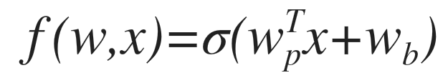



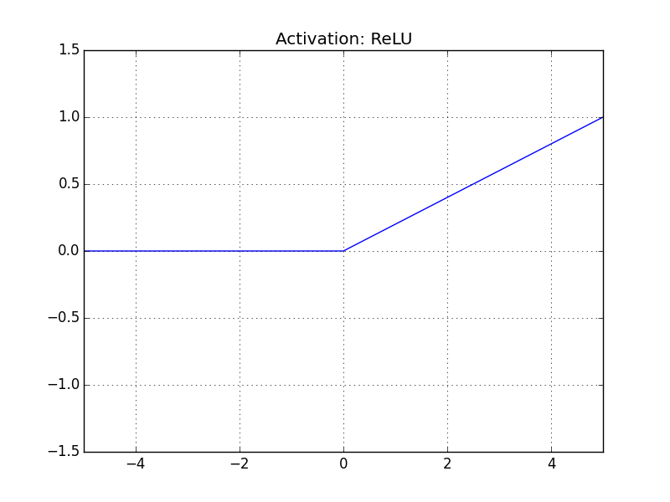
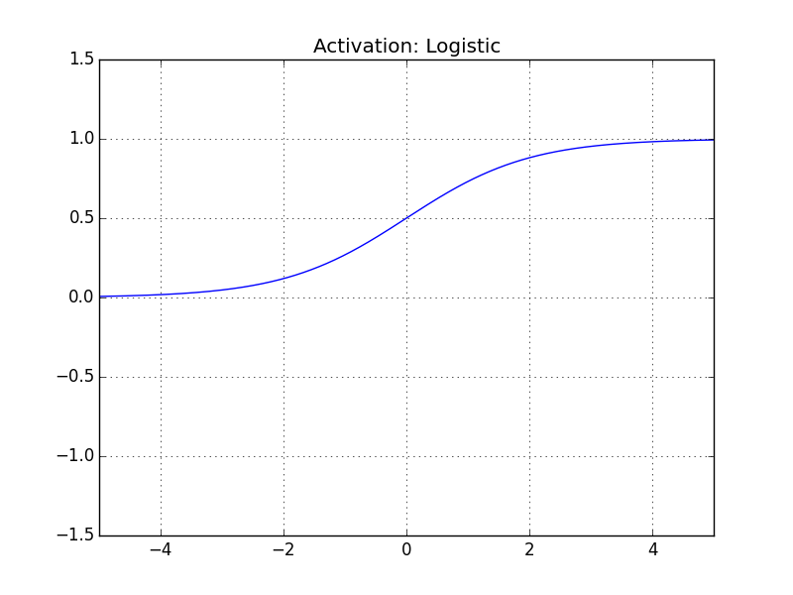
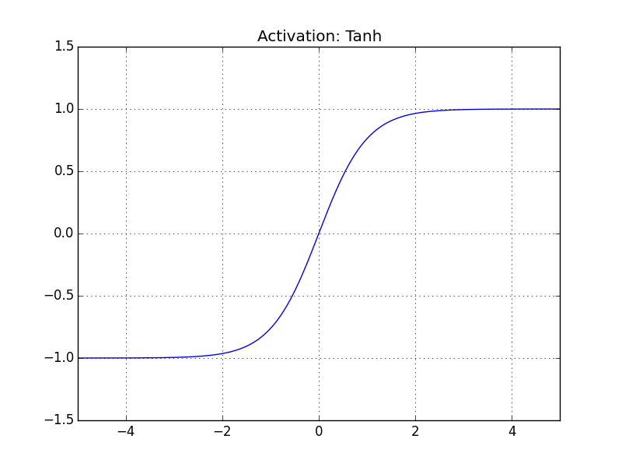
NN’s neurons
Neurons are typically functions of the following form are considered:
Sigma is called “squashing” function; If it is non – linear, than NN (even shallow) is a universal approximator.

Slide 6
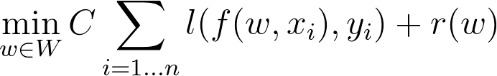
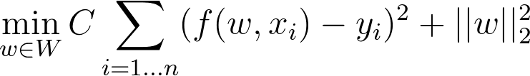
Training of NN
A typical approach – find parameters which minimize:
For example, for regression and with L2 regularization:
Here w contains all the weights of neural net.
Usually solved using some flavor of Stochastic Gradient Descent.
\

Slide 7
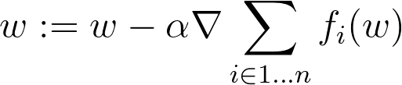
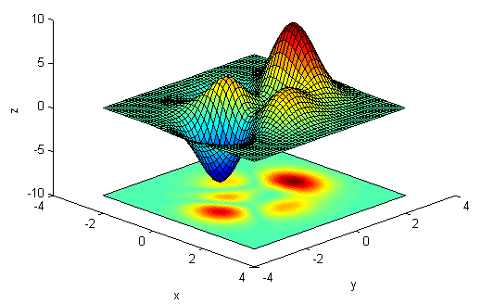
Gradient Descent
No
Random w
Stopping criterion?
End

Slide 8
Gradient Descent
No
Random w
Stopping criterion?
End
Age | Gender | Pain type | Blood pressure | Oldpeak | Sick
70 | 1 | 4 | 130 | 2.4 | yes
67 | 0 | 3 | 115 | 1.6 | no
57 | 1 | 2 | 124 | 0.3 | yes
64 | 1 | 4 | 128 | 0.2 | no
74 | 0 | 2 | 120 | 0.2 | no
65 | 1 | 4 | 120 | 0.4 | no
56 | 1 | 3 | 130 | 0.6 | yes
Use whole
dataset

Slide 9
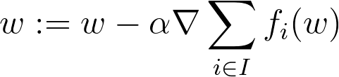
Stochastic Gradient Descent
No
Random w
Stopping criterion?
End
Age | Gender | Pain type | Blood pressure | Oldpeak | Sick
70 | 1 | 4 | 130 | 2.4 | yes
67 | 0 | 3 | 115 | 1.6 | no
57 | 1 | 2 | 124 | 0.3 | yes
64 | 1 | 4 | 128 | 0.2 | no
74 | 0 | 2 | 120 | 0.2 | no
65 | 1 | 4 | 120 | 0.4 | no
56 | 1 | 3 | 130 | 0.6 | yes
Use subset
of dataset

Slide 10
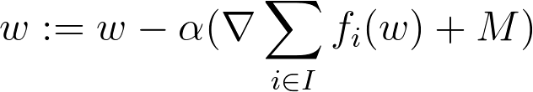
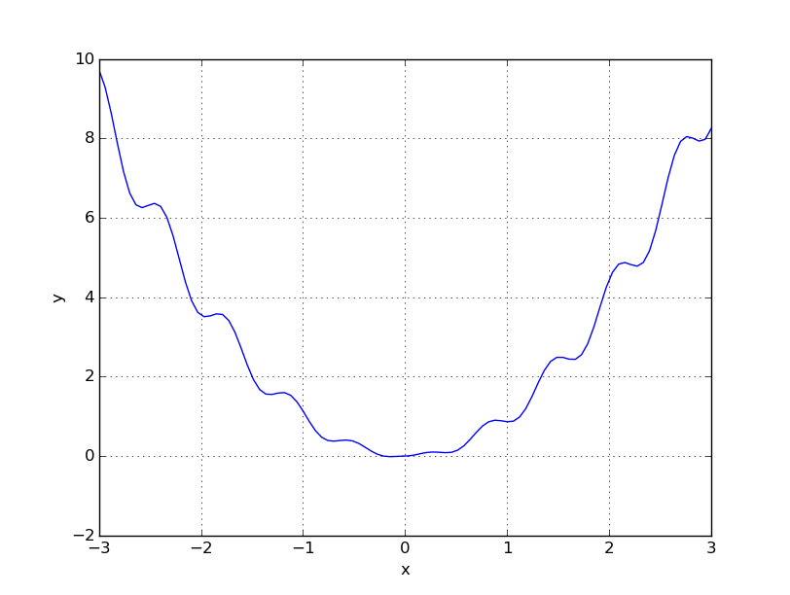
Stochastic Gradient Descent
No
Random w
Stopping criterion?
End
Momentum helps
to avoid local
minima

Slide 11
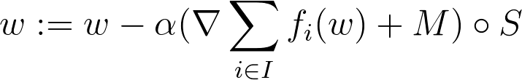
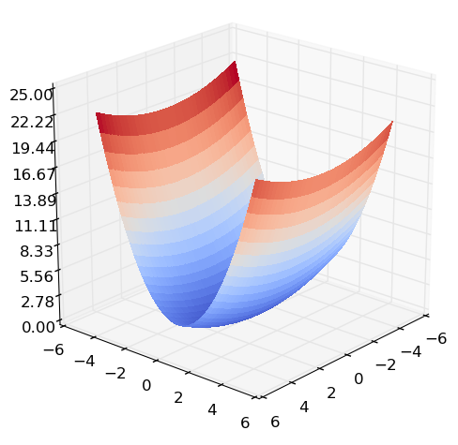
Stochastic Gradient Descent
No
Random w
Stopping criterion?
End
Scaling has effect
similar to
normalization

Slide 12
Stochastic Gradient Descent
No
Random w
Stopping criterion?
End
Too small alpha:
slow convergence
Too large alpha:
divergence

Slide 13
Online demo
Online demo: http://cs.stanford.edu/people/karpathy/convnetjs/demo/mnist.html
You can find the link by googling „Karpathy mnist“
Insert in the “Instantiate a Network and Trainer” contents from here https://goo.gl/uI0O5r and press “change network”.

Slide 14
Layer-wise representation of NN’s
Popular architectures can be represented conveniently as a sequence of layers.
Layer is a vector valued function of vector input.
Layer
w₁^{T} x+b₁
σ(x)
w₂^{T} x+b₂
σ(x)
Input
layer
Output
layer
w_{n+1}^{T}x
w₃^{T} x+b₃
σ(x)
...
w_{n}^{T} x+b₄
σ(x)

Slide 15
Linear function layer
Linear layer is a convenient representation of outputs of linear functions used inside neurons.
W^{T}x is a matrix multiplication of matrix W and vector x.
w₁^{T} x+b₁
Wx+b
w₂^{T} x+b₂
=
Input
w₃^{T} x+b₃
Output
Input
Output
...
w_{n}^{T} x+b₄

Slide 16
Linear function layer
Activation layer takes as input a vector x, and outputs vector y of same size as x, where it holds for every i = 1 … n
y_{i} = σ(x_{i})
where n is a size of input vector x.
σ(x)
σ(x)
σ(x)
=
Input
σ(x)
Output
Input
Output
...
σ(x)

Slide 17
Layer representation of NN
Architecture selection for neural networks is (typically) done on the layer level.
Layers below are represented as blocks.
Red blocks: no parameters, blue: with parameters.
Linear
layer
Activation
layer
Linear
layer
W₁x+b
σ(x)
W₂x+b
Input
layer
Output
layer

Slide 18
Deep neural networks
Repeat N > 1 times
Linear
layer
Activation
layer
Linear
layer
W₁x+b
σ(x)
W₂x+b
Input
layer
Output
layer

Slide 19
Recurrent neural networks
Store activations between different inputs (“have memory”).
Work with sequences of arbitrary size. Memory vector is reset between sequences.
Good at processing sequential data, e.g. text.
t
…
Memory vector
Input 4
Input 3
Linear
layer
Activation
layer
Linear
layer
Input 2
Stack
memory
and input
vectors
W₁x+b
σ(x)
W₂x+b
Copy
outputs
Input 1
Output 1
Input 0
Output 0

Slide 20
Convolutional neural networks
Operates directly on images.
Have “special” layers – convolutional and pooling. Pooling layer: downsize input image.
Repeat N > 1 times
Fully
connected
network
Convolutional
layer
Pooling
layer
conv(x)
pool(x)
FC(x)
Input
layer
Output
layer

Slide 21
Convolutional neural networks
Convolutions demo
Taken from Stanford CS class CS231n: Convolutional Neural Networks for Visual Recognition

Slide 22
Larger NN are easier to train
Other
methods
Small
NN
Larger
NN
Large
NN
Training
Loss

Slide 23
Deep Learning Software
Most of it in python, and can run on both GPU or CPU:
Theano
TensorFlow
Keras
PyTorch
Torch
MXNet
Lasagne
Autograd
Chainer
Deeplearn.js
…

Slide 24
Text encoding for RNN
Words in encoded form are fed to the neural network. To obtain such encoding, the following steps are taken:
Generate vocabulary of all unique words from the training text
To encode the word with its index in the vocabulary
Use one hot encoding on word indexes
Either create a category for all words missing in dictionary or skip them.
1
0
0
0
1
0
0
0
1
Vocabulary:
{‘Car’, ‘Cat’,’House’}
‘Car’
‘Cat’
‘House’

Slide 25
Word embedding
Word encoding can produce very high dimensional vectors. Word embedding reduces this dimension by applying a linear transformation to the word vectors
t
…
Input 4
Memory vector
Input 3
Word
embedding
Linear
layer
Activation
layer
Linear
layer
Input 2
W₀x
W₁x+b
σ(x)
W₂x+b
Input 1
Output 1
Input 0
Output 0

Slide 26
Types of RNN
“Vanilla” RNN: the most simple type of recurrent neural networks. Has relatively few parameters, but does not work well with long sequences.
Long Short Term Memory units: have more parameters per block compared to simple RNN, but in practice work better with long sequences.
Gated recurrent units: work better than simple RNN on long sequences, but have less parameters compared to LSTM.
Is an active research area.

Slide 27
Advantages
Well suited for big data
Is not as computationally expensive as Kernel SVM or KNN for large amounts of data.
Unreasonably flexible
Can take as input directly images, text, structured data etc. Can output directly images, text, structured data etc.
State of the art
Recently dedicated neural networks beat other methods on applications of computer vision and natural language processing -> great hype right now.

Slide 28
Disadvantages
Not very well understood
Does not have a strong theoretical background like SVM.
Requires a lot of data
For neural network to converge properly, large number of parameters are required. For large number of parameters, large amount of data is needed to not overfit.
Bullet proof black box, in case of general purpose feed forward nets
Interpretation is more complicated due to complex models and the topic being recent. Work is done in this area.
NP hard to get the best possible neural network on small amount of data.

Slide 29
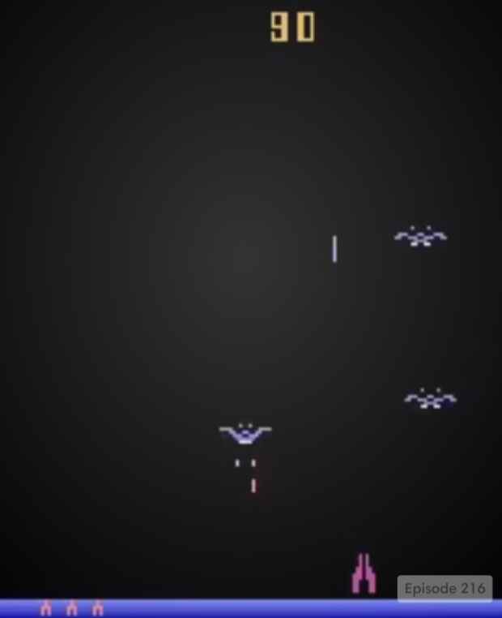
Cool things
Seen so far: learning by example
RL: learning by experience
Age | Blood pressure | Oldpeak | Sick
70 | 130 | 2.4 | yes
67 | 115 | 1.6 | no
57 | 124 | 0.3 | yes
64 | 128 | 0.2 | no
74 | 120 | 0.2 | no
65 | 120 | 0.4 | no
56 | 130 | 0.6 | yes
https://www.youtube.com/watch?v=Q70ulPJW3Gk
Mnih, Volodymyr, et al. "Human-level control through deep reinforcement learning." Nature 518.7540 (2015): 529-533.

Slide 30
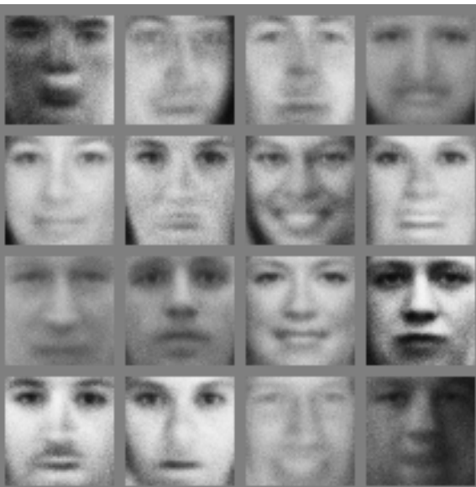
Cool stuff
Seen so far: deterministic output
GN: Stochastic output
GN: Stochastic output
Age | Blood pressure | Oldpeak | Sick
70 | 130 | 2.4 | yes
67 | 115 | 1.6 | no
57 | 124 | 0.3 | yes
64 | 128 | 0.2 | no
74 | 120 | 0.2 | no
65 | 120 | 0.4 | no
56 | 130 | 0.6 | yes
Generate faces:
Goodfellow, Ian, et al. "Generative adversarial nets." Advances in Neural Information Processing Systems. 2014.

Slide 31
Hands on
For a cloud instance, use this:
-:- coming soon!

