Slide 1
NLP for Arabic Songs
General Assembly
Misk Academy

Slide 2
Table of Contents
02
03
01
Dataset
EDA
Problem of Statement
04
Modeling
05
Challenges

Slide 3
Problem Statement
NLP for dialect identification

Slide 4
Dataset
Habibi Corpus, an open-source Arabic song lyrics dataset.
csv file.
527896 rows & 9 columns
30,000 Arabic song lyrics.
6 Arabic dialects.
500,000 sentences.
3.5 million words.

Slide 5
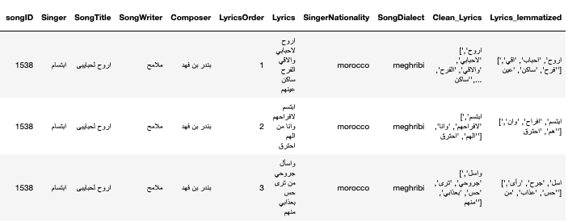
Preprocessing steps
Cleaning
Tokenization
Lemmatization
Stopwords & Regular Exeprestions
NLTK
FARASA

Slide 6
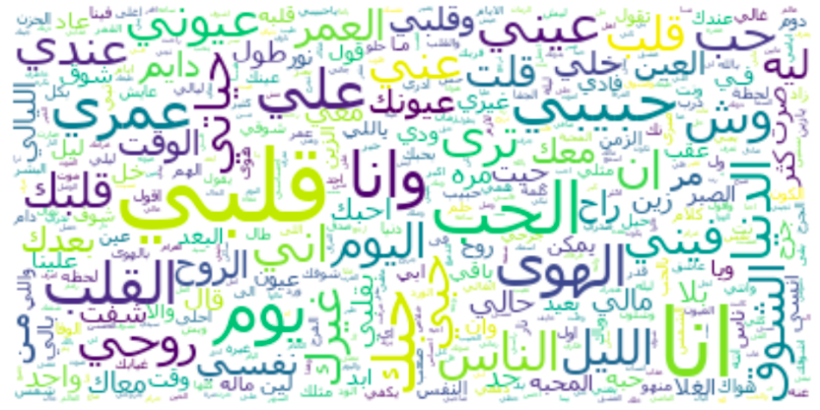
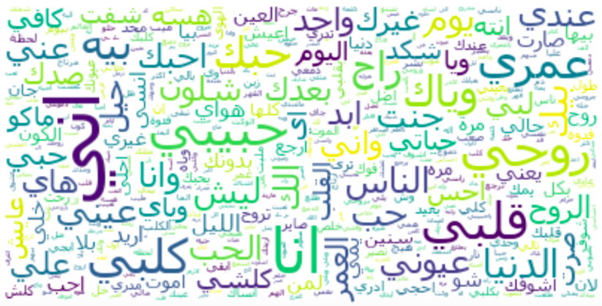
EDA
01
Gulf
02
Iraqi

Slide 7
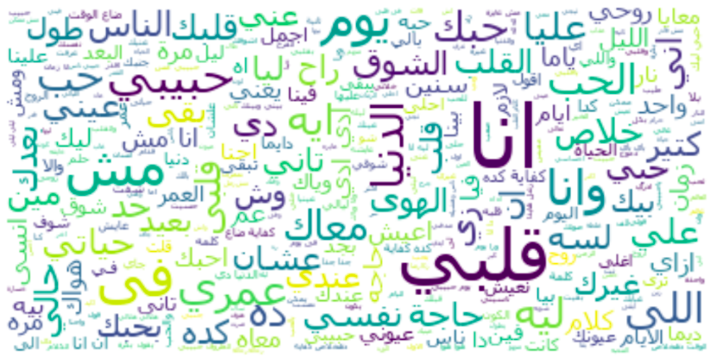
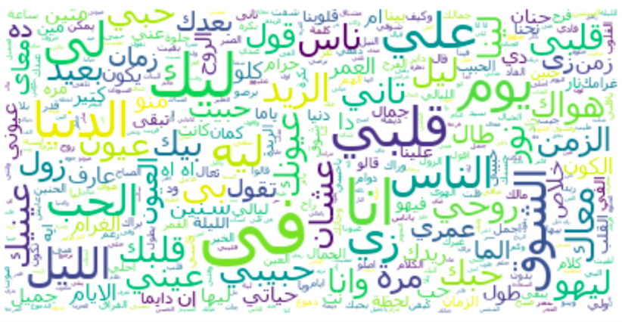
EDA
01
Meghribi (‘Moroco’)
02
Sudan

Slide 8
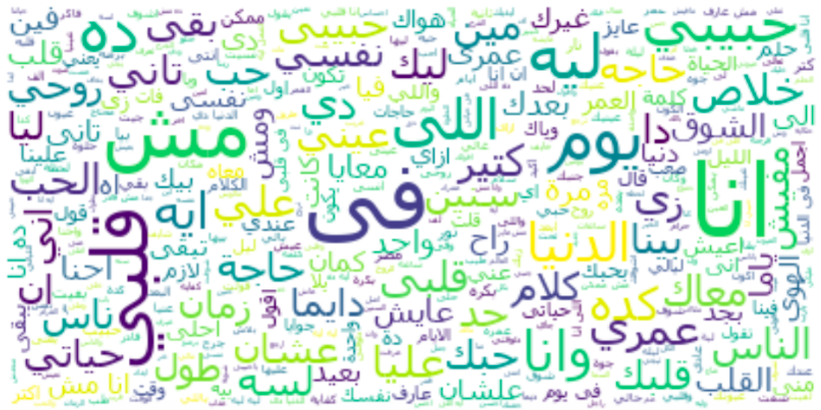
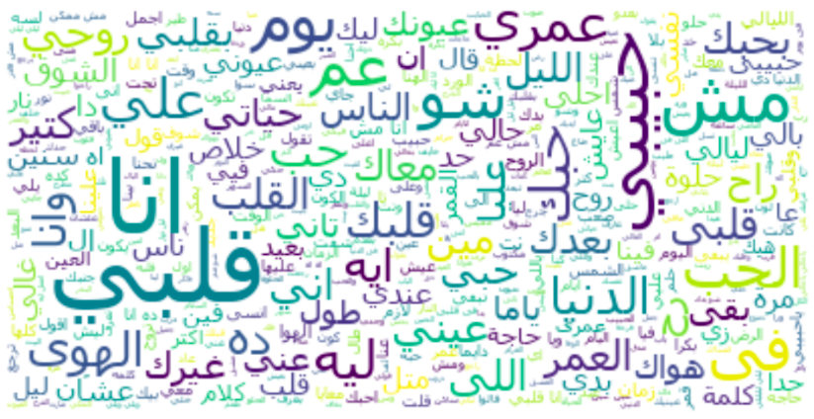
EDA
01
Egyptian
02
Levantine

Slide 9
Modeling
1. Vectorizing Raw Data
2. ML Classifier
Logistic RegressionCV
Random Forest
Gradient Boosting
Decision Tree
Count Vectorization
TF-IDF
Word2Vector

Slide 10
Model Result
 | RF TF-IDF | GB TF-IDF
Precision | 0.68 | 0.599
Recall | 0.667 | 0.498
Accuracy | 0.667 | 0.498
 | CountVect | TF-IDF
LR-CV | 0.591 | 0.592
 | CountVect
DT | 0.593

Slide 11
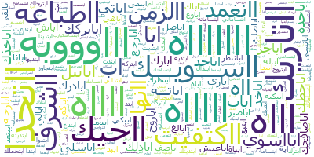
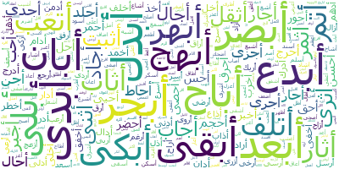
Vectorizer Result
Gulf words
01
Count Vect of nltk lemma
# of unique words = 32 words
02
Count Vect of farasa lemma
# of unique words = 37 words

Slide 12
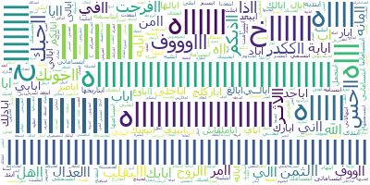
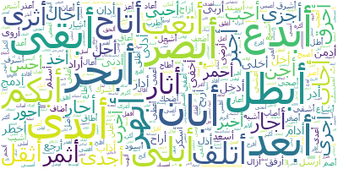
Vectorizer Result
Iraqi words
01
Count Vect of nltk lemma
# of unique words = 32 words
02
Count Vect of farasa lemma
# of unique words = 36 words

Slide 13
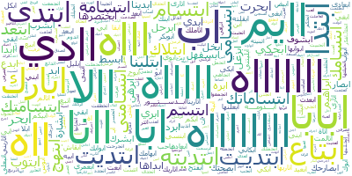
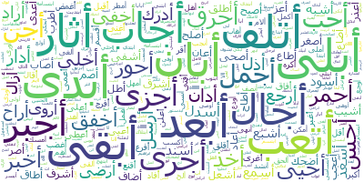
Vectorizer Result
Megribi words
01
Count Vect of nltk lemma
# of unique words = 32 words
02
Count Vect of farasa lemma
# of unique words = 36 words

Slide 14
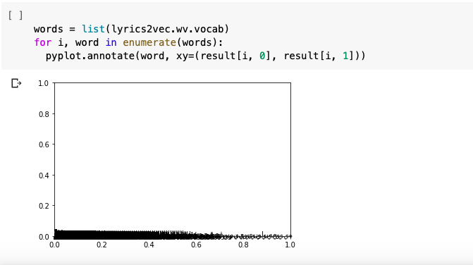
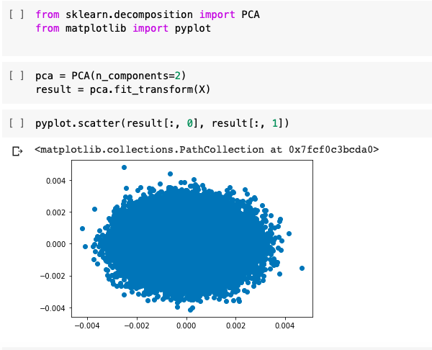
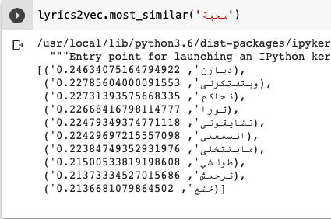
Word2Vector Result

Slide 15
Challenges
Dialect Stop-words
& Regex
CBOW
FARASA API was time consuming
CNN

Slide 16

Thanks

