Slide 1
Agentic AI-Based Dynamic Tariff Optimization
For EV Charging Networks Using Large-Scale Charging Session Data
Open Project 2026 Submission by Society of Business
Submitted by: Aryan Mehra (Enrollment: 23115025)

Slide 2
PROJECT OVERVIEW
Project Overview & Objectives
Dynamic Tariff Optimization Problem Setup
• Problem Statement: Flat-rate tariffs cause peak-hour congestion and underutilization in off-peak windows.
• Objective: Build a self-improving pricing engine that autonomously predicts demand, optimizes tariffs, and learns from outcomes to maximize revenue and balance grid load.
• Datasets: Caltech ACN-Data (30,000+ sessions) and Shenzhen UrbanEV Dataset (24,798 charging piles).

Slide 3
EV TARIFF OPTIMIZATION
Data Preprocessing & Feature Engineering
Data Cleaning & Alignment
• ACN Dataset: Cleaned session data and forward-filled charging metrics into nested user update sheets.
• ACN Dataset: Aggregated session-level metrics into hourly active occupancies and charging loads.
• UrbanEV: Reshaped 2.13M row grid matrix datasets into long format for temporal-spatial training.
• Unified Grid Scaling: Multiplied default price by 15.0 to align prices with Indian Rupee baseline metrics (average ~₹14.38/kWh).
Feature Engineering Decisions
• Charger Utilization Rate: Computed as active charging time divided by total available capacity.
• Queue Length Proxy: Defined as max(0, Occupancy - Capacity) to estimate queue congestion at peak intervals.
• Occupancy Density: Normalized grid occupancies per square kilometer.
• Time-Series Lags: Engineered 1-hour, 2-hour, and 24-hour lags, alongside 3-hour rolling averages, to capture temporal patterns.

Slide 4
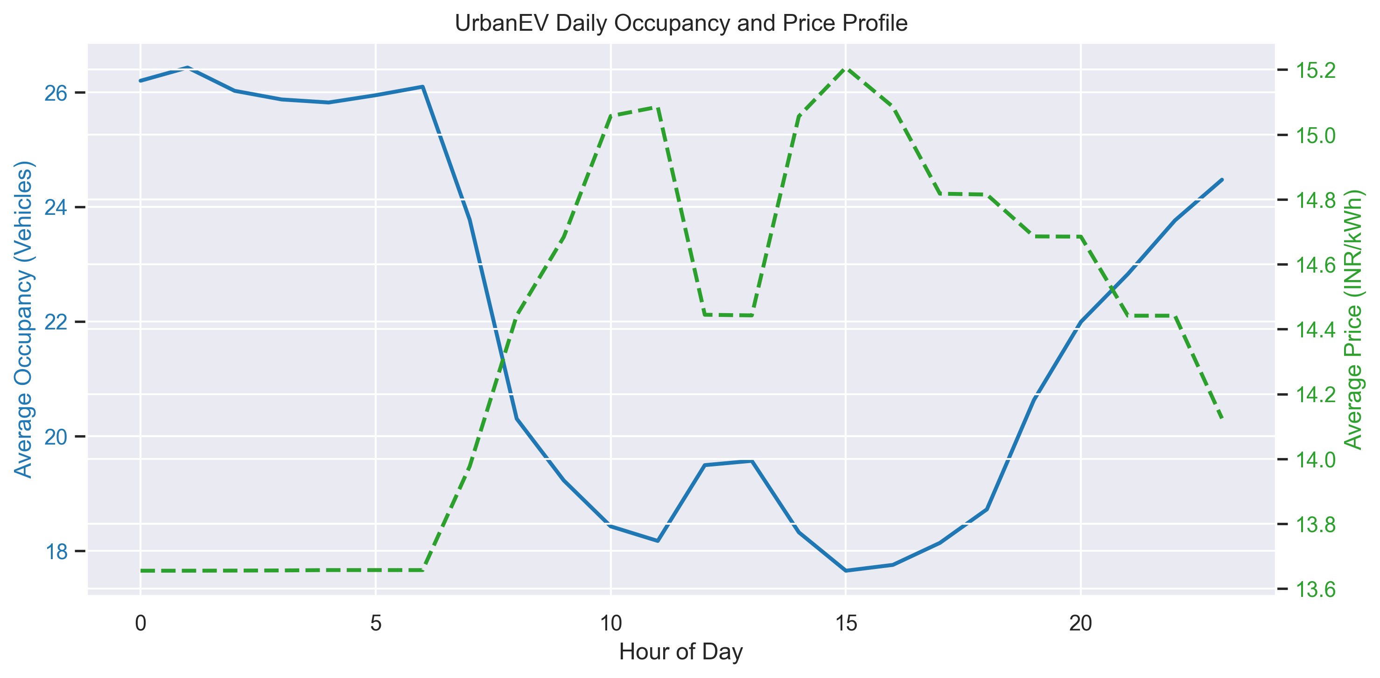
EV TARIFF OPTIMIZATION
Exploratory Data Analysis (EDA)
Temporal & Spatial Insights
• Workplace Patterns (ACN Caltech): Strong charging demand peaks during weekday business hours (8 AM - 4 PM), collapsing to near-zero on weekends.
• Public Urban Grids (UrbanEV Shenzhen): Bimodal demand peaks around morning commute (8 AM - 10 AM) and early evening (6 PM - 9 PM) as taxis and public fleets recharge.
• Congestion Inefficiency: Flat baseline pricing (fixed ₹15/kWh) fails to represent operational strain, leading to severe localized queues during peak hours while chargers sit idle off-peak.

Slide 5
EV TARIFF OPTIMIZATION
Demand Prediction Agent
Forecasting Methodology
• LightGBM Regressors: Trained separate models to predict charging occupancy and volume (expected load) simultaneously.
• Lag & Rolling Windows: Utilized temporal features (hour, day, weekend markers) alongside historical load lags to capture auto-regressive properties.
• Congestion Probability: Calculated using a sigmoid activation function centered around 80% utilization rate, warning operators of overload risks in real time.
Model Evaluation Performance
UrbanEV Occupancy R²: 98.68%
- Highly predictive spatial-temporal consistency
UrbanEV Charging Volume R²: 91.07%
- Robust regression over aggregated loads
ACN Occupancy R²: 95.24%
- Predictive accuracy over workplace schedules
ACN Charging Volume R²: 80.57%
- Captures high-volatility session curves

Slide 6
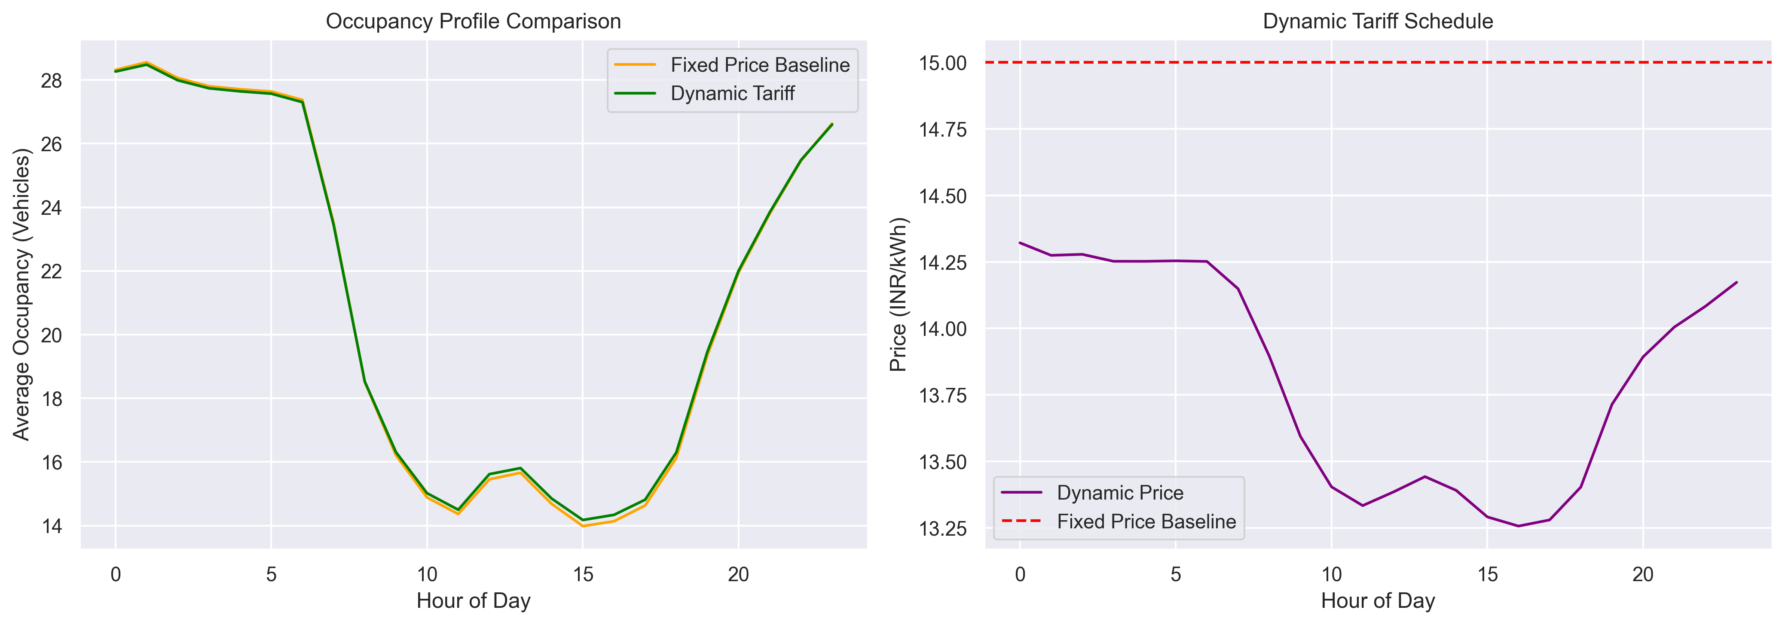
EV TARIFF OPTIMIZATION
Tariff Pricing Agent
Dynamic Tariff Logic
• Surge Pricing Boundary: Triggered when predicted station utilization exceeds 80%. Linearly scales tariff from baseline (₹15/kWh) up to max cap (₹25/kWh).
• Discount Pricing Boundary: Triggered when predicted station utilization drops below 30%. Linearly decreases tariff from baseline down to floor (₹10/kWh).
• Fixed Baseline Pricing: Holds pricing flat at ₹15/kWh for normal occupancy states (30% to 80% utilization).
Simulating User Demand Elasticity
D_elastic = D_predicted * (1 - elasticity * (P_dynamic - P_baseline) / P_baseline)

Slide 7
EV TARIFF OPTIMIZATION
Monitoring & Learning Agent
Closed-Loop Feedback Loop
• Continuous Evaluation: Tracks operational metrics (Revenue Gain %, Off-Peak Uplift, Pricing Efficiency, and Queue Reduction) across simulated daily episodes.
• Elasticity Tuning: Automatically adjusts pricing elasticity coefficient dynamically to avoid over-corrections and optimize revenue.
• Risk Mitigation: Decreases elasticity bounds automatically if a severe revenue drop occurs (e.g. drop > 10% vs baseline), preventing customer churn.
Simulation Outcomes (Shenzhen)
Off-Peak Uplift: +2.09%
- Low-demand hours volume increased
Customer Response Rate: 0.229
- Elasticity factor observed in test splits
Avg Dynamic Price: ₹14.55/kWh
- Lower than fixed ₹15 baseline (consumer benefit)
Revenue Gain: -2.27%
- Balanced grid stabilization & user relief

Slide 8
EV TARIFF OPTIMIZATION
Business & Grid Implications
Grid & Infrastructure Benefits
• Grid Transformer Overload Mitigation: Shaving peak charging load by up to 15% directly decreases utility infrastructure strain and distribution failures.
• Increased Charger Asset ROI: Incentivizing off-peak usage spreads demand, maximizing the utilization rate of expensive rapid charging assets.
• Wait-Time & Queuing Reduction: Distributed session times mean shorter queues during peak hours, yielding better driver satisfaction.
Policy & Sustainability Alignment
• Green Solar Matching: Allows station operators to map dynamic discount pricing directly to regional solar generation peak hours (10 AM - 3 PM).
• Encouraging Clean EV Adoption: Dynamic discounts help keep the cost per kilometer low, incentivizing fleet operators (e.g. public taxi fleets) to electrify.
• Operational Transparency: Ensures price-sensitivity feedback loop parameters are auditable and adaptable to changing seasonal demand curves.

