Slide 1



Notes:
Hey Everyone! Good Morning.
I am Sarthak and for sometime I want you guys to assume that I work as a data scientist for Pizza Hut.

Slide 2
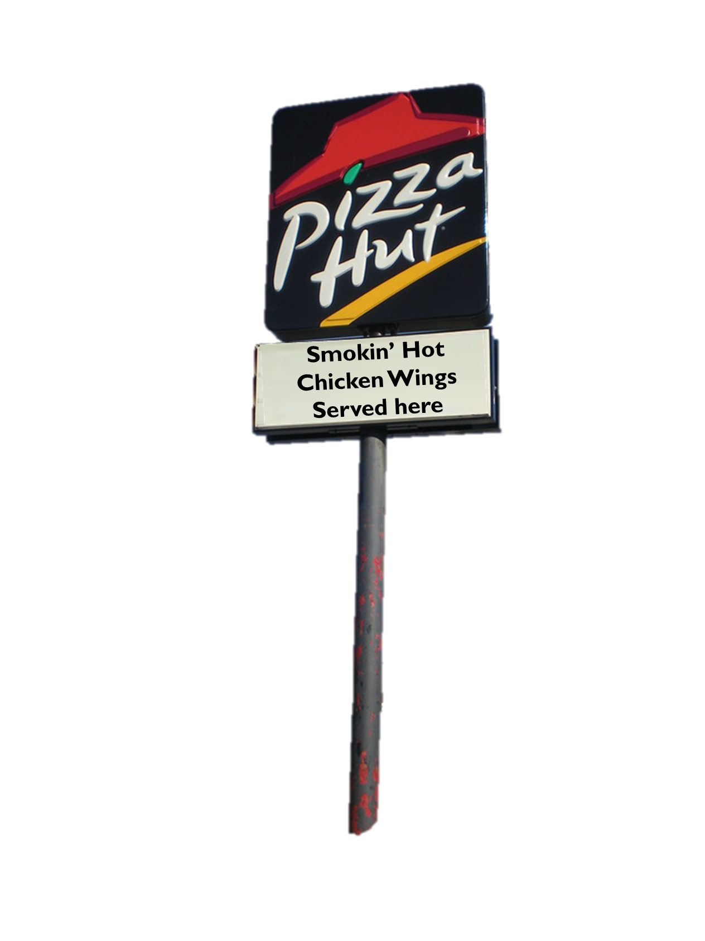
Notes:
Well, we have a fantastic product that is still undersold. We have confidence in our product and we expect it to do really well.
Hence, I have been employed to solve this problem!

Slide 3
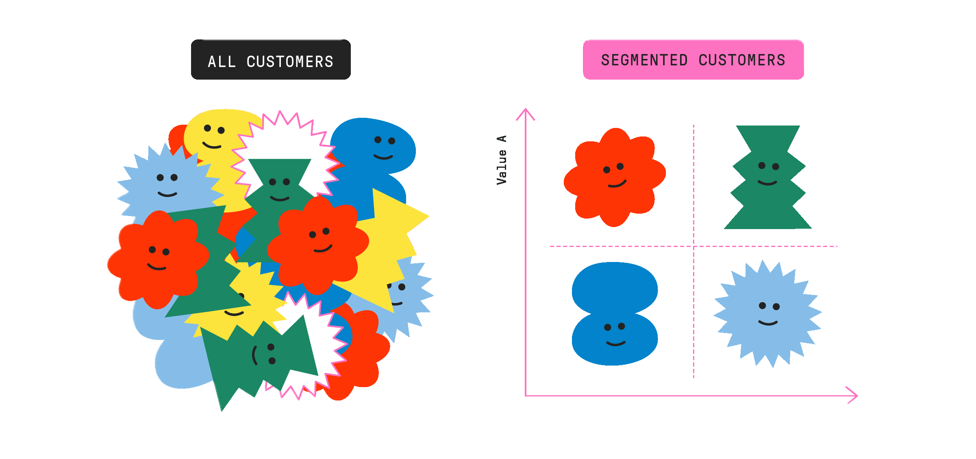

Notes:
We have a customer base and we want to cluster it into….

Slide 4
Notes:
..groups.
So that we are able to identify the different type of customers we have and how we can target each group differently so as to market our chicken wings effectively.
This will help us to save a lot of resources- both time and money. And we can do targeted marketing, and hope to increase the sales of our chicken wings.

Slide 5
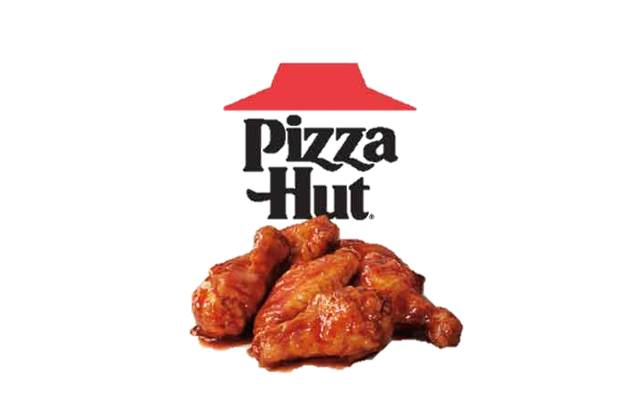
Potential ways to segment our customers?
Visit Frequency
Average Expenditure
Expenditure on Chicken Wings
Expenditure on Other Items
Location
Age
Type of Chicken Wings
Gender
Notes:
We had most of these variables in our dataset. Hence, we proceeded with it directly.

Slide 6
The Dataset
(1,00,000 rows and 319 columns)
Data Variable Categories-
Count and Avg. Bill at different time of the day
L6M Carry Out and Delivery Average Bill
Distinct Stores Count
Execution Time
Latest and L6M Sales(Discount/Coupons)
Average Bill though various sources (Internet, Non-Internet, Bill etc.)
Pizza Attributes (Topping and Size)
Various Categories Spend (Latest and L6M)
Spend and no. of visits to Wing Street stores
Flag Variable- (March, April, May) Pizza/Wings
Notes:
We

Slide 7
Pre-processing Done-
Sparse Vectors Removal
Removing Highly correlated variables (>corr. higher than 0.90)
Removal of variables like Topping and Pizza attributes
Feature Engineering
Min-Max Scaling

Slide 8
Techniques Tried
KMeans after doing PCA of 150+ variables
KMeans after doing Factor Analysis of 45 variables
Using Random Forest to select 35 variables and then using KMeans and DBSCAN
DBSCAN of 45 variables
KMeans of 10 variables, ultimately reducing to 4

Slide 9
Final Variables
Flag_Internet
Flag_Non_Internet
L6M_COUNT_ORDER_CLASS_Wings
FL_WINGS_May

Slide 10
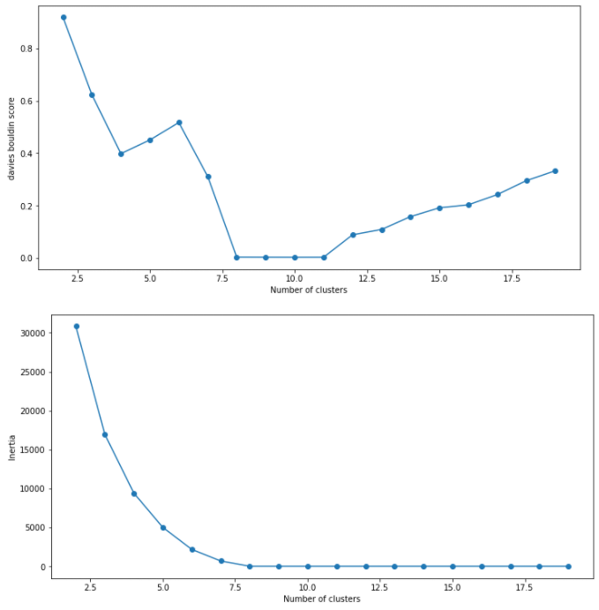
Approach

Slide 11
Approach

Slide 12
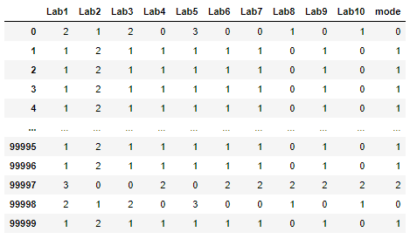
Approach

Slide 13
FIVE Clusters
Internet
Internet
Non- Internet
40%
21%
Extreme Buyers
0.1%
Non- Internet
9.9%
29%

Slide 14
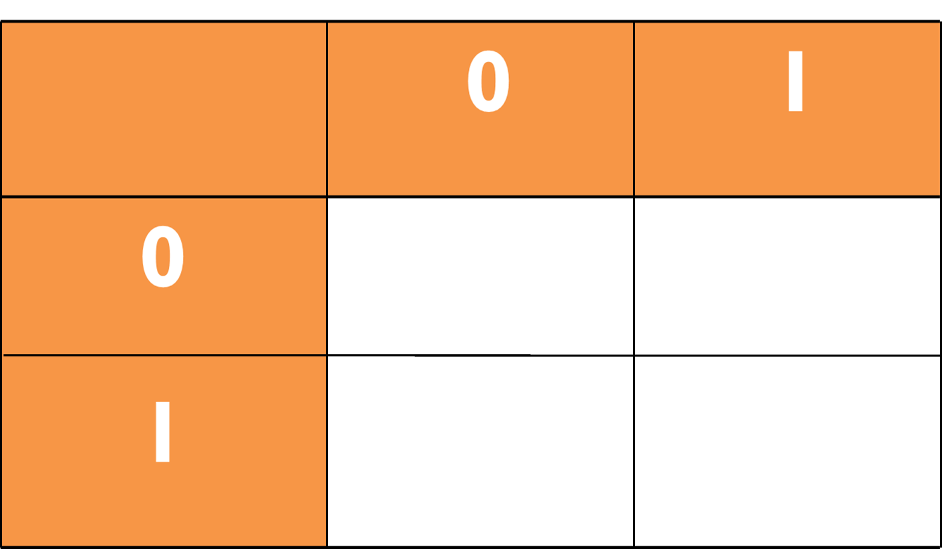
Internet
L6M Average
Wings Count
0.65
0.93
Non-
Internet
1.17
1.99

Slide 15
Internet
Customers
In May
895
3902
Non-
Internet
2737
3020

Slide 16
Marketing techniques
Internet
Internet (A)
Non- Internet (B)
40%
21%
Extreme Buyers
(E)
0.1%
(C)
Non- Internet
(D)
9.9%
29%

Slide 17
As there is high correlation between expenditure on Chicken Wings in L6M and:-
Pizza in L6M
Alcoholic Beverages in L6M
Expenditure during Lunch
Expenditure during Dinner

Slide 18
Things needed to work on-
Marketing techniques
If there can be any more sub-clusters
Applying other techniques to come up with clusters

Slide 19
Thank You!

