Slide 1



Russian Cryptography:
Laws, Standards and Algorithms

Slide 2
Contents
Introduction
Legal Framework in Russia
Key Regulatory Bodies and Organisations
Orders Regulating Cryptography
Domestic Cryptographic Standards
Domestic Cryptographic Algorithms
Kuznechik – close look
3 “Hops” of Kuznechik
SKZI vendor responsibilities
Comparison of RU and CN Systems – 1
Comparison of RU and CN Systems – 2
Q&A
Resources
Введение
Правовая база РФ (ФЗ-шки)
Ключевые регулирующие ведомства и организации
Приказы регулирующие сферу Криптографии в РФ
Отечественные стандарты криптографии (ГОСТЫ)
Отечественные криптографические алгоритмы
Кузнечик под микроскопом
3 “Прыжка” Кузнечика
Обязанности вендоров СКЗИ
Сравнение сфер криптографии РФ и КНР – 1
Сравнение сфер криптографии РФ и КНР – 2
Q&A
Ресурсы

Slide 3

Introduction
Russia’s system, like China’s, has three pillars: Law, Standards, and Technology (algorithms).
Government ensures control over cryptography via legislation, technical standards (GOST), and certified domestic algorithms habr.com, habr.com.
Emphasis on national security and self-reliance in crypto (mandating local ciphers in government and critical systems, creation of “National Certification Center” habr.com).
Cryptography Regulation
Federal Laws (FZ) and decrees
Standards (GOST)
Algorithms

Slide 4
Legal Framework in Russia
Federal Law 149-FZ (2006) – “On Information, Information Technologies and Protection of Information.” This is the core law regulating information security and mentions use of encryption habr.com.
Sectoral Laws: e.g. Federal Law 152-FZ (2006) on Personal Data mandates protection of personal data (encryption is required at certain levels). Recent Law 216-FZ (2024) expanded requirements for using certified encryption in government systems cisoclub.ru.
Decrees and Orders: Presidential decrees and government regulations supplement laws (e.g. Gov. Decree No. 313 (2012) on licensing crypto activities habr.com).
Key takeaway: Russia has no single “Cryptography Law” akin to China’s, general principles of information protection are regulated in 149-FZ, whereas cryptography is regulated in FSB’s decrees.

Slide 5



Key Regulatory Bodies and Organizations
Federal Security Service (FSB): The lead executive authority for cryptography. FSB regulates development, production, sale, and use of encryption tools, including import/export control habr.com. It conducts certification of cryptographic means and issues licenses to crypto developers habr.com.
Federal Service for Technical and Export Control (FSTEC): Regulates broader aspect of information security (e.g. protecting critical infrastructure, threats data bank) en.wikipedia.org.
Technical Committee 26 (TC26): National standardization committee for “Cryptographic Protection of Information.” Develops and updates Russian cryptographic standards (GOST standards for ciphers, hashes, etc.) tc26.ru. It also contributes to international crypto standards.
1
2
3
handles everything cryptography-related.
handles every other InfoSec aspect.
TC26 develops GOST standards.

Slide 6

FSB Orders Regulating Cryptography
FSB Order № 66 (2005): Requirements for crypto developers and vendors.
FAPSI Order № 152 (2001): (outdated) Instruction for using crypto tools for sensitive information.
FSB Order № 378 (2014): Requirements for protecting personal data with cryptography.
FSB Order № 524 (2022): Requirements for protecting information in government IS using certified encryption tools.
FSB Order № 117 (2025): replacement for Order 524. Expands the scope of mandatory encryption.
Notes:
FSB Order № 66 (2005) – “PCZ-2005” Regulations for development, production, distribution, and operation of encryption means habr.com. Focused on requirements for crypto developers and vendors. (Still foundational for crypto industry rules.)
FAPSI Order № 152 (2001) – Instruction on using cryptographic protection for sensitive information (not state secrets) habr.com. Geared toward users of crypto tools; somewhat outdated but legally still in force habr.com.
FSB Order № 378 (2014) – Requirements for protecting personal data with cryptography habr.com. Defines organizational/technical measures and mandates choosing an appropriate class of crypto tools (SKZI) based on data protection level ec-rs.ru. Modernized guidelines for encryption in personal data systems.
FSB Order № 524 (2022) – Established strict requirements to protect information in government information systems (GIS) using FSB-certified encryption tools regulhub.kaspersky.ru. Specified how to determine the required class of crypto protection for state systems. Only FSB-certified crypto products can be used in such systems isoconsulting.ru.
FSB Order № 117 (2025) – New order (Mar 18, 2025) replacing Order 524. Expanded the scope of mandatory encryption beyond just “state information systems” to all electronic systems run by government bodies (including state unitary enterprises, etc.) cisoclub.rucisoclub.ru. Requires exclusive use of FSB-certified cryptographic means to protect data in those systems. (Exceptions: highest government organs and systems handling state secrets are covered by separate regs cisoclub.ru.) This update aligns regs with changes in law (216-FZ) and the evolving threat landscape.

Slide 7
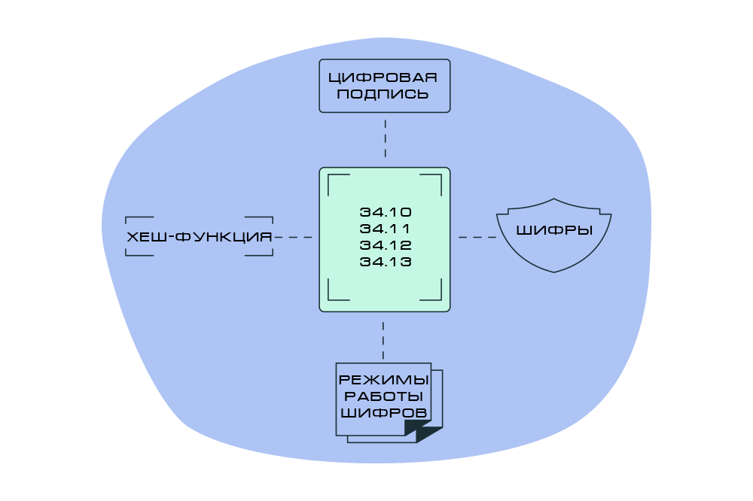
Domestic Cryptographic Standards
Russia uses GOST standards (“ГОСТ” – national state standards) to define cryptographic algorithms and protocols. Current standards (since 2018–2019) cover four main areas habr.com:
Digital Signatures: GOST R 34.10-2018
Hash Function: GOST R 34.11-2018
Block Ciphers: GOST R 34.12-2018
Block Cipher Modes: GOST R 34.13-2018
These GOST standards took effect in 2019 (approved by Rosstandart) and build upon earlier GOST versions habr.com by TC26. They ensure interoperability and security for any certified Russian crypto implementations.
https://habr.com/ru/articles/530816/
Notes:
Digital Signatures: GOST R 34.10-2018 – Elliptic-curve digital signature algorithm (256-bit and 512-bit keys) habr.com. Defines how to generate/verify electronic signatures using elliptic curve operations and a hash (Streebog).
Hash Function: GOST R 34.11-2018 – Hash algorithm standard, defines the Streebog hash function habr.com. Produces 256-bit or 512-bit hash outputs; processes data in 512-bit blocks.
Block Ciphers: GOST R 34.12-2018 – Block cipher algorithms standard habr.com. Specifies two ciphers: Magma (64-bit block, 256-bit key, 32 rounds) and Kuznechik (128-bit block, 256-bit key, 10 rounds SP-network). These are modernized replacements of older Soviet ciphers.
Block Cipher Modes: GOST R 34.13-2018 – Modes of operation for block ciphers (similar to AES modes) habr.com. Includes basic ECB (simple substitution), CBC (chaining), CTR (streaming/XOR mode), OFB/CFB (feedback modes), and an authentication mode (imitovstavka, i.e. MAC) as standardized modes.

Slide 8

Domestic Cryptographic Algorithms
Kuznechik (“Grasshopper”): Russia’s 128-bit block cipher (GOST R 34.12-2015/2018). Uses a substitution-permutation network with 10 rounds and a 256-bit key habr.com.
Magma: The updated name for the classic Soviet GOST 28147-89 cipher (64-bit block, 256-bit key, 32-round Feistel) habr.com.
Streebog Hash: The GOST hash function (GOST 34.11-2012/2018). Outputs 256-bit or 512-bit hashes habr.com.
GOST Digital Signature: GOST 34.10-2012/2018 defines the signature scheme using specified elliptic curves and Streebog hash habr.com. Widely used for signing documents, certificates, etc., within Russia.
🔥
Popular Crypto Products and Libraries:
CryptoPro CSP (a popular Russian cryptographic provider) supports Magma and Kuznechik for encryption as of version 5.0 support.cryptopro.ru. Many Russian browsers, banking systems, and government applications have added support for GOST algorithms (often alongside international ones). By 2024, domestic algorithms became mandatory in certain domains like payment systems habr.com.
https://gostcrypto.readthedocs.io/en/latest/intro.html
Notes:
Kuznechik (“Grasshopper”): Russia’s 128-bit block cipher (GOST R 34.12-2015/2018). Uses a substitution-permutation network with 10 rounds and a 256-bit keyhabr.com. Designed to provide modern security and high performance (intended as a successor to older GOST 28147 cipher). Now mandated in certain systems (e.g. planned use in Russian TLS certificates and eSIMs)habr.com.
Magma: The updated name for the classic GOST 28147-89 cipher (64-bit block, 256-bit key, 32-round Feistel)habr.com. Remains in use for compatibility and legacy systems, and included in new standards. Often used alongside Kuznechik (e.g. both are allowed in Russian government systems).
Streebog Hash: The GOST hash function (GOST 34.11-2012/2018). Outputs 256-bit or 512-bit hasheshabr.com. Used in digital signatures (as the hash algorithm in GOST 34.10) and in other security protocols. It’s analogous to SHA-256/512 in purpose, but with Russia’s own design.
GOST Digital Signature: Based on elliptic curve cryptography (similar to ECDSA but with Russian parameters). GOST 34.10-2012/2018 defines the signature scheme using specified elliptic curves and Streebog hashhabr.com. Widely used for signing documents, certificates, etc., within Russia.
Implementations: These algorithms are implemented in certified crypto libraries and products. For example, CryptoPro CSP (a popular Russian cryptographic provider) supports Magma and Kuznechik for encryption as of version 5.0support.cryptopro.ru. Many Russian browsers, banking systems, and government applications have added support for GOST algorithms (often alongside international ones). By 2024, domestic algorithms became mandatory in certain domains like payment systemshabr.com.

Slide 9
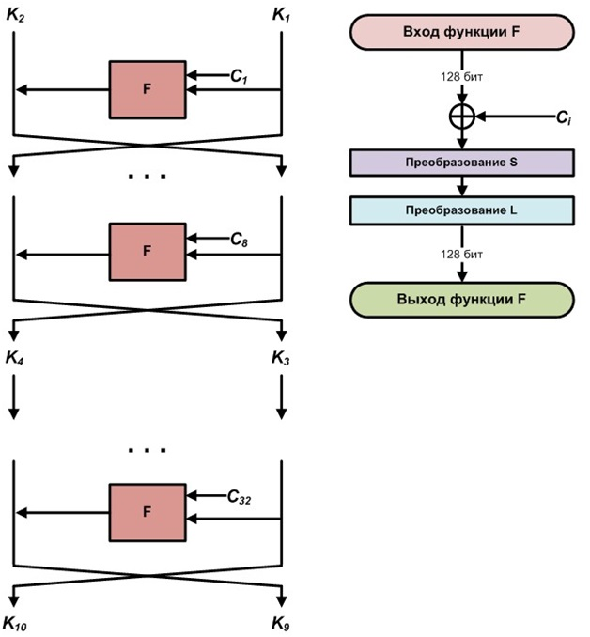
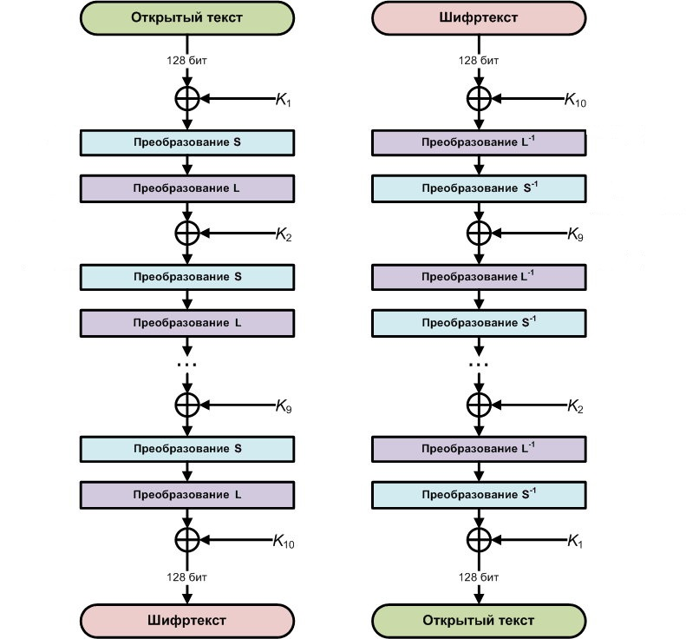
Kuznechik - close look
🔑 Key Expansion (round key generation)
🔁 Main Round Operations (10 total)
plaintext
cyphertext
https://habr.com/ru/articles/459004/
cyphertext
plaintext
Notes:
When we inspect any algorithms, we should ask ourselves 2 questions: how secrets are generated, how does the algorithm works
🔑 Key Expansion (Preprocessing stage)
The cipher operates on 128-bit blocks using a 256-bit master key (not generated), which is split into two halves (128 bit each = 16 bytes) and expanded into 10 round keys using a Feistel-like construction over 8 rounds for every pair of round keys.
This key expansion uses 3 operations: XOR, S-box substitution and linear transformation over the Galois Field GF(2⁸).
Controlled by 32 iteration constants C1,C2,…,C32​ . Iteration constants Ci are obtained by L-transforming the sequence number of the iteration.
🔁 Main Round Operations (10 total)
For encryption and decryption, Each round performs three key steps:
1.XOR – the block is combined with the round key using byte-wise XOR.
2.S-box substitution – each byte is replaced via a fixed nonlinear lookup table to introduce confusion.
3.Linear transformation – the block is shifted and mixed using Galois-field multiplication with a fixed vector, diffusing each byte’s influence across the block.
After 9 full rounds, the 10th round ends with a final XOR. The decryption process reverses these steps, using the inverse S-box and inverse linear transform.
This elegant combination of nonlinear and linear algebra ensures high security while remaining efficient for both hardware and software.

Slide 10
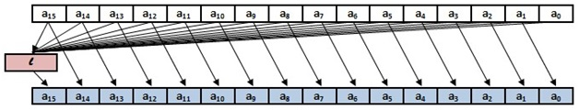
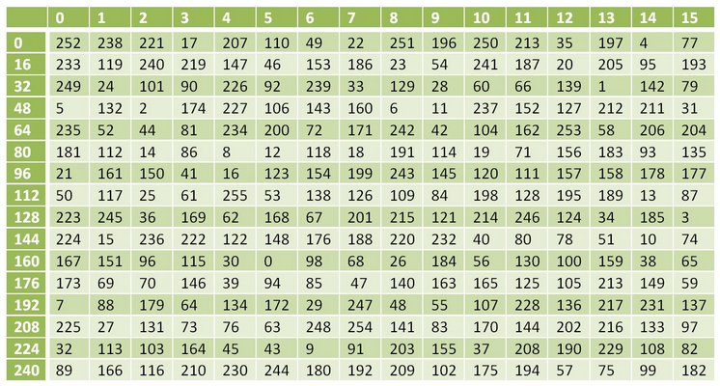
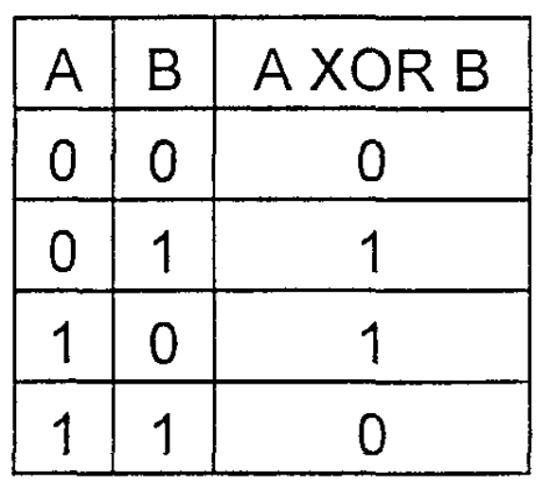











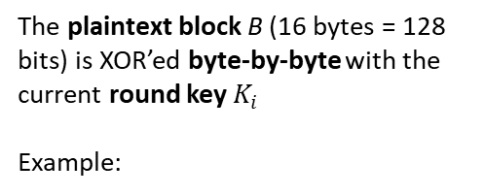

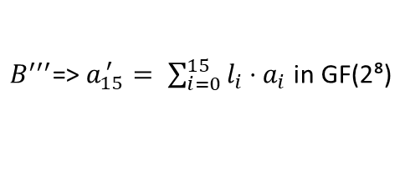
3 “Hops” of Kuznechik
1. XOR:
$$B′=B_{i}\text{​}​⊕K_{i}\text{​}​$$
2. Substitution:
$$B′′\text{[}\text{i}\text{]}=\text{S}\text{(}B′\text{[}\text{i}\text{])}$$
3. Linear Transformation:
$$B′′′=\text{L}\text{(}B′′\text{)}=R^{16}\text{(}B′′\text{)}$$
The plaintext block B (16 bytes = 128 bits) is XOR’ed byte-by-byte with the current round key $K_{i}$
Example:
Each byte in the XOR’ed block is replaced using an S-box — a ${256}_{10}$-entry lookup table.
The L function in Kuznechik is essentially defined as 16 successive applications of the R function:
16 rounds of a function R, where we compute new block by shifting each byte by 1 byte to the right:
$$B\text{=[0}\text{x}\text{88, 0}\text{x}\text{99, ..., 0}\text{x}\text{11]}$$
$B^{′′′}\text{=>}{ a}_{15}^{ ′}= \sum_{i=0}^{15}{l_{i}}\text{⋅}{ a}_{i} \text{in} \text{GF}\text{(2⁸)}$
$$K_{i}\text{​=[0}\text{x}\text{77, 0}\text{x}\text{66, ..., 0}\text{x}\text{88]}$$
where $l_{i}$ is one of the below LSFR coefficients of a predefined vector) and ${ a}_{i}$​ are the $B′′$block’s bytes.
$$\text{Then}\text{: }B^{′}\text{[0]}=\text{0}\text{x}\text{88⊕0}\text{x}\text{77, }\text{etc}\text{.}$$
$B^{′′}=$ (${ a}_{0}$,${ a}_{1}$​,...,${ a}_{15}$​)
(148,32,133,16,194,192,1,251,1,192,194,16,133,32,148,1)
where higher 4 bits = row, lower 4 bits = column #
In Galois Field GF(2⁸), each $l_{i}$ byte (8-bit value) is interpreted as a polynomial of degree ≤ 7,
$\text{S}\text{(0}\text{x}\text{00)=0}\text{xFC}$,
$$\text{..., }\text{S}\text{(}{0xFF}_{16}\text{)} \text{=} {182}_{10} \text{= }{0xB6}_{16}$$
Introduces nonlinearity — critical for resisting differential and linear cryptanalysis.
148 $=$ 1001 0100 (binary) $=$ 0x94 (hex) $=$ $x^{7}+x^{4}+x^{2}$
Bit Position (left to right) | 7 | 6 | 5 | 4 | 3 | 2 | 1 | 0
Bit Value (0x94) | 1 | 0 | 0 | 1 | 0 | 1 | 0 | 0
https://habr.com/ru/articles/459004/
Notes:
The vector (148,32,…., 1) used in Kuznechik (GOST R 34.12-2015) is the linear transformation vector for the L-function — also referred to as the LFSR coefficients (linear feedback shift register). These values are:
1. Not derived from a mathematical field structure like a basis or generator, but are explicitly defined in the standard for the purpose of achieving strong diffusion across the 128-bit block.
2. They were hand-picked and fixed by the designers (Kuznetsov, Nechaev, et al.) to meet certain cryptographic criteria:
Guaranteeing invertibility of the L-function
Avalanche effect (changing one bit in input should affect all output bits)
Resistance to known attacks (like differential or linear cryptanalysis)

Slide 11

SKZI vendor responsibilities
There are several main aspects regarding licensing, import and use of cryptographic tools for information protection:
Licensing of Providers (Decree № 313, 2012)
Mandatory Certification of SKZI*
Import / Export Controls (all rules listed here)
Operational Compliance (article about SKZI classes)
SKZI Certification
Process of SKZI certification:
prepare docs -> submit to lab -> checks compliance and robustness -> assigned a class of SKZI -> certificate issued -> product added to the state register
developer
*SKZI - СКЗИ – “Means (tools) of Cryptographic Information Protection
https://habr.com/ru/companies/infotecs_official/articles/701546/
Notes:
Licensing of Providers: Companies developing, producing, or integrating cryptographic tools need a special FSB license habr.com. This ensures only authorized firms (with proper personnel and facilities) handle cryptographic tech. The licensing process is governed by Government Decree No.313-2012 habr.com.
Mandatory Certification: All cryptographic tools (СКЗИ – “Means of Cryptographic Information Protection”) used in protected systems must be certified by FSB. The FSB’s certification confirms the product meets Russian crypto standards and security requirementscisoclub.ru. Only FSB-certified hardware/software can be used to protect sensitive data in government, personal data, or classified systemscisoclub.rucisoclub.ru.
Import/Export Controls: To import any device or software with encryption into Russia (or EAEU), an FSB notification certificate is requiredmastcert.com. The manufacturer or importer files a notification (self-declaration) to FSB listing the crypto capabilities of the productmastcert.com. Customs will only clear items on the basis of this FSS notification. (Export of strong encryption may also require authorization under Russian law.)
Operational Compliance: Organizations using SKZI must follow proper usage rules (as per FSB orders). For example, they must monitor the validity of their crypto tool’s FSB certificate and only allow installation/maintenance by licensed entitiesec-rs.ruec-rs.ru. FSB can conduct audits to verify compliance with crypto regulations.
Certification Process: Vendors submit their crypto product for evaluation by an FSB-accredited lab. The FSB reviews compliance with GOST algorithms and robustness. Products are assigned a class of SKZI based on the assumed attacker capabilities they counter (per Order 378)ec-rs.ru. Once approved, a certificate of conformity is issued and the product is added to the state register of certified crypto tools.

Slide 12


Mapping table – laws, standards, etc.
Aspect | China | Russia
Legal Basis | Dedicated Cryptography Law (2019) with defined categories: Core, Ordinary (state secrets), Commercial encryption | No single dedicated cryptography law; relies on broader legislation (149-FZ) and detailed FSB orders
Regulatory Authorities | Regulation: State Cryptography Administration (SCA) Research: CAS, DACAS, Universities, National Labs, OSCCA labs Certification: SCA, OSCCA (under SCA) Standards: OSCCA/SCA | Regulation: Government and Federal Security Service (FSB) Research: Universities, National Labs, FSB labs Certification: Federal Security Service (FSB) Standards: Technical Committee 26
Certification Regime | Mandatory SCA certification or cryptographic review for encryption products (especially commercial); strict import licensing | Mandatory FSB certification (SKZI); notification-based import control system
Philosophy & Strategy | Encourages domestic crypto industry growth, research, innovation under strict Party oversight | Promotes domestic crypto industry (CryptoPro, Infotecs), strongly regulated under FSB supervision, emphasizes cryptographic sovereignty
Mandatory Use | Required in government, military, banking, telecommunications, and critical infrastructure (since 2019) | Required in government systems, financial services, critical infrastructure, and personal data systems (phased since 2019, reinforced by 2025)
Notes:
Legal Basis: China enacted a Cryptography Law (2019) as a comprehensive framework, categorizing encryption into core and ordinary (for state secrets) and commercial encryptionthediplomat.com. Russia does not have a single dedicated crypto law; instead it relies on broader laws (like 149-FZ) and a web of FSB orders for specific areashabr.com. Both approaches aim to assert state control, but China’s is more centralized in one law.
Regulatory Authority: China’s crypto is overseen by the State Cryptography Administration (SCA) – a specialized agency under the Communist Party’s Central Officethediplomat.com. It manages standards, certification (especially for commercial encryption products), and enforcement of the Crypto Law. Russia’s equivalent role is taken by the FSB, with FSTEC coordinating on general InfoSecen.wikipedia.org. In short, China has a civilian cryptography authority (SCA), whereas Russia entrusts cryptography to its security service (FSB).
Standards & Algorithms: Both countries promote home-grown algorithms via national standards. China uses the SM series (SM2 signature, SM3 hash, SM4 block cipher, etc.) as state-approved algorithms in government and commercial products. Russia uses GOST algorithms (GOST 34.10, Streebog, Kuznechik, Magma, etc.) in all official capacities. Each country mandates these algorithms in critical systems – e.g. Chinese government networks and banking use SM algorithms, and Russian banks and government sites are moving to GOST TLS and encryptionhabr.com. Neither country relies on foreign ciphers (like RSA/AES) for domestic high-security applications.
Certification Regime: Both have strict certification for crypto products. China requires products with encryption to undergo SCA certification or cryptographic review (especially for commercial encryption used by businesses). Russia’s FSB certification of SKZI is analogous, ensuring only approved crypto modules are used in regulated sectors. Import controls exist in both: China has import license requirements for certain encryption tech, Russia uses the FSB notification systemmastcert.com. These regimes can pose barriers to foreign products (must comply or use approved algorithms).
Philosophy & Strategy: China’s law explicitly encourages growth of the domestic crypto industry and academic research, while maintaining Party oversightthediplomat.com. Russia’s approach is also to foster a domestic industry (companies like CryptoPro, Infotecs, etc.), often led by former state entities, under FSB supervisionhabr.com. Both countries view cryptographic sovereignty as crucial for national security and have moved to limit or replace foreign encryption in sensitive areas.

Slide 13

Mapping table - Algorithms
Functions | Key Type | Category | Algorithms (Russia 🇷🇺) | Algorithms (China CN) | Algorithms (USA US)
Encryption | Symmetric | Stream cipher | None standardized use OFB/CFB/CTR modes with Magma or Kuznechik | ZUC GM/T 0001-2012 ZUC stream cipher | RC4
 |  | Block cipher | Kuznechik, Magma (GOST R 34.12-2015/2018) | SM4 Block size: 128-bit- Key size: 128-bit- Structure: 32-round Feistel network- Standard: GB/T 32907-2016 | AES
 | Public key | General | GOST R 34.10-2018 (ECC), GOST R 34.10-2001 legacy | SM2 (Elliptic Curve-based)- Key size: 256-bit ECC- Standard: GM/T 0003.2-2012 | RSA, ElGamal
Authentication | Symmetric | Hash function | Streebog (GOST R 34.11-2012/2018), HMAC-GOST | SM3 Output size: 256-bit hash- Block size: 512-bit- Standard: GM/T 0004-2012 | SHA, HMAC
 | Public key | Digital signature | GOST R 34.10-2018, paired with Streebog | SM2 | RSA
Identification | Symmetric | Identification | None standardized Russian equivalents in SKZI systems (e.g., CryptoPro ID), | None standardized (didn’t find anything) | NS, Kerberos
 | Public key | Digital signature | GOST R 34.10-2018, used in secure login and identity tokens | SM2 | RSA
商密(shāng mì) – commercial crypto

Slide 14
Q&A
Q1: What is the key difference between the legal basis of cryptography regulation in Russia and China?
Q2: Who is primarily responsible for cryptographic certification and enforcement in Russia, and how does it differ from China’s approach?
Q3: Name at least two Russian GOST cryptographic algorithms and their primary use cases.
Q4: Why do Russia and China mandate using homegrown cryptographic algorithms in critical systems rather than international algorithms like AES or RSA?
Q5: What does the Russian abbreviation SKZI (СKЗИ) stand for, and why is it important for cybersecurity compliance in Russia?
Q6: How does the SM4 block cipher from China differ from Russia’s Kuznechik cipher in terms of key length and cipher structure?
Q7: What are the challenges when integrating national cryptographic standards (like GOST or SM algorithms) with international or global systems?
Notes:
A1: China has a dedicated Cryptography Law (2019), whereas Russia relies on broader information security laws (149-FZ) and a set of specific FSB orders.
A2: In Russia, cryptographic certification is managed by the Federal Security Service (FSB), a security-focused agency. In contrast, China’s cryptography is regulated by the civilian-run State Cryptography Administration (SCA).
A3: Kuznechik (block cipher, modern encryption), Magma (legacy-compatible cipher), Streebog (hash functions), GOST R 34.10-2018 (digital signatures).
A4: Both countries aim for cryptographic sovereignty, national security, and protection against potential backdoors or vulnerabilities associated with foreign algorithms.
A5: SKZI stands for “Средства Криптографической Защиты Информации” (Means of Cryptographic Protection of Information). These certified products are mandatory for protecting sensitive government and personal data systems.
A6: SM4 uses a 128-bit key, a 128-bit block, and a 32-round unbalanced Feistel structure. Kuznechik uses a 256-bit key, a 128-bit block, and a 10-round SP-network structure.
A7: Challenges include interoperability issues, limited international support, potential compliance barriers, and the need for dual-cryptography implementations to maintain compatibility.

Slide 15
Resources
Articles:
Other materials:
Russian Cryptography Legislation explained
Explaining 4 main Russian standards
Using GOST for Runet websites
Explaining Kuznechik (Grasshopper) Algorithm
Article about SKZI
Federal law 149
Decree 313
Import/export rules
GOST Python library
Biggest Crypto Vendor in Russia
Tc26 standards
Orders:
FSB Order № 66 (2005): Requirements for crypto developers and vendors.
FAPSI Order № 152 (2001): (outdated) Instruction for using crypto tools for sensitive information.
FSB Order № 378 (2014): Requirements for protecting personal data with cryptography.
FSB Order № 524 (2022): Requirements for protecting information in government IS using certified encryption tools.
FSB Order № 117 (2025): replacement for Order 524. Expands the scope of mandatory encryption.

