Slide 1

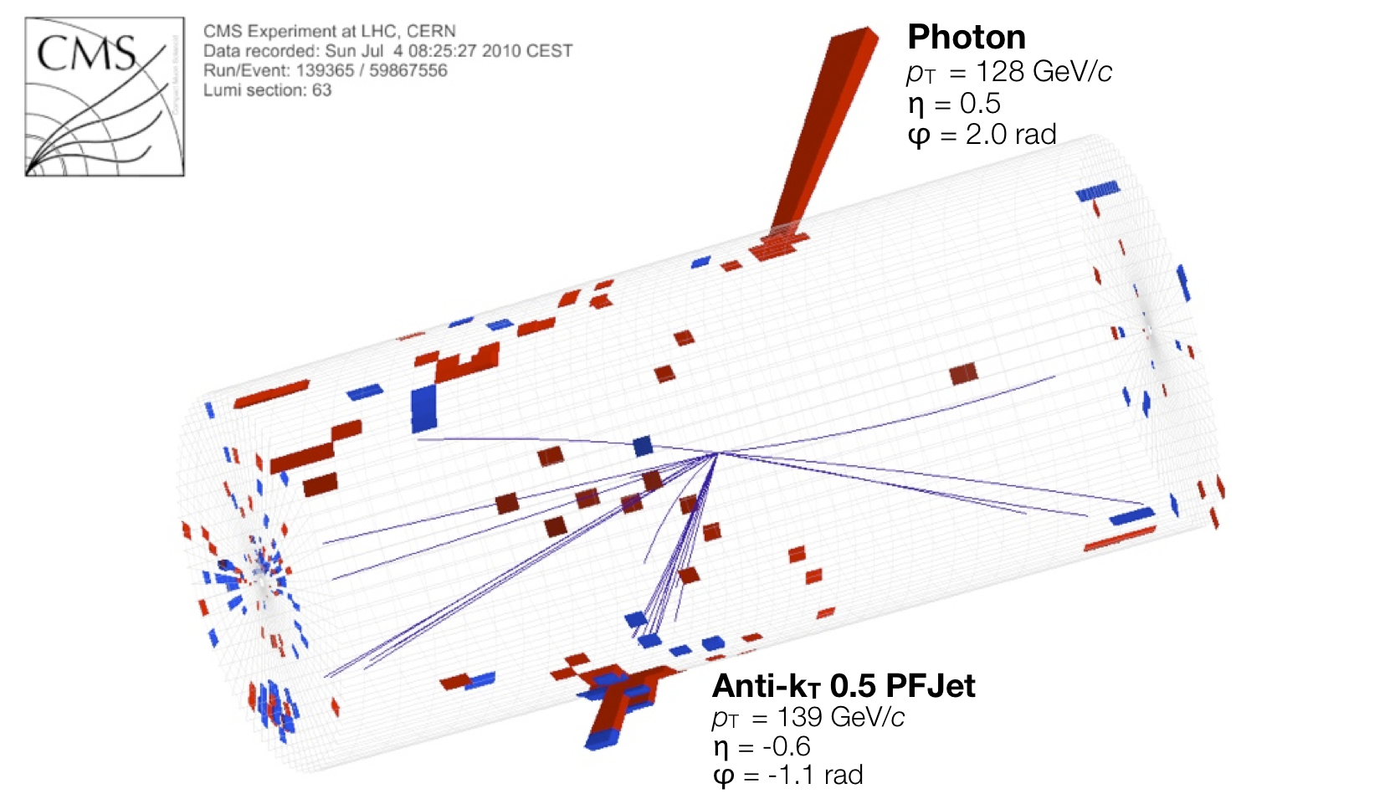
Hbb jet tagging with CMS open data. Data pipeline plan
Department of physics and astronomy
Rice university
Collin Arbour and iason krommydas , 09/22/2022

Slide 2

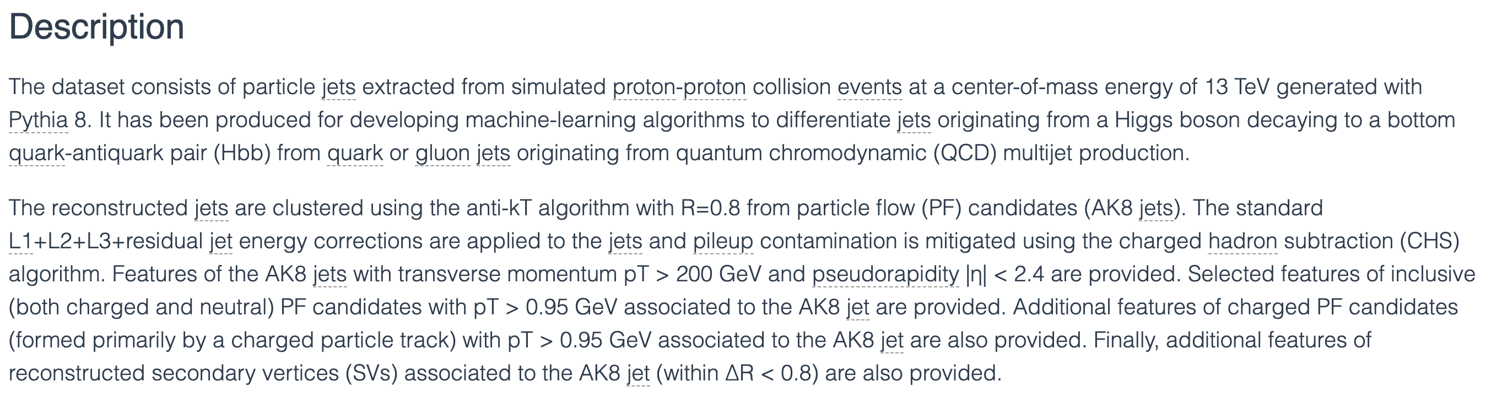
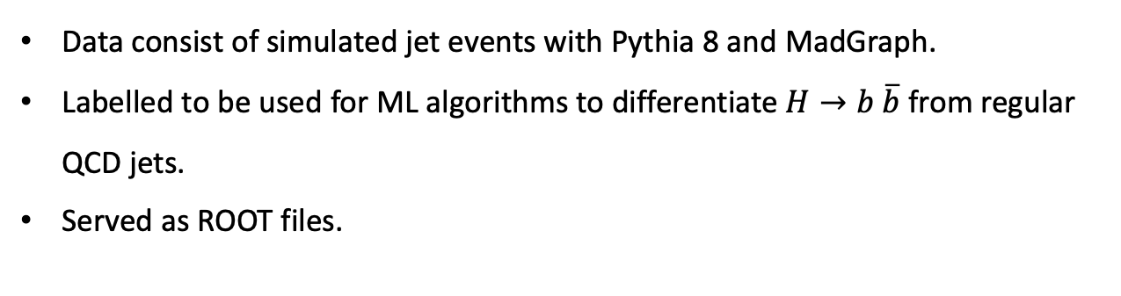
The data
http://opendata.cern.ch/record/12102 DOI:10.7483/OPENDATA.CMS.JGJX.MS7Q
Data consist of simulated jet events with Pythia 8 and MadGraph.
Labelled to be used for ML algorithms to differentiate $H→b \overline{b}$from regular QCD jets.
Served as ROOT files.

Slide 3
Literature
This particular dataset hasn’t been used in the literature.
Generally, a lot of research has been done on jet classification.
b-tagging is very common in the literature.
Hbb-tagging is slightly less common.
Different algorithms and architectures used. We couldn’t find a full pipeline ready for use.
We will not be copying any algorithms.
We will be using our own methods and architectures.

Slide 4
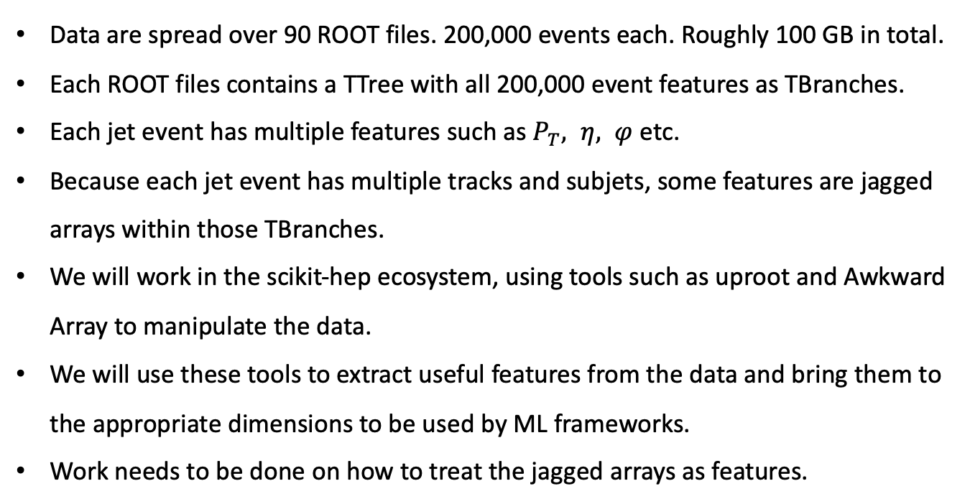
Data wrangling
Data are spread over 90 ROOT files. 200,000 events each. Roughly 100 GB in total.
Each ROOT files contains a TTree with all 200,000 event features as TBranches.
Each jet event has multiple features such as $P_{T}, η, φ$ etc.
Because each jet event has multiple tracks and subjets, some features are jagged arrays within those TBranches.
We will work in the scikit-hep ecosystem, using tools such as uproot and Awkward Array to manipulate the data.
We will use these tools to extract useful features from the data and bring them to the appropriate dimensions to be used by ML frameworks.
Work needs to be done on how to treat the jagged arrays as features.

Slide 5
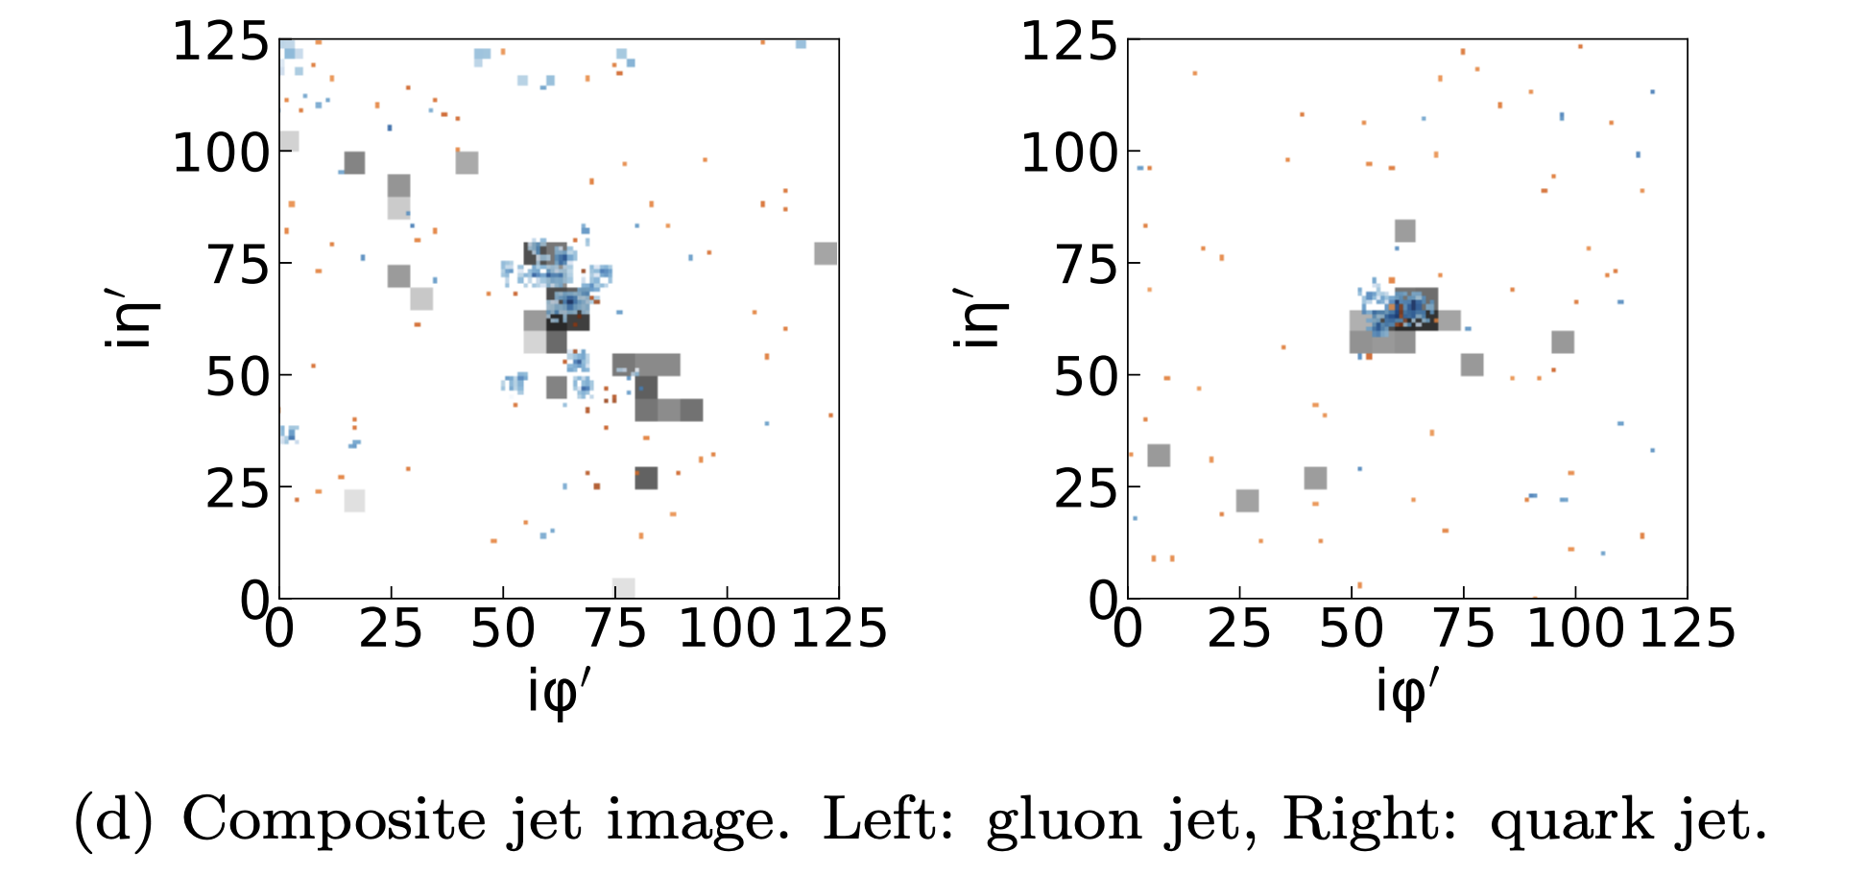
Data wrangling
We will also try to create jet images to use with image classification methods.
This will most likely not be possible with the current state of the dataset.
We will have to resort to using the raw MiniAOD files that were used to create this dataset that contain ECAL and HCAL hits.
Source: arXiv:1902.08276

Slide 6
Data exploration
We firstly plan to use the usual data exploration methods such as: plotting histograms of the features, creating correlation matrices, standard scaling, PCA, eigendecomposition of the correlation matrix, Kullback–Leibler divergence.

Slide 7
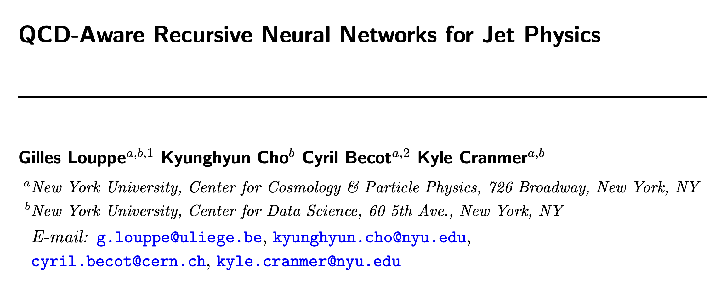
Modelling
We plan to use Deep Neural Networks and Recurrent Neural Networks.
We also plan to use simpler binary classification methods such as BDTs and/or Linear, Logistic, Least-squares classifiers.
If we also manage to create jet images, we will use Convolutional Neural Networks.

Slide 8
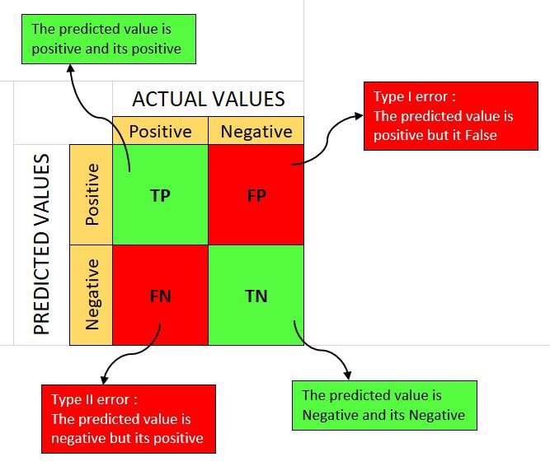
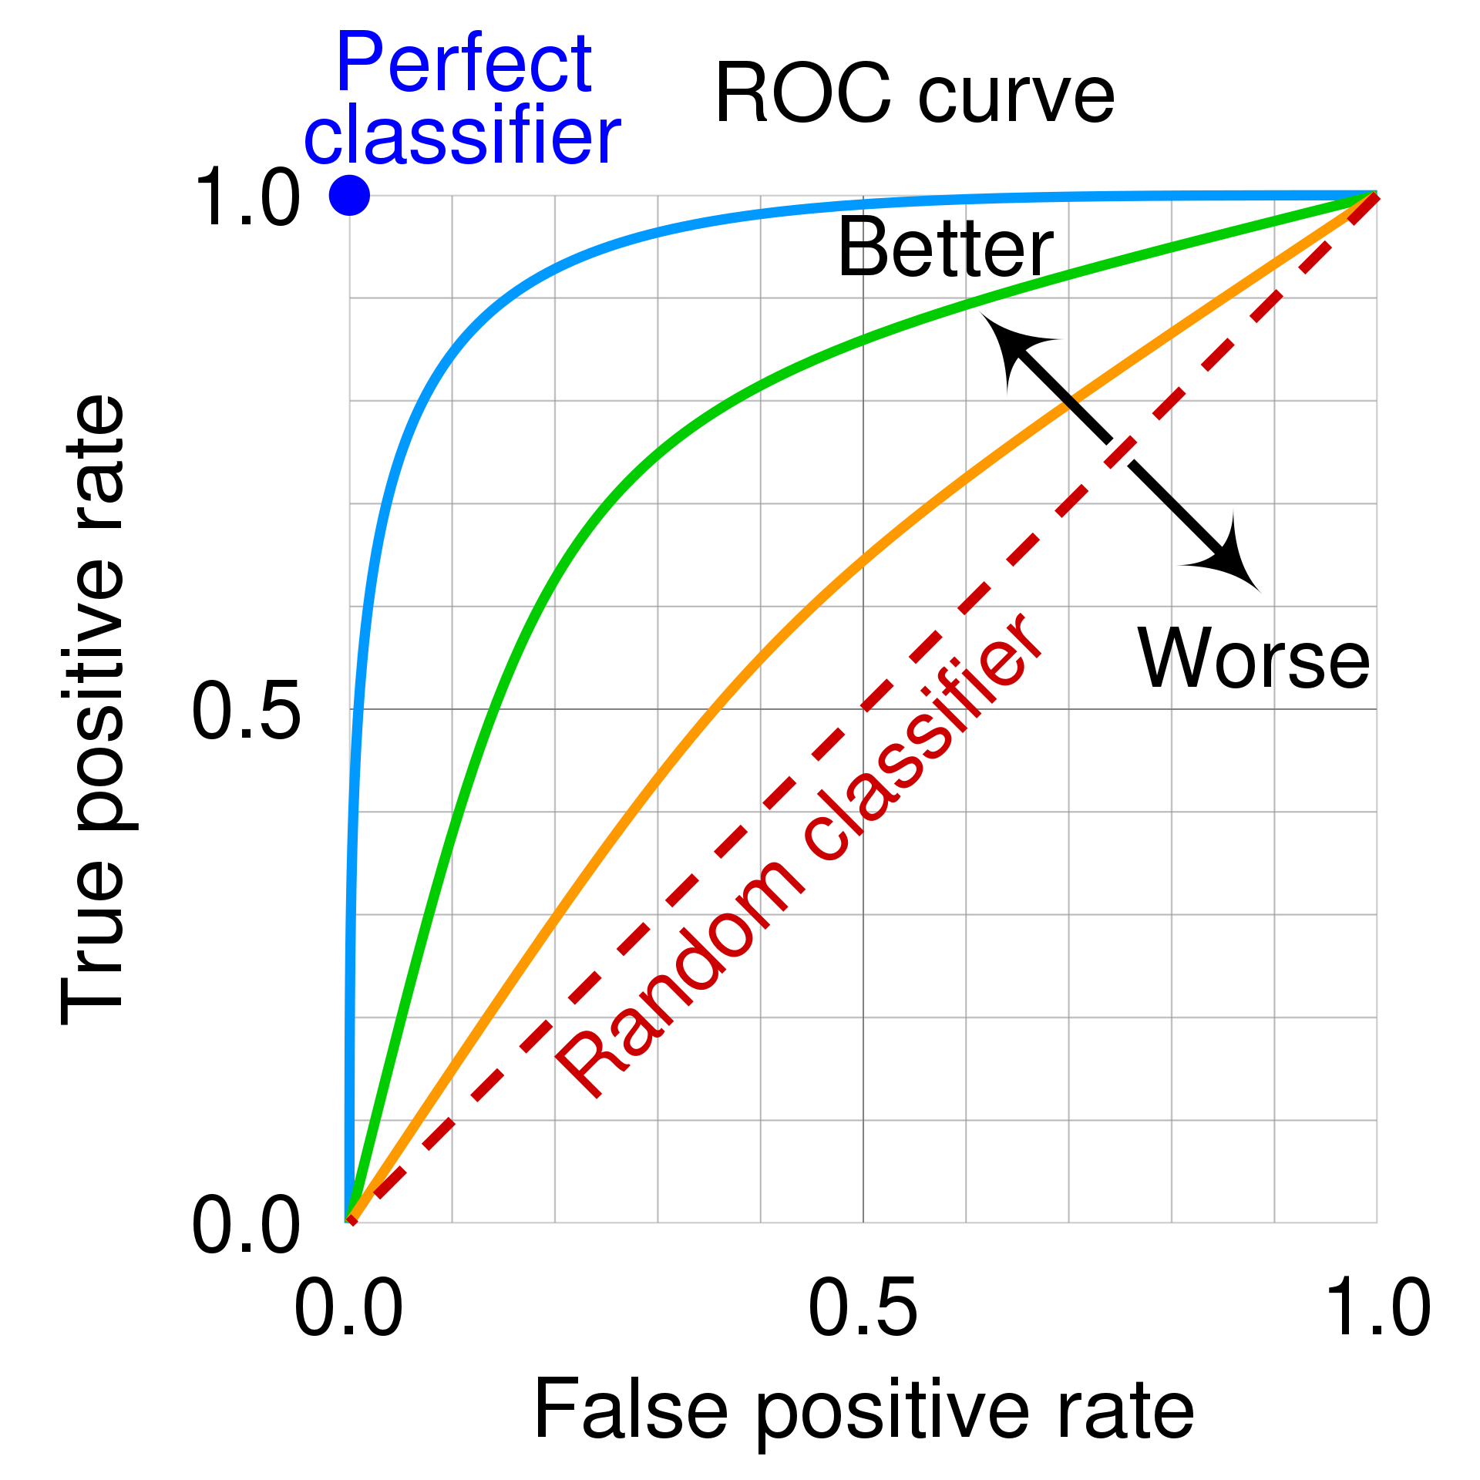
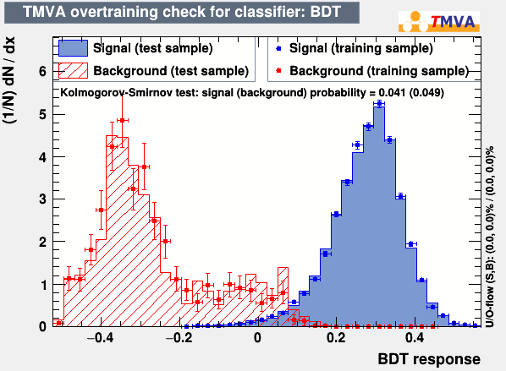
Validation
Accuracy
Confusion Matrix
ROC curves
KS plot

Slide 9
Thank you!

