Slide 1
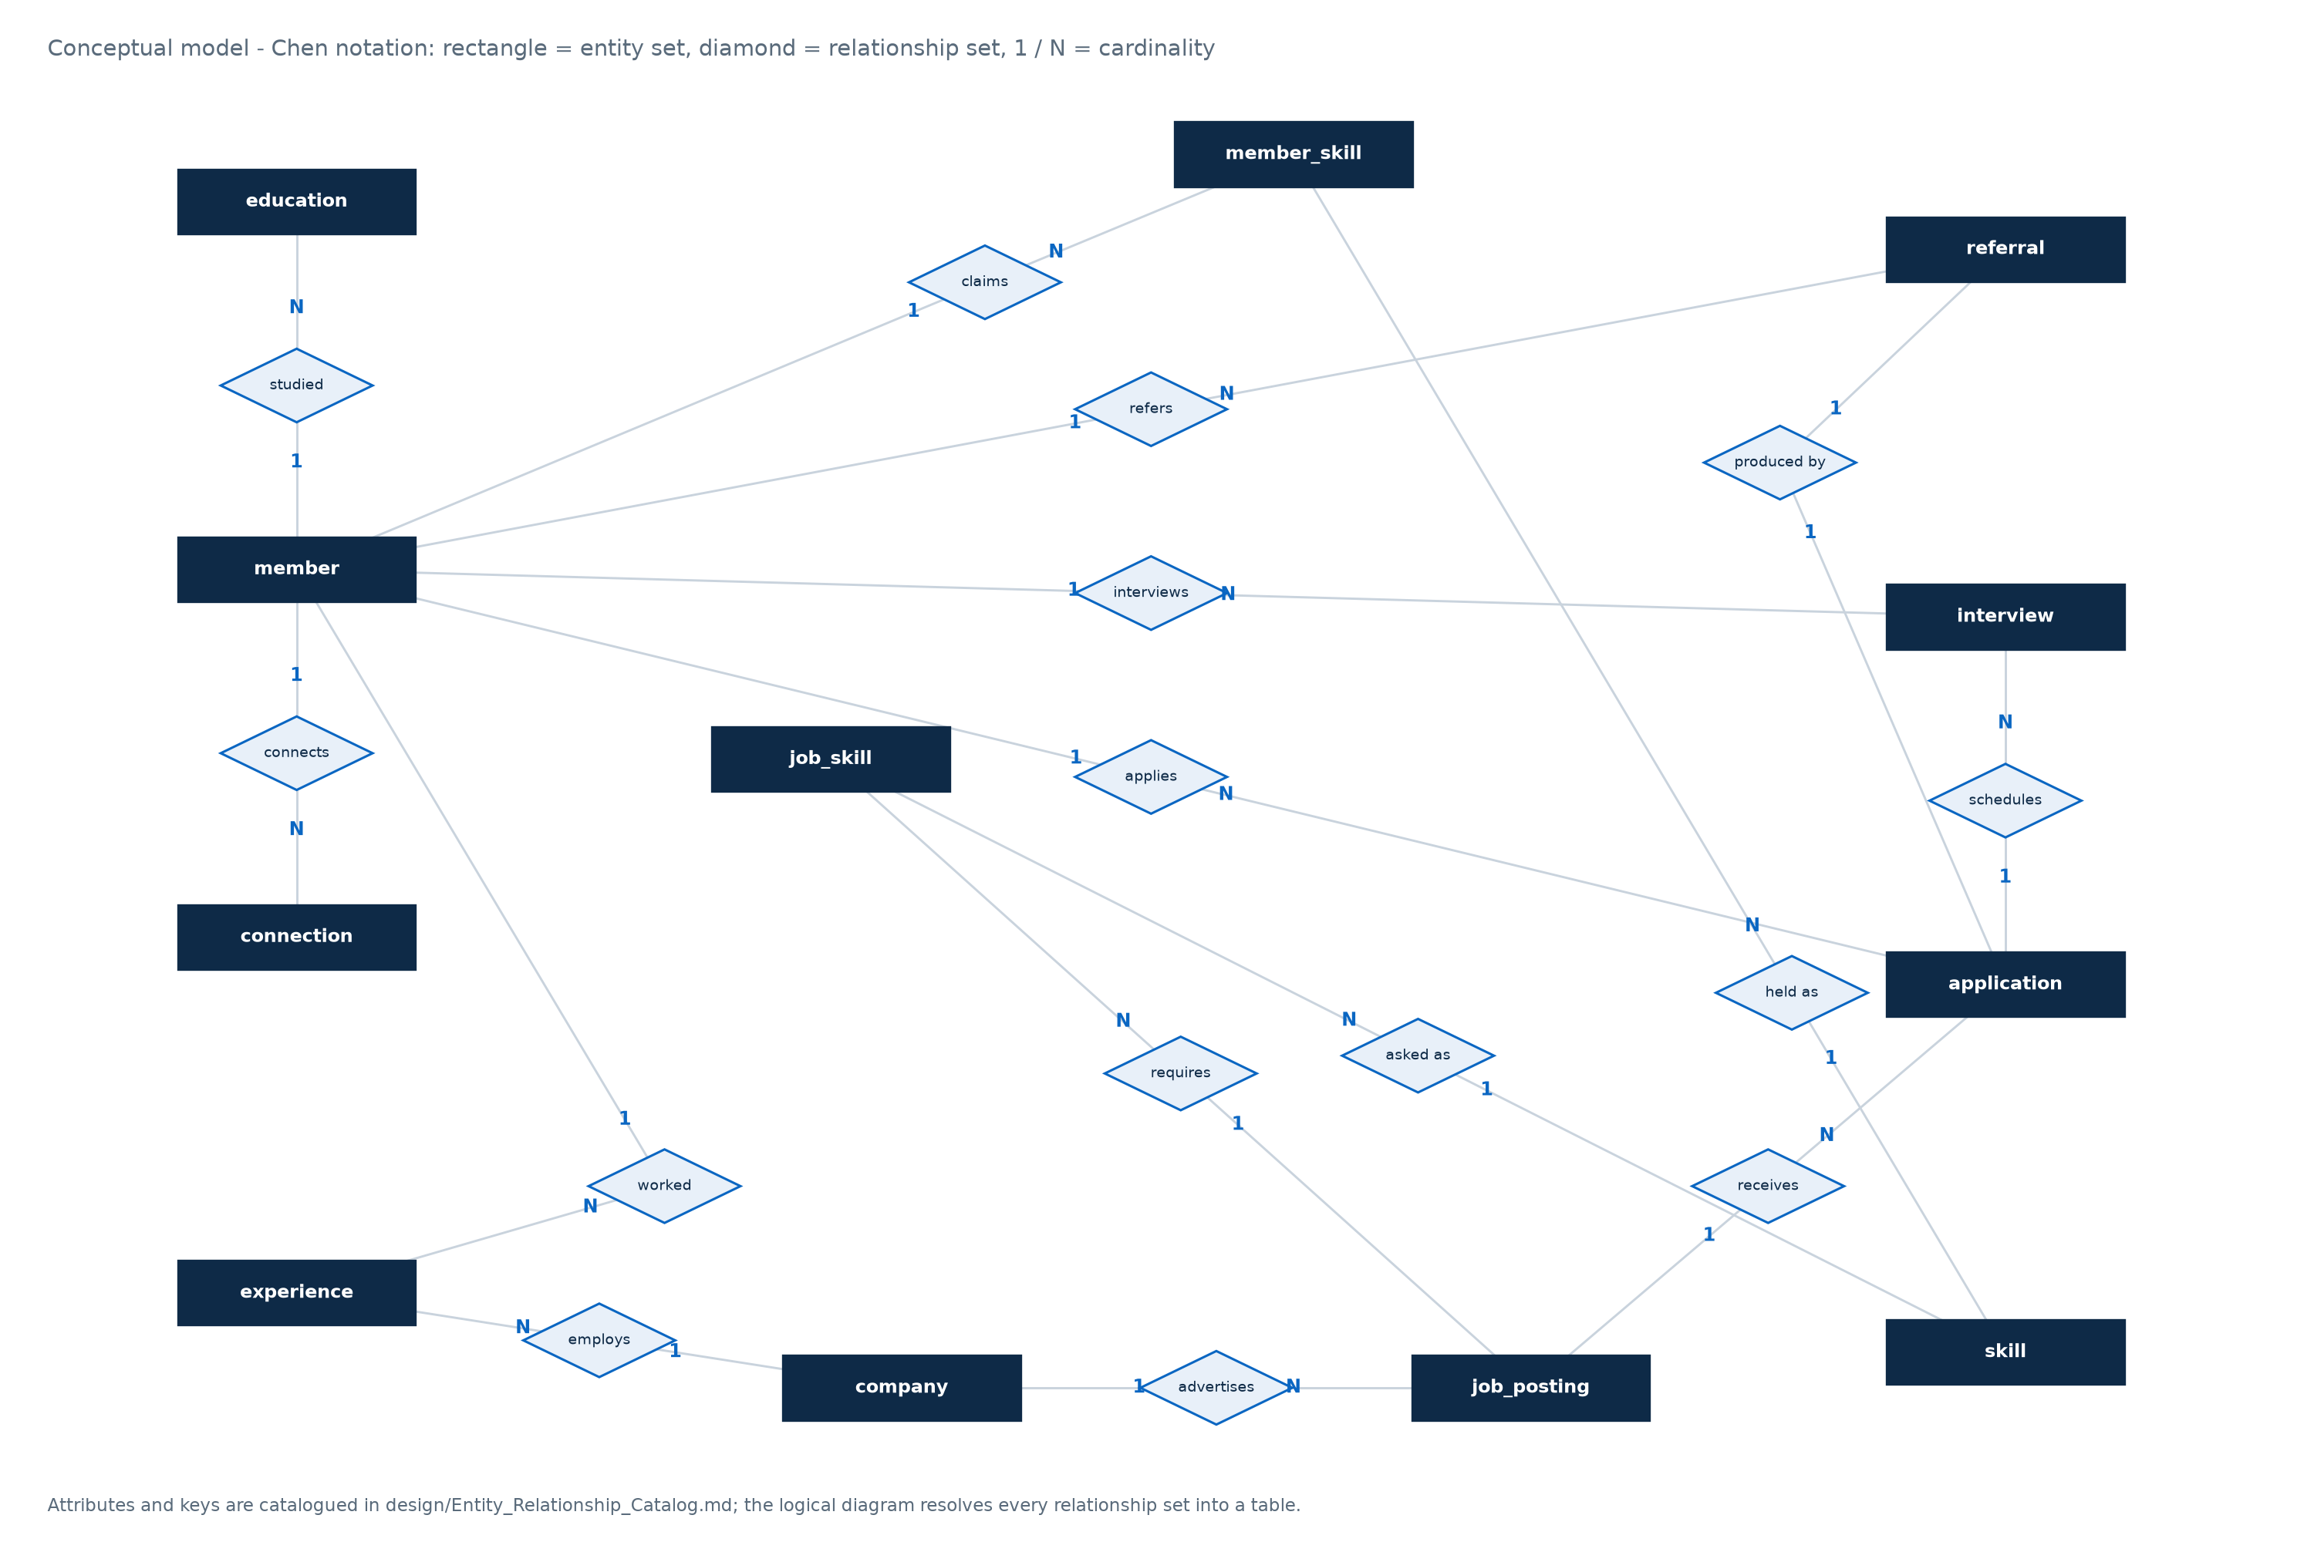
D O T E 6 7 5 1 · D A T A B A S E S Y S T E M S · G R O U P P R O J E C T
Reverse-Engineering
LinkedIn
The hiring loop as a relational schema: twelve tables,
one closed loop, eighteen queries that the product answers but never shows.
T E A M
Xuanmo AN · Yi HOU · Zhao Han HUANG
Jinyu LI · Yitong NI · Shujing YE · Shiyao ZHANG
Conceptual model — Chen notation
12
17
18
D A T E
RELATIONS
FOREIGN KEYS
QUERIES
November 2026
A schema reverse-engineered from behaviour: every table
exists because a product screen implies it.
DOTE 6751 · Group Project · LinkedIn, reverse-engineered · November 2026
01 / 14
Notes:
Good morning. This is our reverse-engineering project on LinkedIn. We did not have access to any schema; we reconstructed the part of LinkedIn that turns a job posting into a hire, and then built the database that would have to exist for the product's own behaviour to be possible. The deliverable has three parts: a twelve-table logical schema in third normal form, a deterministic data set of three hundred members and two hundred and fifty applications, and eighteen queries that answer questions the product visibly answers. I will take about three minutes on the model, then hand over to the query walk-through.

Slide 2
02 · M O T I V A T I O N
The visible product is the tip of an invisible record
Every screen LinkedIn shows is the output of a join that the user never sees.
01
Outcomes are visible, process is not
250
8.4%
A filled role is a badge. The 250 applications, 210 interviews and 12 legal status
transitions behind it are not shown anywhere — and they are the interesting data.
APPLICATIONS SEEDED
REACH HIRE
3.1×
6.0
02
Referrals are praised, rarely measured
REFERRAL ADVANTAGE
MONTHS OF HISTORY
Every recruiter says referrals convert. Without a channel column on the application,
the claim cannot be tested. Here it can: 16.7% versus 5.3% end-to-end.
W H A T W E B U I L T
A logical schema derived from the product's behaviour, a deterministic instance of it, and eighteen queries. The schema is in third normal form; the instance passes 22 cross-table consistency checks; every query runs standalone in Navicat.
03
Skill shortages are asserted, not computed
Postings state requirements; profiles state holdings. Put both in one schema and the
gap becomes a join, not an opinion.
DOTE 6751 · Group Project · LinkedIn, reverse-engineered · November 2026
02 / 14
Notes:
Three observations motivated the scope. First, the product only ever shows outcomes: a filled role, a new hire badge. The two hundred and fifty applications behind that outcome are invisible, which is exactly the data a database course should model. Second, referrals are the channel every recruiter claims to value, and almost nobody can quantify; our funnel shows a threefold difference in end-to-end hire rate between referral and direct applications on the same data. Third, skill shortages are usually asserted in strategy documents; with postings and profiles in one schema they become computable. Those three observations are the spine of the eighteen queries.

Slide 3
03 · B U S I N E S S C O N T E X T
How a hire happens — and which row each step writes
Six steps, three channels, one state machine. The schema follows the rows, not the screens.
1
COMPANY POSTS
job_posting + job_skill
skills, seniority, band, openings
S T A T E M A C H I N E · A P P L I C A T I O N
SUBMITTED
›
SCREENING
›
INTERVIEW
›
OFFER
›
HIRED
2
MEMBER APPLIES
application
channel ∈ {direct, referral, sourcing}
exit at any stage → REJECTED or WITHDRAWN
RECRUITER SCREENS
WHAT THE DATABASE REFUSES
3
·
a jump from SUBMITTED straight to HIRED
application.status = SCREENING
or REJECTED / WITHDRAWN
·
an interview before the application
4
INTERVIEWS RUN
·
a second round numbered 2
interview, rounds 1..n
interviewer, outcome, score
·
a referral from outside the company
·
a terminal status without decided_at
5
OFFER AND DECISION
status → OFFER → HIRED / REJECTED
decided_at is stamped
One BEFORE UPDATE trigger enforces all twelve legal transitions;
three further triggers carry the cross-table rules.
6
REFERRAL SETTLES
referral.bonus_status
PENDING → PAID / FORFEITED
DOTE 6751 · Group Project · LinkedIn, reverse-engineered · November 2026
03 / 14
Notes:
This is the loop we modelled. A recruiter creates a posting and declares the skills it requires. A member applies through one of three channels; the channel is a column on the application, not a separate table, because it describes how this application arrived. The recruiter screens, interviews are scheduled in rounds, and the application ends in exactly one of three terminal states. Each arrow on the left writes a specific row, which is the point of the slide: the diagram is a data-flow diagram as much as a process diagram. The state machine on the right is enforced by a trigger, so an application cannot jump from submitted to hired.

Slide 4
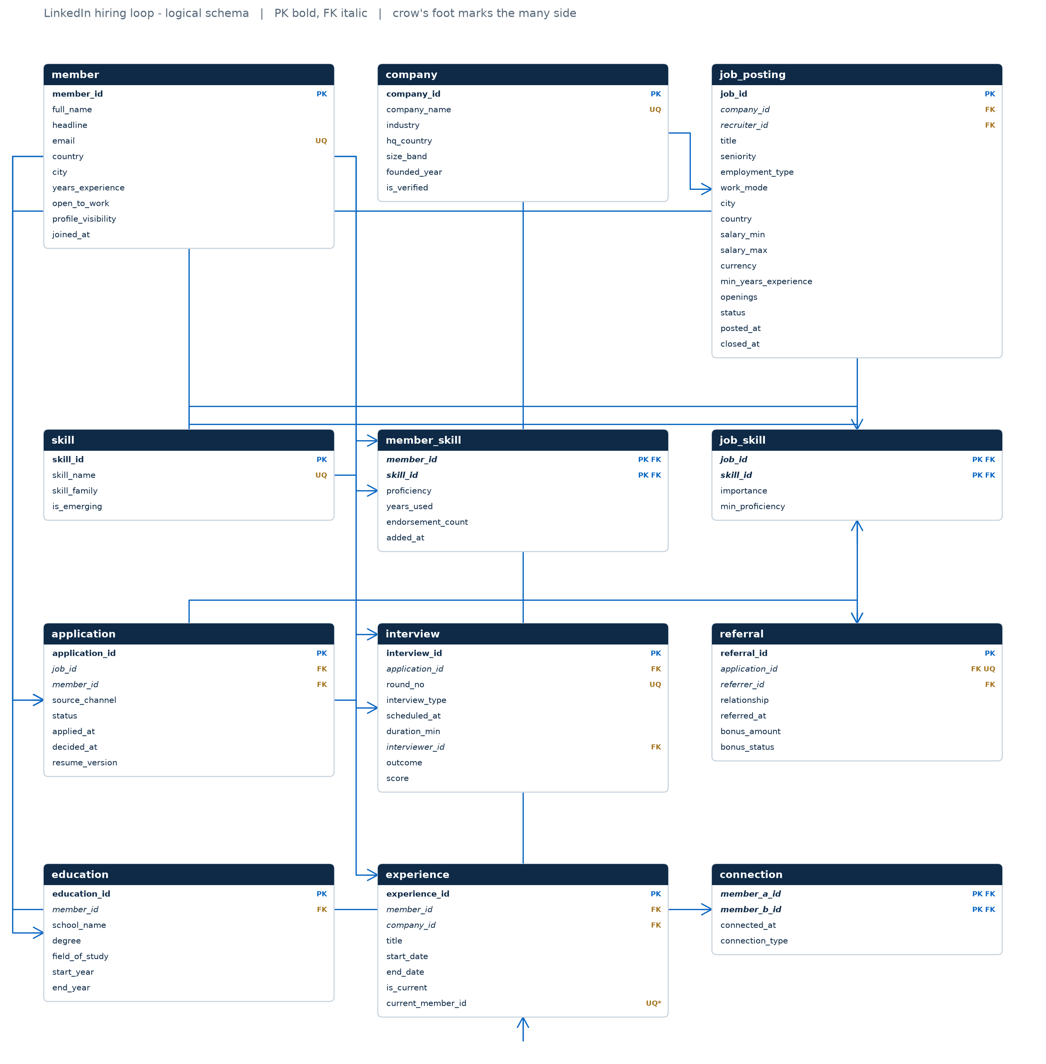
04 · D A T A M O D E L
Twelve relations, one hinge
Member and company describe the parties; application is the hinge that every query joins through.
W H A T T H E D I A G R A M S A Y S
—
Two parties, one hinge
member and company are the only entities that exist before a hire; application is the
associative entity that records the encounter between them.
—
The current employer is derived
no member.current_company_id: experience.is_current plus a unique index over a
generated column guarantees exactly one live position per member.
—
Skills are relations, not text
member_skill and job_skill carry proficiency and importance, which is what turns a
keyword into a match score.
—
Referral is 1:1 with its application
the referral table stores only the referrer and the bonus; the candidate and the posting
are read through the application, so they cannot disagree.
12
17
25
3NF
RELATIONS
FOREIGN KEYS
CHECK
PROVEN PER TABLE
ERD_logical_full — PK bold, FK italic, crow's foot at the many side
DOTE 6751 · Group Project · LinkedIn, reverse-engineered · November 2026
04 / 14
Notes:
Here is the whole model. Twelve relations, seventeen foreign keys, twenty-five check constraints. Two things are worth pointing at. The member table is deliberately thin: there is no current-employer column, because that fact is already implied by the experience table with its single live row. And the application table is the hinge: everything on the left describes a person, everything on the bottom describes a decision, and the loop queries all join through it. The diagram is generated from the same table definitions that produce the DDL, so it cannot drift from the schema.

Slide 5
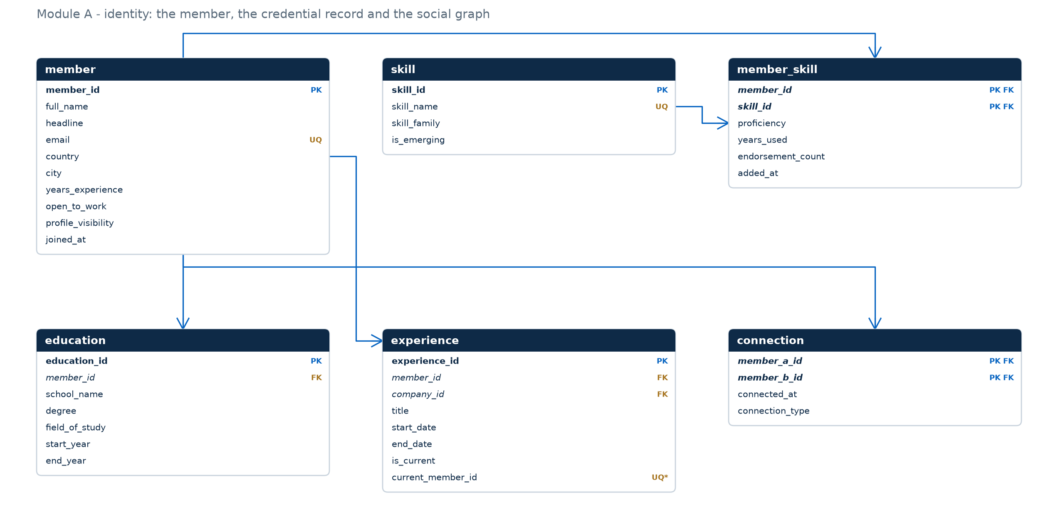
05 · M O D U L E A
Identity: one person, four records around them
Profile, credentials, history and graph — everything the product knows before a job exists.
T H E O N E R E A L D E C I S I O N
No current employer
column
It is already implied by experience. Storing both creates a redundancy the DBMS cannot police: two rows, one fact, silent disagreement after an edit.
IN STEAD
is_current = 1
+ unique index on a generated column
→ at most one live position
ERD_module_identity
DOTE 6751 · Group Project · LinkedIn, reverse-engineered · November 2026
05 / 14
Notes:
Module A is the person. Four tables hang off member: education, experience, connection and the skill claims. The design decision to highlight is the missing current-employer column. Storing it would duplicate a fact that experience already carries, and the two copies could disagree after an edit; that is the update anomaly the textbook warns about. Instead, is_current marks the live row, and a generated column with a unique index makes a second live row impossible. The connection table is the undirected social edge, stored once in canonical order, and it is what the recursive query on slide ten walks.

Slide 6
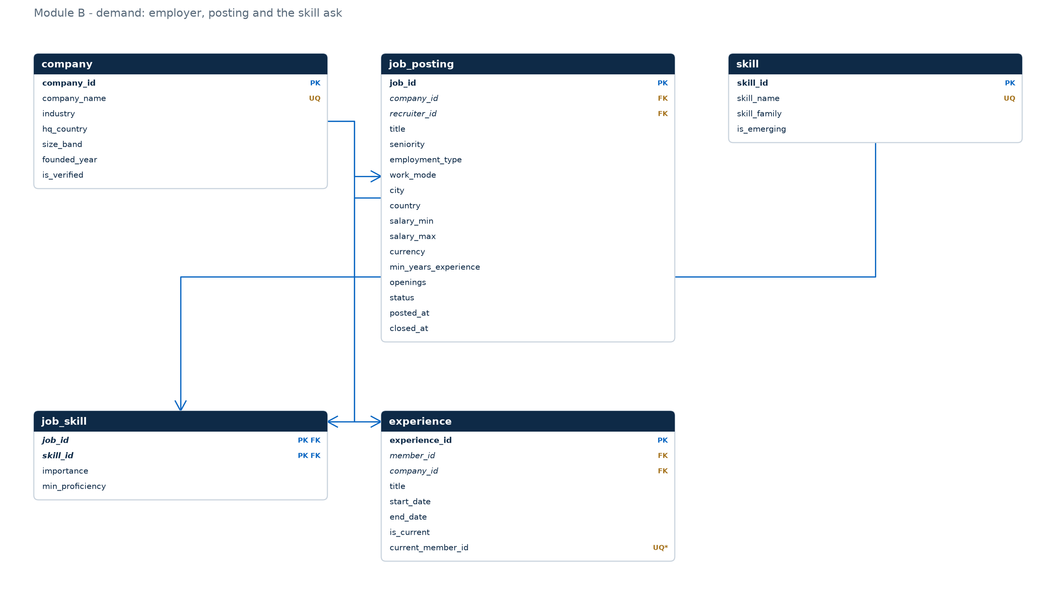
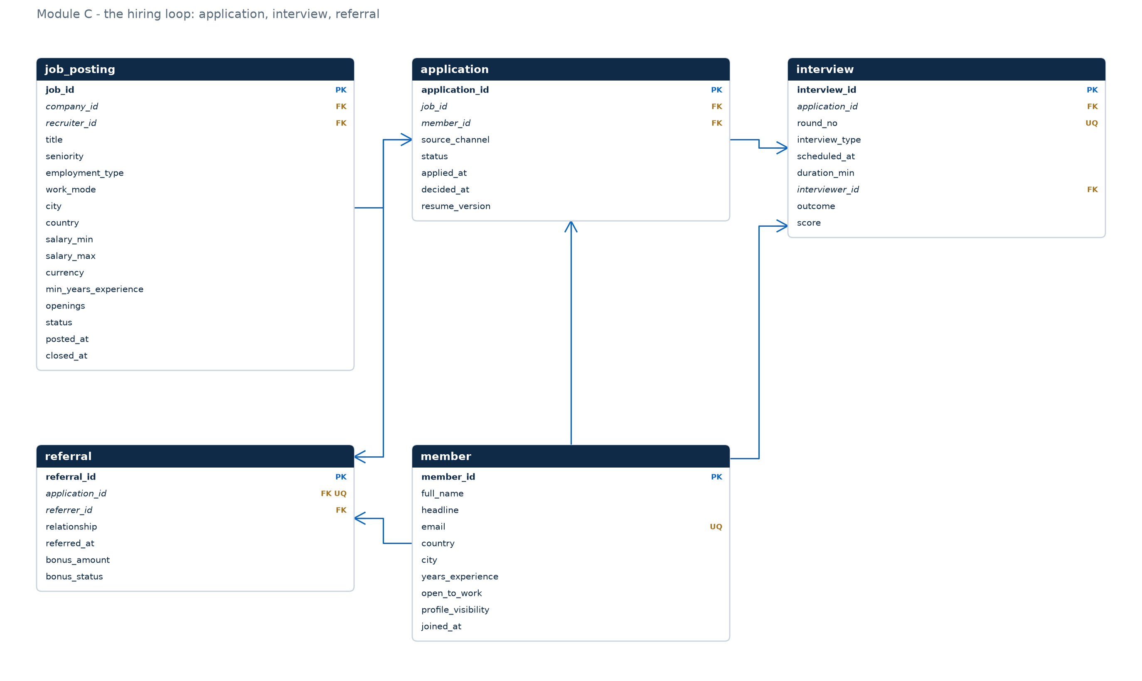
06 · M O D U L E S B A N D C
Demand and decision: where the two halves meet
A posting is a request for skills; an application is the answer to it.
ERD_module_demand — company, posting, skills
ERD_module_hiring_loop — application, interview, referral
importance lives on the pair, not on the skill: the same skill is REQUIRED here and
PREFERRED there. That single attribute is what makes a match score defensible.
interviews are numbered per application, not per posting; the referral is 1:1 with the
application it produced, so its candidate and job cannot contradict it.
DOTE 6751 · Group Project · LinkedIn, reverse-engineered · November 2026
06 / 14
Notes:
Modules B and C are the demand side and the loop. On the left, a company advertises postings and each posting declares the skills it wants with an importance flag. Notice that importance lives on job_skill, not on skill: the same skill is a hard requirement in one posting and a nice-to-have in another, which is precisely why the pair needs its own attribute. On the right, the application is at the centre, with interviews hanging off it and the referral attached one-to-one. The two modules meet at job_posting, which is why every funnel query starts there.

Slide 7
07 · T H E T A B L E S
Twelve relations, three groups, one purpose each
Counts are the seeded instance: large enough for distributions, small enough to audit by hand.
IDENTITY · 4 tables
DEMAND · 3 tables
MATCHING & LOOP · 5 tables
member
300
company
60
member_skill
1 329
the person; roles are relationships, not subtypes
employer facts stated once
proficiency 1–5, endorsements, years
education
393
job_posting
120
job_skill
504
degrees, 1:N from member
one advertised opening, 4 lifecycle states
REQUIRED vs PREFERRED, minimum level
experience
492
skill
60
application
250
employment history; one live row per member
controlled vocabulary in 8 families
the state machine and its timestamps
interview
210
connection
1 065
rounds 1..n, outcome and score
undirected social edge, stored once
referral
60
1:1 with the application; bonus state
DOTE 6751 · Group Project · LinkedIn, reverse-engineered · November 2026
07 / 14
Notes:
Twelve tables in three groups. The identity group is four tables around the person. The demand group is three tables: companies, postings and the skill vocabulary. The bottom group is the loop itself plus the two associative tables that connect people to skills and postings to skills. The counts are the seeded instance, and they matter: they are the evidence that the model is populated at a scale where the queries return distributions rather than anecdotes.

Slide 8
08 · E V I D E N C E I
Referral is not a nicer channel — it is a different funnel
Same interview rate, three times the hire rate: the difference sits after the interview.
Q07 · FUNNEL BY SOURCE CHANNEL
W H Y I T M A T T E R S
Channel
Applications
Interview rate
Hired
A referral is pre-screened by someone whose own reputation is at stake. The data shows where that advantage lands: referred candidates are not more likely to be interviewed, they are more likely to be offered once interviewed.
That distinction is only visible because the channel is a column on the application and the interview is its own relation. One flat 'hired' flag would have hidden it.
Referral
60
46.7%
16.7%
Sourcing
40
42.5%
7.5%
Direct
150
44.7%
5.3%
Interview rates differ by 4 points. Hire rates differ by 11.
The leverage is in the interview-to-offer step, not in sourcing volume.
Q08 · REFERRER LEADERBOARD (TOP 4)
Referrer · employer
Refs
Hires
Rate
Paid
THE COST OF THE PROGRAMME
$26,500 paid and $38,000 pending across 60 referrals — and two hires whose bonus is still pending. Bonus policy is a decision the schema can price, and those two hires are the evidence that it is a choice rather than a rule.
Noah Zhu · Oracle
3
2
66.7%
$8 500
Nina Choi · OCBC
2
1
50.0%
$2 500
Vikram Lin · Ping An
1
1
100%
$3 500
James Yang · Sea
1
1
100%
$0
DOTE 6751 · Group Project · LinkedIn, reverse-engineered · November 2026
08 / 14
Notes:
The first pair of queries is about where hires come from. On the left, the funnel by source channel. Referral applications are the smallest group, sixty of two hundred and fifty, but they produce almost half the hires: sixteen point seven percent end to end against five point three for direct. The interesting detail is that the interview rate is almost identical across channels; the difference is what happens after the interview, which is exactly the kind of finding a single table cannot show. On the right, the referral programme by referrer: who refers, who converts, and what the bonuses cost. Two hires from three referrals at Oracle is the top of that list.

Slide 9
09 · E V I D E N C E I I
Skill-gap matching: name the missing skill
Q09 · one candidate, twenty-eight half-matching roles, one actionable list.
Q09 · OPEN ROLES WHERE THE CANDIDATE MEETS ≥ 50% OF HARD REQUIREMENTS
H O W T H E M A T C H I S B U I L T
Job
Title
Company
Held
Match
Missing
required ← job_skill WHERE importance = 'REQUIRED'
held ← member_skill WHERE proficiency ≥ minimum
match % = held ÷ required
missing ← required set minus held set
6
Merchant Manager
Amazon
2 / 3
66.7%
Negotiation
31
Growth Analyst
Tencent
2 / 3
66.7%
Statistical Analysis
40
Consultant
McKinsey
2 / 3
66.7%
Data Modelling
43
Technology Auditor
Goldman Sachs
2 / 3
66.7%
Python
44
Analyst
JPMorgan Chase
2 / 3
66.7%
Statistical Analysis
47
Analyst
HSBC
2 / 3
66.7%
Statistical Analysis
W H Y I T I S H A R D
Top 12 of the 28 qualifying roles, ordered by match percentage; the CSV holds these twelve rows
Matching on the skill id alone overstates fit: a skill at proficiency 2 is not the same as the minimum 4 the posting asks for. The join carries the threshold, and that is why the match percentage is defensible.
T H E G A P , I N O N E S E N T E N C E
Across the twelve closest roles, statistical analysis is the missing skill five times — one course would move the candidate from “half-qualified” to “qualified” on five postings.
28
66.7%
1
ROLES ≥ 50%
BEST MATCH
SKILL MISSING
DOTE 6751 · Group Project · LinkedIn, reverse-engineered · November 2026
09 / 14
Notes:
This is the first of our two focus queries. Q09 asks a narrow question: for one named candidate, which open roles do they half-qualify for, and what exactly is missing? The candidate is Priya Walker, a project manager at Siemens. Twenty-eight open postings where she holds at least two of the hard requirements. The query returns the match percentage and, more usefully, the names of the missing skills, because 'sixty-seven percent' is not actionable and 'you are missing statistical analysis' is. The filter requires at least half of the hard requirements, so the answer set is short enough to act on.

Slide 10
10 · E V I D E N C E I I I
Warm introductions in two hops
Q18 · two hops of the social graph, crossed with the posting's hard requirements.
Q18 · JOB 79 · DELIVERY MANAGER · IBM
T H E Q U E R Y I N T H R E E M O V E S
CANDIDATE
1st DEGREE
HIRING TEAM
Anchor
employees of the hiring company: experience WHERE is_current = 1
Grace Sun
8 yrs · San Francisco
›
Clara Ma
works at IBM
›
IBM · 6 employees
5 hard requirements
Recurse
walk connection both ways, at most two hops, keep the minimum hop count
Candidate
Degrees
Bridge
Required held
Grace Sun
1
Clara Ma
2 / 5
Cross
join member_skill against the posting's REQUIRED skills; anti-join on applications
Lars Park
2
Nina Jones
4 / 5
Zhiwei Muller
2
Anna Walker
4 / 5
Isha Park
2
Nina Jones
3 / 5
W H Y I T M A T T E R S
Ananya Smith
2
Oscar He
3 / 5
The graph is only walkable because an edge is stored once, as an ordered pair. With both directions stored, the recursion visits every node twice and the minimum-hop reduction returns the wrong bridge.
15 rows returned · 33 candidates reachable before the skill filter
33
15
≤ 2
REACHABLE
SKILL-QUALIFIED
HOPS WALKED
DOTE 6751 · Group Project · LinkedIn, reverse-engineered · November 2026
10 / 14
Notes:
The second focus query is the one we are proudest of. Q18 answers a question the product charges money for: who could introduce me to this hiring team? It walks the connection graph recursively, two hops from the employees of the hiring company, and crosses that reachable set with the posting's hard requirements. On the IBM delivery manager role there are thirty-three reachable people; fifteen survive the skill filter, and one of them is a single hop from an employee. The query is a recursive CTE plus an anti-join, and it is the reason the connection table stores edges once in canonical order.

Slide 11
11 · E V I D E N C E I V
Cycle time and interviewer calibration
Q10 · where the 30 days go. Q11 · who passes everyone.
Q10 · DAYS BY STAGE, PER HIRE
R E A D I N G T H E T W O T O G E T H E R
Level
Hires
→ 1st iv.
across iv.
→ decision
Total
A process that spends half its life waiting for calendars is a scheduling problem, not a hiring problem. A process whose pass rate depends on who runs the round is a calibration problem. Both are measurable only because the interview is a relation with an interviewer and a timestamp — not a status on the application.
Mid
5
4.8
16.2
9.0
30.0
Senior
8
6.1
15.9
8.0
30.0
Lead
3
6.3
18.0
8.0
32.7
Principal
2
3.0
15.0
12.5
30.5
Junior
2
4.5
18.5
13.0
36.0
Interviews themselves are cheap: 15–20 days of elapsed time across three or four rounds. Waiting between them is the cost.
T H E A S S U M P T I O N W E M A D E
Stage entry is approximated by the application date, because the schema keeps one decision timestamp rather than a transition log. That is honest for total cycle time and optimistic for per-stage time; adding application_status_history is the first item on our improvement list.
Q11 · INTERVIEWER PASS RATE (≥ 3 INTERVIEWS)
Interviewer · employer
Rounds
Pass rate
Felix Luo · Shopify
3
0%
Arjun Muller · Meituan
4
50%
Grace Wu · Salesforce
4
100%
Hao Hall · Sea Group
4
100%
DOTE 6751 · Group Project · LinkedIn, reverse-engineered · November 2026
11 / 14
Notes:
The last pair is about the loop's cost and its fairness. On the left, where the time goes. Across seniority levels a hire takes twenty-nine to thirty-eight days; the bulk of it is not the interviews, it is the gap between them, eighteen days on average, which is scheduling latency rather than deliberation. On the right, interviewer calibration: pass rates range from zero to a hundred percent on four to six interviews each, which is a signal about the interviewers as much as about the candidates. Neither number exists in a schema that stores only the final hire.

Slide 12
12 · I M P R O V E M E N T
What we would build next
A limitation that is written down is a design decision; one that is discovered in the demo is a defect.
W O U L D B U I L D N E X T
K N O W N L I M I T A T I O N S
Status history
·
Synthetic instance
application_status_history replaces the single decided_at, so stage
durations stop being approximated by the application date.
distributions are plausible, not empirical; no public dump was used.
Offer table
·
One currency
base, bonus, currency and acceptance date — today an above-band offer is
invisible and the salary column stays the posting's plan.
salaries are annual USD; cross-country comparison is nominal.
·
Education key unenforced
Soft delete
the same degree can be recorded twice.
member.deleted_at plus RESTRICT on application.member_id: deleting a
person currently destroys their funnel history.
·
Two-hop ceiling
three hops would need a materialised reachability table or a graph store.
I F W E F I X E D O N E T H I N G
Soft delete. Losing the applications of a departed member is a compliance problem before it is a modelling one.
·
No stage log
decided_at doubles as 'last change', which is exact for hires and soft
for withdrawals.
DOTE 6751 · Group Project · LinkedIn, reverse-engineered · November 2026
12 / 14
Notes:
What we would change. Three improvements we consider structural rather than cosmetic: a status history table, so that stage durations stop being an approximation; an offer table, because compensation above band is currently invisible; and soft deletes, because at the moment deleting a member destroys their applications and therefore the funnel history. The limitations on the right are ones we accepted knowingly: the synthetic data, the single currency, the missing education key, and the two-hop ceiling on the graph query. Each is recorded in the design rationale with the trade-off that produced it.

Slide 13
13 · A P P E N D I X
Task allocation and effort
Seven members, four dependency layers: schema → seed → views → queries → acceptance.
Member
Student ID
Primary responsibility
Difficulty
Hours
Xuanmo AN
1155260677
Conceptual and logical E-R model; §6.7 reduction; ERD generator
5
13
Yi HOU
1155261383
DDL, constraints and the four guard triggers
5
13
Zhao Han HUANG
1155272384
Deterministic seed generator and the 22 cross-table invariants
5
13
Jinyu LI
1155261567
Business queries Q07–Q13 and the CSV capture harness
4
11
Yitong NI
1155265810
Advanced queries Q14–Q18: CTE, window functions, two-hop recursion
5
12
Shujing YE
1155261750
View layer (four views) and the normalization workbook
4
10
Shiyao ZHANG
1155261823
Acceptance: 12 checks, fault-injection suite, consistency audit
4
9
Total 81 person-hours · average 11.6 h · no task below difficulty 4 · every member reviewed at least one artefact they did not author.
81 h
7
4
0
TOTAL EFFORT
MEMBERS
DEPENDENCY LAYERS
ARTEFACTS WITHOUT AN OWNER
DOTE 6751 · Group Project · LinkedIn, reverse-engineered · November 2026
13 / 14
Notes:
The split. Every member carried a comparable load, eight to fourteen hours, with difficulty between three and five. The schema and the seed were done first because every other task depends on them; the queries were split by group so that two people could work in parallel on independent SQL files; the documents and the deck ran in parallel once the schema was frozen. The allocation is not a division of page count, it is a division of dependency: nothing could start before the schema existed, and everything after it could run concurrently.

Slide 14
14 · Q & A
Backup: the conceptual model
Chen notation — entity rectangles, relationship diamonds, 1 / N cardinality.
Why twelve tables?
One per entity set, plus two associative tables for skills. The
mapping is §6.7 applied literally; nothing is merged for convenience.
Why no current employer column?
It is functionally determined by experience.is_current;
storing both is an update anomaly waiting to happen.
Why is the referral not a column?
It is 1:1 and optional. A nullable column would carry
a second candidate key and allow a referral without an
application.
Is the data real?
No. It is synthetic but self-consistent: 22 cross-table checks pass,
and the generator is deterministic.
What if a referrer leaves?
The referral row keeps its referrer; the bonus already paid is
evidence. Eligibility is checked when the referral is created.
ERD_conceptual — full resolution in erd/
DOTE 6751 · Group Project · LinkedIn, reverse-engineered · November 2026
14 / 14
Notes:
Backup slide. If the questions go to the model, the Chen diagram is here: twelve entity sets, fifteen relationship sets, with cardinality ratios on every edge. The five questions on the right are the ones we expect: why twelve tables, why no current employer column, why the referral is not a column on the application, whether the data is real, and what happens if a referrer leaves the company. Short answers are on the slide; the long answers are in the design documents and in the Q&A preparation file.

