Slide 1
D O T E 6 7 5 1 · G R O U P P R O J E C T
SubSplit
Escrow-protected subscription sharing
A family plan is priced for six people. SubSplit makes five strangers
safe enough to buy the other seats — money in escrow, released one
month at a time, with a record both sides can point at.
11
15
18
November 2026
relations
foreign keys
queries
Xuanmo AN · Yi HOU · Zhao Han HUANG · Jinyu LI
Yitong NI · Shujing YE · Shiyao ZHANG
DOTE 6751 · Group Project · SubSplit · November 2026
01 / 14
Notes:
Open with the price gap, not with the technology. Six seats cost about one and a half individual subscriptions, so the discount is real — the problem is that the six people are strangers. Say the project name once and move on; the model comes on slide 4.

Slide 2
02 · MOTIVATION
A household price for people who have no household
Six seats for the price of one and a half. The discount assumes a trust that does not exist yet.
THE MEMBER'S RISK
THE HOST'S CHORE
Paid for a year, holds nothing
Owes the platform, not the rent
The host owns the account. One password change, one silent removal, and twelve months of money sit with a stranger who has no obligation to answer.
Five people, one small transfer each, every month. Chasing friends for HK$18 costs more in awkwardness than the money is worth.
So the design question is not how to split a bill.
It is how to make a stranger's promise enforceable — with a database, not with goodwill.
DOTE 6751 · Group Project · SubSplit · November 2026
02 / 14
Notes:
Two fears, one slide. The member loses a year of money to a password change; the host spends every month chasing small transfers. Land on the sentence at the bottom: the design question is not how to split a bill, it is how to make a promise enforceable.

Slide 3
03 · BUSINESS CONTEXT
How a group works, and where the money sits
Six seats, twelve prepaid months, held in escrow and released one month at a time.
1
HOST VERIFIES THE BILL
The platform checks the official invoice before a group goes live.
E S C R O W P O O L · A L L G R O U P S
HK$26,113
2
GROUP OPENS SIX SEATS
The host sets the price per seat per month; the group is listed as recruiting.
still held for members across 300 seats
3
MEMBERS PREPAY 12 MONTHS
58% already released to hosts
Money lands in the escrow pool — not in the host's account.
Prepaid by members
HK$61,577
4
PLATFORM RELEASES 1/12
Released to hosts
HK$35,464
One month is paid to the host each cycle; the platform keeps a 5% fee.
Platform fee (5%)
HK$1,772
Frozen the moment a dispute is filed.
6
12
5%
1/12
SEATS PER GROUP
MONTHS PREPAID
PLATFORM FEE
RELEASED MONTHLY
DOTE 6751 · Group Project · SubSplit · November 2026
03 / 14
Notes:
Walk the four steps left to right, slowly: the platform never takes ownership of the subscription, it takes custody of the money. Then point at the card: HK$26,113 is still held right now, and 58% has already been released. That number is live from the database, not illustrative.

Slide 4
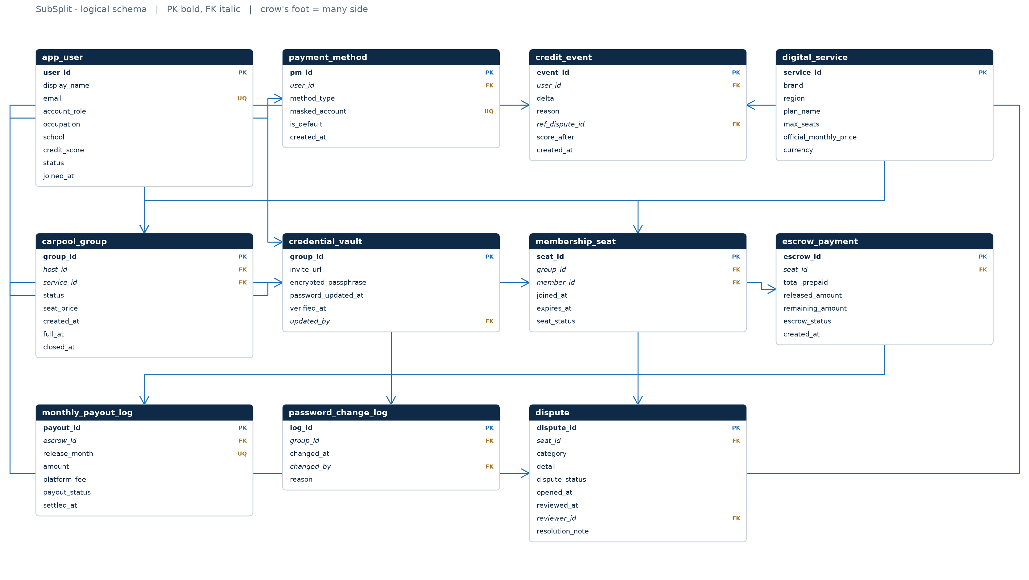
04 · DATABASE STRUCTURE
Eleven relations, fifteen foreign keys
The whole schema at once. Module views follow, because eleven boxes on one page is a map, not a diagram.
WEAK ENTITY
credential_vault borrows group_id as its own key — no group, no credential.
ASSOCIATIVE ENTITY
membership_seat is the M:N link promoted to an entity with its own life cycle.
LEDGER
monthly_payout_log keys on (escrow_id, release_month): a month cannot be paid twice.
DOTE 6751 · Group Project · SubSplit · November 2026
04 / 14
Notes:
Do not read the ERD out loud. Point at three things: the weak entity at the right, the seat table in the middle, and the ledger at the bottom. Say that eleven boxes on one page is a map, and the next two slides zoom in.

Slide 5
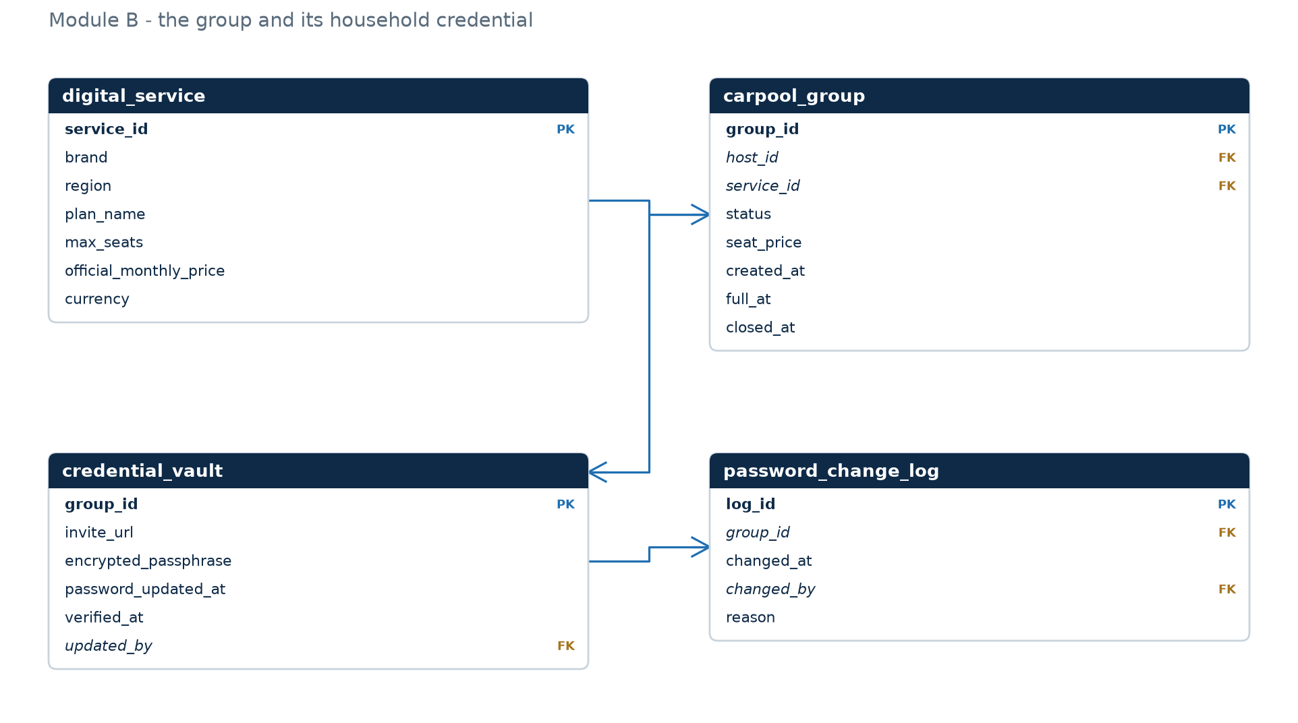
05 · DATABASE STRUCTURE
The group and its credential
One host, one product, one credential: the 1:1 that makes a shared household auditable.
1:1 BY CONSTRUCTION
group_id is both the primary key and the foreign key of credential_vault — a second vault for the same group is impossible.
CAPACITY IS A PRODUCT FACT
max_seats lives in digital_service, never copied into the group; the trigger joins to read it.
EVERY CHANGE IS JOURNALLED
trg_password_log writes a row whenever password_updated_at moves.
DOTE 6751 · Group Project · SubSplit · November 2026
05 / 14
Notes:
This is the module that makes the platform auditable: one group, one credential, one source of truth for the seat ceiling. The key sentence is that group_id is both the primary key and the foreign key — so a second vault for the same group cannot exist.

Slide 6
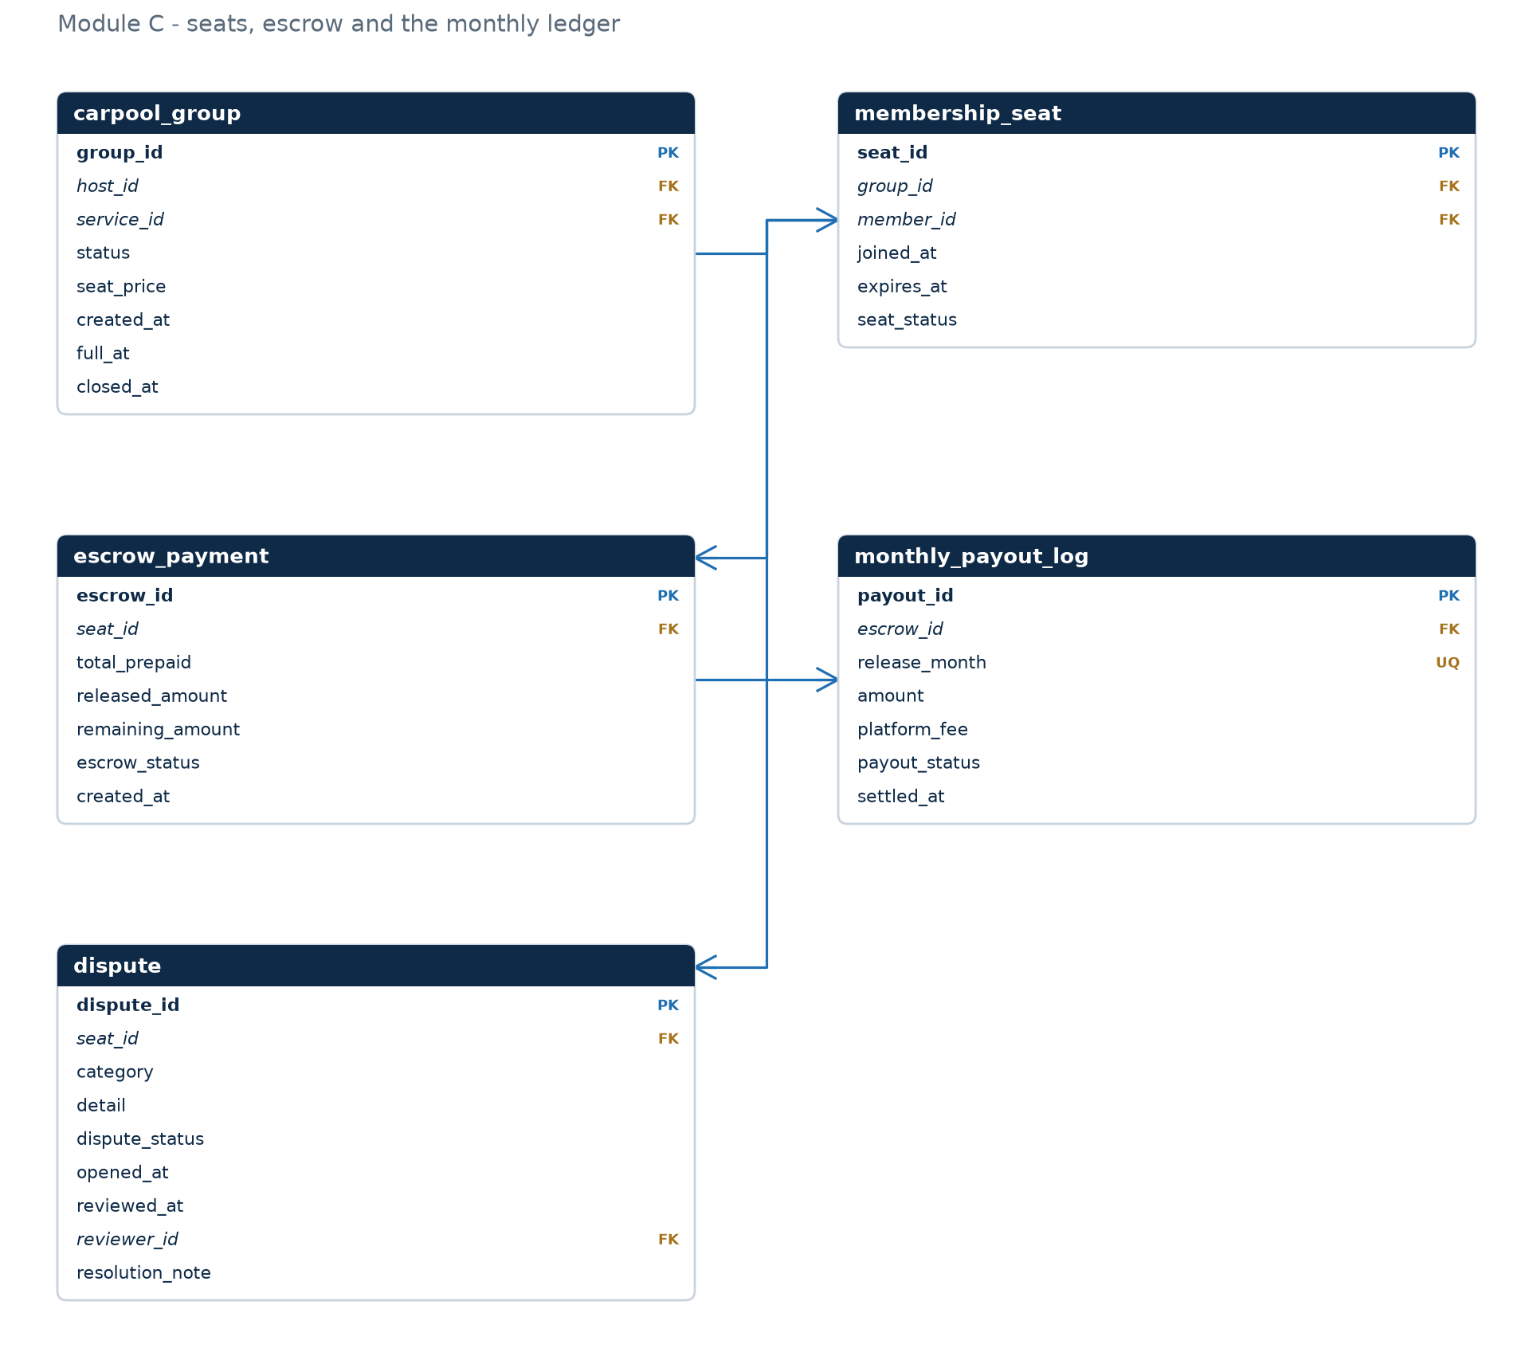
06 · DATABASE STRUCTURE
Seats, escrow and the monthly ledger
Money has three homes: what was prepaid, what has been released, and what is still owed.
1:1 SEAT → ESCROW
seat_id is unique in escrow_payment, so a seat has exactly one pot of money.
BALANCE IS A CACHE
remaining = total − released is a CHECK, not an assumption; Q11 audits every row.
COMPLAINT FREEZES MONEY
a dispute never deletes a payout; it changes escrow_status and blocks the next release.
DOTE 6751 · Group Project · SubSplit · November 2026
06 / 14
Notes:
Money module. Trace one seat: the member prepays, the escrow holds it, the ledger releases one twelfth. The CHECK constraint is the reason a careless UPDATE cannot invent money.

Slide 7
07 · DATABASE STRUCTURE
What each table is for
Eleven tables, 76 attributes. Every one of them answers a question the business actually asks.
Table | Rows | Why it exists
app_user | 300 | identity, role, credit score
payment_method | 379 | several instruments, one default
digital_service | 8 | product dictionary: brand, region, seat ceiling
carpool_group | 60 | one host reselling one product
credential_vault | 60 | the household credential (weak entity)
membership_seat | 300 | who sits where, for how long
escrow_payment | 300 | the prepayment held for one seat
monthly_payout_log | 2,172 | every release, with its fee
password_change_log | 74 | credential history, for risk
dispute | 33 | complaints and their state machine
credit_event | 109 | why the score moved
READING THE TABLE
Three of the eleven are history tables — they exist because a value is not enough, the sequence matters:
· password_change_log answers “how many times in 30 days”, which a single timestamp cannot.
· monthly_payout_log answers “how much has actually been paid”, and makes double payment impossible.
· credit_event answers “why is this host at 60”, which a number alone cannot.
DOTE 6751 · Group Project · SubSplit · November 2026
07 / 14
Notes:
A quick reference table, not a slide to read. Say the row counts out loud once — 300 members, 60 groups, 2,172 releases — because it proves the data is real. Then move to queries.

Slide 8
08 · SQL QUERIES
Eighteen queries, six on stage
Three families: lookups a member runs, analysis the business runs, and controls that only make sense over time.
6
LOOKUPS
7
BUSINESS
5
ADVANCED
find a group, a seat, a credential
revenue, fill time, refunds, ranking
CTEs, windows, anti-joins, audits
Q01 · PRECISE SEAT HUNTING
Recruiting groups on Spotify Hong Kong, exactly one seat left, host with a perfect score.
group | price | host | seats
1 | 20.22 | Olivia CHU | 5/6
46 | 21.63 | Peter ZHANG | 5/6
SELECT g.group_id, ds.brand, g.seat_price, u.credit_score,
COUNT(s.seat_id) AS seats_taken,
ds.max_seats - COUNT(s.seat_id) AS seats_left
FROM carpool_group g
JOIN digital_service ds USING (service_id)
JOIN app_user u ON u.user_id = g.host_id
LEFT JOIN membership_seat s
ON s.group_id = g.group_id AND s.seat_status = 'ACTIVE'
WHERE g.status = 'RECRUITING' AND ds.brand = 'Spotify'
AND ds.region = 'HK' AND u.credit_score = 100
GROUP BY g.group_id, ds.brand, g.seat_price, u.credit_score, ds.max_seats
HAVING seats_left = 1;
The search is narrow by design: a member with a year of money at stake wants the one group that is about to fill and whose host has never defaulted.
DOTE 6751 · Group Project · SubSplit · November 2026
08 / 14
Notes:
Start with the shape of the 18 queries, then narrow to Q01. The point of Q01 is not the SQL, it is the narrowness: one seat left, host with a perfect score. Read the two result rows, then go on.

Slide 9
09 · SQL QUERIES
Fraud is a pattern, not a payment
Q05 joins credential history to complaints and returns the queue an administrator should open first.
group | host | service | status | score | pwd / 30d | complaints
26 | Lok TSANG | Disney+ | ACTIVE | 60 | 6 | 3
34 | Jason MA | Netflix | ACTIVE | 39 | 6 | 2
12 | Mandy FUNG | Disney+ | FULL | 60 | 5 | 3
9 | Mei MA | Spotify | RECRUITING | 60 | 5 | 3
8 | Grace CHAN | Netflix | ACTIVE | 60 | 4 | 6
35 | Yitong CHEUNG | Apple One | FULL | 30 | 3 | 4
READ IT AS A RULE, NOT A SCORE
Three credential changes in thirty days is what a host does when a paying member has been locked out. Two “cannot log in” complaints on the same group is what the members do next.
The query deliberately does not refund, suspend or punish: it produces a ranked queue. The decision stays with an administrator, and the state machine in dispute makes that decision visible.
33
6
0
DISPUTES ON FILE
GROUPS FLAGGED
AUTOMATIC REFUNDS
DOTE 6751 · Group Project · SubSplit · November 2026
09 / 14
Notes:
This is the slide to slow down on. Explain the two conditions as a story: a host keeps changing the password, and two members cannot get in. The query returns six groups; it does not punish anyone. The decision is human.

Slide 10
10 · SQL QUERIES
What the platform earns, and what people actually buy
Q04 aggregates the ledger by month; Q02 ranks services by the seats students occupy.
service | seats | groups
Netflix HK | 42 | 11
ChatGPT HK | 26 | 9
YouTube HK | 24 | 9
Spotify US | 22 | 7
Spotify HK | 20 | 6
Netflix-HK leads because it has the widest price gap between the individual plan and a six-seat family plan — the same gap that motivates the platform.
Peak month: HK$176 in fees. The August dip is a month with fewer releases, not a decline in the business.
DOTE 6751 · Group Project · SubSplit · November 2026
10 / 14
Notes:
Two charts: what the platform earns, and what people buy. Mention that the last month is excluded from the chart because it has only started — otherwise the line looks like a crash. Netflix-HK leads because its price gap is the widest.

Slide 11
11 · SQL QUERIES
Two questions that only make sense over time
Both need a window function: one looks at the previous month, the other at the previous row in the same escrow.
Q10 · CONSECUTIVE BLOCKED MONTHS
Q17 · MONTH-OVER-MONTH FEE GROWTH
LAG(payout_status) over each escrow finds groups that stopped paying twice in a row — a stronger signal than a single blocked month.
LAG over an aggregated month series: the fee this month compared with the fee last month, in one pass.
WITH ledger AS (
SELECT escrow_id, release_month, payout_status,
LAG(payout_status) OVER (
PARTITION BY escrow_id
ORDER BY release_month) AS prev
FROM monthly_payout_log)
SELECT escrow_id, release_month FROM ledger
WHERE payout_status = 'BLOCKED'
AND prev = 'BLOCKED';
month | fee | prev | Δ %
2026-04 | 138.86 | 135.19 | 2.7
2026-05 | 147.11 | 138.86 | 5.9
2026-06 | 176.09 | 147.11 | 19.7
2026-07 | 168.06 | 176.09 | -4.6
2026-08 | 140.59 | 168.06 | -16.3
2026-09 | 168.24 | 140.59 | 19.7
26 rows across the seeded data — every one of them belongs to a group already under dispute.
Both are plain SELECTs: nothing is precomputed, nothing is cached.
The same function answers two different questions — that is the point of learning it once, not twice.
DOTE 6751 · Group Project · SubSplit · November 2026
11 / 14
Notes:
Both queries use LAG, for two different questions. If someone asks what a window function is, say: an aggregate that keeps the row, so you can compare a row with its neighbour.

Slide 12
12 · LIMITATIONS
What this design does not do
Honest scope, and the three places we would go next.
MODELLED, NOT IMPLEMENTED
KNOWN LIMITS
NEXT
— Escrow as a state machine, not a payment gateway
— No partial months: leave on day 20, keep the month
— Materialised view for the market listing
— Credential as encrypted text, not a secrets manager
— No cross-region pricing: comparisons stay within a region
— Partition the ledger by year once it passes ~10M rows
— Host bill verification as a date, not a process
— A determined host can still lie — we only make it visible
— Archival policy for CLOSED groups older than two years
Every limit above is a decision we made on purpose, and each has a next step — which is why the design is finished, not unfinished.
DOTE 6751 · Group Project · SubSplit · November 2026
12 / 14
Notes:
Be honest here, and specific. Every bullet is a decision, not an excuse. End on the closing line — the design is finished, not unfinished.

Slide 13
13 · APPENDIX
Task allocation
Seven members, one schema. Hours are estimates agreed at the start; difficulty is 1–5.
Student | ID | Task | Difficulty | Hours
Xuanmo AN | 1155260677 | Conceptual E-R model: entities, relationships, cardinality limits, weak-entity decision | 4 | 11
Yi HOU | 1155261383 | E-R to relations: §6.7 mapping rules, key placement, 3NF/BCNF proof | 5 | 13
Zhao Han HUANG | 1155272384 | DDL and integrity constraints: CHECK, unique keys, referential actions, indexes | 5 | 12
Jinyu LI | 1155261567 | Triggers and views: seat ceiling, default instrument, credential journal, balance upkeep | 5 | 12
Yitong NI | 1155265810 | Deterministic seed generator and the transaction episodes | 4 | 10
Shujing YE | 1155261750 | Eighteen queries: grouping, window functions, CTEs, result capture | 4 | 11
Shiyao ZHANG | 1155261823 | Acceptance suite, fault injection and ledger reconciliation | 4 | 10
Total 79 hours. Difficulty follows the number of concepts a task touches, not the number of lines written.
DOTE 6751 · Group Project · SubSplit · November 2026
13 / 14
Notes:
Appendix, not presented. If asked, say the hours are estimates agreed before the work started, and the difficulty follows the number of concepts a task touches.

Slide 14
14 · BACKUP
If you ask us this, here is the answer
Prepared responses to the seven questions this design invites.
Why store the balance if it is derivable?
Why manual review instead of auto-refund?
It is read on every dashboard view; the ledger is written monthly. A CHECK makes the identity enforceable, and Q11 audits it.
Two coordinated friends could drain any host. Detection is automatable; judgement is not.
Is this 3NF?
Why not NoSQL?
BCNF everywhere. The proof lists every functional dependency and every candidate key.
Money, seats and state transitions need multi-row invariants; that is the relational model's home ground.
How do you stop double-selling a seat?
What happens if a host deletes the account?
UNIQUE(group_id, member_id) plus a trigger that counts seats against digital_service.max_seats.
RESTRICT on carpool_group.host_id: the group must be closed and its escrow settled first.
Where is the evidence it runs?
subsplit_db on MySQL 8.0.40; every query executed, results saved in query_results/.
DOTE 6751 · Group Project · SubSplit · November 2026
14 / 14
Notes:
Only if there is time or a question. The first three answers are the ones most likely to be asked.

