Slide 1

Excuser Application
Developed by Iana Setrakova, Mehmet Yiter, Alexandre Scebba, Konstantin Khorev

Slide 2
1. Purpose of the Project Goal:
To develop a fun web application that allows users to create and share excuses for various situations.
Uses: Various scenarios like being late, missing a meeting, or just making humorous excuses.

Slide 3
2. Technology and Tools
Frontend: HTML, CSS, JavaScript, jQuery
Backend: Spring Boot, Java
Database: MySQL
Other Tools: Postman, IntelliJ IDEA, Lombok

Slide 4
3. Features
Excuse Generator:
Users can create random excuses in different categories (family, work, friends, etc.). Funny GIFs are shown alongside the excuses.
Excuse History:
Users can view the excuses they have created and save them. The history of recorded excuses is listed.
Add Comment:
Users can add comments to each excuse. Comments and relevant excuses appear together.
User Management:
Users can log in to the application. User information is stored in local storage and session management is provided.

Slide 5
4. Technical Details
Database Structure:
excuses: The table where excuses are stored.
comments: The table where the comments added to the excuses are stored.
users: Table containing user information.
Backend Operations: Created RESTful APIs using Spring Boot. Database operations were performed using JDBC Template.
Frontend Operations: AJAX calls were made with jQuery. The user interface was designed with Bootstrap and for templates used Figma.

Slide 6
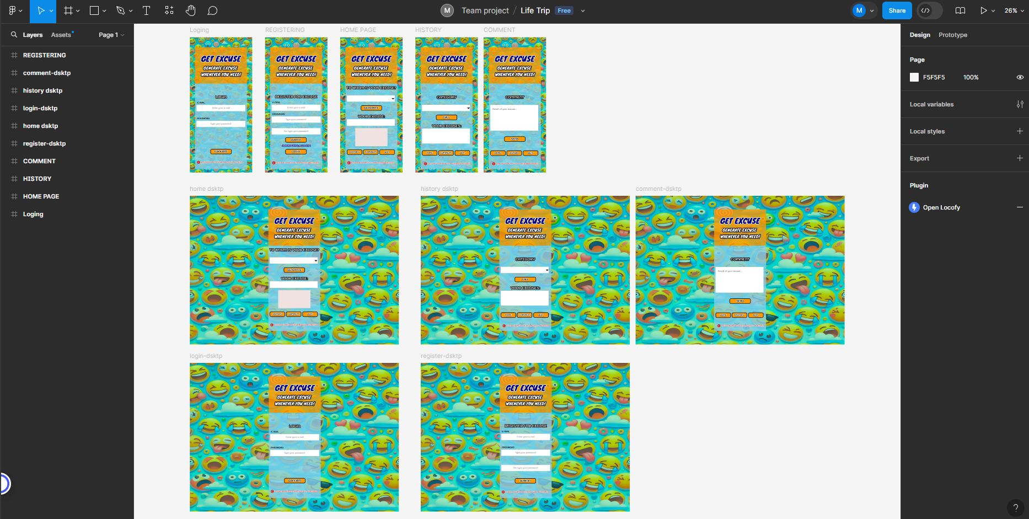
Our first design was like this, but over time it took its current form to meet the project requirements.

Slide 7
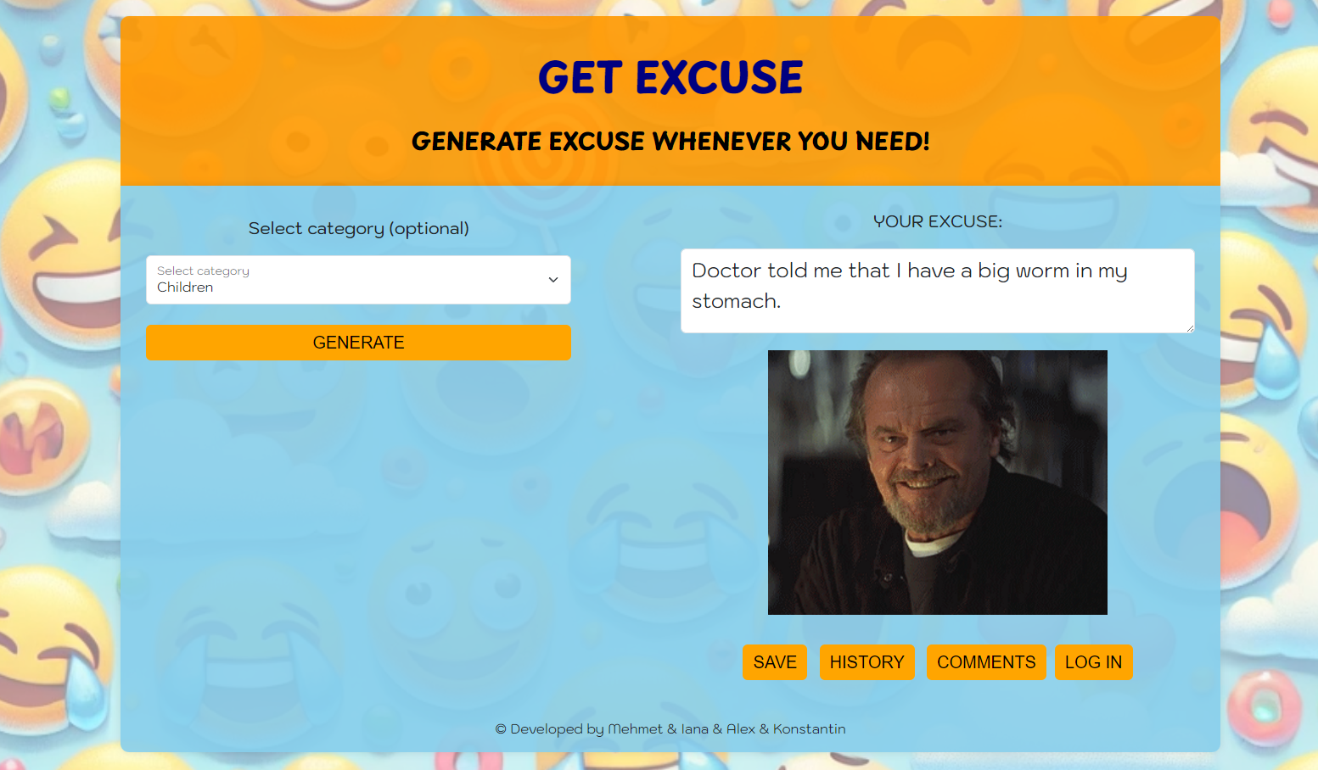
Last version of our project is like this.

