Slide 1


Library Management System
Team 6
Tamara Plante, Iana Setrakova, Médérick Blouin

Slide 2


Requirements
The library system helps keep track of a large catalogue of books and supports borrowing and returning them.
The system tracks of who currently has a particular book, as well as if any late fees need to be paid upon its return. The system also has detailed information on each book in the catalogue, a list of employees, and a list of members with their information.
Members can borrow eBooks directly from the system.

Slide 3
Key Functionalities
Catalogue Management: Manages detailed book information including authors, categories, titles, publishers, publication years, locations, and available copies.
Membership Management: Stores members' personal details including names, birthdates, contact information (phone and email), addresses, and subscription status (e.g., student or newsletter).
Checkout Management:
Tracks book borrowing and returns, including due dates.
Limits borrowing of physical books by 10 per member at a time, subject to their account status.
Returning of eBook automatically upon their checkout’s end date.
Late Fee Management: Tracks overdue book fees and payment deadlines.
Employee Database: Stores unique employee IDs, names, and roles.

Slide 4
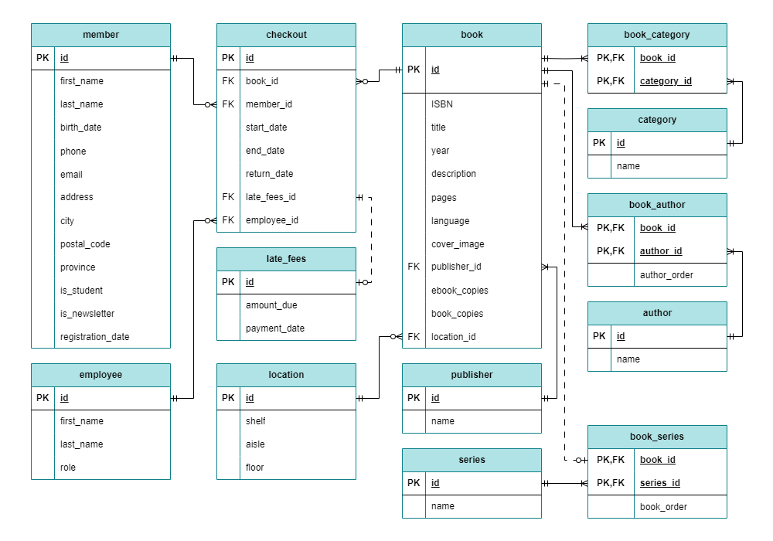
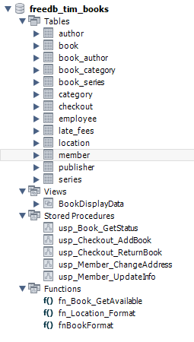

Slide 5
Availability
Book Status
Available formats
DELIMITER //
CREATE PROCEDURE usp_Book_GetStatus(arg_book_id INT)
BEGIN
SELECT
fn_Book_GetAvailable(id, TRUE) AS available,
fn_Location_Format(location_id) AS location,
(SELECT end_date FROM checkout
WHERE
book_id = book.id
AND employee_id <> 1
AND return_date IS NULL
ORDER BY end_date
LIMIT 1) AS earliest_return
FROM book
WHERE id = arg_book_id;
END //
DELIMITER ;
CALL usp_Book_GetStatus(20);
SELECT
title,
`year`,
fn_Book_GetAvailable(id, TRUE) AS book_avail,
fn_Book_GetAvailable(id, FALSE) AS ebook_avail
FROM book WHERE id = 29;

Slide 6
Checkout a Book
IF val_has_book > 0 THEN
SIGNAL SQLSTATE '45000' SET MESSAGE_TEXT = 'Checkout denied. Book already checked out by this member.';
ELSEIF val_book_count = val_book_limit THEN
SIGNAL SQLSTATE '45000' SET MESSAGE_TEXT = 'Checkout denied. Book limit reached.';
END IF;
-- Get the member's unpaid late fees
SELECT SUM(amount_due) INTO val_fees
FROM checkout
JOIN late_fees ON late_fees_id = late_fees.id
WHERE
member_id = arg_member_id
AND payment_date IS NULL;
IF val_fees IS NOT NULL THEN
SET error_msg = CONCAT('Checkout denied. Late fees due: ', val_fees, '$');
SIGNAL SQLSTATE '45000' SET MESSAGE_TEXT = error_msg;
END IF;
-- Error: If there's any checkout that are late and not returned.
-- Checkout
INSERT INTO checkout (book_id, member_id, start_date, end_date, employee_id)
VALUES (arg_book_id, arg_member_id, CURDATE(), DATE_ADD(CURDATE(), INTERVAL 14 DAY), arg_employee_id);
SELECT * FROM checkout WHERE id = LAST_INSERT_ID(); END //
DELIMITER ;
CALL usp_Checkout_AddBook(8, 2, 6);
With the following validations:
A member can borrow 10 books at a time.
A member can borrow a single copy of a book.
Their account must be in good standing.
DELIMITER //
CREATE PROCEDURE usp_Checkout_AddBook(arg_book_id INT, arg_member_id INT, arg_employee_id INT)
BEGIN
DECLARE val_book_limit TINYINT DEFAULT 10;
DECLARE val_book_count TINYINT;
DECLARE val_has_book TINYINT;
DECLARE val_fees DECIMAL(5, 2);
DECLARE error_msg VARCHAR(50);
-- Get the member's currently borrowed books (ignoring ebooks)
SELECT COUNT(*), SUM(IF(book_id = arg_book_id, 1, 0))
INTO val_book_count, val_has_book
FROM checkout
WHERE
member_id = arg_member_id
AND employee_id <> 1
AND return_date IS NULL;

Slide 7
Checkout Highlight
Before
After
-- ensure the member unique book id in current checkout
SELECT COUNT(*) INTO book_count FROM checkout
WHERE
member_id = arg_member_id
AND employee_id <> 1 -- ignore ebooks
AND book_id = arg_book_id
AND return_date IS NULL
LIMIT 1;
-- unique book id checkout
IF book_count > 0 THEN
SIGNAL SQLSTATE '45000' SET MESSAGE_TEXT =
'Checkout denied. Book already checked out by this member.';
END IF;
-- get the count of member's currently borrowed books
SELECT COUNT(*) INTO book_count FROM checkout
WHERE
member_id = arg_member_id
AND employee_id <> 1 -- ignore ebooks
AND return_date IS NULL
LIMIT book_limit;
-- limit of 10 books can be borrowed
IF book_count = book_limit THEN
SIGNAL SQLSTATE '45000' SET MESSAGE_TEXT =
'Checkout denied. Book limit reached.';
END IF;
-- Get the member's currently borrowed books (ignoring ebooks)
SELECT COUNT(*), SUM(IF(book_id = arg_book_id, 1, 0))
INTO book_count, has_book
FROM checkout
WHERE
member_id = arg_member_id
AND employee_id <> 1
AND return_date IS NULL;
IF has_book > 0 THEN
SIGNAL SQLSTATE '45000' SET MESSAGE_TEXT =
'Checkout denied. Book already checked out by this member.';
ELSEIF book_count = book_limit THEN
SIGNAL SQLSTATE '45000' SET MESSAGE_TEXT =
'Checkout denied. Book limit reached.';
END IF;

Slide 8
Return a Book
-- Check if the return was late
SET val_late_days = DATEDIFF(val_today, val_end_date);
IF val_late_days > 0 THEN
SET val_fees = val_amount_per * val_late_days;
INSERT INTO late_fees (amount_due) VALUES (val_fees);
SET insert_lfi = LAST_INSERT_ID();
END IF;
-- Update the checkout entry with return date and late_fees if any
UPDATE checkout
SET return_date = val_today, late_fees_id = insert_lfi
WHERE id = val_id;
SELECT
member_id,
book_id,
late_fees_id,
val_late_days AS days_late,
val_fees AS amount_due
FROM checkout
WHERE id = val_id;
END //
DELIMITER ;
CALL usp_Checkout_ReturnBook(29, 1);
Generating fees
If the return date is late, generate late fees of 0.50$/day.
DELIMITER //
CREATE PROCEDURE usp_Checkout_ReturnBook(arg_book_id INT, arg_member_id INT)
BEGIN
DECLARE val_today DATE DEFAULT CURDATE();
DECLARE val_late_days INT DEFAULT 0;
DECLARE val_fees DECIMAL(5, 2) DEFAULT 0;
DECLARE val_amount_per DECIMAL(5, 2) DEFAULT 0.50;
DECLARE val_id INT;
DECLARE val_end_date DATE;
DECLARE insert_lfi INT;
-- Get checkout infos
SELECT id, end_date
INTO val_id, val_end_date
FROM checkout
WHERE
member_id = arg_member_id
AND book_id = arg_book_id
AND return_date IS NULL;

Slide 9
Catalogue View
CREATE VIEW BookDisplayData AS
SELECT
b.id,
b.ISBN,
b.title AS 'Title’,
GROUP_CONCAT(DISTINCT(a.`name`) ORDER BY ba.author_order ASC SEPARATOR ', ') as 'Author(s)',
GROUP_CONCAT(DISTINCT(c.`name`) ORDER BY c.`name` ASC SEPARATOR ', ') as 'Category',
s.`name` AS 'Series',
b.`description` AS 'Description’,
p.`name` AS 'Publisher''s name',
b.cover_image AS 'Cover image’,
fnBookFormat(b.id) AS 'Book Format’,
b.pages AS 'Number of pages',
b.`language` AS 'Language',
b.`year` AS 'Year',
fn_Location_Format(b.location_id) AS 'Location'
FROM book AS b
LEFT JOIN book_author AS ba ON b.id = ba.book_id
LEFT JOIN author AS a ON ba.author_id = a.id
LEFT JOIN book_category AS bc ON b.id = bc.book_id
LEFT JOIN category AS c ON bc.category_id = c.id
LEFT JOIN publisher AS p ON b.publisher_id = p.id
LEFT JOIN book_series AS bs ON b.id = bs.book_id
LEFT JOIN series AS s ON bs.series_id = s.id
GROUP BY b.id;
Retrieve the complete book catalogue data with:
Authors and Series
Available book formats
Location details

Slide 10
Catalogue View Data
SELECT * FROM BookDisplayData;

Slide 11
Added Functionalities
Get books by a category
Get the book formats
SELECT
c.`name` as 'Category',
b.id,
b.ISBN,
b.title AS 'Title',
GROUP_CONCAT(DISTINCT(a.`name`) ORDER BY ba.author_order ASC SEPARATOR ', ') as 'Author(s)',
s.`name` AS 'Series',
fnBookFormat(b.id) AS 'Book Format'
FROM book AS b
JOIN book_author AS ba ON b.id = ba.book_id
JOIN author AS a ON ba.author_id = a.id
JOIN book_category AS bc ON b.id = bc.book_id
JOIN category AS c ON bc.category_id = c.id
JOIN book_series AS bs ON b.id = bs.book_id
JOIN series AS s ON bs.series_id = s.id
WHERE c.name LIKE '%fiction%'
GROUP BY b.id;
DELIMITER //
CREATE FUNCTION fnBookFormat(argBookID INT)
RETURNS VARCHAR(50) NOT DETERMINISTIC
BEGIN
DECLARE bookFormatString VARCHAR(50);
DECLARE ebook_copies_var INT;
DECLARE book_copies_var INT;
SELECT ebook_copies, book_copies
INTO ebook_copies_var, book_copies_var
FROM book WHERE id = argBookID;
IF ebook_copies_var > 0 AND book_copies_var > 0 THEN
SET bookFormatString = CONCAT('eBooks: ', ebook_copies_var, ', Printed books: ', book_copies_var);
ELSEIF ebook_copies_var > 0 THEN
SET bookFormatString = CONCAT('eBooks: ', ebook_copies_var);
ELSEIF book_copies_var > 0 THEN
SET bookFormatString = CONCAT('Printed books: ', book_copies_var);
ELSE
SET bookFormatString = 'Unknown format';
END IF;
RETURN bookFormatString;
END //
DELIMITER ;
SELECT fnBookFormat(20) AS 'Book Format';

Slide 12
Added Functionalities
Get the members with unpaid late fees
Get books by an author's name
SELECT
`member`.id,
`member`.first_name,
`member`.last_name,
late_fees.amount_due
FROM late_fees
JOIN checkout ON late_fees.id = checkout.late_fees_id
JOIN `member` ON checkout.member_id = `member`.id
WHERE late_fees.payment_date IS NULL;
SELECT
author.`name`,
book.title,
book.`description`,
book.pages,
book.`language`,
book.id
FROM book
JOIN book_author ON book.id = book_author.book_id
JOIN author ON book_author.author_id = author.id
WHERE author.`name` LIKE '%Tolkien%';

Slide 13
Thank You
Tamara Plante
Iana Setrakova
Médérick Blouin

