Slide 1


Library Management System
Team 6
Tamara Plante, Iana Setrakova, Médérick Blouin

Slide 2


Requirements
The library requires a database to keep track of a large catalogue of books. It must be capable of managing the borrowing of books by members who will be aided by staff.
The system keeps track of who currently has a particular book, as well as if any late fees will need to be paid upon its return. The detailed information on each book in the catalogue, a list of employees, and a list of members with their information must be maintained.
The members are capable of viewing eBooks directly from the system.

Slide 3
Key functionalities
Catalogue Management: Stores information about each book, including its unique book ID, ISBN, author, category, title, publisher, publication year, number of copies, description and more.
Membership Management: Stores library members' personal details like member ID, name, date of birth, phone, email, physical address, if they are a student, if they subscribed to the newsletter.
Checkout Management: Tracks book borrowing and returning, as well as due dates. eBooks can be viewed directly from the system.
Late Fee Management: Tracks the amount due and payment date.
Employee Database: Stores a list of employee unique IDs, names, and roles.

Slide 4
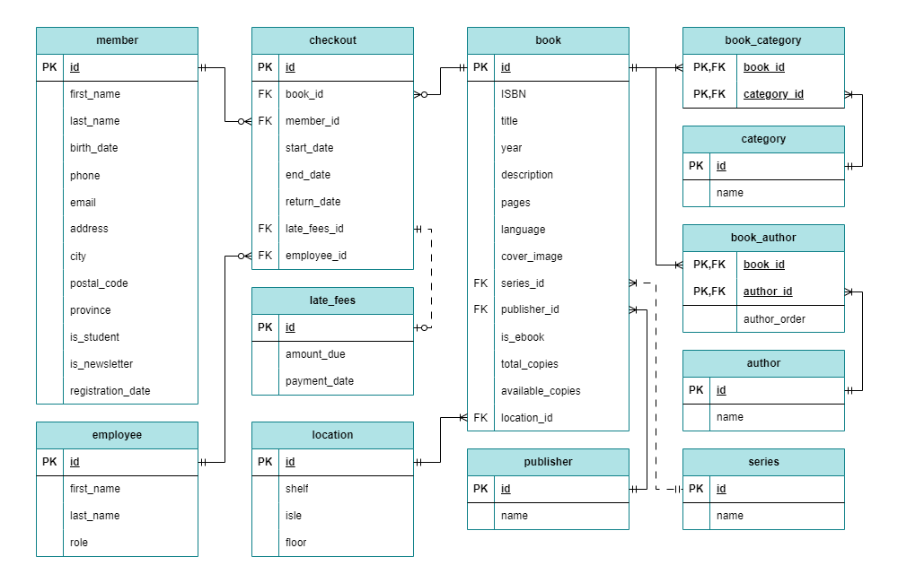

Slide 5
Thank you

