Slide 1
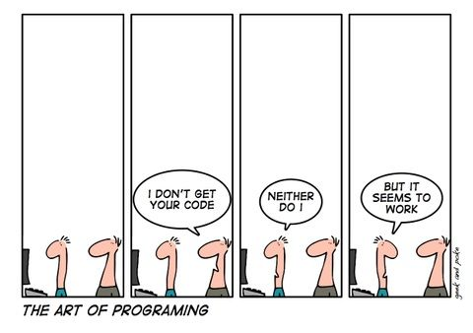
Code Review Club
A group to talk about coding

Slide 2
Rules
200 lines or less of code for 1 hour
Everyone (strongly) encouraged to present
Moderate discussion
Don’t get hung up on stylistic choices
Avoid stating opinion as fact
Don’t shame raw code
Be careful of assumed knowledge (e.g. jargon)

Slide 3
Discussion Topics
Does the code perform as expected?
Are coding guidelines followed (e.g. PEP-8)?
Is the code easy to read and understand?
Is the code properly documented?
Is the code efficient (enough)?
Testing
Licensing
Compare to previous methods
Dependencies
See github.com/astropy/CONTRIBUTING.md

Slide 4
