Slide 1
DockCoders
By Alexandar Baev, Ivan Tsrangalov, Ivan Georgiev and Mariyan Ivanov

Slide 2
TABLE OF CONTENTS
01
02
04
05
Introduction
Our team
03
Used programs
Stages of development
Final result

Slide 3
01
INTRODUCTION
What is our project about?

Slide 4
02
Our team

Slide 5
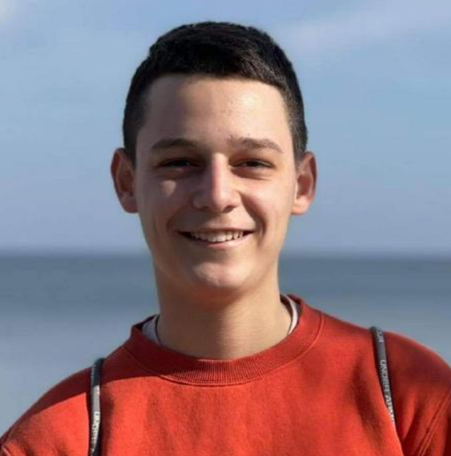

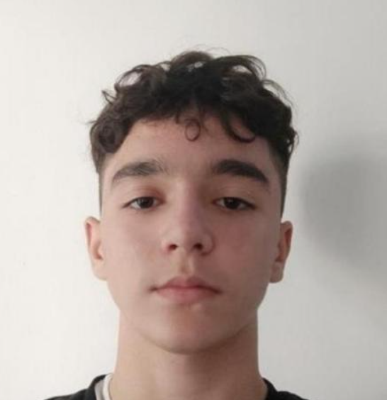

Backend developer
QA engineer
Scrum trainer
Backend developer

Slide 6
03
Used programs

Slide 7







Slide 8
04
Stages of development

Slide 9
Stage 1
Making up the team
Stage 2
Coming up with a plan and following it
Stage 3
Testing the product when it’s done
Stage 4
Presenting

Slide 10
05
Final result
Let’s see the project

