Slide 1
Chapter 17
BOOTP
and
DHCP

Slide 2
CONTENTS
BOOTP
DHCP

Slide 3
17.1
BOOTP

Slide 4
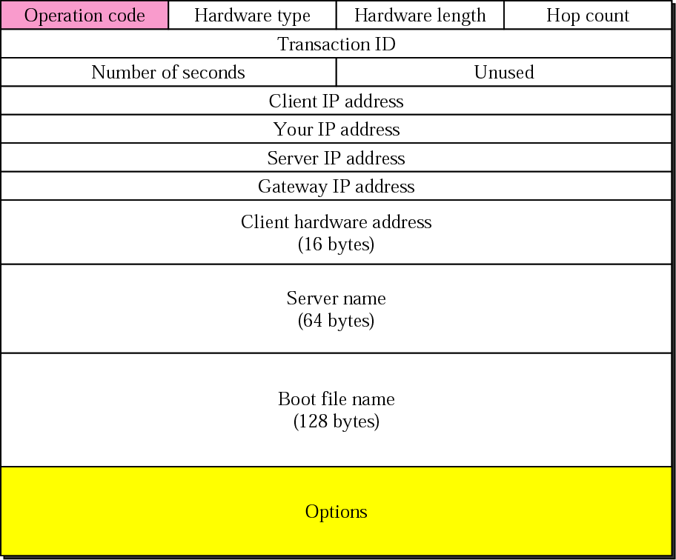
Figure 17-1
BOOTP packet format

Slide 5
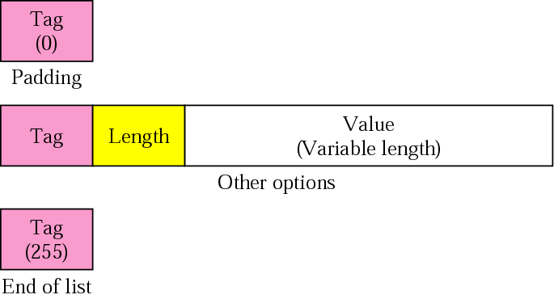
Figure 17-2
Option format

Slide 6
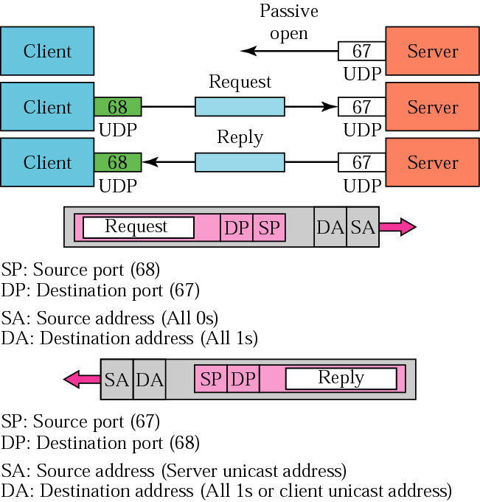
Figure 17-3
BOOTP operation

Slide 7
18.1
DHCP

Slide 8
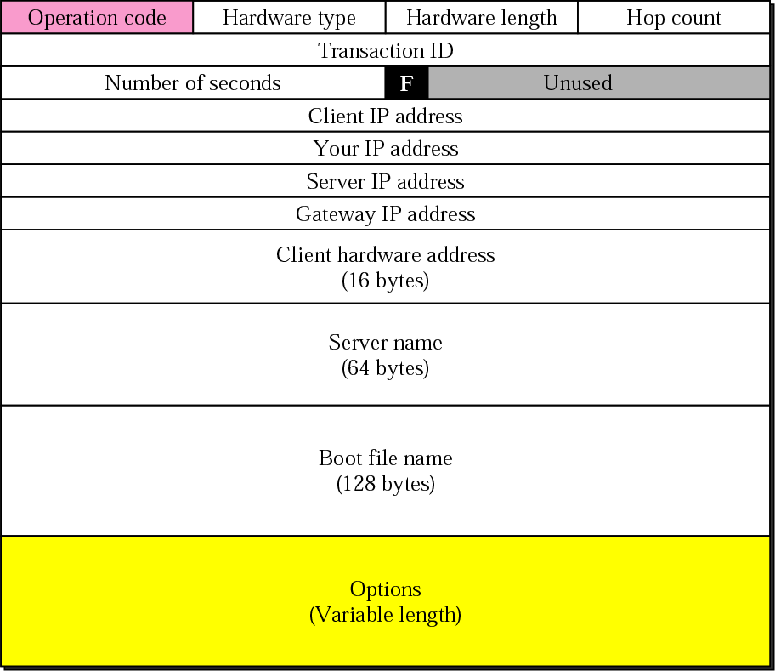
Figure 17-4
DHCP packet

Slide 9
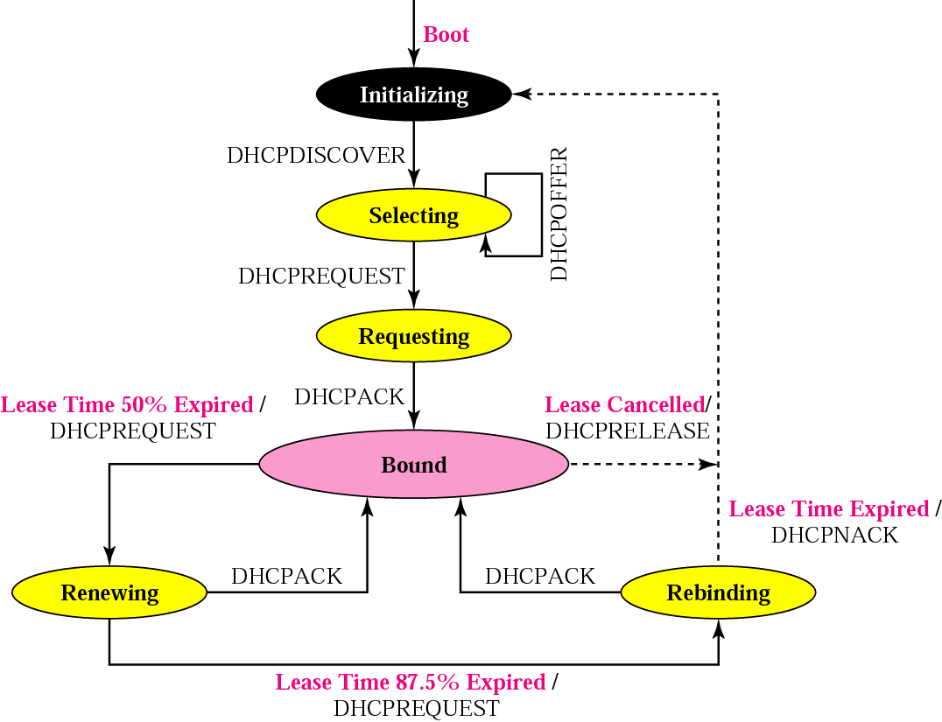
Figure 17-5
DHCP transition diagram

Slide 10
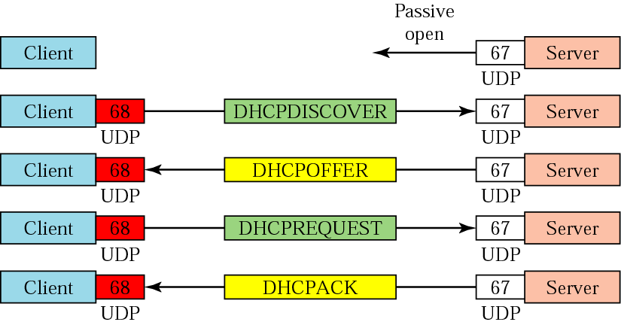
Figure 17-6: Part I
Exchanging messages

Slide 11
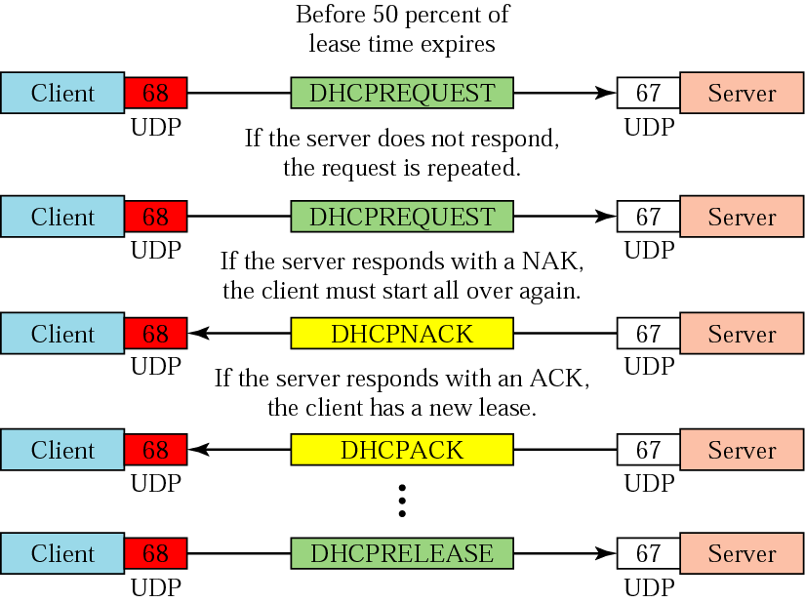
Figure 17-6: Part II
Exchanging messages

