Slide 1
Chapter 27
Mobile
IP

Slide 2
CONTENTS
ADDRESSING
AGENTS
THREE PHASES
AGENT DISCOVERY
REGISTRATION
DATA TRANSFER
INEFFICIENCY IN MOBILE IP

Slide 3
27.1
ADDRESSING

Slide 4

The IP addresses are designed
to work with stationary
hosts because part of the address
defines the network to
which the host is attached.

Slide 5
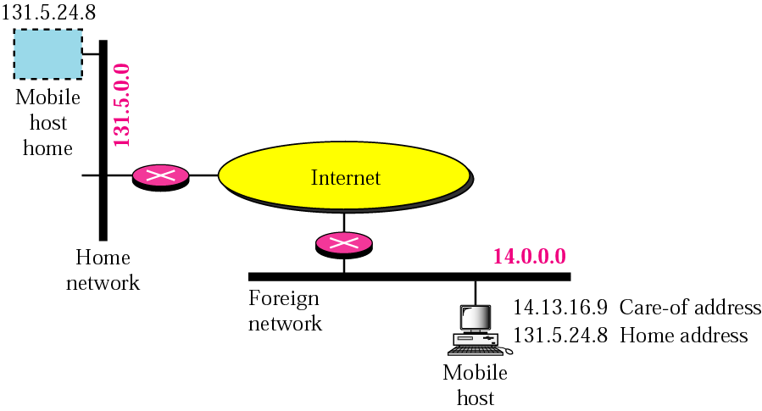
Figure 27-1
Host address and care-of address

Slide 6
Mobile IP has two addresses
for a mobile host:
one home address and one care-of address.
The home address is permanent;
the care-of address changes as the mobile
host moves from one network to another.

Slide 7
27.2
AGENTS

Slide 8
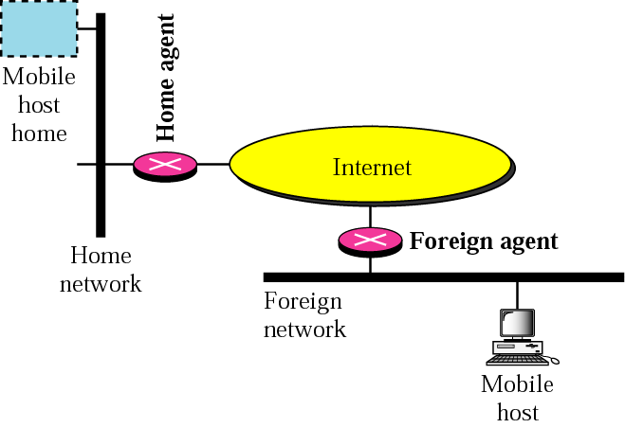
Figure 27-2
Home agent and foreign agent

Slide 9
When the mobile host and
the foreign agent are the same,
the care-of address is
called a co-located
care-of address.

Slide 10
27.3
THREE PHASES

Slide 11
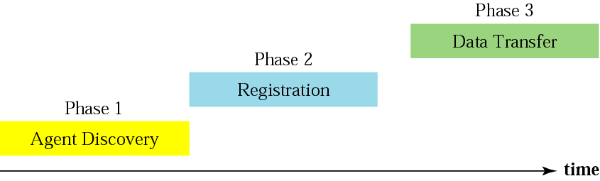
Figure 27-3
Remote host and mobile host communication

Slide 12
27.4
AGENT DISCOVERY

Slide 13
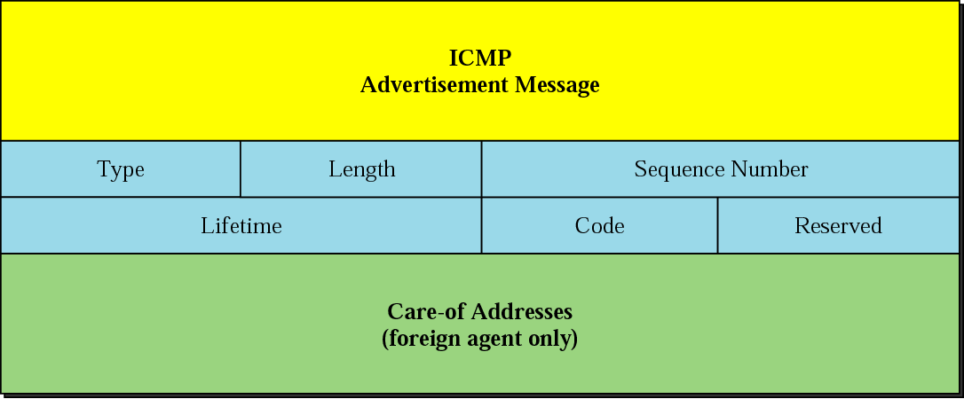
Figure 27-4
Agent advertisement

Slide 14
Mobile IP does not use a new packet
type for agent advertisement;
it uses the router
advertisement packet of ICMP,
and appends an agent
advertisement message.

Slide 15
Mobile IP does not use a new packet
type for agent solicitation;
it uses the router solicitation
packet of ICMP.

Slide 16
27.5
REGISTRATION

Slide 17
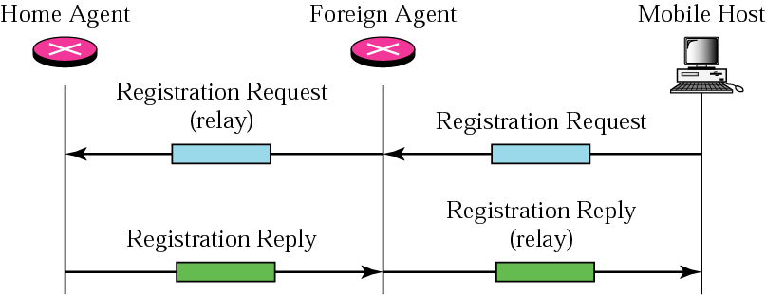
Figure 27-5
Registration request and reply

Slide 18
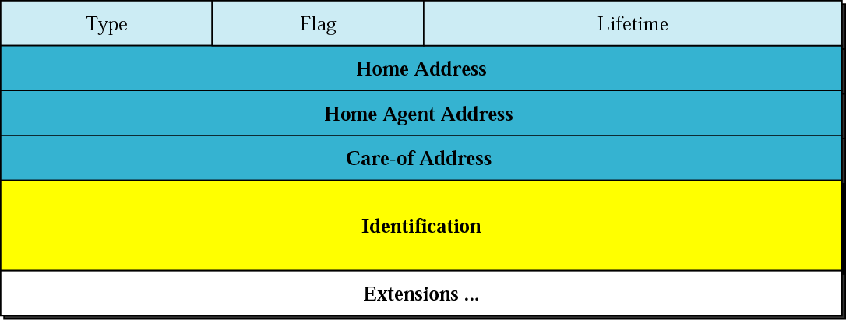
Figure 27-6
Registration request format

Slide 19
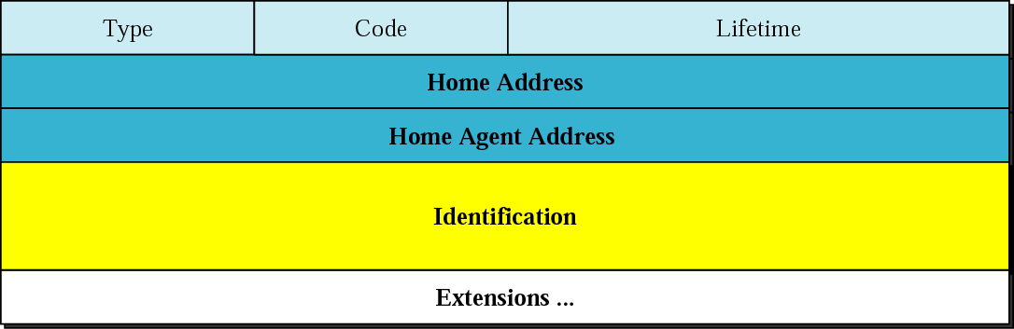
Figure 27-7
Registration reply format

Slide 20
A registration request or reply
is sent by
UDP using the
well-known port 434.

Slide 21
27.6
DATA
TRANSFER

Slide 22
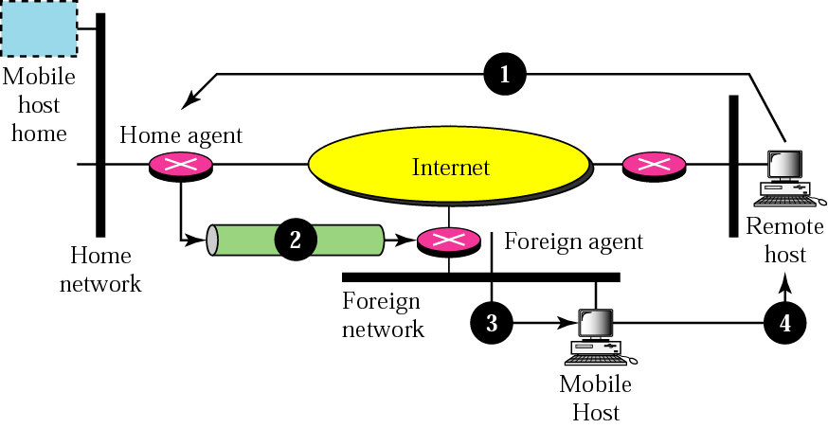
Figure 27-8
Data transfer

Slide 23
The movement of the
mobile host is transparent
to the rest of the Internet.

Slide 24
27.7
INEFFICIENCY
IN
MOBILE IP

Slide 25
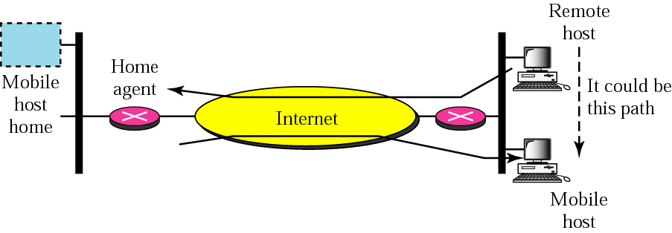
Figure 27-9
Double crossing

Slide 26
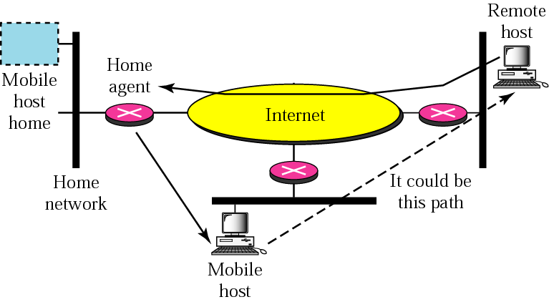
Figure 27-10
Triangle routing

