Slide 1
Chapter 30
Private Networks,
Virtual Private Networks,
and
Network Address
Translation

Slide 2
CONTENTS
PRIVATE NETWORKS
VIRTUAL PRIVATE NETWORKS (VPN)
NETWORK ADDRESS RESOLUTION (NAT)

Slide 3
30.1
PRIVATE NETWORKS

Slide 4
30.2
VIRTUAL PRIVATE
NETWORKS
(VPN)

Slide 5
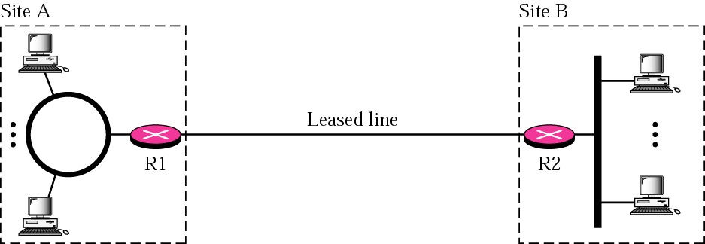
Figure 30-1
Private network

Slide 6
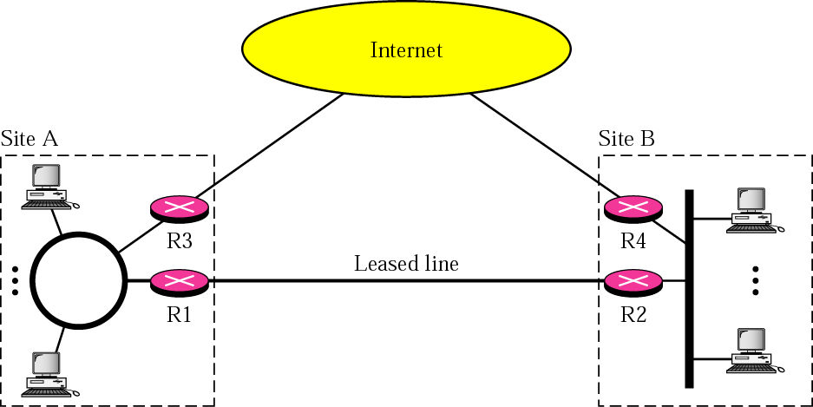
Figure 30-2
Hybrid network

Slide 7
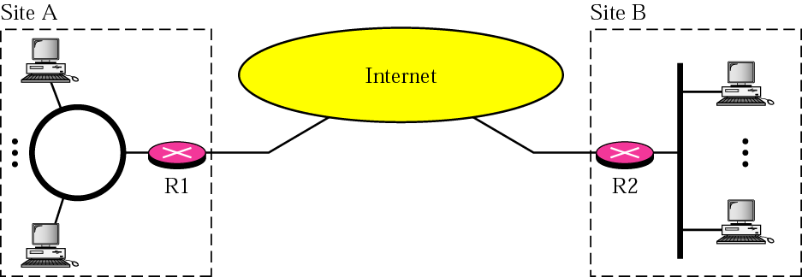
Figure 30-3
Virtual private network

Slide 8
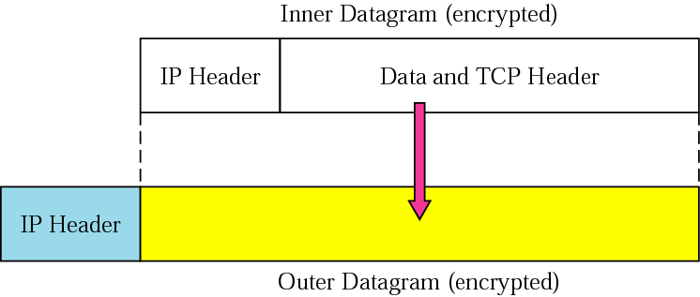
Figure 30-4
Tunneling

Slide 9
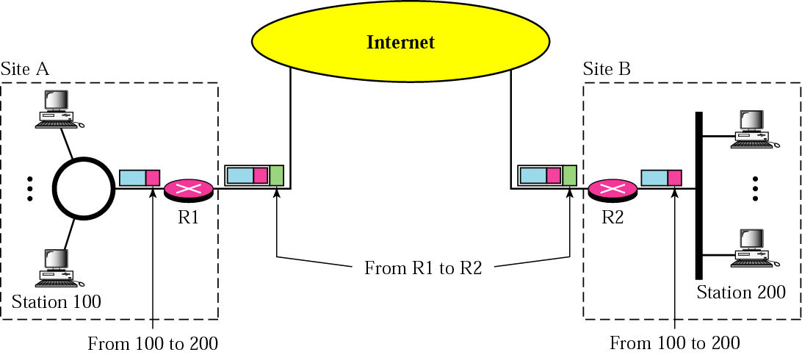
Figure 30-5
Addressing in a VPN

Slide 10
30.3
NETWORK ADDRESS
TRANSLATION
(NAT)

Slide 11
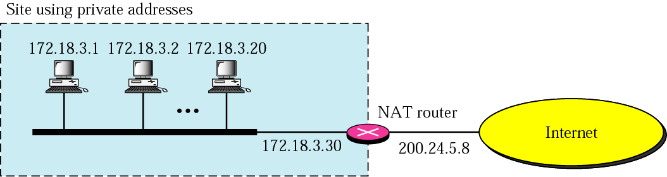
Figure 30-6
NAT

Slide 12
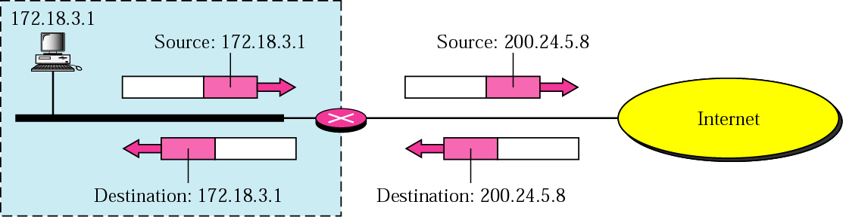
Figure 30-7
Address translation

Slide 13
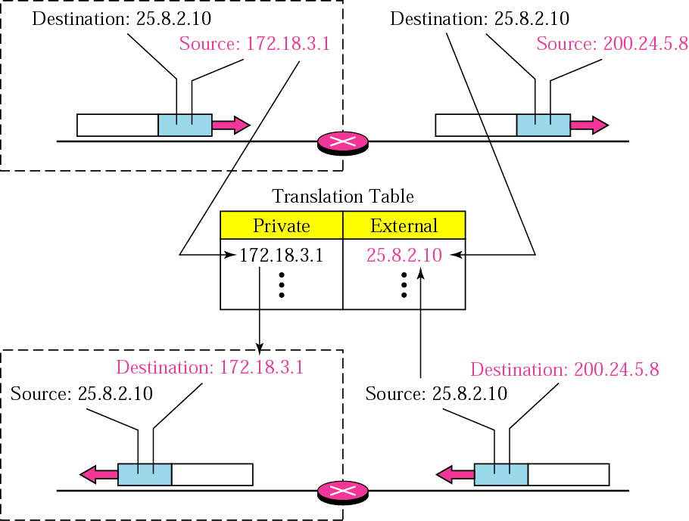
Figure 30-8
Translation

Slide 14
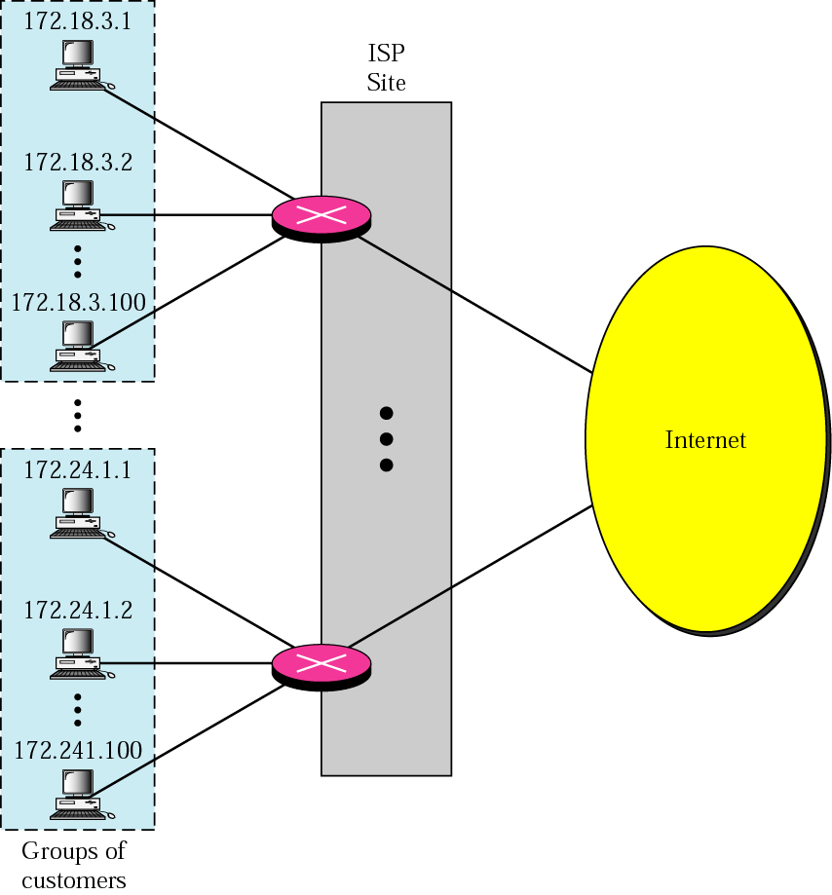
Figure 30-9
An ISP and NAT

