Slide 1

Применение R-CNN, SSD (Single Shot MultiBox Detector), PVANet, YOLO и т.п. для детектирования объектов на изображениях
Васильева Инна
Мошкина Дарья
Высшая школа экономики, Нижний Новгород, 2017
www.hse.ru

Slide 2

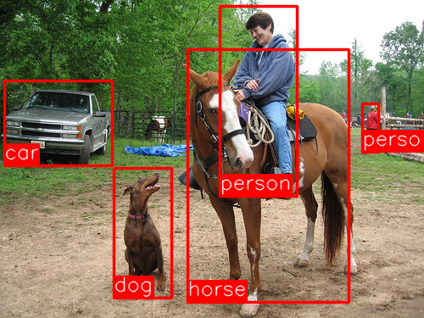
Задача детектирования объектов на изображениях
Object detection is the task of finding the different objects in an image and classifying them.
фото
фото
фото
Высшая школа экономики, Нижний Новгород, 2017

Slide 3
SSD – Single Shot Multibox Detector
Advantages
фото
фото
фото
Высшая школа экономики, Нижний Новгород, 2017

Slide 4
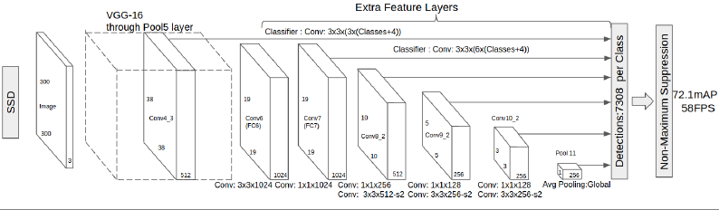
SSD: How it works
фото
фото
Eliminating bounding box proposals and subsequent pixel or feature resampling stage
Adding convolution feature layers to the end of the base network to predict detections at multiple scales
фото
Высшая школа экономики, Нижний Новгород, 2017

Slide 5
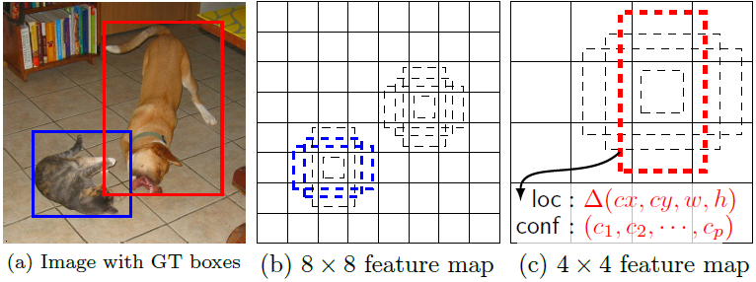
SSD: How it works
фото
фото
Needs an input image and ground truth boxes for each object during training
Evaluate a small set(e.g.4)of default boxes of different aspect ratios at each locations in several feature maps with different scales.
Filters match these default boxes to the ground truth boxes and predict both the shape offsets and confidence for all object categories for each default box
The feed-forward convolutional network produces a fixed-size collection of bounding boxes and scores for the presence of object class in those boxes
фото
Высшая школа экономики, Нижний Новгород, 2017

Slide 6
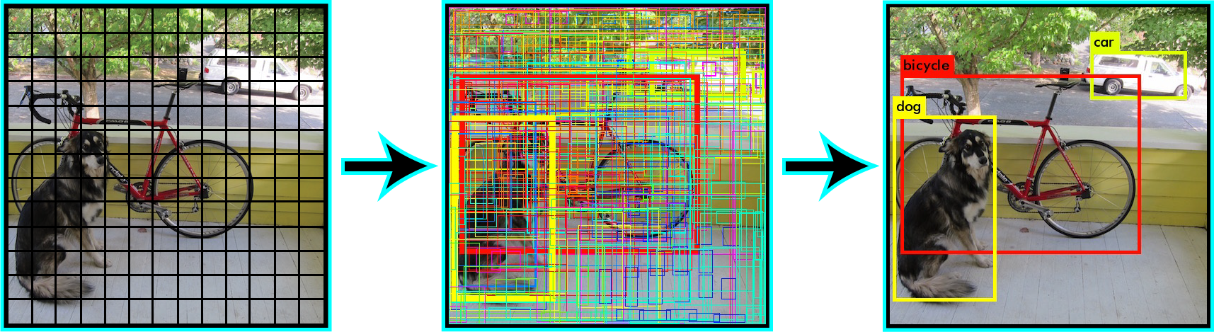
YOLO – You Only Look Once
A single neural network is used to the full image. This network divides the image into regions and predicts bounding boxes and probabilities for each region. These bounding boxes are weighted by the predicted probabilities..
фото
фото
фото
Высшая школа экономики, Нижний Новгород, 2017
Notes:
https://pjreddie.com/darknet/yolo/
https://arxiv.org/pdf/1612.08242.pdf

Slide 7
YOLO: Advantages
Advantages over classifier-based systems:
It looks at the whole image at test time so its predictions are informed by global context in the image.
Makes predictions with a single network evaluation unlike systems like R-CNN which require thousands for a single image. This makes it extremely fast, more than 1000x faster than R-CNN and 100x faster than Fast R-CNN.
Maintaining a proper accuracy range
Able to recognize a wide variety of objects
фото
фото
фото
Высшая школа экономики, Нижний Новгород, 2017
Notes:
https://pjreddie.com/darknet/yolo/
https://arxiv.org/pdf/1612.08242.pdf

Slide 8
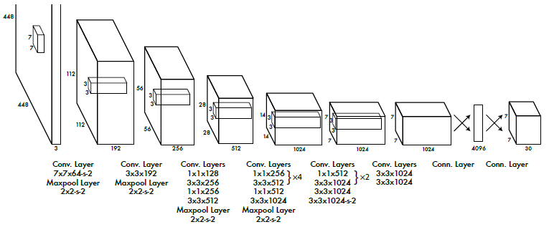
YOLO: How it works
No bounding box proposals and subsequent pixel or feature resampling stage
A neural network predicts bounding boxes and class probabilities directly from full images in one evaluation
фото
фото
фото
Высшая школа экономики, Нижний Новгород, 2017
Notes:
https://pjreddie.com/darknet/yolo/
https://arxiv.org/pdf/1612.08242.pdf

Slide 9
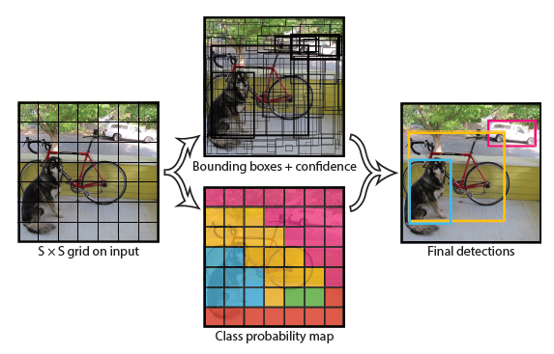
YOLO: How it works
Uses features from the entire image to predict each bounding box
Divides the input image into a grid. If the center of an object falls into a grid cell, the cell is responsible for detecting that object.
Each grid cell predicts bounding boxes and confidence scores for those boxes
Each grid also predicts conditional (conditioned on the grid cell containing an object) class probabilities
фото
фото
фото
Высшая школа экономики, Нижний Новгород, 2017
Notes:
https://pjreddie.com/darknet/yolo/
https://arxiv.org/pdf/1612.08242.pdf

Slide 10

YOLO: How it works
Confidence scores: confidence that the box contains an object + how accurate the box is.
фото
Conditional class probabilities: conditioned on the grid cell containing an object.
фото
At test time, multiply the conditional class probabilities and the individual box confidence predictions, giving class-specific confidence scores for each box
Showing both the probability of that class appearing in the box and how well the predicted box fits the object
фото
Высшая школа экономики, Нижний Новгород, 2017
Notes:
https://pjreddie.com/darknet/yolo/
https://arxiv.org/pdf/1612.08242.pdf

Slide 11


