Slide 1
Pharmacy Management System
PMS Project Report
Ayush Pathak (AJU/180352) Debashish Bera (AJU/180140)

Slide 2
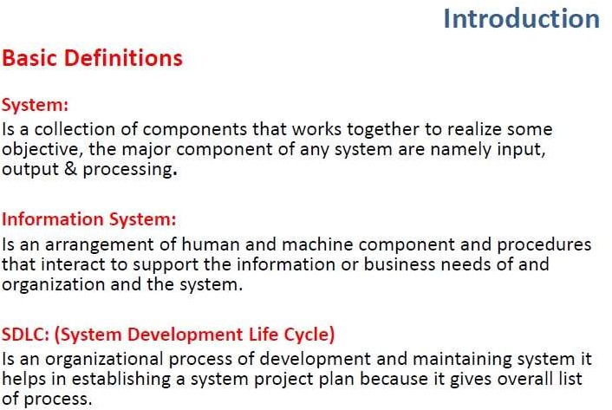

Slide 3
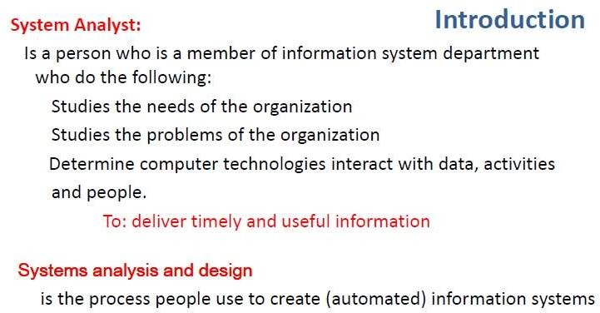

Slide 4
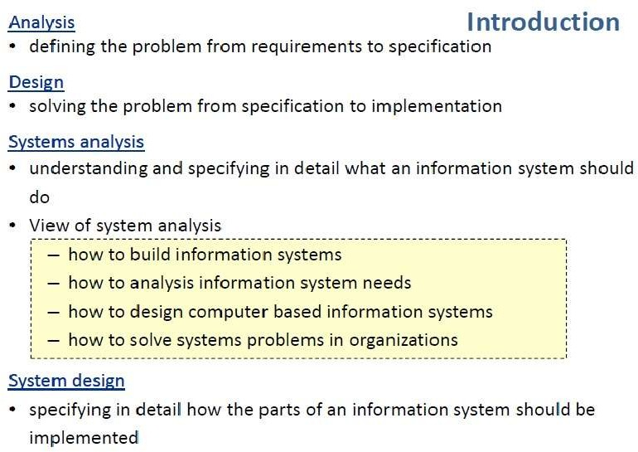

Slide 5
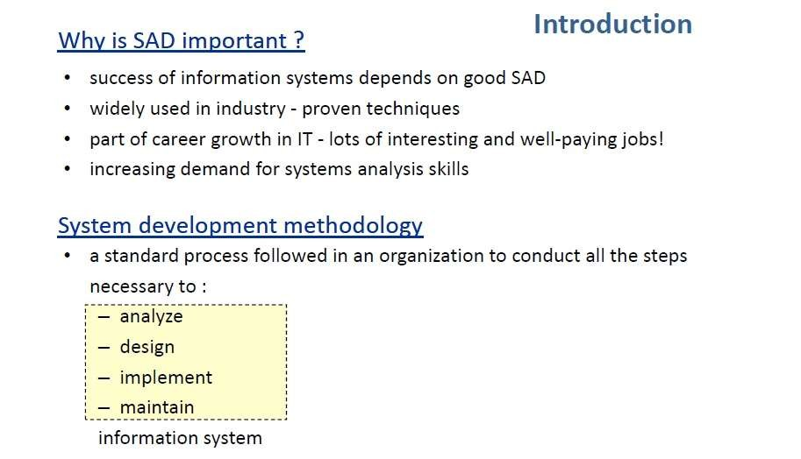

Slide 6
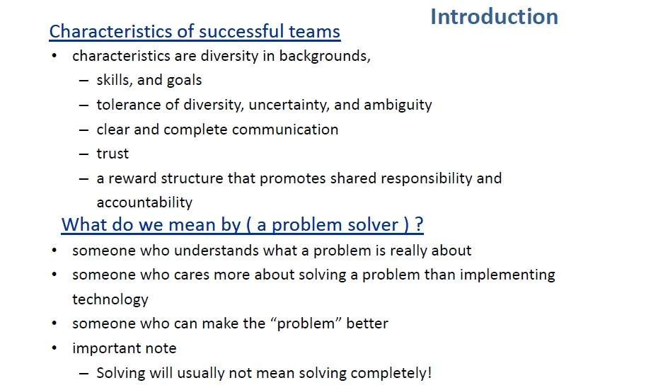

Slide 7
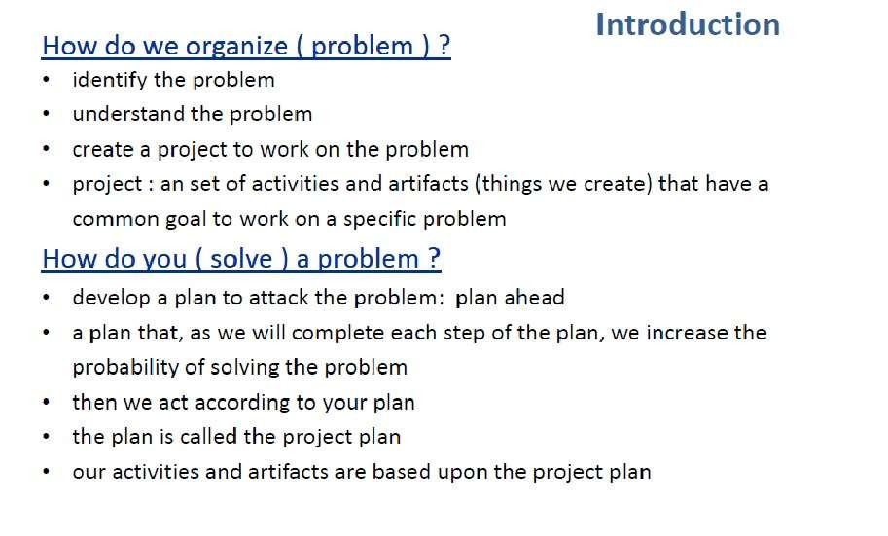

Slide 8
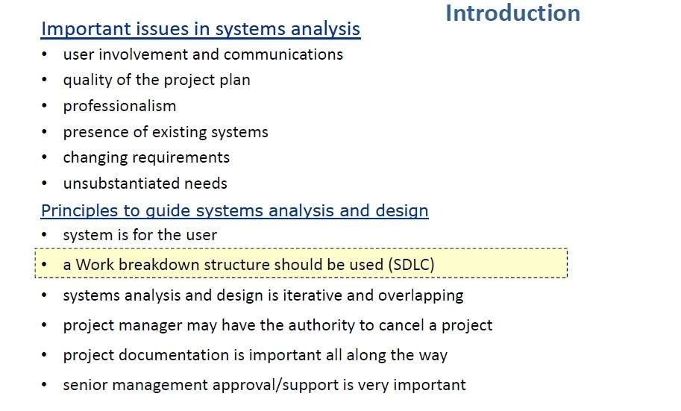

Slide 9
Current system
The current pharmacy system were manually base system which is almost all works on the pharmacy organization is accomplished by papers. Among thus Medicine data search in order to buy, audit, and other related works. And the other one is data security, the data’s can be accessed anyone who entered to the pharmacy house as friends, other Humans without the volunteer of the pharmacist.
The pharmacists work in tedious situation because of the upper reasons. Not efficient on arrange medicine on the shelf meaning arrangement method is difficult to take in mind.
In current system almost all pharmacies do not use computerized system but use computer for giving bills only for the sold medicine to the user. And use manual searching of medicine on shelf because of manual based system and there is nothing which gives alarm for the finished or sold medicine.

Slide 10
Also there is a difficulty on store the data which wastes resources as well as time to retrieve the necessary data from the manually based data system. So generally the current system does not arrange medicine in systematic way, does not store the medicine appropriate data, security for the data is low, does not indicate how much medicine is needed and sold quickly and efficiently.
The pharmacy system will implement by the pharmacy unit of the organization. At present, manual system is being utilized. This system requires the pharmacist to manually monitor each drug that is available in the pharmacy shelf. This involves manually entry up on arrival of batches of drugs and upon drugs’ movement out of the unit, for example, dispensing to patients or product recall or loan to other clinics/hospitals. Upon a certain period such as month, the pharmacist is required to generate reports on the movement of drugs. This is to monitor the justification of ordering in order to replenish the already diminishing stocks. In addition, ordering of drugs is also being done manually. Significant amount of time is allocated for writing order as one needs to go through the stocks’ balance and rough estimate of the amount to order. This usually led to mistakes as one May over or under-order.
Thus, in this aspect, the workload of a pharmacist increases. As a result, sometimes, patient care, in terms of counseling, is compromised due to time.

Slide 11
ANALYSIS OF A PHARMACY
PMS- PHARMACY MANAGEMENT SYSTEM
Requirement Analysis:
A regular maintenance of supplier details, customer details (Bulk&
ordinary delivery), tablet details, Billing
We face a problem of identifying the expiry date of each tablet and the quantity and rate.
also
For that case we are maintaining the database for storing the expiry date of each tablet and also the quantity, rate.
Prior intimation about the expiry must be indicated one month in advance, and also minimal level of stock must be maintained and reported to the viewer.
For the sake of regular customers our pharmacy is providing customer ID in order to supply the stock in time.

Slide 12
Suppliers:
Maintenance of a separate database for a list of Suppliers, and their products being supplied. And their price list of their products, manufactured date and expired date.
Customers:
Corporate Customers
Hospitals.
Military Purposes.
Small Pharmacy
Industrial Purposes.
RetailCustomers
Regular Customers

Slide 13
OVERVIEW
The pharmacy management system provides functions on identify medication usages instruction, minimize human errors in medication safety, facilitate accessibility of drugs’ information and information management among employees, providing optimal drugs movement in pharmacy unit, enable reports with in significantly short period of time, despite simultaneous usage of database for the purpose stated above.
The system will solve the problem of the current system by minimizing time wastage and reduce resources which simply change manual based system to computerized system.

Slide 14
Proposed system.
The pharmacy management system is design based on computer science students in order to illuminate the problem of the current system which provided by the system involved all the pharmaceutical employees of the pharmacy. This accessibility of the information will be great advantage as it reduced further medical errors associated with physicians and nurses.
The system handles all aspects of the inventory control function. It allows the pharmacist to receive new batches of drugs, delete obsolete drugs and modify the current dosage and identification of drug in the database. Furthermore, the system eases the process of stock replenishment.
On the other hand, PMS enables dispensation process. It stores all the physicians’ prescription of the patients. A summarized list of drugs dispensed to the patient can be viewed for monitoring purposes.

Slide 15
With the proposed system, the pharmacist will be able to monitor the movement of the drugs with ease. The system is design to track the entry of refresh batches of drugs, be it upon orders from manufacture or loan from the hospital/clinics. It also monitors the drug’s movement history, thus leads to better inventory management of money allocated for the purchase of drugs.
Compared to the current manual system, the implementation of Pharmacy management system will reduced the time spent for paperwork, leading to concentration on improving pharmaceutical care of patients, especially emphasis on patients’ counseling and patient medication monitoring. It will be greatly embraced by the pharmacy profession as it is one giant leap towards pharmaceutical care of patients.

Slide 16
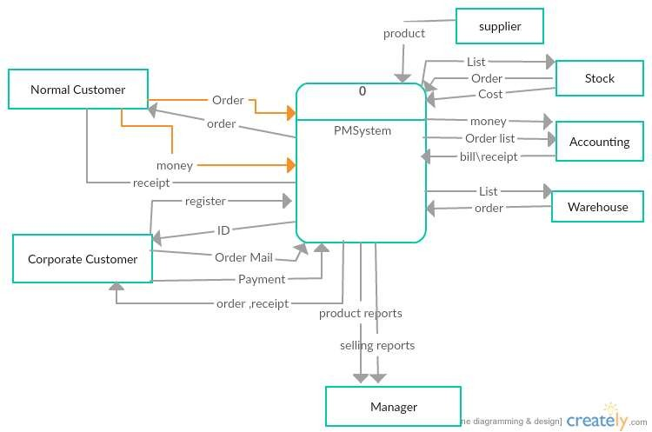
PMS Context Diagram

Slide 17
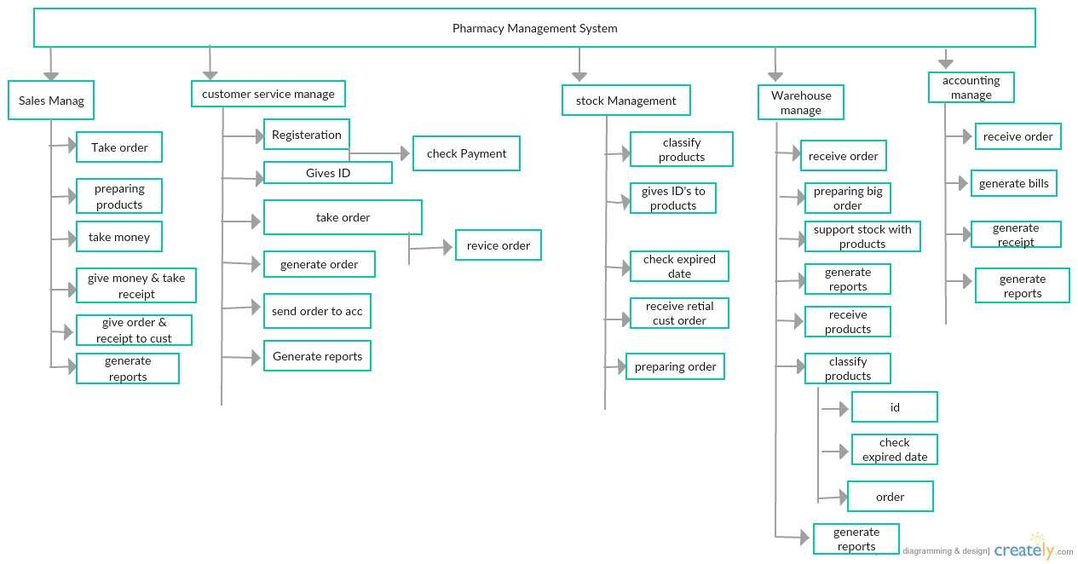

Slide 18
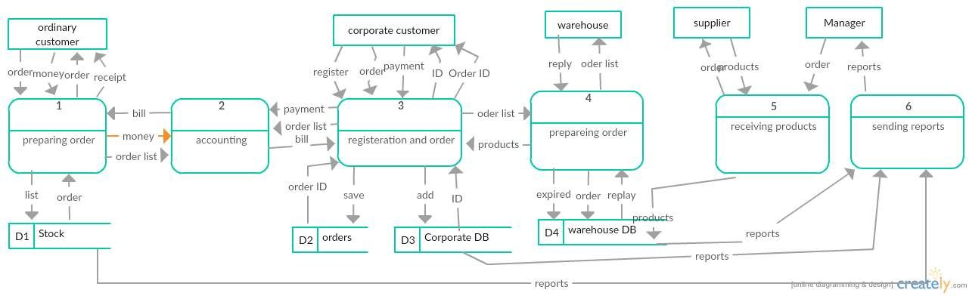
PMS DFD Level 0

Slide 19
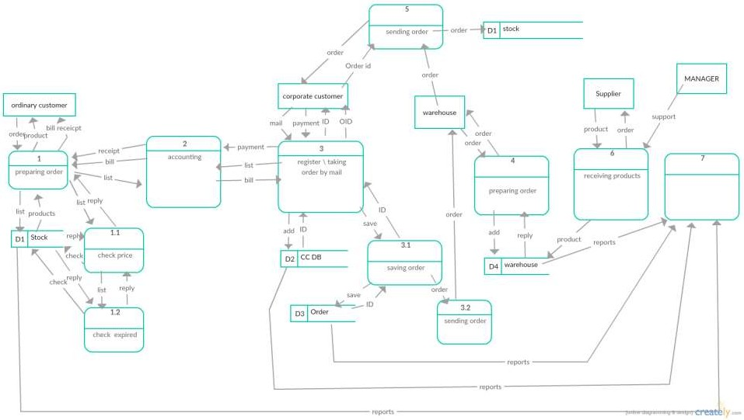
PMS DFD Level 1

Slide 20
Entities and Attributes
1
-Corporate Customer
3-WareHou
se
ID
Name Addres s Order
Product ID
Product Quantity Product Price Expired Date Product Name wareHouse ID
ID
Email
2-StockDB
4-Orders
Product ID Product Quantity Product Price Expired Date Product Name Stock ID
Product ID
Product Quantity
Product Price Expired Date Product Name

Slide 21
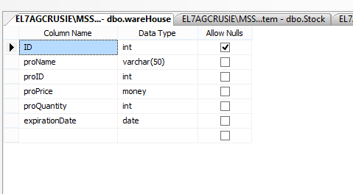
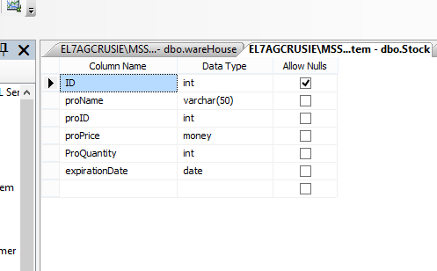
WAREHOUSE DB
Stock DB

Slide 22
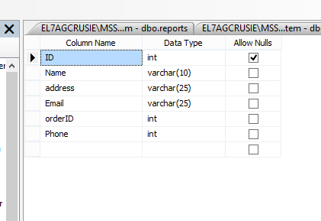
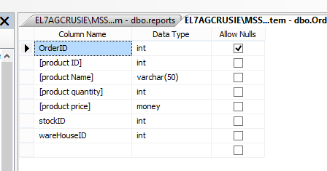
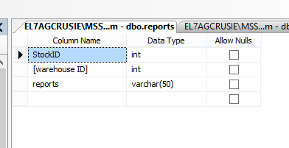
[corporate customer]
ORDER
reports

Slide 23
Interface And Coding
At 1st Connection Code

Slide 24
Login form

Slide 25
Login Code

Slide 26



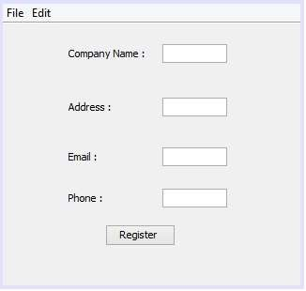
Search
Update
Close

Slide 27
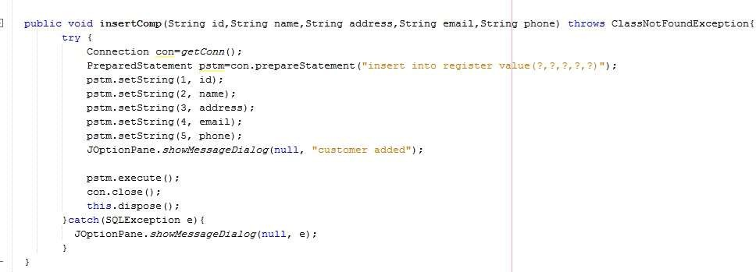
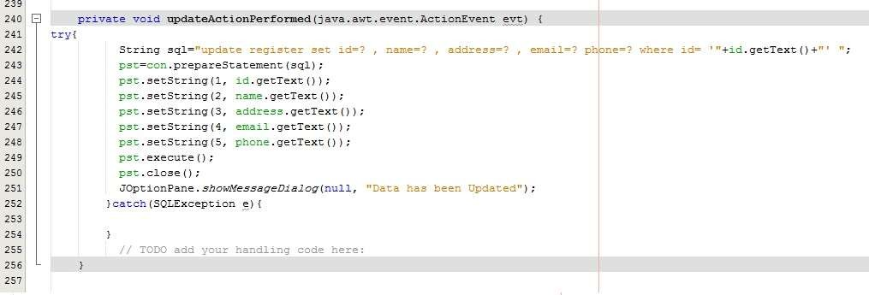
Register Button
Update Button

Slide 28
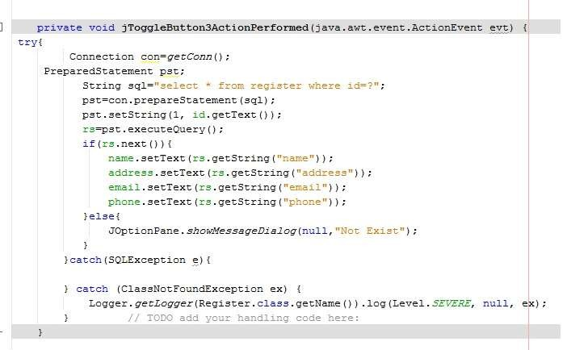
Search Button

Slide 29


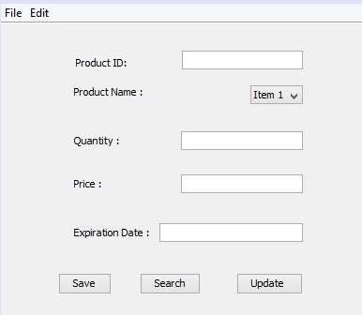

Slide 30
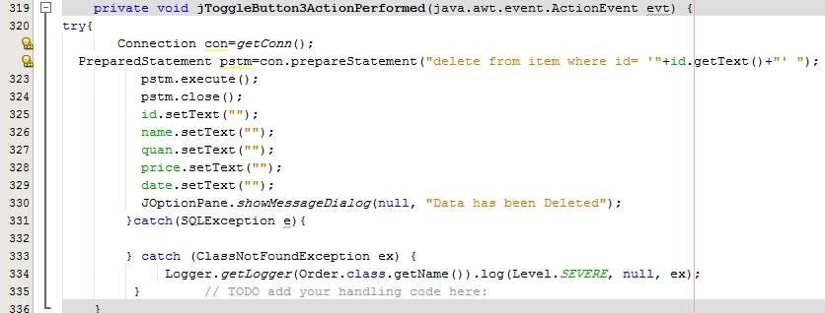
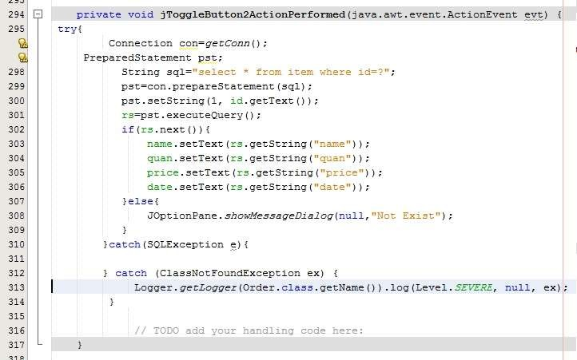
Delete Code
Search Code

Slide 31
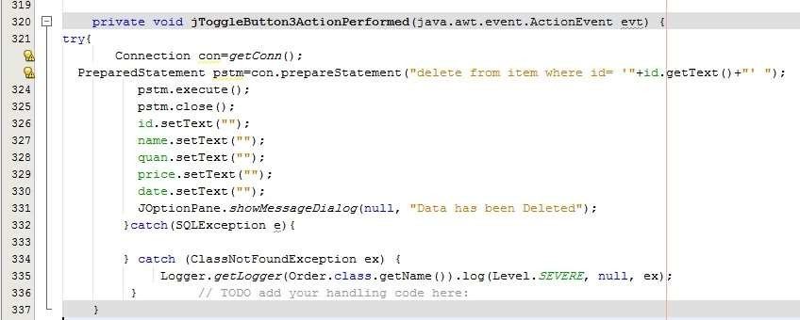
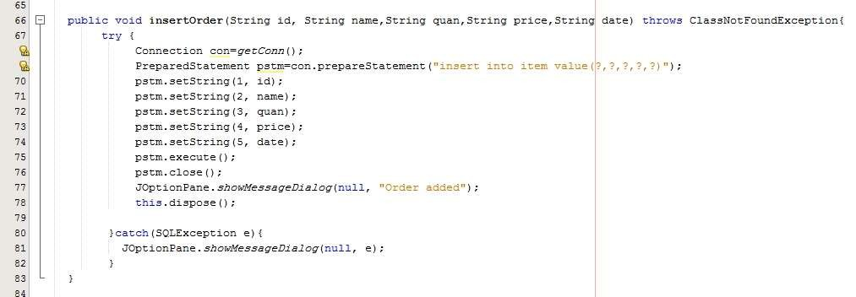
Delete Code
Save Button

Slide 32
Thank you

