Slide 1
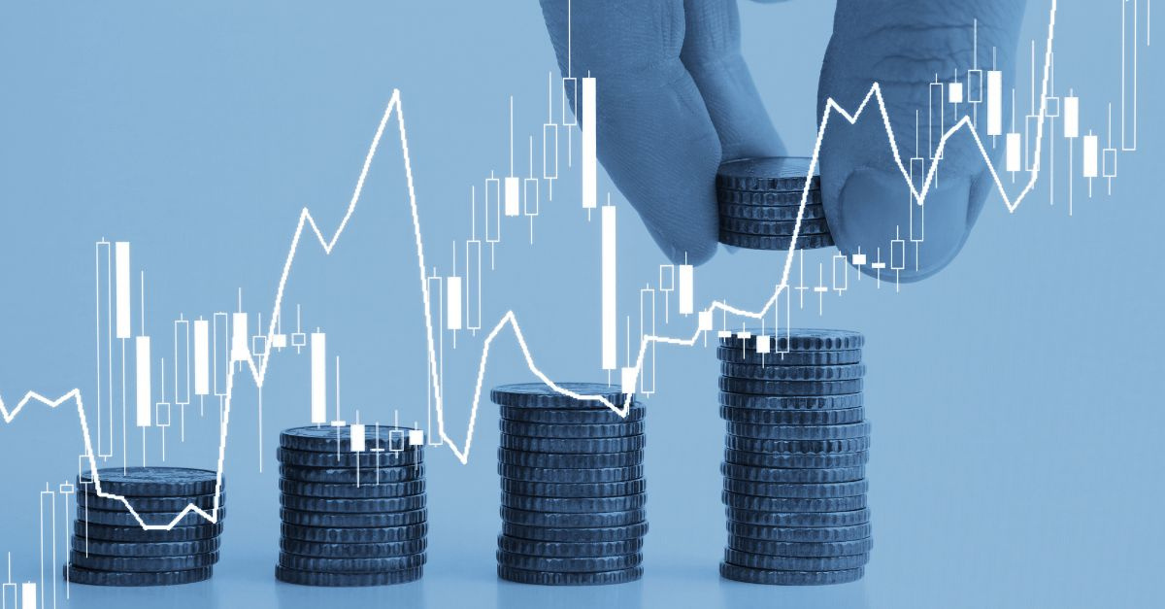
07 May, 2026
An Explainable Multimodal Neural Framework
for Financial Risk Management

Slide 2
Introduction
Modern AI agents lack transparency, their inner workings are hidden.
They act autonomously, make accurate predictions, but offer no accountability.
We don’t understand their reasoning, yet their pattern recognition could benefit us greatly.
Understanding these models enables control, compliance, and widespread adoption.
Markets date back to the dawn of commerce. Today, they are highly complex, extracting patterns is hard but immensely rewarding.
Jim Simons founded Renaissance Technologies in 1982, pioneering AI in finance. His hedge fund became one of the most successful ever.
"A computer can never be held accountable, therefore a computer must never make a management decision" from 1979 IBM training manual/presentation.

Slide 3
Literature Review & Baseline Adoption
Paper 2:
Financial asset price prediction with graph neural network-based temporal deep learning models
3 types of GNNs on crypto (volatile) & forex (stable)
Older ML fails on unstable time-series data
GNNs predict, analyze & find patterns even in messy data
Consistently accurate results
Captures complex data patterns
Paper 3:
TradingAgents - Multi-Agents LLM Financial Trading Framework
IModern LLMs in orchestrated workflow → digital hedge fund
Each agent does a human job
Different data types → appropriate agents → full market context
Added context → strong predictive power
Multi-modal data + distributed system (one job per agent)
Paper 1:
A Survey of Explainable Artificial Intelligence (XAI) in Financial Time Series Forecasting
Latest techniques & progress in XAI for financial time series forecasting

Slide 4

Data Methodology
Tabular fundamentals data: Structured company-level financial data extracted from SEC EDGAR filings, including revenue, assets, liabilities, debt, cash, equity, profitability, leverage, and balance-sheet indicators.
This data represents the internal financial condition of each company.
It was collected from SEC EDGAR bulk archives and cleaned into point-in-time company fundamentals.
These features helped build company profiles, map tickers to SEC identifiers, and support later financial-risk analysis.
Due to data sparsity and class imbalance, this data stream was later discontinued , along with the entire stream of models that relied on it.

Slide 5
Data Methodology
SEC Textual Filings Data: Narrative financial disclosures extracted from SEC filings, including 10-K, 10-Q, 8-K, and DEF 14A reports.
Macro/Regime Data: Economic indicators from FRED, including interest rates, inflation, unemployment, credit spreads, and recession signals.
These two streams added context beyond raw prices. SEC filings captured company-level language, risks, events, and management discussion, while macro data described the broader economic environment.
Together, they helped the system understand both firm-specific information and market-wide regimes.

Slide 6
Data Methodology
Historical Market Data: Daily OHLCV stock data from 2000–2024 was merged from multiple sources to reduce sparsity and ticker gaps.
Cross-Asset Relational Data: Built from the cleaned market panel by converting stock returns into correlation graphs and asset-relation networks.
The raw market data was sparse and inconsistent across tickers, so multiple datasets were standardised, merged, and filled.
Missing values were handled using linear imputation, KNN-based filling, and ARIMA-based temporal estimates.
Final market panel was complete, Stock-return relationships converted into graph structures for contagion and regime modeling
.

Slide 7
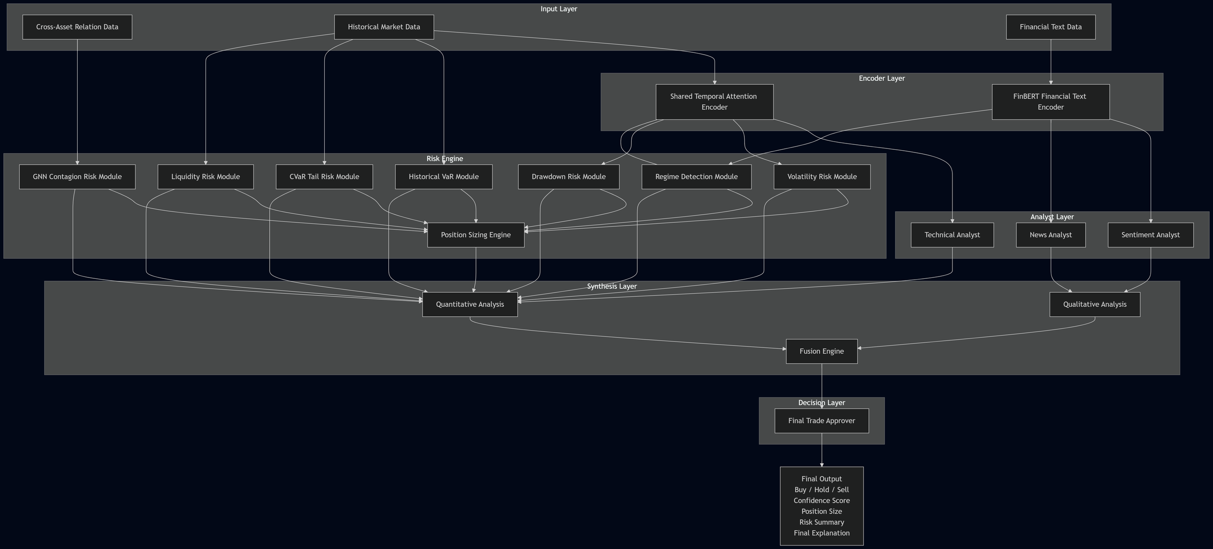
WorkFlow

Slide 8
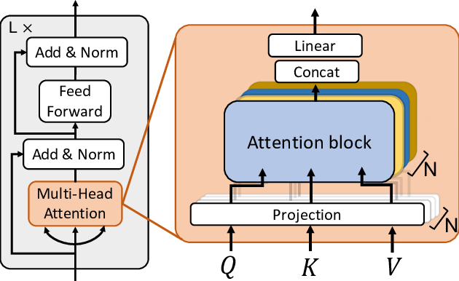
Temporal Encoder:
The Temporal Encoder receives historical market sequences such as prices, returns, volume, volatility, and technical indicators. It converts each stock’s time-series behaviour into a compact temporal embedding. This embedding captures trend, momentum, instability, and recent market behaviour for downstream risk and analyst models.
Input Layer
Cross-Asset Graph Input:
The cross-asset relational data is passed directly into the StemGNN Contagion Module. Stocks are treated as graph nodes, while edges represent relationships such as return correlation, sector similarity, beta similarity, and ETF-like co-movement. This allows the model to learn how risk spreads across connected assets instead of analysing each stock in isolation.
FinBERT Text Encoder:
The FinBERT Encoder processes SEC filing text and converts financial language into 256-dimensional embeddings. These embeddings preserve information from company disclosures, risk factors, management discussion, and event-based filings. The encoded text is then passed to the Sentiment Analyst, News Analyst, and fusion layer for qualitative financial interpretation.

Slide 9
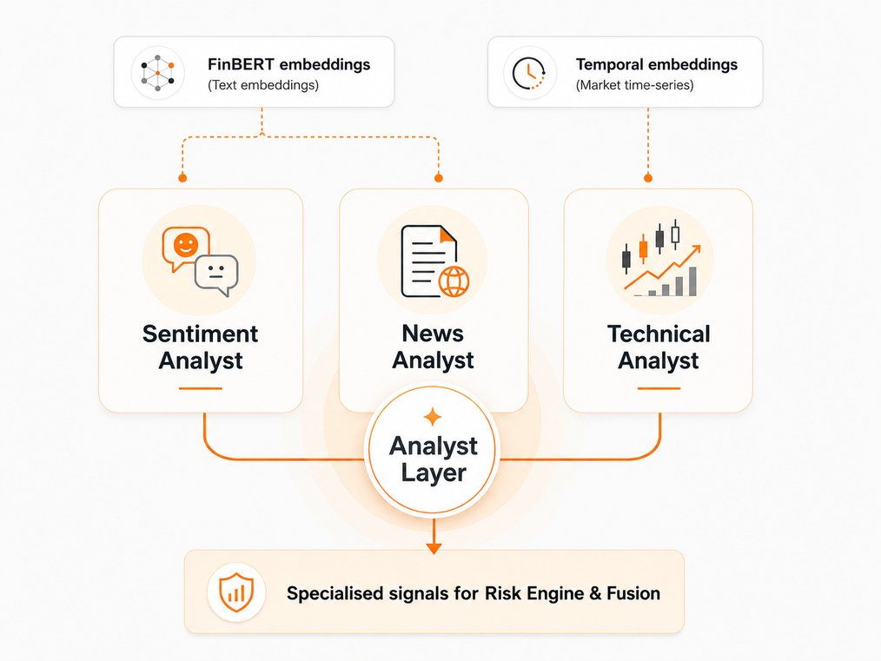
Analyst Layer
Sentiment Analyst:
Uses FinBERT text embeddings from SEC filings to estimate whether the company’s textual information is linked with bullish, neutral, or bearish future market behaviour. Instead of using simple human-labelled sentiment, it learns from market-derived labels, allowing financial text to be connected with actual future stock reactions.
Technical Analyst:
Uses the temporal embeddings generated from historical market data. It studies price movement, returns, volume, volatility, and technical behaviour to identify trend strength, momentum, and timing signals. Its role is to provide the system with a quantitative view of how the stock is behaving in the market. This operates on prices rather than company news.
News Analyst:
Uses attention-based document analysis to identify which filing chunks or event-related disclosures matter most. It focuses on event impact, importance, risk relevance, volatility warnings, and drawdown-related signals. The attention mechanism also helps show which parts of the text influenced the model’s output.
Together, these analysts convert raw embeddings into specialised market, sentiment, and event-level signals for the final risk and fusion layers.

Slide 10
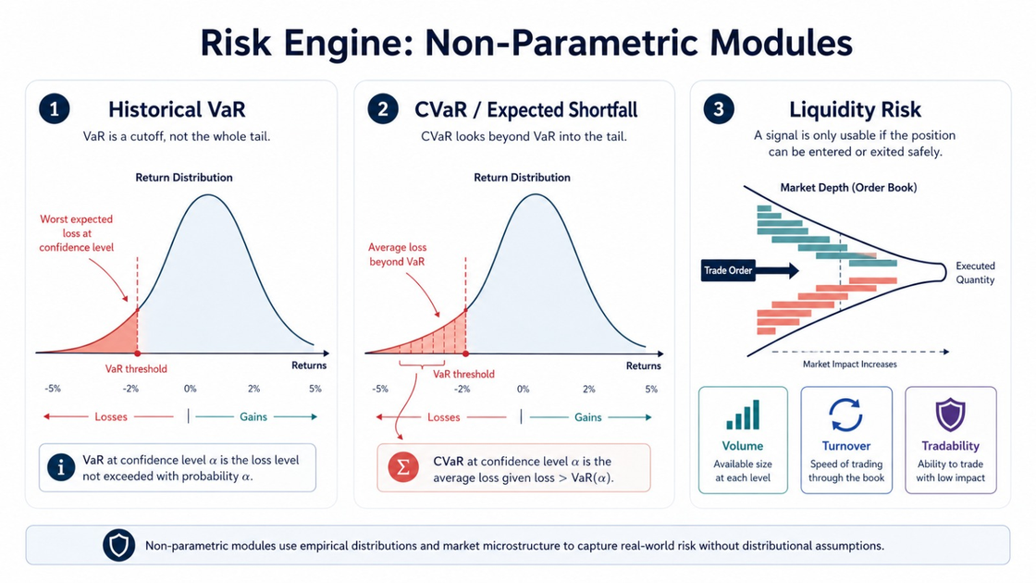
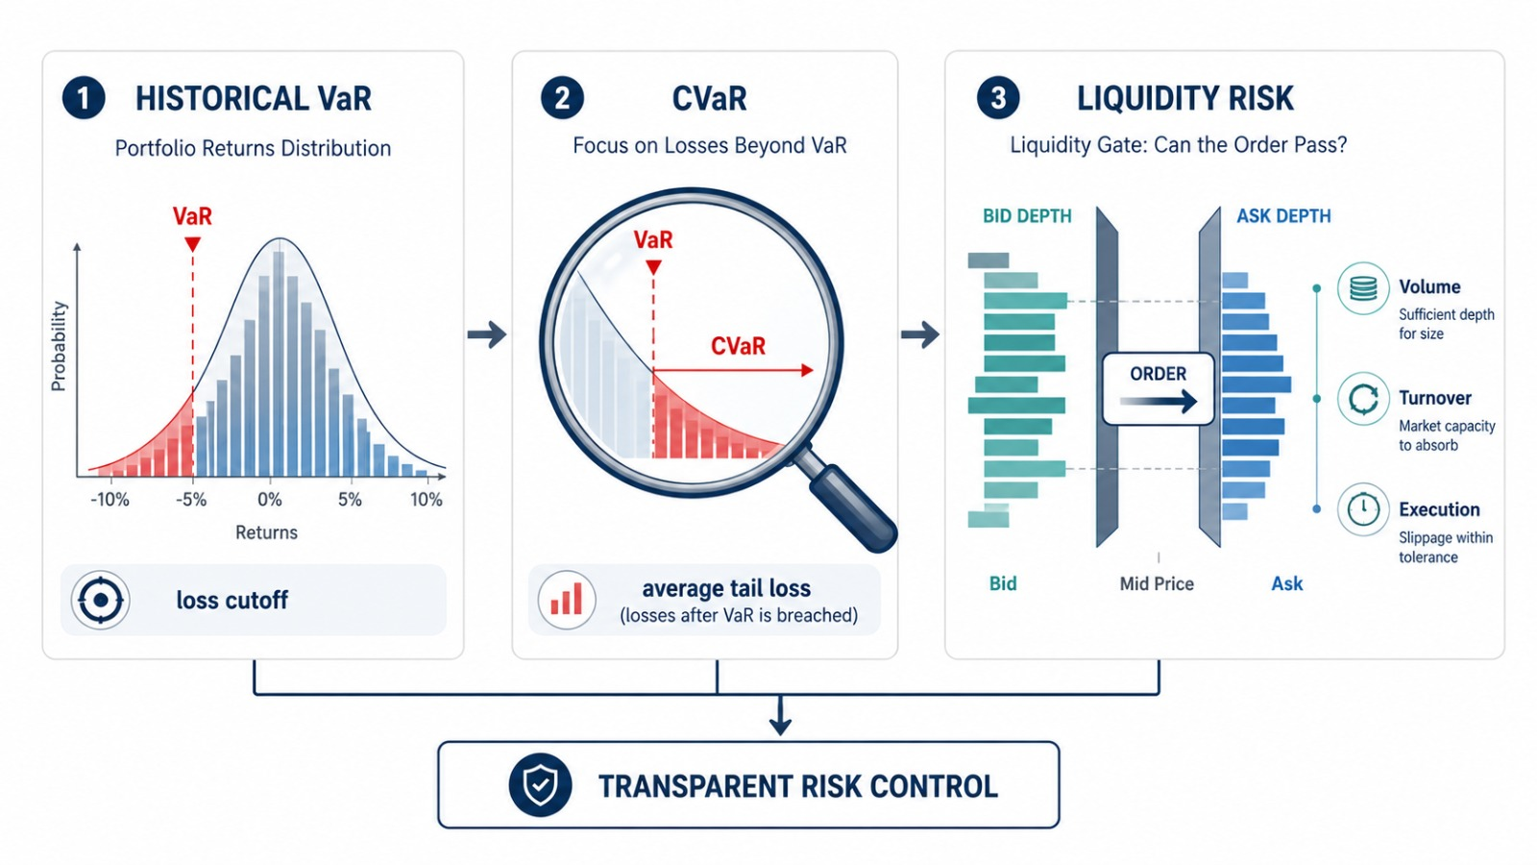
Risk Engine
Historical VaR:
Estimates the worst expected loss at a chosen confidence level using past return distributions. It is non-parametric, so it does not assume returns follow a normal distribution.
CVaR / Expected Shortfall:
Measures the average loss beyond the VaR threshold. This gives a deeper view of tail risk by showing how bad losses can become when VaR is breached.
Liquidity Risk:
Assesses whether a position can be entered or exited safely using volume, turnover, and tradability rules. This module protects the system from signals that look profitable but are hard to execute in real markets.
These modules were kept transparent and statistical because risk controls must be explainable, auditable, and easy to inspect.

Slide 11
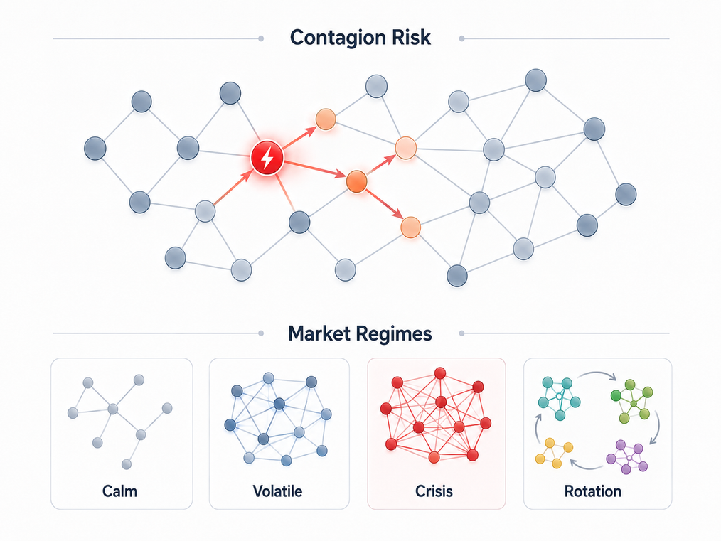
Risk Engine
Regime Detection Module — MTGNN
Uses graph structure to identify the current market condition.
Studies how connected or clustered the market has become.
Classifies market state as calm, volatile, crisis, or rotation.
High graph density may indicate panic or systemic stress.
Strong clusters may indicate sector rotation.
Provides regime confidence and graph-based explanation signals.
Together, these two GNN modules allow the Risk Engine to understand both how risk spreads and what state the market is currently in.
Contagion Risk Module — StemGNN
Uses cross-asset return graphs to model how risk spreads between connected stocks.
Treats stocks as nodes and relationships as edges.
Learns hidden dependencies that simple correlation may miss.
Predicts contagion risk across 5-day, 20-day, and 60-day horizons.
Helps identify which stocks are vulnerable to market-wide shocks.
Also highlights influential assets that may act as “risk spreaders”.

Slide 12
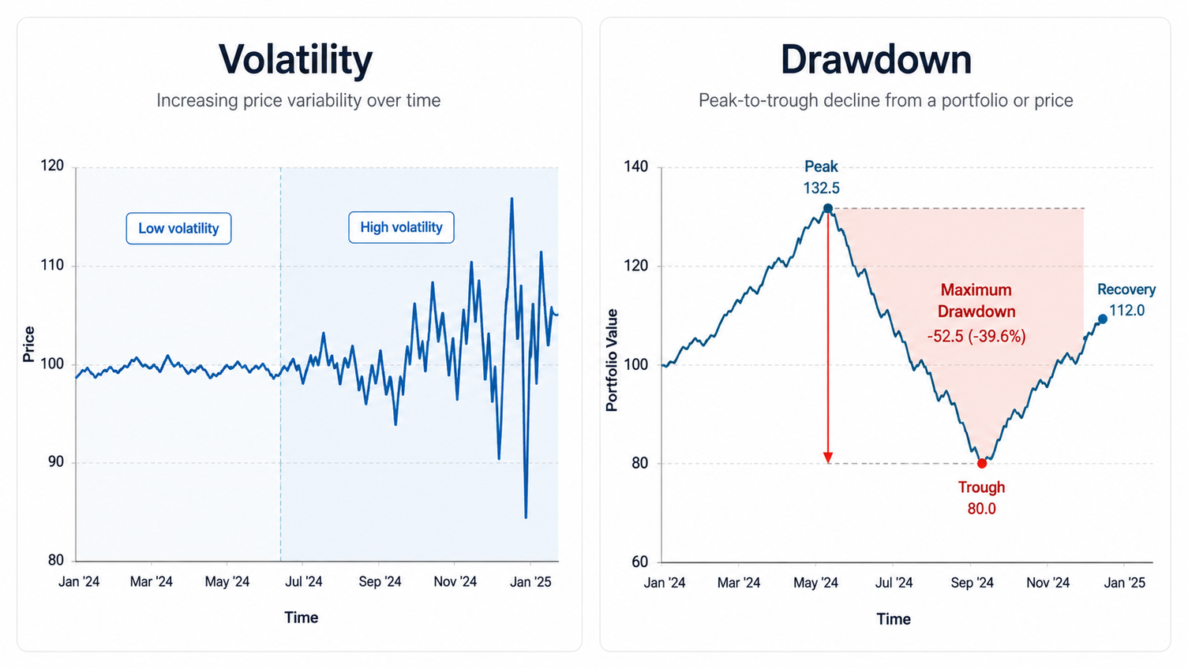
Risk Engine
Volatility Module:
Estimates how unstable or uncertain a stock’s price movement is.
Uses historical returns and temporal market features to detect sudden changes in risk.
Helps the system understand whether a stock is moving normally or becoming unpredictable.
Produces short-term and medium-term volatility estimates.
High volatility warns the system that even a correct signal may be dangerous to act on.
Its output is used by the Risk Engine to adjust confidence, position size, and final trade approval.
Drawdown Module:
Measures how badly a stock or portfolio can fall from a recent high.
Focuses on downside risk instead of average prediction error.
Detects whether a stock is entering a loss-heavy period.
Helps estimate expected drawdown over short and medium horizons.
Protects the system from entering trades where the possible fall is too large.
Its output supports risk filtering, position reduction, and final decision control.

Slide 13
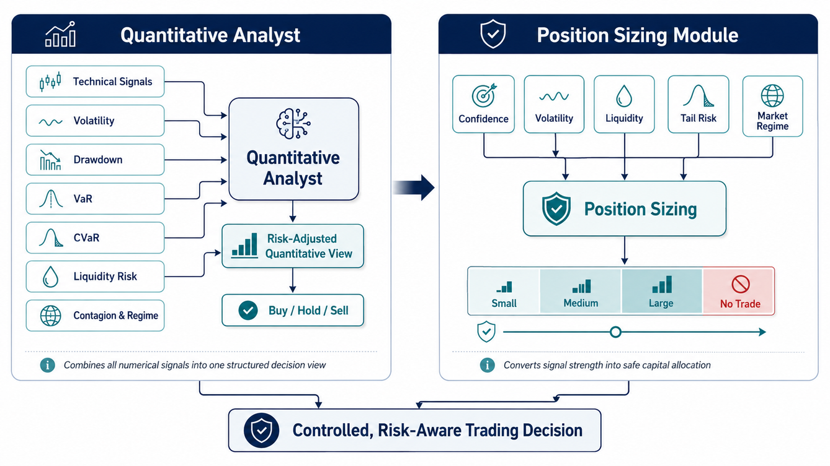
Synthesis Layer
Position Sizing Module:
Converts the final risk-adjusted signal into a safe allocation size.
Uses confidence, volatility, drawdown, liquidity, contagion, and regime state.
Gives larger position sizes only when signal strength is high and risk is controlled.
Reduces or blocks trades when liquidity is weak or tail risk is too high.
Keeps the system from making aggressive decisions during unstable market conditions.
Works as the final quantitative safety gate before fusion.
Quantitative Analyst:
Combines technical signals with all numerical risk-module outputs.
Uses market trends, volatility, drawdown, VaR, CVaR, liquidity, contagion, and regime risk.
Converts raw model outputs into one structured quantitative view.
Decides whether the numerical evidence supports Buy, Hold, or Sell.
Reduces confidence when risk signals are too high, even if price momentum looks strong.
Acts as the main bridge between the Risk Engine and final decision layer.

Slide 14
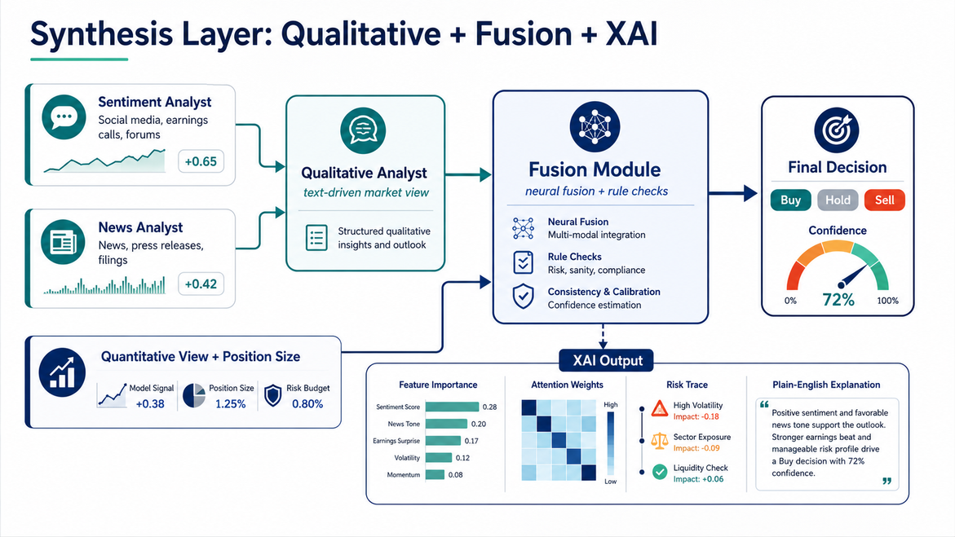
Synthesis Layer
Qualitative Analyst:
Combines Sentiment Analyst and News Analyst outputs.
Interprets SEC filing language, risk disclosures, and event signals.
Produces a qualitative market view: bullish, neutral, or bearish.
XAI Output:
Shows which modules influenced the final decision most.
Includes attention weights, SHAP/LIME-style feature importance, graph explanations, and risk summaries.
Converts the system from a black box into a traceable financial glass box.
Fusion Module:
Takes quantitative signals, qualitative signals, risk scores, and position sizing output.
Uses neural fusion to combine learned embeddings and module predictions.
Applies rule-based checks so high-risk trades can be reduced or blocked.
Produces the final Buy / Hold / Sell decision with confidence.

Slide 15
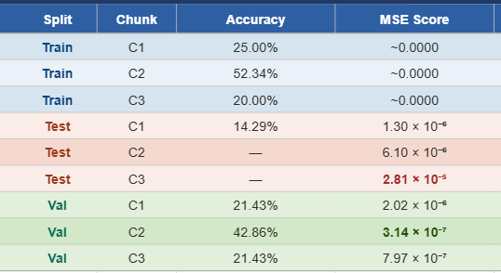
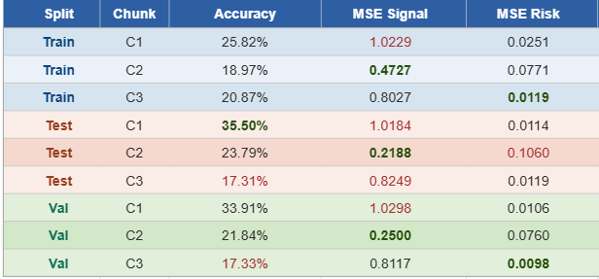
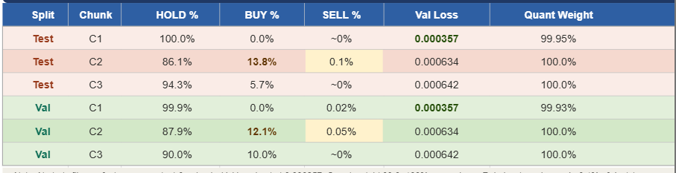
Results
Table 1 - Quantitative Model
Table 2 - Qualitative Model
Table 3 - Fusion module

Slide 16
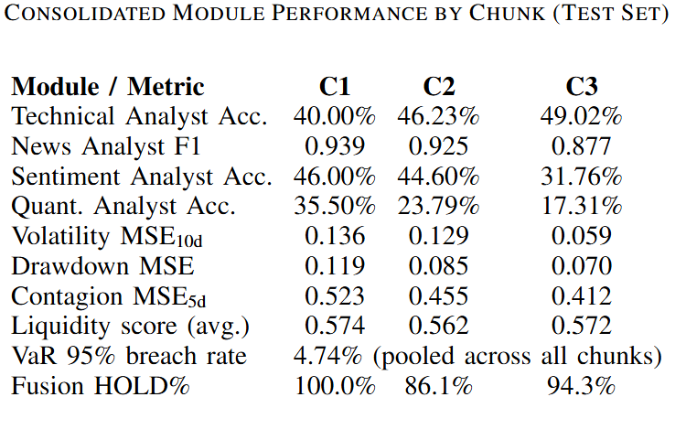

Results

Slide 17

07 May, 2026
thank you so much!

