Slide 1

Other Types of Virtualization & Virtualization and Cloud Computing
Seyyed Ahmad Javadi sajavadi@aut.ac.ir
Spring 2024

Slide 2
Application-level Virtualization
Allowing applications to be run in runtime environments that do not natively support all the features required by such applications.
Applications are not installed in the expected runtime environment but are run as though they were.
Partial file systems
Libraries
Operating system component emulation.

Slide 3
Application-level Virtualization (cont.)
Emulation is performed by a thin layer
A program or an operating system component which is in charge of executing the application.
Emulation can also be used to execute program binaries compiled for different hardware architectures.
A popular application virtualization solution: Wine
Allowing Unix-like operating systems to execute programs written for the Microsoft Windows platform.

Slide 4
Application-level Virtualization (cont.)
Wine acts as a container for the guest application
A set of libraries, called Winelib
A similar solution for the Mac OS X environment is CrossOver
Allows running Windows applications directly on the Mac OS X.
“Wine (originally an acronym for "Wine Is Not an Emulator") is a compatibility layer capable of running Windows applications on several POSIX-compliant operating systems, such as Linux, macOS, & BSD. Instead of simulating internal Windows logic like a virtual machine or emulator, Wine translates Windows API calls into POSIX calls on-the-fly, eliminating the performance and memory penalties of other methods and allowing you to cleanly integrate Windows applications into your desktop.”
https://www.winehq.org/

Slide 5
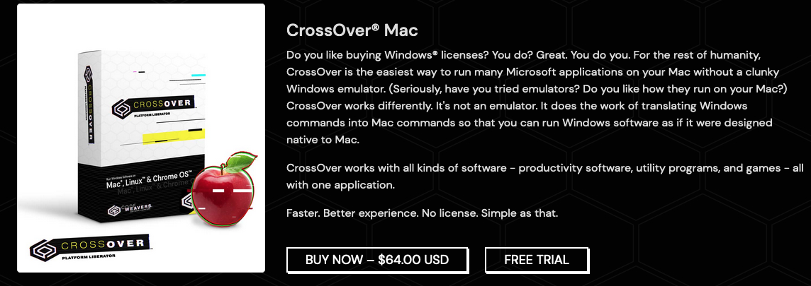
Application-level Virtualization (cont.)
https://www.codeweavers.com/crossover
https://www.youtube.com/watch?v=FCmSHPd-OG4

Slide 6
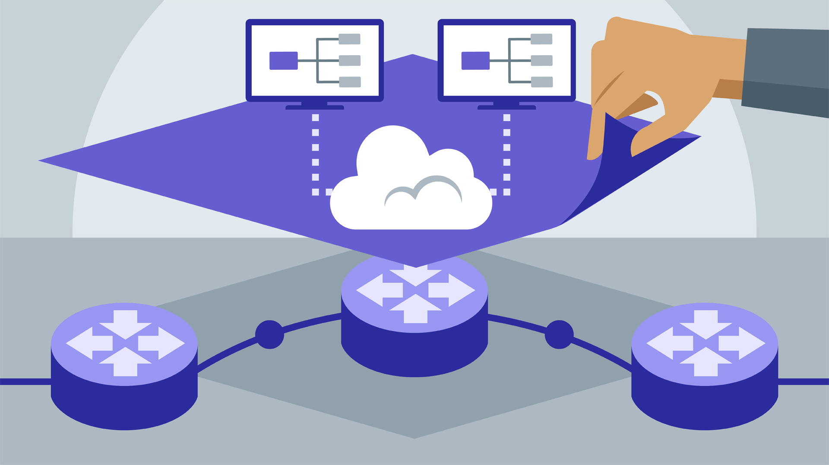
Network Virtualization
Segment the physical network resources in cloud data centers into smaller segmentations and lease it to cloud tenants
Like leasing VMs in clouds enabled by host virtualization.

Slide 7
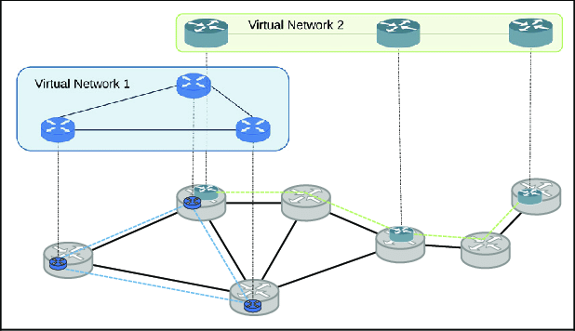
Network Virtualization
Multiple virtual networks (VNs) share a physical network and run isolated protocol stacks.
Network virtualization allows users to design and deploy a network without requiring knowledge of the physical network.
Virtual network 1
Virtual network 2
Physical network

Slide 8
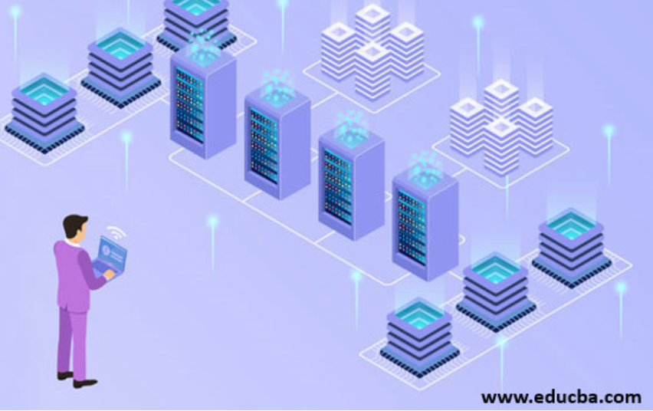
Storage Virtualization
A system administration practice that allows decoupling the physical organization of the hardware from its logical representation.
Users do not have to be worried about the specific location of their data, which can be identified using a logical path.

Slide 9
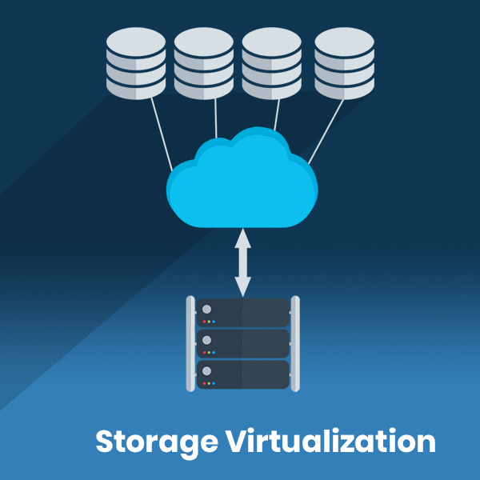
Storage Virtualization (cont.)
Grouping multiple (possibly heterogeneous) storage devices that are seen as a single virtual storage space.
https://www.veritis.com/solutions/virtualization/storage-virtualization-services/

Slide 10
Storage Virtualization (cont.)
Two main abstractions to represent storage virtualization:
Virtual volumes
Simplifies the task of assigning disks to VMs.
Virtual data objects
Enables scalable and redundant creation and retrieval of data objects directly into/from the cloud.
The details of which disks and partitions contain which objects or volumes are transparent to users
Facilitates storage management for cloud providers.

Slide 11
Virtualization and Cloud Computing
Virtualization plays an important role in cloud computing
It allows for the appropriate degree of customization, security, isolation, and manageability that are fundamental for delivering IT services on demand.
Virtualization technologies are primarily used to offer configurable computing environments and storage.

Slide 12
Virtualization and Cloud Computing (cont.)
Hardware virtualization is an enabling factor for IaaS (Infrastructure-as-a-Service)
Programming language virtualization is leveraged in PaaS (Platform-as-a-Service).
Virtualization gives the opportunity to design more efficient computing systems by means of consolidation
Which is performed transparently to cloud computing service users.

Slide 13
Consolidation
When resources are underutilized, we can reduce the number of active physical resources by aggregating virtual machines over a smaller number of resources that become fully utilized
Using VM migration (but when? how?)
Live migration: moving the instance while it is running which is more complex but more efficient.

Slide 14

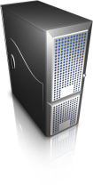
Consolidation (cont.)
Server A
(running)
Server B
(running)
VM
VM
VM
VM
VM
VM
Virtual Machine Manager
Before Migration
Server A
(running)
Server B
(inactive)
VM
VM
VM
VM
VM
VM
Virtual Machine Manager
After Migration

Slide 15
Virtualization Disadvantages
Performance degradation.
Inefficiency and degraded user experience.
Security holes and new threats.

Slide 16
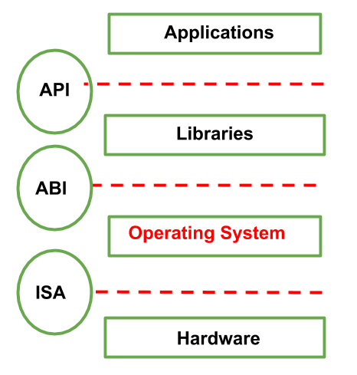
Performance degradation
One of the major concerns in using virtualization technology
Since virtualization interposes an abstraction layer between the guest and the host, the guest can experience increased latencies.

Slide 17
Performance degradation-Root causes
In the case of hardware virtualization
Overhead introduced by the following activities:
Maintaining the status of virtual processors
Support of privileged instructions
Trap and simulate privileged instructions
Support of paging within VM
….

Slide 18
Performance degradation-Type 2 hypervisor
The degradation is more serious
Since hypervisor is installed on top of an operating system
Similar consideration can be made in the case of virtualization technologies at higher levels
In the case of programming language virtual machines
Java, .NET, and others
Binary translation and interpretation can slow down the execution of managed applications.

Slide 19
Inefficiency
Virtualization can sometime lead to an inefficient use of the host.
In particular, some of the specific features of the host cannot be exposed by the abstraction layer and then become inaccessible.
In hardware virtualization, this could happen for device drivers:
The virtual machine can sometime simply provide a default graphic card that maps only a subset of the features available in the host.

Slide 20
Security holes and new threats
Virtualization opens the door to a new&unexpected form of phishing
The capability of emulating a host in a completely transparent manner led the way to malicious programs that are designed to extract sensitive information from the guest.
In the case of hardware virtualization, malicious programs can preload themselves before the operating system and act as a thin virtual machine manager toward it.
Examples: BluePill and SubVirt

Slide 21
Security holes and new threats
The same considerations can be made for programming-level virtual machines.
Modified versions of the runtime environment can access sensitive information or monitor the memory locations utilized by guest applications while these are executed.

