Slide 1
YTL Cement - SAP S/4HANA Transformation
Business Case & Technical Architecture
Generated with PlantUML

Slide 2
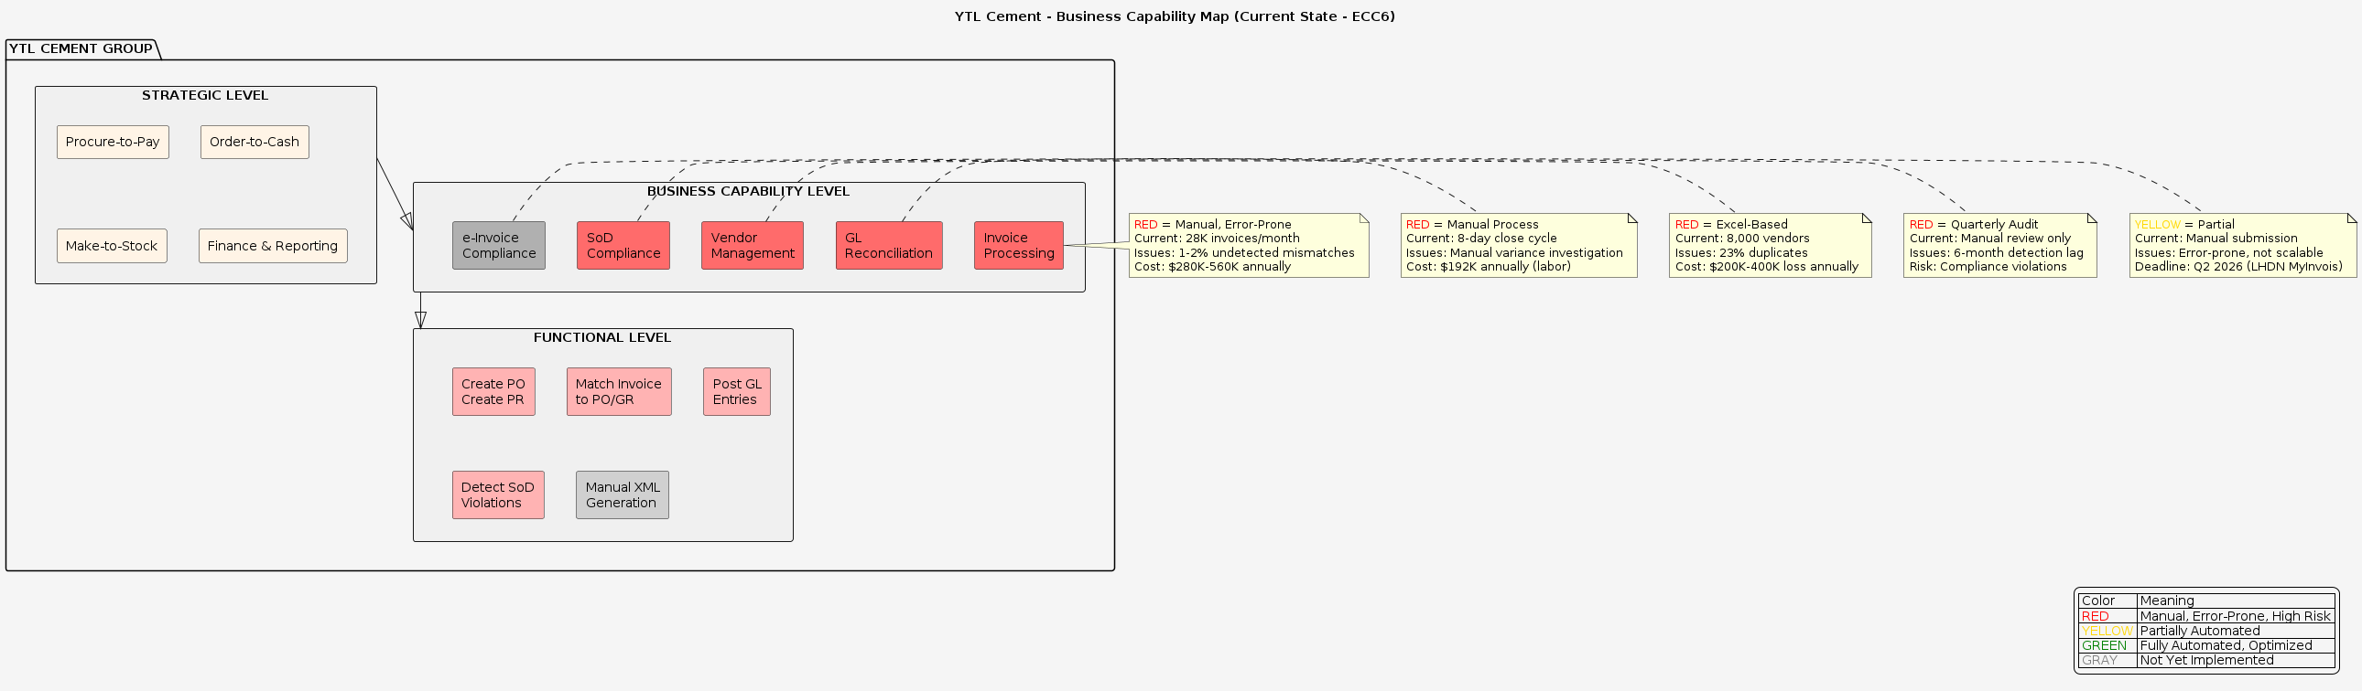
Business Capability Map - Current State (AS-IS)
Notes:
Current state shows manual processes in RED with significant cost and risk issues

Slide 3
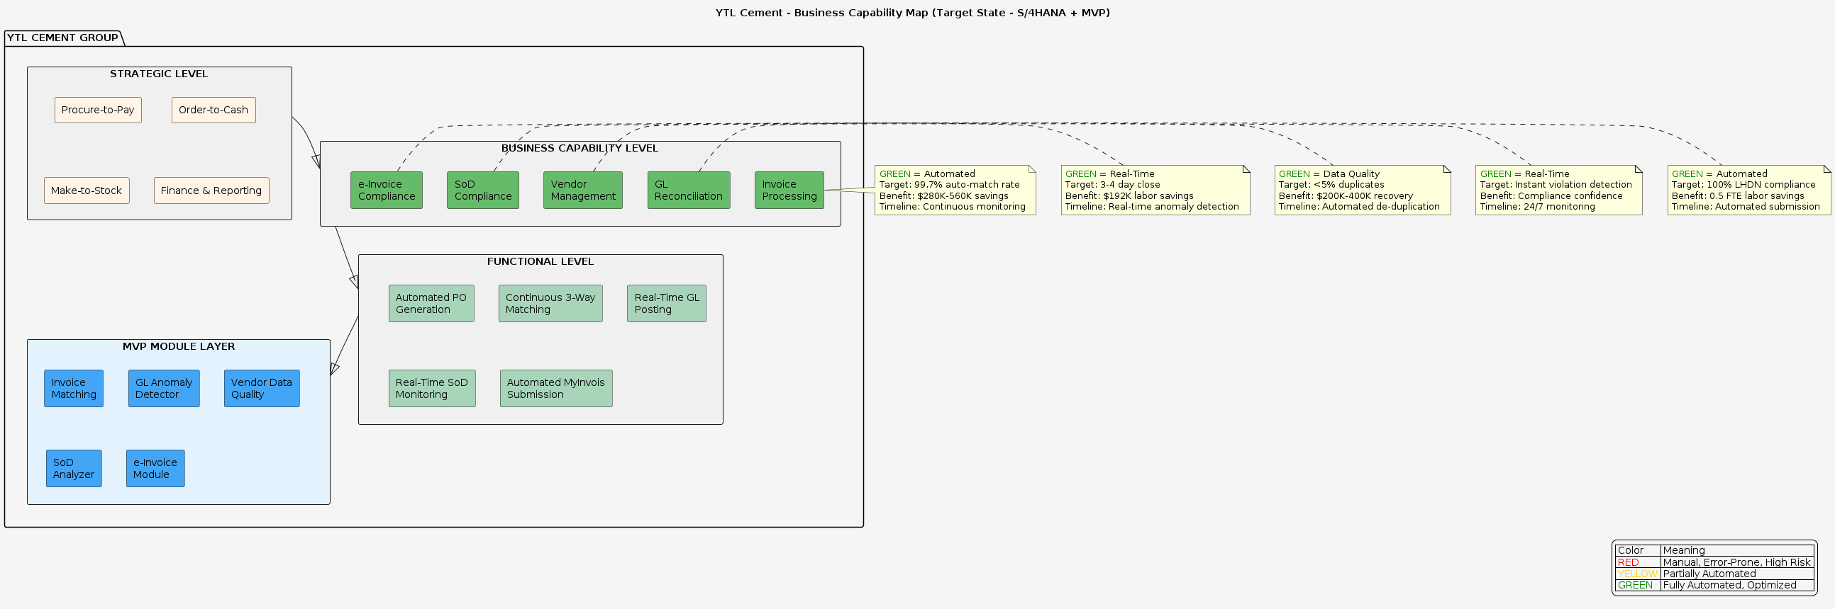
Business Capability Map - Target State (TO-BE)
Notes:
Target state shows automated processes in GREEN with MVP modules providing intelligence

Slide 4
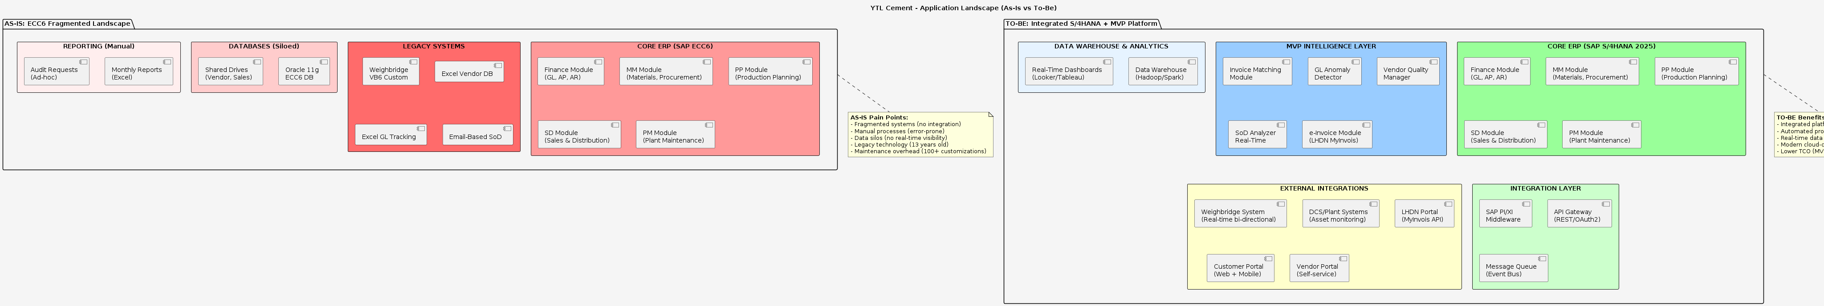
Application Landscape - AS-IS vs TO-BE
Notes:
Comparison of fragmented legacy systems vs integrated S/4HANA platform

Slide 5
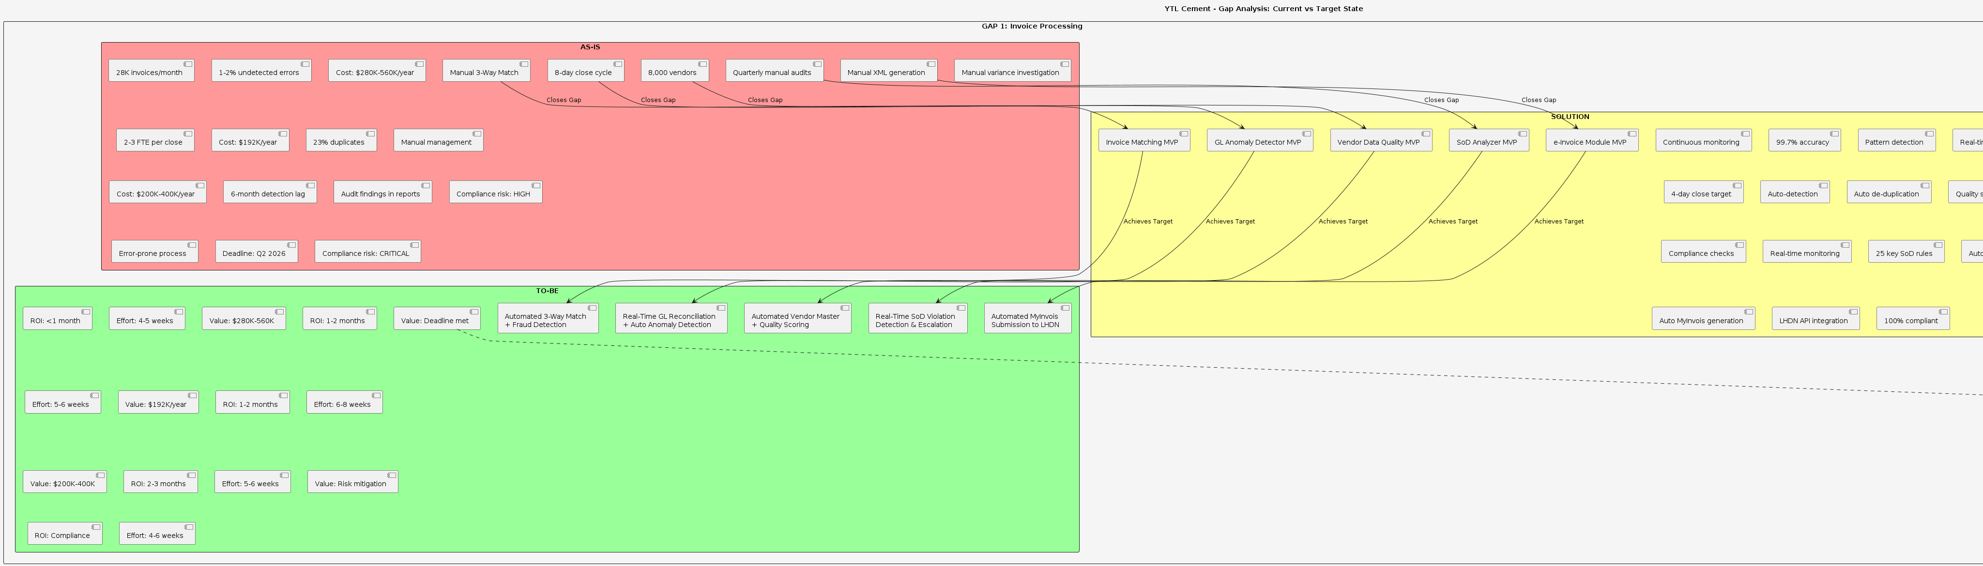
Gap Analysis - 5 Major Gaps & Solutions
Notes:
5 critical gaps addressed by MVP modules with 10-16 month payback period

Slide 6
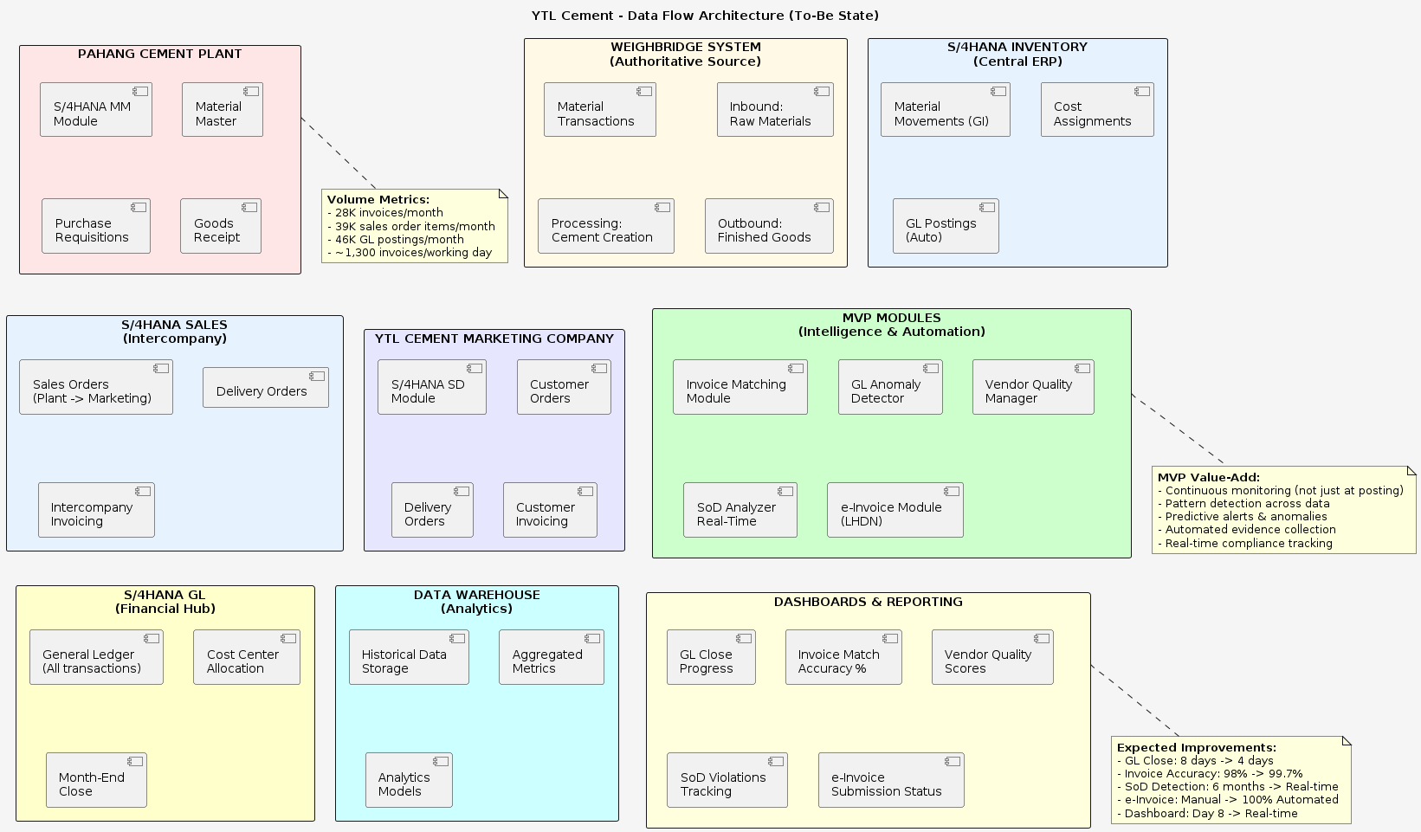
Data Flow Architecture
Notes:
End-to-end data flow from plant to marketing with MVP intelligence layer

Slide 7
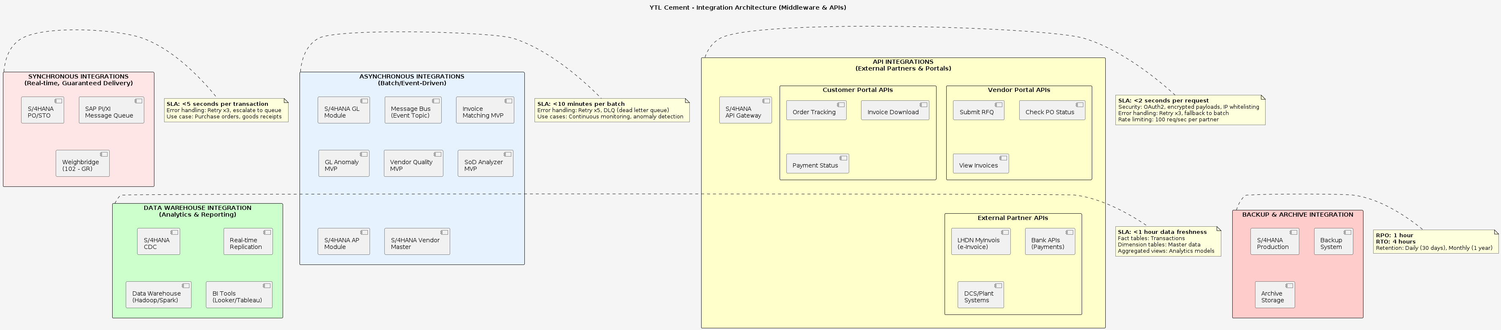
Integration Architecture - Middleware & APIs
Notes:
Synchronous, asynchronous, and API integrations with SLA specifications

Slide 8
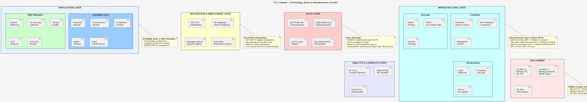
Technology Stack & Infrastructure
Notes:
Complete technology stack from application layer to infrastructure deployment

Slide 9
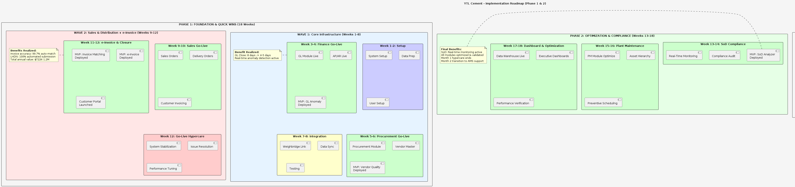
Implementation Roadmap - 18 Week Phased Approach
Notes:
Phase 1 (Weeks 1-12) Foundation & Quick Wins, Phase 2 (Weeks 13-18) Optimization

Slide 10
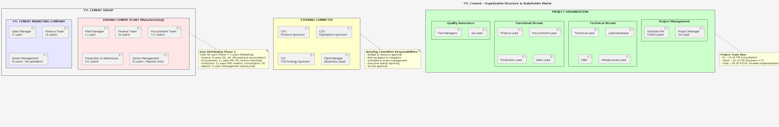
Organization Structure & Stakeholder Matrix
Notes:
Project organization with 46 plant users + 3 marketing users in Phase 1

Slide 11
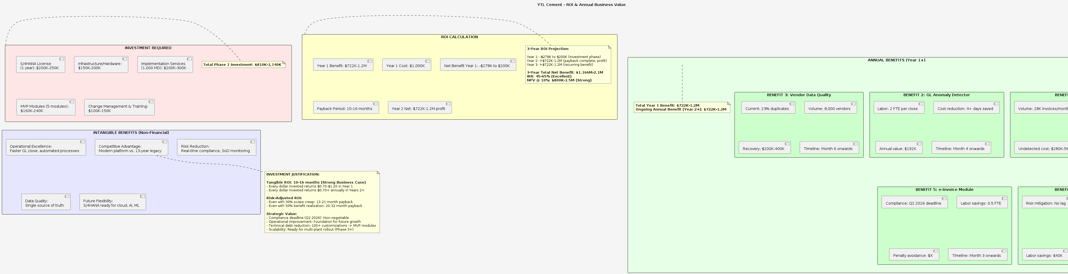
ROI & Annual Business Value
Notes:
Total investment $810K-1,140K with $722K-1.2M annual benefit, 10-16 month payback

