Slide 1
Exploration of Important Housing Features and Price Prediction Modeling in Ames, Iowa
Ibrahim Awad
NYC Data Science Academy Fellow

Slide 2
Motivation
We want to know how a house buyer describes their dream house. Do they start with describing the neighborhood, the number of rooms, the number of cars in the garage, etc?! What are their preferences?! We also want to develop a model to predict the house prices based on the available preferences.
We will use a dataset of homes in Ames, Iowa to explores 79 variables and to build a prediction model using the train dataset. Then, the model will be used to predict the house prices in the test dataset.

Slide 3
Objectives
Data cleaning and handling missing data
Examining highly correlated features
Build a prediction model
Explore important features
Predict house prices from the test dataset

Slide 4
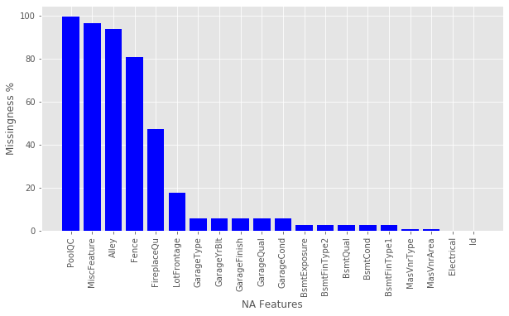
Data Cleaning
Missingness Percentage

Slide 5
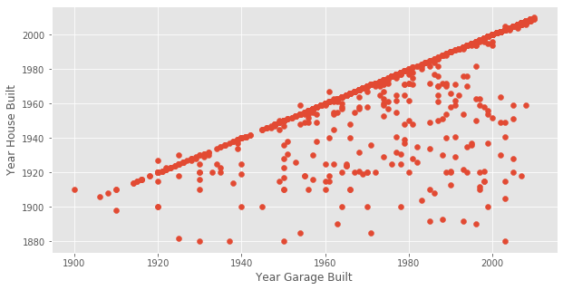
Data Cleaning
Some features are missing because they don’t exist in the houses such as PoolQC, MiscFeatures, Alley, etc. These are the most missing data and imputed as None.
Year Garage Built is highly correlated with House Year Built (0.84 correlation).
GarageYrBlt is removed and replaced by Garage (1 for yes and 0 for no garage)

Slide 6
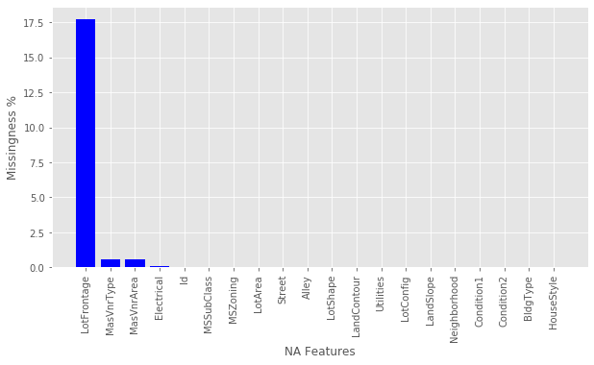
Data Cleaning
Now, missingness is down to ~18%.

Slide 7
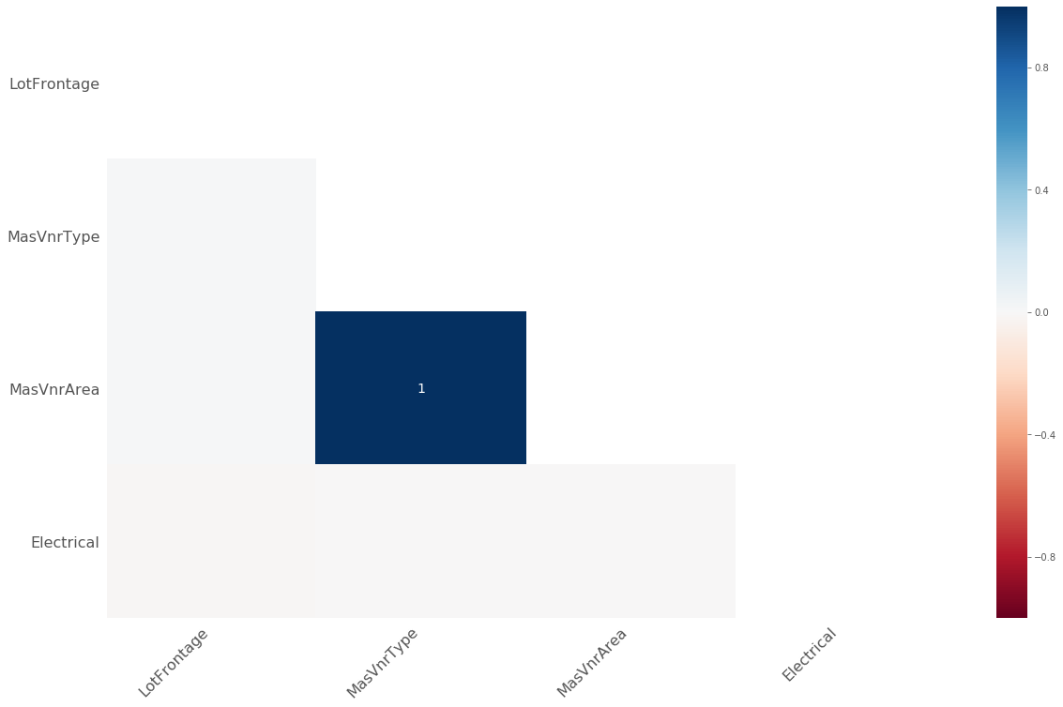
Data Cleaning
The missing data in MasVnrType and MasVnrArea are perfectly correlated.
Missing data are in the same observations.
MasVnrArea is imputed as “0” while “MasVnrType” is imputed as “None”

Slide 8
Data Cleaning
Only one observation is missing from “Electrical”. It is deleted.
Now, only 17.5% is missing in LotFrontage.
This missing data is imputed using KNN using Gower distance to more accurately account for the numerical, ordinal and categorical features.
The imputation error when it was tested on a sub-test data is 11.7 feet (16.8% of the mean Lot Frontage).
Now, the train dataset is free of missing data.

Slide 9
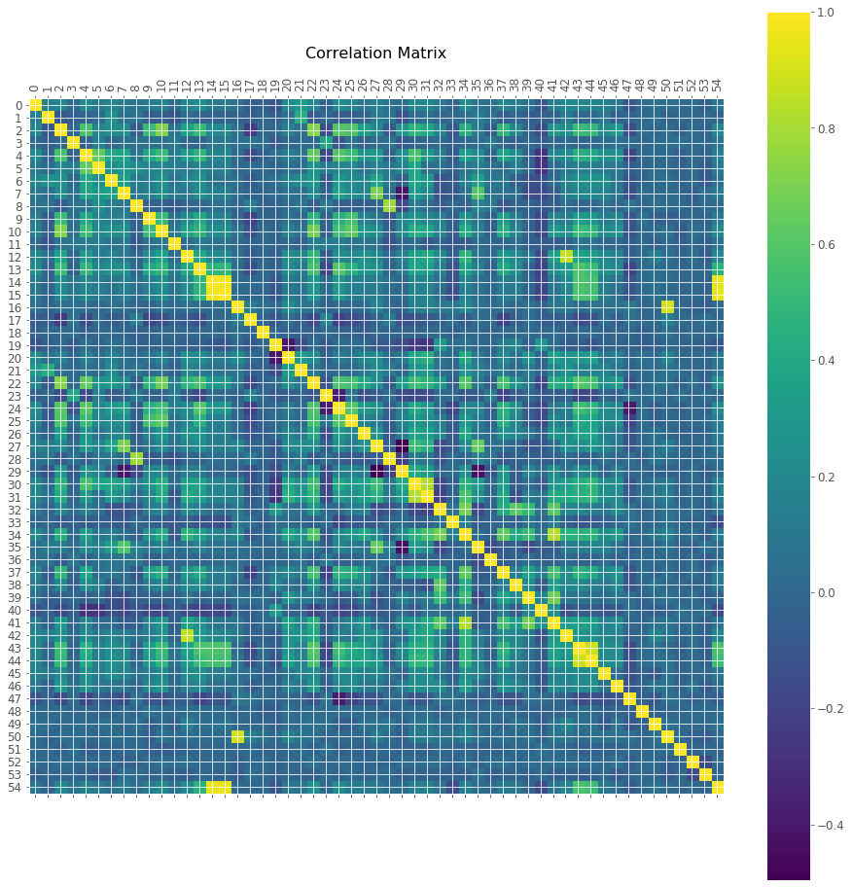
Examining Highly Correlated Features (Numerical and Ordinal)

Slide 10
Examining Highly Correlated Features (Numerical and Ordinal)
'GarageQual' and 'GarageCond' are highly correlated and they have the same correlation with the rest of the features. One of them will be enough.
'TotalBsmtSF' and '1stFlrSF' are highly correlated and they have almost the same correlation with the rest of the features. One of them will be enough.
'GarageCars'and 'GarageArea' are highly correlated and they have almost the same correlation with the rest of the features. One of them will be enough.
'GarageCond', '1stFlrSF' and 'GarageArea’ are dropped from the data.
The total number of numerical and ordinal features is now 52 instead of 55.

Slide 11
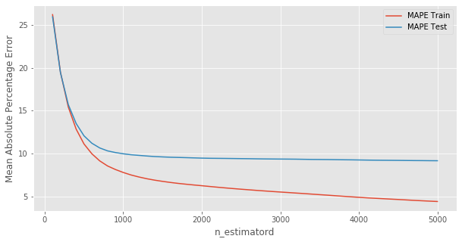
Build a Prediction Model
Gradient Boosting Tree Regressor is used with a learning rate of 0.005 to model the data.
Mean Absolute Percentage Error (MAPE) is evaluated to determine the quality of the model

Slide 12
Build a Prediction Model
Cross-Validation is performed at 1000 trees on the original train dataset.
The best model is found at
Maximum depth: 5
Maximum features: 25
A tree model is fitted using validated parameters and MAPE is as follows:
Train MAPE: 5.16%
Test MAPE: 8.82%

Slide 13
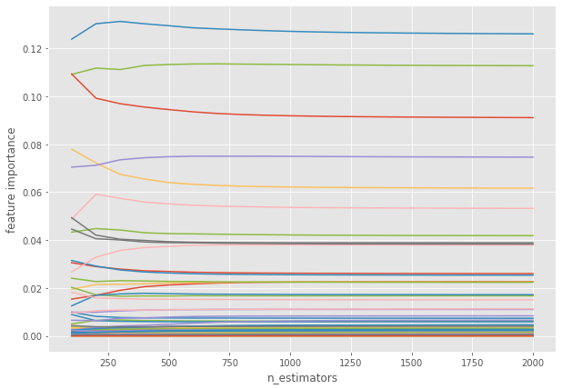
Feature Importance

Slide 14
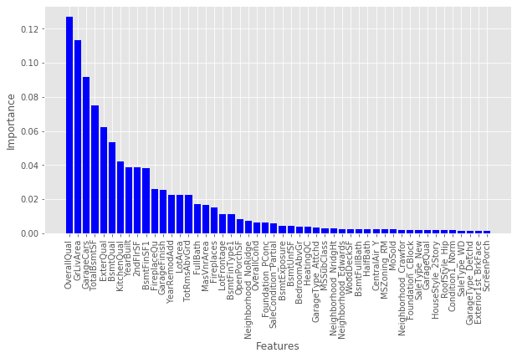
Feature Importance

Slide 15
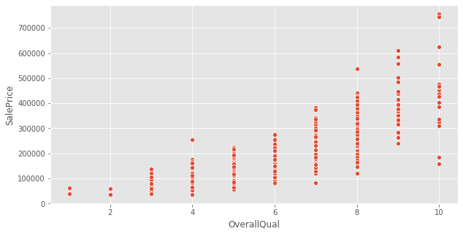
Feature Importance
Sale Price vs. Overall Finish Quality

Slide 16
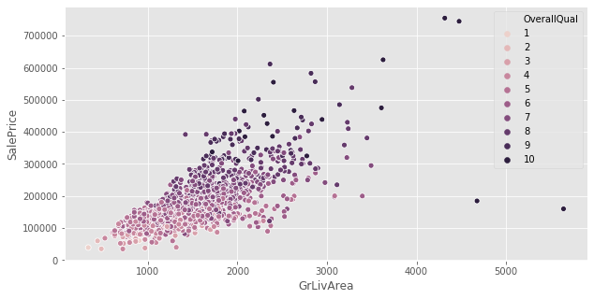
Feature Importance
Sale Price vs. Ground Living Area

Slide 17
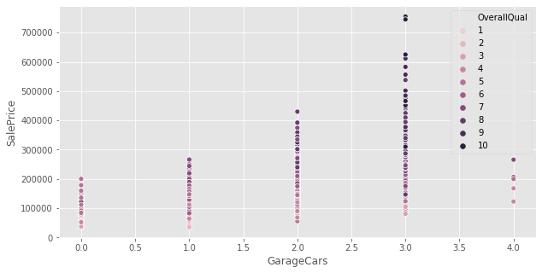
Feature Importance
Sale Price vs. Garage Cars

Slide 18
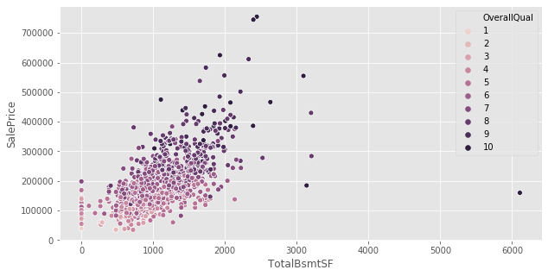
Feature Importance
Sale Price vs. Total Basement Square Ft

Slide 19
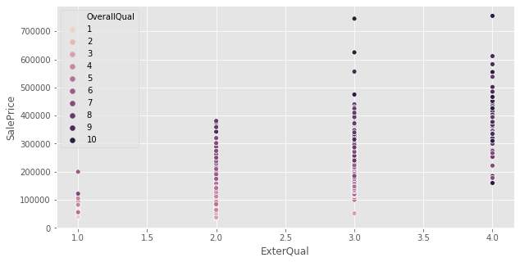
Feature Importance
Sale Price vs. Exterior Quality

Slide 20
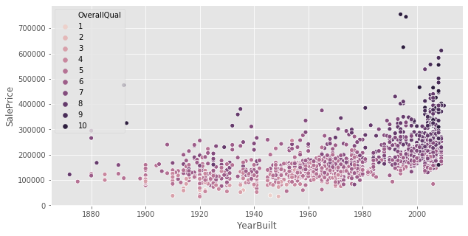
Feature Importance
Sale Price vs. Year Built

Slide 21
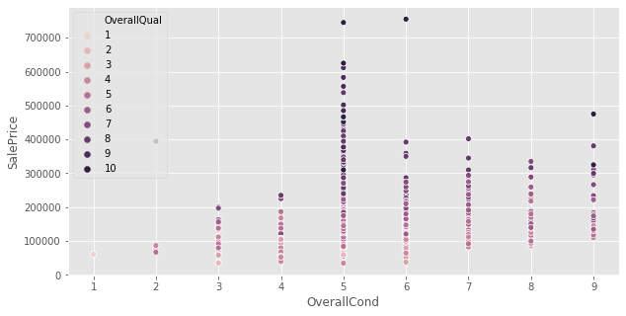
Feature Importance
Sale Price vs. Overall House Condition

Slide 22
Prediction of House Prices on Test Dataset
Data was cleaned in the same way as the train set.
Same features were matched after dummifying categorical features.
The trained tree regressor is used to predict the house prices.
The prices were predicted with a Root Mean Squared Logarithmic Error (RMSLE) of 0.134 as compared to the calculated RMSLE of o.081 from the train set.
Both errors have close magnitudes, the difference and the errors are acceptable.

Slide 23
Future Work
Delete any outliers.
Perform more exploratory data analysis—find patterns in the data.
Try multiple linear regression (Lasso, Ridge or Elastic-net). The linear regression conditions have to be checked first.
Explore the importance of feature space more thoroughly—find all possible interactions.

