Slide 1
Effectiveness of Hiring on Linkedin
Ibrahim Awad TDI Applicant

Slide 2

What are people doing on Linkedin?!
Jobs
Employees
Knowledge & Information
Business Networking
Data
Love, professionally

Slide 3
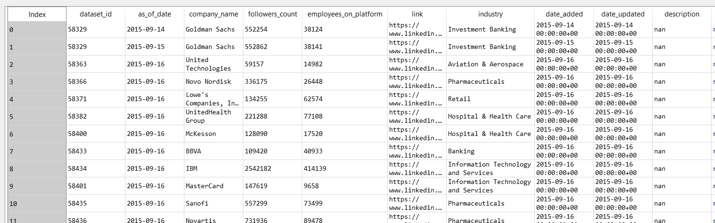
Data Understudy
2,426,196 rows
14 columns
909 MB
131 industries
5028 companies
From 2015 to 2018
Python (Pandas and Numpy)

Slide 4
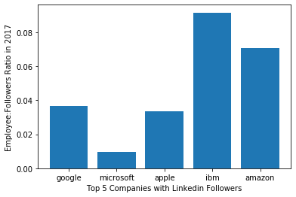
Objective (Hiring Effectiveness: Employee-to-Follower Ratio)
Industry Level
Company Level

Slide 5
Objective
Which industry and what size of company benefit or will benefit the most from hiring on Linkedin?!

