Slide 1
Tito’s Vodka Market Analysis Iowa – February 2021
Ibrahim Awad
NYC Data Science Academy

Slide 2
Objectives
What are the most popular liquor categories in Iowa?
What is the Product Life Cycle (PLC) for each of the most popular liquor brands?
What are the high demand cycles?
What are the characteristics of Tito’s customers (stores in this case)?
What marketing plans can be proposed for each store segment?
What’s the probability that a store would stay active?

Slide 3
Dataset
Data was collected from https://data.iowa.gov/Sales-Distribution/Iowa-Liquor-Sales/m3tr-qhgy.
Data contains liquor transactions by stores in Iowa from 2012 until February 2021.
Data contains ~21 million transactions, ~9000 liquor brands, ~2500 stores.
There were 111 liquor categories, but coarse-grained into 17 categories.
Data are broken into separate relational databases; products, product prices, stores, vendors and transactions.

Slide 4
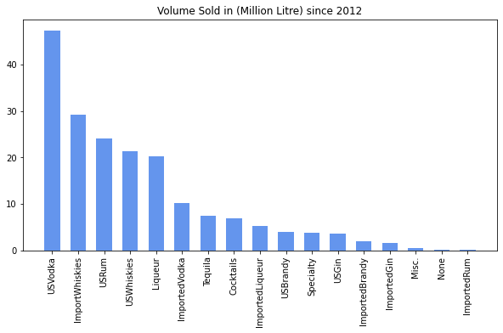
What are the most popular liquor categories in Iowa?

Slide 5
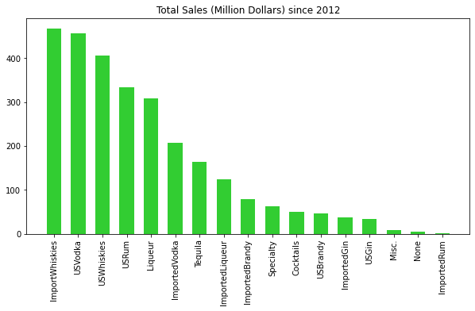
What are the most popular liquor categories in Iowa?

Slide 6
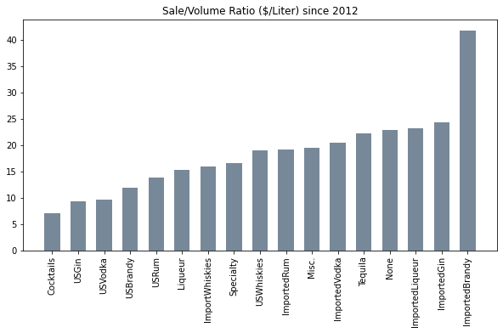
What are the most popular liquor categories in Iowa?
Lots of opportunity
High competition
for Tito’s

Slide 7
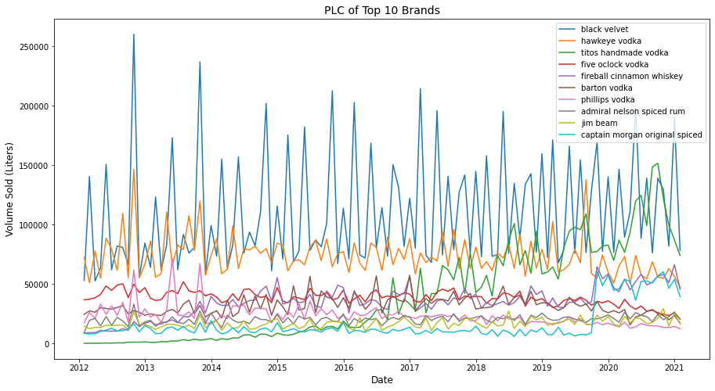
What is the Product Life Cycle (PLC) for each of the most popular liquor brands?

Slide 8
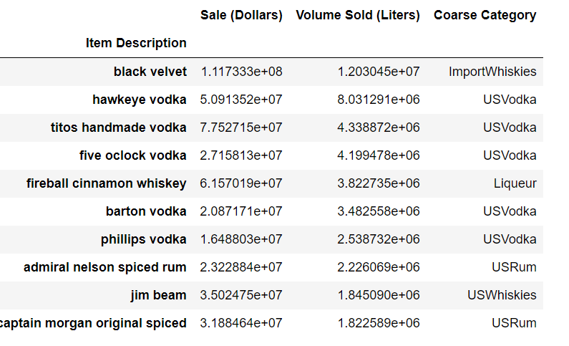
What is the Product Life Cycle (PLC) for each of the most popular liquor brands?

Slide 9
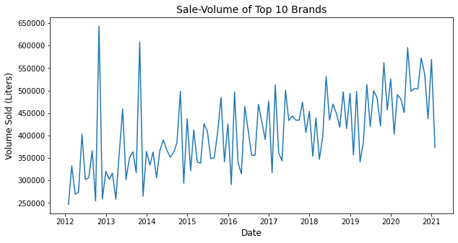
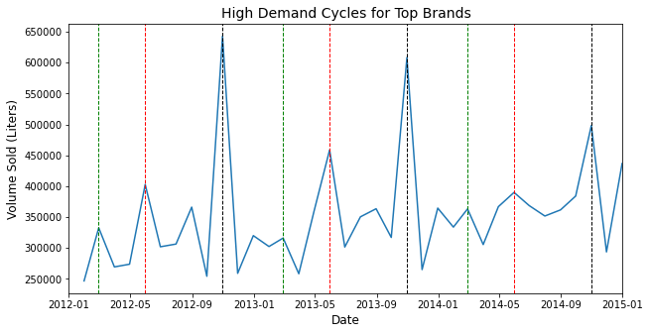
What are the high demand cycles?
High Demand months are February, May and October.
Tito’s Marketing campaigns and promotions to be intensified prior to these dates

Slide 10
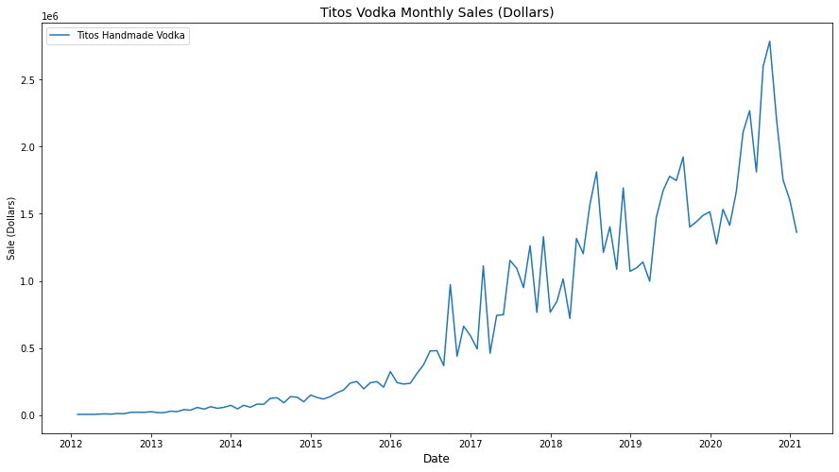
Tito’s Vodka

Slide 11
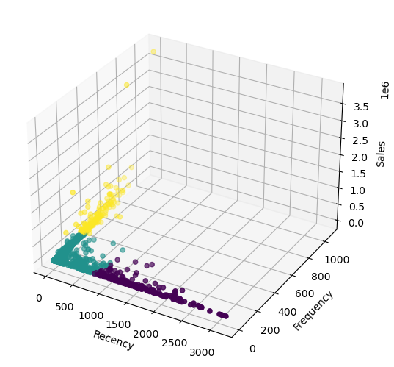
What are the characteristics of Tito’s customers (stores in this case)?
Recency-Frequency-Monetary (RFM) Segmentation
Number of stores 2079
Recency: the number of days a store has been inactive
Frequency: the number of total transactions
Monetary: the revenue (the total sales in this case)
The stores are segmented into 3 segments:
Low Value
Medium Value
Haigh Value
High
Medium
Low

Slide 12
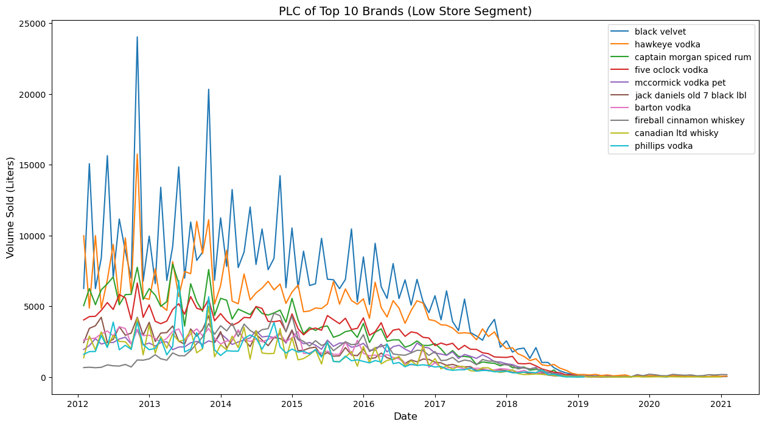
Low Segment

Slide 13
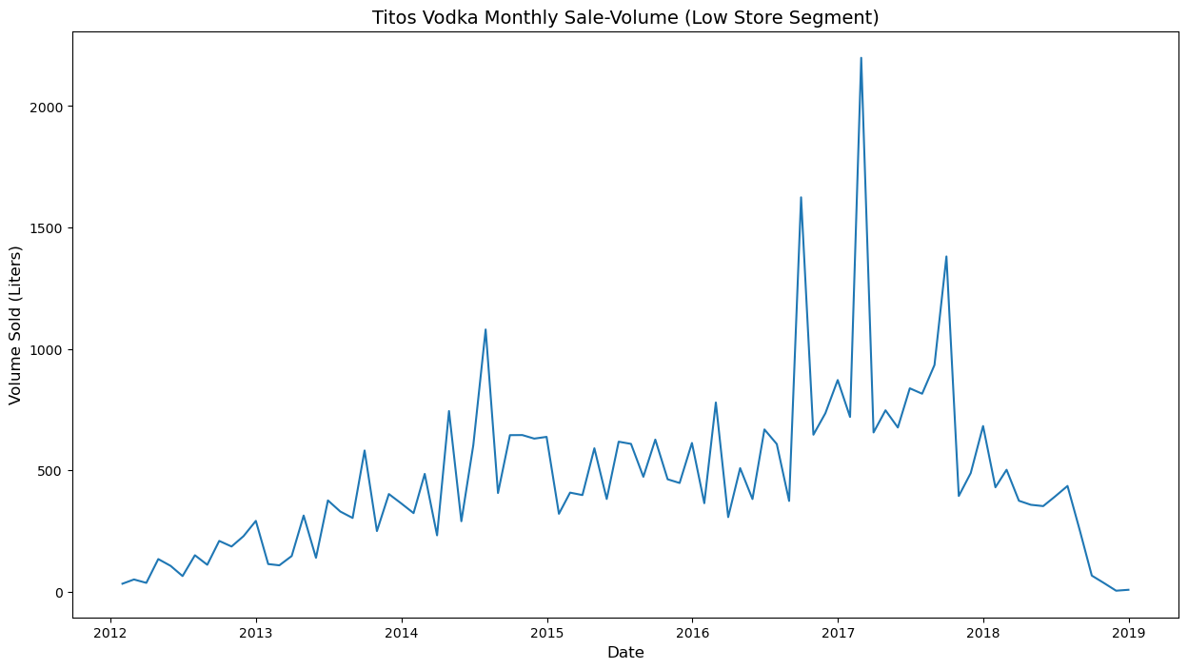
Low Segment

Slide 14
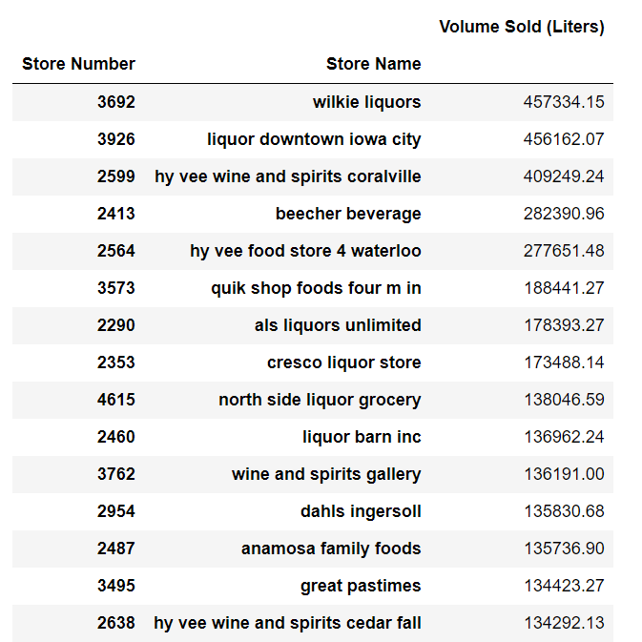
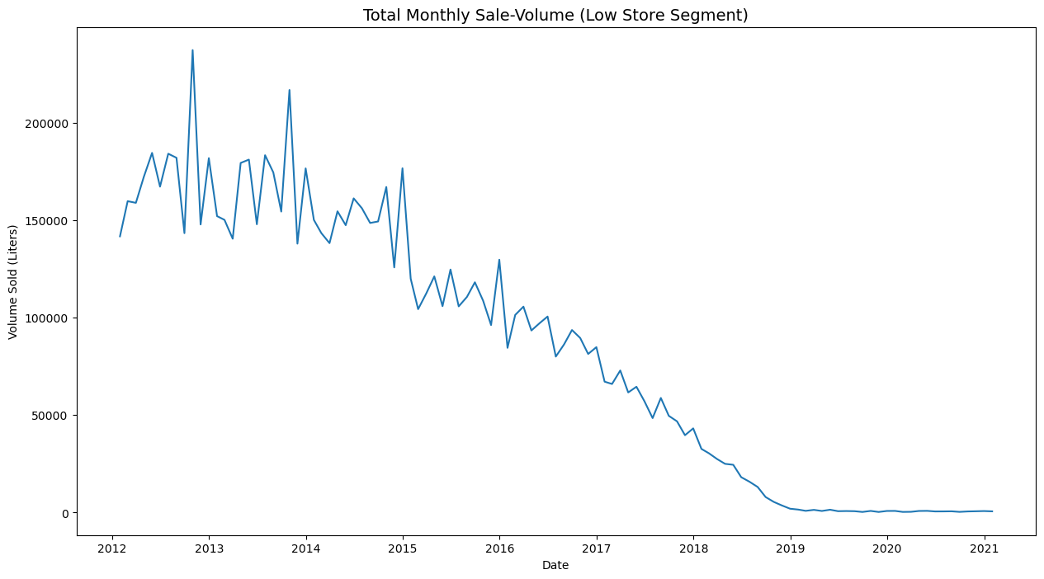
Low Segment

Slide 15
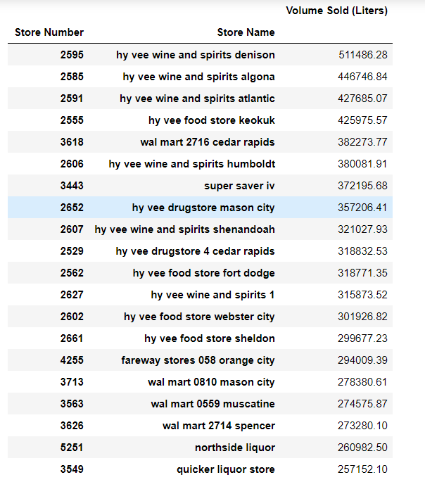
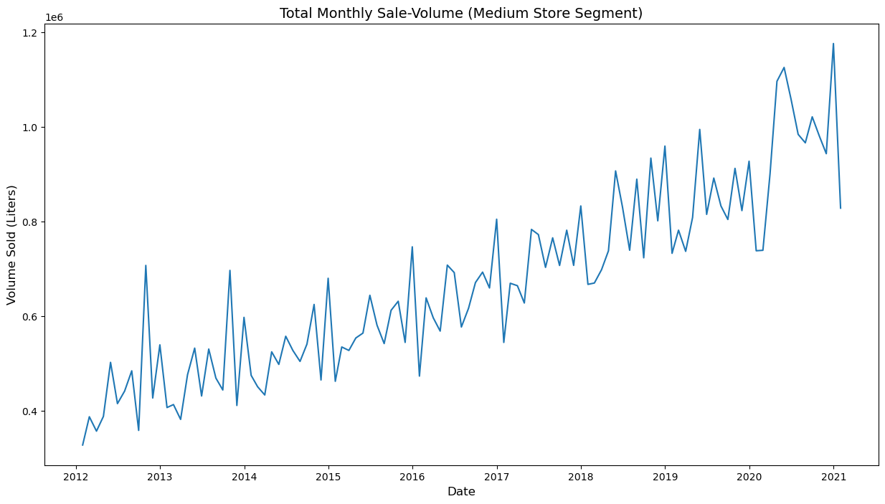
Medium Segment
The top stores in this medium categories are super stores like Hy-Vee and Walmart.
Hy-Vee is a popular super store in the Midwestern states Iowa, Illinois, Kansas, Minnesota, Missouri, Nebraska, South Dakota, and Wisconsin.

Slide 16
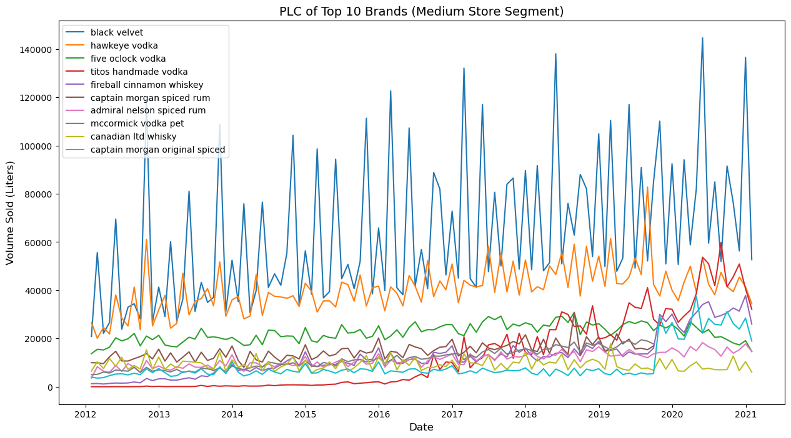
Medium Segment

Slide 17
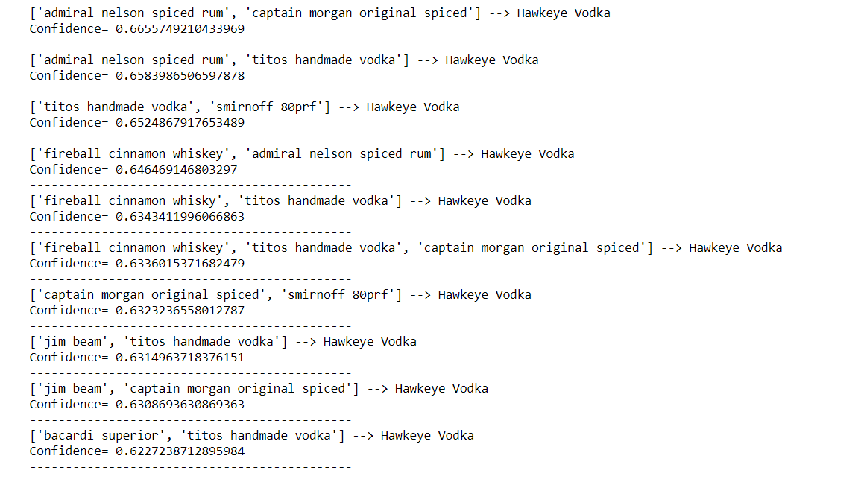
Medium Segment (Market Basket Analysis)

Slide 18
Medium Segment (Promotion Plan)
Offer discounts at the time of sale on Tito’s Vodka and Hawkeye Vodka.
Later, send the customer a newsletter or email campaign with interesting product bundles that includes Tito’s Vodka.
After finishing the sale, offer a coupon enticing the store customer to return and buy the extra items.
In the medium value stores, place Tito’s vodka close to the antecedents baskets for Hawkeye vodka with promotions.

Slide 19
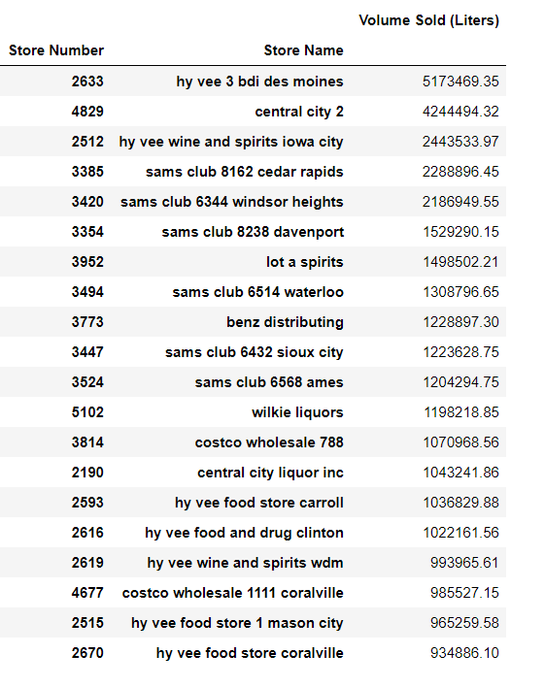
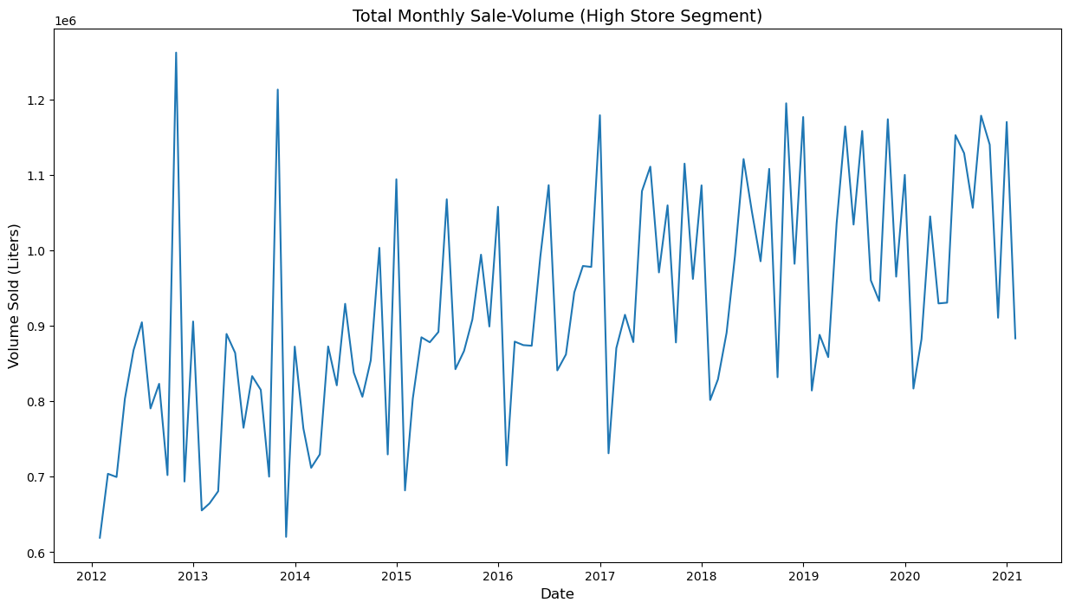
High Segment
This category contains megastores like Sam's Club and Costco
And Hy-Vee in the big cities in Iowa such as Des Moines, Iowa City, Cedar Rapids and Davenport.

Slide 20
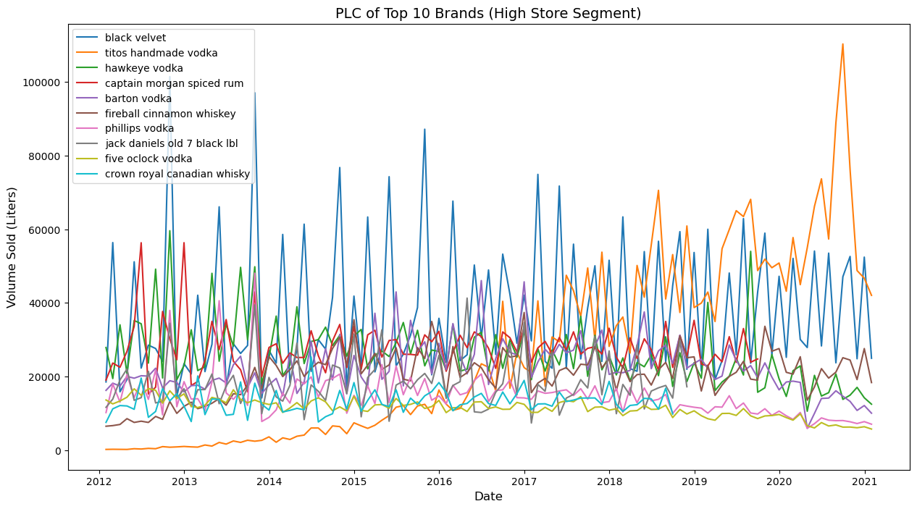
High Segment

Slide 21
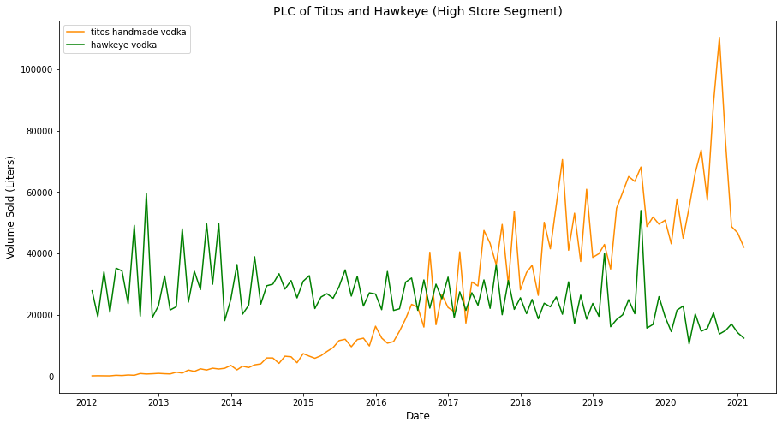
High Segment

Slide 22
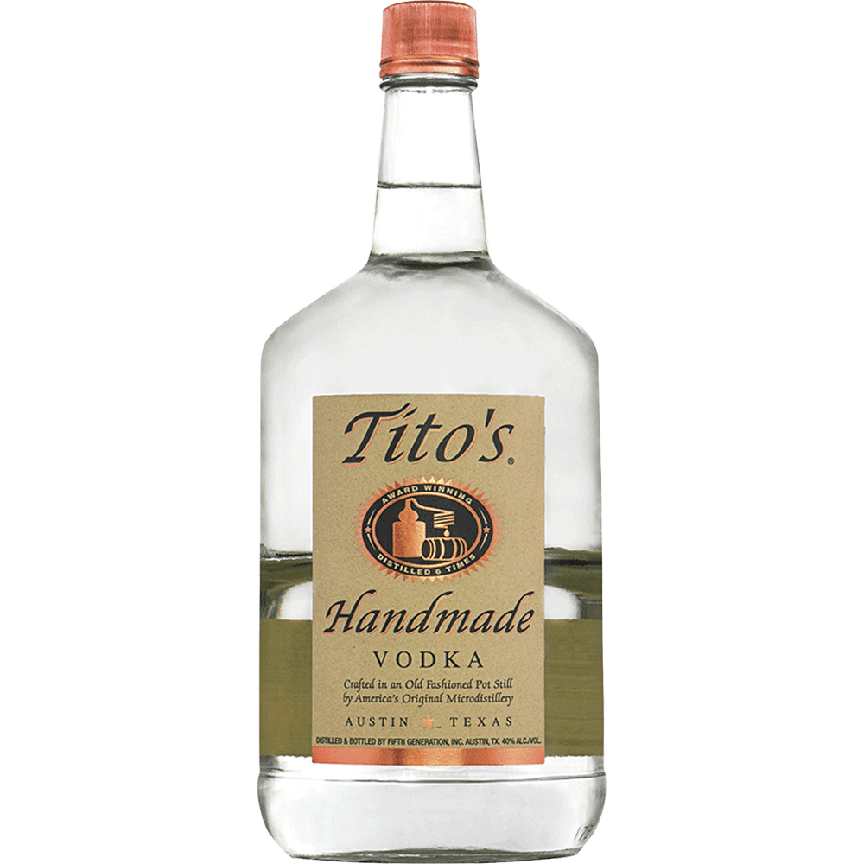
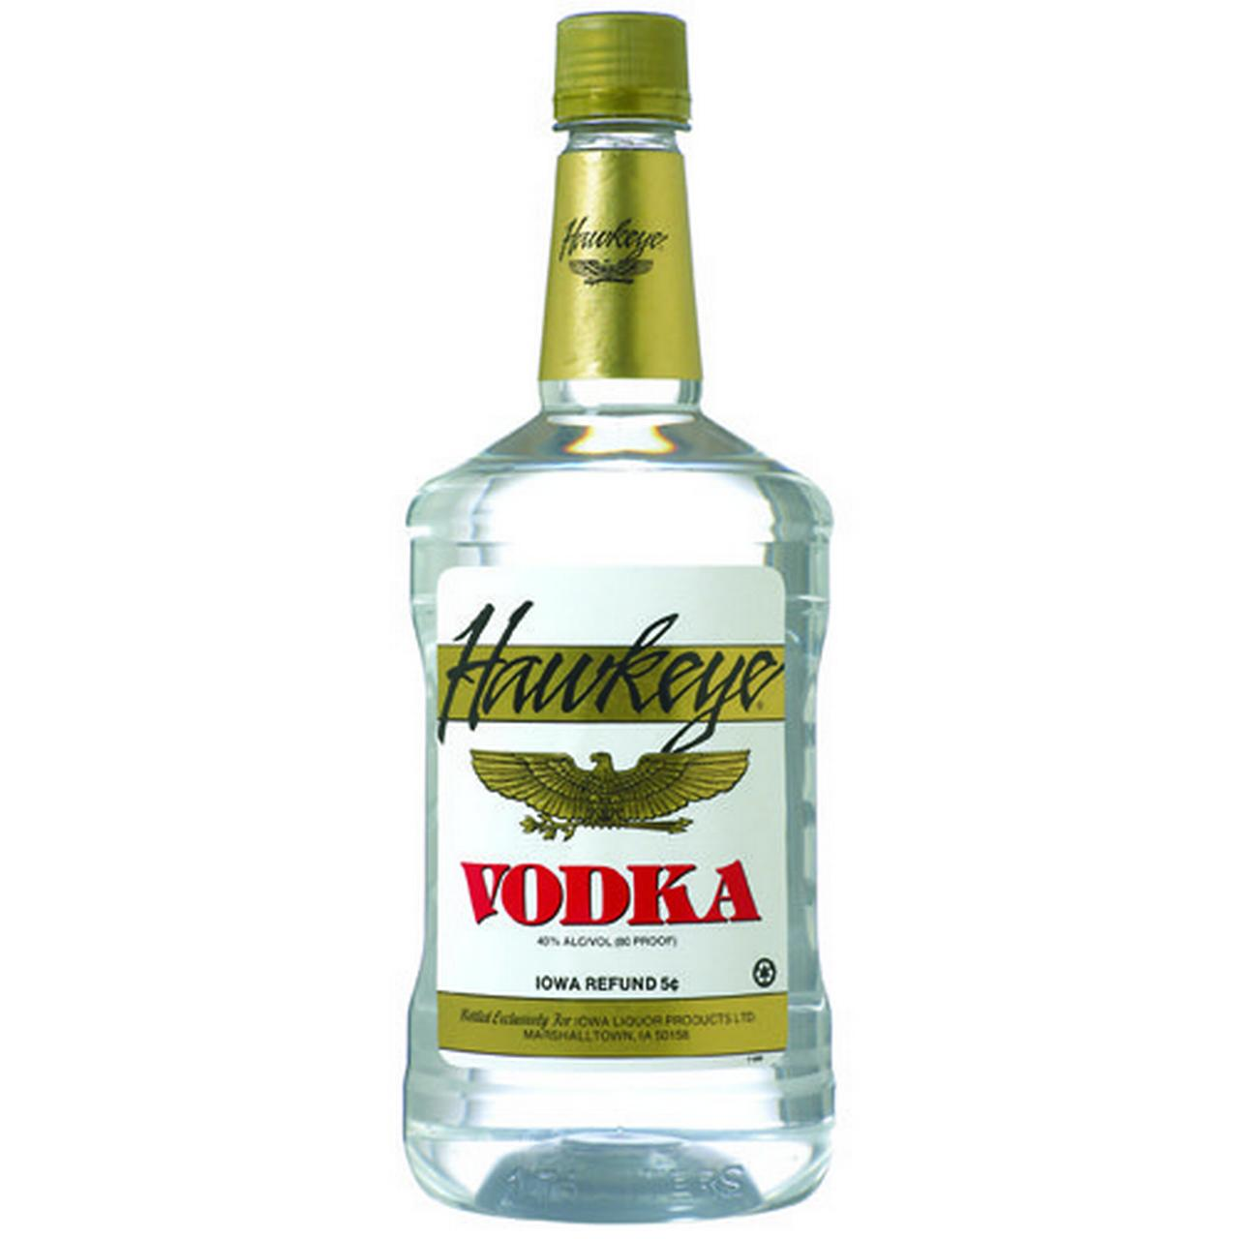

High Segment (Example)
Des Moines
$28.55 1.75 L
$10.99
1.75 L

Slide 23
What’s the probability that a store would stay active? (Customer Lifetime Value Prediction CLVP)
Beta Geometric/Negative Binomial Distribution (BG/NBD) is a probabilistic prediction model that fits the distribution of the customer transaction data and then predict the probability of the life of a customer, number of transactions and sales.
Frequency : the number of repeat purchases
Recency^{CLVP} : the time between the first and the last transaction
T : the time between the first purchase and the end of the transaction period (last date of the time frame considered for the analysis)
Monetary value : it is the mean of a given customers sales value
Train: Jan 2018 to Dec 2019
Validation: Jan 2020 to Feb 2021

Slide 24
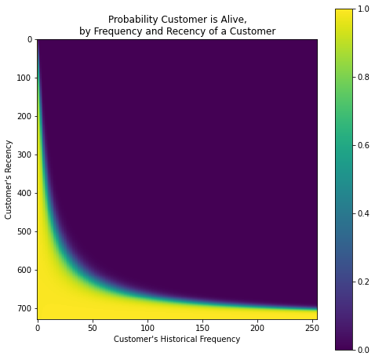
What’s the probability that a store would stay active? (Train: Jan 2018 to Dec 2019)

Slide 25
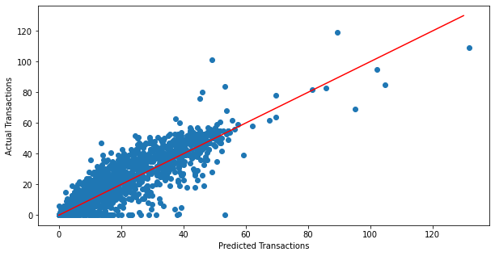
What’s the probability that a store would stay active? (Validation: Jan 2020 to Feb 2021)
21.4
Mean Absolute Error: 6.2 transactions
Average Transaction: 21.42 transactions

Slide 26
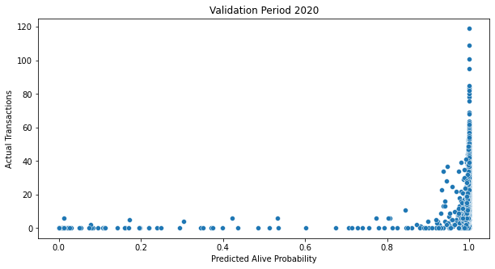
What’s the probability that a store would stay active? (Validation: Jan 2020 to Feb 2021)
21.4

Slide 27
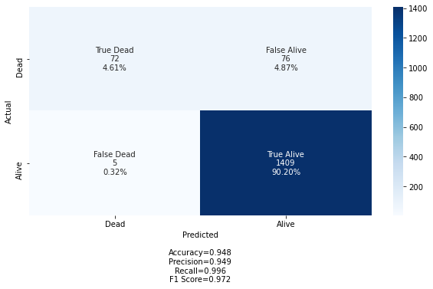
What’s the probability that a store would stay active? (Validation: Jan 2020 to Feb 2021)
21.4

Slide 28
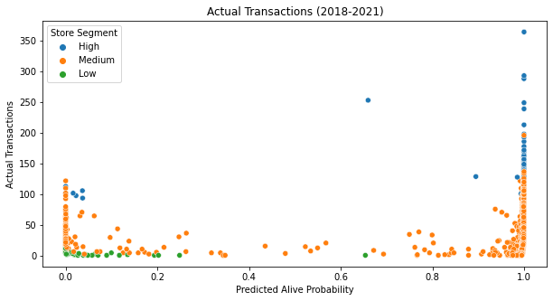
What’s the probability that a store would stay active? (Train + Validation)
21.4

Slide 29
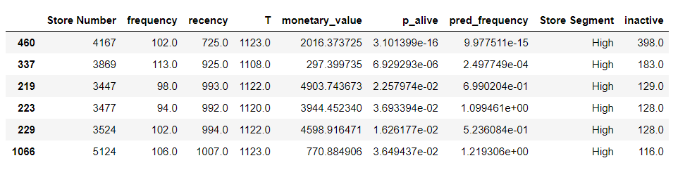
What’s the probability that a store would stay active? (Train + Validation)
21.4

Slide 30
What’s the probability that a store would stay active? (Train + Validation)
21.4
The predicted probabilities along with the predicted segments will be used:
to identify the profitable, highly-profitable and non-profitable stores
to optimize the acquisition spending (spend more on marketing campaigns at highly profitable stores and less on low profitable stores)
to measure the impact of a marketing campaign (repeat the same strategies for highly profitable stores, or change the strategy for low profitable stores)

Slide 31
Conclusions
US Vodka is the most sold liquor category; there is a lot of competition and opportunity.
US Vodka is sold for a fairly cheap price as compared to other popular categories.
Marketing campaigns and promotions to be intensified in February, May and October.
Low value stores are out of the marketing analysis; they are likely out of business.
Medium value stores are very competitive with Hawkeye Vodka.
Tito’s is winning in the high value stores (wholesale/club stores)
BG/NBD model predicts the alive probability with an accuracy of 94.8% and a risk of 5.2%
RFM segmentation and Customer Lifetime Value Prediction are together beneficial to plan and to evaluate marketing campaigns.

