Slide 1
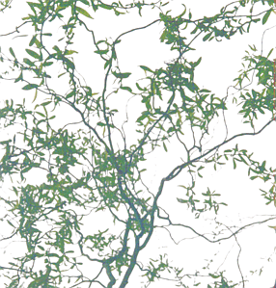
Bender Tutorial
Vanya Belyaev
LAPP/Annecy-le-Vieux & ITEP/Moscow

Slide 2

Outline
Bender/Python overview
Job configuration
Data access
Histograms & N-Tuples
Algorithms
Please keep LoKi manual with you
  Especially for Function/Cuts tables
$LHCBDEV/BENDER/BENDER_v4r1/Doc/LoKiDoc/v3r5/doc/LoKi’*’.(ps,pdf)
Doxygen for LoKi is also useful
$LHCBDEV/BENDER/BENDER_v4r1/Doc/LoKiDoc/v3r5/doc/html/index.html
Bender is not frozen!
Significant improvements in Bender semantics are expected (mainly according to the feedback from you)

Slide 3
Environment (I)
Bender v4r1 ( based on DaVinci v12r2 )
Released in $LHCBDEV area
The package Tutorial/BenderTutor v1r0
Only few essential features of Bender
Out of Tutorial scope
  visualization of histograms
  visualization of event and detector data
  CMT-free mode
  batch jobs

Slide 4
Environment (II)
csh/tcsh:
  lbcmt
  setenv DaVinci_release_area $LHCBDEV
  setenv Bender_release_area $LHCBDEV
zsh/ksh/bash:
  lbcmt
  export DaVinci_release_area=$LHCBDEV
  export Bender_release_area=$LHCBDEV
get the Tutorial package
  BenderEnv v4r1
  cd $HOME/cmtuser
  getpack Tutorial/BenderTutor v1r0
  cd Tutorial/BenderTutor/v1r0/cmt
  make
  source setup.csh ( or . setup.sh )
To be substituted by Bender + cmt.py

Slide 5
Bender/Python tips
Python scripts could be executed as “scripts”
  > python MyBenderScript.py
  > MyBenderScript.py
Python scripts could be executed from the command prompt ( explicit interactivity!)
  > python
  >>> import MyBenderScript
Python scripts could be executed with the command prompt (interactivity with “pawlogon.kumac” )
  > python –i MyBenderScript.py
Common start-up script is possible,
Pere has a lot of nice ideas!

Slide 6
Structure of Gaudi Job
Each “Job” contains 4 essential part
Configuration of Job environment
  <ProjectEnv> scripts, CMT
Configuration of Job’s components
  Top Level algorithms
  properties of Algorithms/Services/Tools
  Input/output
“Analysis Algorithm” coding
Job steering
Bender: cmt.py
GaudiPython + Bender
Bender
GaudiPython + Bender

Slide 7
2 approaches
Start from pure python prompt
define everything from Python
Make a “smooth” transition from DaVinci/LoKi
start with existing configuration
substitute it element by element
Attractive,
but not practical
Choice for tutorial

Slide 8
Minimal Analysis Job
Bender could be used with “no Bender”
Execute some “DaVinci” configuration
The actual configuration from ‘*’.opts file
DaVinci:
  DaVinci MyOptionsFile.opts

Slide 9
Minimal Bender script
from bendermodule import *
import benderconfig as bender
def configure() :
  bender.config( files =
  [‘MyOptionsFile.opts’])
  return SUCCESS
if __name__ == ‘__main__’ :
  configure()
  g.run(100)
  #g.exit()
To be improved
Application and Components Configuration
Job steering
“g” → “gaudi” ? “appMgr”?
../solutions/Minimalistic.py

Slide 10
“Hello, World!” (I)
The simplest possible “algorithm”
Follow LoKi’s style:
  inherit the algorithm from useful base class
  (re)implement the “analyse” method
class HelloWorld(Algo) :
  def analyse( self ) :
    print ‘Hello, World!’
    return SUCCESS
../solutions/HelloWorld.py

Slide 11
“Hello, World!” (II)
One needs to instantiate the algorithm
  alg = HelloWorld( ‘Hello’ )
Add it to the list of ‘active’ algorithms
  g.TopAlg = [ ‘Hello’ ]
Execute ☺
  g.run(10)
Application Configuration
Part of job steering block
../solutions/HelloWorld.py

Slide 12
Access to the data
C++: GaudiAlgorithm/LoKi
const MCParticles* mcps = get<MCParticles>(‘MC/Particles’ )
Python: Bender
  Get as ‘native’ object:
    mcps = self.get( address = ‘MC/Particles’)
  Get as std::vector or Python’s list:
    mcps = self.get( address = ‘MC/Particles’ ,
    vector = TRUE )
    mcps = self.get( address = ‘MC/Particles’ ,
    list = TRUE )
Semantics to be improved
../solutions/DataAccess.py

Slide 13
Attributes and (python) loops
MCParticle
for mcp in mcps :
  print ‘ID=‘ , nameFromPID( mcp.particleID() )
  print ‘PX=‘ , mcp.momentum().px()
  print ‘PY=‘ , mcp.momentum().py()
To know the available attributes:
    help( obj )
    help( type( obj ))
ON-LINE help for ALL Python/Bender functions/classes, sometimes it is VERY useful
From Dictionaries
../solutions/DataAccess.py

Slide 14
Hands-on (I)
Simple algorithm which gets MCVertices from the Gaudi Transient Store and prints number of MCVertices and some information (e.g. x/y/z-position) for some of them
Hints:
The ‘*’.opts file, which could be used
  $BENDERTUTOROPTS/BenderTutor.opts
The analogous example for MCParticles:
  ../solutions/DataAccess.py
The actual solution is
  ../solutions/HandsOn1.py

Slide 15
Lets start with physics analysis
>95% of LoKi’s idioms are in Bender
The semantic is VERY similar
  In spite of different languages
  few ‘obvious’ exceptions
In the game:
  All Functions/Cuts
    a bit more round braces are required
  All (v,mc,mcv)select methods
  loops , plots
  for N-Tuples the functionality is a bit limited
    A lack of template methods,
    ‘farray’ need to be validated
  Start from MC-truth (requires no special configurations)

Slide 16
MCselect statement
Selection of MCParticles which satisfy the certain criteria:
  mcmu = self.mcselect( tag = ‘mcmu’ ,
  cuts = ‘mu+’ == MCABSID )
  beauty = self.mcselect( tag = ‘beauty’ , cuts = BEAUTY )
Refine criteria:
  muFromB = self.mcselect ( tag = ‘muFromC’,
  source = mcmu ,
  cuts = FROMMCTREE( beauty ) )
  muPT = self.mcselect( tag = ‘withPT’ ,
  source = muFromB ,
  cuts = ( MCPT > ( 1 * GeV ) ))
LUG, Tab. 13.4, p.84
Select μ⁺ & μ⁻
Everything which has b or b̄
Everything from “decay” trees (incl. decay-on-flight)
../solutions/MCmuons.py

Slide 17
Change input data
Get and configure EventSelector
  evtSel = g.EvtSel()
  evtSel.open( “file”)
OR
  evtSel.open( [ “file1”, “file2”] )
e.g.
evtSel.open ( ‘LFN:/lhcb/production/DC04/v1/DST/00000543_00000017_5.dst’)
List of input files

Slide 18
Hands On (II, II.5)
Simple algorithm which evaluates the fractions of events which contains of at least B_{s} or beauty baryons
Hints
Relevant MCParticle functions
  MCID, MCABSID , BEAUTY , BARYON
The most trivial “counter” is
  if not Bs.empty() : self.Warning( message = ‘Bs’ )
The analogous algorithm is
  ../solutions/MCmuons.py
The real solution is
  ../solutions/HandsOn2.py
  ../solutions/HandsOn2.5.py
LUG, Tab. 13.4, p.84-87

Slide 19
Find MC–tree ( IMCDecayFinder )
Brilliant tool from O.Dormond
find the MC-decay trees:
mc = self.mctruth()
trees = mc.find( decay =
‘[B_s0 -> (J/psi(1S) -> mu+ mu-) phi(1020)]cc’ )
find MC-decay tree components:
phis = mc.find( decay =
‘ phi(1020) : [B_s0 -> (J/psi(1S) -> mu+ mu-) phi(1020)]cc’ )
extract ‘marked’ MC-decay tree components:
mus = mc.find( decay =
‘ [B_s0 -> (J/psi(1S) -> mu+ ^mu-) phi(1020)]cc’ )
Container(“Range”) of MCParticles
Container(“Range”) of MCParticles
../solutions/MCTrees.py

Slide 20
Add simple histos!
for mu in mus :
  self.plot ( title = ‘PT of muon from J/psi’ ,
  value = MCPT( mu ) / GeV ,
  high = 10 )
  The default values : low = 0, bins = 100, weight = 1
Configuration for histograms:
  g.HistogramPersistency = ‘HBOOK’
  hsvc = g.service(‘HistogramPersistencySvc’)
  hsvc.OutputFile = ‘myhistos.hbook’
MCParticle
../solutions/MCTrees.py

Slide 21
Add the simple N-Tuple
tup = self.nTuple( title = ‘My N-Tuple’ )
zOrig = MCVXFUN( MCVZ )
for mu in mus :
  tup.column( name = ‘PT’, value = MCPT( mu ) / GeV )
  tup.column( name = ‘P’ , value = MCP( mu ) / GeV )
  tup.column( name = ‘Z’ , value = zOrig( mu ) / mm)
  tup.write()
Configuration:
  myAlg = g.algorithm( ‘McTree’ )
  myAlg.NTupleLUN = ‘MC’
  ntsvc = g.service(‘NTupleSvc’)
  ntsvc.Output =
  [“MC DATAFILE=‘tuples.hbook’ TYP=‘HBOOK’ OPT=‘NEW’ ”]
../solutions/MCTrees.py

Slide 22
Component Properties
Algorithms
  alg = g.algorithm(‘MyAlg’)
  alg.NTupleLUN = ‘LUNIT’
Services
  hsvc = g.service(‘HistogramPersistencySvc’)
  hsvc.OutputFile = ‘histo.file’
Tools
  tool = g.property(‘MyAlg.PhysDesktop’)
  tool.InputLocations = [‘/Event/Phys/Charged’]
Everything
  prop = gaudi.iProperty(‘Holder.Name’)
  Prop.PropertyName = Value
MyAlg.NTupleLUN = “LUNIT” ;
HistogramPersistencySvc.OutputFile = “histo.file”;
MyAlg.PhysDesktop.InputLocations = {“/Event/Phys/Charged”};
Holder.Name.PropertyName = Value ;

Slide 23
Hands On (III)
The algorithm which gets the kaons from the decay B_{s} →J/ψ ( φ →K⁺ K⁻ ) , fill histo and N-Tuple
Hints
One need to define input MC files for this decay
  see ../solutions/MCTrees.py
The similar algorithm
  ../solutions/MCTrees.py
The actual solution
  ../solutions/HandsOn3.py

Slide 24
Go from MC to RC data
At this moment one knows how to:
  Deal with MC trees, decays, particles
  Perform simple (python) loops
  Deal with histograms & N-Tuples
    Some knowledge of ‘configuration’
For RC data one must perform non-trivial algorithm configuration to be able to run
  Input for RC particles (or ParticleMaker)
  Dependency on ‘other’ algorithms ( ‘PreLoad’ )

Slide 25
Pre-Load Charged Particles (I)
g.TopAlg += [ ‘LoKiPreLoad/Charged’]
desktop = g.property(‘Charged.PhysDesktop’)
desktop.ParticleMakerType = ‘CombinedParticleMaker’
maker = g.property(‘Charged.PhysDesktop.CombinedPaticleMaker’)
maker.ExclusiveSelection = 1>2
maker.Particles =
[ ‘muon’ , ‘electron’ , ‘kaon’ , ‘proton’ , ‘pion’]
maker.MuonSelection = [ “det=‘MUON’ mu-pi=‘-10.0’ ”]
maker.ElectronSelection = [ “det=‘CALO’ e-pi=‘-2.0’ ”]
maker.KaonSelection = [ “det=‘RICH’ k-pi=‘-5.0’ k-p=‘-5.0’ ”]
maker.ProtonSelection = [ “det=‘RICH’ p-pi=‘-5.0’ ”]
maker.PionSelection = [ “det=‘RICH pi-k=‘-5.0’ ”]
“Universal” configuration suitable almost for all everything
Very loose cuts, to be refined in the algorithm
Complicated??

Slide 26
Pre-Load Charged Particles (II)
Could be done a bit easier:
g.TopAlg += [ ‘LoKiPreLoad/Charged’]
import benderPreLoad as preload
preload.Charged( Name=‘Charged’ ,
Kaons = [ “det=‘RICH’ k-pi=‘-5.0’ k-p=‘-5.0’” ] ,
Pions = [ “det=‘RICH’ pi-k=‘-5.0’” ] )
Alternatively (only hadrons, no e±/μ±)
preload.Hadrons( Name=‘Charged’ ,
Kaons = [ “det=‘RICH’ k-pi=‘-5.0’ k-p=‘-5.0’” ] ,
Pions = [ “det=‘RICH’ pi-k=‘-5.0’” ]
$BENDERPYTHON/benderPreLoad.py
../solutions/RCSelect.py
Also for leptons (e±/μ±)

Slide 27
Algorithm configuration
desktop = g.property(‘MyAlg.PhysDesktop’)
desktop.InputLocations = [ “/Event/Phys/Charged”]
Similar semantic in configuration ( ‘*’.opts ) files:
  MyAlg.PhysDesktop.InputLocations={“/Event/Phys/Charged”} ;
../solutions/RCSelect.py

Slide 28
select/loop statements
muons = self.select ( tag = ‘mu’ ,
cuts = ( ‘mu+’== ABSID ) & ( PT > (1*GeV) ) )
kaons = self.select ( tag = ‘K’ ,
cuts = ( ‘K+’== ABSID ) & ( PIDK > 0 ) )
Loops:
  psis=self.loop(formula=‘mu mu’,pid=‘J/psi(1S)’)
  phis=self.loop(formula=‘K K’,pid=‘phi(1020’)
LUG, Tab. 13.2, p.62-77
../solutions/RCSelect.py

Slide 29
Inside the loops (I)
dmcut = ADMASS(‘J/psi(1S)’) < ( 50 * MeV )
for psi in psis :
  if not 2.5*GeV< psi.mass(1,2) <3.5*GeV : continue
  if not 0 == SUMQ( psi ) : continue
  if not 0 <= VCHI2( psi ) < 49 : continue
  self.plot ( title = “ di-muon invariant mass” ,
  value = M( psi ) / GeV ,
  low = 2.5 , high = 3.50 )
  if not dmcut( psi ) : continue
  psi.save(‘psi’)
psis = self.selected(‘psi’)
print ‘# of selected J/psi candidates:‘, psis.size()
Σq = 0
χ²_{VX} < 49
|ΔM|<50 MeV/c²
../solutions/RCSelect.py

Slide 30
Inside the loops (II)
dmcut = ADMASS(‘phi(1020’) < ( 12 * MeV )
for phi in phis :
  if not phi.mass(1,2) < 1050*MeV : continue
  if not 0 == SUMQ( phi ) : continue
  if not 0 <= VCHI2( phi ) < 49 : continue
  self.plot ( title = “ di-kaon invariant mass” ,
  value = M( phi ) / GeV ,
  low = 1.0 , high = 1.050 )
  if not dmcut( phi ) : continue
  phi.save(‘phi’)
phis = self.selected(‘phi’)
print ‘# of selected phi candidates:‘, phis.size()
Σq = 0
χ²_{VX} < 49
|ΔM|<12 MeV/c²
../solutions/RCSelect.py

Slide 31
Inside the loops (III)
dmcut = ADMASS(‘B_s0’ ) < ( 100 * MeV )
bs = self.loop ( formula = ‘psi phi’ , pid = ‘B_s0’ )
for B in bs :
  if not 4.5*GeV < B.mass(1,2) < 6.5*GeV : continue
  if not 0 <= VCHI2( B ) < 49 : continue
  self.plot ( title = “ J/psi phi invariant mass” ,
  value = M( B ) / GeV ,
  low = 5.0 , high = 6.0 )
  if not dmcut( B ) : continue
  B.save(‘Bs’)
Bs = self.selected(‘Bs’)
print ‘# of selected Bs candidates:‘, Bs.size()
if not Bs.empty() : self.setFilterPassed ( TRUE )
../solutions/RCSelect.py

Slide 32
The last step: MC-truth match
The simplest case: check if RC particle originates from the certain MC-(sub)tree
  The most frequent case
    Check for efficiencies
    Resolution
The opposite task: what MC particle “corresponds” to RC particle
  similar ( MCTRUTH → RCTRUTH )
NB: LoKi (and Bender) uses own concept of MC “loose” matching
  LUG, chapter 15

Slide 33
MC-truth match
mc = self.mctruth(‘MCdecayMatch’)
Select MC-particles
mcBs = mc.find( decay =
‘ [B_s0 -> (J/psi(1S) -> mu+ mu-) phi(1020)]cc ’ )
mcPhi = mc.find( decay =
‘ phi(1020) : [B_s0 -> (J/psi(1S) -> mu+ mu-) phi(1020)]cc ’ )
mcPsi = mc.find( decay =
‘ J/psi(1S) : [B_s0 -> (J/psi(1S) -> mu+ mu-) phi(1020)]cc ’ )
Prepare ‘MC-Truth cuts’
mcCutBs = MCTRUTH ( mc , mcBs )
mcCutPhi = MCTRUTH ( mc , mcPhi )
mcCutPsi = MCTRUTH ( mc , mcPsi )
../solutions/RCMCSelect.py

Slide 34
The last step: MC-truth match
for psi in psis :
if not mcCutPsi ( psi ) : continue
…
for phi in phis :
if not mcCutPhi ( phi ) : continue
…
for B in bs :
if not mcCutBs ( B ) :continue
…
Alternatively :
for B in bs :
psi = B(1)
phi = B(2)
…
tup.column ( name = ‘mcpsi’ , value = mcCutPsi( psi ) )
tup.column ( name = ‘mcphi’ , value = mcCutPhi( phi ) )
tup.column ( name = ‘mc’ , value = mcCutBs ( B ) )
tup.write()
../solutions/RCMCSelect.py

Slide 35
Hands On (IV)
Simple algorithm which selects kaons, plot di-kaon invariant mass with and without MC-truth flags with different PIDK ( = Δ_{LL}(K-π) ) values (& fill N-Tuple with such information)
Hints
The relevant functions/cuts
  PIDK, MCTRUTH
The analogous algorithm
  ../solutions/RCMCSelect.py
The actual solution
  ../solutions/HandsOn4.py

Slide 36
Histo visualization
get the histogram
  hsvc = g.histSvc()
  histo = hsvc[‘/stat/MyAlg/1’]
  from bender<XXX> import plotter
  <XXX> = ROOT, PiRoot, PiHippo
      Panoramix/LaJoconde – not for today ☹
  plotter.plot(histo)
for N-tuples: <XXX> = ROOT
  g.HistogramPersistency = ‘ROOT’

Slide 37
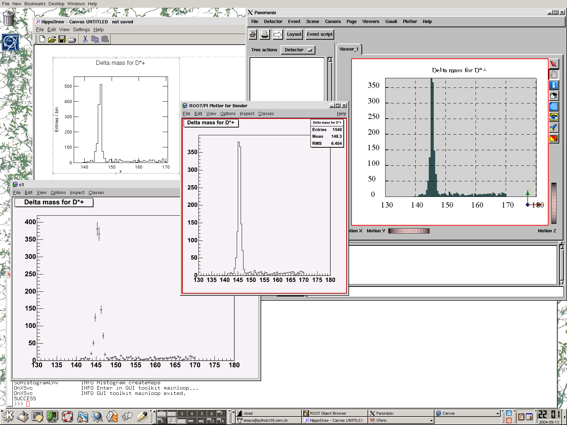
Everything can be combined
HippoDraw
Panoramix/LaJoconde
PI/ROOT
ROOT
Bender/Python prompt

Slide 38
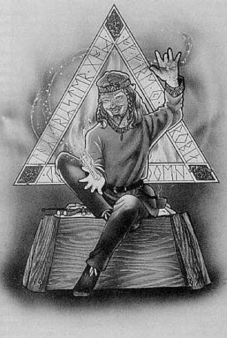


LoKi Bender
Loki is a god of wit and mischief in Norse mythology
Loops & Kinematics
Ostap Suleiman Berta Maria Bender-bei
The cult-hero of books by I.Il’f & E.Petrov: “The 12 chairs” ,“The golden calf”
The title: “The great schemer”
Attractive & brilliant cheater
Essential for successful and good physics analysis

