Slide 1
Van der Waals Force N-Body
Ian Bablewski
Kate Thurmer

Slide 2
What is Van der Waals?
The sum of the attractive and repulsive forces between two molecules other than the forces due to covalent, hydrogen and ionic bonds.
The Van der Waals force includes:
  The force between two permanent dipoles (Keesom force)
  The force between a permanent dipole and a corresponding induced dipole (Debye force)
  The force between two instantaneously introduced dipoles (London dispersion force)
http://en.wikipedia.org/wiki/Van_der_Waals_force

Slide 3
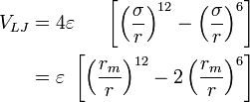
Lennard – Jones Potential
  This potential allows us to closely and efficiently approximate the Van der Waals force
  Where epsilon is the depth of the potential well, sigma is a finite distance at which the inter particle potential is zero and Rm the distance at which the potential is at its minimum.
http://en.wikipedia.org/wiki/Lennard-Jones_potential

Slide 4
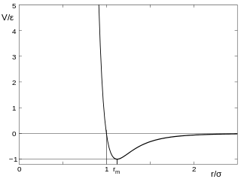
-This graph depicts the 6-12 Lennard- Jones potential as

Slide 5
As in every N-body simulation we are looking to efficiently calculate the force on each body (molecule) with respect to all others.
Force on each particle is calculated as the negative gradient of the 6-12 Lennard-Jones potential.

Slide 6
Basic Algorithm
Each iteration, compute position, velocity and acceleration of each body.
Basic algorithm accounts for the force on each body due to every other body.
  /* Compute Initial Forces */
  Compute_forces(param.npart,mol.x,mol.F);
  /* Each iteration, compute new position and speed for each body */
  for (i=0; I < ITERS; i++)
  {
  // Verlet Integration Part 1
  verletInt1(param.npart,param.dt , mol.x, mol.v,mol.a);
  // If a body is at the edge, reflect it
  box_reflect(param.npart,mol.x,mol.v,mol.a );
  // Compute force on each body due to each other body
  compute_forces(param.npart,mol.x,mol.F);
  // Verlet Integration Part 2
  verletInt2(param.npart,param.dt, mol.x, mol.v, mol.a);
  }

Slide 7
Verlet Integration
Computes position, velocity and acceleration for each body.
Excellent candidate for omp, since iterations are independent and do not share data.
  /* Verlet Integration Part 1: Estimates next position and velocity based on Taylor expansion */
  void verletInt1(int n, float dt, float* x, float* v, float* a) {
  int i =0;
  for(i = 0; i < n; i++)
    {
    v[2*i] = a[2*i] * dt/2.0;
    v[2*i+1] = a[2*i+1] * dt/2.0;
    x[2*i] = v[2*i] * dt;
    x[2*i+1] = v[2*i+1] * dt;
    }
  }
  /* Verlet Integration Part 2: Updates velocity and computes acceleration */
  void verletInt2(int n, float dt, float* x, float* v, float* a) {
  int v0,v1,i =0;
  for(i = 0; i < n; i++)
    {
    v0 = v[2*i];
    v1 = v[2*i+1];
    v[2*i] = a[2*i] * dt/2.0;
    v[2*i] = a[2*i+1] * dt/2.0;
    a[2*i] += (v[2*i]-v0)/dt;
    a[2*i+1] += (v[2*i+1]-v1)/dt;
    }
  }

Slide 8
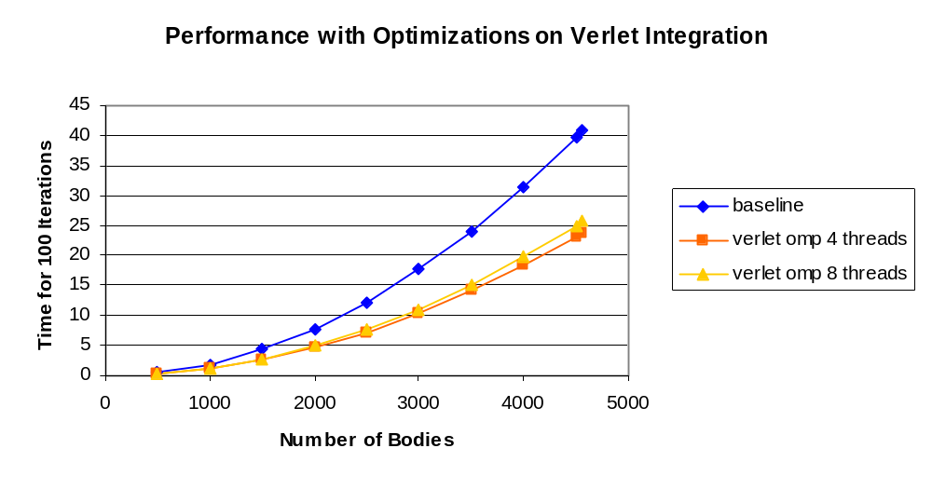
1.7x speedup using omp. Straighforward loops, no data sharing.

Slide 9
Box_reflect
Checks each body’s position; reflects bodies that have crossed an edge.
No data conflicts; each loop iteration is for a single body’s position and velocity.
Not much work done per iteration, since only a small fraction of the bodies will be at an edge.
Optimizations: replace multiplication with repeated addition, unroll the loop, omp.
  /* Box_Reflect: If a body hits the edge of the box, reflect it */
        /* Reverse velocity and acceleration */
        void reflect(float wall, float* x, float* v, float* a)
        {
        *x = (2*wall-(*x));
        *v = -(*v);
        *a = -(*a);
        }
        /* Checks every particle- if once crosses through a wall, reflect */
        void box_reflect(int n, float* x, float* v, float* a)
        {
        int i=0;
        for(i = 0; i < n; i++)
        {
        if(x[2*i] < XMIN) reflect(XMIN,&x[2*i],&v[2*i],&a[2*i]);
        if(x[2*i] > XMAX) reflect(XMAX,&x[2*i],&v[2*i],&a[2*i]);
        if(x[2*i+1] < YMIN) reflect(YMIN,&x[2*i+1],&v[2*i+1],&a[2*i+1]);
        if(x[2*i+1] > YMAX) reflect(YMAX,&x[2*i+1],&v[2*i+1],&a[2*i+1]);
        }
        }

Slide 10
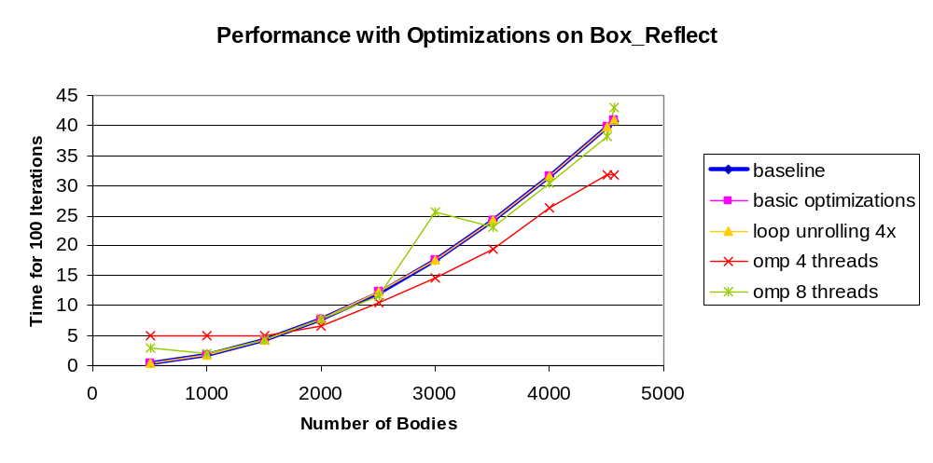
1.2x speedup using omp for larger body counts.
Substantial speedup was not expected since only a small fraction of the bodies will require reflection during a given iteration.

Slide 11
Compute_forces
Computes force of each body on each other body.
For each body, iterate over all other bodies and modify first body’s force.
Inefficient, O(n^2), but iterations are independent so it is easy to parallelize with omp.
        void compute_forces(int n, float* x, float* F)
        {
        int i,j;
        float eps = EPS;
        float sig = SIG;
        float sig2 = sig*sig;
        float dx,dy,lj_scalar;
        for(i = 0; i < n; i++) {
        for(j = 0; j < n; j++) {
        if(i!=j) {
        dx = x[2*j] - x[2*i];
        dy = x[2*j+1] - x[2*i+1];
        lj_scalar = compute_LJ_Scalar(dx*dx+dy*dy,eps,sig2);
        F[2*i] += lj_scalar * dx;
        F[2*i+1] += lj_scalar * dy;
        }
        }
        }
        }

Slide 12
Compute_forces Symmetry Optimization
Exploit the symmetry of the algorithm to cut the loop iterations in half.
Update force vector of both bodies at once, reversing sign for the second body.
Faster, but more complex to parallelize because multiple threads write to the same locations.
        void compute_forces(int n, float* x, float* F)
        {
        int i,j;
        float eps = EPS;
        float sig = SIG;
        float sig2 = sig*sig;
        float dx,dy,lj_scalar;
        for(i = 0; i < n; i++) {
        for(j = i+1; j < n; j++) // fewer iterations
        {
        dx = x[2*j] - x[2*i];
        dy = x[2*j+1] - x[2*i+1];
        lj_scalar = compute_LJ_Scalar(dx*dx+dy*dy,eps,sig2);
        F[2*i] += lj_scalar * dx;
        F[2*i+1] += lj_scalar * dy;
        // update force vector for j-body, reversing the sign
        F[2*j] - = lj_scalar * dx;
        F[2*j+1] - = lj_scalar * dy;
        }
        }
        }

Slide 13
Compute_forces Optimization with omp
based on http://www.cs.cornell.edu/~bindel/class/cs5220-s10/hw2code.pdf
Use temporary arrays to avoid write conflicts during computation.
Serial accumulation at the end kills performance.
        float** Ftemp = malloc(NUM_THREADS*sizeof(float*));
        for (i=0; i< NUM_THREADS; i++)
        Ftemp[i] = malloc(2*n*sizeof(float));
        omp_set_num_threads(NUM_THREADS);
        #pragma omp parallel shared(n,x,F) private(i,j,dx,dy,lj_scalar) {
        float* Ft = Ftemp[omp_get_thread_num()];
        memset(Ft,0,2*n*sizeof(float));
        #pragma omp parallel for schedule(static)
        for(i = 0; i < n; i++)
        for(j = i+1; j < n; j++) {
        dx = x[2*j] - x[2*i];
        dy = x[2*j+1] - x[2*i+1];
        lj_scalar = compute_LJ_Scalar(dx*dx+dy*dy,eps,sig2);
        Ft[2*i] += lj_scalar * dx;
        Ft[2*i+1] += lj_scalar * dy;
        Ft[2*j] -= lj_scalar * dx;
        Ft[2*j+1] -= lj_scalar * dy;
        }
        #pragma omp critical
        for (i=0; i<2*n; i++)
        F[i] += Ft[i];
        }
        for (i=0; i< NUM_THREADS; i++)
        free(Ftemp[i]);
        free(Ftemp); }

Slide 14
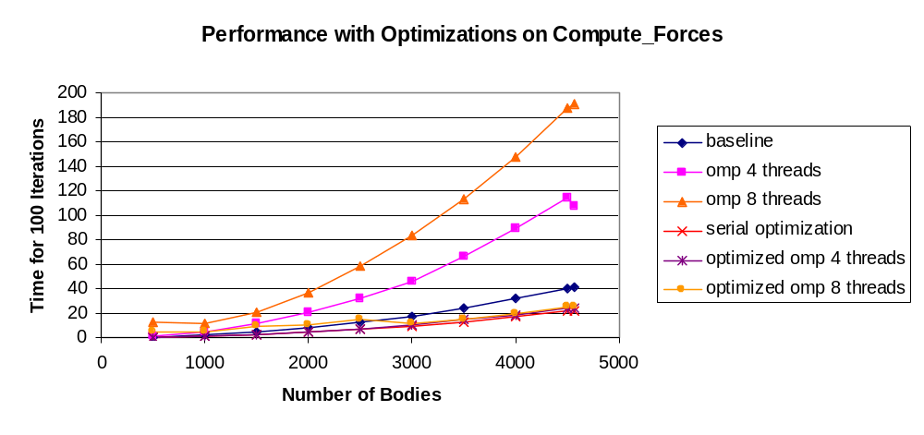
1.8x speedup using serial optimization.
Omp makes it worse for the basic function. Weird?
No additional omp improvement on serial optimization, likely due to serial accumulation at the end of the parallel section.

Slide 15
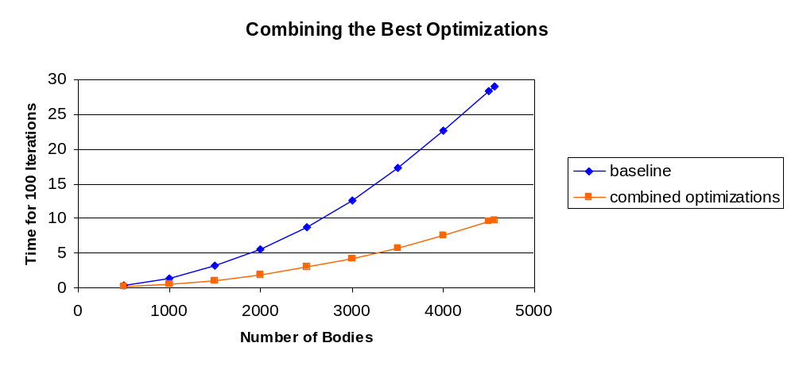
Dream Team:
  omp for box_reflect
  omp for Verlet integration
  Symmetry optimization for compute_forces
Overall 3x speedup.

Slide 16
An Alternative approach: Near Body Approximation
        int main(int argc, char** argv)
        {
        do loop{
  verletInt1(param.npart,param.dt , mol.x, mol.v,mol.a);
  box_reflect(param.npart,mol.x,mol.v,mol.a );
  compute_forces_nearby(param.npart,mol.x,mol.F);
  verletInt2(param.npart,param.dt, mol.x, mol.v, mol.a);
  resetGrid();
  gridSort(param.npart, mol.x);
        }
        }
        void gridSort(int n, float* pos)
        {
        for(i=0;i<n;i++){
        findMoleculePosition();
        recordMoleculePosition();
        }
        }

Slide 17
An Alternative approach: Near Body Approximation
- Only look at molecules adjacent to your very own position. The definition of the Lennar – Jones potential allows us to consider any particle greater than 2.5* sigma away to have zero force influence.
NO NEED TO CALCULATE
CALCULATE
R
If R > 2.5 Sigma we do not consider it a
candidate.

Slide 18
An Alternative approach: Near Body Approximation
Probabilistic maximum number of bodies per square
Benefits:
-We will most likely do may less computations
0
212
2
1
46
2
70
498
56
Store the index to position array
3
4
32
84
48
22
5
66
128
Costs:
We will have to do two memory fetches per calculation
Increase the space complexity of our traditional algorithm as trade off for time complexity
Probabilistic maximum number method allows a chance for a segmentation fault (yet to happen)
Both gridSort and compute_forces_nearby use extensive controls structures making branch prediction very difficult
6
368
7
0
8
402
9
98
8
10
444
238
172
11
12
13
98
14

Slide 19
An Alternative approach: Near Body Approximation
Possible Issues
Contiguous Access: Allowing for multiple cache hits
0
1
2
3
4
Random Access: Gives high number of cache misses
3
4
0
2
1
Does this algorithmic optimization give an improvement?
Serial: O(n^2) Optimized: O(n^2) NearBody: O(?)

Slide 20
An Alternative approach: Near Body Approximation
Insert graph her for first Near short
- Direct serial, serial opt , near compare
Discussion of whats happening in this graph

Slide 21
An Alternative approach: Near Body Approximation
Insert graph her for first Near long
- Direct serial, serial opt , near compare
Discussion of whats happening in this graph

Slide 22
An Alternative approach: Near Body Approximation
Insert graph her for near with flag optimizations
- Direct serial, serial opt , near compare
Discussion of whats happening in this graph

Slide 23
An Alternative approach: Near Body Approximation
Insert graph her for near with flag & threading optimizations
- Direct serial, serial opt , near compare
Discussion of whats happening in this graph

Slide 24
Performance Comparisons
Insert graph serial, opt, near → that shows the cycles per inner loop vs num bodies
- Note that we assume O(n^2) complexity
Discussion of whats happening in this graph

Slide 25
Performance Comparisons
Insert graph serial, opt, near → that shows the cycles per inner loop vs num bodies, LONG
- Note that we assume O(n^2) complexity
Discussion of whats happening in this graph

Slide 26
Performance Comparisons
Insert graph serial, opt, near → that shows the cycles per inner loop vs num bodies, -OFLAGS w normal for comparison
- Note that we assume O(n^2) complexity
Discussion of whats happening in this graph

Slide 27
Performance Comparisons
Insert graph serial, opt, near → that shows the cycles per inner loop vs num bodies, -OMP LONG
- Note that we assume O(n^2) complexity
Discussion of whats happening in this graph

