Slide 1
Gnome Sort
By: Ibad H.

Slide 2
What is Gnome Sort?
Also known as “Stupid Sort”
A very inefficient iteration of insertion sort
Moves each element to its correct slot
Inefficient because it has to recheck many pairs in the process of moving each element to the right slot regardless of the rest of the array
Big O notation of O(n²)
For each element of an array of length n, the sort must iterate through it once to move it to the correct spot and then repeat that process for every element
Meaning as the length of the inputted array grows, the processing time quadratically increases

Slide 3
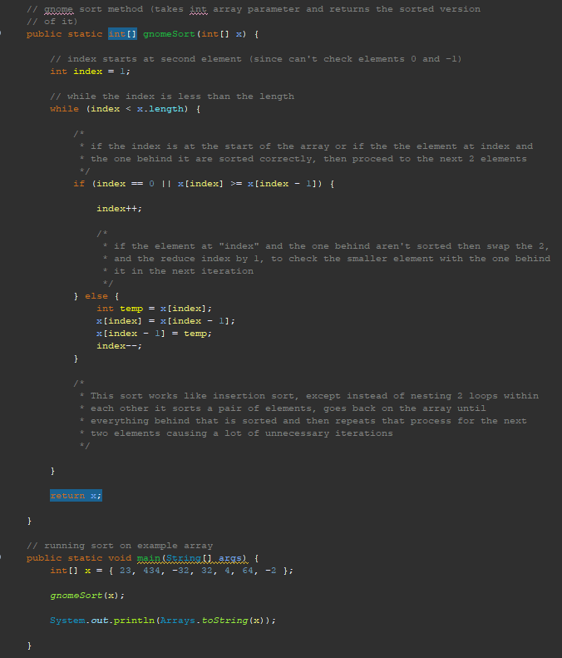
Coded Example

Slide 4
Working Example
Example Array: [6, 3, 5, 8, 2]
*Blue are the two elements in focus, underlined elements are element at array[index]
[6, 3, 5, 8, 2] swaps 6 and 3, goes back
[3, 6, 5, 8, 2] 3 is at the start so go forward
[3, 6, 5, 8, 2] 6 and 3 are correct, goes forward
[3, 6, 5, 8, 2] swaps 6 and 5, goes back
[3, 5, 6, 8, 2] 5 and 3 are correct, goes forward
[3, 5, 6, 8, 2] 6 and 5 are correct, goes forward
[3, 5, 6, 8, 2] 8 and 6 are correct, goes forward
[3, 5, 6, 8, 2] swaps 2 and 8, goes back
[3, 5, 6, 2, 8] swaps 2 and 6, goes back
[3, 5, 2, 6, 8] swaps 2 and 5, goes back
[3, 2, 5, 6, 8] swaps 2 and 3, goes back
[2, 3, 5, 6, 8] 2 is at the start so go forward
[2, 3, 5, 6, 8] 3 and 2 are correct, goes forward
[2, 3, 5, 6, 8] 5 and 3 are correct, goes forward
[2, 3, 5, 6, 8] 6 and 5 are correct, goes forward
[2, 3, 5, 6, 8] 8 and 6 are correct, goes forward

Slide 5
References
What is the average big-Ο complexity of Gnome Sort?. Stack Overflow. (1956, March 1). https://stackoverflow.com/questions/2066541/what-is-the-average-big-%CE%9F-complexity-of-gnome-sort#:~:text=An%20element%20in%20the%20middle,O(n%20*%20n)%20.
GeeksforGeeks. (2023, January 10). Gnome Sort. GeeksforGeeks. https://www.geeksforgeeks.org/gnome-sort-a-stupid-one/
Team, A. (2023, June 15). Gnome Sort. Altcademy Blog. https://www.altcademy.com/blog/gnome-sort/
YouTube. (2016, September 27). Big O notation. YouTube. https://www.youtube.com/watch?v=v4cd1O4zkGw

