Slide 1

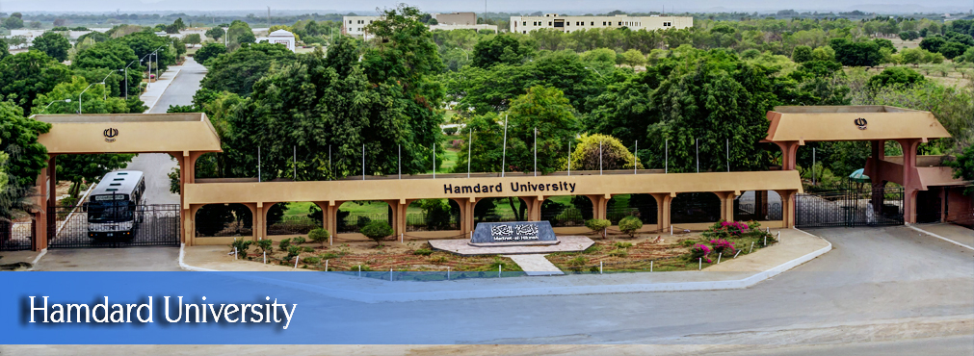
FYP
Proposal
Project Name here
Students name here
Student # 2
Student # 3
Supervisor name here
Hamdard University

Slide 2
Summary
Group Introduction
Problem Statement
FYP Scope
Our methodology
Our Project Plan (Time lines)
Budget / Costing (if any)
Project tools (or H/W required
FYP Deliverables
References
Can have
maximum 20 slides

Slide 3
Group Introduction
Mention name of students here
Student # 1
Student # 2
Your supervisor name here
Explain why you selected him/her as your supervisor ?
Relevant Expertise
Relevant Experience

Slide 4
1- Problem Statement
Define the problem you have observed in 2-3 sentences
FYP Objectives
Why are you doing this project?
What is your motivation ?

Slide 5
2- FYP Scope
Can have
3-4 slides not more
Explain with the help of diagrams and text what is included in the project scope
Clearly mention what is included and what is excluded in your FYP Scope
This will be judged in your final defense (and report)
what was scope and
what is delivered.

Slide 6
3- Our Methodology
Can have
2-3 slides not more
Project Approach (Waterfall/Agile etc)
Team Role & responsibilities

Slide 7
4- Our Project Plan
Plan your activities with discussion among team members
List of all tasks your will perform
Start Date and End Date
Allocation of resource on each task

Slide 8
5- Project tools (or Hardware required)
List any tool required
Dotnet / Java
SQL / Oracle
MS-Office
MS-Project
Hardware requirements (if any)

Slide 9
6- Budget / Costing
Mention the budgeting cost of each item (if any)
Total cost Rs.

Slide 10
7- FYP Deliverables
Mention the project deliverables such as
Requirements documentation
Design Documents (ERD, design etc )
Running software application
Software code in CD

Slide 11
8- Reference
Use Chicago style of referencing
Examples
Book reference
Pollan, Michael. The Omnivore’s Dilemma: A Natural History of Four Meals. New York: Penguin, 2006.
Website reference
Google. “Google Privacy Policy.” Last modified March 11, 2009. http://www.google.com/intl/en/privacypolicy.html.
McDonald’s Corporation. “McDonald’s Happy Meal Toy Safety Facts.” Accessed July 19, 2008. http://www.mcdonalds.com/corp/about/factsheets.html.
Journal reference
Weinstein, Joshua I. “The Market in Plato’s Republic.” Classical Philology 104 (2009): 439–58.

