Slide 1
Languages
Costas Busch - LSU

Slide 2
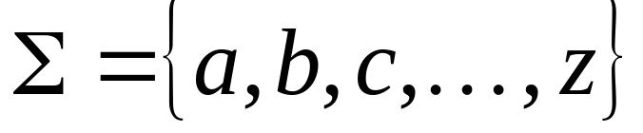
Language: a set of strings
String: a sequence of symbols
from some alphabet
Example:
Strings: cat, dog, house
Language: {cat, dog, house}
Alphabet:
Costas Busch - LSU

Slide 3
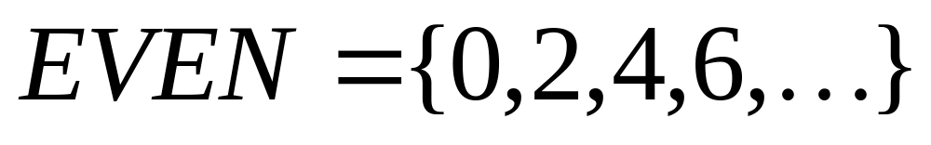
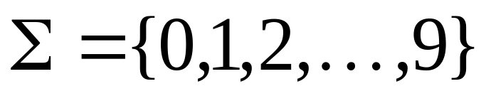
Languages are used to describe
computation problems:
Alphabet:
Costas Busch - LSU

Slide 4

Computation is translated to set membership
Example computation problem:
Is number prime?
Equivalent set membership problem:
Costas Busch - LSU

Slide 5

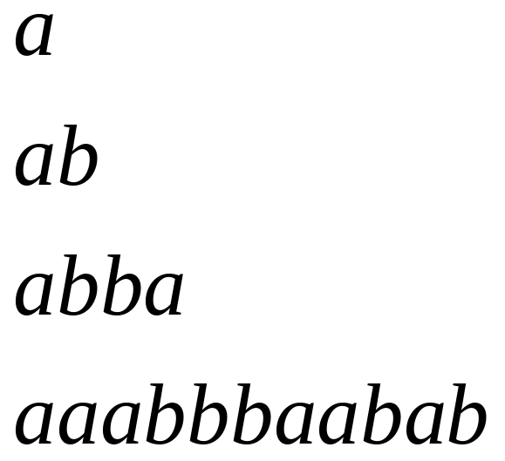
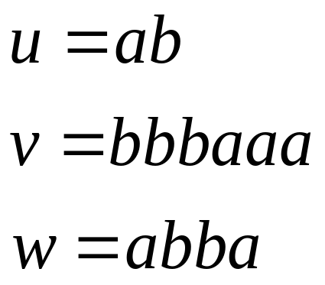
Alphabets and Strings
An alphabet is a set of symbols
Example Alphabet:
A string is a sequence of
symbols from the alphabet
String variables
Example Strings
Costas Busch - LSU

Slide 6
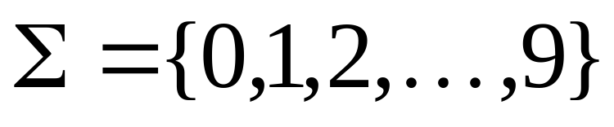
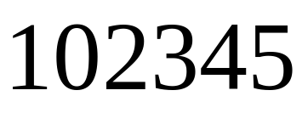
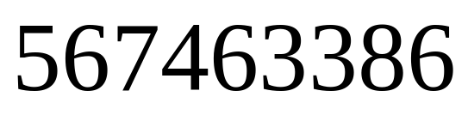
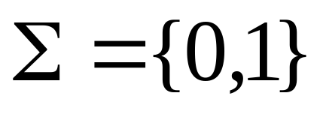

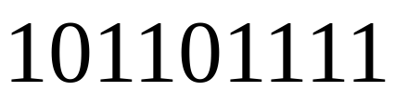
Decimal numbers alphabet
Binary numbers alphabet
Costas Busch - LSU

Slide 7
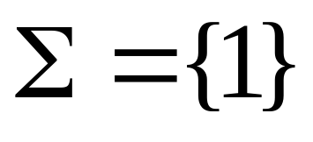

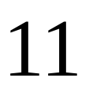
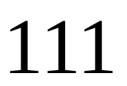
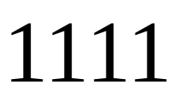





Unary numbers alphabet
Unary number:
Decimal number:
Costas Busch - LSU

Slide 8
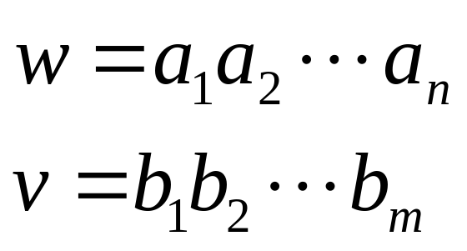
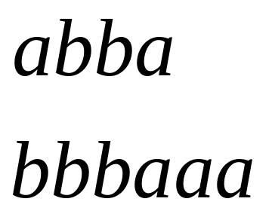
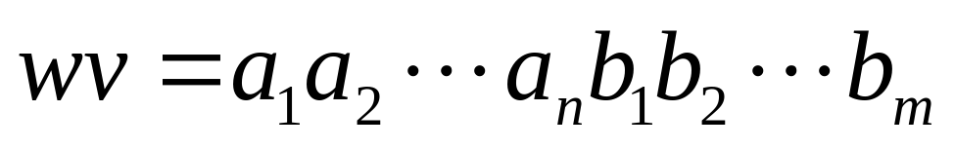
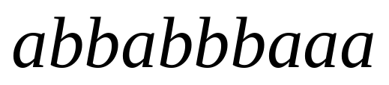
String Operations
Concatenation
Costas Busch - LSU

Slide 9




Reverse
Costas Busch - LSU

Slide 10


String Length
Length:
Examples:
Costas Busch - LSU

Slide 11


Length of Concatenation
Example:
Costas Busch - LSU

Slide 12
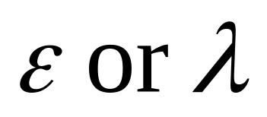
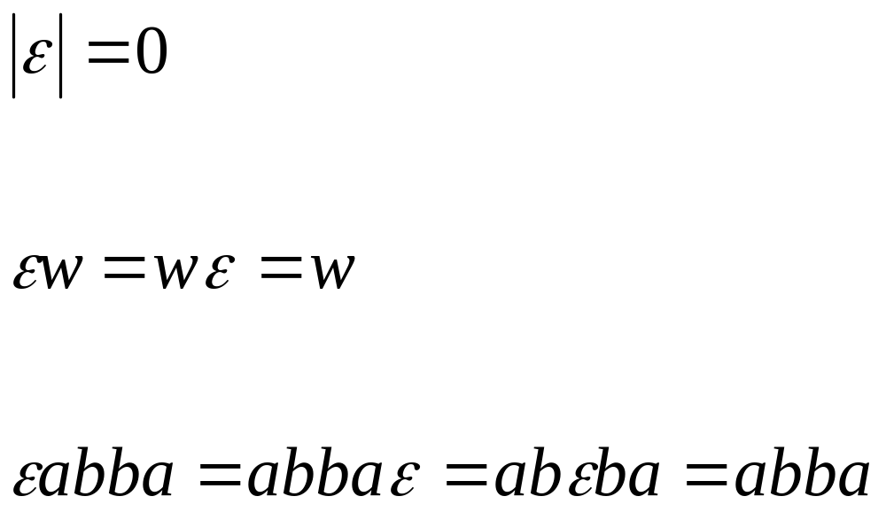
Empty String
A string with no letters is denoted:
Acts as a neutral element
Observations:
Costas Busch - LSU

Slide 13


Substring
Substring of string:
  a subsequence of consecutive characters
String Substring
Costas Busch - LSU

Slide 14

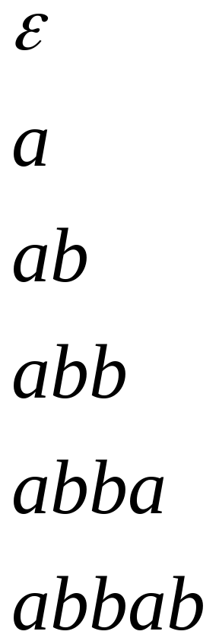
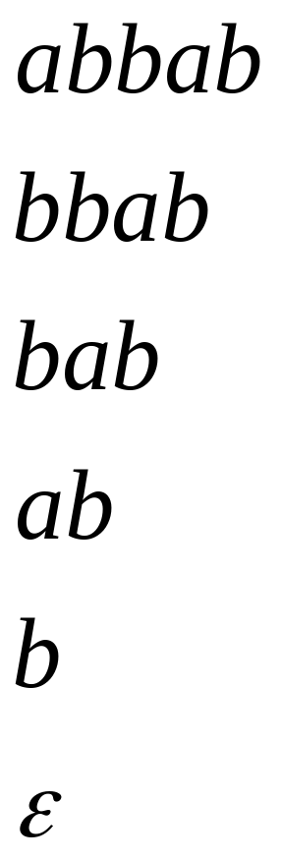

Prefix and Suffix
Prefixes Suffixes
string
prefix
suffix
Costas Busch - LSU

Slide 15


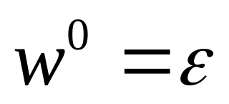
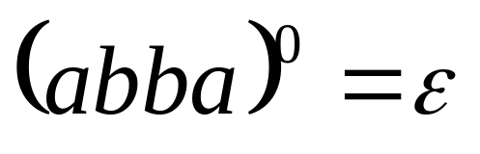
Exponent Operation
Example:
Definition:
Costas Busch - LSU

Slide 16


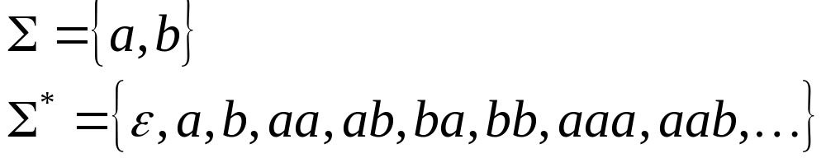
The * Operation
: the set of all possible strings from
alphabet
Costas Busch - LSU

Slide 17



The + Operation
: the set of all possible strings from
alphabet except
Costas Busch - LSU

Slide 18

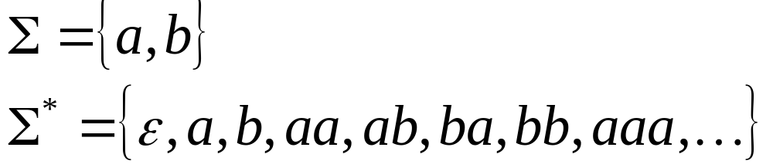
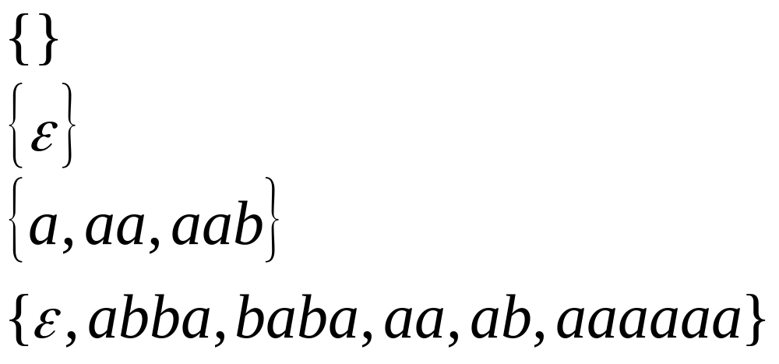
Languages
A language over alphabet
is any subset of
Example:
Languages:
Costas Busch - LSU

Slide 19
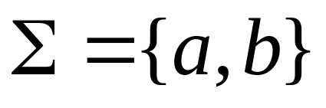
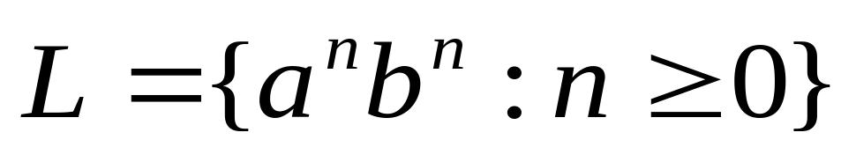
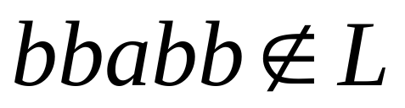
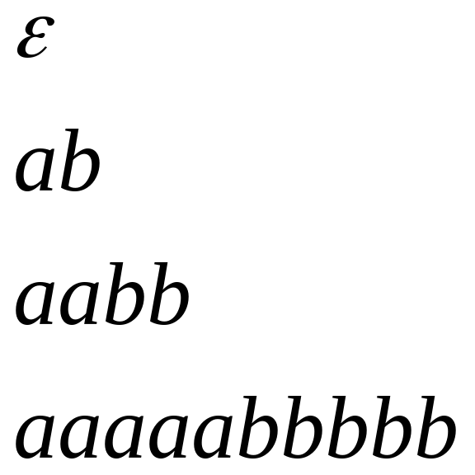
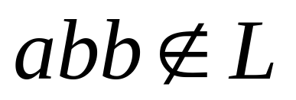

More Language Examples
An infinite language
Alphabet
Costas Busch - LSU

Slide 20
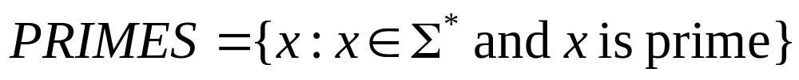

Prime numbers
Numbers divisible by 1 and itself
Alphabet
Language:
Costas Busch - LSU

Slide 21

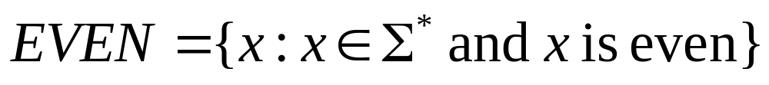
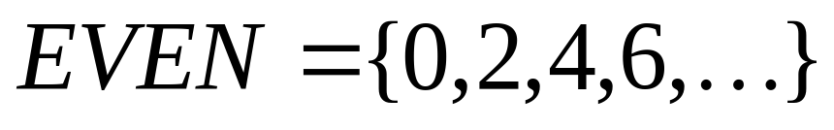
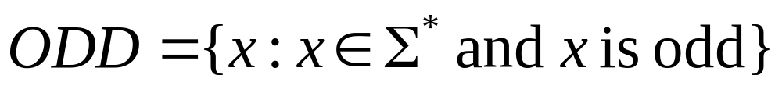
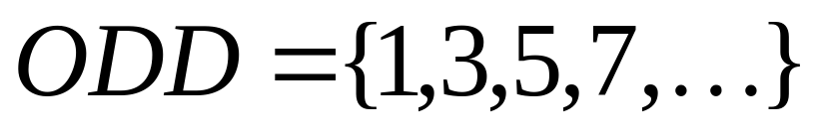
Even and odd numbers
Alphabet
Languages:
Costas Busch - LSU

Slide 22
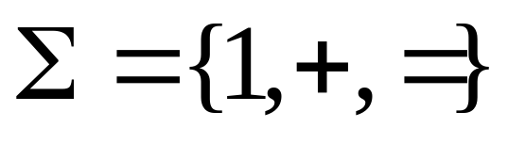
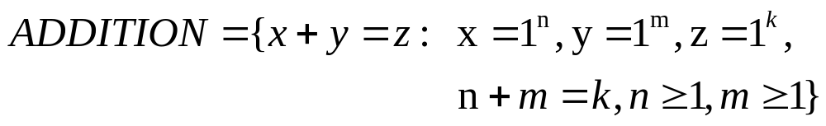
Addition (of unary numbers)
Alphabet:
Language:
Costas Busch - LSU

Slide 23


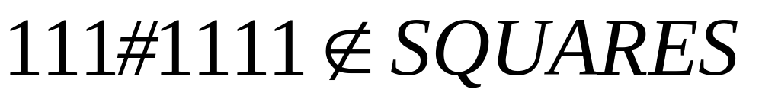
Squares (of unary numbers)
Alphabet:
Language:
Costas Busch - LSU

Slide 24

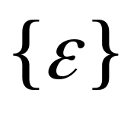
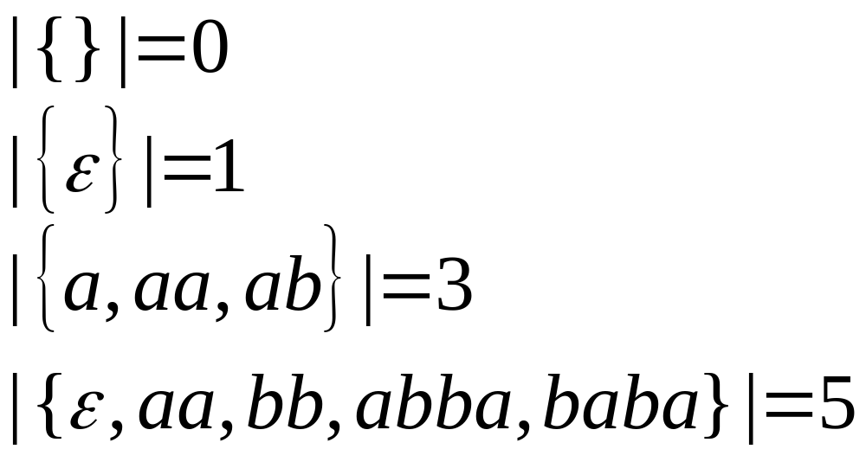
Two special languages
Language with
empty string
Empty language
Size of a language (number of elements):
Costas Busch - LSU

Slide 25
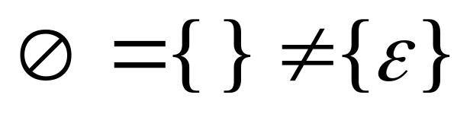

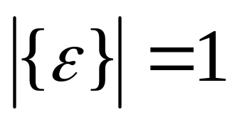
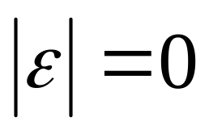
Note that:
Sets
Set size
Set size
String length
Costas Busch - LSU

Slide 26
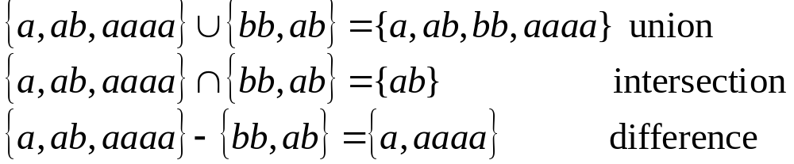
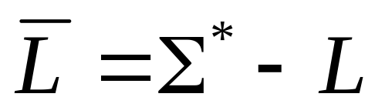
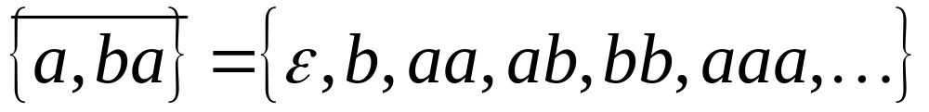
Operations on Languages
The usual set operations:
Complement:
Costas Busch - LSU

Slide 27



Reverse
Definition:
Examples:
Costas Busch - LSU

Slide 28


Concatenation
Definition:
Example:
Costas Busch - LSU

Slide 29


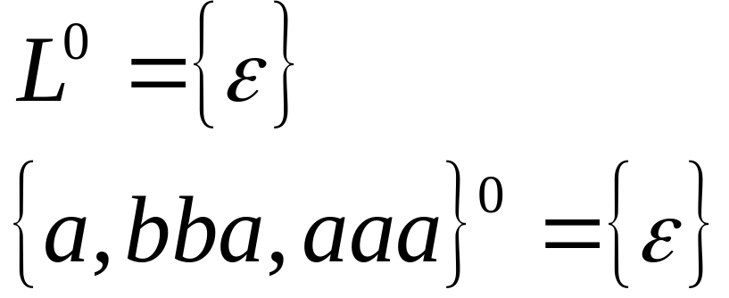
Another Operation
Definition:
Special case:
Costas Busch - LSU

Slide 30



Example
Costas Busch - LSU

Slide 31
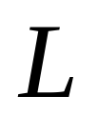






Star-Closure (Kleene *)
All strings that can be constructed from
Definition:
Example:
Costas Busch - LSU

Slide 32



Positive Closure
Definition:
Note that:
Costas Busch - LSU

