Slide 1
Week 3

Slide 2
Alternate Approaches for
Hiding Memory Latency
Consider the problem of browsing the web on a very slow network connection. We deal with the problem in one of three possible ways:
  we anticipate which pages we are going to browse ahead of time and issue requests for them in advance;
  we open multiple browsers and access different pages in each browser, thus while we are waiting for one page to load, we could be reading others; or
  we access a whole bunch of pages in one go - amortizing the latency across various accesses.
The first approach is called prefetching, the second multithreading, and the third one corresponds to spatial locality in accessing memory words.

Slide 3
Multithreading for Latency Hiding
A thread is a single stream of control in the flow of a program.
We illustrate threads with a simple example:
for (i = 0; i < n; i++)
c[i] = dot_product(get_row(a, i), b);
Each dot-product is independent of the other, and therefore represents a concurrent unit of execution. We can safely rewrite the above code segment as:
for (i = 0; i < n; i++)
c[i] = create_thread(dot_product,get_row(a, i), b);

Slide 4
Multithreading for Latency Hiding: Example
In the code, the first instance of this function accesses a pair of vector elements and waits for them.
In the meantime, the second instance of this function can access two other vector elements in the next cycle, and so on.
After l units of time, where l is the latency of the memory system, the first function instance gets the requested data from memory and can perform the required computation.
In the next cycle, the data items for the next function instance arrive, and so on. In this way, in every clock cycle, we can perform a computation.

Slide 5
Multithreading for Latency Hiding
The execution schedule in the previous example is predicated upon two assumptions: the memory system is capable of servicing multiple outstanding requests, and the processor is capable of switching threads at every cycle.
It also requires the program to have an explicit specification of concurrency in the form of threads.
Machines such as the HEP and Tera rely on multithreaded processors that can switch the context of execution in every cycle. Consequently, they are able to hide latency effectively.

Slide 6
Prefetching for Latency Hiding
Misses on loads cause programs to stall.
Why not advance the loads so that by the time the data is actually needed, it is already there!
The only drawback is that you might need more space to store advanced loads.
However, if the advanced loads are overwritten, we are no worse than before!

Slide 7
Tradeoffs of Multithreading and Prefetching
Multithreading and prefetching are critically impacted by the memory bandwidth. Consider the following example:
  Consider a computation running on a machine with a 1 GHz clock, 4-word cache line, single cycle access to the cache, and 100 ns latency to DRAM. The computation has a cache hit ratio at 1 KB of 25% and at 32 KB of 90%. Consider two cases: first, a single threaded execution in which the entire cache is available to the serial context, and second, a multithreaded execution with 32 threads where each thread has a cache residency of 1 KB.
  If the computation makes one data request in every cycle of 1 ns, you may notice that the first scenario requires 400MB/s of memory bandwidth and the second, 3GB/s.

Slide 8
Tradeoffs of Multithreading and Prefetching
Bandwidth requirements of a multithreaded system may increase very significantly because of the smaller cache residency of each thread.
Multithreaded systems become bandwidth bound instead of latency bound.
Multithreading and prefetching only address the latency problem and may often exacerbate the bandwidth problem.
Multithreading and prefetching also require significantly more hardware resources in the form of storage.

Slide 9
Interconnection Networks for Parallel Computers
Interconnection networks carry data between processors and to memory.
Interconnects are made of switches and links (wires, fiber).
Interconnects are classified as static or dynamic.
Static networks consist of point-to-point communication links among processing nodes and are also referred to as direct networks.
Dynamic networks are built using switches and communication links. Dynamic networks are also referred to as indirect networks.
2.4.2 Interconnection Networks for Parallel Computers Page no. 43 of book.

Slide 10
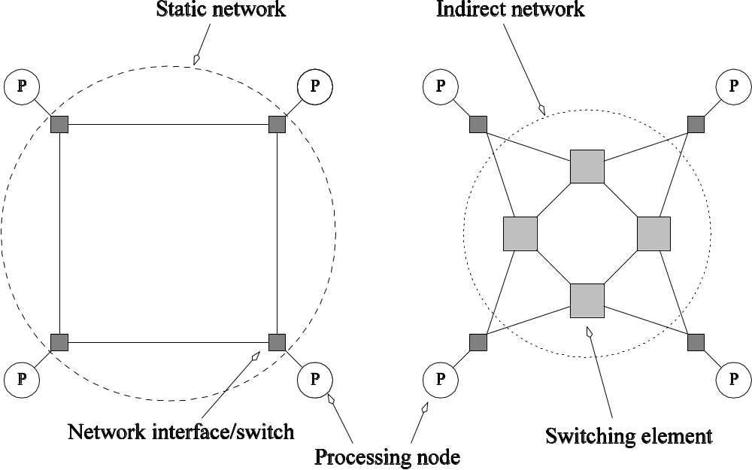
Static and Dynamic
Interconnection Networks
Classification of interconnection networks: (a) a static network; and (b) a dynamic network.

Slide 11
Interconnection Networks
Switches map a fixed number of inputs to outputs.
The total number of ports on a switch is the degree of the switch.
The cost of a switch grows as the square of the degree of the switch, the peripheral hardware linearly as the degree, and the packaging costs linearly as the number of pins.

Slide 12
Interconnection Networks:
Network Interfaces
Processors talk to the network via a network interface.
The network interface may hang off the I/O bus or the memory bus.
In a physical sense, this distinguishes a cluster from a tightly coupled multicomputer.
The relative speeds of the I/O and memory buses impact the performance of the network.

Slide 13
Network Topologies
A variety of network topologies have been proposed and implemented.
These topologies tradeoff performance for cost.
Commercial machines often implement hybrids of multiple topologies for reasons of packaging, cost, and available components.

Slide 14
Network Topologies: Buses
Some of the simplest and earliest parallel machines used buses.
All processors access a common bus for exchanging data.
The distance between any two nodes is O(1) in a bus. The bus also provides a convenient broadcast media.
However, the bandwidth of the shared bus is a major bottleneck.
Typical bus based machines are limited to dozens of nodes. Sun Enterprise servers and Intel Pentium based shared-bus multiprocessors are examples of such architectures.

Slide 15
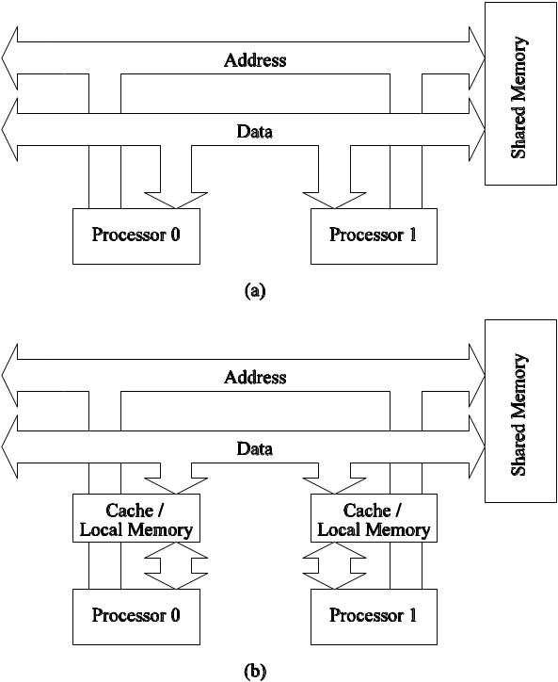
Network Topologies: Buses
Bus-based interconnects (a) with no local caches; (b) with local memory/caches.
Since much of the data accessed by processors is local to the processor, a local memory can improve the performance of bus-based machines.

Slide 16
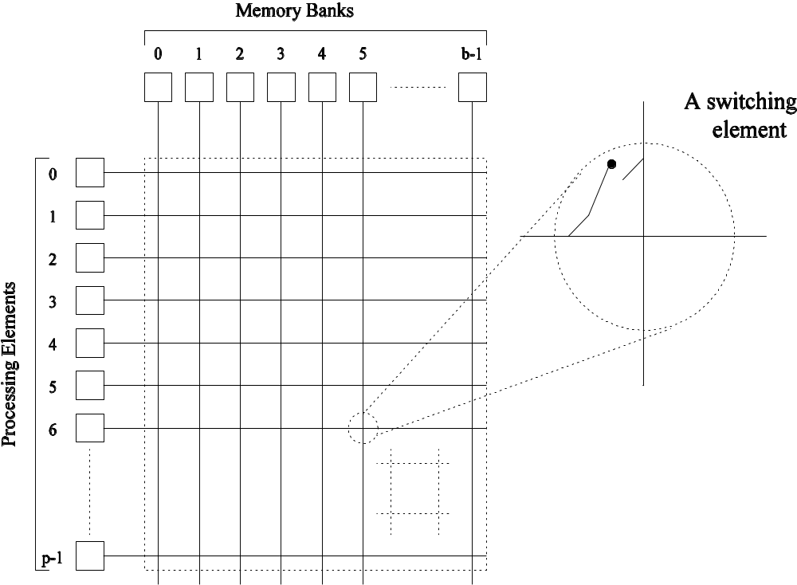
Network Topologies: Crossbars
A crossbar network uses an p×m grid of switches to connect p inputs to m outputs in a non-blocking manner.
A completely non-blocking crossbar network connecting p processors to b memory banks.

Slide 17
Network Topologies: Crossbars
The cost of a crossbar of p processors grows as O(p²).
This is generally difficult to scale for large values of p.
Examples of machines that employ crossbars include the Sun Ultra HPC 10000 and the Fujitsu VPP500.

Slide 18
Message Passing Costs in
Parallel Computers
The total time to transfer a message over a network comprises of the following:
  Startup time (t_{s}): Time spent at sending and receiving nodes (executing the routing algorithm, programming routers, etc.).
  Per-hop time (t_{h}): This time is a function of number of hops and includes factors such as switch latencies, network delays, etc.
  Per-word transfer time (t_{w}): This time includes all overheads that are determined by the length of the message. This includes bandwidth of links, error checking and correction, etc.
Notes:
Startup time (ts): The startup time is the time required to handle a message at the sending and receiving nodes. This includes the time to prepare the message (adding header, trailer, and error correction information), the time to execute the routing algorithm, and the time to establish an interface between the local node and the router. This delay is incurred only once for a single message transfer.
Per-hop time (th): After a message leaves a node, it takes a finite amount of time to reach the next node in its path. The time taken by the header of a message to travel between two directly-connected nodes in the network is called the per-hop time. It is also known as node latency. The per-hop time is directly related to the latency within the routing switch for determining which output buffer or channel the message should be forwarded to.
Per-word transfer time (tw): If the channel bandwidth is r words per second, then each word takes time tw = 1/r to traverse the link. This time is called the per-word transfer time. This time includes network as well as buffering overheads.

Slide 19
Principles of Parallel Algorithm Design
Ananth Grama, Anshul Gupta, George Karypis, and Vipin Kumar
To accompany the text “Introduction to Parallel Computing”,
Addison Wesley, 2003.

Slide 20
Preliminaries: Decomposition, Tasks, and
Dependency Graphs
The first step in developing a parallel algorithm is to decompose the problem into tasks that can be executed concurrently
A given problem may be docomposed into tasks in many different ways.
Tasks may be of same, different, or even interminate sizes.
A decomposition can be illustrated in the form of a directed graph with nodes corresponding to tasks and edges indicating that the result of one task is required for processing the next. Such a graph is called a task dependency graph.
Notes:
Algorithm development is a critical component of problem solving using computers. A sequential
algorithm is essentially a recipe or a sequence of basic steps for solving a given problem using a
serial computer. Similarly, a parallel algorithm is a recipe that tells us how to solve a given
problem using multiple processors. However, specifying a parallel algorithm involves more than
just specifying the steps. At the very least, a parallel algorithm has the added dimension of
concurrency and the algorithm designer must specify sets of steps that can be executed
simultaneously. This is essential for obtaining any performance benefit from the use of a parallel
computer. In practice, specifying a nontrivial parallel algorithm may include some or all of the
following:
Identifying portions of the work that can be performed concurrently.
Mapping the concurrent pieces of work onto multiple processes running in parallel.
Distributing the input, output, and intermediate data associated with the program.
Managing accesses to data shared by multiple processors.
Synchronizing the processors at various stages of the parallel program execution.

Slide 21
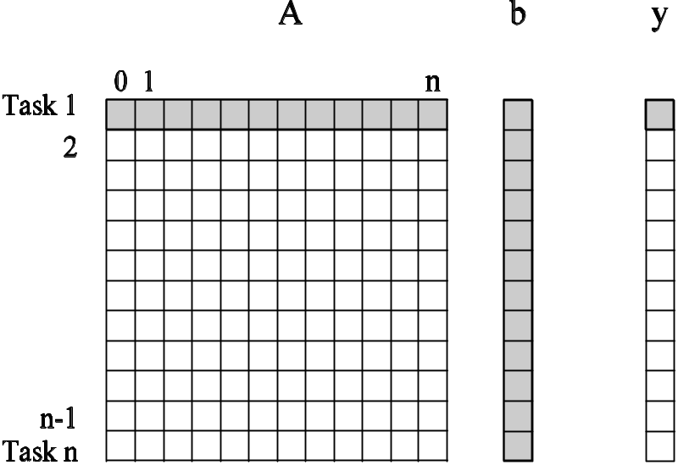
Example: Multiplying a Dense Matrix with a Vector
Computation of each element of output vector y is independent of other elements. Based on this, a dense matrix-vector product can be decomposed into n tasks. The figure highlights the portion of the matrix and vector accessed by Task 1.
Observations: While tasks share data (namely, the vector b ), they do not have any control dependencies - i.e., no task needs to wait for the (partial) completion of any other. All tasks are of the same size in terms of number of operations. Is this the maximum number of tasks we could decompose this problem into?

Slide 22
Example: Database Query Processing
Consider the execution of the query:
MODEL = ``CIVIC'' AND YEAR = 2001 AND
(COLOR = ``GREEN'' OR COLOR = ``WHITE)
on the following database:
ID# | Model | Year | Color | Dealer | Price
4523 | Civic | 2002 | Blue | MN | $18,000
3476 | Corolla | 1999 | White | IL | $15,000
7623 | Camry | 2001 | Green | NY | $21,000
9834 | Prius | 2001 | Green | CA | $18,000
6734 | Civic | 2001 | White | OR | $17,000
5342 | Altima | 2001 | Green | FL | $19,000
3845 | Maxima | 2001 | Blue | NY | $22,000
8354 | Accord | 2000 | Green | VT | $18,000
4395 | Civic | 2001 | Red | CA | $17,000
7352 | Civic | 2002 | Red | WA | $18,000

Slide 23
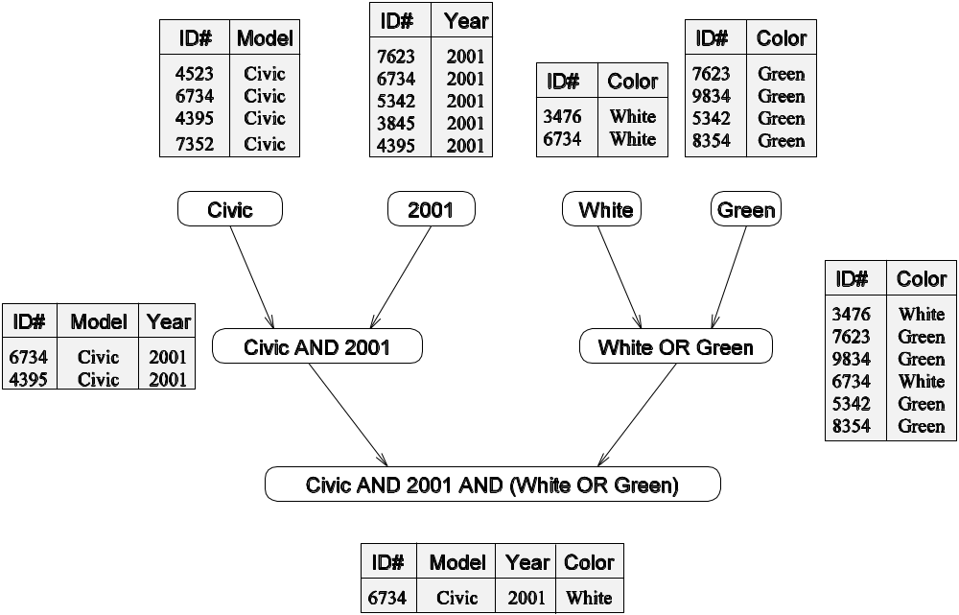
Example: Database Query Processing
The execution of the query can be divided into subtasks in various
ways. Each task can be thought of as generating an intermediate
table of entries that satisfy a particular clause.
Decomposing the given query into a number of tasks.
Edges in this graph denote that the output of one task
is needed to accomplish the next.
Notes:
Each node in this figure is a task that corresponds to an intermediate table that needs to be computed and the arrows between nodes indicate dependencies between the tasks. For example, before we can compute the table that corresponds to the 2001 Civics, we must first compute the table of all the Civics and a table of all the 2001-model cars.

Slide 24
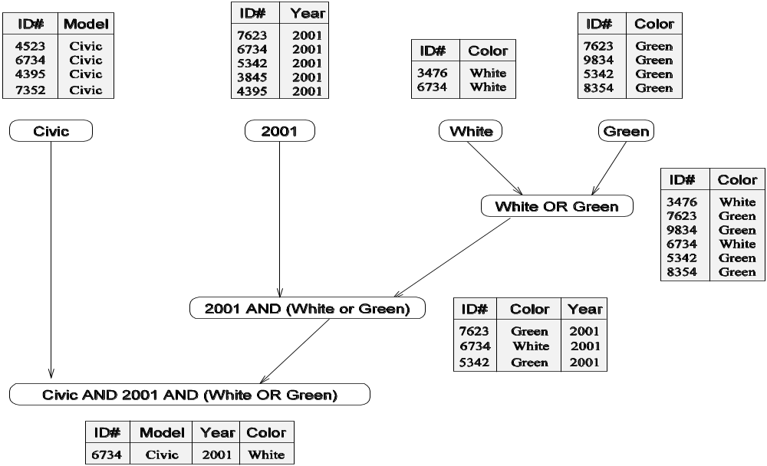
Example: Database Query Processing
Note that the same problem can be decomposed into subtasks in other
ways as well.
An alternate decomposition of the given problem into
subtasks, along with their data dependencies.
Different task decompositions may lead to significant differences with
respect to their eventual parallel performance.
Notes:
For instance, the database query in Example 3.2 can be solved by first computing a table of all green or white cars, then performing an intersection with a table of all 2001 model cars, and finally combining the results with the table of all Civics. This sequence of computation results in the task-dependency graph shown in Figure 3.3.

Slide 25
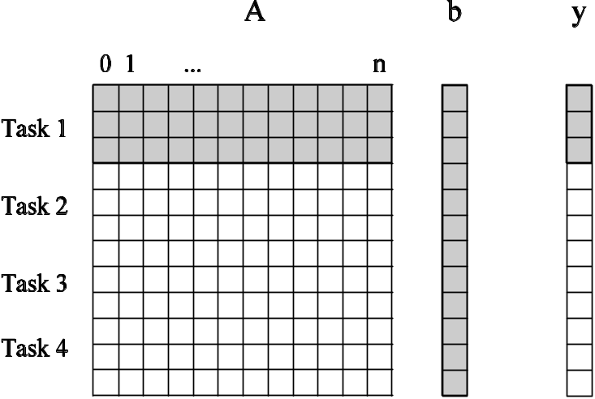
Granularity of Task Decompositions
The number of tasks into which a problem is decomposed determines its granularity.
Decomposition into a large number of tasks results in fine-grained decomposition and that into a small number of tasks results in a coarse grained decomposition.
A coarse grained counterpart to the dense matrix-vector product example. Each task in this example corresponds to the computation of three elements of the result vector.
Notes:
For example, the decomposition for matrix-vector multiplication shown in Figure 3.1 would usually be considered fine-grained because each of a large number of tasks performs a single dot-product. Figure 3.4 shows a coarse-grained decomposition of the same problem into four tasks, where each tasks computes n/4 of the entries of the output vector of length n.

Slide 26
Degree of Concurrency
The number of tasks that can be executed in parallel is the degree of concurrency of a decomposition.
Since the number of tasks that can be executed in parallel may change over program execution, the maximum degree of concurrency is the maximum number of such tasks at any point during execution. What is the maximum degree of concurrency of the database query examples?
The average degree of concurrency is the average number of tasks that can be processed in parallel over the execution of the program. Assuming that each tasks in the database example takes identical processing time, what is the average degree of concurrency in each decomposition?
Average Degree of Concurrency = Total Amount of Work / Critical Path Length
The degree of concurrency increases as the decomposition becomes finer in granularity and vice versa.
Notes:
-In most cases, the maximum degree of concurrency is less than the total number of tasks due to dependencies among the tasks. For example, the maximum degree of concurrency in the task-graphs of Figures 3.2 and 3.3 is four.
-In these task-graphs, maximum concurrency is available right at the beginning when tables for Model, Year, Color Green, and Color White can be computed simultaneously. In general, for task dependency graphs that are trees, the maximum degree of concurrency is always equal to the number of leaves in the tree.
-Both the maximum and the average degrees of concurrency usually increase as the granularity of tasks becomes smaller (finer). For example, the decomposition of matrix-vector multiplication shown in Figure 3.1 has a fairly small granularity and a large degree of concurrency. The decomposition for the same problem shown in Figure 3.4 has a larger granularity and a smaller degree of concurrency.
-The average degree of concurrency of the task graph in Figure 3.5(a) is 2.33 and that of the task graph in Figure 3.5(b) is 1.88 (Problem 3.1), although both task-dependency graphs are based on the same decomposition.

Slide 27
Critical Path Length
A directed path in the task dependency graph represents a sequence of tasks that must be processed one after the other.
The longest such path determines the shortest time in which the program can be executed in parallel.
The length of the longest path in a task dependency graph is called the critical path length.

Slide 28
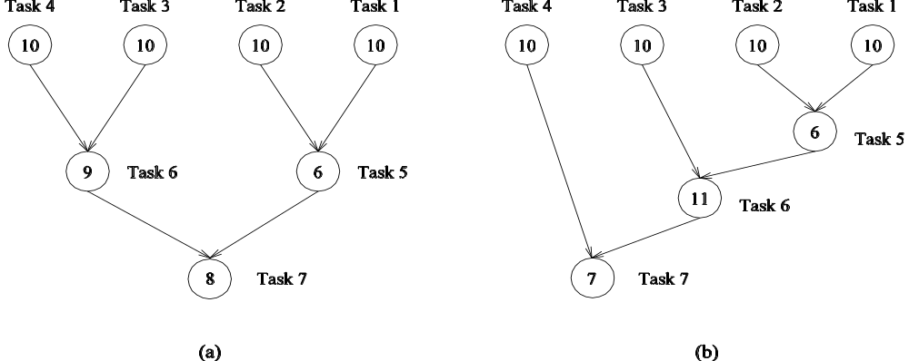
Critical Path Length
Consider the task dependency graphs of the two database query
decompositions:
What are the critical path lengths for the two task dependency graphs?
If each task takes 10 time units, what is the shortest parallel execution time
for each decomposition? How many processors are needed in each case to
achieve this minimum parallel execution time? What is the maximum
degree of concurrency?

