Slide 1
Programming Using the
Message Passing Paradigm
Ananth Grama, Anshul Gupta,
George Karypis, and Vipin Kumar
To accompany the text ``Introduction to Parallel Computing'',
Addison Wesley, 2003.

Slide 2
Topic Overview
Principles of Message-Passing Programming
The Building Blocks: Send and Receive Operations
MPI: the Message Passing Interface
Topologies and Embedding
Overlapping Communication with Computation
Collective Communication and Computation Operations
Groups and Communicators

Slide 3
Principles of
Message-Passing Programming
The logical view of a machine supporting the message-passing paradigm consists of p processes, each with its own exclusive address space.
Each data element must belong to one of the partitions of the space; hence, data must be explicitly partitioned and placed.
All interactions (read-only or read/write) require cooperation of two processes - the process that has the data and the process that wants to access the data.
These two constraints, while onerous, make underlying costs very explicit to the programmer.

Slide 4
Principles of
Message-Passing Programming
Message-passing programs are often written using the asynchronous or loosely synchronous paradigms.
In the asynchronous paradigm, all concurrent tasks execute asynchronously.
In the loosely synchronous model, tasks or subsets of tasks synchronize to perform interactions. Between these interactions, tasks execute completely asynchronously.
Most message-passing programs are written using the single program multiple data (SPMD) model.

Slide 5
The Building Blocks:
Send and Receive Operations
The prototypes of these operations are as follows:
send(void *sendbuf, int nelems, int dest)
receive(void *recvbuf, int nelems, int source)
Consider the following code segments:
P0 P1
a = 100; receive(&a, 1, 0)
send(&a, 1, 1); printf("%d\n", a);
a = 0;
The semantics of the send operation require that the value received by process P1 must be 100 as opposed to 0.
This motivates the design of the send and receive protocols.

Slide 6
Non-Buffered Blocking
Message Passing Operations
A simple method for forcing send/receive semantics is for the send operation to return only when it is safe to do so.
In the non-buffered blocking send, the operation does not return until the matching receive has been encountered at the receiving process.
Idling and deadlocks are major issues with non-buffered blocking sends.
In buffered blocking sends, the sender simply copies the data into the designated buffer and returns after the copy operation has been completed. The data is copied at a buffer at the receiving end as well.
Buffering alleviates idling at the expense of copying overheads.

Slide 7
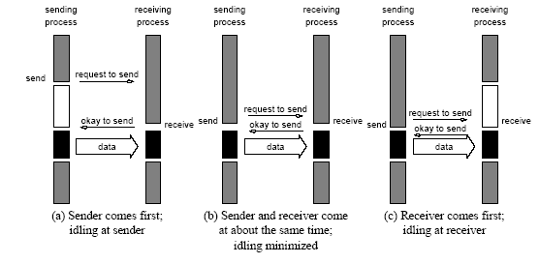
Non-Buffered Blocking
Message Passing Operations
Handshake for a blocking non-buffered send/receive operation.
It is easy to see that in cases where sender and receiver do not
reach communication point at similar times, there can be considerable idling overheads.

Slide 8
Buffered Blocking
Message Passing Operations
A simple solution to the idling and deadlocking problem outlined above is to rely on buffers at the sending and receiving ends.
The sender simply copies the data into the designated buffer and returns after the copy operation has been completed.
The data must be buffered at the receiving end as well.
Buffering trades off idling overhead for buffer copying overhead.

Slide 9
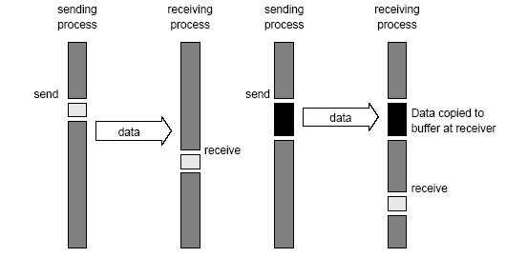
Buffered Blocking
Message Passing Operations
Blocking buffered transfer protocols: (a) in the presence of
communication hardware with buffers at send and receive ends; and (b) in the absence of communication hardware, sender interrupts receiver and deposits data in buffer at receiver end.

Slide 10
Buffered Blocking
Message Passing Operations
Bounded buffer sizes can have signicant impact on performance.
P0 P1
for (i = 0; i < 1000; i++){ for (i = 0; i < 1000; i++){
produce_data(&a); receive(&a, 1, 0);
send(&a, 1, 1); consume_data(&a);
} }
What if consumer was much slower than producer?

Slide 11
Buffered Blocking
Message Passing Operations
Deadlocks are still possible with buffering since receive
operations block.
P0 P1
receive(&a, 1, 1); receive(&a, 1, 0);
send(&b, 1, 1); send(&b, 1, 0);

Slide 12
Non-Blocking
Message Passing Operations
The programmer must ensure semantics of the send and receive.
This class of non-blocking protocols returns from the send or receive operation before it is semantically safe to do so.
Non-blocking operations are generally accompanied by a check-status operation.
When used correctly, these primitives are capable of overlapping communication overheads with useful computations.
Message passing libraries typically provide both blocking and non-blocking primitives.

Slide 13
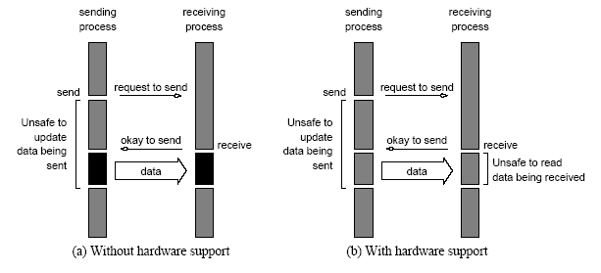
Non-Blocking
Message Passing Operations
Non-blocking non-buffered send and receive operations (a) in
absence of communication hardware; (b) in presence of
communication hardware.

Slide 14
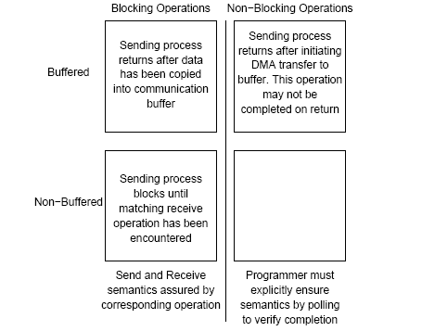
Send and Receive Protocols
Space of possible protocols for send and receive operations.

Slide 15
MPI: the Message Passing Interface
MPI defines a standard library for message-passing that can be used to develop portable message-passing programs using either C or Fortran.
The MPI standard defines both the syntax as well as the semantics of a core set of library routines.
Vendor implementations of MPI are available on almost all commercial parallel computers.
It is possible to write fully-functional message-passing programs by using only the six routines.

Slide 16
MPI: the Message Passing Interface
The minimal set of MPI routines.
MPI_Init | Initializes MPI.
MPI_Finalize | Terminates MPI.
MPI_Comm_size | Determines the number of processes.
MPI_Comm_rank | Determines the label of calling process.
MPI_Send | Sends a message.
MPI_Recv | Receives a message.

Slide 17
Starting and Terminating the MPI Library
MPI_Init is called prior to any calls to other MPI routines. Its purpose is to initialize the MPI environment.
MPI_Finalize is called at the end of the computation, and it performs various clean-up tasks to terminate the MPI environment.
The prototypes of these two functions are:
int MPI_Init(int *argc, char ***argv)
int MPI_Finalize()
MPI_Init also strips off any MPI related command-line arguments.
All MPI routines, data-types, and constants are prefixed by “MPI_”. The return code for successful completion is MPI_SUCCESS.

Slide 18
Communicators
A communicator defines a communication domain - a set of processes that are allowed to communicate with each other.
Information about communication domains is stored in variables of type MPI_Comm.
Communicators are used as arguments to all message transfer MPI routines.
A process can belong to many different (possibly overlapping) communication domains.
MPI defines a default communicator called MPI_COMM_WORLD which includes all the processes.

Slide 19
Querying Information
The MPI_Comm_size and MPI_Comm_rank functions are used to determine the number of processes and the label of the calling process, respectively.
The calling sequences of these routines are as follows:
int MPI_Comm_size(MPI_Comm comm, int *size)
int MPI_Comm_rank(MPI_Comm comm, int *rank)
The rank of a process is an integer that ranges from zero up to the size of the communicator minus one.

Slide 20
Our First MPI Program
#include <mpi.h>
main(int argc, char *argv[])
{
int npes, myrank;
MPI_Init(&argc, &argv);
MPI_Comm_size(MPI_COMM_WORLD, &npes);
MPI_Comm_rank(MPI_COMM_WORLD, &myrank);
printf("From process %d out of %d, Hello World!\n",
myrank, npes);
MPI_Finalize();
}

Slide 21
Sending and Receiving Messages
The basic functions for sending and receiving messages in MPI are the MPI_Send and MPI_Recv, respectively.
The calling sequences of these routines are as follows:
int MPI_Send(void *buf, int count, MPI_Datatype datatype, int dest, int tag, MPI_Comm comm)
int MPI_Recv(void *buf, int count, MPI_Datatype datatype, int source, int tag, MPI_Comm comm, MPI_Status *status)
MPI provides equivalent datatypes for all C datatypes. This is done for portability reasons.
The datatype MPI_BYTE corresponds to a byte (8 bits) and MPI_PACKED corresponds to a collection of data items that has been created by packing non-contiguous data.
The message-tag can take values ranging from zero up to the MPI defined constant MPI_TAG_UB.
Notes:
MPI_Send sends the data stored in the buffer pointed by buf . This buffer consists of consecutive entries of the type specified by the parameter datatype . The number of entries in the buffer is
given by the parameter count . The correspondence between MPI datatypes and those provided by C is shown in Table 6.2 . Note that for all C datatypes, an equivalent MPI datatype is
provided. However, MPI allows two additional datatypes that are not part of the C language. These are MPI_BYTE and MPI_PACKED .
MPI_BYTE corresponds to a byte (8 bits) and MPI_PACKED corresponds to a collection of data items that has been created by packing non-contiguous data. Note that the length of the message in MPI_Send , as well as in other MPI routines, is specified in terms of the number of entries being sent and not in terms of the number of bytes. Specifying the length in terms of the number of entries has the advantage of making the MPI code portable, since the number of bytes used to store various datatypes can be different for different architectures.
The destination of the message sent by MPI_Send is uniquely specified by the dest and comm arguments. The dest argument is the rank of the destination process in the communication domain specified by the communicator comm . Each message has an integer-valued tag associated with it. This is used to distinguish different types of messages. The message-tag can take values ranging from zero up to the MPI defined constant MPI_TAG_UB . Even though the value of MPI_TAG_UB is implementation specific, it is at least 32,767.
MPI_Recv receives a message sent by a process whose rank is given by the source in the communication domain specified by the comm argument. The tag of the sent message must be that specified by the tag argument. If there are many messages with identical tag from the same process, then any one of these messages is received. MPI allows specification of wildcard arguments for both source and tag . If source is set to MPI_ANY_SOURCE , then any process of the communication domain can be the source of the message. Similarly, if tag is set to MPI_ANY_TAG , then messages with any tag are accepted. The received message is stored in continuous locations in the buffer pointed to by buf . The count and datatype arguments of MPI_Recv are used to specify the length of the supplied buffer. The received message should be of length equal to or less than this length. This allows the receiving process to not know the exact size of the message being sent. If the received message is larger than the supplied buffer, then an overflow error will occur, and the routine will return the error MPI_ERR_TRUNCATE .

Slide 22
MPI Datatypes
MPI Datatype | C Datatype
MPI_CHAR | signed char
MPI_SHORT | signed short int
MPI_INT | signed int
MPI_LONG | signed long int
MPI_UNSIGNED_CHAR | unsigned char
MPI_UNSIGNED_SHORT | unsigned short int
MPI_UNSIGNED | unsigned int
MPI_UNSIGNED_LONG | unsigned long int
MPI_FLOAT | float
MPI_DOUBLE | double
MPI_LONG_DOUBLE | long double
MPI_BYTE
MPI_PACKED

Slide 23
Sending and Receiving Messages
MPI allows specification of wildcard arguments for both source and tag.
If source is set to MPI_ANY_SOURCE, then any process of the communication domain can be the source of the message.
If tag is set to MPI_ANY_TAG, then messages with any tag are accepted.
On the receive side, the message must be of length equal to or less than the length field specified.

Slide 24
Sending and Receiving Messages
On the receiving end, the status variable can be used to get information about the MPI_Recv operation.
The corresponding data structure contains:
  typedef struct MPI_Status {
  int MPI_SOURCE;
  int MPI_TAG;
  int MPI_ERROR; };
The MPI_Get_count function returns the precise count of data items received.
  int MPI_Get_count(MPI_Status *status, MPI_Datatype datatype, int *count)

Slide 25
Avoiding Deadlocks
Consider:
int a[10], b[10], myrank;
MPI_Status status;
...
MPI_Comm_rank(MPI_COMM_WORLD, &myrank);
if (myrank == 0) {
MPI_Send(a, 10, MPI_INT, 1, 1, MPI_COMM_WORLD);
MPI_Send(b, 10, MPI_INT, 1, 2, MPI_COMM_WORLD);
}
else if (myrank == 1) {
MPI_Recv(b, 10, MPI_INT, 0, 2, MPI_COMM_WORLD);
MPI_Recv(a, 10, MPI_INT, 0, 1, MPI_COMM_WORLD);
}
...
If MPI_Send is blocking, there is a deadlock.
Notes:
Avoiding Deadlocks The semantics of MPI_Send and MPI_Recv place some restrictions on how we can mix and match send and receive operations. For example, consider the following piece of code in which process 0 sends two messages with different tags to process 1, and process 1 receives them in the reverse order.
If MPI_Send is implemented using buffering, then this code will run correctly provided that sufficient buffer space is available. However, if MPI_Send is implemented by blocking until the matching receive has been issued, then neither of the two processes will be able to proceed. This is because process zero (i.e., myrank == 0 ) will wait until process one issues the matching MPI_Recv (i.e., the one with tag equal to 1), and at the same time process one will wait until process zero performs the matching MPI_Send (i.e., the one with tag equal to 2). This code fragment is not safe, as its behavior is implementation dependent. It is up to the programmer to ensure that his or her program will run correctly on any MPI implementation. The problem in this program can be corrected by matching the order in which the send and receive operations are issued . Similar deadlock situations can also occur when a process sends a message to itself. Even though this is legal, its behavior is implementation dependent and must be avoided.

Slide 26
Avoiding Deadlocks
Consider the following piece of code, in which process i sends a message to process i + 1 (modulo the number of processes) and receives a message from process i - 1 (module the number of processes).
int a[10], b[10], npes, myrank;
MPI_Status status;
...
MPI_Comm_size(MPI_COMM_WORLD, &npes);
MPI_Comm_rank(MPI_COMM_WORLD, &myrank);
MPI_Send(a, 10, MPI_INT, (myrank+1)%npes, 1, MPI_COMM_WORLD);
MPI_Recv(b, 10, MPI_INT, (myrank-1+npes)%npes, 1, MPI_COMM_WORLD);
...
Once again, we have a deadlock if MPI_Send is blocking.

Slide 27
Avoiding Deadlocks
We can break the circular wait to avoid deadlocks as follows:
int a[10], b[10], npes, myrank;
MPI_Status status;
...
MPI_Comm_size(MPI_COMM_WORLD, &npes);
MPI_Comm_rank(MPI_COMM_WORLD, &myrank);
if (myrank%2 == 1) {
MPI_Send(a, 10, MPI_INT, (myrank+1)%npes, 1, MPI_COMM_WORLD);
MPI_Recv(b, 10, MPI_INT, (myrank-1+npes)%npes, 1, MPI_COMM_WORLD);
}
else {
MPI_Recv(b, 10, MPI_INT, (myrank-1+npes)%npes, 1, MPI_COMM_WORLD);
MPI_Send(a, 10, MPI_INT, (myrank+1)%npes, 1, MPI_COMM_WORLD);
}
...
Notes:
When MPI_Send is implemented using buffering, the program will work correctly, since every
call to MPI_Send will get buffered, allowing the call of the MPI_Recv to be performed, which will
transfer the required data. However, if MPI_Send blocks until the matching receive has been
issued, all processes will enter an infinite wait state, waiting for the neighboring process to
issue a MPI_Recv operation. Note that the deadlock still remains even when we have only two
processes. Thus, when pairs of processes need to exchange data, the above method leads to an
unsafe program. The above example can be made safe, by rewriting it as follows:

Slide 28
Sending and Receiving
Messages Simultaneously
To exchange messages, MPI provides the following function:
int MPI_Sendrecv(void *sendbuf, int sendcount,
MPI_Datatype senddatatype, int dest, int sendtag, void *recvbuf, int recvcount, MPI_Datatype recvdatatype, int source, int recvtag, MPI_Comm comm, MPI_Status *status)
The arguments include arguments to the send and receive
functions. If we wish to use the same buffer for both send and
receive, we can use:
int MPI_Sendrecv_replace(void *buf, int count,
MPI_Datatype datatype, int dest, int sendtag,
int source, int recvtag, MPI_Comm comm,
MPI_Status *status)

Slide 29
Overlapping Communication with Computation
In order to overlap communication with computation, MPI provides a pair of functions for performing non-blocking send and receive operations.
  int MPI_Isend(void *buf, int count, MPI_Datatype datatype,
  int dest, int tag, MPI_Comm comm,
  MPI_Request *request)
  int MPI_Irecv(void *buf, int count, MPI_Datatype datatype,
  int source, int tag, MPI_Comm comm,
  MPI_Request *request)
These operations return before the operations have been completed. Function MPI_Test tests whether or not the non-blocking send or receive operation identified by its request has finished.
  int MPI_Test(MPI_Request *request, int *flag,
  MPI_Status *status)
MPI_Wait waits for the operation to complete.
  int MPI_Wait(MPI_Request *request, MPI_Status *status)

Slide 30
Avoiding Deadlocks
Using non-blocking operations remove most deadlocks. Consider:
int a[10], b[10], myrank;
MPI_Status status;
...
MPI_Comm_rank(MPI_COMM_WORLD, &myrank);
if (myrank == 0) {
MPI_Send(a, 10, MPI_INT, 1, 1, MPI_COMM_WORLD);
MPI_Send(b, 10, MPI_INT, 1, 2, MPI_COMM_WORLD);
}
else if (myrank == 1) {
MPI_Recv(b, 10, MPI_INT, 0, 2, &status, MPI_COMM_WORLD); MPI_Recv(a, 10, MPI_INT, 0, 1, &status, MPI_COMM_WORLD);
}
...
Replacing either the send or the receive operations with non-blocking counterparts fixes this deadlock.

Slide 31
Collective Communication and Computation Operations
MPI provides an extensive set of functions for performing common collective communication operations.
Each of these operations is defined over a group corresponding to the communicator.
All processors in a communicator must call these operations.

Slide 32
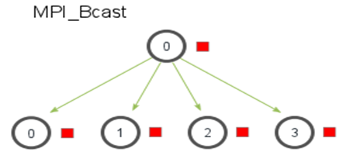
Collective Communication Operations
The barrier synchronization operation is performed in MPI using:
  int MPI_Barrier(MPI_Comm comm)
The one-to-all broadcast operation is:
  int MPI_Bcast(void *buf, int count, MPI_Datatype datatype, int source, MPI_Comm comm)

Slide 33
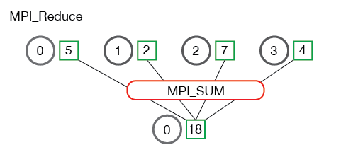
MPI All to one reduction
The all-to-one reduction operation is:
  int MPI_Reduce(void *sendbuf, void *recvbuf, int count, MPI_Datatype datatype, MPI_Op op, int target, MPI_Comm comm)

Slide 34
Predefined Reduction Operations
Operation | Meaning | Datatypes
MPI_MAX | Maximum | C integers and floating point
MPI_MIN | Minimum | C integers and floating point
MPI_SUM | Sum | C integers and floating point
MPI_PROD | Product | C integers and floating point
MPI_LAND | Logical AND | C integers
MPI_BAND | Bit-wise AND | C integers and byte
MPI_LOR | Logical OR | C integers
MPI_BOR | Bit-wise OR | C integers and byte
MPI_LXOR | Logical XOR | C integers
MPI_BXOR | Bit-wise XOR | C integers and byte
MPI_MAXLOC | max-min value-location | Data-pairs
MPI_MINLOC | min-min value-location | Data-pairs

Slide 35
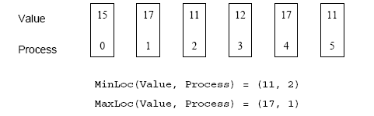
Collective Communication Operations
The operation MPI_MAXLOC combines pairs of values (v_{i}, l_{i}) and returns the pair (v, l) such that v is the maximum among all v_{i} 's and l is the corresponding l_{i} (if there are more than one, it is the smallest among all these l_{i} 's).
MPI_MINLOC does the same, except for minimum value of v_{i}.
An example use of the MPI_MINLOC and MPI_MAXLOC operators.

Slide 36
Collective Communication Operations
MPI datatypes for data-pairs used with the MPI_MAXLOC and MPI_MINLOC reduction operations.
MPI Datatype | C Datatype
MPI_2INT | pair of ints
MPI_SHORT_INT | short and int
MPI_LONG_INT | long and int
MPI_LONG_DOUBLE_INT | long double and int
MPI_FLOAT_INT | float and int
MPI_DOUBLE_INT | double and int

Slide 37
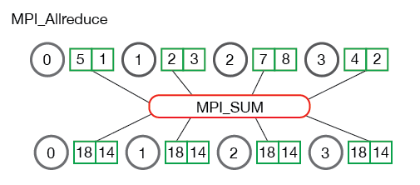
Collective Communication Operations
If the result of the reduction operation is needed by all processes, MPI provides:
  int MPI_Allreduce(void *sendbuf, void *recvbuf,
  int count, MPI_Datatype datatype, MPI_Op op, MPI_Comm comm)

Slide 38

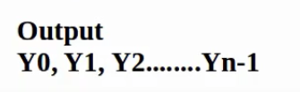


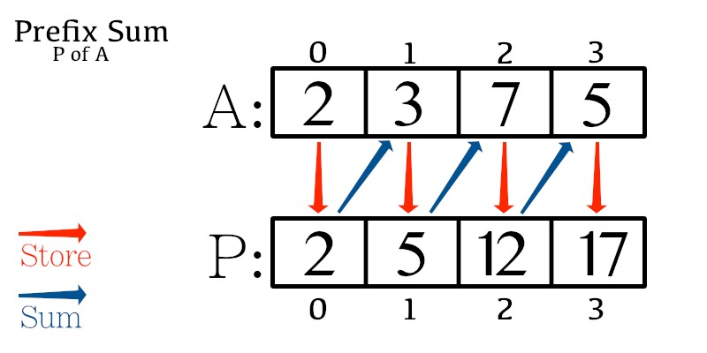


To compute prefix-sums, MPI provides:
  int MPI_Scan(void *sendbuf, void *recvbuf, int count, MPI_Datatype datatype, MPI_Op op,
  MPI_Comm comm)

Slide 39
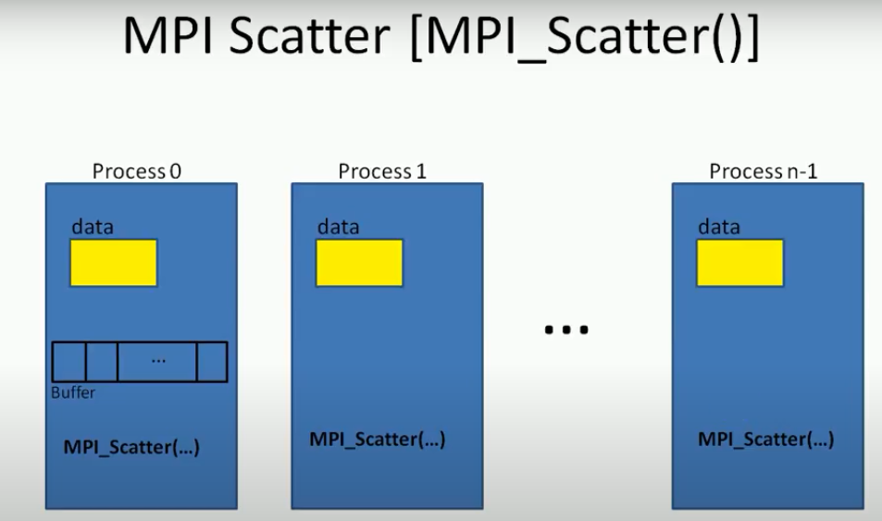

Slide 40
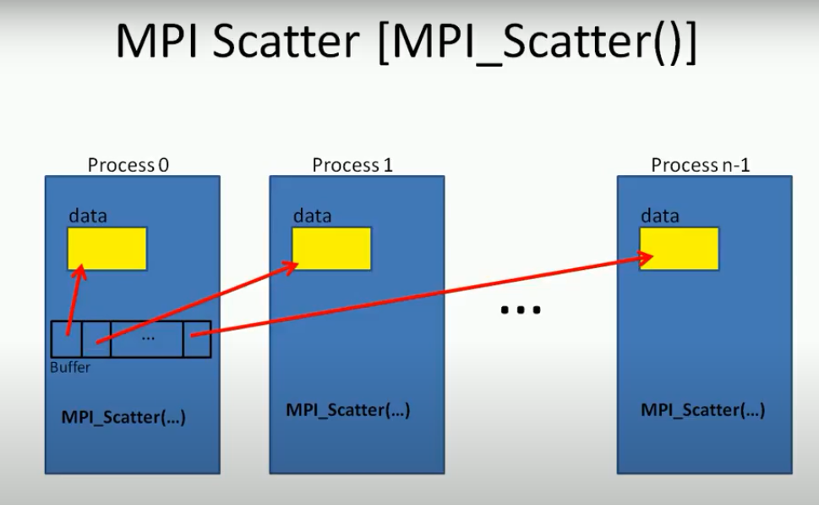

Slide 41
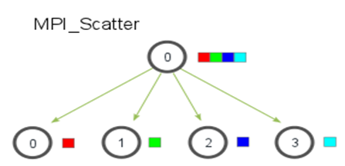
MPI SCATTER
The corresponding scatter operation is:
  int MPI_Scatter(void *sendbuf, int sendcount,
  MPI_Datatype senddatatype, void *recvbuf,
  int recvcount, MPI_Datatype recvdatatype,
  int source, MPI_Comm comm)

Slide 42
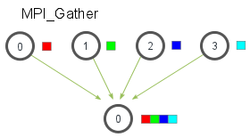
MPI GATHER
The gather operation is performed in MPI using:
  int MPI_Gather(void *sendbuf, int sendcount,
  MPI_Datatype senddatatype, void *recvbuf,
  int recvcount, MPI_Datatype recvdatatype,
  int target, MPI_Comm comm)

Slide 43
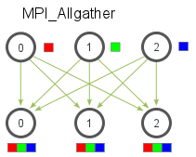
MPI_Allgather function
MPI also provides the MPI_Allgather function in which the data are gathered at all the processes.
  int MPI_Allgather(void *sendbuf, int sendcount, MPI_Datatype senddatatype, void *recvbuf,
  int recvcount, MPI_Datatype recvdatatype,
  MPI_Comm comm)

Slide 44
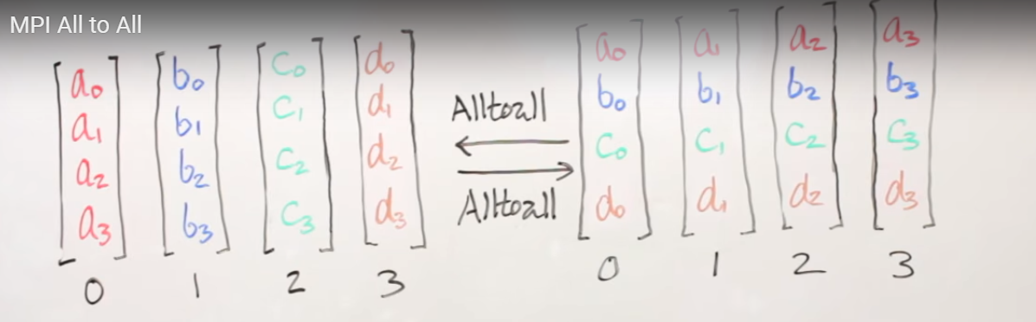
Collective Communication Operations
The all-to-all personalized communication operation is performed by:
  int MPI_Alltoall(void *sendbuf, int sendcount, MPI_Datatype senddatatype, void *recvbuf,
  int recvcount, MPI_Datatype recvdatatype, MPI_Comm comm)
Using this core set of collective operations, a number of programs can be greatly simplified.

Slide 45
Groups and Communicators
In many parallel algorithms, communication operations need to be restricted to certain subsets of processes.
MPI provides mechanisms for partitioning the group of processes that belong to a communicator into subgroups each corresponding to a different communicator.
The simplest such mechanism is:
  int MPI_Comm_split(MPI_Comm comm, int color, int key, MPI_Comm *newcomm)
This operation groups processors by color and sorts resulting groups on the key.

Slide 46
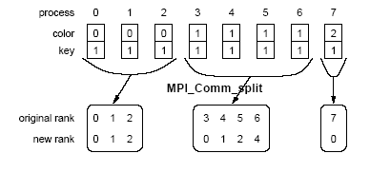
Groups and Communicators
Using MPI_Comm_split to split a group of processes in a communicator into subgroups.

Slide 47
Groups and Communicators
In many parallel algorithms, processes are arranged in a virtual grid, and in different steps of the algorithm, communication needs to be restricted to a different subset of the grid.
MPI provides a convenient way to partition a Cartesian topology to form lower-dimensional grids:
  int MPI_Cart_sub(MPI_Comm comm_cart, int *keep_dims, MPI_Comm *comm_subcart)
If keep_dims[i] is true (non-zero value in C) then the ith dimension is retained in the new sub-topology.
The coordinate of a process in a sub-topology created by MPI_Cart_sub can be obtained from its coordinate in the original topology by disregarding the coordinates that correspond to the dimensions that were not retained.

Slide 48
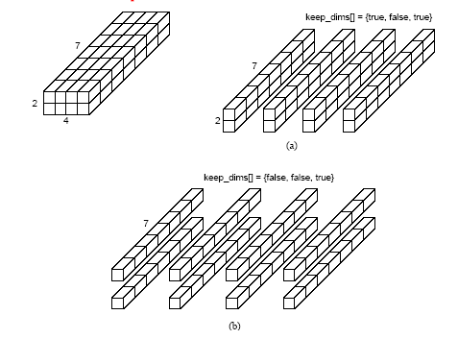
Groups and Communicators
Splitting a Cartesian topology of size 2 x 4 x 7 into (a) four
subgroups of size 2 x 1 x 7, and (b) eight subgroups of size 1 x 1 x 7.

