Slide 1
Week 7

Slide 2
The sections Directive
OpenMP supports non-iterative parallel task assignment using the sections directive.
The general form of the sections directive is as follows:
#pragma omp sections [clause list]
{
  [#pragma omp section
    /* structured block */
  ]
  [#pragma omp section
    /* structured block */
  ]
  ...
}

Slide 3
The sections Directive: Example
#pragma omp parallel
{
  #pragma omp sections
  {
    #pragma omp section
    {
      taskA();
    }
    #pragma omp section
    {
      taskB();
    }
    #pragma omp section
    {
      taskC();
    }
  }
}
http://jakascorner.com/blog/2016/05/omp-sections.html

Slide 4
Nesting parallel Directives
Nested parallelism can be enabled using the OMP_NESTED environment variable.
If the OMP_NESTED environment variable is set to TRUE, nested parallelism is enabled.
In this case, each parallel directive creates a new team of threads.
https://ppc.cs.aalto.fi/ch3/nested/

Slide 5
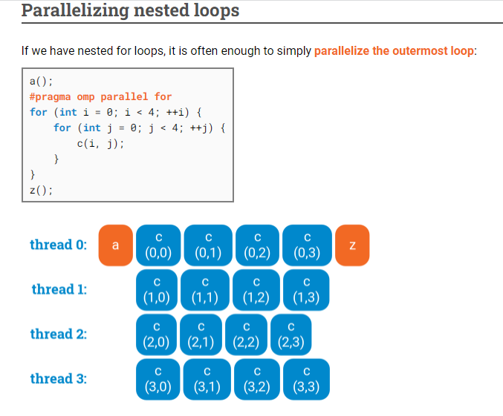


Slide 6
Merging Directives
In our discussion thus far, we use the directive parallel to create concurrent threads, and for and sections to farm out work to threads. If there was no parallel directive specified, the for and sections directives would execute serially (all work is farmed to a single thread, the master thread). Consequently, for and sections directives are generally preceded by the parallel directive. OpenMP allows the programmer to merge the parallel directives to parallel for and parallel sections, respectively. The clause list for the merged directive can be from the clause lists of either the parallel or for / sections directives.

Slide 7
Example
For example:
1 #pragma omp parallel default (private) shared (n)
2 {
3 #pragma omp for
4 for (i = 0 < i < n; i++) {
5 /* body of parallel for loop */
6 }
7 }
is identical to:
1 #pragma omp parallel for default (private) shared (n)
2 {
3 for (i = 0 < i < n; i++) {
4 /* body of parallel for loop */
5 }
6 }
7
and:
1 #pragma omp parallel
2 {
3 #pragma omp sections

Slide 8
Synchronization Constructs in OpenMP
OpenMP provides a variety of synchronization constructs:
  #pragma omp barrier
  #pragma omp single [clause list]
    structured block
  #pragma omp master
    structured block
  #pragma omp critical [(name)]
    structured block
  #pragma omp ordered
    structured block

Slide 9
OpenMP Library Functions
In addition to directives, OpenMP also supports a number of functions that allow a programmer to control the execution of threaded programs.
  /* thread and processor count */
  void omp_set_num_threads (int num_threads);
  int omp_get_num_threads ();
  int omp_get_max_threads ();
  int omp_get_thread_num ();
  int omp_get_num_procs ();
  int omp_in_parallel();

Slide 10
OpenMP Library Functions
  /* controlling and monitoring thread creation */
  void omp_set_dynamic (int dynamic_threads);
  int omp_get_dynamic ();
  void omp_set_nested (int nested);
  int omp_get_nested ();
  /* mutual exclusion */
  void omp_init_lock (omp_lock_t *lock);
  void omp_destroy_lock (omp_lock_t *lock);
  void omp_set_lock (omp_lock_t *lock);
  void omp_unset_lock (omp_lock_t *lock);
  int omp_test_lock (omp_lock_t *lock);
In addition, all lock routines also have a nested lock counterpart
for recursive mutexes.

Slide 11
Environment Variables in OpenMP
OMP_NUM_THREADS: This environment variable specifies the default number of threads created upon entering a parallel region.
OMP_SET_DYNAMIC: Determines if the number of threads can be dynamically changed.
OMP_NESTED: Turns on nested parallelism.
OMP_SCHEDULE: Scheduling of for-loops if the clause specifies runtime

Slide 12
Explicit Threads versus Directive Based Programming
Directives layered on top of threads facilitate a variety of thread-related tasks.
A programmer is rid of the tasks of initializing attributes objects, setting up arguments to threads, partitioning iteration spaces, etc.
There are some drawbacks to using directives as well.
An artifact of explicit threading is that data exchange is more apparent. This helps in alleviating some of the overheads from data movement, false sharing, and contention.
Explicit threading also provides a richer API in the form of condition waits, locks of different types, and increased flexibility for building composite synchronization operations.
Finally, since explicit threading is used more widely than OpenMP, tools and support for Pthreads programs are easier to find.

